Slide 1
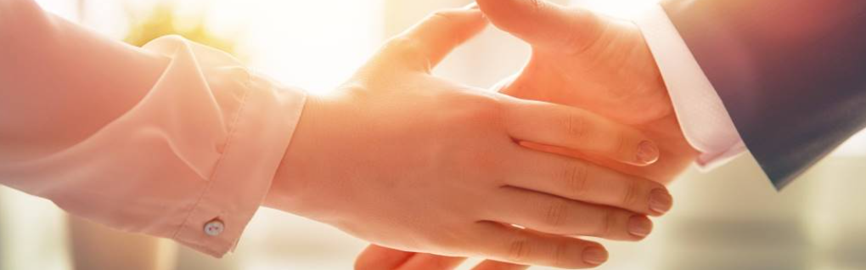
Welcome to our services
New Lebanon Church of Christ
We are Simply Christians.
Our Emphasis is Spiritual, Not Material or Social.
We are striving to be The Same Church as Described in The New Testament.
Please Come Back Again

Slide 2
Deuteronomy 30:19 "I call heaven and earth as witnesses today against you, that I have set before you life and death, blessing and cursing; therefore choose life, that both you and your descendants may live;

Slide 3


Slide 4
Biblical Decision Making

Slide 5
1. Can you ask God to bless your decision that you make?
1. Can you ask God to bless your decision that you make?

Slide 6
1. Can you ask God to bless your decision that you make?
2. Can you thank God for it?

Slide 7
1. Can you ask God to bless your decision that you make?
3. Are you doing this to the glory of God?

Slide 8
4. Will your decision be a stumbling block to others or help them follow Jesus?

Slide 9
5. Are you doing this to please God rather than people?

Slide 10
6. 6. Have you thought ahead about the consequences of your decision?

Slide 11


Slide 12
67. Would you want to be doing whatever you decide when Christ returns?

Slide 13
6
8. Will This decision Give Satan Opportunity To Own More Of My Soul?

