Slide 1
Welcome to our services
New Lebanon Church of Christ
We are Simply Christians.
Our Emphasis is Spiritual, Not Material or Social.
We are striving to be The Same Church as Described in The New Testament.
Please Come Back Again

Slide 2
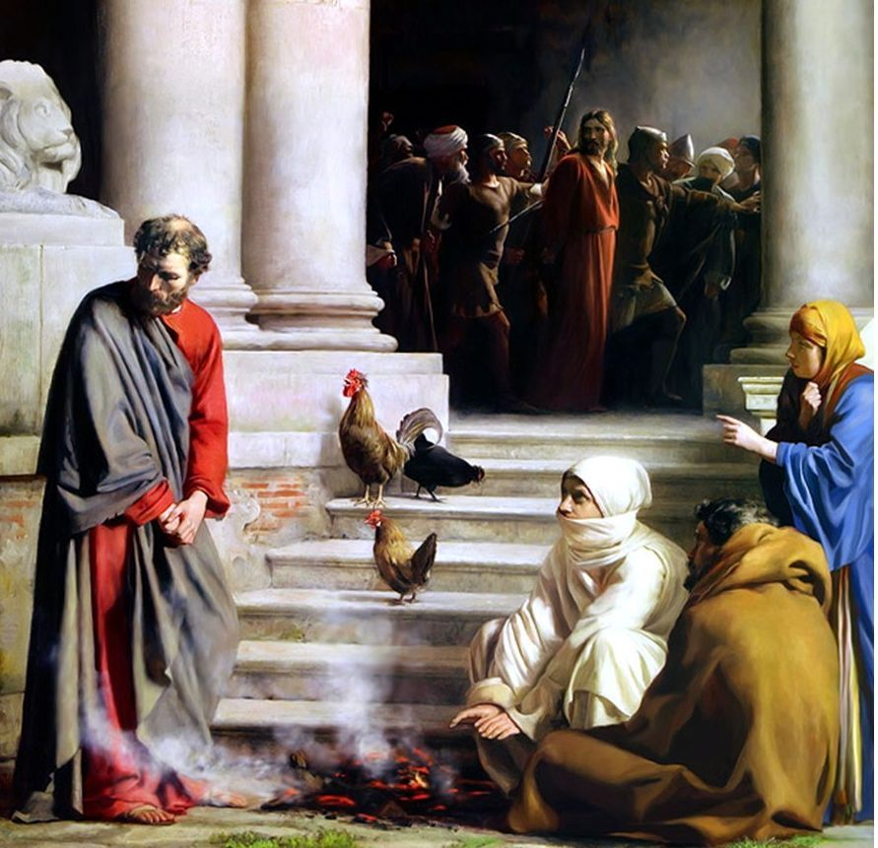
Mark 14:67 And when she saw Peter warming himself, she looked at him and said, "You also were with Jesus of Nazareth."
68 But he denied it, saying, "I neither know nor understand what you are saying." And he went out on the porch, and a rooster crowed.
69 And the servant girl saw him again, and began to say to those who stood by, "This is one of them."
70 But he denied it again. And a little later those who stood by said to Peter again, "Surely you are one of them; for you are a Galilean, and your speech shows it."
71 Then he began to curse and swear, "I do not know this Man of whom you speak!"
72 A second time the rooster crowed. Then Peter called to mind the word that Jesus had said to him, "Before the rooster crows twice, you will deny Me three times." And when he thought about it, he wept.
Mark 14

Slide 3
The Steps In Peter’s Backsliding
Mark 14

Slide 4
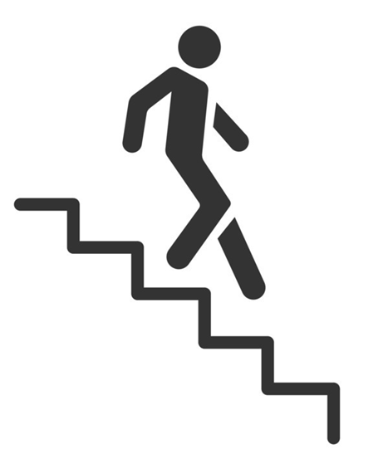
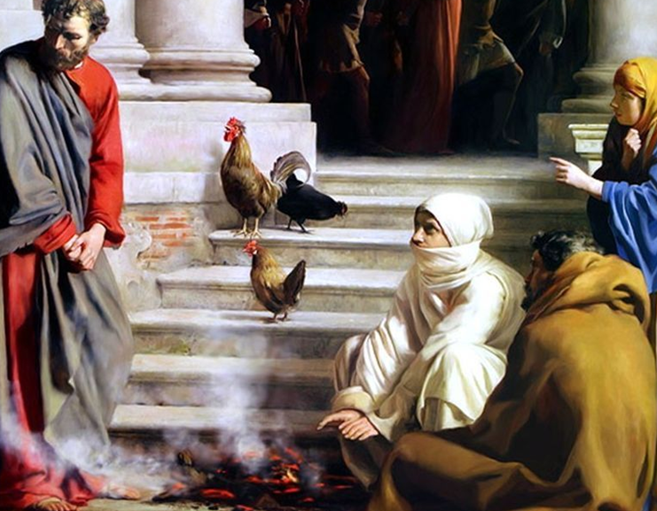
The Steps In Peter’s Backsliding
1. Self-confident

Slide 5
The Steps In Peter’s Backsliding
2. Proud boasting

Slide 6
The Steps In Peter’s Backsliding
3. Dropped his guard

Slide 7
The Steps In Peter’s Backsliding
4. Distanced himself from Christ

Slide 8
The Steps In Peter’s Backsliding
5. Embraced Worldliness

Slide 9
The Steps In Peter’s Backsliding
6. Denied Christ

Slide 10
The Steps In Peter’s Backsliding
7. Acted Recklessly

Slide 11
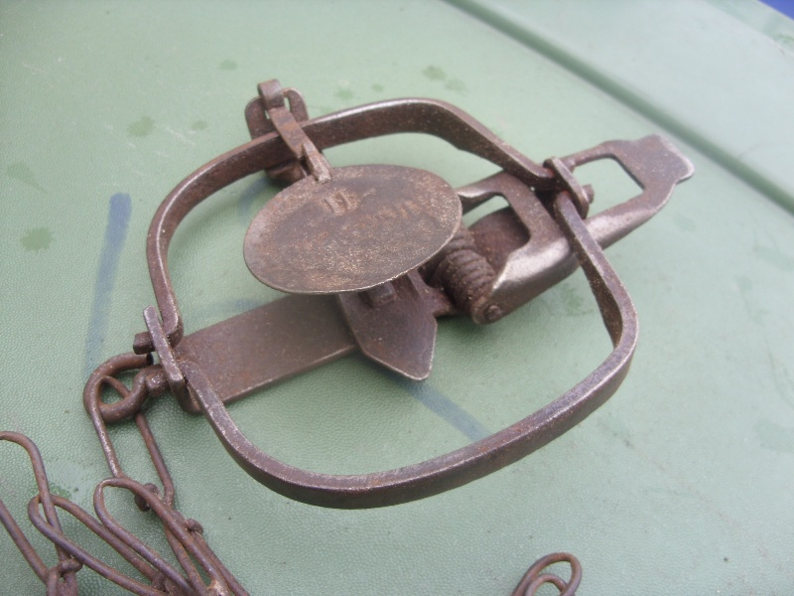
OFFEND (&, 4624), from (OFFENSE, No. 1), signifies “to put a snare or stumblingblock in the way,”
OFFENCE (OFFENSE)
A. Nouns. 1. (1, 4625) originally was “the name of the part of a trap to which the bait is attached, hence, the trap or snare itself, as in Rom. 11:9, RV, ‘stumblingblock,’ quoted from Psa. 69:22, and in Rev. 2:14, for Balaam’s device was rather a trap for Israel than a stumblingblock to them,
2. (4348), “an obstacle against which one may dash his foot” (akin to , “to stumble” or “cause to stumble”; , “to or against,” , “to strike”), is translated “offense” in Rom. 14:20, in v. 13, “a stumblingblock,” of the spiritual hindrance to another by a selfish use of liberty

Slide 12
The Steps In Peter’s Backsliding
Self-confident
Proud boasting
Dropped His Guard.
Distanced himself from Christ.
Embraced Worldliness.
Denied Christ.
Acted Recklessly

Slide 13
Acts 17:11 These were more fair-minded than those in Thessalonica, in that they received the word with all readiness, and searched the Scriptures daily to find out whether these things were so.

