Slide 1
Welcome to our services
New Lebanon Church of Christ
We are Simply Christians.
Our Emphasis is Spiritual, Not Material or Social.
We are striving to be The Same Church as Described in The New Testament.
Please Come Back Again

Slide 2
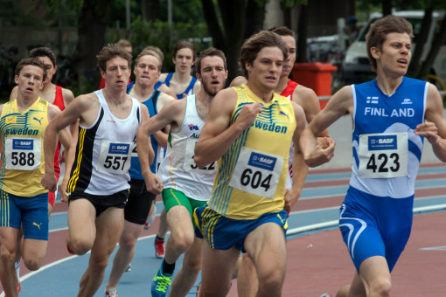
The Life Of The Runner. Heb.12:1-2

Slide 3
The Life Of The Runner. Heb 12:1-2
Heb 12:1 Therefore we also, since we are surrounded by so great a cloud of witnesses, let us lay aside every weight, and the sin which so easily ensnares us, and let us run with endurance the race that is set before us,
2 looking unto Jesus, the author and finisher of our faith, who for the joy that was set before Him endured the cross, despising the shame, and has sat down at the right hand of the throne of God.

Slide 4
The Life Of The Runner. Heb 12:1-2
CONFLICT (Noun)
1. agon (ἀγών, 73), from ago, “to lead,” signifies (a) “a place of assembly,” especially the place where the Greeks assembled for the Olympic and Pythian games; (b) “a contest of athletes,” metaphorically, 1 Tim. 6:12; 2 Tim. 4:7, “fight”; Heb. 12:1, “race”; hence, (c) “the inward conflict of the soul”; inward “conflict” is often the result, or the accompaniment, of outward “conflict,” Phil. 1:30; 1 Thess. 2:2, implying a contest against spiritual foes, as well as human adversaries; so Col. 2:1, “conflict,” kjv; rv, “(how greatly) I strive,” lit., “how great a conflict I have.” See contention, fight, race.¶. Cf. agonizomai (Eng., “agonize”), 1 Cor. 9:25 etc.
2. athlesis (ἄθλησις, 119) denotes “a combat, contest of athletes”; hence, “a struggle, fight,” Heb. 10:32, with reference to affliction. See fight.¶ Cf. athleo, “to strive,” 2 Tim. 2:5 (twice).¶

Slide 5
The Life Of The Runner. Heb 12:1-2
_{2Tim. 4:7} I have fought the good fight, I have finished the race, I have kept the faith.
_{1Cor.9:24} Do you not know that those who run in a race all run, but one receives the prize? Run in such a way that you may obtain it.
_{Gal.2:2} And I went up by revelation, and communicated to them that gospel which I preach among the Gentiles, but privately to those who were of reputation, lest by any means I might run, or had run, in vain.
_{Phil.2:16} holding fast the word of life, so that I may rejoice in the day of Christ that I have not run in vain or labored in vain.
_{2Tim 2:5} And also if anyone competes in athletics, he is not crowned unless he competes according to the rules.

Slide 6
The Life Of The Runner. Heb 12:1-2
(1) The contender must be legally enrolled (2 Tim. 2:5).
(2) Some win and some do not (1 Cor. 9:24).
(3) For the contender in an athletic contest, discipline is an absolute prerequisite of success; (Heb. 12:1).
(4) A host of spectators watch a race (Heb. 12:1).
(5) Patience is required of both the athletic contestant and the Christian,
(6) The winner is rewarded, the earthly contender with a perishable reward, the Christian with an eternal reward (1 Cor. 9:25).
(7) The analogy becomes a contrast in the matter of how many may win. In the earthly contest, only one receives the prize; but in the heavenly contest, every man may do so if run well, all may win!

Slide 7
The Life Of The Runner. Heb 12:1-2
1. An energetic life.

Slide 8
The Life Of The Runner. Heb 12:1-2
2. An ordered life.

Slide 9
The Life Of The Runner. Heb 12:1-2
3. A persevering life

Slide 10
The Life Of The Runner. Heb 12:1-2
4. An upward life.

Slide 11
The Life Of The Runner. Heb 12:1-2
5. A believing life.

Slide 12
The Life Of The Runner. Heb 12:1-2
6. A self-denying life

Slide 13
The Life Of The Runner. Heb 12:1-2
7. A hopeful life.

Slide 14
The Life Of The Runner. Heb 12:1-2
8. A public life.

Slide 15
The Life Of The Runner. Heb 12:1-2
An energetic life
An ordered life
A persevering life
An upward life
A believing life
A self-denying life
A hopeful life
A public life

Slide 16
Acts 17:11 These were more fair-minded than those in Thessalonica, in that they received the word with all readiness, and searched the Scriptures daily to find out whether these things were so.

