Slide 1
Welcome to our services
New Lebanon Church of Christ
We are Simply Christians.
Our Emphasis is Spiritual, Not Material or Social.
We are striving to be The Same Church as Described in The New Testament.
Please Come Back Again

Slide 2
Deuteronomy 14:2 "For you are a holy people to the LORD your God, and the LORD has chosen you to be a people for Himself, a special treasure above all the peoples who are on the face of the earth.
1

Slide 3
You Are A Holy People To The Lord
Let’s define the word -
Holy
Describes something or someone that is set apart for God’s purposes and possesses purity and divine significance.
Holy qādôš (קָדוֹשׁ, 6918), “holy.” There are two separate original forms of the root. The one signifies “pure” and “devoted,” as in Akkadian qadistu and in Hebrew qadec, “holy.” The word describes something or someone
In the Old Testament qadosh has a strongly religious connotation. In one sense the word describes an object or place or day to be “holy” with the meaning of “devoted” or “dedicated” to a particular purpose: “And the priest shall take holy water in an earthen vessel …” (Num. 5:17). Particularly the sabbath day is “devoted” as a day of rest:
2

Slide 4
You Are A Holy People To The Lord
Let’s look at some Key Passages
Exodus 19:5
Leviticus 20:23
Isaiah 6:3
1Peter 1:14
Lev.10:3
Lev. 22:1
3

Slide 5
You Are A Holy People To The Lord
Lev.7:18… it shall be an abomination, and the soul that eats of it shall bear his iniquity.
Lev.11:10 …they shall be an abomination unto you:
Lev.11:11 They shall be even an abomination unto you; …in abomination.
Lev.11:12 …an abomination unto you.
Lev.11:13 in abomination … they are an abomination
Lev.11:20 an abomination unto you.
Lev.11:23 an abomination unto you.
Lev.11:41 an abomination; it shall not be eaten.
Lev.11:42 for they are an abomination.
4

Slide 6
You Are A Holy People To The Lord
Abomination
A. Noun.
to˓ebah (תּוֹעֵבָה, 8441), “abomination; loathsome, detestable thing.” Cognates of this word appear only in Phoenician and Targumic Aramaic. The word appears 117 times and in all periods.
First, to˓ebah defines something or someone as essentially unique in the sense of being “dangerous,” “sinister,” and “repulsive” to another individual. This meaning appears in Gen. 43:32 (the first occurrence)

Slide 7
You Are A Holy People To The Lord
Now let’s consider—
A warning Is Given
Distinctions Must Be Made

Slide 8
You Are A Holy People To The Lord
The reasons for Holiness
His sovereign claim over us. Lev 11:44
What he has done for us. Lev. 11:45
His holy character. Lev. 11:45
Our relationship to Him. 11:45

Slide 9
You Are A Holy People To The Lord
2Cor. 6:14 Do not be unequally yoked together with unbelievers. For what fellowship has righteousness with lawlessness? And what communion has light with darkness? 15 And what accord has Christ with Belial? Or what part has a believer with an unbeliever? 16 And what agreement has the temple of God with idols? For you are the temple of the living God. As God has said: "I will dwell in them And walk among them. I will be their God, And they shall be My people."
17 Therefore "Come out from among them And be separate, says the Lord. Do not touch what is unclean, And I will receive you." 18 "I will be a Father to you, And you shall be My sons and daughters, Says the LORD Almighty.".

Slide 10
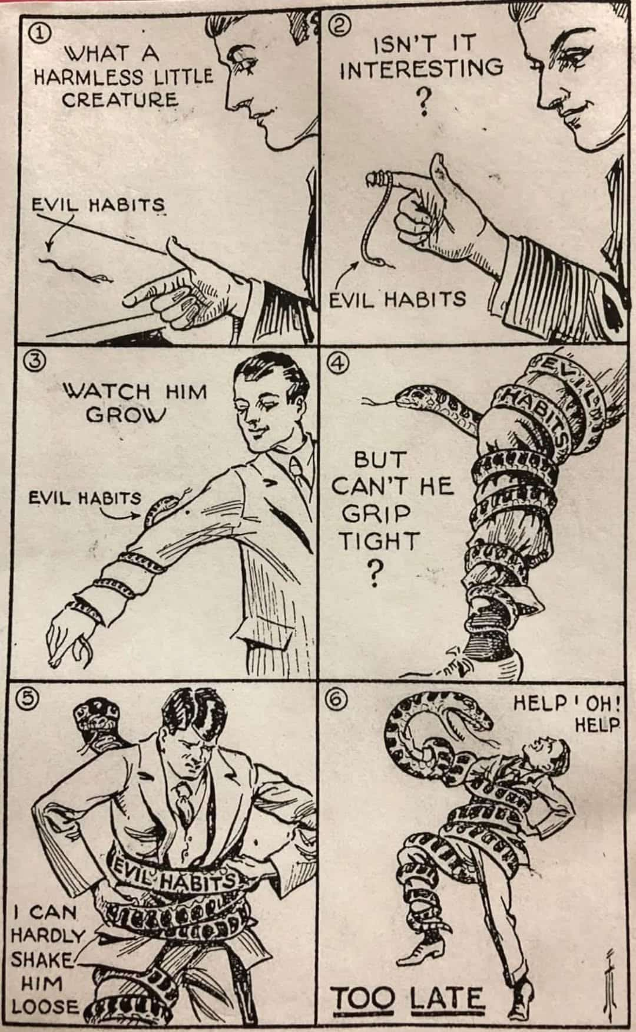

Slide 11
Deuteronomy 14:2 "For you are a holy people to the LORD your God, and the LORD has chosen you to be a people for Himself, a special treasure above all the peoples who are on the face of the earth.

