Slide 1
Welcome to our services
New Lebanon Church of Christ
We are Simply Christians.
Our Emphasis is Spiritual, Not Material or Social.
We are striving to be The Same Church as Described in The New Testament.
Please Come Back Again

Slide 2
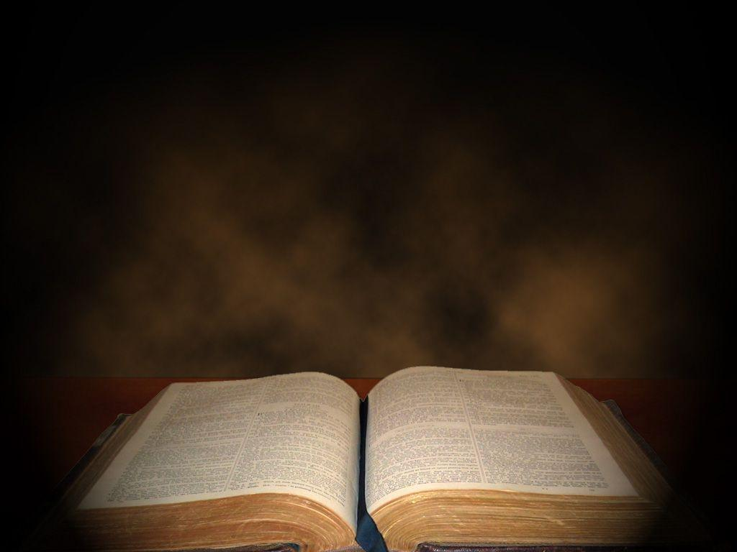
And if Christ is not risen…
1Corinthians 15:14
And if Christ is not risen, then our preaching is empty and your faith is also empty.

Slide 3
And if Christ Is Not Risen… 1Cor.15
1Co 15:12 Now if Christ is preached that He has been raised from the dead, how do some among you say that there is no resurrection of the dead?
13 But if there is no resurrection of the dead, then Christ is not risen.
14 And if Christ is not risen, then our preaching is empty and your faith is also empty.
15 Yes, and we are found false witnesses of God, because we have testified of God that He raised up Christ, whom He did not raise up--if in fact the dead do not rise.
16 For if the dead do not rise, then Christ is not risen.
17 And if Christ is not risen, your faith is futile; you are still in your sins!

Slide 4
And if Christ Is Not Risen… 1Cor.15
18 Then also those who have fallen asleep in Christ have perished.
19 If in this life only we have hope in Christ, we are of all men the most pitiable.
20 But now Christ is risen from the dead, and has become the firstfruits of those who have fallen asleep.
21 For since by man came death, by Man also came the resurrection of the dead.
22 For as in Adam all die, even so in Christ all shall be made alive.
23 But each one in his own order: Christ the firstfruits, afterward those who are Christ's at His coming.
24 Then comes the end, when He delivers the kingdom to God the Father, when He puts an end to all rule and all authority and power.

Slide 5
And if Christ Is Not Risen… 1Cor.15
The Significance Of Christ’s Resurrection
Paul reasons on this great truth from two different standpoints—
The negative. “If Christ be not risen”—then what?
The positive. “But now is Christ risen,”—then what? As if one should say: “If the sun should not rise again, then what would happen?” But now the sun is risen and becomes self-evident.

Slide 6
And if Christ Is Not Risen… 1Cor.15
If Christ is not risen -
1.
Then Christ’s own testimony was A lie.

Slide 7
And if Christ Is Not Risen… 1Cor.15
If Christ is not risen -
2.
Then his disciples were completely deceived.

Slide 8
And if Christ Is Not Risen… 1Cor.15
If Christ is not risen -
3.
Then His Church is a fraud.

Slide 9
And if Christ Is Not Risen… 1Cor.15
If Christ is not risen -
4.
Then Christian Life Is A Fairy Tale.

Slide 10
And if Christ Is Not Risen… 1Cor.15
If Christ is not risen -
5.
Then we who believe in immortality have been living in a fool’s paradise.

Slide 11
And if Christ Is Not Risen… 1Cor.15
If Christ is not risen -
6.
Then we are of all men the most miserable.

Slide 12
And if Christ Is Not Risen… 1Cor.15
But Now is Christ Risen (v. 20).

Slide 13
And if Christ Is Not Risen… 1Cor.15
1. Then our preaching is not in vain, it is POWER.

Slide 14
And if Christ Is Not Risen… 1Cor.15
2. Then our faith is real.

Slide 15
And if Christ Is Not Risen… 1Cor.15
3. Then We are Free From Our Sins (v. 17).

Slide 16
And if Christ Is Not Risen… 1Cor.15
4. Then those who have died in Christ are alive. (V. 18).

Slide 17
And if Christ Is Not Risen… 1Cor.15
5. Then we are not of all men the most miserable, we are the most joyful. (V. 19).

Slide 18
And if Christ Is Not Risen… 1Cor.15
John 5:28 "Do not marvel at this; for the hour is coming in which all who are in the graves will hear His voice
29 "and come forth--those who have done good, to the resurrection of life, and those who have done evil, to the resurrection of condemnation.
1Thess, 4:16 For the Lord Himself will descend from heaven with a shout, with the voice of an archangel, and with the trumpet of God. And the dead in Christ will rise first.
17 Then we who are alive and remain shall be caught up together with them in the clouds to meet the Lord in the air. And thus we shall always be with the Lord.

Slide 19
Acts 17:11 These were more fair-minded than those in Thessalonica, in that they received the word with all readiness, and searched the Scriptures daily to find out whether these things were so.

