Slide 1
Welcome to our services
New Lebanon Church of Christ
We are Simply Christians.
Our Emphasis is Spiritual, Not Material or Social.
We are striving to be The Same Church as Described in The New Testament.
Please Come Back Again

Slide 2
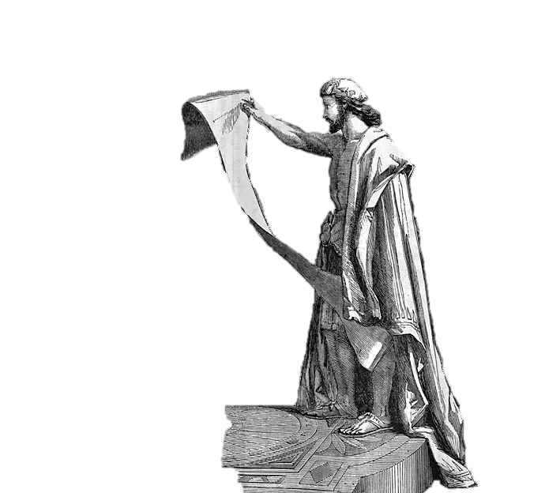
The Stirred-Up Spirit
Ezra 1:1 Now in the first year of
Cyrus king of Persia, that the word of the LORD by the mouth of Jeremiah might be fulfilled, the LORD stirred up the spirit of Cyrus king of Persia, so that he made a proclamation throughout all his kingdom, and also put it in writing, saying,
1

Slide 3
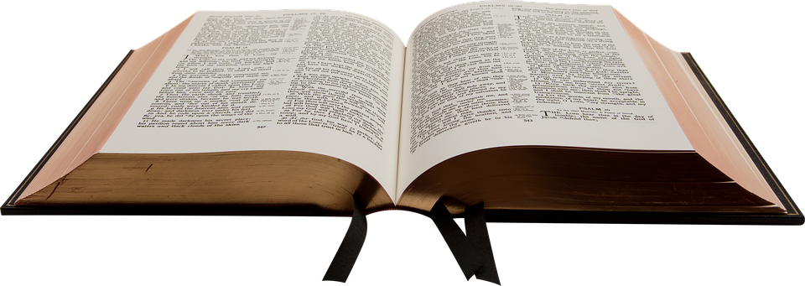
The Stirred-Up Spirit
The accession of Cyrus to the throne was another marvelous fulfilment of prophecy
Isaiah 44:28. Who says of Cyrus, 'He is My shepherd, And he shall perform all My pleasure, Saying to Jerusalem, "You shall be built," And to the temple, "Your foundation shall be laid."'
The very name of the Jews’ liberator was mentioned 150 years beforehand!
2

Slide 4
The Stirred-Up Spirit
Three distinct prophecies found their-fulfilment:
1. The punishment of the king of Babylon
(Jer. 25:12). Then it will come to pass, when seventy years are completed, that I will punish the king of Babylon and that nation, the land of the Chaldeans, for their iniquity,' says the LORD; 'and I will make it a perpetual desolation.
2. The end of the seventy years’ captivity
(Jer. 29:10) For thus says the LORD: After seventy years are completed at Babylon, I will visit you and perform My good word toward you, and cause you to return to this place.
3. The coming of the deliverer named. We can use these words, “The Lord stirred up the spirit of Cyrus,” as a key to unlock some of the treasures of this chapter – To help us make application.
3

Slide 5
The Stirred-Up Spirit
1. The Spirit Needs Stirring Up.
4

Slide 6
The Stirred-Up Spirit
2. God Alone can Stir up the Spirit.
5

Slide 7
The Stirred-Up Spirit
3. The Means by which the Spirit was Stirred up. The word.
(a) the Word of God.
(b) The providence of God.
6

Slide 8
The Stirred-Up Spirit
4. The Evidences of a Stirred-up Spirit.
(a) There is faith in the word of God.
(b) There is confession of the purpose of God.
(c) There are generous things devised for the honor of God.
7

Slide 9
The Stirred-Up Spirit
The application for us here at New Lebanon?
Someone has said, “Expect much from God, and attempt much for God.” …., “God never uses a discouraged worker.”
8

Slide 10
The Stirred-Up Spirit
Ezra 1:1 Now in the first year of
Cyrus king of Persia, that the word of the LORD by the mouth of Jeremiah might be fulfilled, the LORD stirred up the spirit of Cyrus king of Persia, so that he made a proclamation throughout all his kingdom, and also put it in writing, saying,
9

