Slide 1
Welcome to our services
New Lebanon Church of Christ
We are Simply Christians.
Our Emphasis is Spiritual, Not Material or Social.
We are striving to be The Same Church as Described in The New Testament.
Please Come Back Again

Slide 2
Blot, Wash, Cleanse. Psalm 51
Psalm 51:1-2. Blot out my transgressions. Wash me thoroughly from my iniquity, And cleanse me from my sin.
1

Slide 3
Blot, Wash, Cleanse. Psalm 51
Ashamed –ASHAMED (to be), SHAME
1. aischuno (αἰσχύνομαι, 153), from aischos, “shame,” (a) “to have a feeling of fear or shame which prevents a person from doing a thing,” Luke 16:3; (b) “the feeling of shame arising from something that has been done,” 2 Cor. 10:8; Phil. 1:20; 1 John 2:28, the possibility of being “ashamed” before the Lord Jesus at His judgment seat with His saints; in 1 Pet. 4:16, of being ashamed of suffering as a Christian.¶
2. epaischunomai (ἐπαισχύνομαι, 1870 being “ashamed” of persons, Mark 8:38; Luke 9:26; the gospel, Rom. 1:16; former evil doing, Rom. 6:21; “the testimony of our Lord,” 2 Tim. 1:8; suffering for the gospel, v. 12;
Ashamed –ASHAMED (to be), SHAME
1. aischuno (αἰσχύνομαι, 153), from aischos, “shame,” (a) “to have a feeling of fear or shame which prevents a person from doing a thing,” Luke 16:3; (b) “the feeling of shame arising from something that has been done,” 2 Cor. 10:8; Phil. 1:20; 1 John 2:28, the possibility of being “ashamed” before the Lord Jesus at His judgment seat with His saints; in 1 Pet. 4:16, of being ashamed of suffering as a Christian.¶
2. epaischunomai (ἐπαισχύνομαι, 1870 being “ashamed” of persons, Mark 8:38; Luke 9:26; the gospel, Rom. 1:16; former evil doing, Rom. 6:21; “the testimony of our Lord,” 2 Tim. 1:8; suffering for the gospel, v. 12;
2

Slide 4
Blot, Wash, Cleanse. Psalm 51
1. “BLOT ”Forgetfulness Of Sin (1, 9).
3

Slide 5
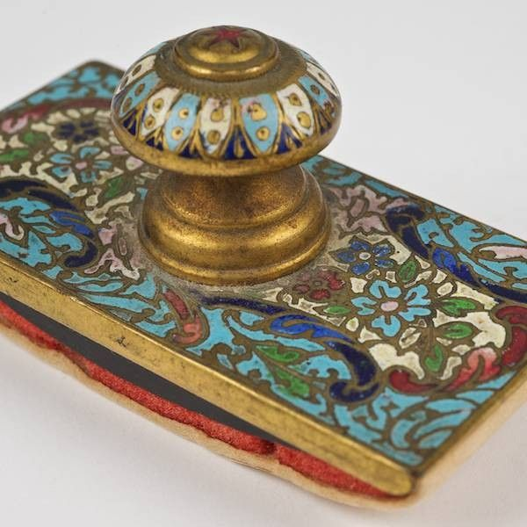
Blot Out
exaleipho (ἐξαλείφω, 1813), from ek, “out,” used intensively, and aleipho, “to wipe,” signifies “to wash, or to smear completely.” Hence, metaphorically, in the sense of removal, “to wipe away, wipe off, obliterate”; Acts 3:19, of sins; Col. 2:14, of writing; Rev. 3:5, of a name in a book; Rev. 7:17; 21:4, of tears.
W. E. Vine, Merrill F. Unger, and William White Jr.,

Slide 6
Blot, Wash, Cleanse. Psalm 51
2. “WASH”
Desire For Purity (v.2).
4

Slide 7
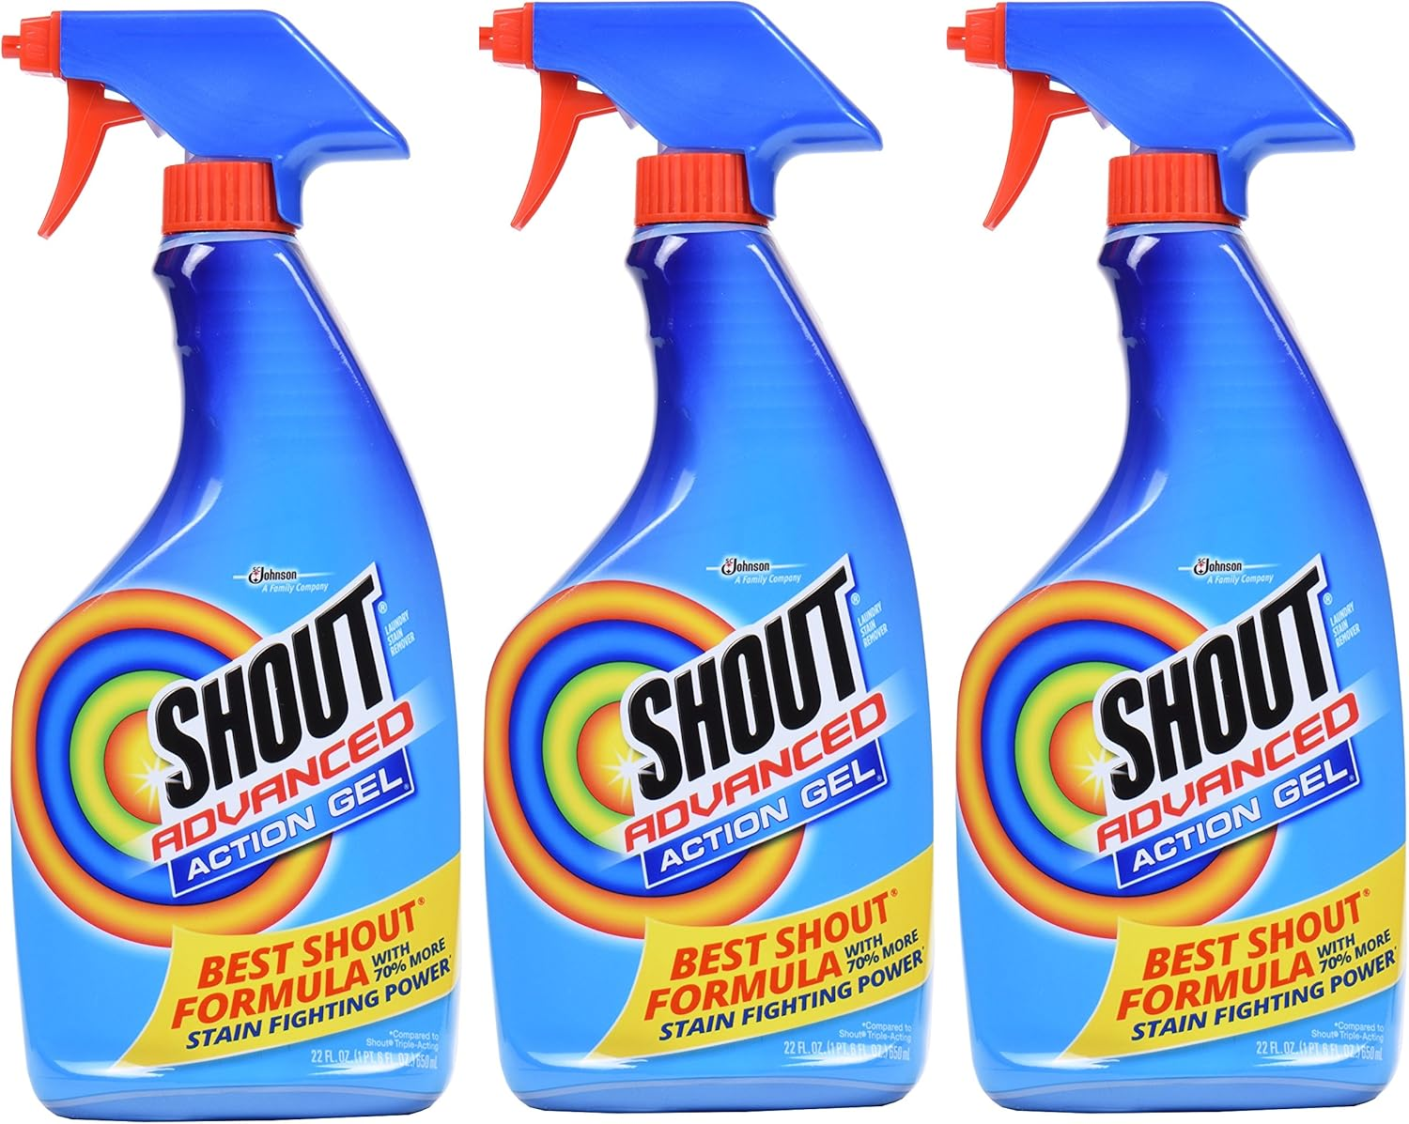

Slide 8
Blot, Wash, Cleanse. Psalm 51
3. “CLEANSE”—Admission Into Fellowship
5

Slide 9
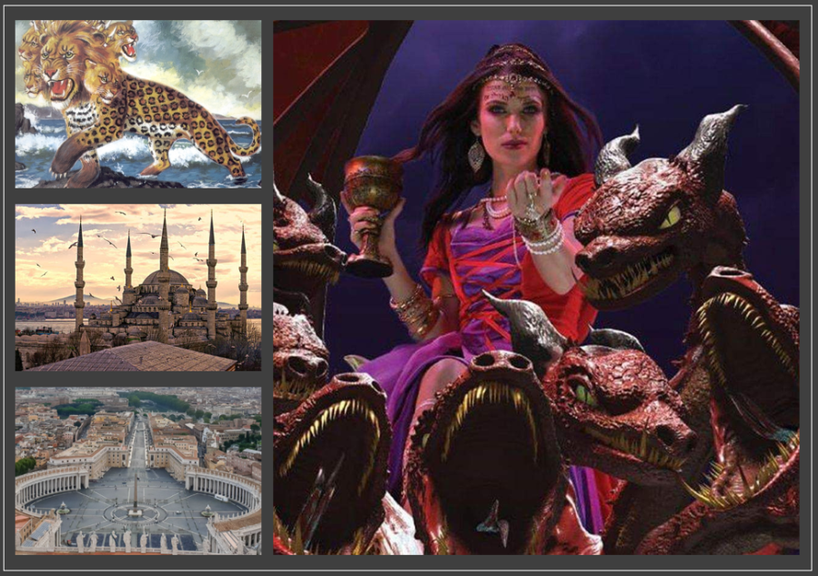
Rev. 17:4 And the woman was arrayed in purple and scarlet color, and decked with gold and precious stones and pearls, having a golden cup in her hand full of abominations and filthiness of her fornication: 5 And upon her forehead was a name written, MYSTERY, BABYLON THE GREAT, THE MOTHER OF HARLOTS AND ABOMINATIONS OF THE EARTH.
Isaiah 1:18 "Come now, and let us reason together," Says the LORD, "Though your sins are like scarlet, They shall be as white as snow; Though they are red like crimson, They shall be as wool.
6

Slide 10
Blot, Wash, Cleanse. Psalm 51
4. The EAR
Psalm 51:8 Make me to hear joy and gladness; that the bones which thou hast broken may rejoice.
7

Slide 11
Blot, Wash, Cleanse. Psalm 51
5. The TONGUE
Psalm 51:14 Deliver me from the guilt of bloodshed, O God, The God of my salvation, And my tongue shall sing aloud of Your righteousness.
8

Slide 12
Blot, Wash, Cleanse. Psalm 51
6. The LIPS
Psalm 51:15 O Lord, open my lips, And my mouth shall show forth Your praise.
9

Slide 13
10

