Slide 1
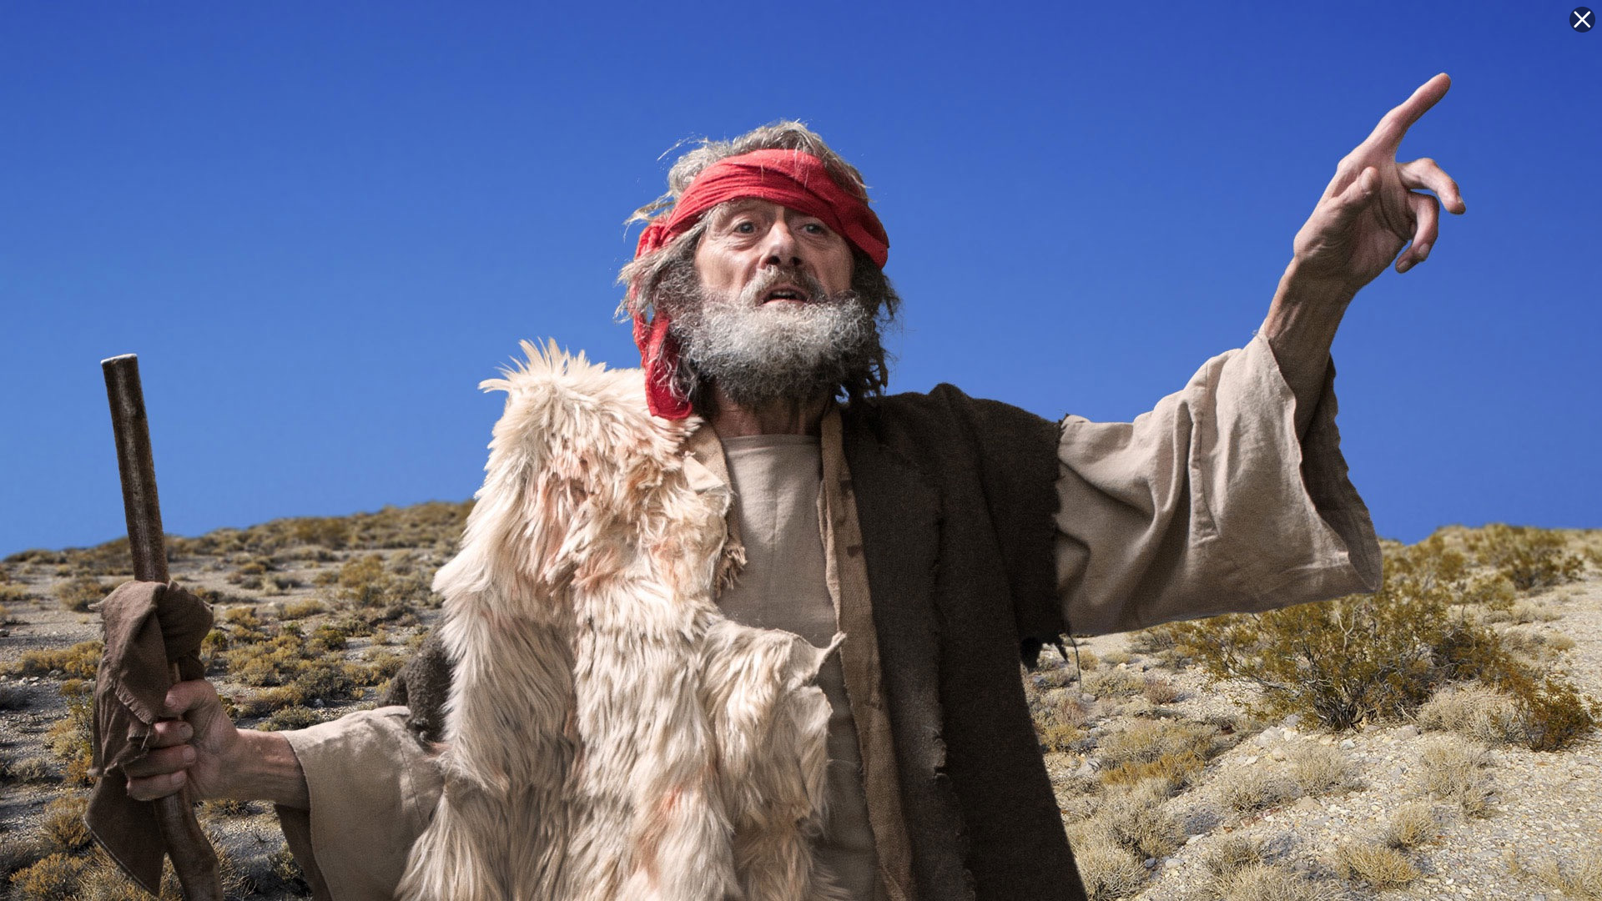

Minor Prophet Series
Lesson Five –
Haggai
Zechariah
Malachi
2Kings 21:10 And the LORD spoke by His servants the prophets, saying…

Slide 2
The Mission Of The Prophets—
They were to WARN the people that those who would not repent of idolatry would be destroyed.
They were to PROMISE that a remnant would be saved and that from this remnant would come the man, Christ Jesus, a descendant of David, who would sit on David’s throne and establish a kingdom which would never be destroyed.

Slide 3
Jeremiah 3:8-9
"Then I saw that for all the causes for which backsliding Israel had committed adultery, I had put her away and given her a certificate of divorce; yet her treacherous sister Judah did not fear, but went and played the harlot also….
with stones and trees.” (NKJV)
7

Slide 4
Jeremiah 31:31 "Behold, the days are coming, says the LORD, when I will make a new covenant with the house of Israel and with the house of Judah-
32 "not according to the covenant that I made with their fathers in the day that I took them by the hand to lead them out of the land of Egypt, My covenant which they broke, though I was a husband to them, says the LORD.
33 "But this is the covenant that I will make with the house of Israel after those days, says the LORD: I will put My law in their minds, and write it on their hearts; and I will be their God, and they shall be My people.
8

Slide 5
Hosea--Jehovah will be the God of all nations.
Joel--A vision of the gospel age.
Amos--A descendant of David will rule the world.
Obadiah--Edom shall perish.
Jonah--God wants His enemies saved.
Micah--The coming King and His reign.
Nahum--Judgment on the city of Nineveh.
Habakkuk--God’s people will be victorious.
Zephaniah--A new message for God’s people.
Haggai--The second temple and the greater temple of the future.
Zechariah--The coming King and His kingdom.
Malachi--The closing message while the people awaited the Messiah.

Slide 6
Jonah
Nahum
Amos
Hosea
Isaiah
Jeremiah
Joel
Micah
Zephaniah
Habakkuk
Obadiah
Before exile
During exile
Ezekiel
Daniel
Haggai
Zechariah
Malachi
After exile

Slide 7

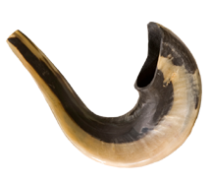
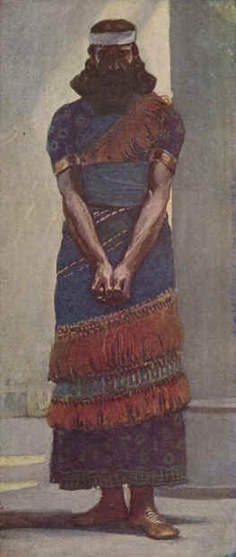
Haggai
Who: Haggai
What: Prophecy and Hope
Where: Judah
When: c. 520 BC
Why: To urge the people to complete rebuilding the temple.
The Prophet Haggai

Slide 8
Haggai
Outline (Chapter)
  Rebuild the Temple (1)
  Blessings and David’s Throne (2)
The Prophet Haggai
Notes:
Image: The Prophet Haggai by James Tissot, 1888.

Slide 9
Haggai
Key Verse
“This is what I covenanted with you when you came out of Egypt. And my Spirit remains among you. Do not fear.”—Haggai 2:5
Menu

Slide 10
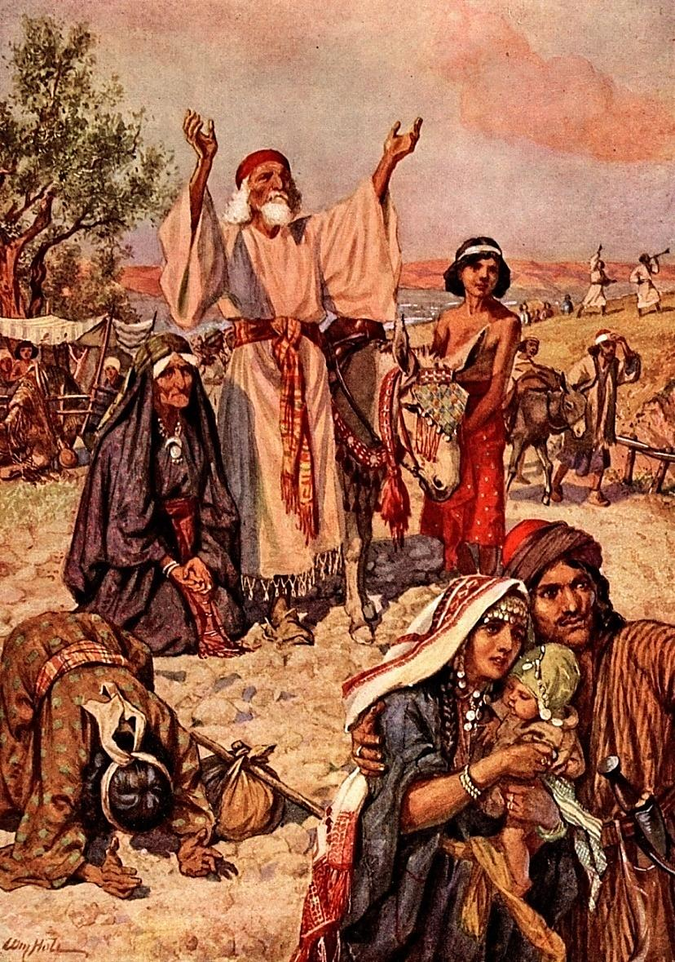
After 70 Years Of Exile
They Returned To Canaan
Three Returns From Captivity
The 1st lead by
Zerubbabel with: 42,360 Jews, 7,337 servants, 200 singers, 736 horses, 245 mules, 435 camels, 6,720 asses, 5,400 gold and silver vessels.
The 2nd lead by
Ezra with: 1,754 men, 100 talents, 750 talents of silver.
The 3rd lead by
Nehemiah: Army escorts supplied by Artaxerxes I. Nehemiah rebuilt and fortified Jerusalem.
Zerubbabel— the grandson of King Jehoiachin (Ezra 3:2; Haggai 1:1). He was heir to the throne of Judah and is listed in the genealogy of our Lord.
When Cyrus allowed the Jews to return to their own land, he appointed Zerubbabel governor of the colony.
After the 3rd “Return” there were still small groups returning in the time of Malachi which was about 100 years after the Jews began to return to Jerusalem.

Slide 11


Chronology Of The Jews Restoration
49,897 Jews returned from Babylon to Jerusalem.
In the 7th month they built an altar and offered sacrifice.
Work on the temple began, but was soon stopped.
Work on the temple renewed by Haggai and Zechariah.
The temple was completed.
Esther became Queen of Persia.
Ezra went from Babylon to Jerusalem.
Nehemiah rebuilt the wall around Jerusalem.
Nehemiah returned again from Babylon.

Slide 12
Two Periods After
The Return
1st period:
Zerubbabel—Governor
Joshua—Priest
The temple was rebuilt (Ezra 3-6)
Haggai and Zechariah—Prophets
Lasted about 20 years
Esther
2nd Period:
Nehemiah—Governor
Ezra—Priest
Rebuilt the wall; Jerusalem was restored
Malachi—Prophet
Lasted about 25 years
Ezra
gives an account of both periods.
Nehemiah
tells of the 2nd period.
Esther
comes in between the two periods.
Haggai began his ministry 18 years after the people began to return from captivity.

Slide 13
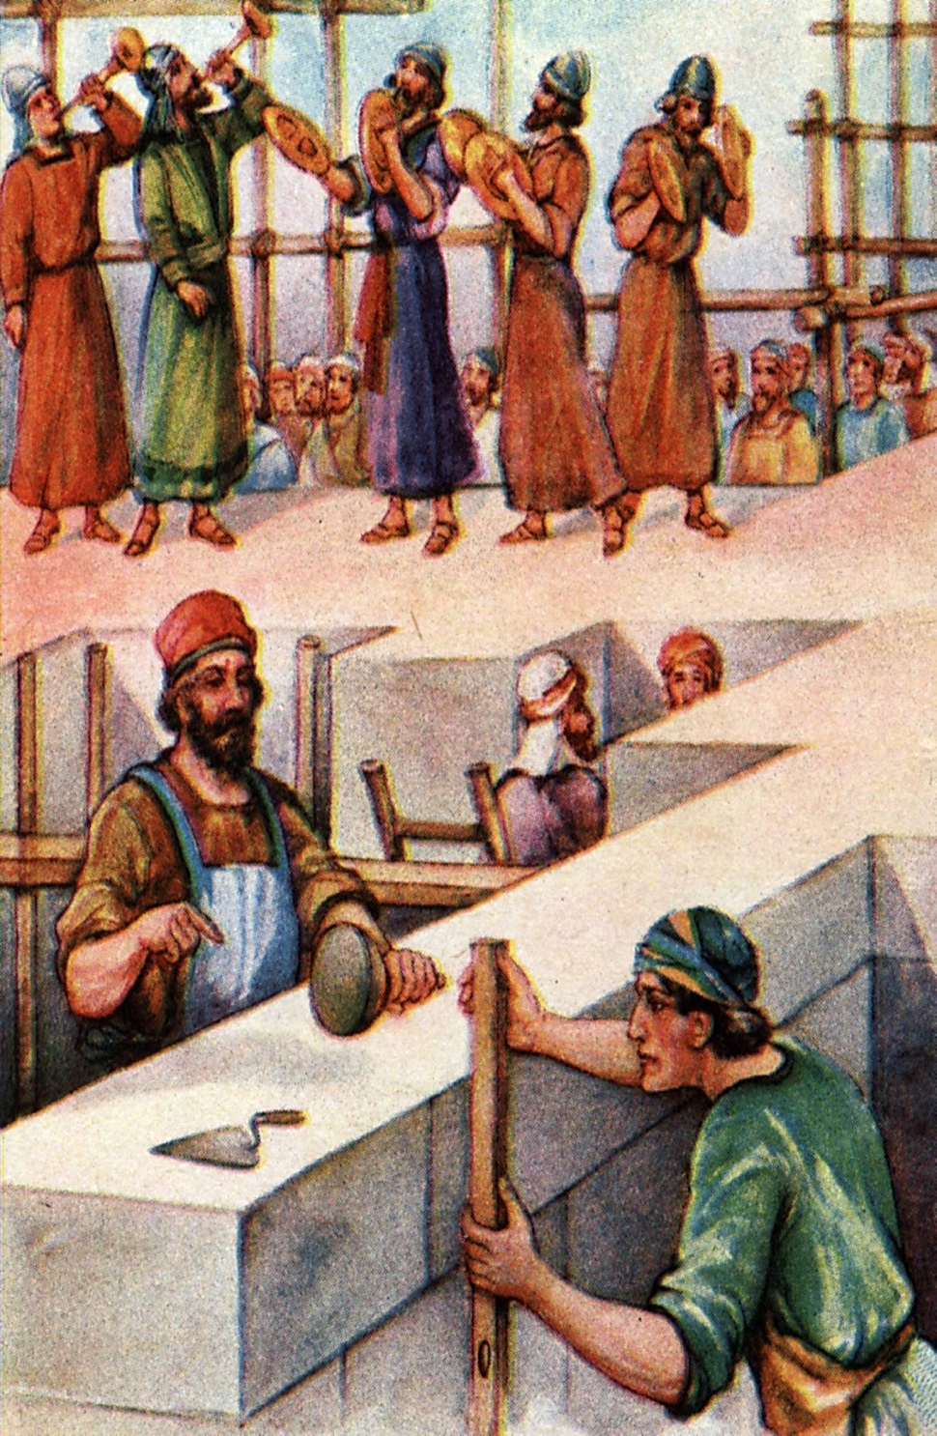
HISTORICAL SETTING
We have no personal history of the prophet Haggai other than he was the earliest of the prophets of the restoration.
In the reign of Darius, the 3rd of the Persian kings, in the 2nd year of his reign, Haggai was sent.

Slide 14
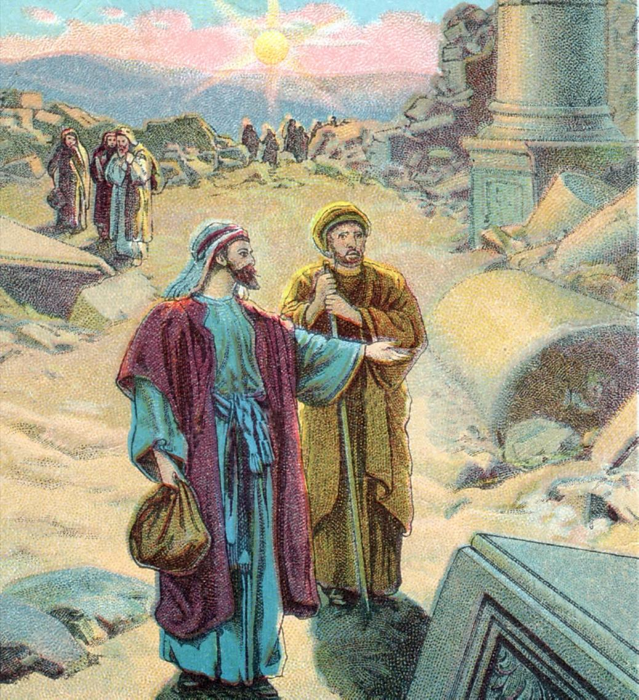
Chapter 1
I. A Message of Rebuke
Only a handful of people had returned to Jerusalem from Babylon. They were few in number and continually harassed by enemies. Because of opposition from the Persians the Jews neglected the Lord’s house and built homes for themselves. God punished the people for this. In response to Haggai’s appeal the people set themselves to the work of restoration.

Slide 15
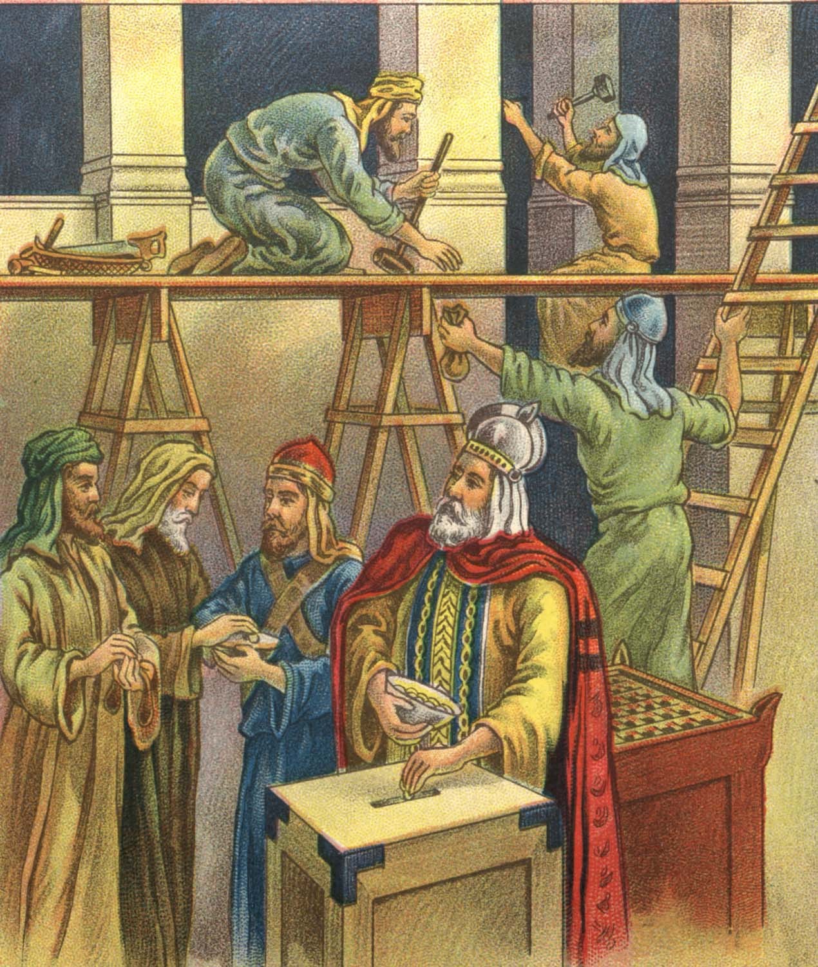
Chapter 2:1-9
II. A Message of Courage
This section was written to cheer the workers. They could see that the building which they were erecting did not compare with the one which Solomon had built. Haggai assured them that this latter house would be greater than the former. (It was greater because it would know the presence of the Lord Jesus Christ, not because it was a greater physical building.)

Slide 16
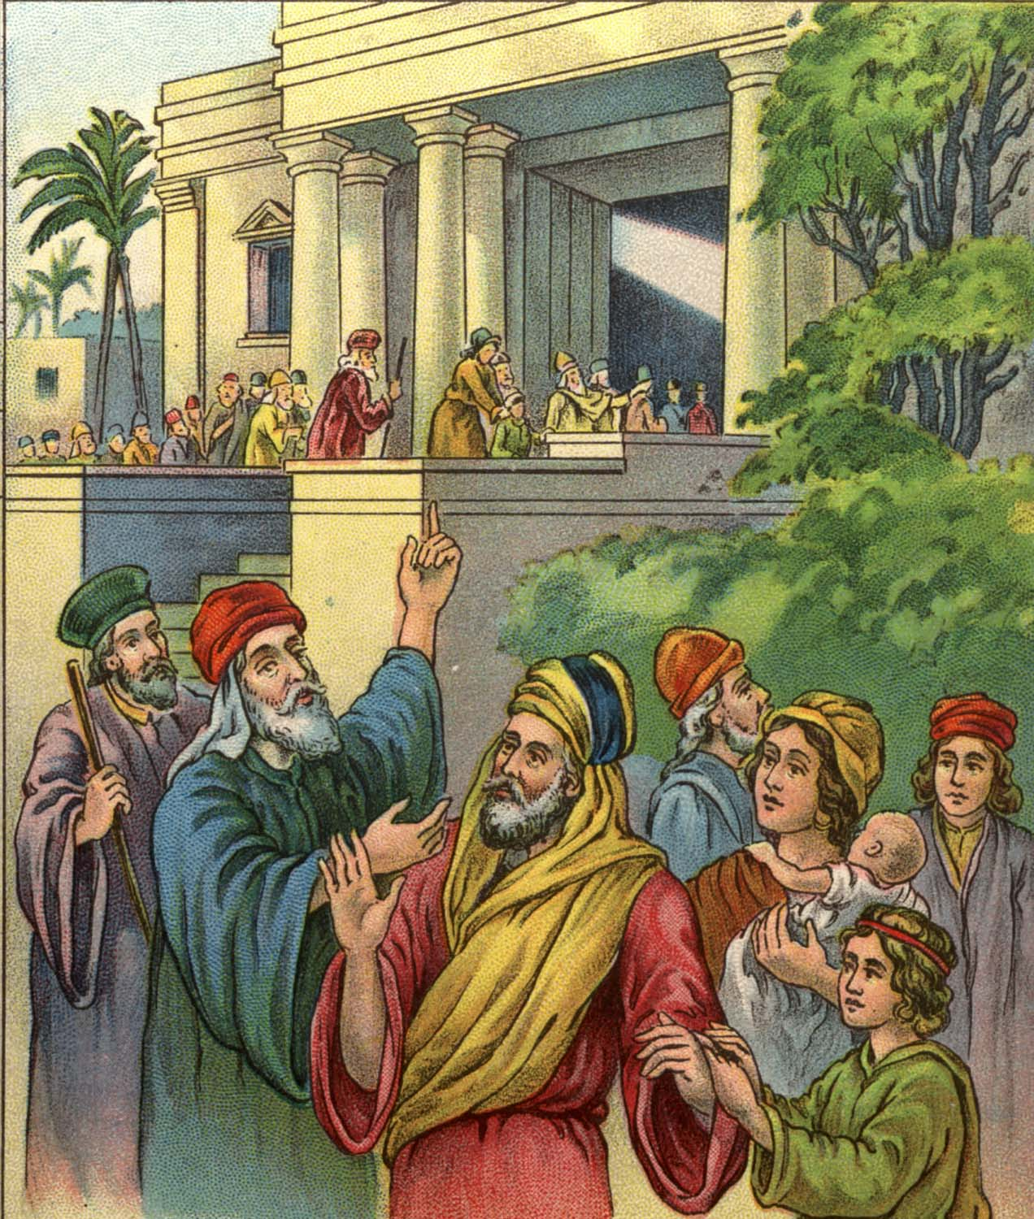
Chapter 2:10-23
III. A Message of Assurance
A message of cleansing and blessing was delivered three months after the temple was started. Haggai made the people see their sinfulness and sought to bring them to repentance. He told them, “from this day will I bless you.” God sometimes withholds prosperity of wealth to give prosperity of soul.

Slide 17
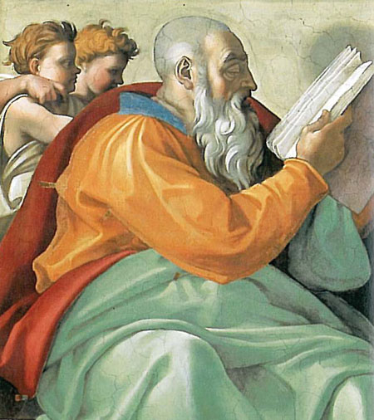
Zechariah
Who: Zechariah
What: Prophecy and Hope
Where: Judah
When: c. 520–518 BC
Why: To give hope to the remnant.
The Prophet Zechariah

Slide 18
Zechariah
Outline (Chapter)
  Zechariah’s Visions (1–8)
  Oracles against the Nations (9–14)
The Prophet Zechariah

Slide 19
Zechariah
Key Verse
“Rejoice greatly, O Daughter of Zion! Shout, Daughter of Jerusalem! See, your king comes to you, righteous and having salvation, gentle and riding on a donkey, on a colt, the foal of a donkey.”—Zechariah 9:9
Menu

Slide 20
After 70 Years Of Exile
They Returned To Canaan
Three Returns From Captivity
The 1st lead by
Zerubbabel with: 42,360 Jews, 7,337 servants, 200 singers, 736 horses, 245 mules, 435 camels, 6,720 asses, 5,400 gold and silver vessels.
The 2nd lead by
Ezra with: 1,754 men, 100 talents, 750 talents of silver.
The 3rd lead by
Nehemiah: Army escorts supplied by Artaxerxes I. Nehemiah rebuilt and fortified Jerusalem.
The Jews began a journey of more than 700 miles across the desert from Babylon to Jerusalem.
Not just people from the tribe of Judah but from other tribes as well. The term “all Israel” is used of those who returned.
Zerubbabel— the grandson of King Jehoiachin (Ezra 3:2; Haggai 1:1). He was heir to the throne of Judah and is listed in the genealogy of our Lord.
When Cyrus allowed the Jews to return to their own land, he appointed Zerubbabel governor of the colony and gave back the golden vessels which Nebuchadnezzar had taken from the temple.
After the 3rd “Return” there were still small groups returning in the time of Malachi which was about 100 years after the Jews began to return to Jerusalem.

Slide 21
Chronology Of The Jews Restoration
49,897 Jews returned from Babylon to Jerusalem.
In the 7th month they built an altar and offered sacrifice.
Work on the temple began, but was soon stopped.
Work on the temple renewed by Haggai and Zechariah.
The temple was completed.
Esther became Queen of Persia.
Ezra went from Babylon to Jerusalem.
Nehemiah rebuilt the wall around Jerusalem.
Nehemiah returned again from Babylon.

Slide 22
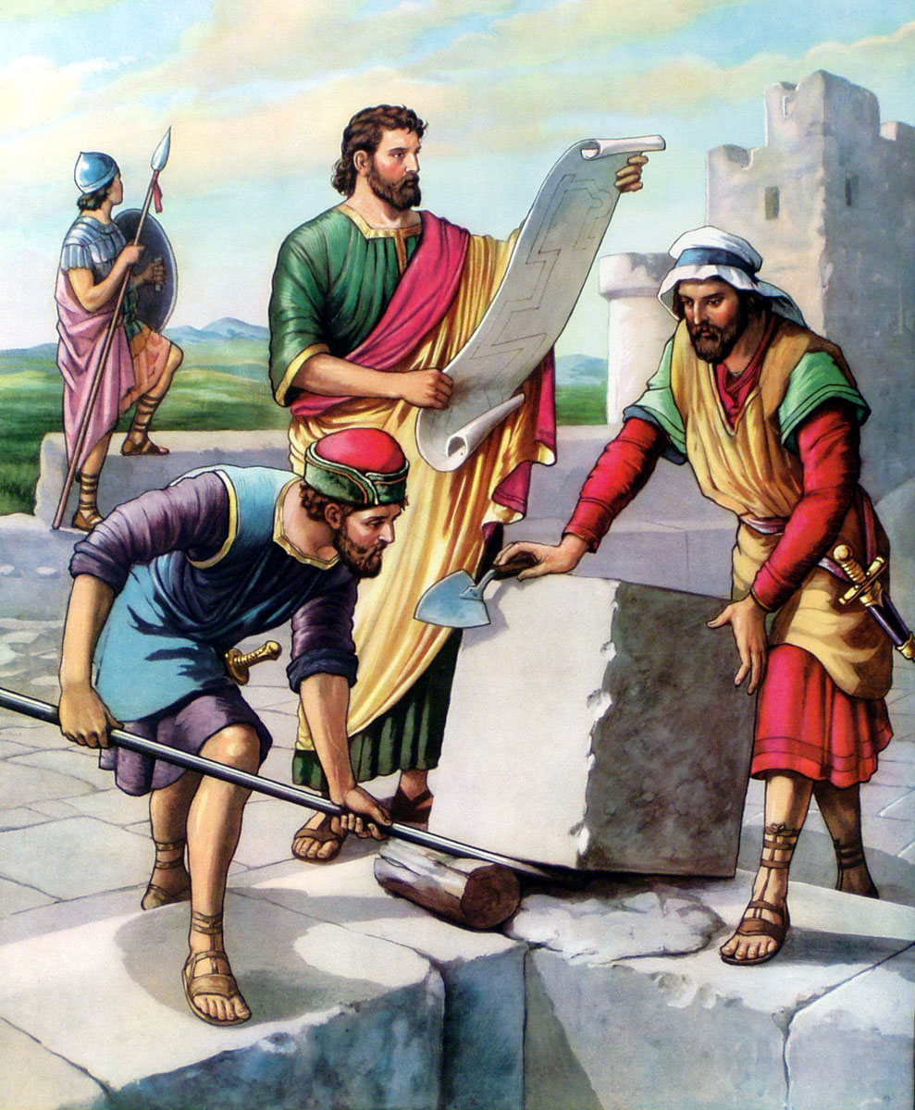
After the foundation sat for 15 years Haggai urged the Jews to again undertake the work of rebuilding the temple despite the threatening objections.
Four months later he was joined by Zechariah. In four years the temple was completed.

Slide 23
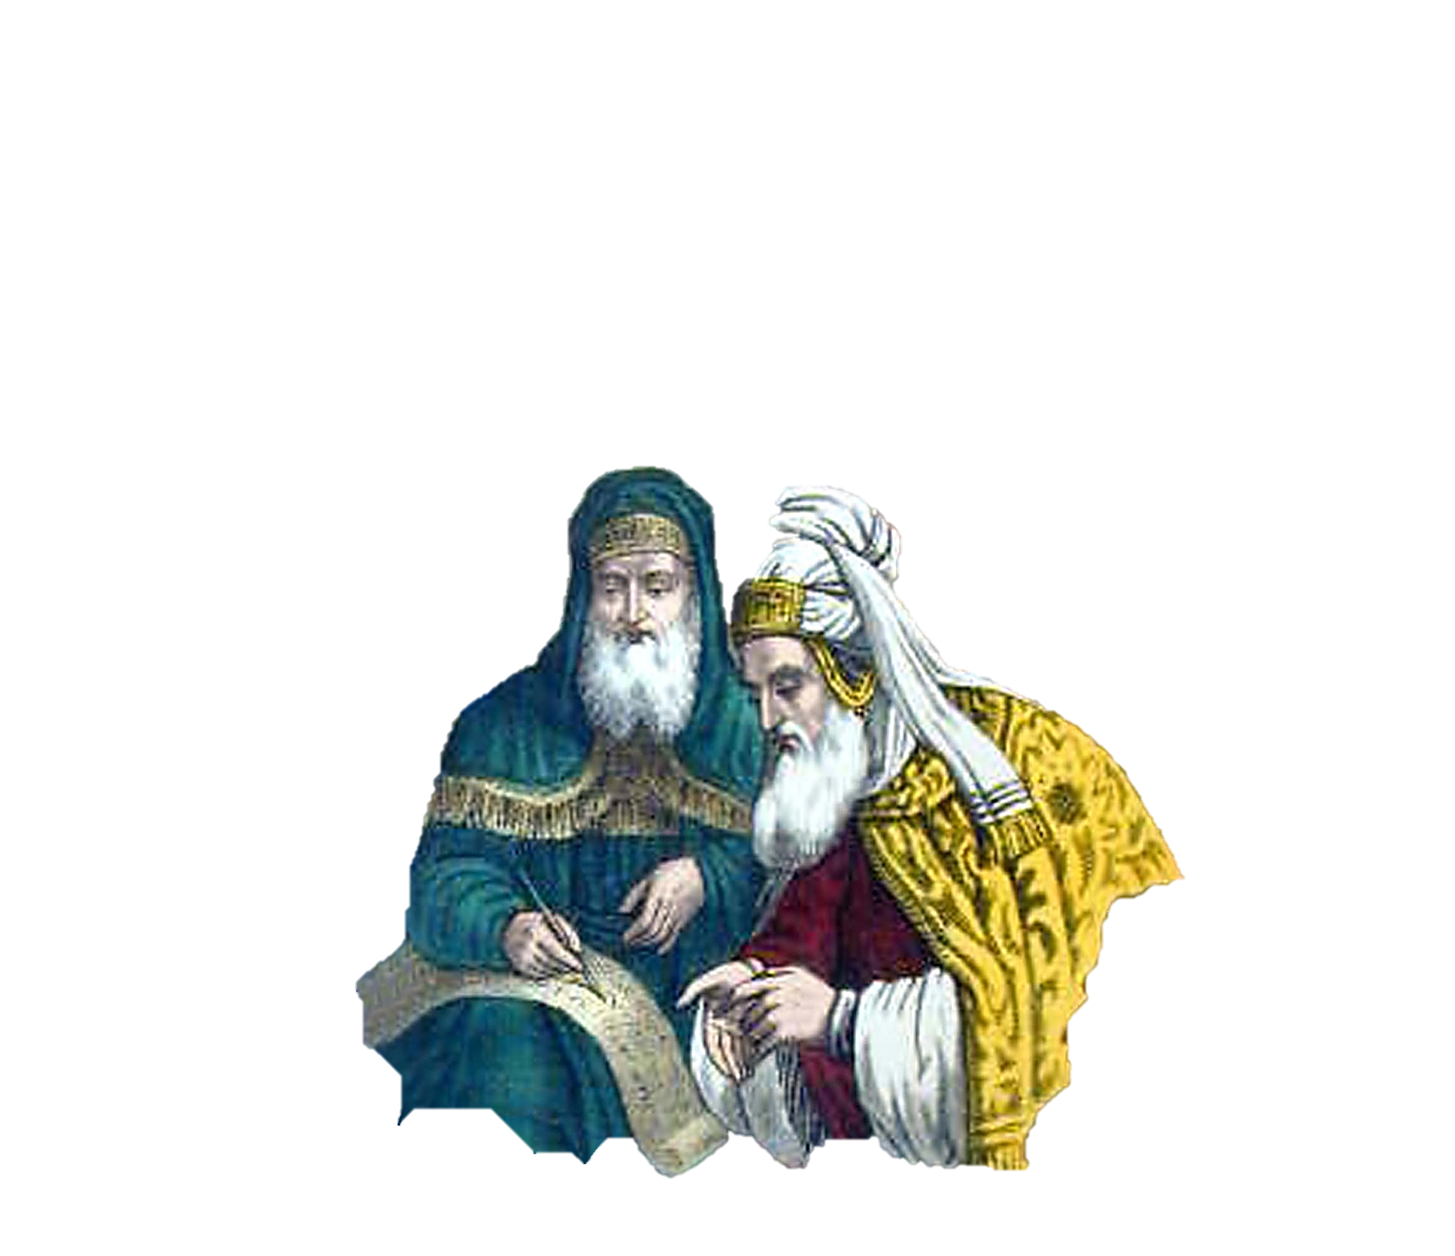
PROPHET & PRIEST
Not only was Zechariah a co-worker with Haggai in promoting the rebuilding of the temple, but he was also both a prophet and a priest (Nehemiah 12:12, 16).

Slide 24
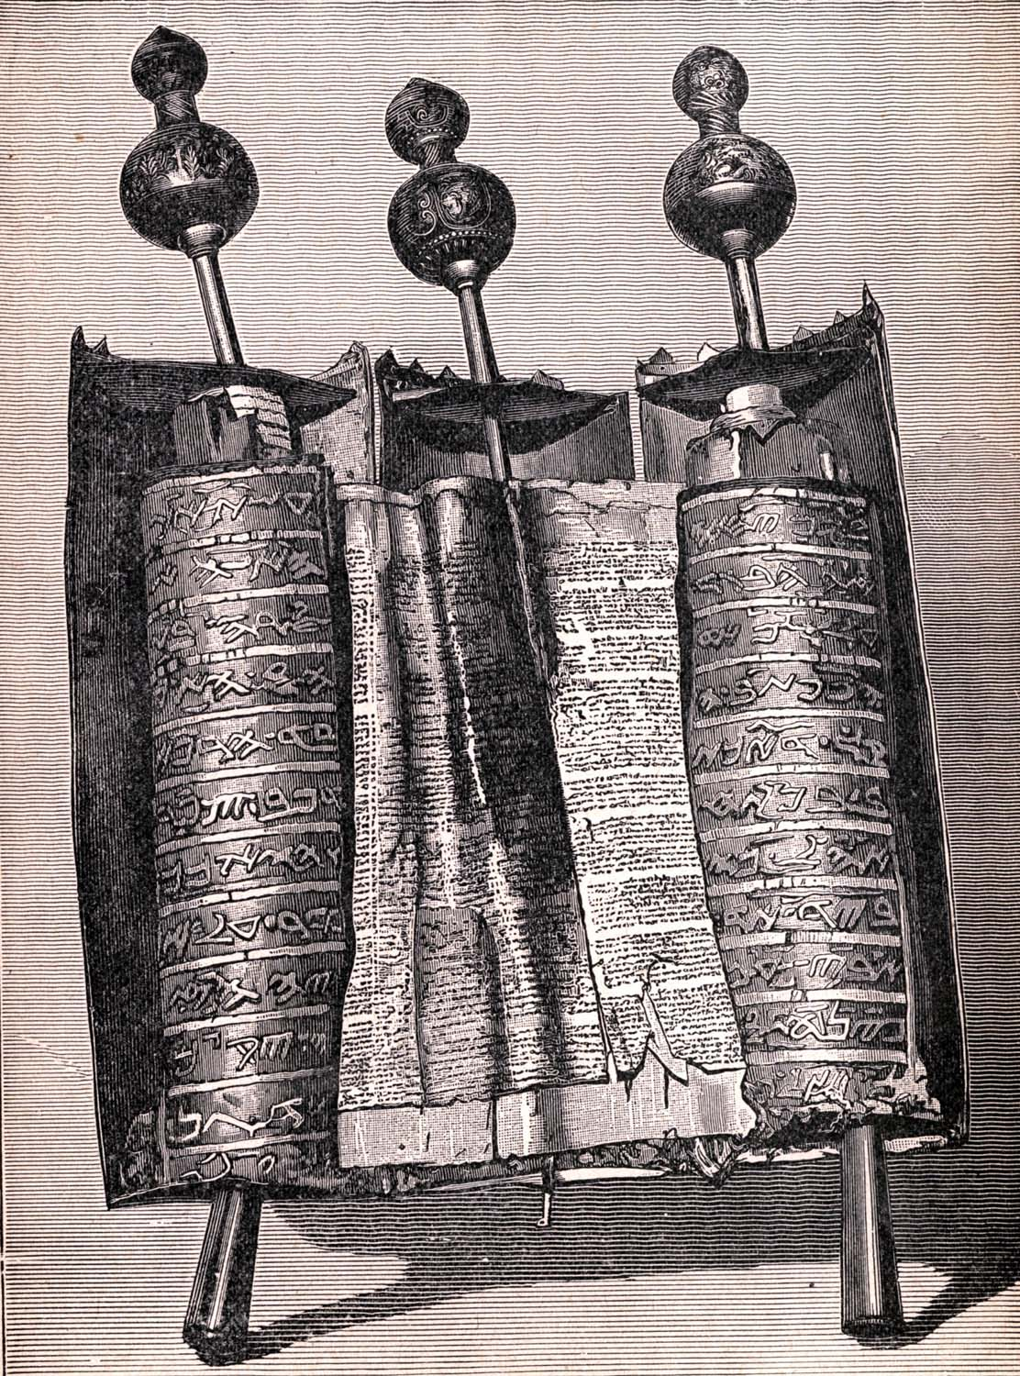
VISIONS OF ZECHARIAH
The book of Zechariah has two main points:
THE RETURN OF THE JEWS FROM BABYLON
&
THE COMING OF CHRIST
Let’s take a look at these two points by looking at the . . .
Visions of Zechariah

Slide 25
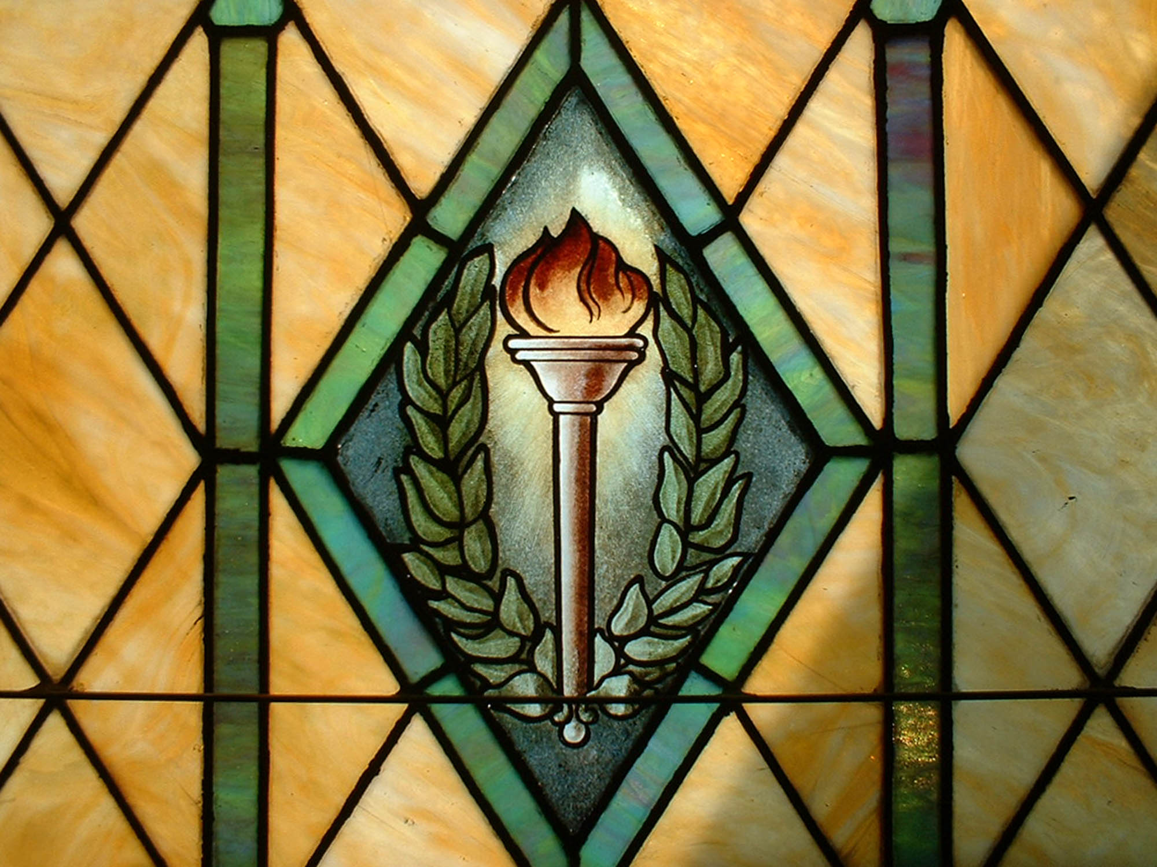
In addition to the
VISIONS
which pictured the Jews coming home
from Babylonian captivity and
re-inhabiting Palestine and their
future hope of the coming of Christ
the book of Zachariah records many
PROPHECIES
concerning the Messiah.
Perhaps only Isaiah records more.
Some of these are—

Slide 26
The Messiah and the Kingdom
Christ the Branch Zechariah 3:8
Christ the Servant Zechariah 3:8
Christ’s Entry into Jerusalem on a Colt Zechariah 9:9
Christ the Good Shepherd Zechariah 9:16
Christ the Betrayed for 30 Pieces of Silver Zechariah 11:12, 13
Christ’s Hands Pierced Zechariah 12:10
Christ ‘s People Saved Zechariah 13:1
Christ wounded in the House of His Friends Zechariah 13:6
Christ the Smitten Shepherd Zechariah 13:7
Christ on the Mount of Olives Zechariah 14:3-8

Slide 27
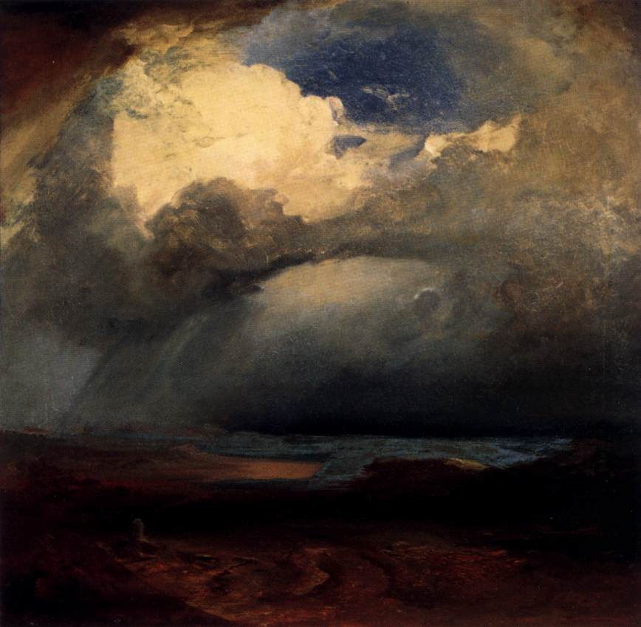
Malachi
Who: Malachi
What: Prophecy and Judgment
Where: Judah
When: c. 400s BC
Why: To examine Judah’s actions and make sure God has priority.
Notes:
Image: The Battlefield by Carl Rottmann, 1849.

Slide 28
Malachi
Outline (Chapter)
  Six Prophetic Speeches (1–3)
  Day of the Lord (4)

Slide 29
Malachi
Key Verse
“But for you who revere my name, the sun of righteousness will rise with healing in its wings.”—Malachi 4:2
Menu

Slide 30
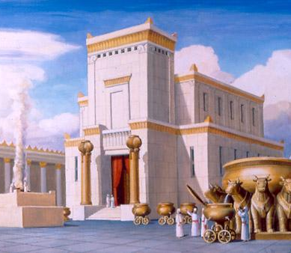

Two Periods After
The Return
1st period:
Zerubbabel—Governor
Joshua—Priest
The temple was rebuilt (Ezra 3-6)
Haggai and Zechariah—Prophets
Lasted about 20 years
Esther
2nd Period:
Nehemiah—Governor
Ezra—Priest
Rebuilt the wall; Jerusalem restored
Malachi—Prophet
Lasted about 25 years
THE BOOK OF
Ezra
gives an account of both periods.
____________________
THE BOOK OF
Nehemiah
tells of the 2nd period.
____________________
THE BOOK OF
Esther
comes in between the two periods.
Esther appeared on the scene about 40 years after the temple was rebuilt and about 30 years before the wall of Jerusalem was rebuilt.
Malachi began his ministry about 100 years after the Jews began to return from captivity.

Slide 31
OUTLINE OF MALACHI
I. Sins of the Priests
Malachi 1:1 - 2:9
The priests had become irreverent and neglectful. God said, “where is mine honor? . . . O priests, that despise my name.” The prophet rebukes careless priests who offered worthless animals— animals so defective they would not be presented to the governor (1:7, 8, 12, 13). They refused to work except for money. As long as the priests were in this condition, the people could hardly be expected to observe God’s law. Carelessness in worship, mixed marriages with women of outside tribes became common. Some divorced their Israelite wives to marry heathen women (2:10-16).

Slide 32
OUTLINE OF MALACHI
II. Sins of the People
Malachi 2:10 - 3:18
The people complained that God did not love them as much as He should (1:2). They were guilty of social sins (3:5). They were skeptical and indifferent. But, some were still faithful to God, willing and anxious to hear His word (3:16).
Many of the Jews had become idolaters, and they robbed God by not bringing in the tithes and offerings. “Will a man rob God?” (3:8). God commanded, “bring ye all the tithe into the storehouse.” The tithe was an outward recognition that they belonged to God.

Slide 33
OUTLINE OF MALACHI
III. Coming Things
Malachi 3, 4
The Jews complained that God did not distinguish between good men and bad, but blessed all alike (2:17). God told them that one day wicked people would be punished. He promised to send His messenger in the power and spirit of Elijah (John the Baptist) to prepare the way for His Son. This Son would sit in judgment and separate the evil from the good (3:1).
Malachi closed with the message of all the Old Testament prophets— Christ is coming. The Son of Righteousness will come with healing in His wings and all man will flow to him. All of the Old Testament pointed forward to the coming of Christ.

