Slide 1
Welcome to our services
New Lebanon Church of Christ
We are Simply Christians.
Our Emphasis is Spiritual, Not Material or Social.
We are striving to be The Same Church as Described in The New Testament.
Please Come Back Again

Slide 2
How is
my writing ?
2 Cor.3:1-3

Slide 3
2Cor. 3:1 Do we begin again to commend ourselves? Or do we need, as some others, epistles of commendation to you or letters of commendation from you? 2 You are our epistle written in our hearts, known and read by all men;
3 clearly you are an epistle of Christ, ministered by us, written not with ink but by the Spirit of the living God, not on tablets of stone but on tablets of flesh, that is, of the heart.

Slide 4
The style of a letter depends largely on the occasion it is written for.

Slide 5
1. A letter is written on prepared material.

Slide 6
2. A letter bears the expression of the writer.

Slide 7
3. A letter bears the signature of the writer.

Slide 8
4. A letter should be legible.

Slide 9
5. A letter should be free of blots.

Slide 10
6. A letter is known by its handwriting.

Slide 11
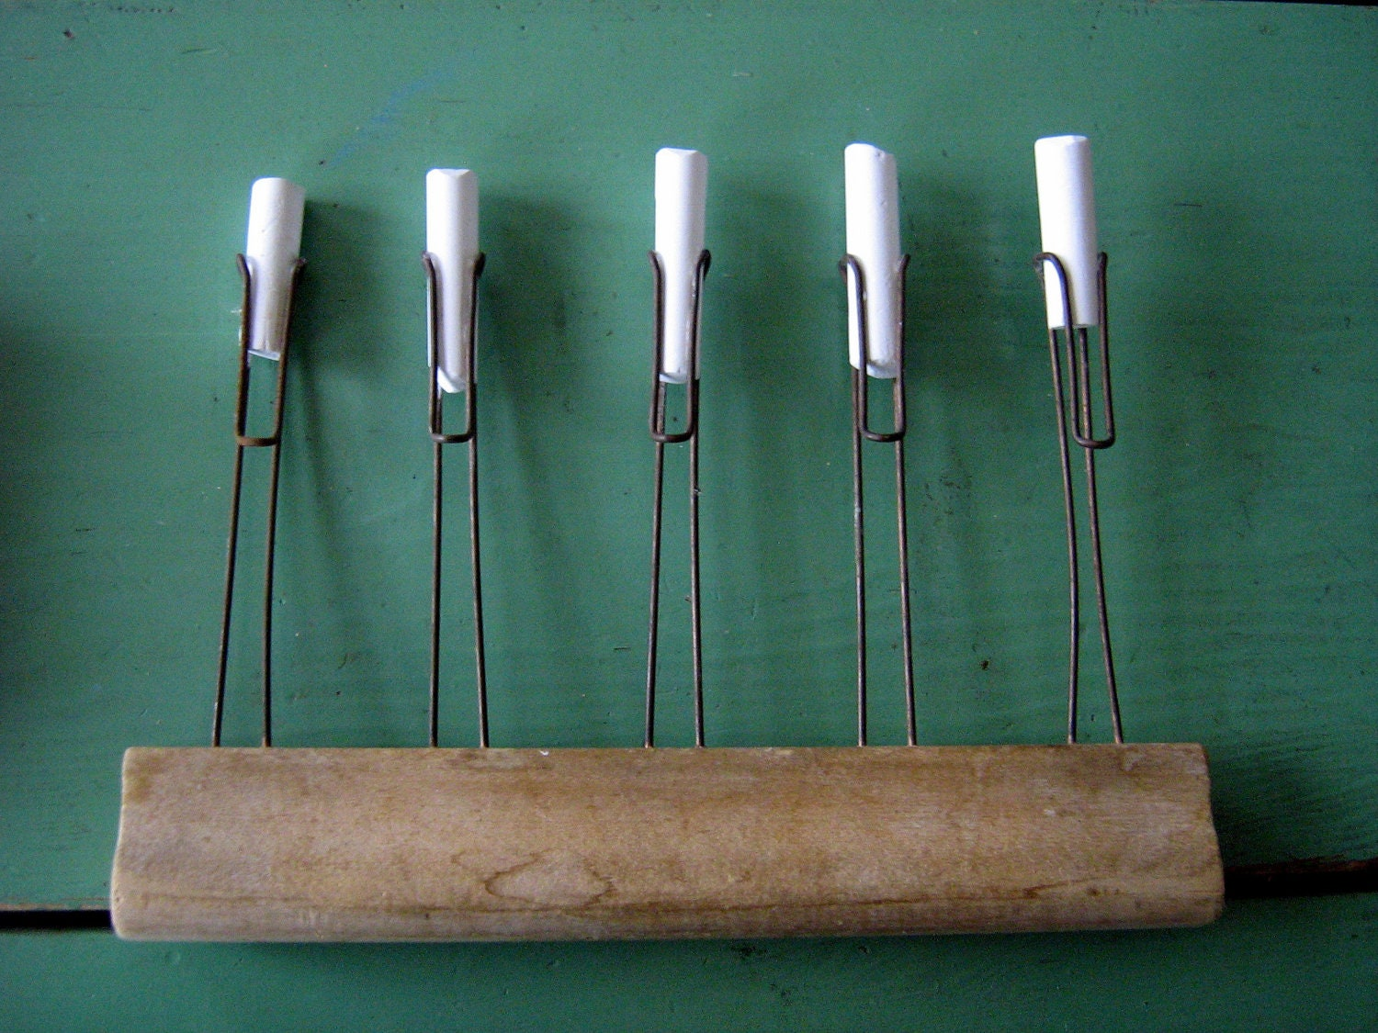

Slide 12
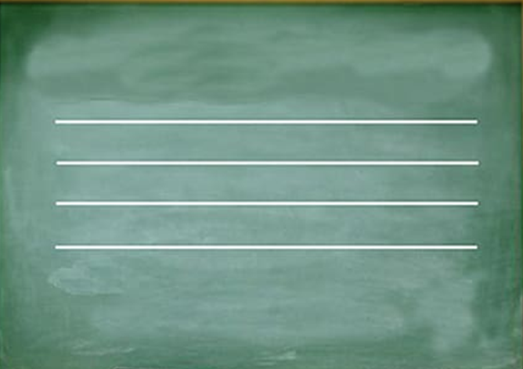

Slide 13
2 Cor 3:2 You are our epistle written in our hearts, known and read by all men;
2 Peter 3:1 Beloved, I now write to you this second epistle (in both of which I stir up your pure minds by way of reminder), 2 that you may be mindful of the words which were spoken before by the holy prophets, and of the commandment of us, the apostles of the Lord and Savior,

