Slide 1
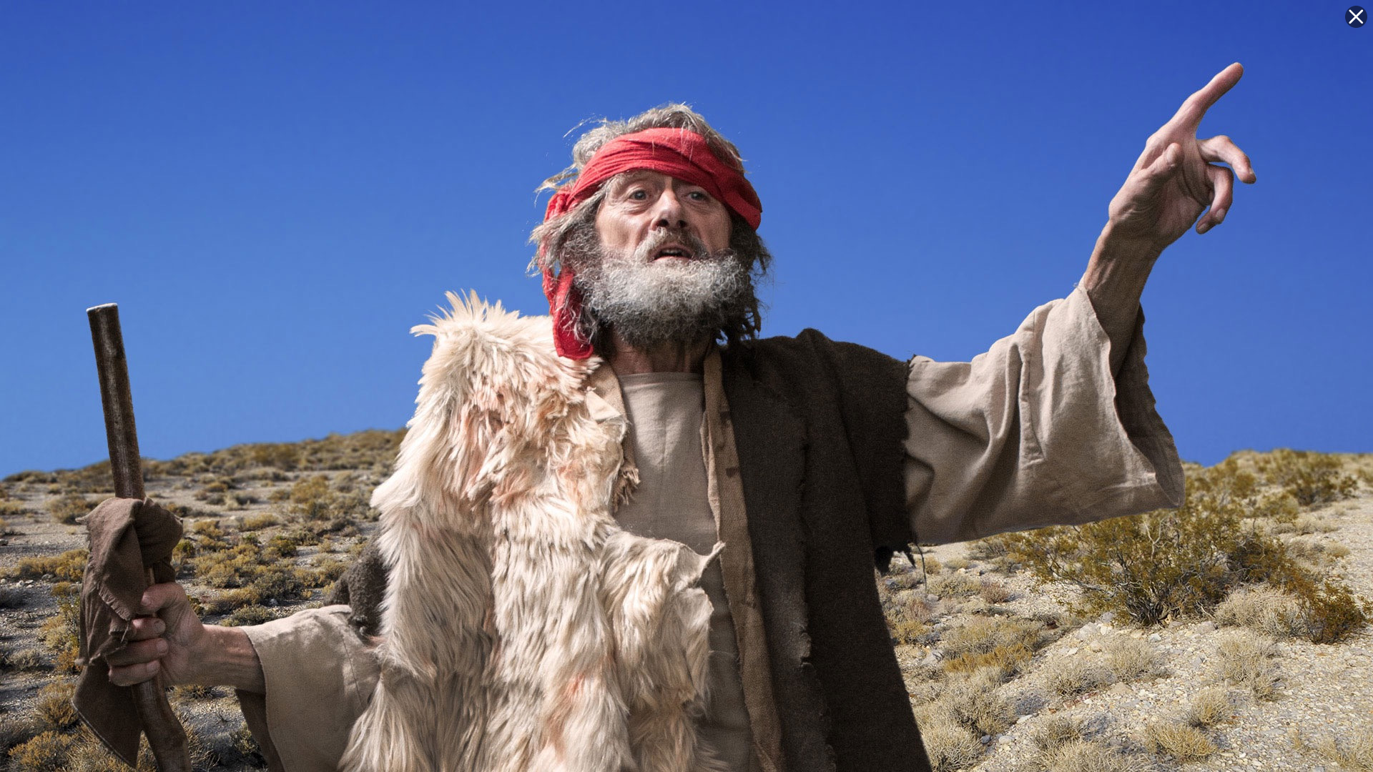
Minor Prophet Series
Lesson Four –
Nahum
Habakkuk
Zephaniah
2Kings 21:10 And the LORD spoke by His servants the prophets, saying…

Slide 2
The Mission Of The Prophets—
They were to WARN the people that those who would not repent of idolatry would be destroyed.
They were to PROMISE that a remnant would be saved and that from this remnant would come the man, Christ Jesus, a descendant of David, who would sit on David’s throne and establish a kingdom which would never be destroyed.

Slide 3
Jeremiah 3:8-9
"Then I saw that for all the causes for which backsliding Israel had committed adultery, I had put her away and given her a certificate of divorce; yet her treacherous sister Judah did not fear, but went and played the harlot also….
with stones and trees.” (NKJV)
7

Slide 4
Jeremiah 31:31 "Behold, the days are coming, says the LORD, when I will make a new covenant with the house of Israel and with the house of Judah-
32 "not according to the covenant that I made with their fathers in the day that I took them by the hand to lead them out of the land of Egypt, My covenant which they broke, though I was a husband to them, says the LORD.
33 "But this is the covenant that I will make with the house of Israel after those days, says the LORD: I will put My law in their minds, and write it on their hearts; and I will be their God, and they shall be My people.
8

Slide 5
Hosea--Jehovah will be the God of all nations.
Joel--A vision of the gospel age.
Amos--A descendant of David will rule the world.
Obadiah--Edom shall perish.
Jonah--God wants His enemies saved.
Micah--The coming King and His reign.
Nahum--Judgment on the city of Nineveh.
Habakkuk--God’s people will be victorious.
Zephaniah--A new message for God’s people.
Haggai--The second temple and the greater temple of the future.
Zechariah--The coming King and His kingdom.
Malachi--The closing message while the people awaited the Messiah.

Slide 6
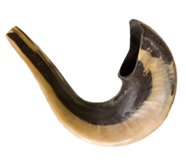
Nahum
Who: Nahum
What: Prophecy and Judgment
Where: Judah and Nineveh
When: c. 663–612 BC
Why: To pronounce judgment on Nineveh and the Assyrian empire.

Slide 7
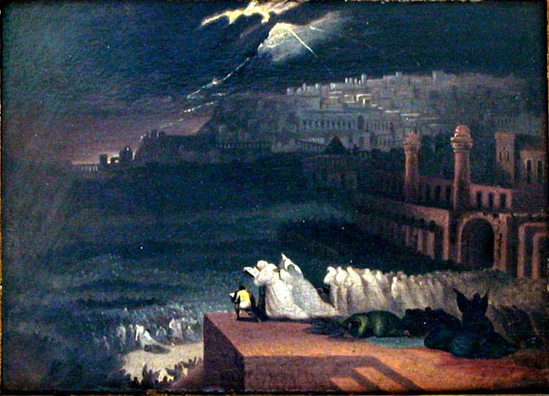
Nahum
Outline (Chapter)
Judgment and Mercy (1)
Nineveh’s Destruction (2–3)
The Fall of Nineveh
Notes:
Image: The Fall of Nineveh by Joseph Martin, c. 1840.

Slide 8
Nahum
Key Verse “The LORD is good, a refuge in times of trouble. He cares for those who trust in him.” —Nahum 1:7
Menu

Slide 9
The Prophet Nahum

Slide 10
NAHUM 1:1; 2:13; 3:1 The burden of Nineveh....Behold, I am against thee, saith the Lord of hosts....Woe to the bloody city!
NAHUM 1:15 Behold upon the mountains the feet of him that bringeth good tidings, that publish peace!

Slide 11
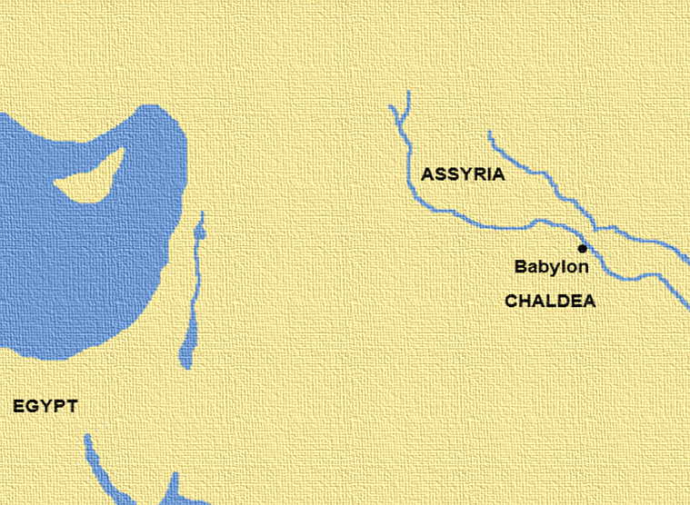
Nahum 1:15
“Behold upon the mountains the feet of him that bringeth good tidings, that publisheth peace! O Judah, keep thy solemn feasts, perform thy vows: for the wicked shall no more pass through thee; he is utterly cut off.”
THE PROPHET NAHUM is unknown except by the book which bears his name. He lived at Elkosh, the location of which is uncertain (1:1). He prophesied as if he were a Judean (1:15).
Cyprus
SYRIA
SAMARIA
JUDAH
Sinai
Arabia

Slide 12
Nahum 2:8-9
“⁸But Nineveh is of old like a pool of water: yet they shall flee away. Stand, stand, shall they cry; but none shall look back.”
Nahum prophesied after the fall of the Egyptian city No and before the fall of Nineveh. His small book of only 3 chapters was written to pronounce God’s wrath on Nineveh, which was one of the cruelest cities on earth.
SYRIA
Cyprus
ISRAEL
JUDAH
No
Sinai
Arabia

Slide 14
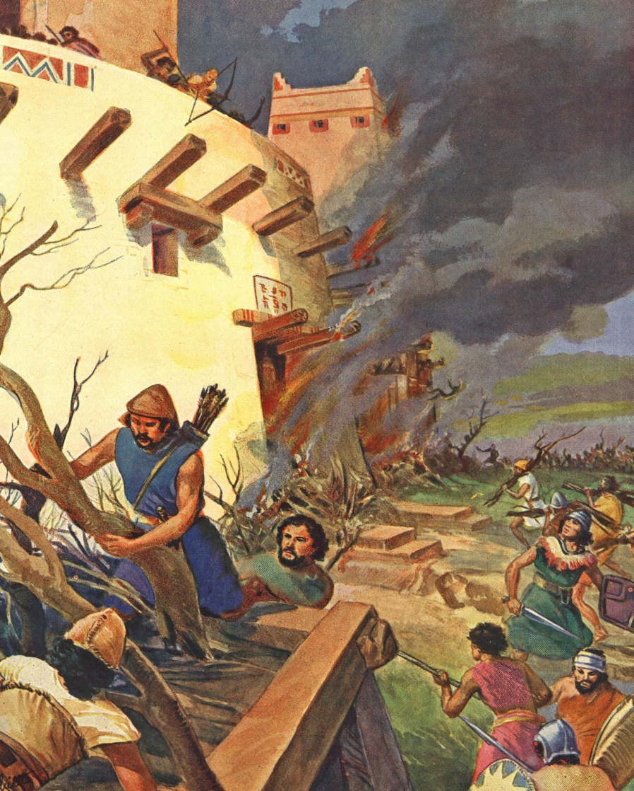
Chapter 2
¹He that dasheth in pieces is come up before thy face: keep the munition, watch the way, make thy loins strong, fortify thy power mightily.
²For the LORD hath turned away the excellency of Jacob, as the excellency of Israel: for the emptiers have emptied them out, and marred their vine branches.
³The shield of his mighty men is made red, the valiant men are in scarlet: the chariots shall be with flaming torches in the day of his preparation, and the fir trees shall be terribly shaken.
⁴The chariots shall rage in the streets, they shall justle one against another in the broad ways: they shall seem like torches, they shall run like the lightnings.
⁵He shall recount his worthies: they shall stumble in their walk; they shall make haste to the wall thereof, and the defence shall be prepared.
⁶The gates of the rivers shall be opened, and the palace shall be dissolved.
⁷And Huzzab shall be led away captive, she shall be brought up, and her maids shall lead her as with the voice of doves, tabering upon their breasts.
⁸But Nineveh is of old like a pool of water: yet they shall flee away. Stand, stand, shall they cry; but none shall look back.
⁹Take ye the spoil of silver, take the spoil of gold: for there is none end of the store and glory out of all the pleasant furniture.
Chapter 2
¹⁰She is empty, and void, and waste: and the heart melteth, and the knees smite together, and much pain is in all loins, and the faces of them all gather blackness.
¹¹Where is the dwelling of the lions, and the feedingplace of the young lions, where the lion, even the old lion, walked, and the lion’s whelp, and none made them afraid?
¹²The lion did tear in pieces enough for his whelps, and strangled for his lionesses, and filled his holes with prey, and his dens with ravin.
¹³Behold, I am against thee, saith the LORD of hosts, and I will burn her chariots in the smoke, and the sword shall devour thy young lions: and I will cut off thy prey from the earth, and the voice of thy messengers shall no more be heard.
Chapter 3
¹Woe to the bloody city! it is all full of lies and robbery; the prey departeth not; ²The noise of a whip, and the noise of the rattling of the wheels, and of the pransing horses, and of the jumping chariots.
³The horseman lifteth up both the bright sword and the glittering spear: and there is a multitude of slain, and a great number of carcases; and there is none end of their corpses; they stumble upon their corpses:
Chapter 3
⁴Because of the multitude of the whoredoms of the wellfavoured harlot, the mistress of witchcrafts, that selleth nations through her whoredoms, and families through her witchcrafts.
⁵Behold, I am against thee, saith the LORD of hosts; and I will discover thy skirts upon thy face, and I will shew the nations thy nakedness, and the kingdoms thy shame.
⁶And I will cast abominable filth upon thee, and make thee vile, and will set thee as a gazingstock.
⁷And it shall come to pass, that all they that look upon thee shall flee from thee, and say, Nineveh is laid waste: who will bemoan her? whence shall I seek comforters for thee?
⁸Art thou better than populous No, that was situate among the rivers, that had the waters round about it, whose rampart was the sea, and her wall was from the sea?
⁹Ethiopia and Egypt were her strength, and it was infinite; Put and Lubim were thy helpers.
¹⁰Yet was she carried away, she went into captivity: her young children also were dashed in pieces at the top of all the streets: and they cast lots for her honourable men, and all her great men were bound in chains.
Chapter 3
¹¹Thou also shalt be drunken: thou shalt be hid, thou also shalt seek strength because of the enemy.
¹²All thy strong holds shall be like fig trees with the firstripe figs: if they be shaken, they shall even fall into the mouth of the eater.
¹³Behold, thy people in the midst of thee are women: the gates of thy land shall be set wide open unto thine enemies: the fire shall devour thy bars.
¹⁴Draw thee waters for the siege, fortify thy strong holds: go into clay, and tread the morter, make strong the brickkiln.
¹⁵There shall the fire devour thee; the sword shall cut thee off, it shall eat thee up like the cankerworm: make thyself many as the cankerworm, make thyself many as the locusts.
¹⁶Thou hast multiplied thy merchants above the stars of heaven: the cankerworm spoileth, and flieth away.
¹⁷Thy crowned are as the locusts, and thy captains as the great grasshoppers, which camp in the hedges in the cold day, but when the sun ariseth they flee away, and their place is not known where they are.
Chapter 3
¹⁸Thy shepherds slumber, O king of Assyria: thy nobles shall dwell in the dust: thy people is scattered upon the mountains, and no man gathereth them.
¹⁹There is no healing of thy bruise; thy wound is grievous: all that hear the bruit of thee shall clap the hands over thee: for upon whom hath not thy wickedness passed continually?
Chapters 2 - 3
NAHUM
The Execution
Nahum pictured Nineveh’s siege, fall, and desolation with graphic even poetic eloquence.
The Medes and Babylonians completely destroyed Nineveh, and were aided by a sudden rise of the Tigris River which carried away a great part of the wall, and assisted their attack. The city was partly destroyed by fire.

Slide 15
So completely did Nineveh disappear that no trace of the city was found for many years. In 1845, Layard confirmed the suspicions of the Englishman, Claud James Rich, who in 1820 thought the mounds across the Tigris from Mosul were the ruins of Nineveh. The ruins of this city have now been largely uncovered.
Cyprus
SYRIA
Euphrates River
Tigris River
SAMARIA
JUDAH

Slide 16
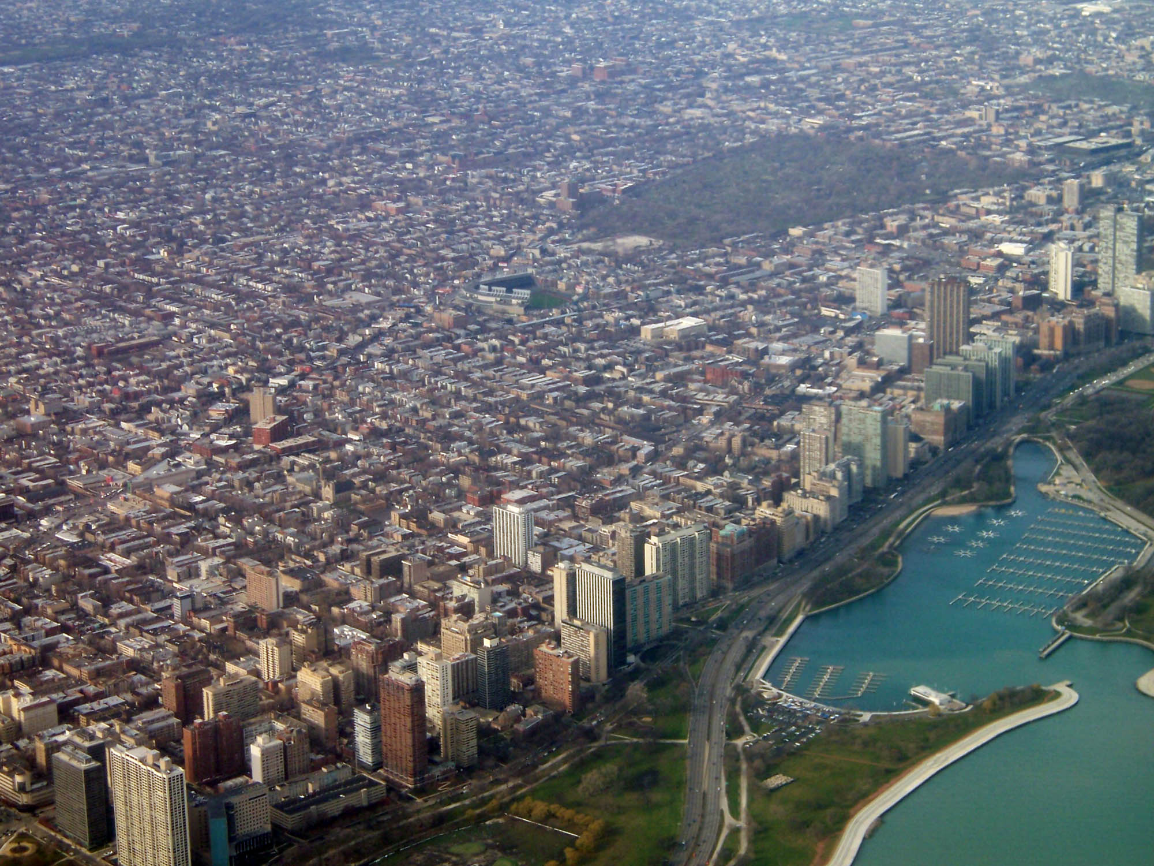
Nineveh is a type of all nations that turn their backs on God. She sinned, and her great wealth and strength were not sufficient to save her. The person or nation that deliberately and finally rejects God, deliberately, finally, and fatally elects doom.

Slide 17
Nahum about God destroying Nineveh. Nineveh will fall.
chapter 1- fall of Nineveh declared.
chapter 2 - fall of Nineveh described
chapter 3 - why God would destroy Nineveh.
The question asked in Nahum… “Who is in charge?”
Nineveh fell in 612 BC

Slide 18
Habakkuk
Who: Habakkuk
What: Prophecy and Judgment
Where: Judah
When: c. 609–598 BC
Why: To affirm that the wicked will not prevail and to remind Judah that God is in control.

Slide 19
Habakkuk
Outline (Chapter)
Tough Questions (1–2)
Praise to the Lord (3)

Slide 20
Habakkuk
Key Verse “Yet I will rejoice in the LORD, I will be joyful in God my Savior.”—Habakkuk 3:18
Menu

Slide 21
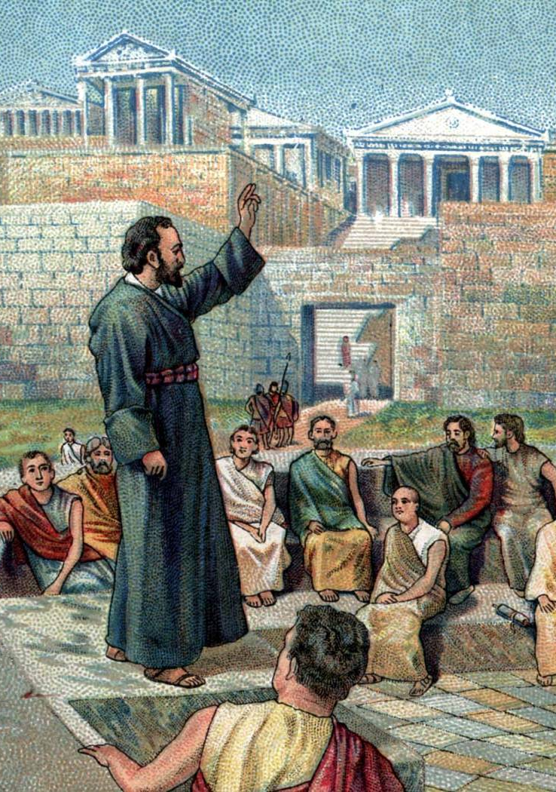
THE PROPHET
Almost nothing is known about the family of Habakkuk. He was a poet who had great depth of imagination. He is conversational, descriptive, indignant, and appreciative of Jehovah. He is continually telling about God’s power and glory, his mercy and justice, and how he will save and sustain his people.
The first part of his book is written in ordinary prophetic style, while the second is in the form of a psalm or hymn.

Slide 22
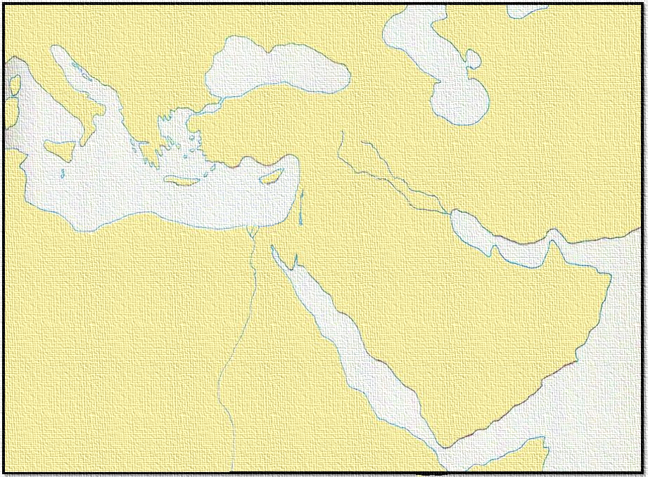
Babylon Empire
ASSYRIA
Jerusalem
EGYPT
In 607 B.C. Jeremiah had already been preaching about 20 years. Habakkuk did not begin his ministry until about 3 years later.
For hundreds of years Assyria, Egypt, and Babylon battled for world supremacy. Egypt was the ruler a thousand years before Assyria became the world power and ruled 300 years. Though Egypt had declined it was still ambitious. Then Babylon won out when it broke the power of the Assyrians about 607 B.C. and crushed Egypt two years later in the battle of Carchemish, 605 B.C.

Slide 23
Babylon Empire
ASSYRIA
Jerusalem
EGYPT
Babylon furnished the background for Jeremiah’s and Habakkuk’s ministries just as Assyria did for the ministry of Isaiah. The Northern Kingdom (Israel) and most of Judah had been captured, but Jerusalem survived. Habakkuk joined Jeremiah in pleading with the Jews to repent and hopefully save Jerusalem from destruction.

Slide 24
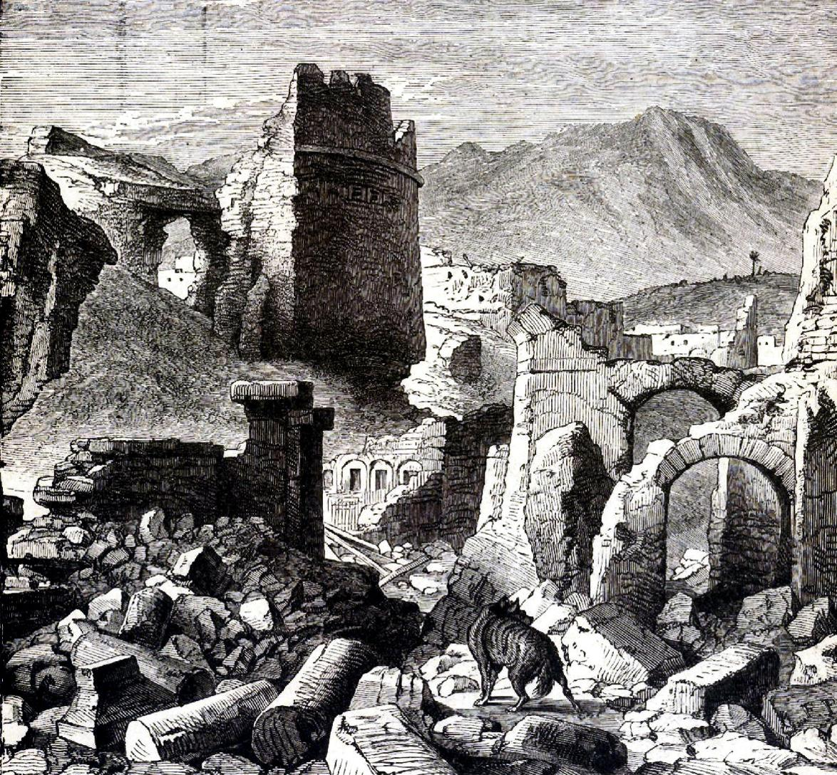
Jerusalem was partly destroyed in 606 B.C., further destroyed in 597 B.C., and finally burned and laid waste in 586 B.C. Jeremiah lived through the terrible 40 years at the close of the monarchy, while the nation was in its death throws. We do not know how long Habakkuk’s ministry lasted, but it is consoling to think he aided Jeremiah as they gave God’s last message to a city which had been hopelessly attached to idols.

Slide 25
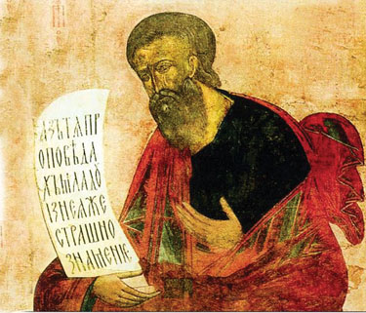
Zephaniah
Who: Zephaniah
What: Prophecy and Judgment
Where: Judah
When: c. 641–628 BC
Why: To motivate repentance.
The Prophet Zephaniah
Notes:
Image: Great Day of Wrath by Joseph Martin, c. 1840.

Slide 26
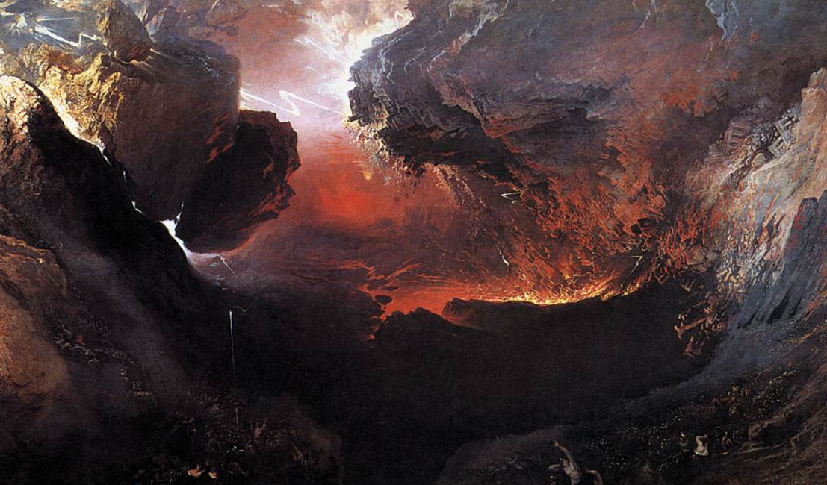
Zephaniah
Outline (Chapter)
Judgment on Judah (1)
Judgment on the Nations (2)
Promise of Restoration (3)
Great Day of Wrath

Slide 27
Zephaniah
Key Verse “The great day of the LORD is near—near and coming quickly. Listen! The cry on the day of the LORD will be bitter, the shouting of the warrior there.”—Zephaniah 1:14
Menu

Slide 28
The question that Hosea asks: does God still love us? Yes.
The question Joel asks: am I ready for the day of the Lord?
The question Amos asks? how do we communicate a message that is true but we know is going to be unpopular?

Slide 29
The question Obadiah ask does: does God have people he thinks of as his enemies and his friends?
The question Jonah asks: do I care about the lost like God does?
The question Micah asks: what does the Lord require of us?

Slide 30
The question Nahumn asks: who is in charge?
The question Habakkuk asks: what about when we don't understand God's will?
The question addressed in Zephaniah is anyone truly faithful to God anymore? yes.
Chapter 2:7 2:9 chapter 3: 9-13 . God has always had a remanent that love God and sought to abide in his word so God would be merciful to them.

Slide 31
Babylon Empire
ASSYRIA
Jerusalem
EGYPT
607 B.C. – about 20 years after Zephaniah began preaching.
It had been nearly 100 years since Assyria had taken Israel into captivity. The condition of the whole of western Asia, including Palestine, indicated impending upheaval. Assyria, Egypt, and Babylon were battling for world supremacy. Babylon won out when it broke the power of the Assyrians about 607 B.C. and crushed Egypt two years later in the battle of Carchemish, 605 B.C.

Slide 32
Zephaniah spoke and wrote primarily for the correction and warning of Judah and Jerusalem, though he drew illustrations from the sins and fates of other people. He raised his voice against idolatry and he, no doubt, had had a decided influence upon the work of reform by the pious King Josiah.
Babylon Empire
SYRIA
Cyprus
SAMARIA
JUDAH
Sinai
Arabia

Slide 33
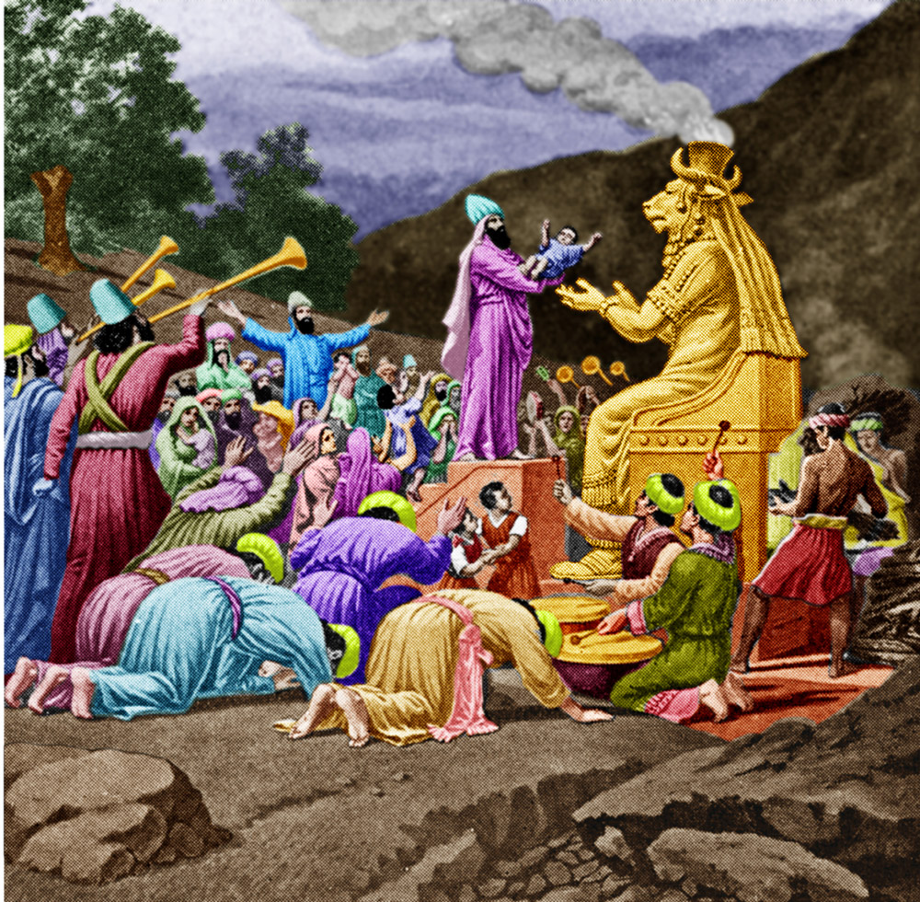
Chapter 1
I. Judah Searched
Jehovah is in the midst of the land for judgment.
Zephaniah denounced—
Idol worshippers
Those that swear by God and then by Molech
Those who turn back
from the Lord

Slide 34
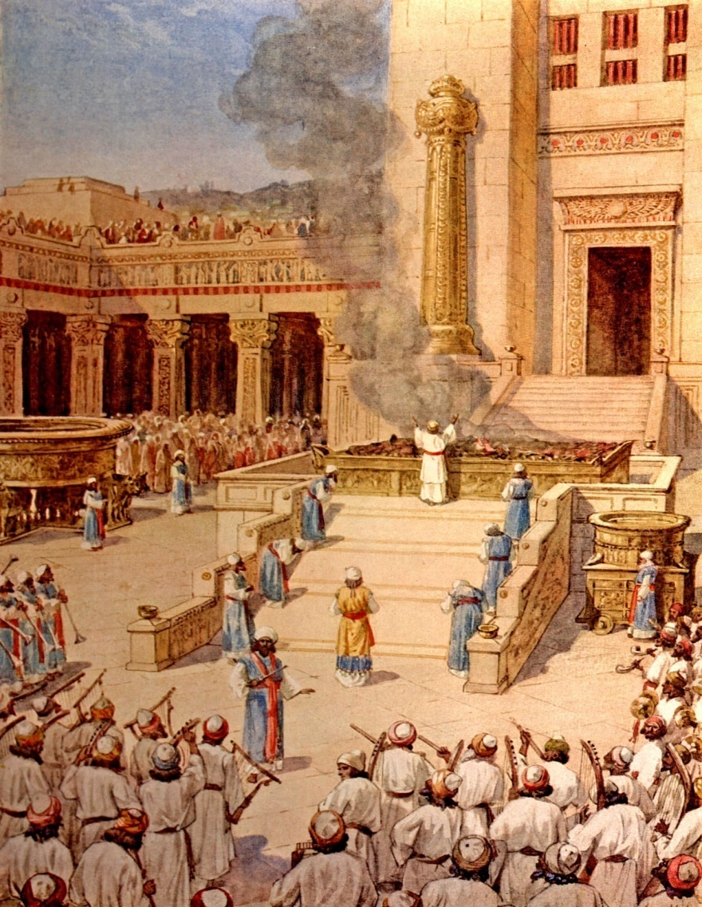
Chapter 2
II. The Nations Searched
The prophet called upon the people to seek God and declared that nothing but repentance could save them.
The Jews taught that Jerusalem was the place of worship. The Samaritians declared that Mount Gerizim ought to be the religious center, but Zephaniah taught that spiritual worship did not depend upon a place, but on the presence of God.

Slide 35
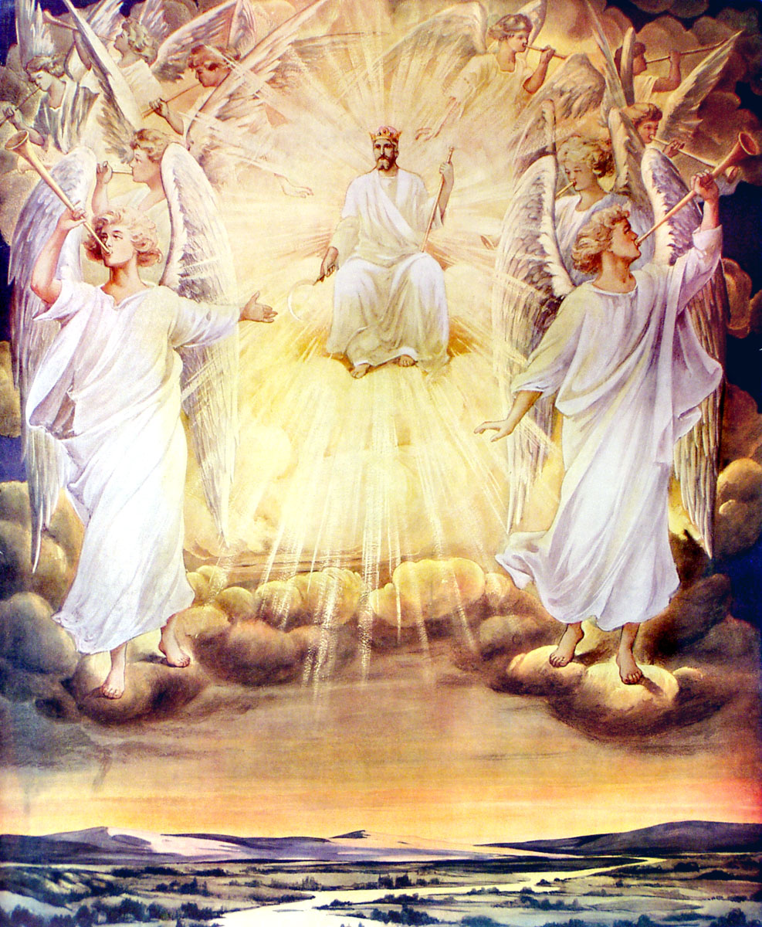
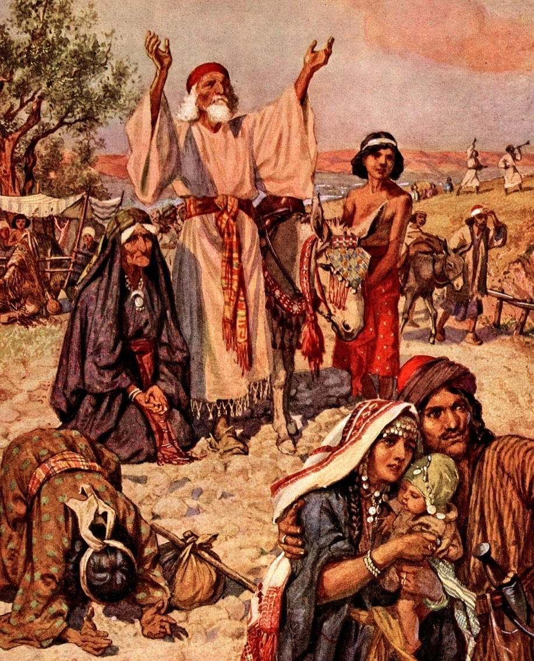
Chapter 3
III. Israel Restored
Zephaniah wrote concerning the rejoicing of the Lord’s people when they would return from Babylonian captivity.
He also looked forward to the time when Christ should begin His reign on the throne of David, and all people would rejoice in His kingdom.

