Slide 1
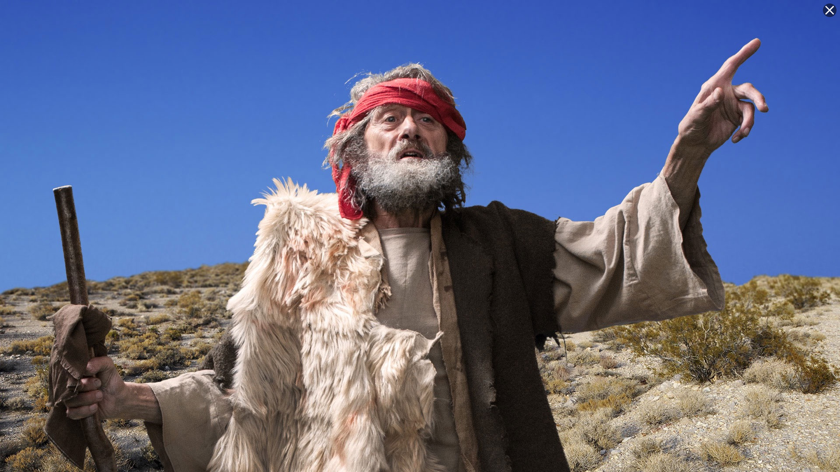
Minor Prophet Series
Lesson Two –
Hosea
Joel
Amos

Slide 2
Jeremiah 3:8-9
"Then I saw that for all the causes for which backsliding Israel had committed adultery, I had put her away and given her a certificate of divorce; yet her treacherous sister Judah did not fear, but went and played the harlot also….
with stones and trees.” (NKJV)
7

Slide 3
Jeremiah 31:31 "Behold, the days are coming, says the LORD, when I will make a new covenant with the house of Israel and with the house of Judah-
32 "not according to the covenant that I made with their fathers in the day that I took them by the hand to lead them out of the land of Egypt, My covenant which they broke, though I was a husband to them, says the LORD.
33 "But this is the covenant that I will make with the house of Israel after those days, says the LORD: I will put My law in their minds, and write it on their hearts; and I will be their God, and they shall be My people.
8

Slide 4
Hosea - Jehovah will be the God of all nations.
Joel - A vision of the gospel age.
Amos - A descendant of David will rule the world.
Obadiah--Edom shall perish.
Jonah--God wants His enemies saved.
Micah--The coming King and His reign.
Nahum--Judgment on the city of Nineveh.
Habakkuk--God’s people will be victorious.
Zephaniah--A new message for God’s people.
Haggai--The second temple and the greater temple of the future.
Zechariah--The coming King and His kingdom.
Malachi--The closing message while the people awaited the Messiah.

Slide 5
Jonah
Nahum
Amos
Hosea
Isaiah
Jeremiah (Lamentations)
Joel
Micah
Zephaniah
Habakkuk
Obadiah
Before exile
During exile
Ezekiel
Daniel
Haggai
Zechariah
Malachi
After exile

Slide 6
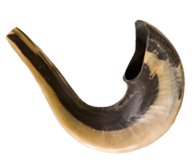
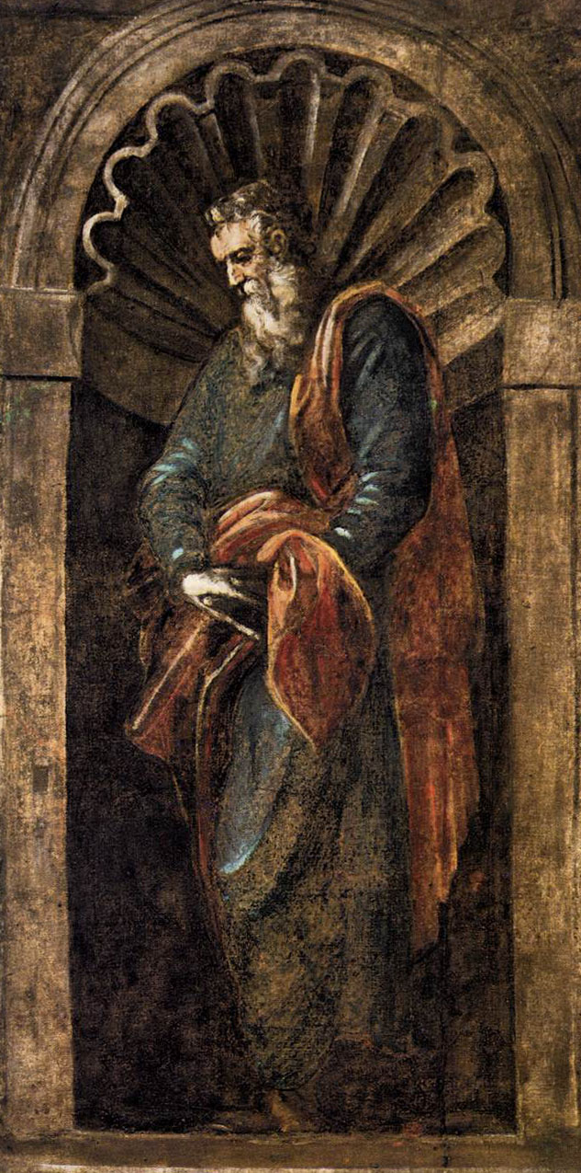
Hosea
Who: Hosea
What: Prophecy and Warnings
Where: Israel
When: c. 752–722 BC
Why: To illustrate Israel’s spiritual adultery and warn of destruction.
Notes:
Image: A Prophet by Tintoretto, 1566–67.

Slide 7
Hosea
Outline (Chapter)
The Unfaithful Wife (1–3)
The Unfaithful Nation (4–14)

Slide 8
Hosea
Key Verse “Because you have rejected knowledge, I also reject you as my priests; because you have ignored the law of your God, I also will ignore your children.”—Hosea 4:6
Menu

Slide 9
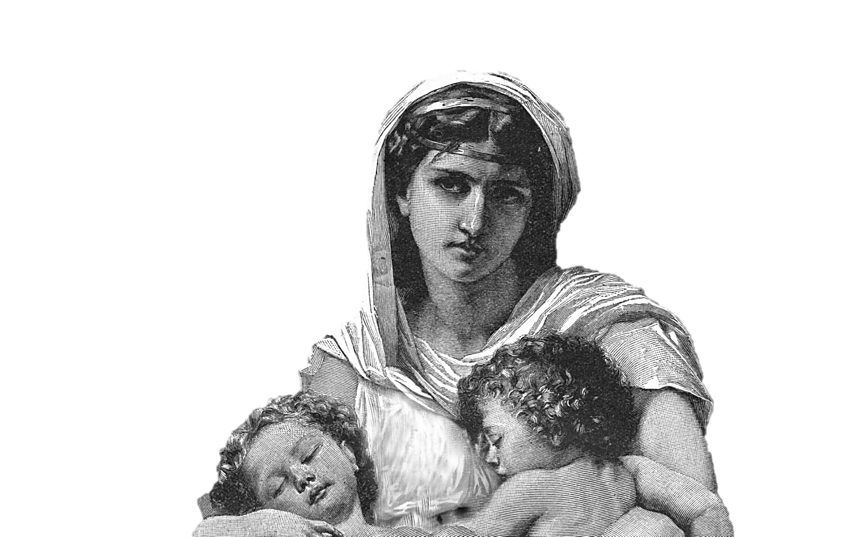
Hosea 1:2
“The beginning of the word of the LORD by Hosea. And the LORD said to Hosea, Go, take unto thee a wife of whoredoms and children of whoredoms: for the land hath committed great whoredom, departing from the LORD.”
Jeremiah 3:8-9

Slide 10
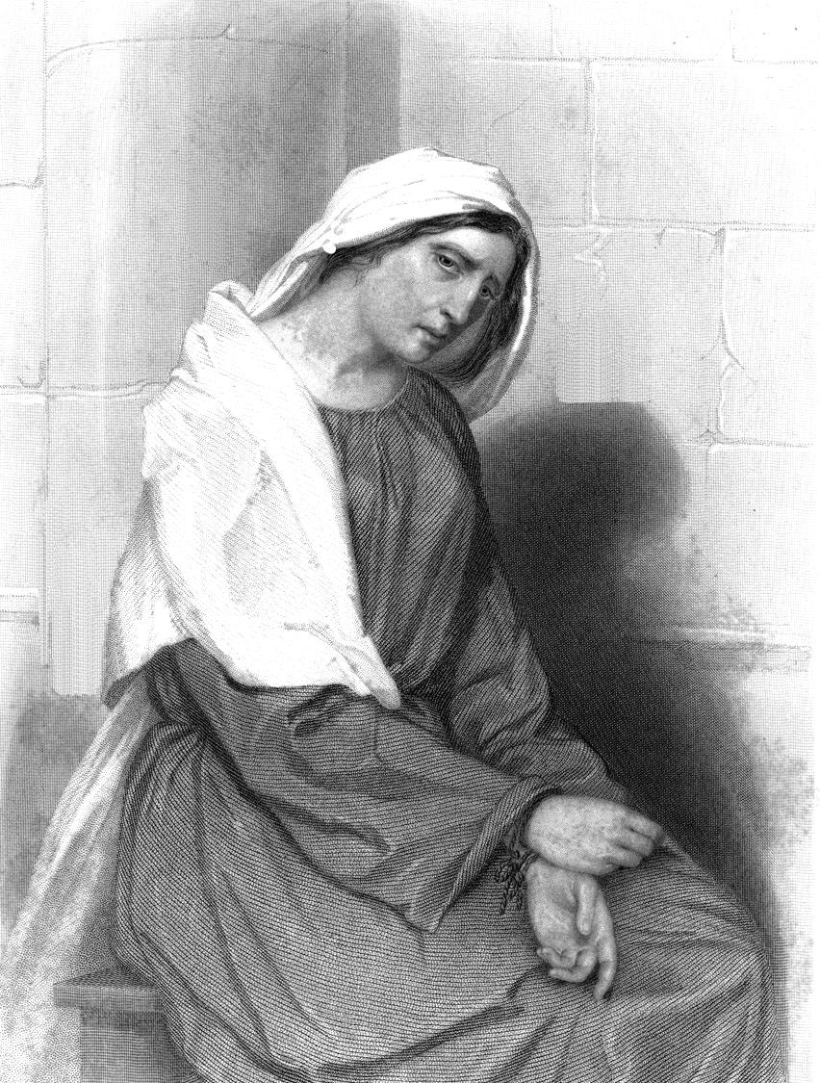
Hosea 1:10 – 3:5
After Gomer had shamed herself and her family and had lost the ability to be successful at her trade, she was brought back, and with patient love she was admitted to Hosea’s home there to await in penitence and grief a time of restoration to full favor.
Just so Israel, for a time, was denied a king and God’s protection, but later returned to Jehovah.

Slide 11
2 Kings 16
“⁹And the king of Assyria hearkened unto him: for the king of Assyria went up against Damascus, and took it, and carried the people of it captive to Kir, and slew Rezin.”
Despite the warnings of prophets like Hosea, Israel made alliances with heathen nations, warred against Judah (their own brethren), and would not repent of idolatry. This is an account of how God punished them using their enemy Assyria.
Then Hoshea made a conspiracy against Pekah, killed him and reigned in his stead.
Tiglathpileser was King of Assyria
SYRIA
Cyprus
Rezin was king of Syria
Rezin was killed
ISRAEL
Part of ISRAEL
Pekah King of Israel
Pekah Murdered
Hoshea King of Israel
JUDAH
Ahaz was King of Judah
Sinai
Arabia

Slide 12
King Hoshea refused to pay tribute to Shalmaneser IV. He relied upon So, the king of Egypt, to help defend him against Shalmaneser, but no help came. For 3 weary years Shalmaneser IV attacked Israel.
Shalmaneser IV succeeded Tiglathpileser as King of Assyria.
Cyprus
Shalmaneser IV was King of Assyria
ISRAEL
Hoshea King of Israel
JUDAH
Ahaz was King of Judah
So King of Egypt
Sinai
Arabia

Slide 13
2 Kings 17:18
“Therefore the LORD was very angry with Israel, and removed them out of his sight: there was none left but the tribe of Judah only.”
Finally, after 3 years of Shamaneser IV and his Assyrian army laying siege against Israel, Sargon II, who succeeded Shalmaneser IV, carried away all of Israel to Assyria. King Hoshea was even taken captive.
Hoshea had reigned 9 years. He was the last King of Israel . . .
Cyprus
Shalmaneser IV King of Assyria
Sargon II King of Assyria
ISRAEL
Hoshea King of Israel
JUDAH
Ahaz was King of Judah
So King of Egypt
Sinai
Arabia

Slide 14
God’s Symbols For Sin
Hosea 3:1 An adulterous wife
Hosea 4:11 A wine inflamed drunkard
Hosea 4:16 A back sliding heifer
Hosea 6:9 A troop of robbers
Hosea 7:4 Adulterers
Hosea 7:7 Hot as an oven
Hosea 7:8 A cake not turned (half baked)
Hosea 7:11 Like a silly dove
Hosea 7:16 Like a deceitful bow
Hosea 8:8 Swallowed up
Hosea 8:8 A vessel wherein is no pleasure
Hosea 8:9 A wild ass

Slide 15
I Will Allure Her
Hosea 2:14 "Therefore, behold, I will allure her, Will bring her into the wilderness, And speak comfort to her.
I betroth her in:
Righteousness
Justice
Lovingkindness
Compassion
Faithfulness
4

Slide 16
God is a Jealous God
Ex 20:5. For I, the LORD your God, am a jealous God,
Ex 34:14 '(for you shall worship no other god, for the LORD, whose name is Jealous, is a jealous God),
Deut. 4:24 "For the LORD your God is a consuming fire, a jealous God.
Heb. 12:29 For our God is a consuming fire.
Deut. 5:9 you shall not bow down to them nor serve them. For I, the LORD your God, am a jealous God, visiting the iniquity of the fathers upon the children to the third and fourth generations of those who hate Me,
Deut. 6:15 '(for the LORD your God is a jealous God among you), lest the anger of the LORD your God be aroused against you and destroy you from the face of the earth.
Joshua 24:19 But Joshua said to the people, "You cannot serve the LORD, for He is a holy God. He is a jealous God; He will not forgive your transgressions nor your sins.
Nahum 1:2 God is jealous, and the LORD avenges; The LORD avenges and is furious. The LORD will take vengeance on His adversaries, And He reserves wrath for His enemies;
3

Slide 17
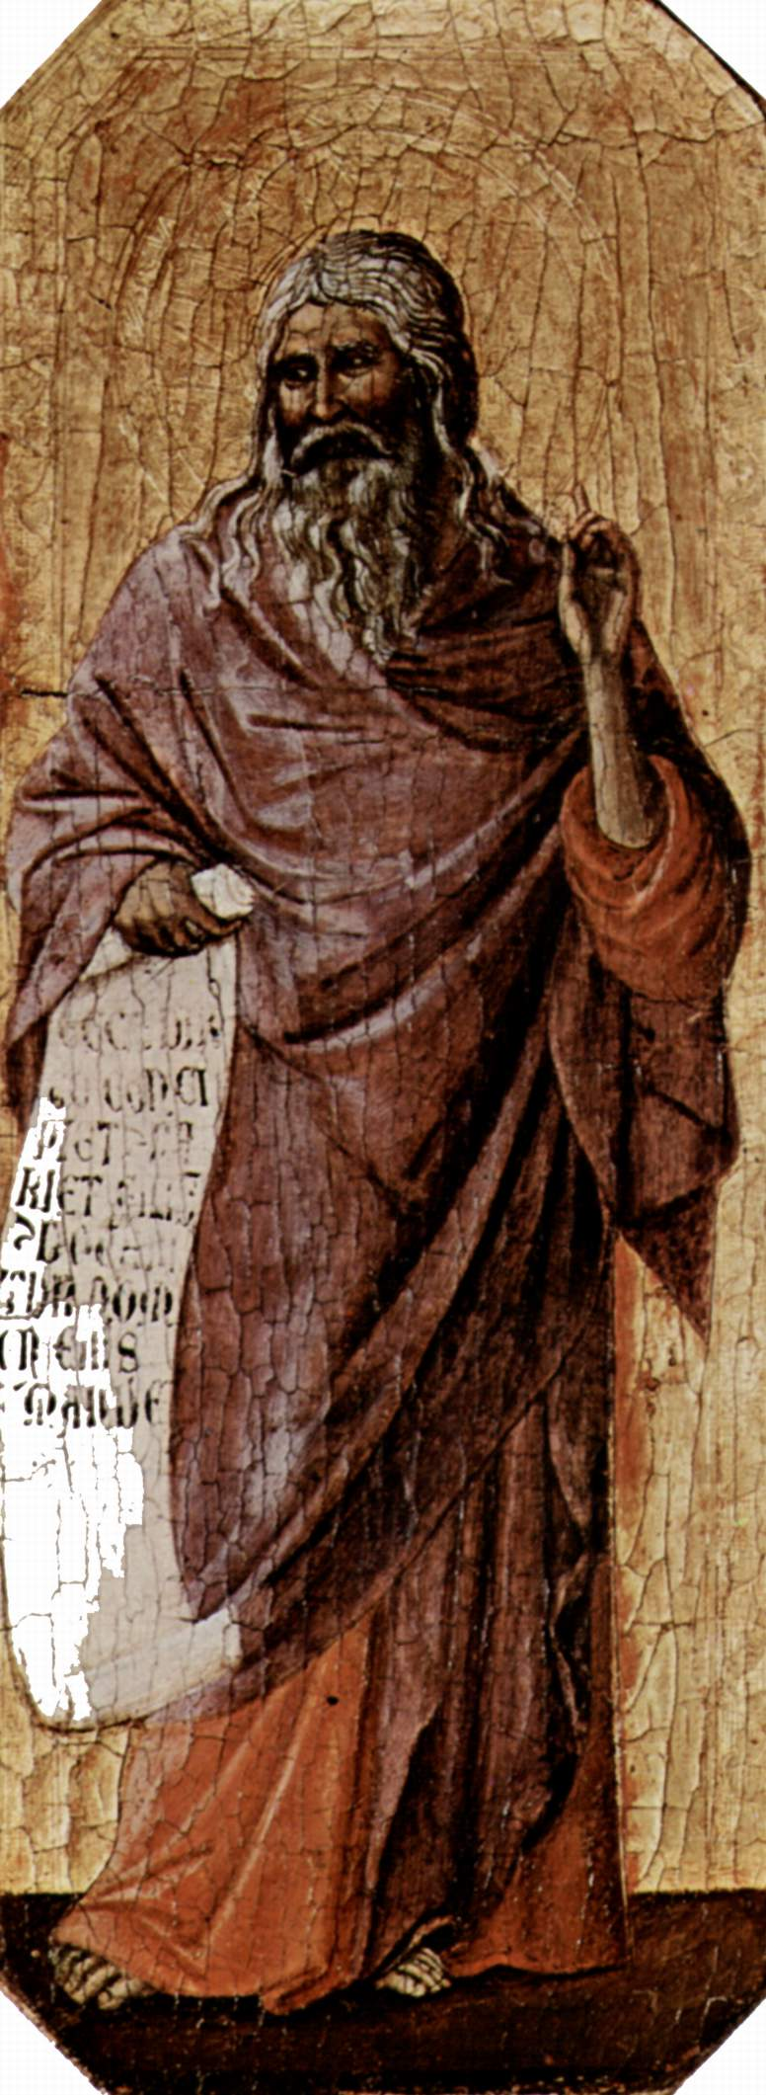
Joel
Who: Joel
What: Prophecy and Judgment
Where: Judah
When: Unknown
Why: To call Judah to repentance in order to avoid judgment.

Slide 18
Joel
Outline (Chapter)
Locust (1)
Blessings and Curses (2–3)
Notes:
Image: A Prophet by Duccio di Buoninsegna, 1308–11.

Slide 19
Joel
Key Verse “And afterward, I will pour out my Spirit on all people. Your sons and daughters will prophesy, your old men will dream dreams, your young men will see visions.”—Joel 2:28b
Menu

Slide 20
Most Quoted Passages From Joel
Joel 2:28-31
“²⁸And it shall come to pass afterward, that I will pour out my spirit upon all flesh; and your sons and your daughters shall prophesy, your old men shall dream dreams, your young men shall see visions: ²⁹And also upon the servants and upon the handmaids in those days will I pour out my spirit. ³⁰And I will shew wonders in the heavens and in the earth, blood, and fire, and pillars of smoke. ³¹The sun shall be turned into darkness, and the moon into blood, before the great and the terrible day of the LORD come.”

Slide 21
Acts 2:16 "But this is what was spoken by the prophet Joel:
17 'And it shall come to pass in the last days, says God, That I will pour out of My Spirit on all flesh; Your sons and your daughters shall prophesy, Your young men shall see visions, Your old men shall dream dreams.
18 And on My menservants and on My maidservants I will pour out My Spirit in those days; And they shall prophesy.
19 I will show wonders in heaven above And signs in the earth beneath: Blood and fire and vapor of smoke.
20 The sun shall be turned into darkness, And the moon into blood, Before the coming of the great and awesome day of the LORD.
21 And it shall come to pass That whoever calls on the name of the LORD Shall be saved.'

Slide 22
Most Quoted Passages From Joel
Joel 3:10
“Beat your plowshares into swords, and your pruninghooks into spears: let the weak say, I am strong.”
Joel 3:14
“Multitudes, multitudes in the valley of decision: for the day of the LORD is near in the valley of decision.”

Slide 23
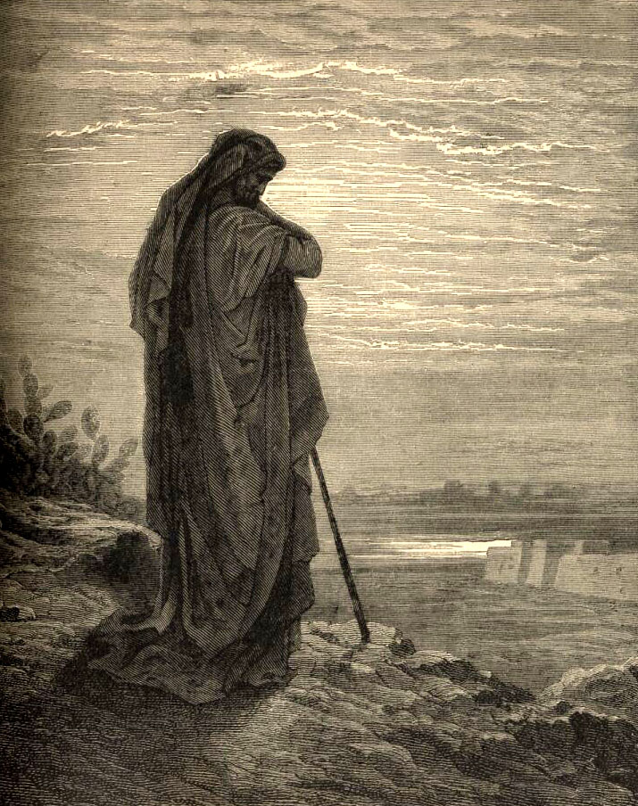
Amos
Who: Amos
What: Prophecy and Judgment
Where: Israel
When: c. 760–753 BC
Why: To accuse and judge Israel for injustice and lack of mercy.
The Prophet Amos

Slide 24
Amos
Outline (Chapter)
Neighbors Punished (1)
Israel’s Destruction (2–8)
Future Hope (9)
The Prophet Amos
Notes:
Amos by Gustave Dore

Slide 25
Amos
Key Verse “Seek good, not evil, that you may live. Then the LORD God Almighty will be with you, just as you say he is.”—Amos 5:14
Menu

Slide 26
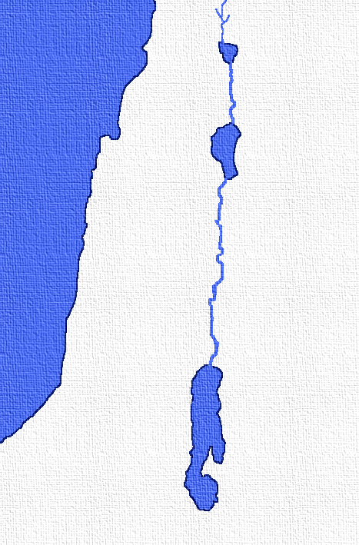
Amos lived in Tekoa which was nine miles from Bethlehem in the Southern Kingdom of Judah.
Yet, he prophesied mainly for Israel and only incidentally for Judah.
ISRAEL
Jordan River
JUDAH
Jerusalem
Bethlehem
TEKOA
Dead Sea

Slide 27
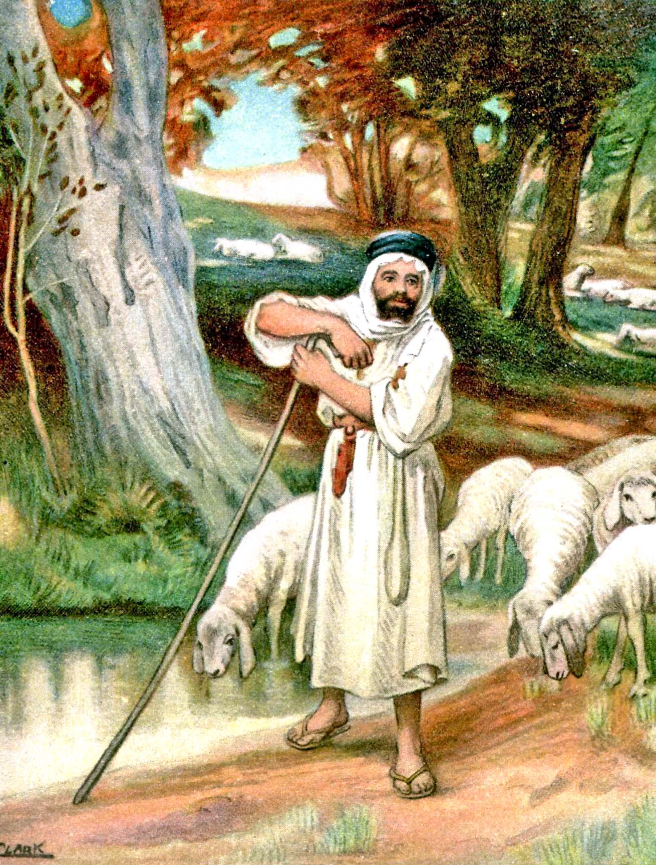
He was a herdsmen and a cultivator of sycamore trees.
[The Sycamore tree referred to was not like the one we think of today. It actually bore fruit.]
Amos 7:14
“Then answered Amos, and said to Amaziah, I was no prophet, neither was I a prophet’s son; but I was an herdman, and a gatherer of sycomore fruit.”

Slide 28
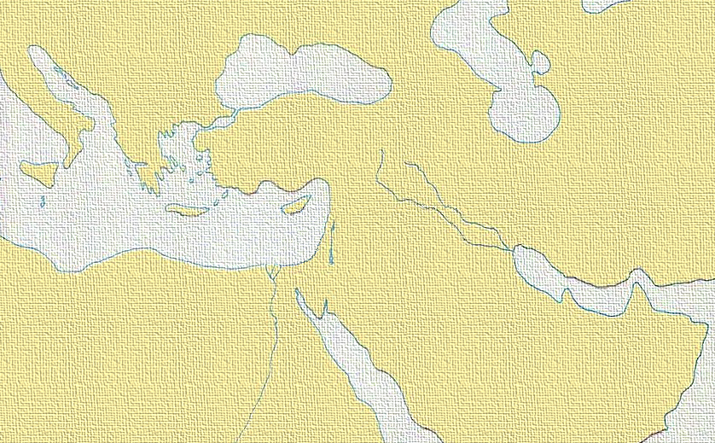
Amos prophesied the rise of Assyria to greater power and eventual dominion over Israel as a punishment for their sins.
Syria
ASSYRIA
Israel
Judah
Egypt
Arabia

Slide 29
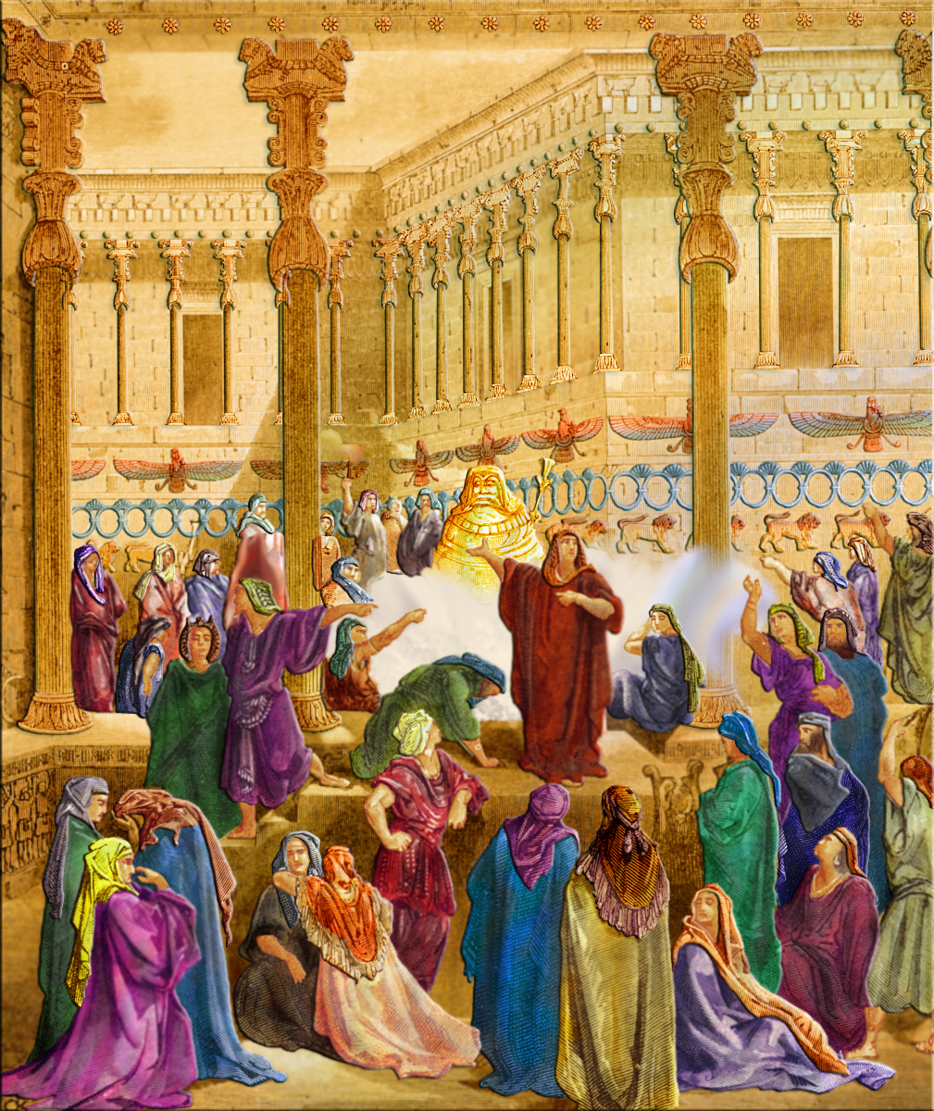
The kingdom of Israel was outwardly at peace but there was idolatry, immorality and political unrest present despite their prosperity.

Slide 30
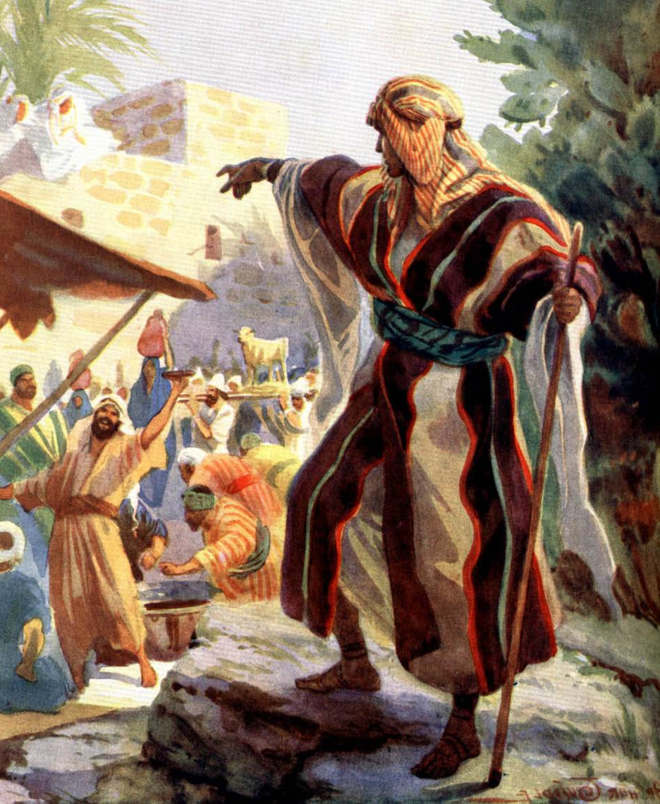
The purpose of Amos was to warn Israel of her coming doom and to predict the coming of the great Messianic Kingdom through Christ.

Slide 31
AMOS 1 – 2
Judgment Against Nations
This simple country preacher left his home in Judah and traveled 22 miles to Bethel in the Northern Kingdom to preach against the Kingdom of Israel.
The people of Bethel had substituted calf worship for the worship of Jehovah, (I Kings 12:25-33).
Jordan River
ISRAEL
BETHEL
JUDAH
Jerusalem
Bethlehem
TEKOA
Dead Sea

Slide 32
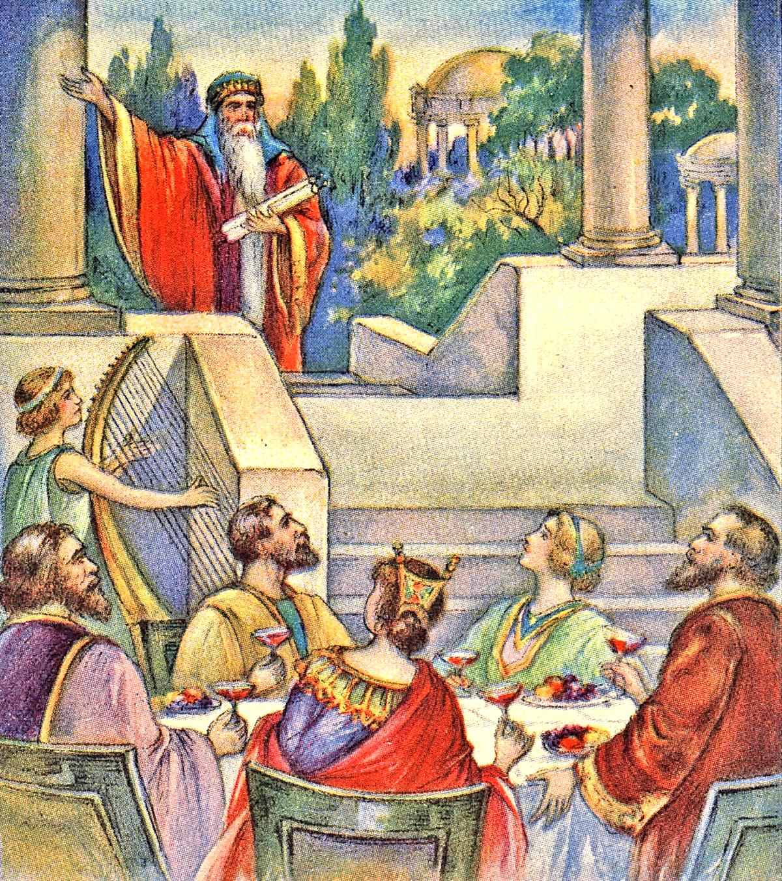
AMOS 3 – 6
Judgment Against Israel
Amos was called to tell of certain punishment.
He told Israel they were greedy, unjust, unclean and profane.
They defended themselves on the ground that they were God’s chosen people (3:2). Amos reminded them that they would be condemned and punished regardless of who they were if they rejected God.
Amos called the women of his day “kine of Bashan” because they cared only for luxury and worldly pleasure (4:1). He exhorted them to repent but they refused to do so.
Since the people refused God’s warning, Amos told them—
“Prepare to meet thy God, O Israel” (4:12).

Slide 33
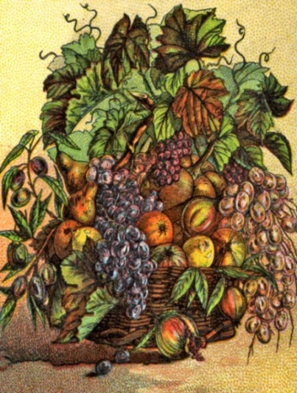
VISIONS REGARDING THE FUTURE
Amos 7:1-3 The Devouring Locust
Amos 7:4-6 The Consuming Fire
Amos 7:7-11 The Searching Plumb Line
Amos 8:1-10 The Summer Fruit Basket
Amos 9:1-10 The Lord at the Altar

Slide 34
Amos
A Prophet Of God
The people of Israel were skeptical regarding the predictions of Amos. They were living under prosperous conditions and considered him to be a pessimist and alarmist, but in less than fifty years his announcement of the doom of Israel was fulfilled.

Slide 35
The Minor Prophets. Lesson 2 - Hosea, Joel, Amos
Conclusion:
Joel was a rugged prophet who foretold the coming of the Spirit on Pentecost.
Hosea was a tender, compassionate man whose great heart was broken by his unfaithful wife.
Amos was a strong man of the working class, who boldly carried God’s message to people who rejected both him and God’s message.
We can learn from these great men the importance of keeping on preaching God’s word no matter if the people reject it and us.
newlebanoncoc.com

Slide 36
Minor Prophet Series
2Kings 21:10 And the LORD spoke by His servants the prophets, saying…

