Slide 1
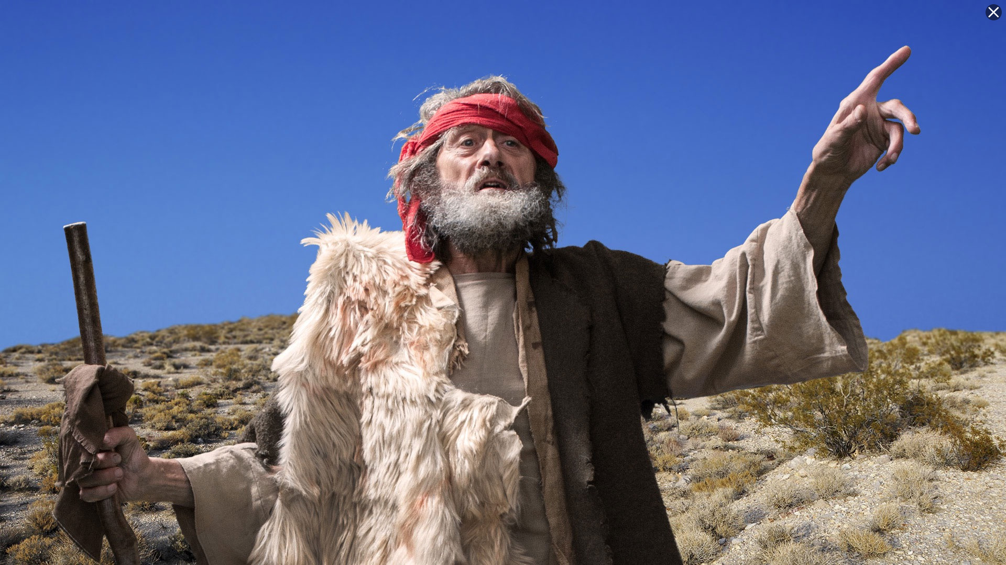
Minor Prophet Series
Lesson Three –
Obadiah
Jonah
Micah
2Kings 21:10 And the LORD spoke by His servants the prophets, saying…

Slide 2
The Mission Of The Prophets—
They were to WARN the people that those who would not repent of idolatry would be destroyed.
They were to PROMISE that a remnant would be saved and that from this remnant would come the man, Christ Jesus, a descendant of David, who would sit on David’s throne and establish a kingdom which would never be destroyed.

Slide 3
Jeremiah 3:8-9
"Then I saw that for all the causes for which backsliding Israel had committed adultery, I had put her away and given her a certificate of divorce; yet her treacherous sister Judah did not fear, but went and played the harlot also….
with stones and trees.” (NKJV)
7

Slide 4
Jeremiah 31:31 "Behold, the days are coming, says the LORD, when I will make a new covenant with the house of Israel and with the house of Judah-
32 "not according to the covenant that I made with their fathers in the day that I took them by the hand to lead them out of the land of Egypt, My covenant which they broke, though I was a husband to them, says the LORD.
33 "But this is the covenant that I will make with the house of Israel after those days, says the LORD: I will put My law in their minds, and write it on their hearts; and I will be their God, and they shall be My people.
8

Slide 5
Hosea--Jehovah will be the God of all nations.
Joel--A vision of the gospel age.
Amos--A descendant of David will rule the world.
Obadiah--Edom shall perish.
Jonah--God wants His enemies saved.
Micah--The coming King and His reign.
Nahum--Judgment on the city of Nineveh.
Habakkuk--God’s people will be victorious.
Zephaniah--A new message for God’s people.
Haggai--The second temple and the greater temple of the future.
Zechariah--The coming King and His kingdom.
Malachi--The closing message while the people awaited the Messiah.

Slide 6
Jonah
Nahum
Amos
Hosea
Isaiah
Jeremiah (Lamentations)
Joel
Micah
Zephaniah
Habakkuk
Obadiah
Before exile
During exile
Ezekiel
Daniel
Haggai
Zechariah
Malachi
After exile

Slide 7
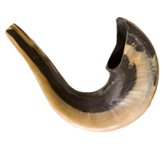
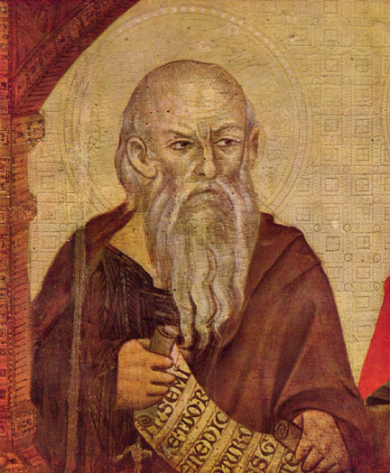
Obadiah
Who: Obadiah
What: Prophecy
Where: Judah
When: c. 586 BC
Why: To prophesy against Edom.
The Prophet Obadiah
Notes:
Image: The Prophet Obadiah (Artist Unknown)

Slide 8
Obadiah
Key Verse “Because of the violence against your brother Jacob, you will be covered with shame; you will be destroyed forever.”—Obadiah 10
Menu

Slide 9
Obadiah
Key Verse “Because of the violence against your brother Jacob, you will be covered with shame; you will be destroyed forever.”—Obadiah 10
Menu

Slide 10
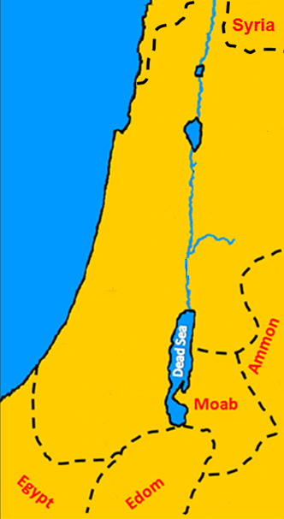
Edom figures prominently in the prophetic Scriptures as the scene of great future judgments.
It is the only neighbor of the Israelites who was not given any promise of mercy from God.
Jerusalem

Slide 11
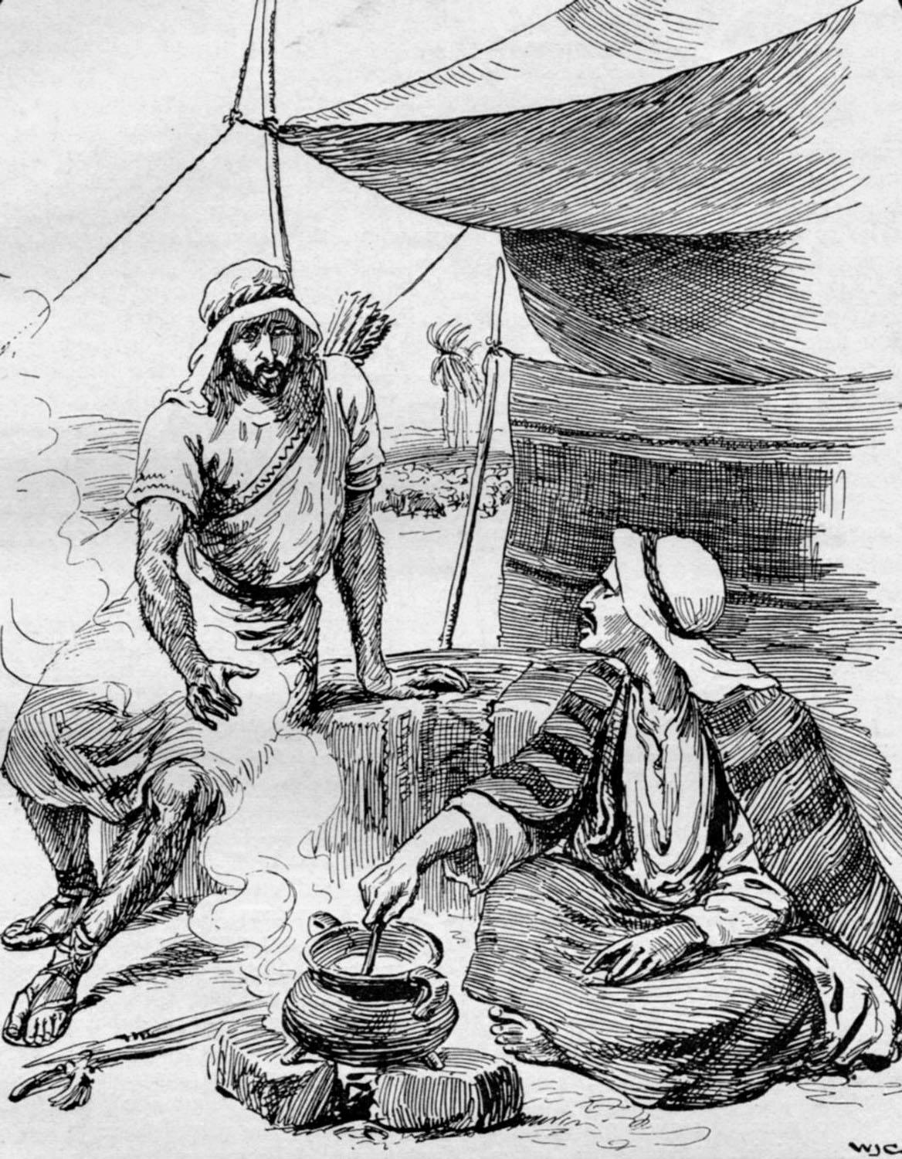
The Edomites
were the descendants of
Esau
brother to Jacob
and
son of Isaac.

Slide 12
Isaac
Son of Abraham and Sarah.
Ishmael
Son of Abraham and Hagar,
Sarah’s handmaid.
Abraham
Isaac Ishmael
Jacob 12 sons
Esau Mahalath

Slide 13
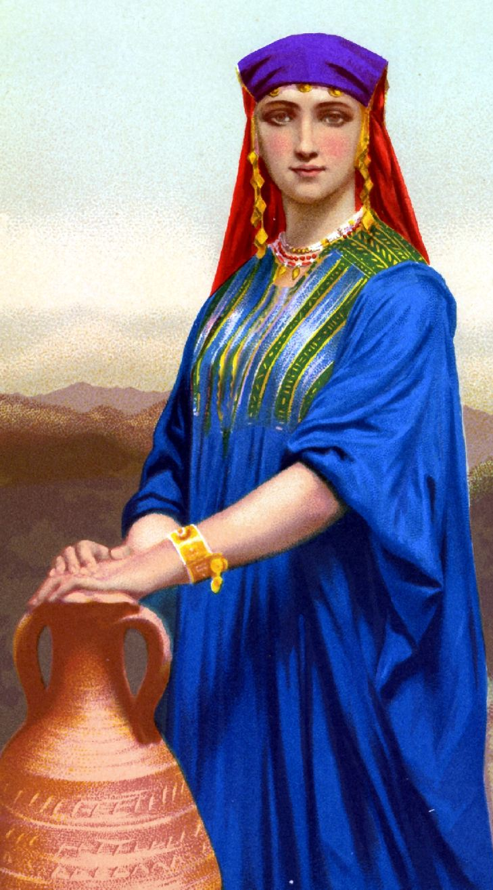
Esau married Mahalath to displease his parents (Gen. 28:9) since his father Isaac had specifically forbidden his brother Jacob from marrying Canaanite women.
Abraham
Isaac Ishmael
Jacob 12 sons
Esau Mahalath

Slide 14
The Edomites would go on raiding expeditions and then retreat to their impregnable fortress where they kept alive in their hearts a bitter hatred toward the Israelites that began with Jacob and Esau.
Jerusalem

Slide 15
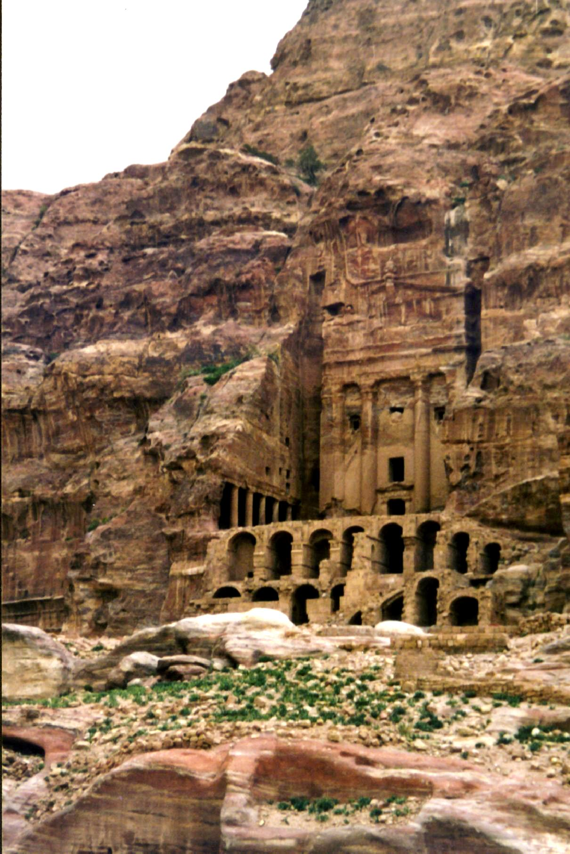
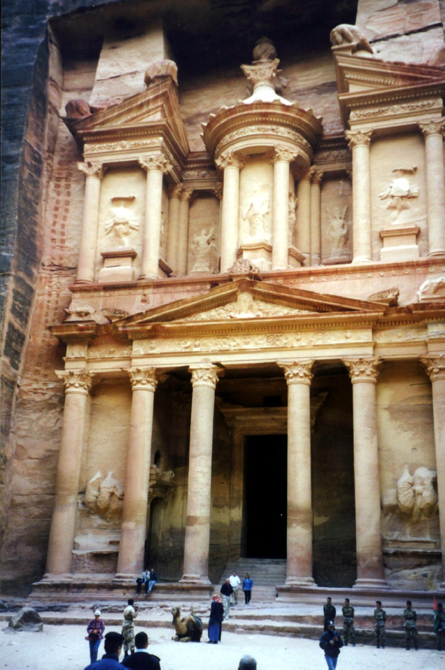
The fame of Edom came not from the Edomites themselves, for they were eventually driven out by the Nabatean Empire. They were forced to go west to an area south of Judea, which in New Testament times was known as Idumaea, the Greek for Edom.
The Nabatean Empire is responsible for the beautiful architectural features we can still see today cut into the solid sandstone. Also remarkable were the systems for water conservation involving dams, cisterns, and conduits which resulted in cultivation of formerly barren areas.
The Nabataeans strategically situated their capital, PETRA, on a pass through the Shara mountains that divided ancient Arabia and Syria from Palestine and Egypt. It was a crossroads for the caravan trade. In Roman times 30,000 lived in the city.
The ruins of PETRA are a tourism destination because of its amazing history and architecture.

Slide 16
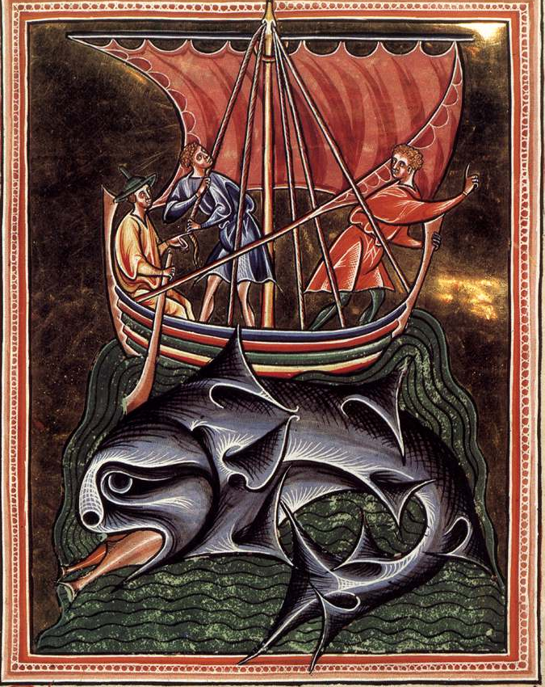
Jonah
Who: Jonah
What: Story of God’s Mercy
Where: Nineveh
When: c. 783–753 BC
Why: To show that God loves all.
Notes:
Image: Whales (Artist Unknown)

Slide 17
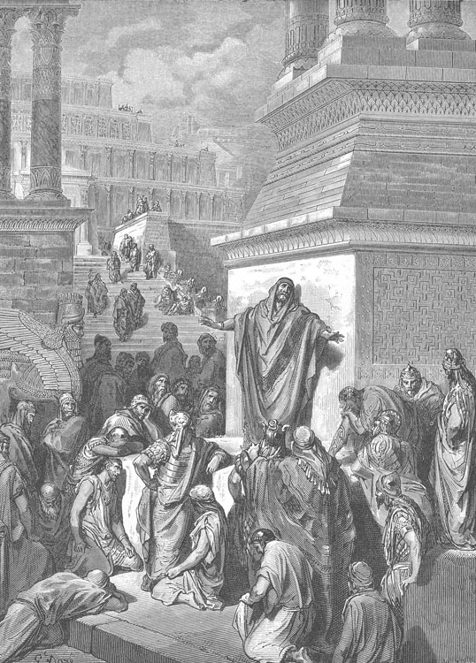
Jonah
Outline (Chapter)
Jonah Flees (1)
Jonah Prays (2)
Jonah’s Anger with God’s Mercy (3–4)
Jonah Preaches in Nineveh

Slide 18
Jonah was an unwilling missionary to the city of Nineveh.
The fact that Nineveh had defeated Israel many years before Jonah’s time, and forced them to pay tribute would explain Jonah’s attitude toward the city.

Slide 19
Before the time of Jonah
Nineveh,
ruled by Shalmaneser II,
had defeated Ahab and forced Jehu to pay tribute. It was a heathen city and Jonah had no love for the people there.
KINGS OF ISRAEL
Jeroboam 975-954
Nadab 954-953
Baasha 953-930 Elah 930-929
Zimri 929
Omri 929-918
Ahab 918-897
Ahaziah 897-896
Joram 896-884
Jehu 884-856
Jehoahaz 856-841
Joash 841-825
Jeroboam II 825-784
Zechariah 773
Shallum 772
Menahem 772-762
Pekahiah 762-760
Pekah 760-740
Hoshea 730-721
Shalmaneser—
The title of five Assyrian kings, of whom one is mentioned in the Old Testament.

Slide 20
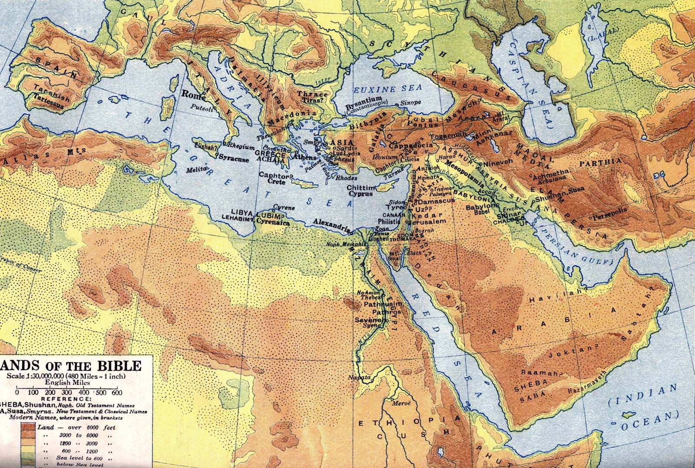
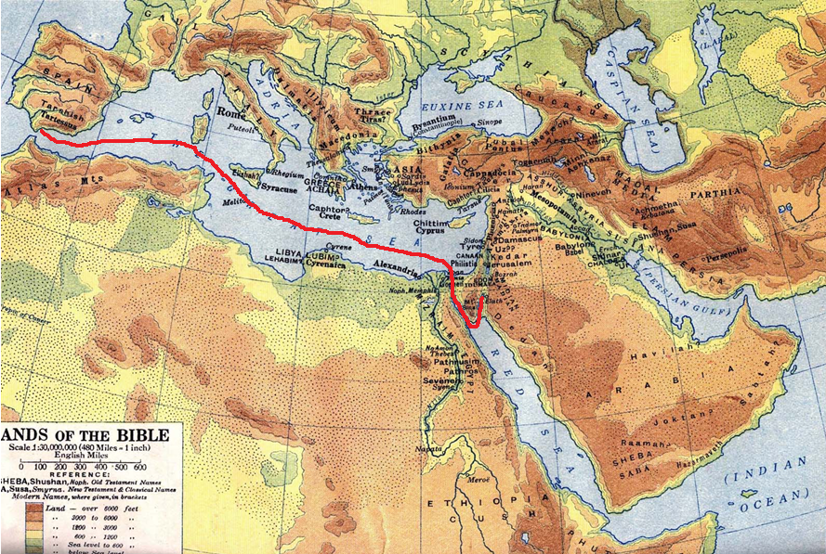
Nineveh
Tarshish—
Possibly in southern Spain near Gibraltar. Because of mineral wealth the Phoenicians established a colony there.
Joppa
Jonah was going as far from Nineveh as he could get!

Slide 21
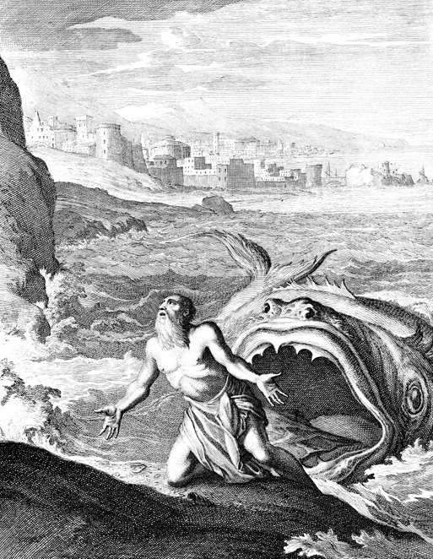
Jonah 2
“¹⁰And the LORD spake unto the fish, and it vomited out Jonah upon the dry land.”

Slide 22
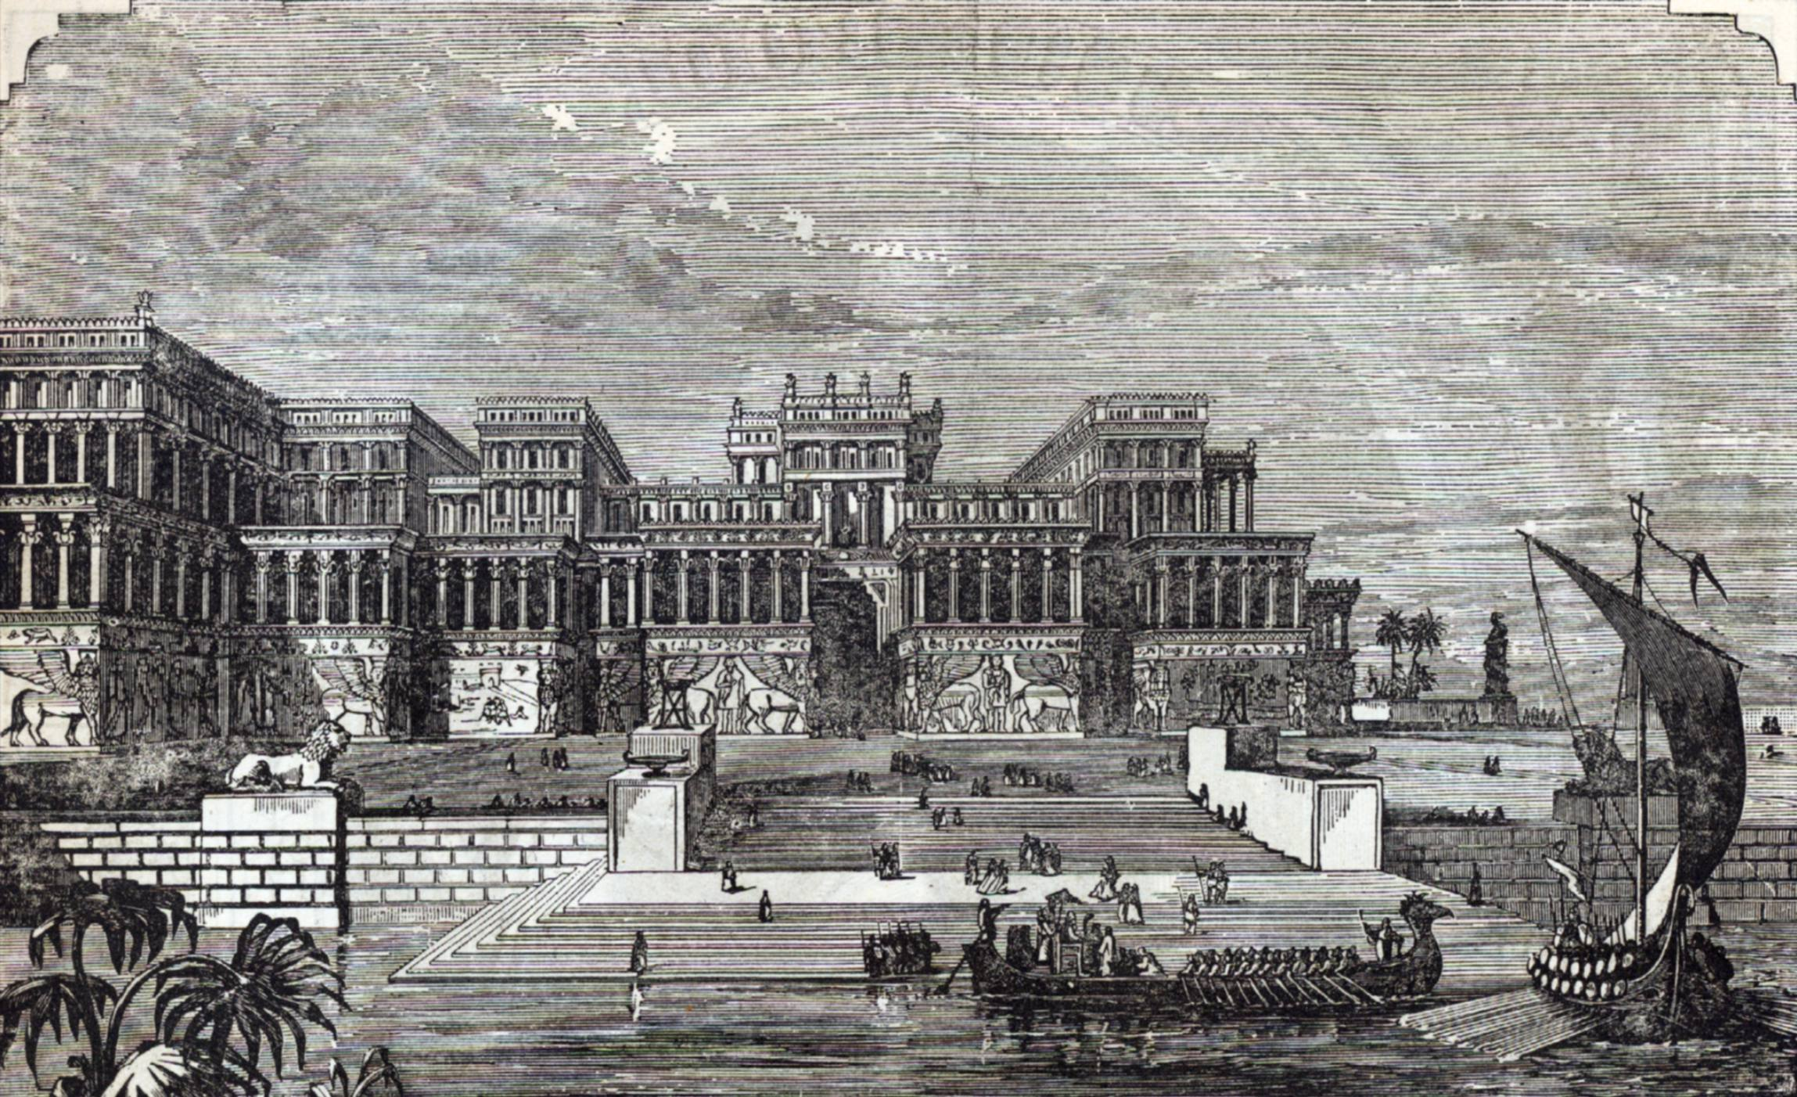
Jonah 3
“⁴And Jonah began to enter into the city a day’s journey, and he cried, and said,
Yet forty days, and Nineveh shall be overthrown.”

Slide 23
Micah
Who: Micah
What: Prophecy and Judgment
Where: Israel and Judah
When: c. 738–698 BC
Why: To warn people of judgment and to offer hope.

Slide 24
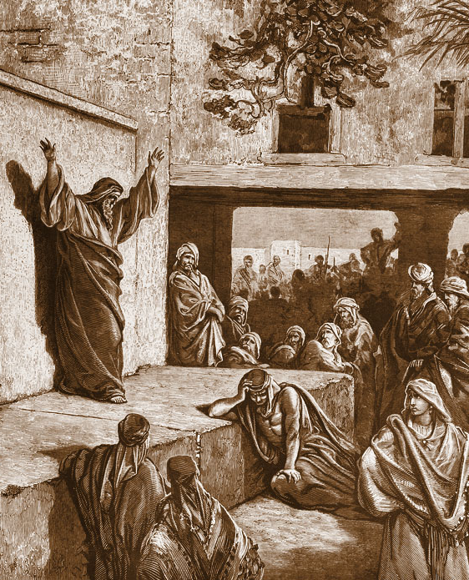
Micah
Outline (Chapter)
Judgment and Deliverance (1–5)
Confession and Restoration (6–7)
Micah Preaching to the Israelites

Slide 25
Micah
Key Verse “He has showed you, O man, what is good. And what does the LORD require of you? To act justly and to love mercy and to walk humbly with your God.”—Micah 6:8
Deut. 10:12 "And now, Israel, what does the LORD your God require of you, but to fear the LORD your God, to walk in all His ways and to love Him, to serve the LORD your God with all your heart and with all your soul,
Micah Preaching to the Israelites
Menu

Slide 26
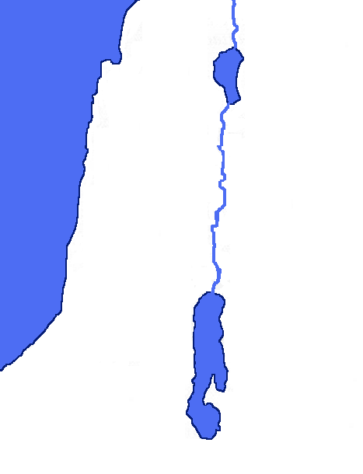
THE PROPHET
Micah lived in western Judah. His home town, Moreshethgath, had been part of the land of the Philistines.
Since the conquest of Uzziah (2 Chron. 26) the territory of the Philistines had been in the possession of Judah.
His residence in the country gave him an interest in the fortunes of the nation outside the capitol.
This map depicts
the Philistine territory before
the conquest of Uzziah.
SAMARIA
Jerusalem
MOAB
JUDAH
Philistines
DEAD SEA

Slide 27
Hoshea refused to pay tribute to Shalmaneser IV. He relied upon So, the king of Egypt, to help defend him against Shalmaneser, but no help came. Shalmaneser IV attacked Israel. For 3 weary years he besieged Israel in the land of Samaria (2 Kings 17:5).
Tiglathpileser, King of Assyria, took captives from Israel. His son, Shalmaneser IV was the next King of Assyria.
SYRIA
Cyprus
Tiglathpileser King of Assyria
Shalmaneser IV King of Assyria
ISRAEL
Part of ISRAEL
Hoshea King of Israel
JUDAH
Hezekiah King of Israel
So King of Egypt
Sinai
Arabia

Slide 28
Finally, after 3 years of Shamaneser IV and his Assyrian army laying siege against Samaria, Sargon II, who succeeded Shalmaneser IV, attacked Samaria and carried away Israel to Assyria. King Hoshea was even taken captive.
“Therefore the LORD was very angry with Israel, and removed them out of his sight: there was none left but the tribe of Judah only” (2 Kings 17:18).
SYRIA
Cyprus
Shalmaneser IV King of Assyria
Sargon II King of Assyria
ISRAEL
Part of ISRAEL
Hoshea King of Israel
JUDAH
Hezekiah King of Israel
Sinai
Arabia

Slide 29
Assyria continued to strive to be a world power. Sennacherib defeated Babylon after he heard of Merodach-baladan’s scheme to form an alliance of nations (including Judah) to stand against Assyria. Merodach was forced to flee.
SYRIA
Cyprus
Sennacherib King of Assyria
SAMARIA
Merodach-baladan
King of Babylon
JUDAH
Hezekiah King of Israel
Sinai
Arabia

Slide 30
Next, Sennacherib directed his attention to the West where again the people had become restless under the Assyrian yoke.
SYRIA
Cyprus
Sennacherib King of Assyria
SAMARIA
JUDAH
Hezekiah King of Israel
Sinai
Arabia

Slide 31
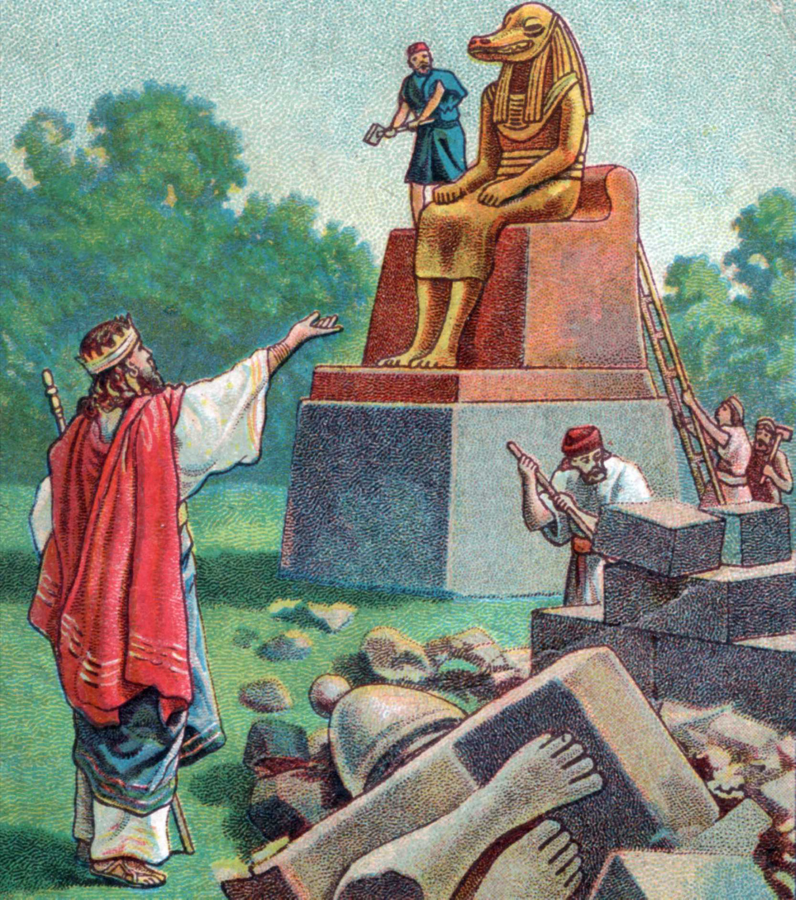
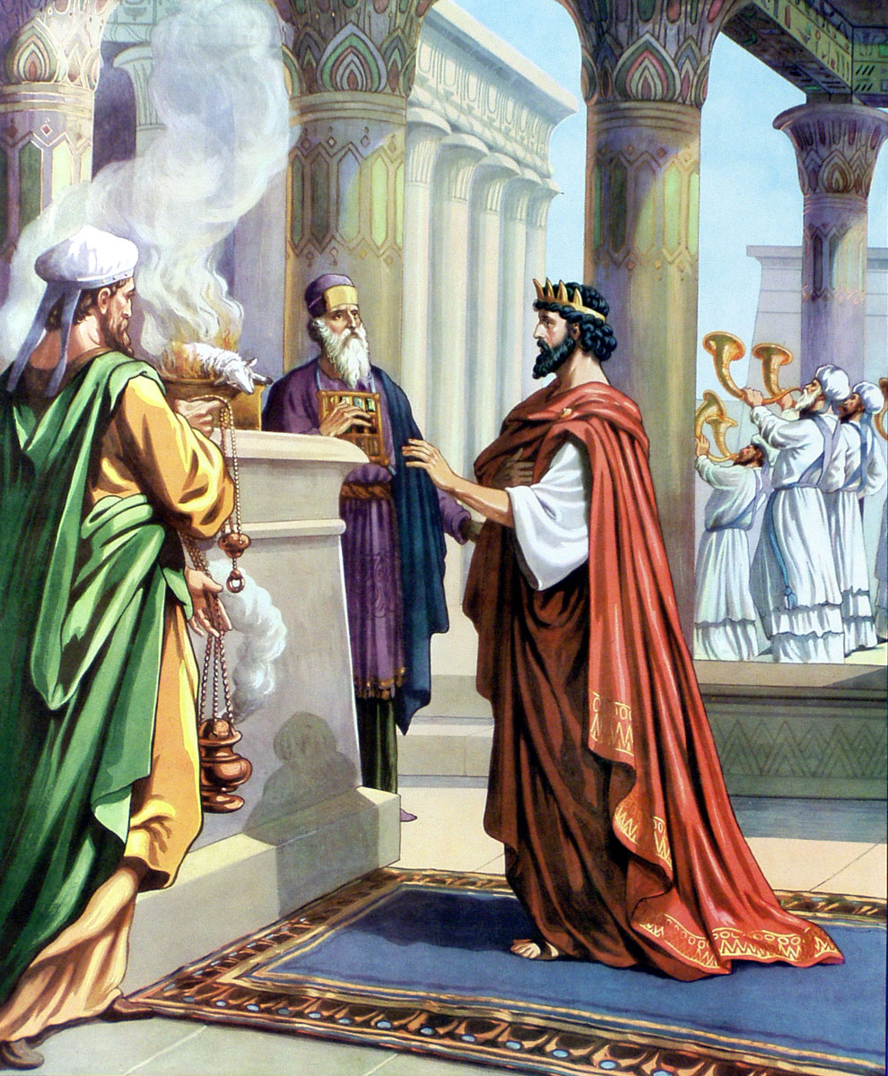
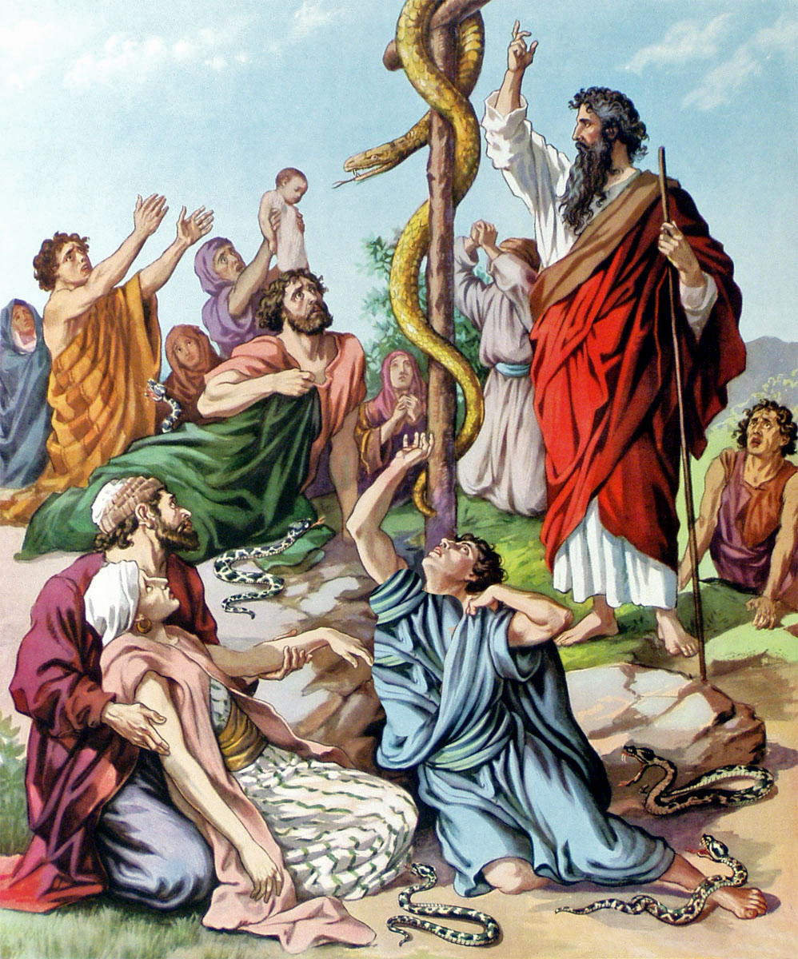
MEANWHILE . . .
in Judah
King Hezekiah
had removed the
high places,
torn down the images,
and broken in pieces the brass serpent
that Moses had made because the people burned incense to it.
He restored the temple and observed the Passover.

Slide 32
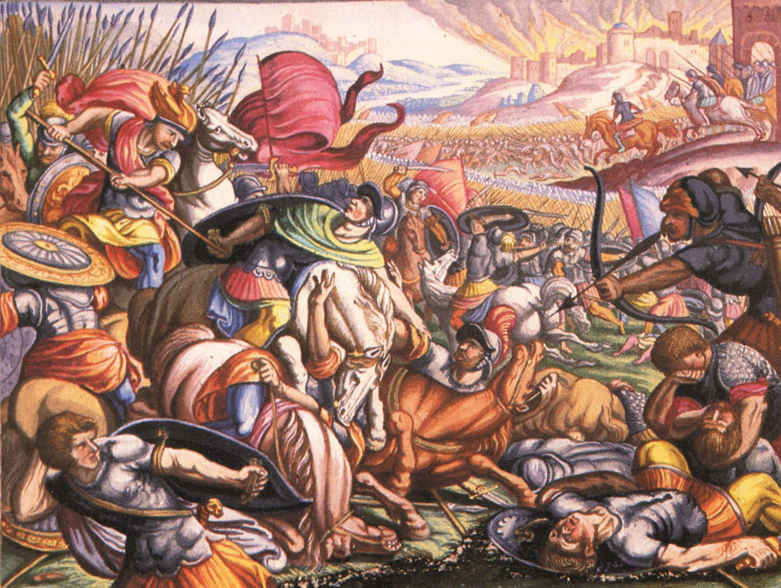
Yet, Sennacherib King of Assyria descended upon Judah. God was chastising the people of Judah because they did not willingly part with their idols but kept them in their hearts. Assyria took most of the fenced cities and demanded ransom from King Hezekiah to spare Jerusalem.

Slide 33
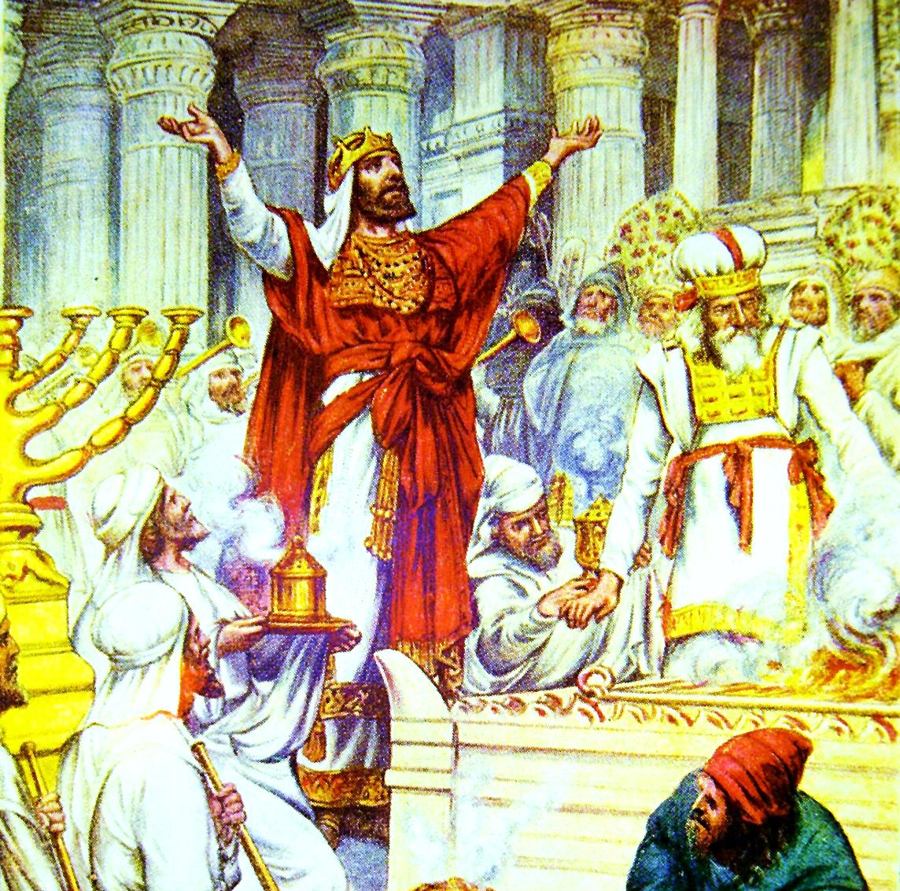
Hezekiah paid dearly to purchase safety for Jerusalem. Where was his courage and confidence in God? To raise the huge ransom, he was forced to empty the public treasures and take the golden plates off the doors and pillars of the temple.

Slide 34
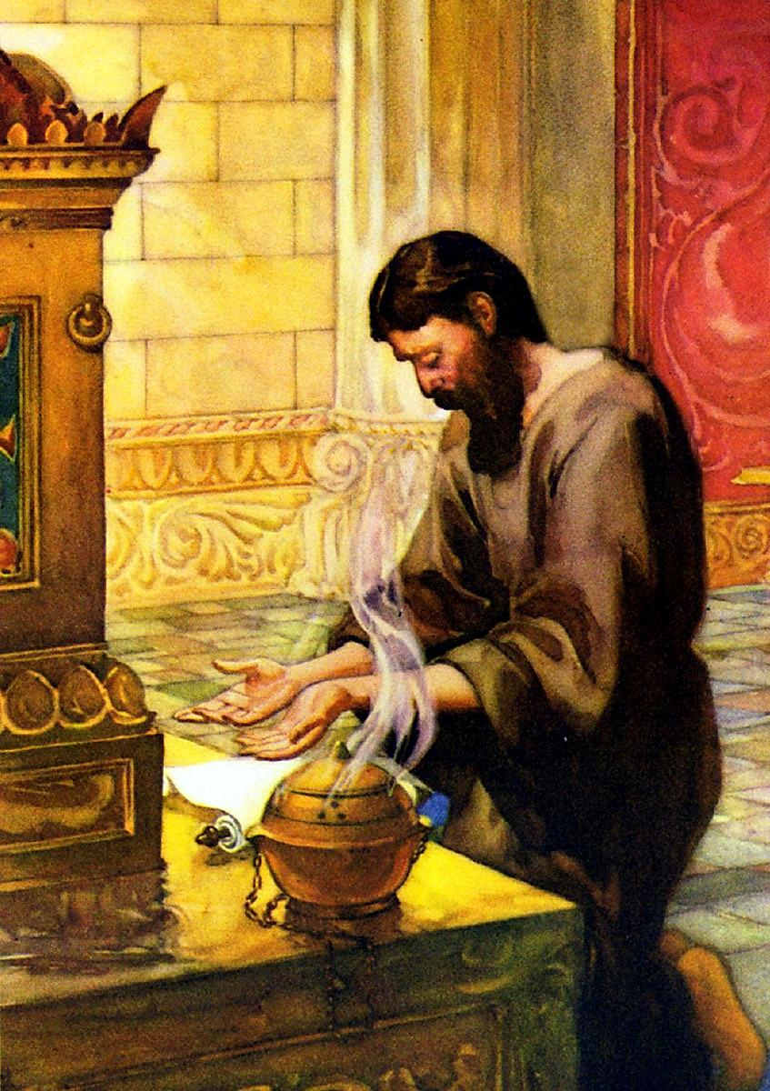
Hezekiah’s reaction—
He rent his clothes and put on sackcloth at the indignities done to God.
He went up to the temple
to pray.
He sent for Isaiah.
Isaiah lived in Jerusalem.
Micah lived a distance away.

Slide 35
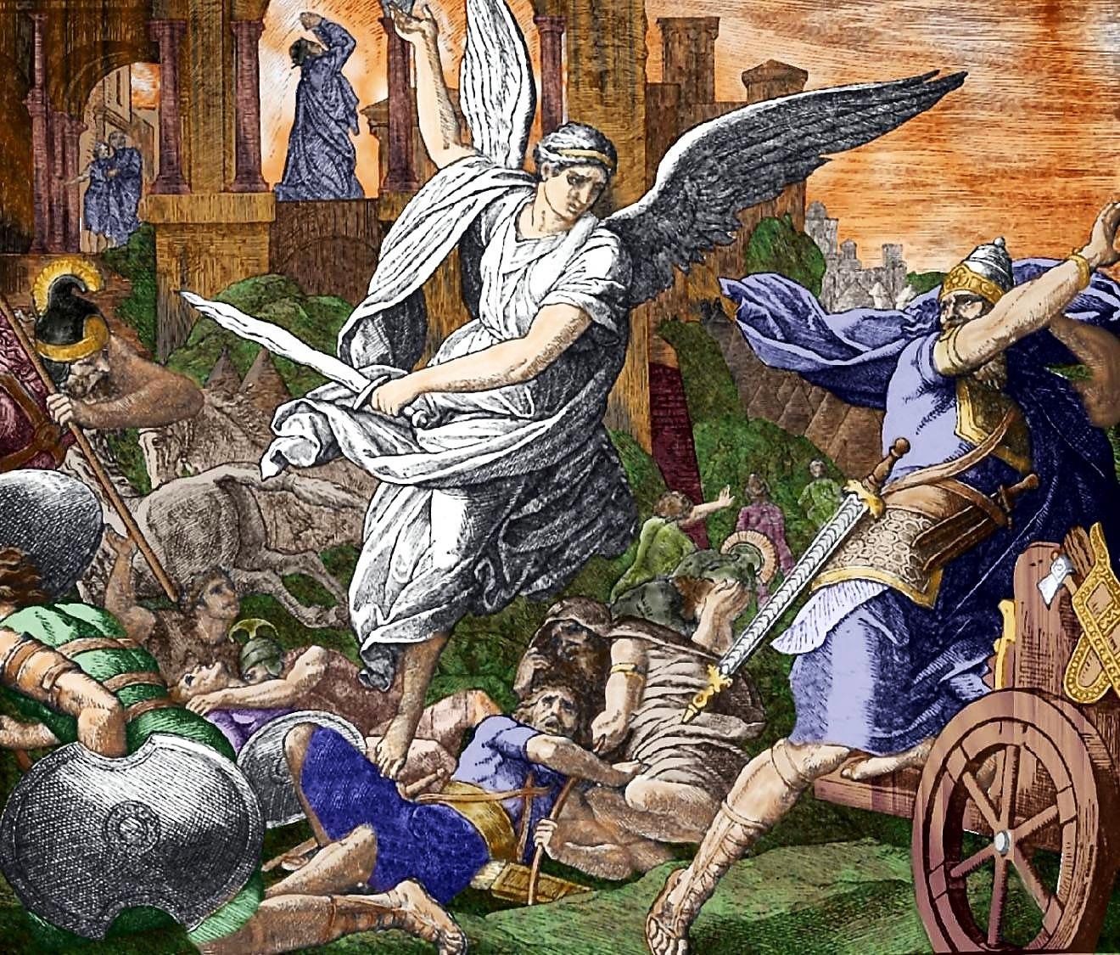
185,000 ASSYRIANS KILLED BY AN ANGEL
2 Kings 19
“³⁵And it came to pass that night, that the angel of the LORD went out, and smote in the camp of the Assyrians an hundred fourscore and five thousand: and when they arose early in the morning, behold, they were all dead corpses.”

Slide 36
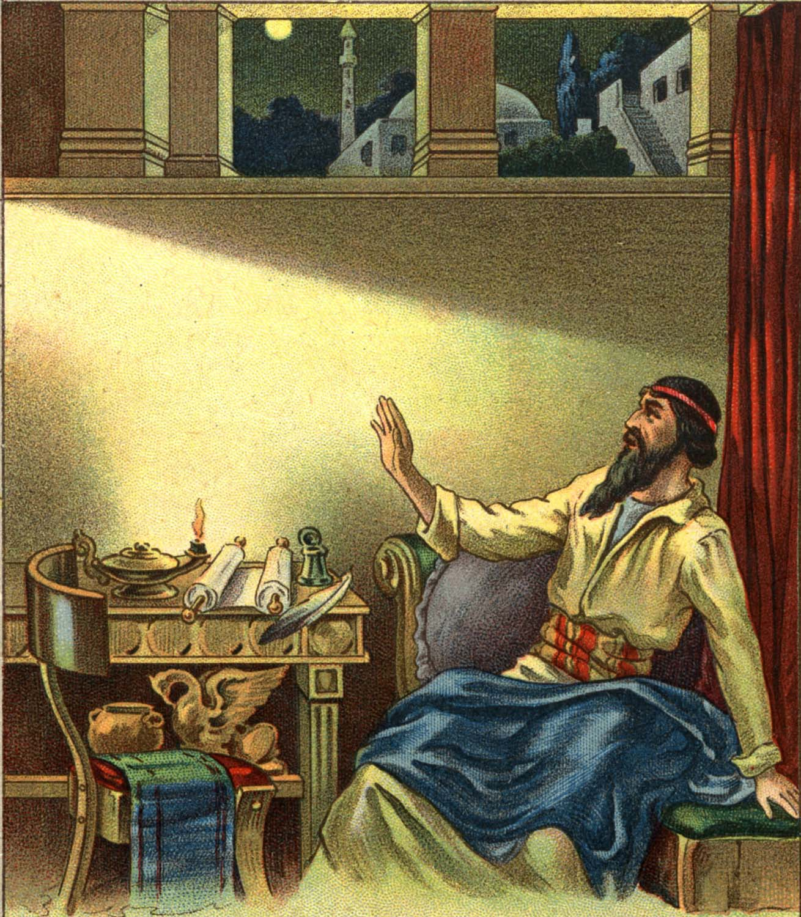
Micah was a prophet during these events of the reign of Hezekiah along with the major prophet, Isaiah.
As you can see from the previous overview we do not know much about his involvement in the events of his time, though he was present in Judah all during the reign of Hezekiah and into that of Manasseh.
The book of Micah addresses the sins and dangers of Jerusalem in the days of Hezekiah.
His message oscillates between condemnation for present sins and God’s purpose and ultimate blessing for his people.

Slide 37
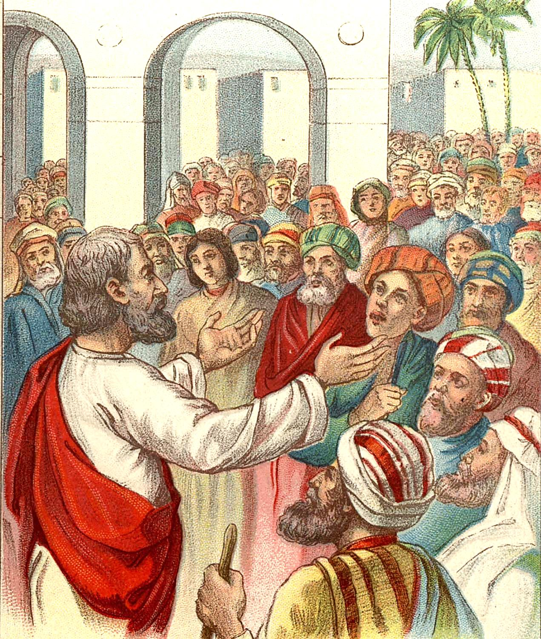
CHAPTER 4
The Messianic Hope
Micah is full of contrasts. Verses 1-8 sweep us on to a new Jerusalem, from which God’s word goes out to all men in an era of peace and plenty.
Verses 9-13 return us to the condemned city, to a nation in exile, to God’s judgment on all the nations around.
NOTE:
Assyria is the enemy in Micah’s day, but like prophecies in Isaiah Micah 4:10 looks over 100 years ahead to Babylon, the power that would eventually destroy Jerusalem.

Slide 38
CHAPTER 5
The King From Bethlehem
In the midst of the Assyrian siege, Micah speaks of a deliverer, the ultimate deliverer, who would come, like David of old, from Bethlehem.
VOCABULARY—
Ephrathah: area around
Bethlehem
Nimrod: Assyria
(see Gen. 10:8-12).
OR UNTO YOU IS BORN THIS DAY IN THE CITY OF DAVID A SAVIOUR WHICH IS CHRIST THE LORD.
(LUKE 2:11)

Slide 39
A CATALOG OF NATIONAL SINS
Micah 1:7 Idolatry
Micah 2:2 Covetousness
Micah 2:2 Oppression
Micah 3:10 Violence
Micah 2:6 Encouraging false prophets
Micah 3:1-3 Corruption of princes
Micah 3:5-7 Corruption of prophets
Micah 3:11 Corruption of priests
Micah 3:9 Bribery
Micah 6:10 Dishonesty

Slide 40
Minor Prophet Series
Lesson Three –
Obadiah
Jonah
Micah
2Kings 21:10 And the LORD spoke by His servants the prophets, saying…

