Slide 1
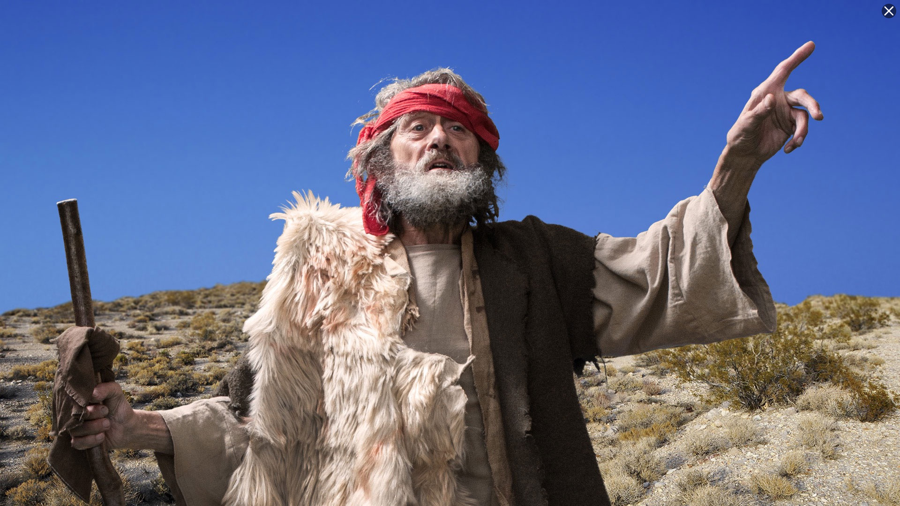
Minor Prophet Series
Lesson One –
Overview
2Kings 21:10 And the LORD spoke by His servants the prophets, saying…

Slide 2
The Bible is a book from God , about God, and about the relationship he wants to have with man.
It is the story of
The salvation of man
That comes thru Christ
To bring honor and glory to God.
Jesus wants us
To love him.
To submit to him as our lord.
To keep his commandments
To walk in his ways
To cling to him
To serve him
To serve him with all our heart, soul mind and strength. God is a jealous God and God will not accept our scraps and leftovers.
The Mission of the prophets was to WARN the people that those who would not repent of idolatry would be destroyed. They were to PROMISE that a remnant would be saved and that from this remnant would come the man, Christ Jesus, and establish a kingdom which would never be destroyed.

Slide 3
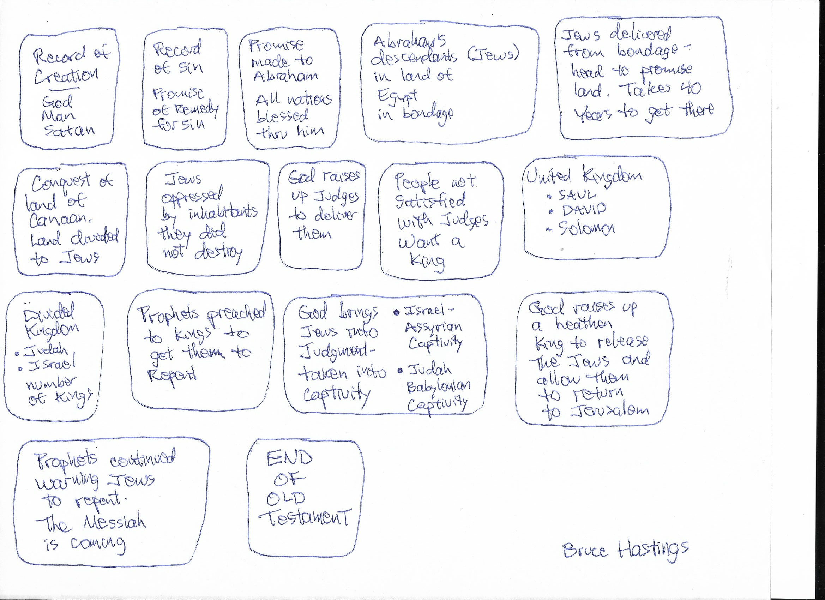
Old Testament Simplified

Slide 4
Esther ends Old Testament Time line. Prophets fall in historical books

Slide 5
Divided Kingdom
39 Kings
Northern – 10 tribes
Southern – 2 tribes
KINGS OF JUDAH
Rehoboam
Abijah
Asa
Jehoshaphat
Jehoram
Ahaziah
Athaliah
Joash
Amaziah
Uzziah
Jotham
Ahaz
Hezekiah
Manasseh
Amon
Josiah
Jehoahaz
Jehoiakim
Jehoiachin
Zedekiah
KINGS OF ISRAEL
Jeroboam 975-954
Nadab 954-953
Baasha 953-930 Elah 930-929
Zimri 929
Omri 929-918
Ahab 918-897
Ahaziah 897-896
Joram 896-884
Jehu 884-856
Jehoahaz 856-841
Joash 841-825
Jeroboam II 825-784
Zechariah 773
Shallum 772
Menahem 772-762
Pekahiah 762-760
Pekah 760-740
Hoshea 730-721
Judah and Benjamin
975-958
958-955
955-914
914-892
892-884
885
885-878
878-839
839-810
810-758
758-742
742-726
726-698
698-643
643-641
641-610
610
610-599
599
599-588
Falls to
Assyrians
722 BC
Falls to
Babylon
586 BC
538 BC
Cyrus edict allows
Jews to return to
Jerusalem

Slide 6
17 Prophets
Lesson One – Introduction and Overview
Minor Prophets (12)
Hosea
Joel
Amos
Obadiah
Jonah
Micah
Nahum
Habakkuk
Zephaniah
Haggai
Zechariah
Malachi
Major Prophets (5)
Isaiah
Jeremiah
Lamentations
Ezekiel
Daniel

Slide 7
Classification “major” and “minor” is based on the size of the books. Not on the content.
Minor Prophets (12)
Hosea
Joel
Amos
Obadiah
Jonah
Micah
Nahum
Habakkuk
Zephaniah
Haggai
Zechariah
Malachi
Major Prophets (5)
Isaiah
Jeremiah
Lamentations
Ezekiel
Daniel

Slide 8
Remember 4 Places, and 3 Times
Prophets before exile to get people to repent.
Prophets during the exile.
Prophets after the exile
2

Slide 9
Jonah
Nahum
Amos
Hosea
Isaiah
Jeremiah (Lamentations)
Joel
Micah
Zephaniah
Habakkuk
Obadiah
Before exile
During exile
Ezekiel
Daniel
Haggai
Zechariah
Malachi
After exile

Slide 10
What is a prophet?
A spokesman for God. Prophets were sometimes called Seers because they could “see” into the future. The prophetic office was not hereditary as the priests’ office was. Each man received his call from God.

Slide 11
Old Testament Books—
Genesis through Esther HISTORICAL books that tell the rise
and fall of the Hebrew nation.
Job through Songs of Solomon POETICAL books that mainly belong
to the golden age of the Hebrews.
Isaiah through Malachi PROPHETICAL books that belong to
the days of the fall of the Hebrew
nation.

Slide 12
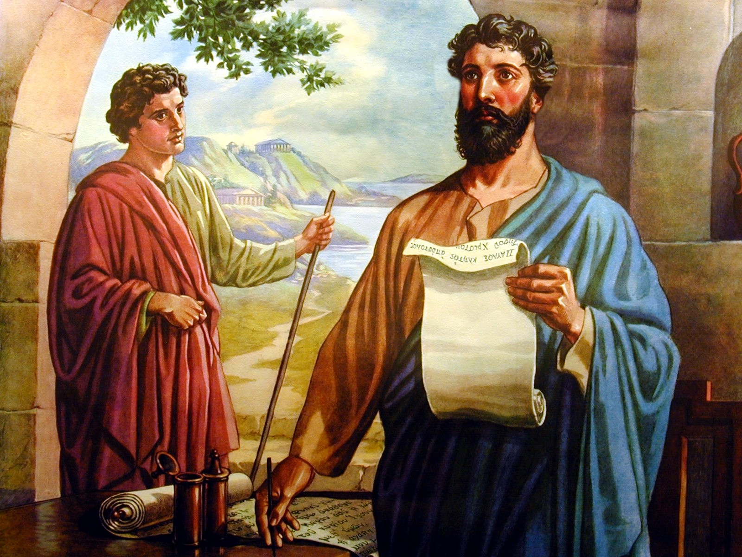
Abraham was a patriarch and prophet (Gen. 20:7).
Noah prophesied the flood.
Joseph prophesied 7 years of plenty and 7 years of famine.
Moses and Aaron were prophets (Ex. 7:1, Num. 12:6 Deut. 34:10).
Gideon was a prophet (Judg. 6:8, 13).
Samuel was a prophet (1 Sam. 3:20).
Gad was a prophet for King David (1 Sam. 22:5).
Nathan was a prophet for King David (2 Sam. 7:2).
Ahijah was a prophet for Jeroboam (1 Kgs. 11:29).
Jehu was a prophet for King Baasha (1 Kgs. 16:7).
Elijah prophesied about the fall of the Northern Kingdom (1 Kgs.).
Elisha also prophesied about the fall of the Northern Kingdom (2 Kgs.).
Obed was a prophet for King Asa (2 Chron. 15:8).
Then of course there are the books of the prophets both Major and Minor.
Jeremiah and Ezekiel were priests and prophets.
Isaiah, Daniel, and Zephaniah were of royal blood.
Amos was also a farmer.
John The Baptist
Christ
The gift of prophecy was given by the laying on of hands of the apostles.
There were prophets in all the ages.
Patriarchal Age
Mosaical Age
Christian Age

Slide 13
Isaiah--The coming of Christ and the establishment of His Kingdom.
Jeremiah--Jerusalem’s sin, destruction and future glory.
Lamentations--A funeral dirge over the destruction of Jerusalem.
Ezekiel--Fall of Jerusalem, restoration of God’s people.
Daniel--The four worldly kingdoms and God’s everlasting kingdom.
Hosea--Jehovah will be the God of all nations.
Joel--A vision of the gospel age.
Amos--A descendant of David will rule the world.
Obadiah--Edom shall perish.
Jonah--God wants His enemies saved.
Micah--The coming King and His reign.
Nahum--Judgment on the city of Nineveh.
Habakkuk--God’s people will be victorious.
Zephaniah--A new message for God’s people.
Haggai--The second temple and the greater temple of the future.
Zechariah--The coming King and His kingdom.
Malachi--The closing message while the people awaited the Messiah.

Slide 14
Prophets
Chronological Order
Of The Prophets—
Jonah
Joel
Amos
Hosea
Isaiah
Micah
Jeremiah
Zephaniah
Nahum
Habakkuk
Obadiah
Daniel
Ezekiel
Haggai
Zechariah
Malachi
It is difficult to find two commentaries that agree on the chronological order of the prophets.
Even the dates of the kings of Israel and Judah can only be approximate due to overlapping reigns, associated sovereignty, intervals of anarchy, and parts of years counted as whole years.

Slide 15
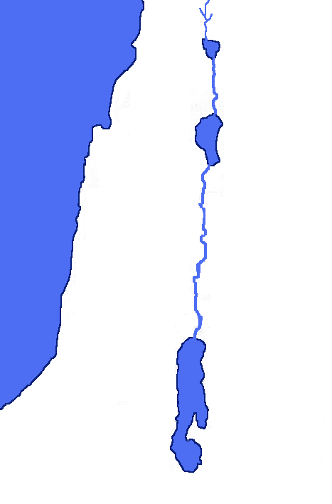
Jonah
Joel
Amos
Hosea
Isaiah
Micah
Jeremiah
Zephaniah
Nahum
Habakkuk
Obadiah
Daniel
Ezekiel
Haggai
Zechariah
Malachi
Prophets
NAHUM prophesied
to Nineveh
EZEKIEL & DANIEL prophesied as exiles in Babylon
HOSEA prophesied
in Israel
ISRAEL
JONAH sailed from Joppa – then went to Nineveh
From Tekoa AMOS went to prophesy to Israel
JUDAH
Prophets in Judah: JOEL, ISAIAH, JEREMIAH, ZEPHANIAH, HABAKKUK, HAGGAI, ZECHARIAH, MALACHI,
From his home in southern Judah MICAH prophesied to Jerusalem & Samaria
Edom, subject of the prophecy of OBADIAH

Slide 16
Jeremiah 3:8-9
"Then I saw that for all the causes for which backsliding Israel had committed adultery, I had put her away and given her a certificate of divorce; yet her treacherous sister Judah did not fear, but went and played the harlot also….
with stones and trees.” (NKJV)
7

Slide 17
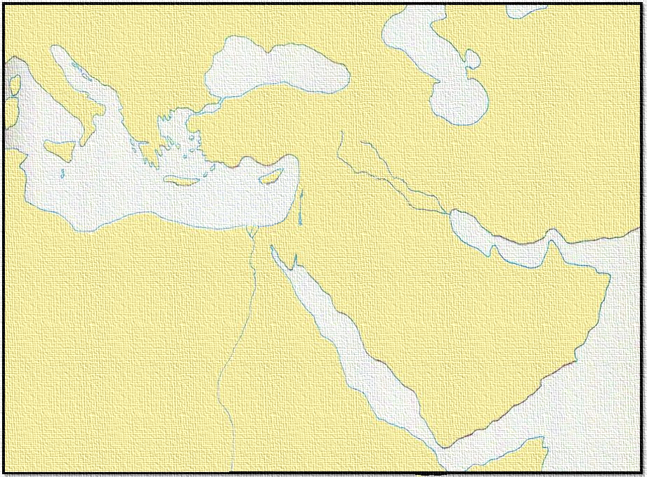
Prophets
Jonah
Joel
Amos
Hosea
Isaiah
Micah
Jeremiah
Zephaniah
Nahum
Habakkuk
Obadiah
Daniel
Ezekiel
Haggai
Zechariah
Malachi
Persian Empire
CANAAN
EGYPT
ARABIA
PERSIAN EMPIRE
AFRICA
At the end of 70 years Babylon was captured by Persia. The Persian king allowed the Jews to return to Palestine.

Slide 18
Isaiah 44:28 Who says of Cyrus, 'He is My shepherd, And he shall perform all My pleasure, Saying to Jerusalem, "You shall be built," And to the temple, "Your foundation shall be laid.“
45:1 "Thus says the LORD to His anointed, To Cyrus, whose right hand I have held-To subdue nations before him And loose the armor of kings, To open before him the double doors, So that the gates will not be shut:

Slide 19
Prophets
Two Periods After
The Return
1st period:
Zerubbabel—Governor
Joshua—Priest
The temple was rebuilt (Ezra 3-6)
Haggai and Zechariah—Prophets
Lasted about 20 years
Esther was a Persian Queen
2nd Period:
Nehemiah—Governor
Ezra—Priest
Rebuilt the wall; Jerusalem was restored
Malachi—Prophet
Lasted about 25 years
Jonah
Joel
Amos
Hosea
Isaiah
Micah
Jeremiah
Zephaniah
Nahum
Habakkuk
Obadiah
Daniel
Ezekiel
Haggai
Zechariah
Malachi
Persian Empire

Slide 20
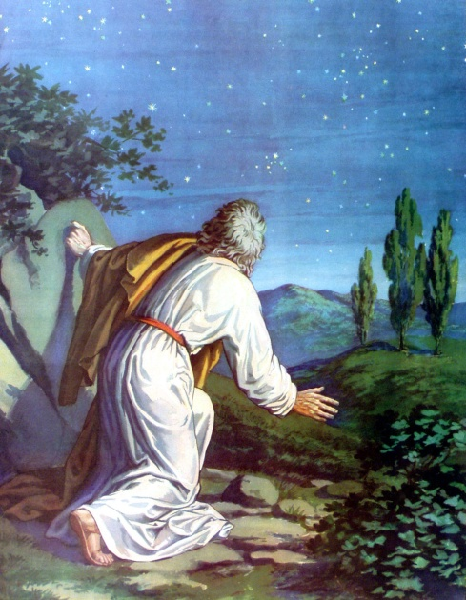
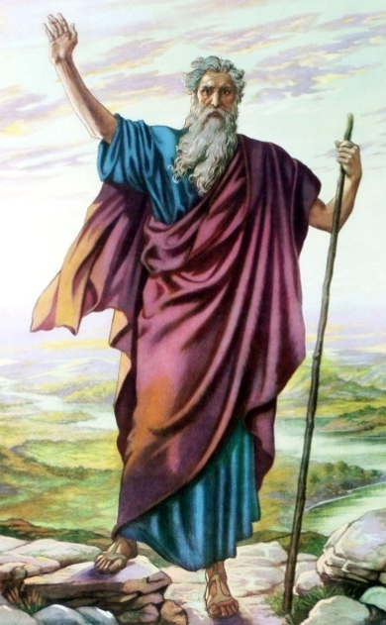
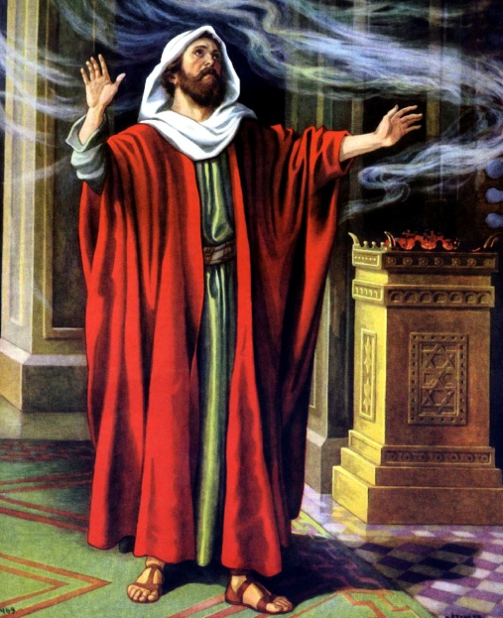
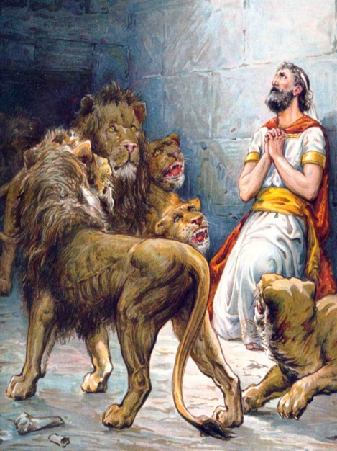
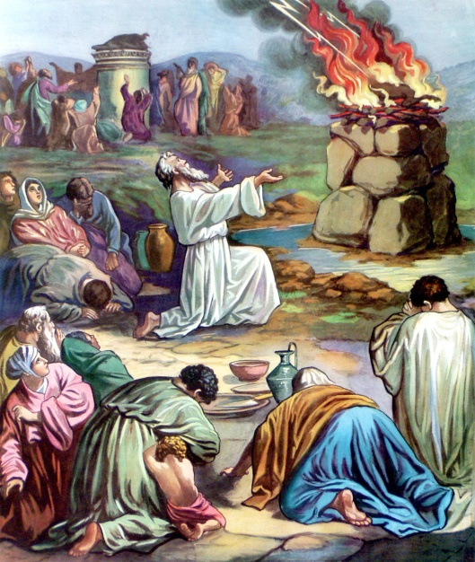
As The Prophets Foretold
the Hebrew kingdom was destroyed . . .

Slide 21
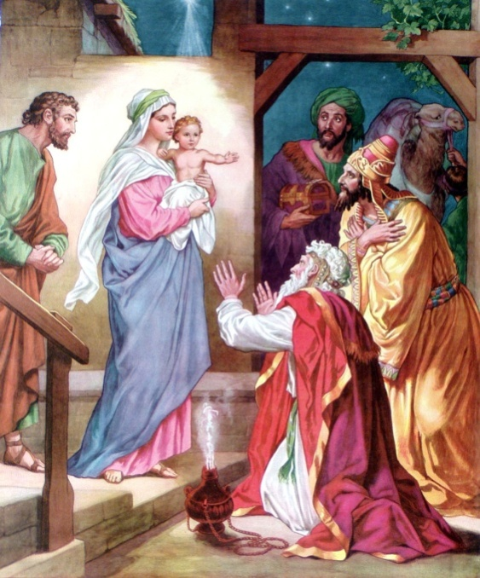
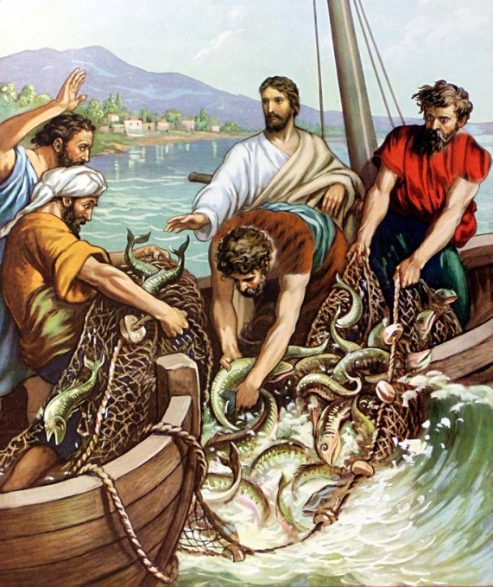
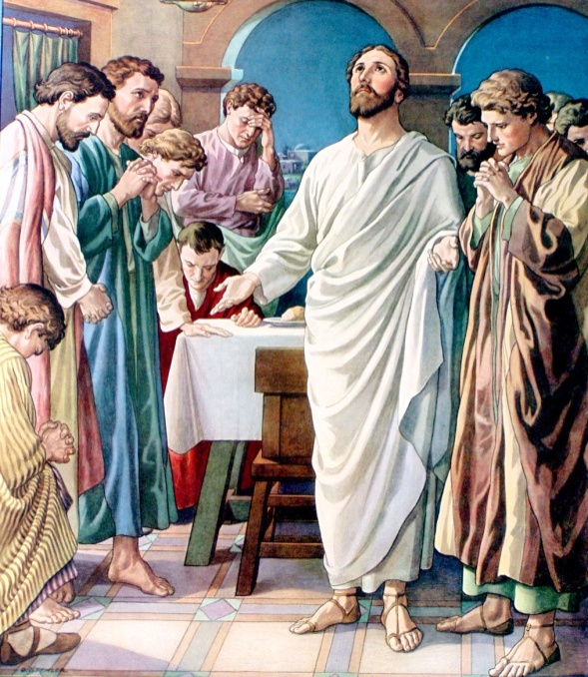
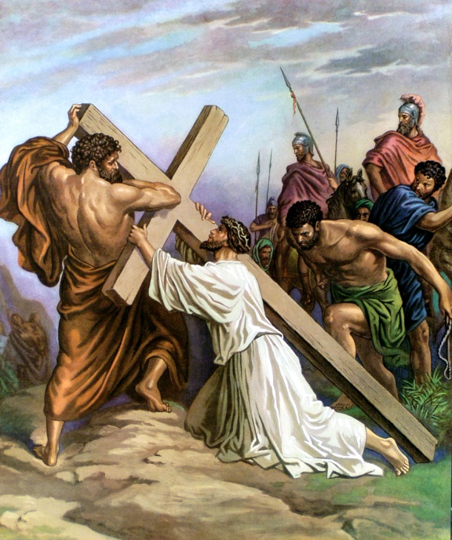
As The Prophets Foretold
Christ was born of a virgin, in Bethlehem
and is King of His everlasting Kingdom.

Slide 22
Jeremiah 31:31 "Behold, the days are coming, says the LORD, when I will make a new covenant with the house of Israel and with the house of Judah-
32 "not according to the covenant that I made with their fathers in the day that I took them by the hand to lead them out of the land of Egypt, My covenant which they broke, though I was a husband to them, says the LORD.
33 "But this is the covenant that I will make with the house of Israel after those days, says the LORD: I will put My law in their minds, and write it on their hearts; and I will be their God, and they shall be My people.
8

Slide 23
Minor Prophet Series
2Kings 21:10 And the LORD spoke by His servants the prophets, saying…

