Slide 1
The Just Shall Live By Faith
Habakkuk 2:1 I will stand my watch And set myself on the rampart, And watch to see what He will say to me, And what I will answer when I am corrected.
2 Then the LORD answered me and said: "Write the vision And make it plain on tablets, That he may run who reads it.
3 For the vision is yet for an appointed time; But at the end it will speak, and it will not lie. Though it tarries, wait for it; Because it will surely come, It will not tarry.
4 "Behold the proud, His soul is not upright in him; But the just shall live by his faith.

Slide 2
The Just Shall Live By His
Hab 2:4 "Behold the proud, His soul is not upright in him; But the just shall live by his faith.

Slide 3
The Just Shall Live By Faith
Just, Justice, Righteousness
jus'-tis (tsedhaqah; tsedheq; dikaiosune): The original Hebrew and Greek words are the same as those rendered "righteousness." This is the common rendering, and in about half the cases where we have "just" and "justice" in the King James Version, the American Standard Revised Version has changed to "righteous" and "righteousness." It must be constantly borne in mind that the two ideas are essentially the same.
Righteousness
ri'-chus-nes (tsaddiq, adjective, "righteous," or occasionally "just" tsedheq, noun, occasionally = "riahteousness," occasionally = "justice"; dikaios, adjective, dikaiosune, noun, from dike, whose first meaning seems to have been "custom"; the general use suggested conformity to a standard: righteousness, "the state of him who is such as he ought to be" (Thayer):

Slide 4
The Just Shall Live By Faith
Faith
Faith Strong’s Greek #2570
pistis (πίστις, 4102), primarily, “firm persuasion,” a conviction based upon hearing (akin to peitho, “to persuade”), is used in the NT always of “faith in God or Christ, or things spiritual.”
The word is used of (a) trust, Rom. 3:25 (b) trust-worthiness, Matt. 23:23; Rom. 3:3, RV, “the faithfulness of God”; Gal. 5:22; Titus 2:10, “fidelity”; (c) by metonymy, what is believed, the contents of belief, the “faith,” Acts 6:7; 14:22; Gal. 1:23; 3:25
A firm conviction, producing a full acknowledgement of God’s revelation or truth,
A personal surrender to Him,
A conduct inspired by such surrender,
The object of Abraham’s “faith” was not God’s promise (that was the occasion of its exercise); his “faith” rested on God Himself, Rom. 4:17, 20–21. See ASSURANCE, BELIEF, FAITHFULNESS, FIDELITY.
W. E. Vine, Merrill F. Unger, and William White Jr., Vine’s Complete Expository Dictionary of Old and New Testament Words

Slide 5
The Just Shall Live By Faith
Faith - singular
Acts 6:7
Then the word of God spread, and the number of the disciples multiplied greatly in Jerusalem, and a great many of the priests were obedient to the faith.
Jude 1:3
Beloved, while I was very diligent to write to you concerning our common salvation, I found it necessary to write to you exhorting you to contend earnestly for the faith which was once for all delivered to the saints.

Slide 6
What about being saved by faith?
Many churches say your faith will save you.
Ephesians 2:8 For by grace you have been saved through faith, and that not of yourselves; it is the gift of God,
9 not of works, lest anyone should boast.

Slide 7
Eph.2:8,9 For by grace you have been saved through faith, and that not of yourselves; it is the gift of God, 9 not of works, lest anyone should boast.
Acts 19:1 And it happened, while Apollos was at Corinth, that Paul, having passed through the upper regions, came to Ephesus. And finding some disciples ---
Acts 19:5 When they heard this, they were baptized in the name of the Lord Jesus.
6 And when Paul had laid hands on them, the Holy Spirit came upon them, and they spoke with tongues and prophesied.

Slide 8
Paul’s reference to salvation in the past perfect tense as something done and accomplished already has no reference to final destiny but to the primary obedience that makes a true child of God.
Eph.2:8

Slide 9
The Just Shall Live By Faith
“Faith” in the biblical sense means faithfulness, integrity, perseverance, and fidelity. “Here ‘faithfulness’ as well as ‘faith’ is in view.”
It is generally agreed that Paul in Rom. 1:17; Gal. 3:11; and Heb. 10:38 referred to the LXX; and, if so, the passage referred to is there rendered, “The just shall live by my faith,” a clear reference not to the inward act of believing on the part of God’s servant, but to the “faith” or “religion” God had established.

Slide 10
The Just Shall Live By Faith
This passage in Habakkuk makes it certain that Paul referred to the same thing.
“Faith” as used by the apostle might be paraphrased as “Christianity” or “the holy religion of Christ.” That is why Paul’s key reference to the “obedience of faith” stands both at the beginning and at the end of Romans.
Paul’s reference to this passage shows that he was referring to exactly the same thing, namely, “fidelity.”

Slide 11
The Just Shall Live By Faith
‘Faithfulness’ is a more accurate translation than ‘faith’ of the Hebrew in this passage.” “In Habakkuk, the words mean, ‘The righteous survives if he is faithful.’
We might add that that is exactly what being justified by faith means throughout the N.T. As the apostle John wrote it, “Be thou faithful unto death, and I will give thee the crown of life” (Rev. 2:10).
The false doctrine that any kind of a so-called experience in the believer’s heart provides any short-cut to salvation by “faith only” is a deadly delusion.

Slide 12
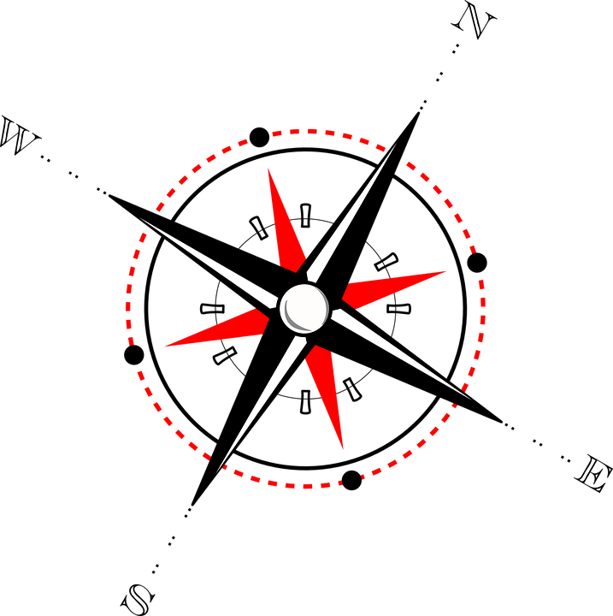
The Just Shall Live By Faith
Rom 1:17 For in it the righteousness of God is revealed from faith to faith; as it is written, "The just shall live by faith."
Romans 1:14 I am a debtor both to Greeks and to barbarians, both to wise and to unwise. 15 So, as much as is in me, I am ready to preach the gospel to you who are in Rome also.
16 For I am not ashamed of the gospel of Christ, for it is the power of God to salvation for everyone who believes, for the Jew first and also for the Greek.
17 For in it the righteousness of God is revealed from faith to faith; as it is written, "The just shall live by faith."

Slide 13
The Just Shall Live By Faith
Since the righteous shall live by faith, without faith none shall live.
Truth does not mold the character of a man unless it is practiced.
To see a truth, to believe a truth, does not mold the character unless it changes the purpose and the life.

Slide 14
The Just Shall Live By Faith
Hence, “faith apart from works is dead.” (James 2:20.) And faith fits for the blessings of God by leading us to follow God in his ways, and so makes our character like God’s character. Thus faith leads from one stage or degree of faith to another and higher one.

Slide 15
The Just Shall Live By Faith
Gal. 2:20 "I have been crucified with Christ; it is no longer I who live, but Christ lives in me; and the life which I now live in the flesh I live by faith in the Son of God, who loved me and gave Himself for me.

Slide 16
The Just Shall Live By Faith
Gal. 3:10 For as many as are of the works of the law are under the curse; for it is written, "Cursed is everyone who does not continue in all things which are written in the book of the law, to do them."
11 But that no one is justified by the law in the sight of God is evident, for "the just shall live by faith."
12 Yet the law is not of faith, but "the man who does them shall live by them."

Slide 17
The Just Shall Live By Faith
Heb 10:38 Now the just shall live by faith; But if anyone draws back, My soul has no pleasure in him.

Slide 18
The Just Shall Live By Faith
Habakkuk 2:4
Romans 1:17
Gal.2:20
Gal.3:10-12
Heb.10:38
Heb. 11
Rom. 8:36-39

Slide 19
The Just Shall Live By Faith
Heb 11:1 Now faith is the substance of things hoped for, the evidence of things not seen.
3 By faith we understand that the worlds were framed by the word of God, so that the things which are seen were not made of things which are visible.
4 By faith Abel offered to God a more excellent sacrifice than Cain,

Slide 20
The Just Shall Live By Faith
5 By faith Enoch was taken away so that he did not see death,
6 But without faith it is impossible to please Him, for he who comes to God must believe that He is, and that He is a rewarder of those who diligently seek Him.

Slide 21
The Just Shall Live By Faith
Heb 11:7 By faith Noah, being divinely warned of things not yet seen, moved with godly fear, prepared an ark for the saving of his household,
8 By faith Abraham obeyed when he was called to go out to the place which he would receive as an inheritance.
9 By faith he dwelt in the land of promise as in a foreign country, dwelling in tents with Isaac and Jacob, the heirs with him of the same promise;
10 for he waited for the city which has foundations, whose builder and maker is God.

Slide 22
The Just Shall Live By Faith
Heb 11:11 By faith Sarah herself also received strength to conceive seed, and she bore a child when she was past the age, because she judged Him faithful who had promised.
12 Therefore from one man, and him as good as dead, were born as many as the stars of the sky in multitude--innumerable as the sand which is by the seashore.
13 These all died in faith, not having received the promises, but having seen them afar off were assured of them, embraced them and confessed that they were strangers and pilgrims on the earth. 14 For those who say such things declare plainly that they seek a homeland.

Slide 23
The Just Shall Live By Faith
17 By faith Abraham, when he was tested, offered up Isaac, and he who had received the promises offered up his only begotten son,

Slide 24
The Just Shall Live By Faith
Heb 11:20 By faith Isaac blessed Jacob and Esau concerning things to come.
21 By faith Jacob, when he was dying, blessed each of the sons of Joseph, and worshiped, leaning on the top of his staff.
22 By faith Joseph, when he was dying, made mention of the departure of the children of Israel, and gave instructions concerning his bones.
23 By faith Moses, when he was born, was hidden three months by his parents, because they saw he was a beautiful child; and they were not afraid of the king's command.
24 By faith Moses, when he became of age, refused to be called the son of Pharaoh's daughter, 25 choosing rather to suffer affliction with the people of God than to enjoy the passing pleasures of sin, 26 esteeming the reproach of Christ greater riches than the treasures in Egypt; for he looked to the reward.

Slide 25
The Just Shall Live By Faith
27 By faith he forsook Egypt, not fearing the wrath of the king; for he endured as seeing Him who is invisible.
28 By faith he kept the Passover and the sprinkling of blood, lest he who destroyed the firstborn should touch them.
29 By faith they passed through the Red Sea as by dry land, whereas the Egyptians, attempting to do so, were drowned.
30 By faith the walls of Jericho fell down after they were encircled for seven days.

Slide 26
The Just Shall Live By Faith
Heb 11:31 By faith the harlot Rahab did not perish with those who did not believe, when she had received the spies with peace.
32 And what more shall I say? For the time would fail me to tell of Gideon and Barak and Samson and Jephthah, also of David and Samuel and the prophets:
33 who through faith subdued kingdoms, worked righteousness, obtained promises, stopped the mouths of lions,
34 quenched the violence of fire, escaped the edge of the sword, out of weakness were made strong, became valiant in battle, turned to flight the armies of the aliens.

Slide 27
The Just Shall Live By Faith
Heb 11:35 Women received their dead raised to life again. And others were tortured, not accepting deliverance, that they might obtain a better resurrection.
36 Still others had trial of mockings and scourgings, yes, and of chains and imprisonment.
37 They were stoned, they were sawn in two, were tempted, were slain with the sword. They wandered about in sheepskins and goatskins, being destitute, afflicted, tormented—
38 of whom the world was not worthy. They wandered in deserts and mountains, in dens and caves of the earth.
39 And all these, having obtained a good testimony through faith, did not receive the promise,
40 God having provided something better for us, that they should not be made perfect apart from us.

Slide 28
The Just Shall Live By Faith
What can stop us from living by faith?
Rom. 8:36 As it is written: "For Your sake we are killed all day long; We are accounted as sheep for the slaughter."
37 Yet in all these things we are more than conquerors through Him who loved us.
38 For I am persuaded that neither death nor life, nor angels nor principalities nor powers, nor things present nor things to come,
39 nor height nor depth, nor any other created thing, shall be able to separate us from the love of God which is in Christ Jesus our Lord.
Hab 2:4 "Behold the proud,
His soul is not upright in him;
But the just shall live by his faith.

Slide 29
The Just Shall Live By
Habakkuk 2:4
Romans 1:17
Gal.2:20
Gal.3:10-12
Heb.10:38
Heb. 11
Rom. 8:36-39

