Slide 1
Welcome to our services
New Lebanon Church of Christ
We are Simply Christians.
Our Emphasis is Spiritual, Not Material or Social.
We are striving to be The Same Church as Described in The New Testament.
Please Come Back Again

Slide 2
Our Greatest Enemy
Gen.3:1 Now the serpent was more cunning than any beast of the field which the LORD God had made. And he said to the woman, "Has God indeed said, 'You shall not eat of every tree of the garden’?
2 Cor.11:3 But I fear, lest somehow, as the serpent deceived Eve by his craftiness, so your minds may be corrupted from the simplicity that is in Christ.

Slide 3
Our Greatest Enemy
1. The Devil’s Power Of Days Past.
Luke 22:31
And the Lord said, "Simon, Simon! Indeed, Satan has asked for you, that he may sift you as wheat. 32 "But I have prayed for you, that your faith should not fail; and when you have returned to Me, strengthen your brethren."

Slide 4
Our Greatest Enemy
Deut. 29:29 "The secret things belong to the LORD our God,
but those things which are revealed belong to us and to our children forever, that we may do all the words of this law.

Slide 5
Our Greatest Enemy
1. The Devil’s Power Of Days Past.
2 Cor. 12:7 And lest I should be exalted above measure by the abundance of the revelations, a thorn in the flesh was given to me, a messenger of Satan to buffet me, lest I be exalted above measure.
John 13:2 And supper being ended, the devil having already put it into the heart of Judas Iscariot, Simon's son, to betray Him,
John 13:27 Now after the piece of bread, Satan entered him. Then Jesus said to him, "What you do, do quickly."

Slide 6
Our Greatest Enemy
1. The Devil’s Power Of Days Past.
John 6:70 Jesus answered them, "Did I not choose you, the twelve, and one of you is a devil?“
Acts 5:3,4 But Peter said, "Ananias, why has Satan filled your heart to lie to the Holy Spirit and keep back part of the price of the land for yourself?
4 "While it remained, was it not your own? And after it was sold, was it not in your own control? Why have you conceived this thing in your heart? You have not lied to men but to God."

Slide 7
Our Greatest Enemy
2. Understand The Devil’s Power Is Limited
1 Cor.10:13 No temptation has overtaken you except such as is common to man; but God is faithful, who will not allow you to be tempted beyond what you are able, but with the temptation will also make the way of escape, that you may be able to bear it.
James 4:7 Therefore submit to God. Resist the devil and he will flee from you.

Slide 8
Our Greatest Enemy
2. Understand The Devil’s Power Is Limited
Job 1:12 And the LORD said to Satan, "Behold, all that he has is in your power; only do not lay a hand on his person." So Satan went out from the presence of the LORD.
When rebuked by the messenger of Jehovah he had to remain silent:
Zech.3:2 And the LORD said to Satan, "The LORD rebuke you, Satan! The LORD who has chosen Jerusalem rebuke you! Is this not a brand plucked from the fire?"

Slide 9
Our Greatest Enemy
2. Understand The Devil’s Power Is Limited
His authority over the world kingdoms was delivered to him:
Luke 4:6 And the devil said to Him, "All this authority I will give You, and their glory; for this has been delivered to me, and I give it to whomever I wish. 7 "Therefore, if You will worship before me, all will be Yours." 8 And Jesus answered and said to him, "Get behind Me, Satan! For it is written, 'You shall worship the LORD your God, and Him only you shall serve.'"

Slide 10
Our Greatest Enemy
2. Understand The Devil’s Power Is Limited
Satan had to ask for the apostles:
Luke 22:31 And the Lord said, "Simon, Simon! Indeed, Satan has asked for you, that he may sift you as wheat. 32 "But I have prayed for you, that your faith should not fail; and when you have returned to Me, strengthen your brethren."

Slide 11
Our Greatest Enemy
2. Understand The Devil’s Power Is Limited
He can snatch no one out of the Lord’s hand:
John 10:28 "And I give them eternal life, and they shall never perish; neither shall anyone snatch them out of My hand.
29 "My Father, who has given them to Me, is greater than all; and no one is able to snatch them out of My Father's hand.

Slide 12
Our Greatest Enemy
2. Understand The Devil’s Power Is Limited
When resisted, he flees:
James 4:4 Adulterers and adulteresses! Do you not know that friendship with the world is enmity with God? Whoever therefore wants to be a friend of the world makes himself an enemy of God. 5 Or do you think that the Scripture says in vain, "The Spirit who dwells in us yearns jealously"?
6 But He gives more grace. Therefore He says: "God resists the proud, But gives grace to the humble."7 Therefore submit to God. Resist the devil and he will flee from you. 8 Draw near to God and He will draw near to you. Cleanse your hands, you sinners; and purify your hearts, you double-minded.

Slide 13
Our Greatest Enemy
2. Understand The Devil’s Power Is Limited
When cast into hell he will be tormented eternally:
Rev. 20:10 The devil, who deceived them, was cast into the lake of fire and brimstone where the beast and the false prophet are. And they will be tormented day and night forever and ever.
God is greater than the Devil:
1 John 4:4 You are of God, little children, and have overcome them, because He who is in you is greater than he who is in the world.

Slide 14
Our Greatest Enemy
3. How Does The Devil Work Today?
Satan blinds people:
2 Cor. 4:4 whose minds the god of this age has blinded, who do not believe, lest the light of the gospel of the glory of Christ, who is the image of God, should shine on them.

Slide 15
Our Greatest Enemy
3. How Does The Devil Work Today?
Satan deceives by acting like a minister of light:
2Cor 11:12 But what I do, I will also continue to do, that I may cut off the opportunity from those who desire an opportunity to be regarded just as we are in the things of which they boast.
13 For such are false apostles, deceitful workers, transforming themselves into apostles of Christ.
14 And no wonder! For Satan himself transforms himself into an angel of light. 15 Therefore it is no great thing if his ministers also transform themselves into ministers of righteousness, whose end will be according to their works.

Slide 16
Our Greatest Enemy
3. How Does The Devil Work Today?
He takes the word from people’s heart:
Luke 8:12 "Those by the wayside are the ones who hear; then the devil comes and takes away the word out of their hearts, lest they should believe and be saved.

Slide 17
Our Greatest Enemy
3. How Does The Devil Work Today?
Satan is full of trickery:
1Tim. 3:5 (for if a man does not know how to rule his own house, how will he take care of the church of God?); 6 not a novice, lest being puffed up with pride he fall into the same condemnation as the devil. 7 Moreover he must have a good testimony among those who are outside, lest he fall into reproach and the snare of the devil.

Slide 18
Our Greatest Enemy
3. How Does The Devil Work Today?
1 John 3:8,9 He who sins is of the devil, for the devil has sinned from the beginning. For this purpose the Son of God was manifested, that He might destroy the works of the devil. 9 Whoever has been born of God does not sin, for His seed remains in him; and he cannot sin, because he has been born of God.

Slide 19
Our Greatest Enemy
4. How Do We View The Devil Today?
We should be aware of his wiles: Ephesians 6:11
Eph 6:11 Put on the whole armor of God, that you may be able to stand against the wiles of the devil.
2Cor. 2:9 For to this end I also wrote, that I might put you to the test, whether you are obedient in all things. 10 Now whom you forgive anything, I also forgive. For if indeed I have forgiven anything, I have forgiven that one for your sakes in the presence of Christ, 11 lest Satan should take advantage of us; for we are not ignorant of his devices.

Slide 21
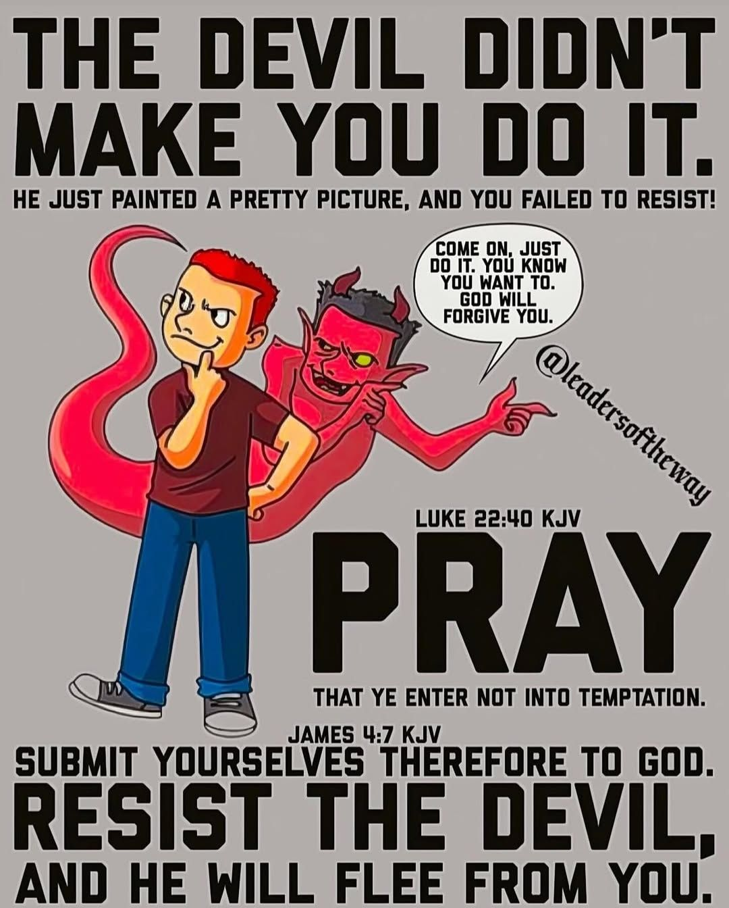

Slide 23
Our Greatest Enemy
4. How Do We View The Devil Today?
We want to be mindful of his evil devices, but we do not want to think of him too highly:
Rom. 8:36 As it is written: "For Your sake we are killed all day long; We are accounted as sheep for the slaughter."37 Yet in all these things we are more than conquerors through Him who loved us.
38 For I am persuaded that neither death nor life, nor angels nor principalities nor powers, nor things present nor things to come,
39 nor height nor depth, nor any other created thing, shall be able to separate us from the love of God which is in Christ Jesus our Lord.

Slide 24
Our Greatest Enemy
4. How Do We View The Devil Today?
We want to be mindful of his evil devices, but we do not want to think of him too highly:
1John 4:4 You are of God, little children, and have overcome them, because He who is in you is greater than he who is in the world.

Slide 25
Our Greatest Enemy
4. How Do We View The Devil Today?
We want to be mindful of his evil devices, but we do not want to think of him too highly:
Matt. 4:4 But He answered and said, "It is written, 'Man shall not live by bread alone, but by every word that proceeds from the mouth of God.‘’
Matt. 4:7 Jesus said to him, "It is written again, 'You shall not tempt the LORD your God.‘’
Matt. 4:10 Then Jesus said to him, "Away with you, Satan! For it is written, 'You shall worship the LORD your God, and Him only you shall serve.‘’

Slide 26
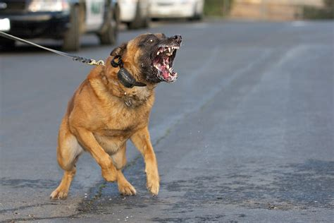
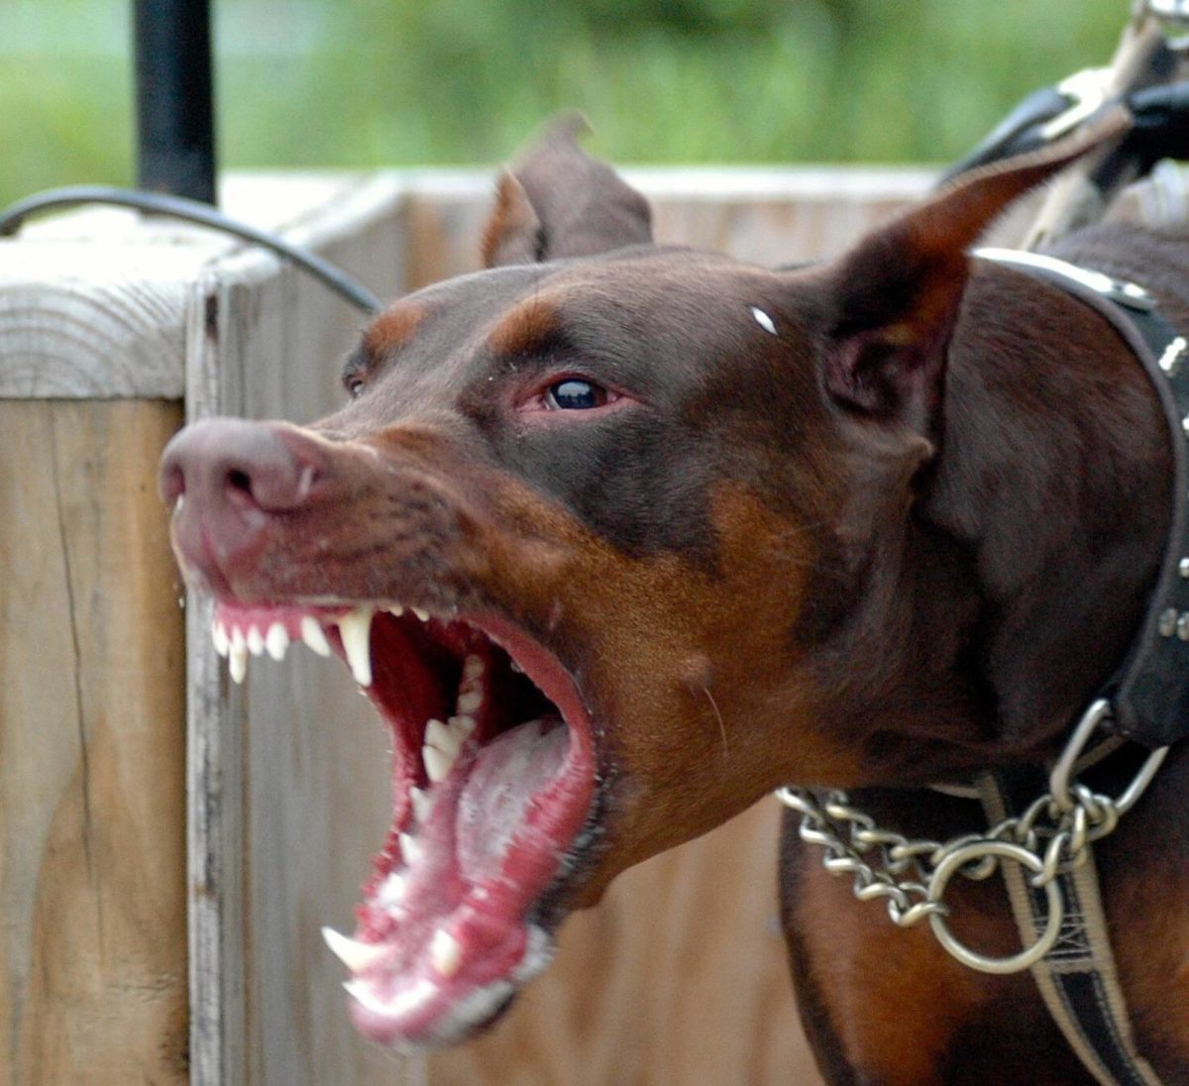
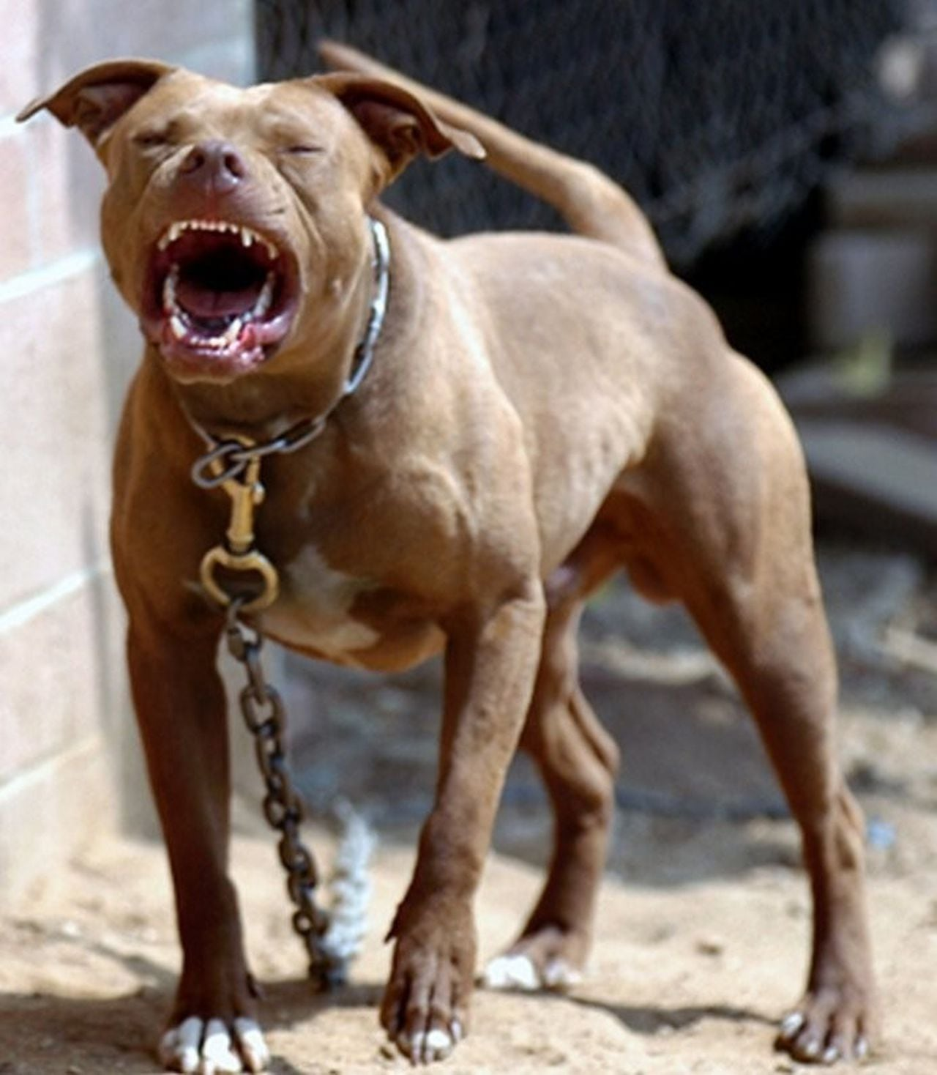
How do YOU view your greatest enemy?

