Slide 1
Welcome to our services
New Lebanon Church of Christ
We are Simply Christians.
Our Emphasis is Spiritual, Not Material or Social.
We are striving to be The Same Church as Described in The New Testament.
Please Come Back Again

Slide 2
Do You Know The Church That Jesus Built?
Mark 9:1 And he said unto them, Verily I say unto you, That there be some of them that stand here, which shall not taste of death, till they have seen the kingdom of God come with power. kjv

Slide 3
Do You Know The Church That Jesus Built?
While Jesus Christ walked the earth He stated, “I will build my church” (Matt. 16:18).
In Eph. 4:4 we learn that “there is one body” while from Col. 1:18 we read that Christ “is the head of the body, the church.”
My church. One body. The body. The church. All of these terms are singular indicating that there is only ONE.

Slide 4
Do You Know The Church That Jesus Built?
Yet in today’s world there are thousands of churches all teaching different doctrines.
This one says you must be baptized – that one says you don’t. Some tell you to worship on Sunday – others on Saturday or perhaps not at all. It can be a mass of confusion.
But God does not create confusion. He also does not accept people worshipping in man-made churches rather than the one Jesus died for. If we want to be pleasing to God then we need to know more about the church that Jesus built.

Slide 5
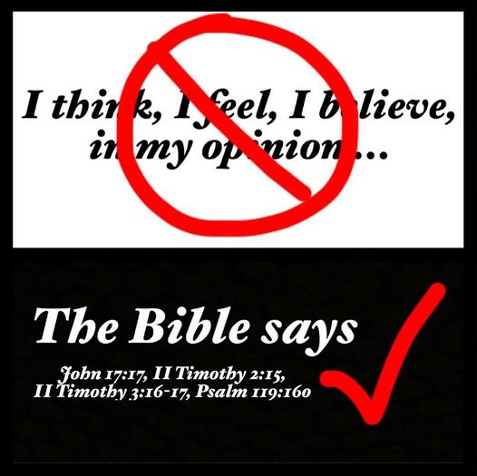

Slide 6
Do You Know The Church That Jesus Built?
Know what it is ?
The word “church” comes from the Greek word that means those who are “called out.”

Slide 7
NT:1577 (Strong’s number) Thayer’s definition
ekkleesia, ekklesias, hee (from ekkleetos called out or forth, and this from ekkaleoo); properly, a gathering of citizens called out from their homes into some public place; an assembly; so used:
1. among the Greeks from Thucydides (423 B.C.) (compare Herodotus (484-408 B.C.) 3, 142) down, an assembly of the people convened at the public place of council for the purpose of deliberating: Acts 19:39.
2. in the Septuagint (LXX) often equivalent to qaahaal, the assembly of the Israelites, Judg 21:8; 1 Chron 29:1, etc., especially when gathered for sacred purposes, Deut 31:30 (Deut 32:1); Josh 8:35 (Josh 9:8), etc.; in the N.T. thus in Acts 7:38; Heb 2:12.
3. any gathering or throng of men assembled by chance or tumultuously: Acts 19:32,41.
4. in the Christian sense,
a. an assembly of Christians gathered for worship: en ekkleesia, in the religious meeting, 1 Cor 14:19,35;
en tais ekkleesiais, 1 Cor 14:34;
sunerchesthai en ekkleesia, 1 Cor 11:18;

Slide 8
Do You Know The Church That Jesus Built?
Know what it is ?
The church is the Family of God (1 Tim. 3:15).
The church is the Pillar and Ground of Truth (1 Tim. 3:15)
1Timothy 3:15 but if I am delayed, I write so that you may know how you ought to conduct yourself in the house of God, which is the church of the living God, the pillar and ground of the truth.

Slide 9
Do You Know The Church That Jesus Built?
Know the Founder ?
Jesus promised to build His church (Matt. 16:18).
Jesus purchased the church with His blood (Acts 20:28).
Matt. 16:18 "And I also say to you that you are Peter, and on this rock I will build My church, and the gates of Hades shall not prevail against it.
Acts 20:28 "Therefore take heed to yourselves and to all the flock, among which the Holy Spirit has made you overseers, to shepherd the church of God which He purchased with His own blood.

Slide 10
Acts 2:47 praising God and having favor with all the people. And the Lord added to the church daily those who were being saved.
These churches are too late to be the Lord’s church.
These churches are not the Bride of Christ (Eph.5) Christ has ONE Bride.
Which church were those in Acts 2:47 added to?

Slide 11
Do You Know The Church That Jesus Built?
Know the Founder ?
Jesus is the Head of the church (Col. 1:18).
The church is His spiritual body (Col. 1:18).
Col. 1:18 And He is the head of the body, the church, who is the beginning, the firstborn from the dead, that in all things He may have the preeminence.

Slide 12
Do You Know The Church That Jesus Built?
Know when it began ?
It was promised in the last days of Jerusalem (Isaiah 2:2-4).
Isaiah 2:2 Now it shall come to pass in the latter days That the mountain of the LORD'S house Shall be established on the top of the mountains, And shall be exalted above the hills; And all nations shall flow to it.
3 Many people shall come and say, "Come, and let us go up to the mountain of the LORD, To the house of the God of Jacob; He will teach us His ways, And we shall walk in His paths." For out of Zion shall go forth the law, And the word of the LORD from Jerusalem.
4 He shall judge between the nations, And rebuke many people; They shall beat their swords into plowshares, And their spears into pruning hooks; Nation shall not lift up sword against nation, Neither shall they learn war anymore.

Slide 13
Do You Know The Church That Jesus Built?
Know when it began ?
The church was near in John’s day (Matt. 3:1,2).
Matt. 3:1 In those days John the Baptist came preaching in the wilderness of Judea,
2 and saying, "Repent, for the kingdom of heaven is at hand!"

Slide 14
Do You Know The Church That Jesus Built?
Know when it began ?
Jesus told His disciples that they should not taste of death till they see the Kingdom of God come with power.
Mark 9:1 And he said unto them, Verily I say unto you, That there be some of them that stand here, which shall not taste of death, till they have seen the kingdom of God come with power. kjv

Slide 15
Do You Know The Church That Jesus Built?
Know when it began ?
They were told that they would receive that power when the Holy Spirit came upon them (Acts 1:8).
All these things came to pass on Pentecost (Acts 2).
"But you shall receive power when the Holy Spirit has come upon you; and you shall be witnesses to Me in Jerusalem, and in all Judea and Samaria, and to the end of the earth."

Slide 16
Time of the establishment
of the church that Christ built.
On the day of Pentecost, the apostles preached the gospel in Jerusalem
Acts 2
Thereafter, the church existed.
Acts 2:47, 5:11
Any “church” that came into existence after that day of Pentecost in Jerusalem
cannot be the church that belongs to Christ.

Slide 17
Do You Know The Church That Jesus Built?
Know how it is described ?
The Body of Christ (Eph. 4:12).
The Church of Christ (Rom. 16:16).
Eph. 4:12 for the equipping of the saints for the work of ministry, for the edifying of the body of Christ,
Rom. 16:16 Greet one another with a holy kiss. The churches of Christ greet you.

Slide 18
Do You Know The Church That Jesus Built?
Know what God offers there ?
Forgiveness of sins is in the Church (Eph. 1:17).
Eph 1:7 In Him we have redemption through His blood, the forgiveness of sins, according to the riches of His grace

Slide 20
Do You Know The Church That Jesus Built?
Know what God offers there ?
Redemption is in the Church (Col. 1:14).
Col. 1:14 in whom we have redemption through His blood, the forgiveness of sins.

Slide 21
Do You Know The Church That Jesus Built?
Know what God offers there ?
Salvation is in the Church (2 Tim. 2:10).
2Tim. 2:10 Therefore I endure all things for the sake of the elect, that they also may obtain the salvation which is in Christ Jesus with eternal glory.

Slide 22
Do You Know The Church That Jesus Built?
Know what God offers there ?
All spiritual blessings are in the Church (Eph. 1:3).
Eph 1:3 Blessed be the God and Father of our Lord Jesus Christ, who has blessed us with every spiritual blessing in the heavenly places in Christ,

Slide 23
Do You Know The Church That Jesus Built?
Know what God offers there ?
The saved are in the Church (Acts 2:47).
Acts 2:47 praising God and having favor with all the people. And the Lord added to the church daily those who were being saved.

Slide 24
Do You Know The Church That Jesus Built?
Know how it worships ?
The Church sings (Eph.5:19; Col. 3:16).
The Church prays (1 Thess. 5:17; Luke 18:1).
The Church gives (1 Cor. 16:1,2; Acts 20:35).
The Church teaches (2 Tim. 2:2; Acts 20:7).
The Church communes with our Lord (Acts 20:7; 1 Cor. 11:23-29).

Slide 25
NT:1577 (Strong’s number) Thayer’s definition
ekkleesia, (from ekkleetos called out or forth, and this from ekkaleoo); properly, a gathering of citizens called out from their homes into some public place; an assembly; so used:
Heb. 10:24 And let us consider one another in order to stir up love and good works,
25 not forsaking the assembling of ourselves together, as is the manner of some, but exhorting one another, and so much the more as you see the Day approaching.
26 For if we sin willfully after we have received the knowledge of the truth, there no longer remains a sacrifice for sins,

Slide 26
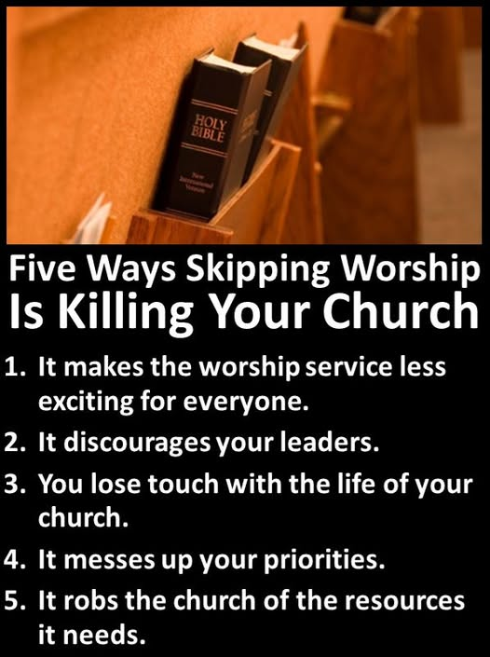

Slide 27
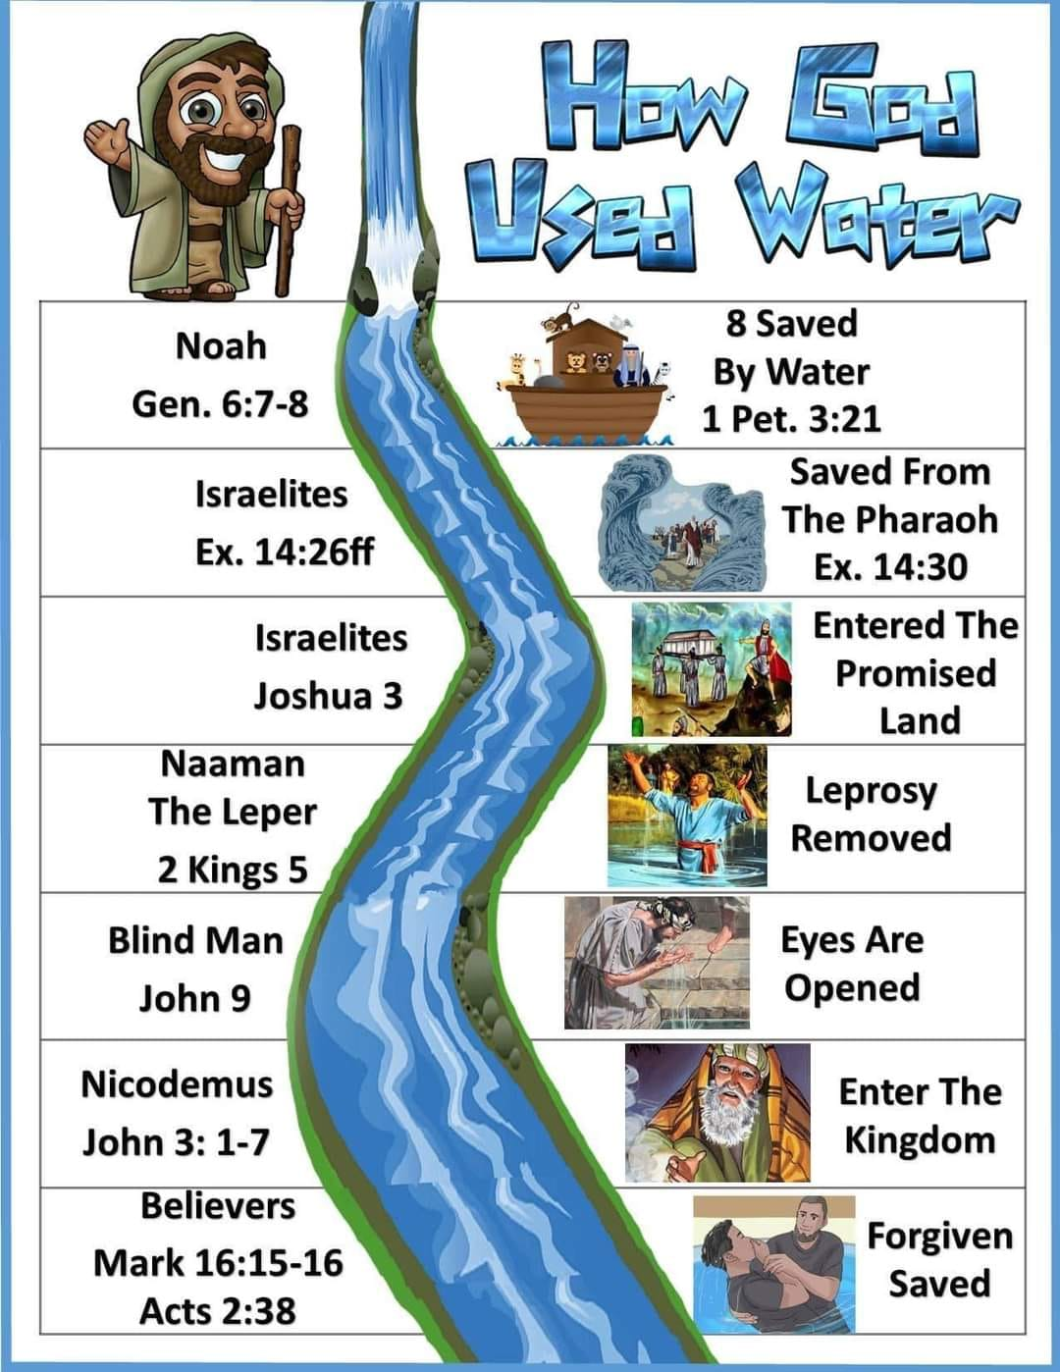
Do You Know The Church That Jesus Built?
Know how to get into the church ?

Slide 28
