Slide 1
Welcome to our services
New Lebanon Church of Christ
We are Simply Christians.
Our Emphasis is Spiritual, Not Material or Social.
We are striving to be The Same Church as Described in The New Testament.
Please Come Back Again

Slide 2
Carry A Little Honey
Genesis 43:1 Now the famine was severe in the land. 2 And it came to pass, when they had eaten up the grain which they had brought from Egypt, that their father said to them, "Go back, buy us a little food.“
3 But Judah spoke to him, saying, "The man solemnly warned us, saying, 'You shall not see my face unless your brother is with you.'"
4 "If you send our brother with us, we will go down and buy you food.

Slide 3
Carry A Little Honey
5 "But if you will not send him, we will not go down; for the man said to us, 'You shall not see my face unless your brother is with you.'"
6 And Israel said, "Why did you deal so wrongfully with me as to tell the man whether you had still another brother?“
7 But they said, "The man asked us pointedly about ourselves and our family, saying, 'Is your father still alive? Have you another brother?' And we told him according to these words. Could we possibly have known that he would say, 'Bring your brother down'?"
8 Then Judah said to Israel his father, "Send the lad with me, and we will arise and go, that we may live and not die, both we and you and also our little ones.

Slide 4
Carry A Little Honey
9 "I myself will be surety for him; from my hand you shall require him. If I do not bring him back to you and set him before you, then let me bear the blame forever.
10 "For if we had not lingered, surely by now we would have returned this second time."
11 And their father Israel said to them, "If it must be so, then do this: Take some of the best fruits of the land in your vessels and carry down a present for the man-a little balm and a little honey, spices and myrrh, pistachio nuts and almonds.
12 "Take double money in your hand, and take back in your hand the money that was returned in the mouth of your sacks; perhaps it was an oversight.

Slide 5
Carry A Little Honey
13 "Take your brother also, and arise, go back to the man.
14 "And may God Almighty give you mercy before the man, that he may release your other brother and Benjamin. If I am bereaved, I am bereaved!"
15 So the men took that present and Benjamin, and they took double money in their hand, and arose and went down to Egypt; and they stood before Joseph.

Slide 6
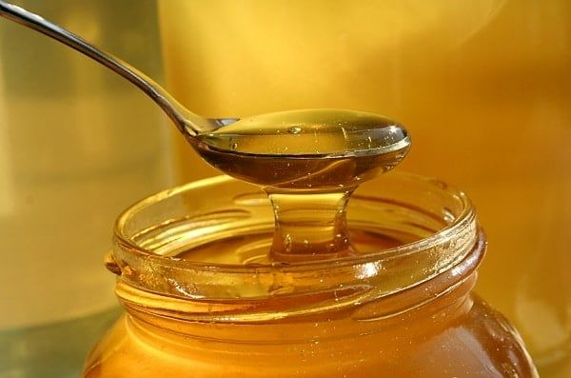
Carry A Little Honey
Genesis 43:11 And their father Israel said to them, "If it must be so, then do this: Take some of the best fruits of the land in your vessels and carry down a present for the man-a little balm and a little honey, spices and myrrh, pistachio nuts and almonds.

Slide 7
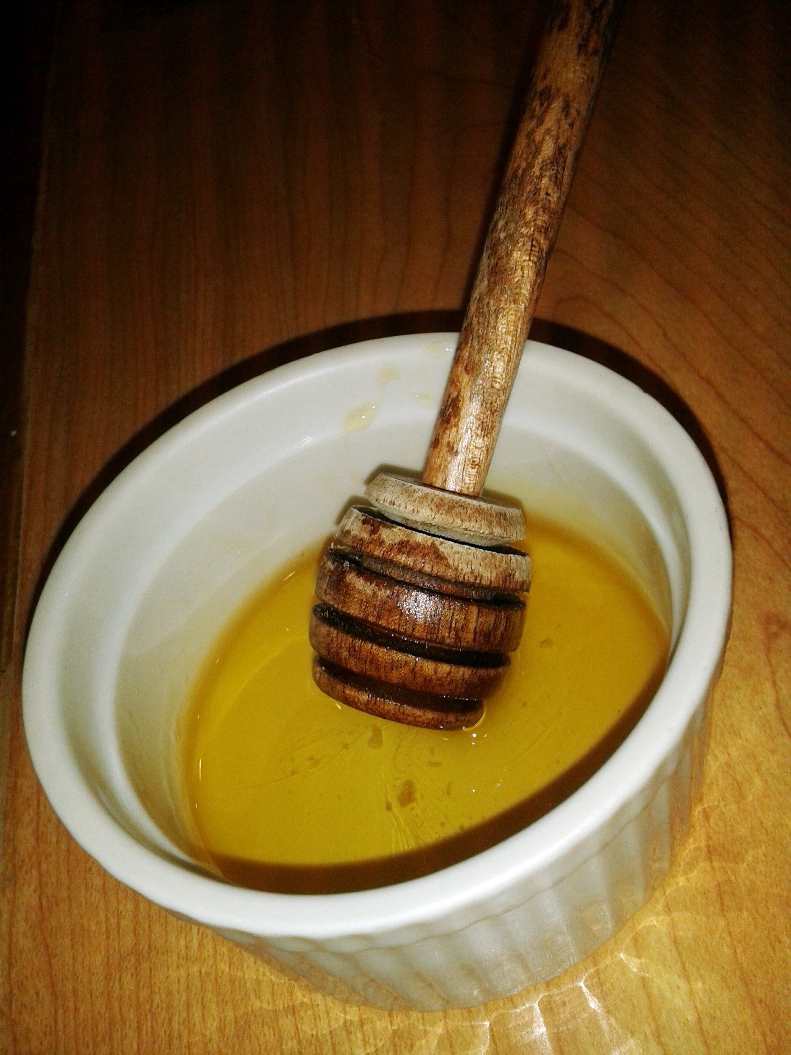
Carry A Little Honey
Jacob said, "Carry a little honey."
That is good advice for us today.
Not literally, but figuratively.
Jacob had been through enough troubles in his life that he learned some lessons about dealing with people. (How about us today?)

Slide 8
Carry A Little Honey
1. Where can we get some honey?
Psalm 19:7 The law of the LORD is perfect, converting the soul; The testimony of the LORD is sure, making wise the simple; 8 The statutes of the LORD are right, rejoicing the heart; The commandment of the LORD is pure, enlightening the eyes;
9 The fear of the LORD is clean, enduring forever; The judgments of the LORD are true and righteous altogether.
10 More to be desired are they than gold, Yea, than much fine gold; Sweeter also than honey and the honeycomb.

Slide 9
Carry A Little Honey
Psalm 119:103 How sweet are Your words to my taste, Sweeter than honey to my mouth!
We get our “honey” from the word of God.
We should have and keep an abundant supply of honey.

Slide 10
Carry A Little Honey
Col. 3:16 Let the word of Christ dwell in you richly in all wisdom,
teaching and admonishing
one another in psalms and hymns and spiritual songs,
singing with grace in your hearts to the Lord.

Slide 11
Carry A Little Honey
1Sam. 14:29 Then said Jonathan, My father hath troubled the land: see, I pray you, how mine eyes have been enlightened, because I tasted a little of this honey.
Sarcasm, ridicule, bitterness, should not be uttered by one professing to follow God.
Knowing his sons as Jacob did, he could well have meant, "Not only take a little honey in your jars, take a little sweetness in your soul. Do not be your usual angry, bitter unpleasant self."

Slide 12
Carry A Little Honey
Some don’t carry honey with them because they don’t spend time in God’s word.
The more time you spend in God’s word, the more honey you will have to carry.

Slide 13
Carry A Little Honey
2. Why should we carry a little honey?
First, do it for your own sake.
It is not enough to be good. Most of us know those who are morally good, but very disagreeable.
They have strength of character, but not beauty of soul.
They are religious, but lack attractiveness and cheerfulness.
We should demonstrate the joy, peace and tranquility of a Christian

Slide 14
Carry A Little Honey
Our peace and tranquility should come from the honey of God. Not from the medicine cabinet in the bathroom.
Maybe if some people opened their bible more often than their pill bottle, they would need fewer pills. (God -1000s years – medicine)
But a person who is a chronic complainer, disillusioned, pessimistic, needs to seriously examine his or her life.

Slide 15
Carry A Little Honey
There is enough to make a person sour, somber, cynical, bitter and sad if we dwell on the ingratitude, misunderstanding, misrepresentation, failure and hypocrisy of many people in the brotherhood.
Yet often, the greatest problem is our own attitude, not the objective situation.

Slide 16
Carry A Little Honey
- Attitude -
Two shoe salesmen were sent deep into the jungle to see if they could sell shoes.
The first one said, "Bring me home. Nobody wear shoes where I am."
The other sent the urgent message, "Send me 2000 pair of shoes immediately. Nobody wears shoes where I am."

Slide 17
Carry A Little Honey
Jesus knows better than any of us the dark clouds and shadows of life.
He was a "Man of sorrows and acquainted with grief."
He felt loneliness that none of us have yet felt, deserted by men and forsaken of God.
He was misunderstood, mocked, mistreated and murdered by His enemies.
Yet he said, "My peace I leave with you."
James said, "Count it all joy when ye fall into divers trials" (James 1:2).
This is not only a command, but gives encouragement to "carry a little honey."

Slide 18
Carry A Little Honey
3.We need to do it not only for our own sakes, but for the sake of others.
Since there are so many things in life that bring disappointment, discouragement and despair, many need our help and encouragement.
They need the "honey" of encouragement. Heb. 12:12 Therefore strengthen the hands which hang down, and the feeble knees,

Slide 19
Carry A Little Honey
Paul says in Gal. 6:2, "Bear ye one another's burdens and so fulfill the law of Christ."
Does anybody here have burdens today?
Would You rather I help you carry your burdens with a little honey, or a little vinegar?

Slide 20
Carry A Little Honey
2Cor. 1:3 Blessed be the God and Father of our Lord Jesus Christ, the Father of mercies and God of all comfort,
4 who comforts us in all our tribulation, that we may be able to comfort those who are in any trouble, with the comfort with which we ourselves are comforted by God.
5 For as the sufferings of Christ abound in us, so our consolation also abounds through Christ.

Slide 21
Carry A Little Honey
I need to try to carry a little honey of encouragement and appreciation.
I’m not talking about dealing with sin. I am not talking about compromise.
I am talking about our brothers and sisters that need our help (all of us) and talking about the outsider.
Where have our manners gone???
Please, thank you, I appreciate you,
Neg. thank you- (“no problem”) (It’s my pleasure)

Slide 22
Carry A Little Honey
We need to carry a little honey in the home.
lot
There would be more wonderful things done and fewer problems if we could carry a little honey in the home.
By some strange reason, many of us show less appreciation, courtesy in the home than we do anywhere in life.
Husbands - wives
Parents- children
We need to carry a little honey in the home, in church and social relationships as we recognize good, encourages any effort that is right, show appreciation and praise for even small things.

Slide 23
Carry A Little Honey
How does one learn to do this?
Acts 4:13 gives a clue.
"They took knowledge of them that they had been with Jesus."
Those who are born with a sunny disposition may not need to have credit for being sweet, but those of us who may have a tendency to gripe, complain and find fault may have to work at it harder.

Slide 24
Carry A Little Honey
But we can do it as we live closer to the Lord. The more we really let the life of Christ be manifest in our mortal flesh (2Cor. 4:11) the more we will carry a little honey.
(For we who live are always delivered to death for Jesus' sake, that the life of Jesus also may be manifested in our mortal flesh.)

Slide 25
Carry A Little Honey
1Peter 3:5 For in this manner, in former times, the holy women who trusted in God also adorned themselves, being submissive to their own husbands,
6 as Sarah obeyed Abraham, calling him lord, whose daughters you are if you do good and are not afraid with any terror………..
7 Husbands, likewise, dwell with them with understanding, giving honor to the wife, as to the weaker vessel, and as being heirs together of the grace of life, that your prayers may not be hindered.
8 Finally, all of you be of one mind, having compassion for one another; love as brothers, be tenderhearted, be courteous;

Slide 26
Carry A Little Honey
5. We need to carry a little honey in the church
Eph 4:31 Let all bitterness, wrath, anger, clamor, and evil speaking be put away from you, with all malice.
32 And be kind to one another, tenderhearted, forgiving one another, just as God in Christ forgave you.
5:1 Therefore be imitators of God as dear children.
2 And walk in love, as Christ also has loved us and given Himself for us, an offering and a sacrifice to God for a sweet-smelling aroma.

Slide 27
Carry A Little Honey
Heb. 12:15 looking carefully lest anyone fall short of the grace of God; lest any root of bitterness springing up cause trouble, and by this many become defiled;
"Bitter envying" -- James 3:14 But if you have bitter envy and self-seeking in your hearts, do not boast and lie against the truth.15 This wisdom does not descend from above, but is earthly, sensual, demonic.16 For where envy and self-seeking exist, confusion and every evil thing are there.17 But the wisdom that is from above is first pure, then peaceable, gentle, willing to yield, full of mercy and good fruits, without partiality and without hypocrisy.

Slide 28
Carry A Little Honey
1John 4: 20 – 21 If someone says, "I love God," and hates his brother, he is a liar; for he who does not love his brother whom he has seen, how can he love God whom he has not seen? 21 And this commandment we have from Him: that he who loves God must love his brother also.

Slide 29
Carry A Little Honey
6. We need to carry a little honey in the world.
There are some people that just aren’t fun to be around. --- About as much fun as going to the dentist to have a root canal.
We want to make sure we are not one of those people.
How are we going to be a POSITIVE influence in the world if our countenance, our speech, and our behavior is anything less than Christ-like.

Slide 30
Carry A Little Honey
Jacob’s advice to his sons to carry a little honey was good advice.
It’s good advice for us also, to carry a little honey.
What is honey? The word of God.
We don’t carry it like we carry our bible.
We carry it in our life:
Our attitude
Our speech
Our countenance
Our actions

Slide 31
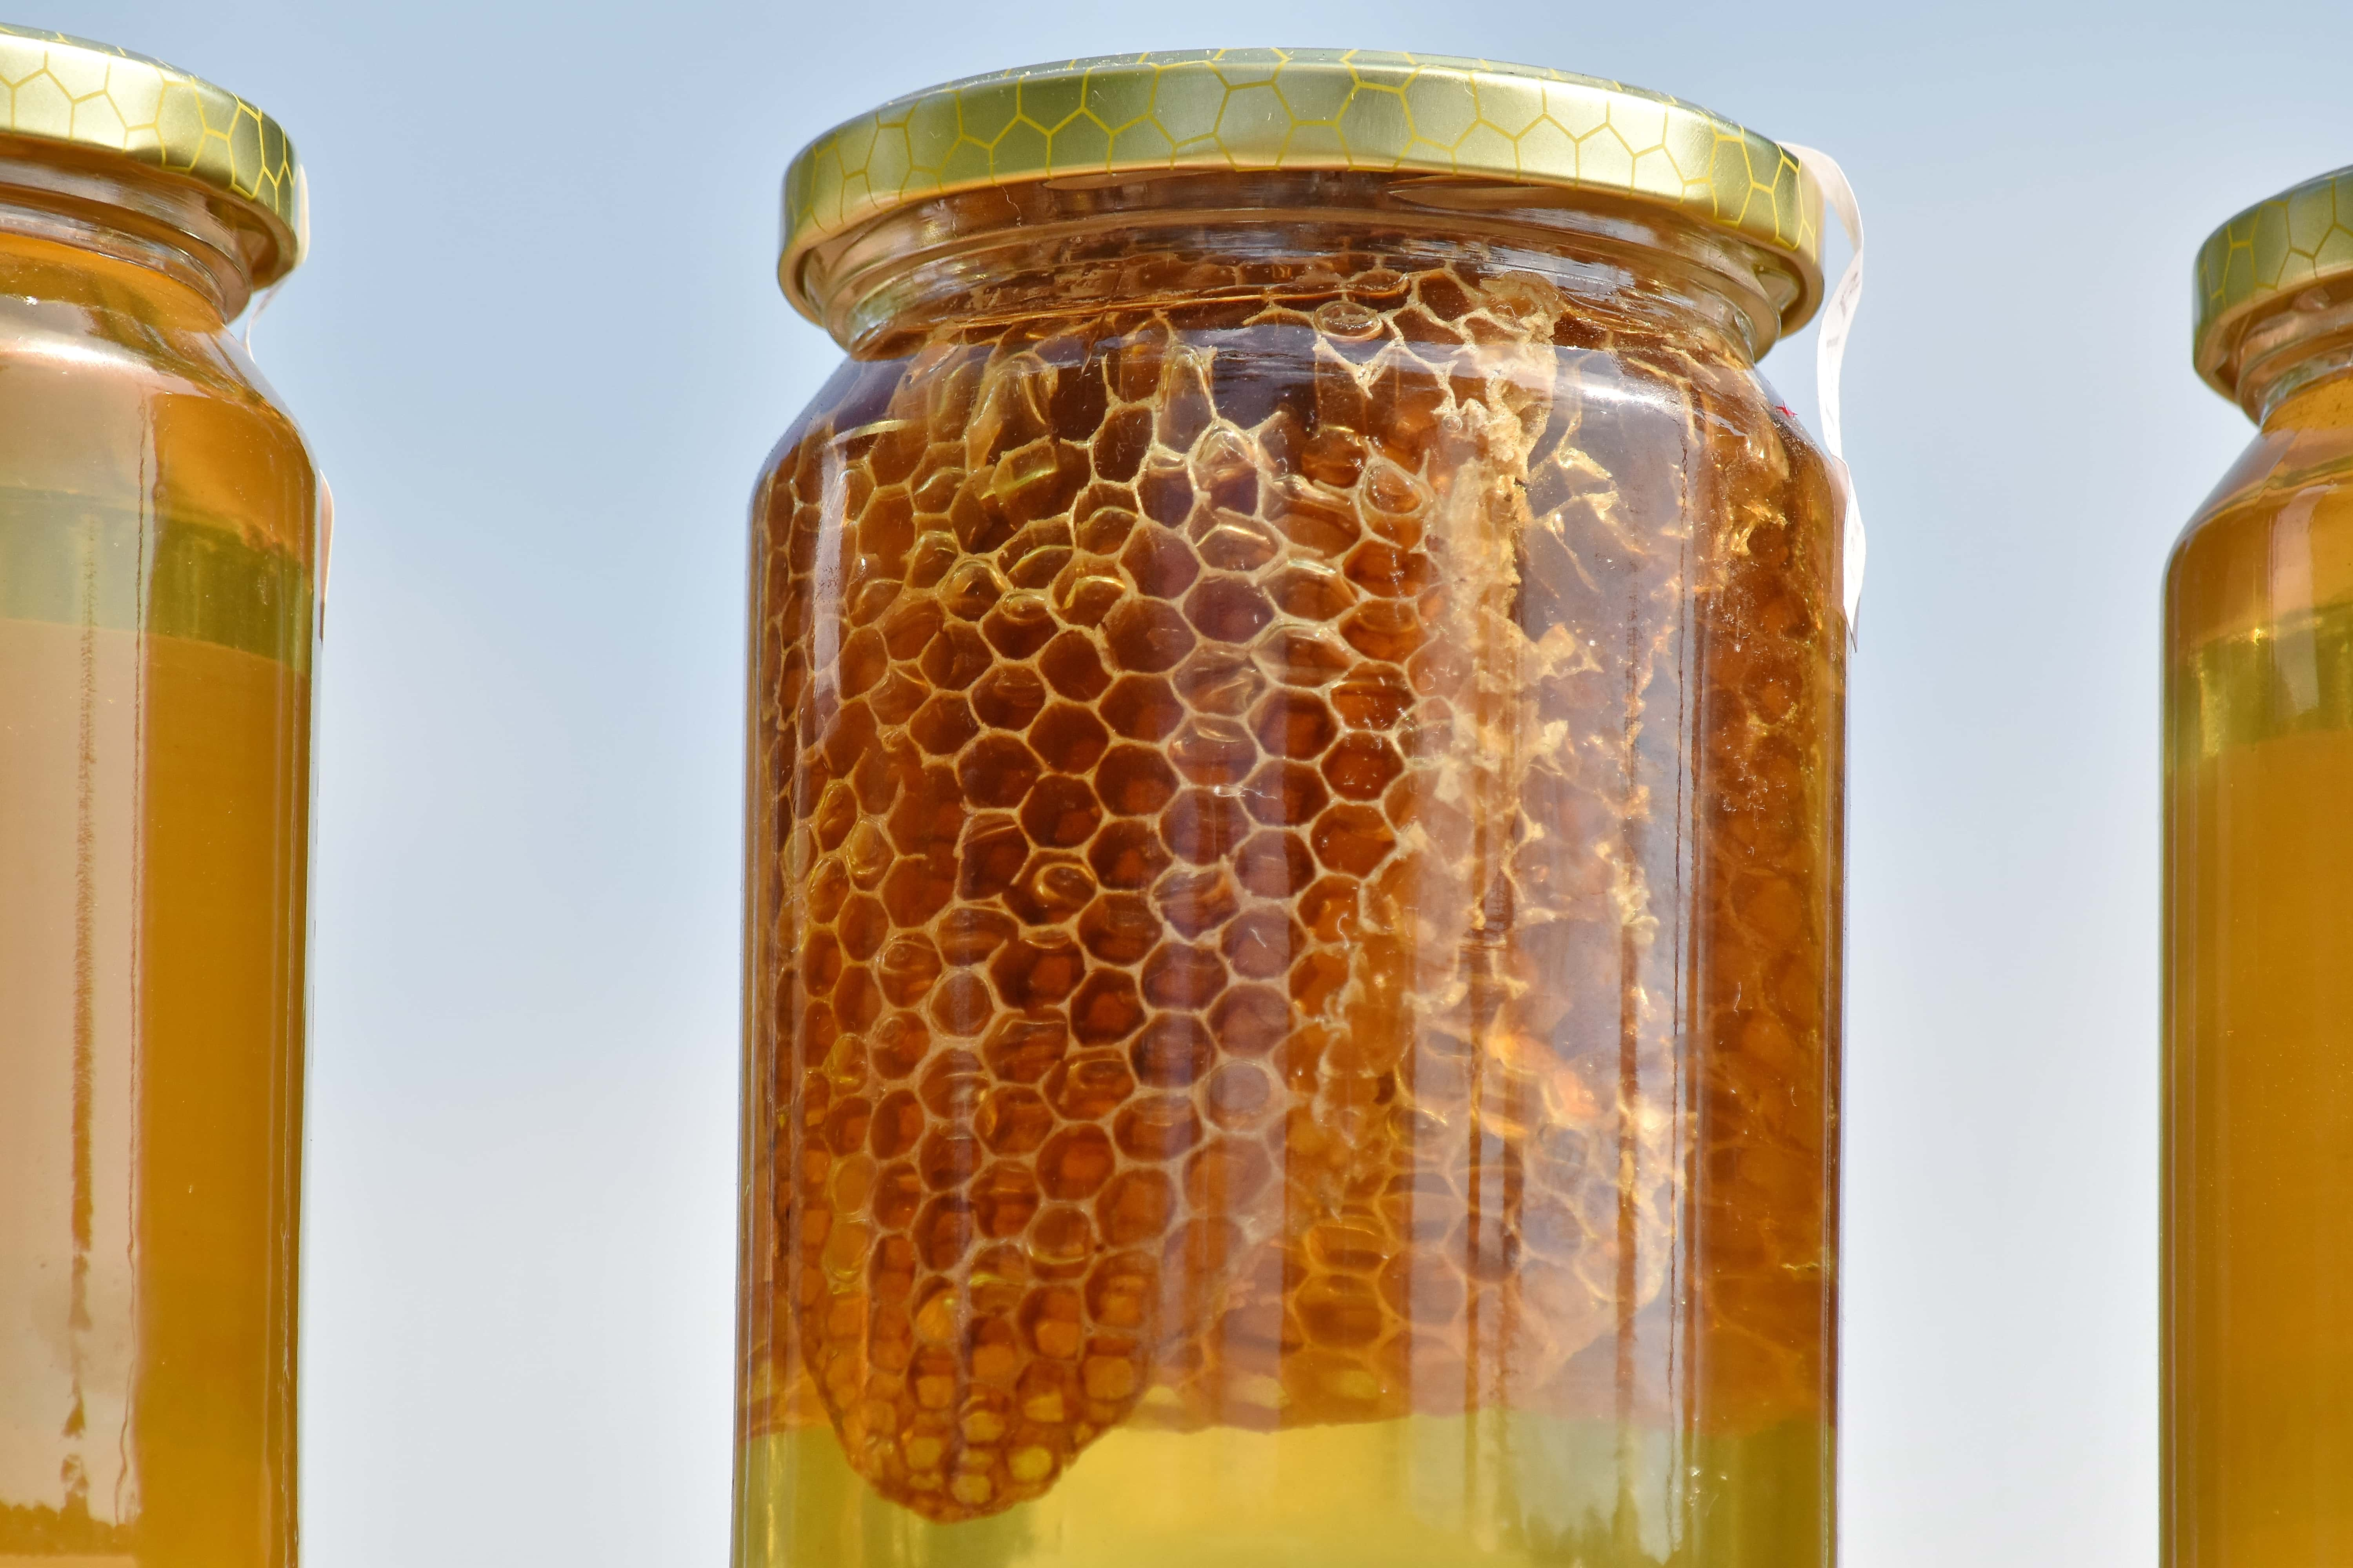
Carry A Little Honey
We need to carry it for ourselves.
We need to carry some for others.
We need to carry it in our home.
We need to carry it in the church.
We need to carry it in the world.

