Slide 1
Welcome to our services
New Lebanon Church of Christ
We are Simply Christians.
Our Emphasis is Spiritual, Not Material or Social.
We are striving to be The Same Church as Described in The New Testament.
Please Come Back Again

Slide 2
The Power of Purity
2Kings 23:25 Now before him there was no king like him, who turned to the LORD with all his heart, with all his soul, and with all his might, according to all the Law of Moses; nor after him did any arise like him.

Slide 3
The Power of Purity

Slide 5
Divided Kingdom
39 Kings
Northern – 10 tribes
Southern – 2 tribes
KINGS OF JUDAH
Rehoboam
Abijah
Asa
Jehoshaphat
Jehoram
Ahaziah
Athaliah
Joash
Amaziah
Uzziah
Jotham
Ahaz
Hezekiah
Manasseh
Amon
Josiah
Jehoahaz
Jehoiakim
Jehoiachin
Zedekiah
KINGS OF ISRAEL
Jeroboam 975-954
Nadab 954-953
Baasha 953-930 Elah 930-929
Zimri 929
Omri 929-918
Ahab 918-897
Ahaziah 897-896
Joram 896-884
Jehu 884-856
Jehoahaz 856-841
Joash 841-825
Jeroboam II 825-784
Zechariah 773
Shallum 772
Menahem 772-762
Pekahiah 762-760
Pekah 760-740
Hoshea 730-721
Judah and Benjamin
975-958
958-955
955-914
914-892
892-884
885
885-878
878-839
839-810
810-758
758-742
742-726
726-698
698-643
643-641
641-610
610
610-599
599
599-588
Falls to
Assyrians
722 BC
Falls to
Babylon
586 BC
538 BC
Cyrus edict allows
Jews to return to
Jerusalem

Slide 7
The Power of Purity
2Kings 23:1 Now the king sent them to gather all the elders of Judah and Jerusalem to him. 2 The king went up to the house of the LORD with all the men of Judah, and with him all the inhabitants of Jerusalem-the priests and the prophets and all the people, both small and great. And he read in their hearing all the words of the Book of the Covenant which had been found in the house of the LORD.

Slide 8
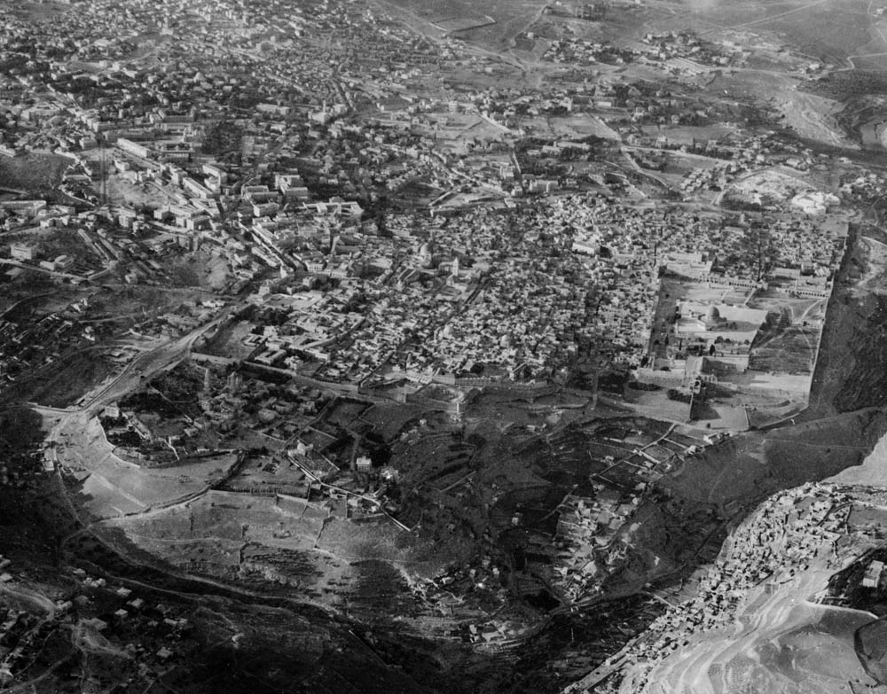
The king went up to the house of Yahweh with all the men of Judah and . . . Jerusalem
Location of temple
Area of Josiah’s palace
Western Hill
Central Valley
City of David
Kidron Valley
Hinnom Valley
Jerusalem in 1931 (aerial view from the south)
23:2
Notes:
This American Colony photo was taken in 1931, prior to the heavy modern expansion of the city. The late afternoon light also brings the various valleys into high relief, making it easier to see the topography of the area. The yellow dotted line indicates the approximate extent of the city in the days of Josiah.
mat15844

Slide 9
The Power of Purity
2Kings 23:3
3 Then the king stood by a pillar and made a covenant before the LORD, to follow the LORD and to keep His commandments and His testimonies and His statutes, with all his heart and all his soul, to perform the words of this covenant that were written in this book. And all the people took a stand for the covenant.

Slide 10
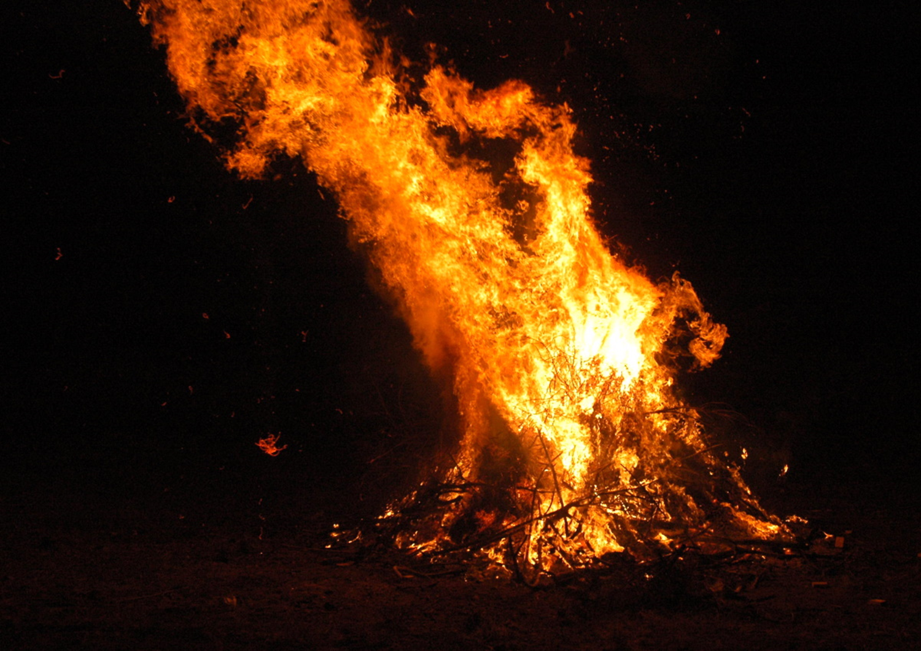
The Power of Purity
2Kings 23:4 And the king commanded Hilkiah the high priest, the priests of the second order, and the doorkeepers, to bring out of the temple of the LORD all the articles that were made for Baal, for Asherah, and for all the host of heaven; and he burned them outside Jerusalem in the fields of Kidron, and carried their ashes to Bethel.

Slide 11
The Power of Purity
V4 Get rid of physical objects
Stop and think about any physical objects that might be stumbling blocks to us or our family. When your possessions prevent you from living righteously and serving God, it’s time to get rid of them. Don’t let the financial price of the object keep you from getting rid of it. What is the value of your soul??? The price for hanging onto these objects may be your SOUL.

Slide 12
The Power of Purity
Just like Josiah, we must remove those things around us that trigger or enable us to sin.
The primary focus on cleaning our house should be to restore purity to your heart.

Slide 13
The Power of Purity
2Kings 23:5 Then he removed the idolatrous priests whom the kings of Judah had ordained to burn incense on the high places in the cities of Judah and in the places all around Jerusalem, and those who burned incense to Baal, to the sun, to the moon, to the constellations, and to all the host of heaven. 6 And he brought out the wooden image from the house of the LORD, to the Brook Kidron outside Jerusalem, burned it at the Brook Kidron and ground it to ashes, and threw its ashes on the graves of the common people.

Slide 14
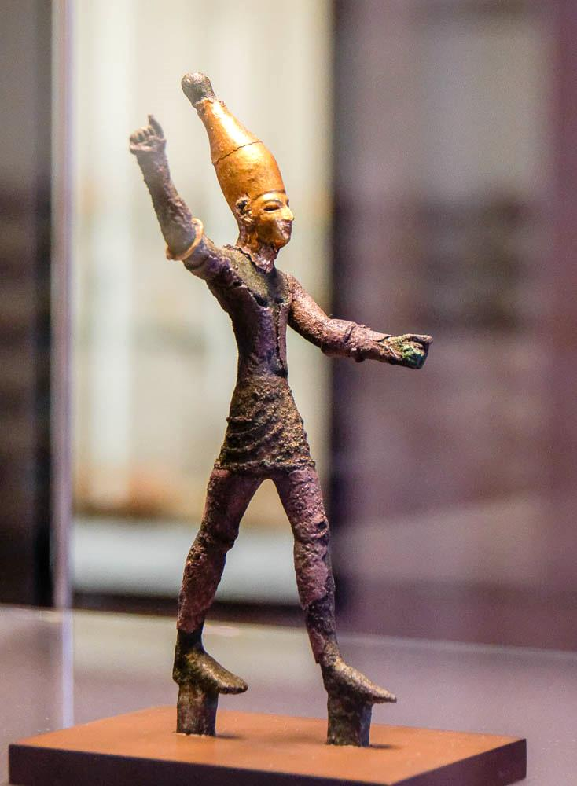
The Power of Purity
2Kings 23: 5
V5 Get rid of people that promote sin
“Oh I can’t tell somebody that I can’t be friends with them anymore.” It may be time to end relationships that are holding you back from zealously walking with God. You cannot allow people to drag you down and stop walking with God.
It is important to create boundaries with coworkers and family members who hinder you from your walk with God.

Slide 15
The Power of Purity
2Kings 23:7 Then he tore down the ritual booths of the perverted persons that were in the house of the LORD, where the women wove hangings for the wooden image.
8 And he brought all the priests from the cities of Judah, and defiled the high places where the priests had burned incense, from Geba to Beersheba; also he broke down the high places at the gates which were at the entrance of the Gate of Joshua the governor of the city, which were to the left of the city gate.

Slide 16
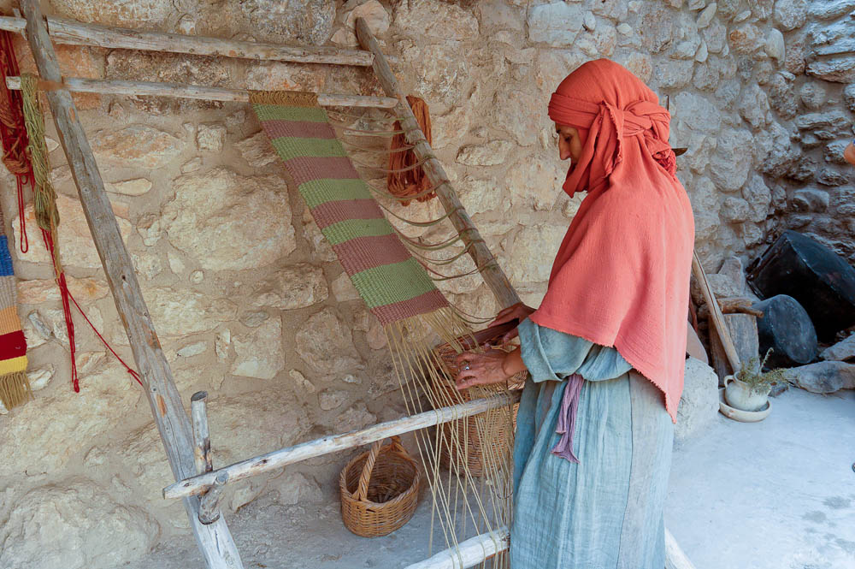
He tore down the houses . . . where the women wove hangings for Asherah
Woman weaving at Nazareth Village
23:7
Notes:
tb102704385

Slide 17
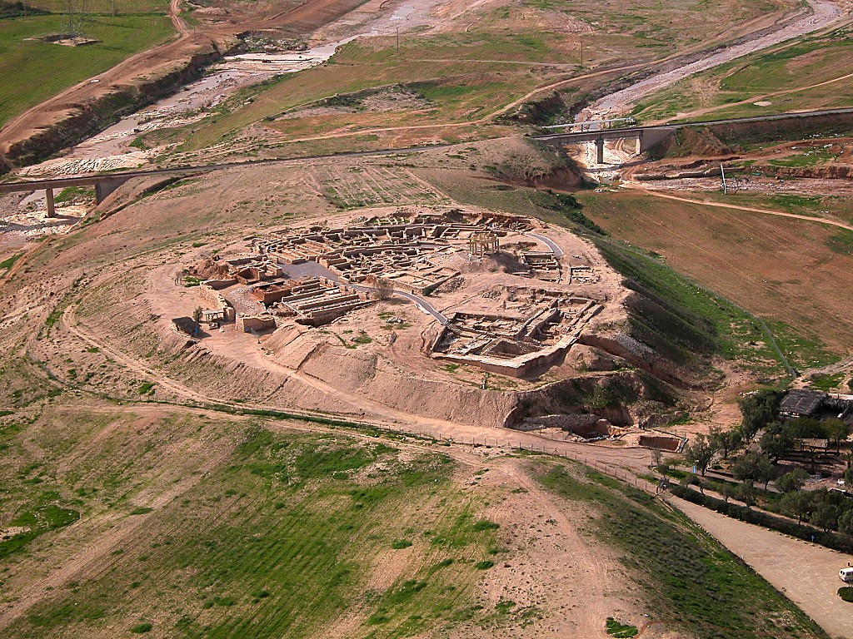
He defiled the high places where the priests had burned sacrifices, from Geba to Beersheba
Beersheba, modern Tel Sheva (aerial view from the east)
23:8
Notes:
Beersheba was always listed as the southern border city, “from Dan to Beersheba.” This is recorded nine times in describing all of Israel, beginning in Judges 20. Beersheba was within the tribal allotment given to Judah, but the city belonged to Simeon (Josh 15:28; 1 Chr 4:28; Josh 19:2; 1 Chr 4:28).
tb010703524

Slide 18
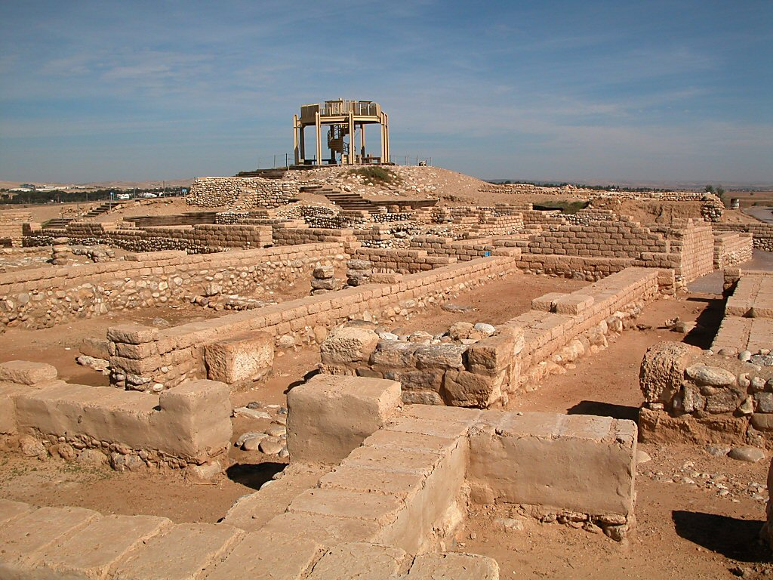
He defiled the high places where the priests had burned sacrifices, from Geba to Beersheba
Excavations at Beersheba
23:8
Notes:
Excavations at Beersheba were carried out by Yohanan Aharoni in 1969–1975, and by Ze’ev Herzog in 1976. Reconstruction began in 1990. After the various levels were unearthed, dated, and characterized, emphasis was placed upon revealed broad areas of the lower city (level II) which serves as a prototype for the study of planned Israelite cities. Level II dates to the 8th century BC.
There are 15 levels in Beersheba, beginning with the Chalcolithic and then skipping to the Iron Age, around 1200 BC. The occupation ends in the Early Arabic period in the 7th–8th centuries AD. There are nine Iron Age strata, the earliest of which dates to 1100 BC. Beersheba was a walled city from the 10th century. Stratum VII (ca. 1000 BC) shows that the buildings (typically four-room variations) were built in a circle around the perimeter of the mound, with the rear walls connected together and facing outward, forming a basic security system. The houses opened inward where flocks and herds might be penned in at night. Stratum VI indicates a decline in the buildings in the 10th century.
Stratum V reveals a leveling operation of the tell, and the construction of a solid 13-foot-thick (4-m), offset-inset city wall. Stone foundations were found preserved in some places up to 5 feet (1.5 m) high. A mud brick superstructure was built on top. The wall was protected by a 20-degree glacis. The fosse was dug 10–13 feet (3–4 m) deep at the bottom of the glacis system. There is a debate on the date of this stratum. Stratum IV was short-lived. Aharoni dated it to the middle of Asa’s reign (ca. 885 BC). The last major city consisted of two phases, Stratum III–II. The tell was last occupied in the Early Arabic period.
tb110702430

Slide 19
The Power of Purity
2Kings 23:9 Nevertheless the priests of the high places did not come up to the altar of the LORD in Jerusalem, but they ate unleavened bread among their brethren. 10 And he defiled Topheth, which is in the Valley of the Son of Hinnom, that no man might make his son or his daughter pass through the fire to Molech.
V7-10 Get rid of places where you might sin.
If you have a drinking problem, stay away from bars and restaurants that serve alcohol. Stay away

Slide 20
The Power of Purity
Psalm 1:1 Blessed is the man that walketh not in the counsel of the ungodly, nor stands in the way of sinners, nor sits in the seat of the scornful.
2 But his delight is in the law of the LORD; and in his law doth he meditate day and night.
Josiah knew that the high places had to be torn down for the people to leave there sin. You also need to be aware when certain places and situations are dangerous for you. If girls night out is constantly full of gossip, skip it. If you lose control of your temper at sporting events, don’t go. Stop going to places that are bad for your heart. We must PURIFY our heart.

Slide 21
The Power of Purity
2Kings 23:10 And he defiled Topheth, which is in the Valley of the Son of Hinnom, that no man might make his son or his daughter pass through the fire to Molech.
11 Then he removed the horses that the kings of Judah had dedicated to the sun, at the entrance to the house of the LORD, by the chamber of Nathan-Melech, the officer who was in the court; and he burned the chariots of the sun with fire.

Slide 22
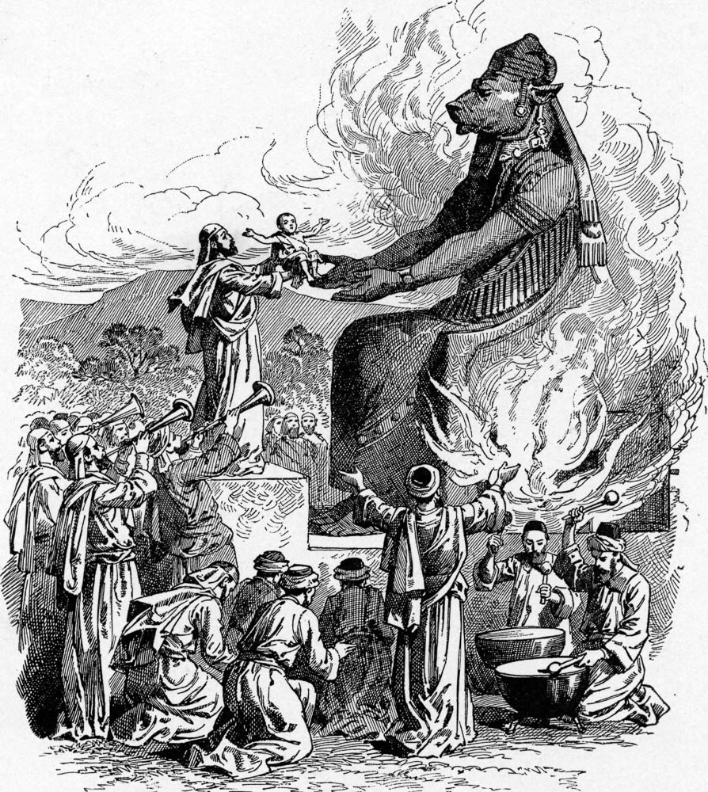
That no man might make his son or his daughter to pass through the fire to Molech
Offering to Molech, from Charles Foster’s Bible Pictures, 1897
23:10
Notes:
Virtually nothing is known of the manner in which offerings to Molech were made. This imaginative image comes from Charles Foster’s Bible Pictures and What They Teach Us, 1897.
fbp074

Slide 23
The king went up to the house of Yahweh with all the men of Judah and . . . Jerusalem
Location of temple
Area of Josiah’s palace
Western Hill
Central Valley
City of David
Kidron Valley
Hinnom Valley
Jerusalem in 1931 (aerial view from the south)
23:2
Notes:
This American Colony photo was taken in 1931, prior to the heavy modern expansion of the city. The late afternoon light also brings the various valleys into high relief, making it easier to see the topography of the area. The yellow dotted line indicates the approximate extent of the city in the days of Josiah.
mat15844

Slide 24
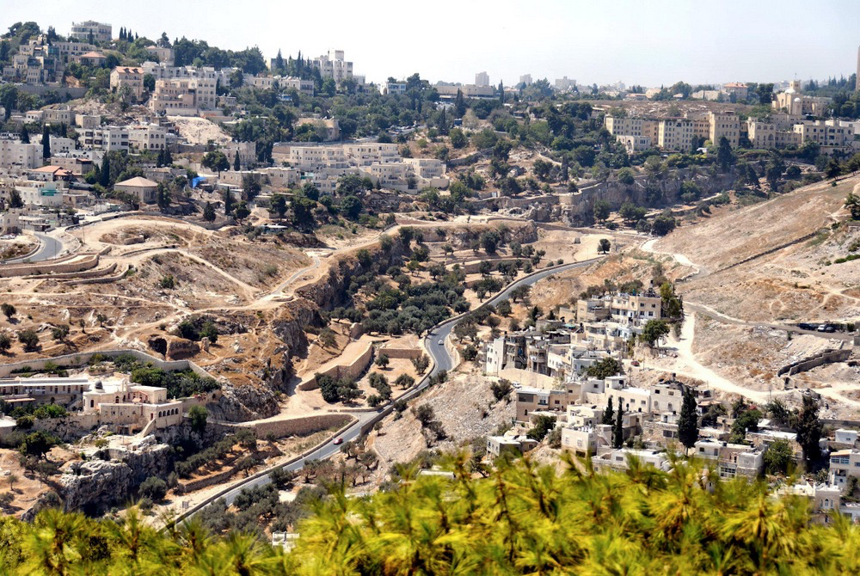
And he defiled Topheth, which is in the valley of Ben-Hinnom
Hinnom Valley (from the east)
23:10
Notes:
The meaning of the word Topheth (Heb. תֹּפֶת) is unclear. One possibility is that it comes from Aramaic/Syriac tephaya (תְּפָיָא), referring to a fireplace or cooking hearth (so HALOT), and that the word has been repointed with the vowels of the word “shame” (Heb. bosheth, בּשֶׁת; Schmitz 1992: 601). Such an understanding seems compatible with the connection of the word to human sacrifice by means of fire.
The Topheth to Molech was located in the Valley of (Ben-)Hinnom outside of the city of Jerusalem. While there remains some debate among scholars, most agree that the cult of Molech in Jerusalem and across the Mediterranean involved the actual human sacrifice of infants (either male or female—cf. 2 Kgs 23:10), and that in the case of Judah this occurred at a place known as the Topheth (2 Kgs 23:10; Jer 7:31-32; 19:6,11-14).
Reference:
Schmitz, Philip C.
1992 Tophet. Anchor Bible Dictionary, vol. 6, ed. D. N. Freedman. New York: Doubleday.
tb091306311

Slide 25
The Power of Purity
V11 Get rid of the passing benefits
The fact that Josiah destroyed the horses and chariots is noteworthy. They were valuable assets for any nation. Josiah could have repurposed them for his own use but instead he destroyed them. Why? Because he put his faith in God, not horses,

Slide 26
The Power of Purity
Deut. 17:16 "But he shall not multiply horses for himself, nor cause the people to return to Egypt to multiply horses, for the LORD has said to you, 'You shall not return that way again.'
( 17 "Neither shall he multiply wives for himself, lest his heart turn away; nor shall he greatly multiply silver and gold for himself.) - Josiah did not want anything to corrupt the nation. You must remember that no matter what benefit or pleasure Satan promises from sin, Sin always leads to death. Get rid of the things that draw you away from God.

Slide 27
There will always be some things to sacrifice when you clean your spiritual house and prepare for greater zeal.
But, there is nothing you would let go of in this life that compares to what you gain in Jesus Christ.

Slide 28
The Power of Purity
Mark 10:29 So Jesus answered and said, "Assuredly, I say to you, there is no one who has left house or brothers or sisters or father or mother or wife or children or lands, for My sake and the gospel's,
30 "who shall not receive a hundredfold now in this time--houses and brothers and sisters and mothers and children and lands, with persecutions--and in the age to come, eternal life.

Slide 29
The Power of Purity
2Kings 23:12 The altars that were on the roof, the upper chamber of Ahaz, which the kings of Judah had made, and the altars which Manasseh had made in the two courts of the house of the LORD, the king broke down and pulverized there, and threw their dust into the Brook Kidron.

Slide 30
The Power of Purity
V12 Get rid of the pieces forever
V12 shows that Josiah was never going back. The altars were smashed into dust and tossed into the brook of Kidron to sail away and never return. Your resolve to “abhor what is evil and cling to what is good” should be absolute (Rom.12:9). Any impurity that stifles your zeal, no matter how small, should be cast off so you are prepared to follow the Lord.

Slide 31
The Power of Purity
2Kings 23:21 Then the king commanded all the people, saying, "Keep the Passover to the LORD your God, as it is written in this Book of the Covenant." 22 Such a Passover surely had never been held since the days of the judges who judged Israel, nor in all the days of the kings of Israel and the kings of Judah.
23 But in the eighteenth year of King Josiah this Passover was held before the LORD in Jerusalem.

Slide 32
The Power of Purity
V 21-23 Replace them with proper practices
Preparing for purity and zeal is not the end of having fun. In fact, it is just the beginning of the most meaningful and enjoyable life that you can have. When Josiah removed the negative influences from Jerusalem, he quickly filled the void with godliness. (Observed the Passover). There are many good deeds you can now loving engage in when you are no longer smothered by sin in your life.

Slide 33
The Power of Purity
When you are seeking to incorporate proper things, pay special attention to the people you surround yourself with.
By observing the Passover, Josiah was able to bring many zealous servants of God who had previously been isolated from one another.
The encouragement of worshipping God side by side with those who have a common zeal for the Lord is extremely valuable.

Slide 34
The Power of Purity
v4 Get rid of physical objects
v5 Get rid of people that promote sin
v11 Get rid of the passing benefits
v12 Get rid of the pieces forever
v21-23 Replace them with proper practices

Slide 35
The Power of Purity
Preparing your environment removes many obstructions to your purity and zeal so that your spiritual fire is not extinguished.
The more you can purify now, the more intense your fire can grow in the future.

Slide 36
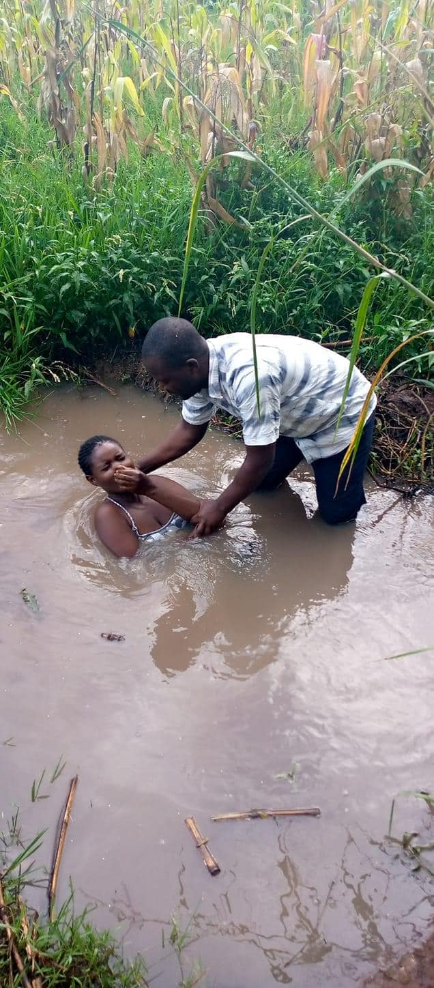
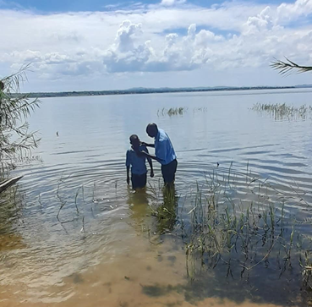
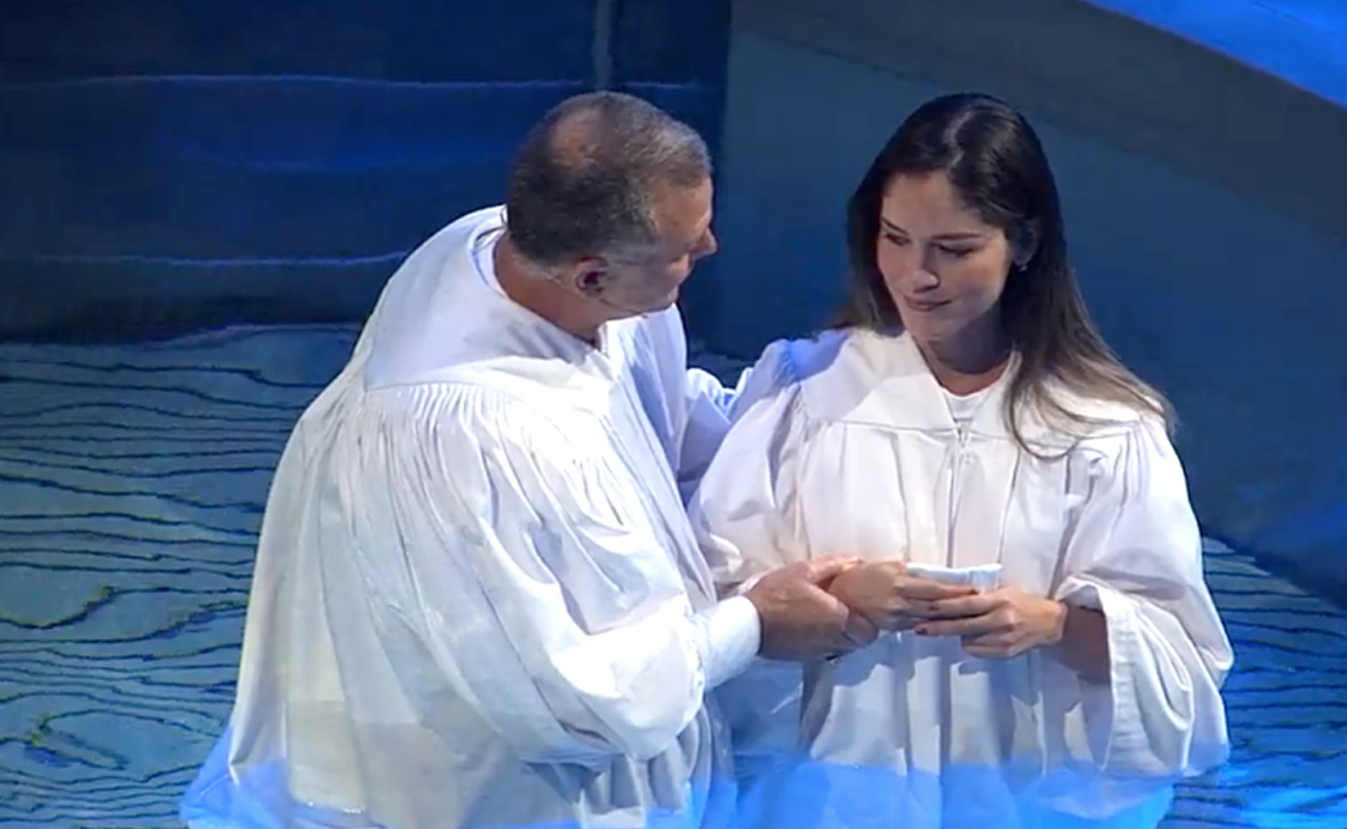
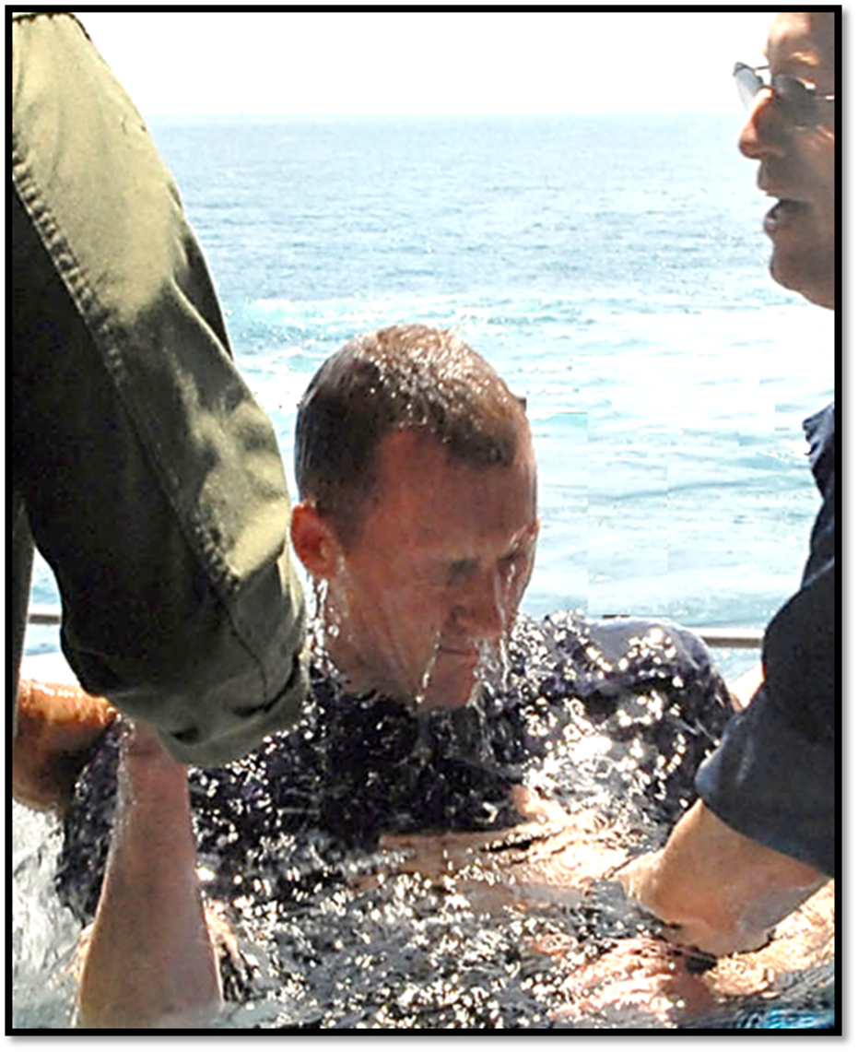
Acts 22:16
'And now why are you waiting? Arise and be baptized, and wash away your sins, calling on the name of the Lord.'

