Slide 1
Welcome to our services
New Lebanon Church of Christ
We are Simply Christians.
Our Emphasis is Spiritual, Not Material or Social.
We are striving to be The Same Church as Described in The New Testament.
Please Come Back Again

Slide 2
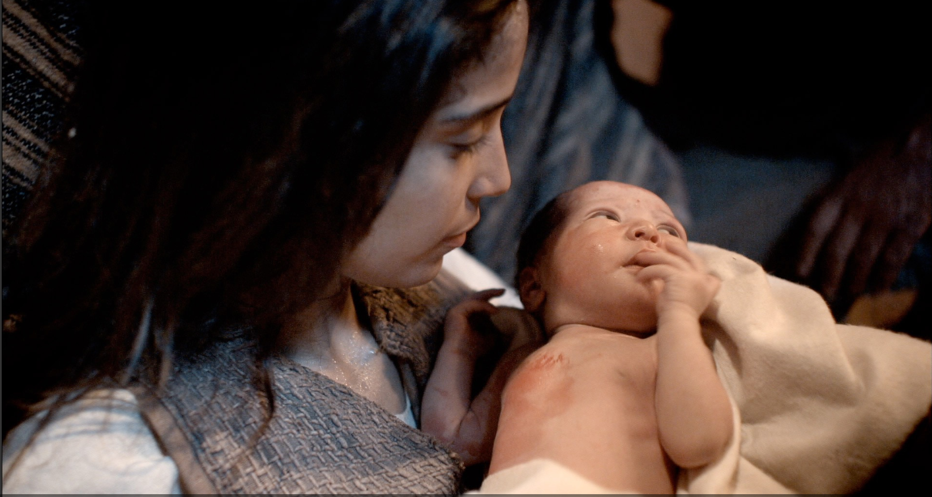
For Unto Us a Child Is Born. Isaiah 9
Isaiah 9:6 For unto us a Child is born, Unto us a Son is given; And the government will be upon His shoulder. And His name will be called Wonderful, Counselor, Mighty God, Everlasting Father, Prince of Peace.

Slide 3
For Unto Us a Child Is Born. Isaiah 9

Slide 4
For Unto Us a Child Is Born. Isaiah 9
Isaiah 9:1 Nevertheless the gloom will not be upon her who is distressed, As when at first He lightly esteemed The land of Zebulun and the land of Naphtali, And afterward more heavily oppressed her, By the way of the sea, beyond the Jordan, In Galilee of the Gentiles.
2 The people who walked in darkness Have seen a great light; Those who dwelt in the land of the shadow of death, Upon them a light has shined.
3 You have multiplied the nation And increased its joy; They rejoice before You According to the joy of harvest, As men rejoice when they divide the spoil.

Slide 5
For Unto Us a Child Is Born. Isaiah 9
4 For You have broken the yoke of his burden And the staff of his shoulder, The rod of his oppressor, As in the day of Midian.
5 For every warrior's sandal from the noisy battle, And garments rolled in blood, Will be used for burning and fuel of fire.

Slide 6
For Unto Us a Child Is Born. Isaiah 9
6 For unto us a Child is born, Unto us a Son is given; And the government will be upon His shoulder. And His name will be called Wonderful, Counselor, Mighty God, Everlasting Father, Prince of Peace.
7 Of the increase of His government and peace There will be no end, Upon the throne of David and over His kingdom, To order it and establish it with judgment and justice From that time forward, even forever. The zeal of the LORD of hosts will perform this.

Slide 7
For Unto Us a Child Is Born. Isaiah 9
This was not a prophecy of the immediate future, but it is a prophecy of the “latter” times, and therefore, in the Old Testament related to the times of the Messiah.
The pain that came upon Zebulun and Naphtali in the pre-Christian era was due partially to their physical location on the northern border of the Promised land. They were the first to experience repeated invasions; and Isaiah’s prophecy here shows that the treatment of the lands of these tribes was worse than that of some of the others, And that they would also be the first to enjoy the benefits of Christ’s kingdom. Look at the passage from Matt. 4:12–16:>>>

Slide 8
For Unto Us a Child Is Born. Isaiah 9
Matt. 4:12 Now when Jesus had heard that John was cast into prison, he departed into Galilee;
13 And leaving Nazareth, he came and dwelt in Capernaum, which is upon the sea coast, in the borders of Zebulun and Naphtali:
14 That it might be fulfilled which was spoken by Esaias the prophet, saying,
15 The land of Zebulun, and the land of Nephtali, by the way of the sea, beyond Jordan, Galilee of the Gentiles;
16 The people which sat in darkness saw great light; and to them which sat in the region and shadow of death light is sprung up.

Slide 10
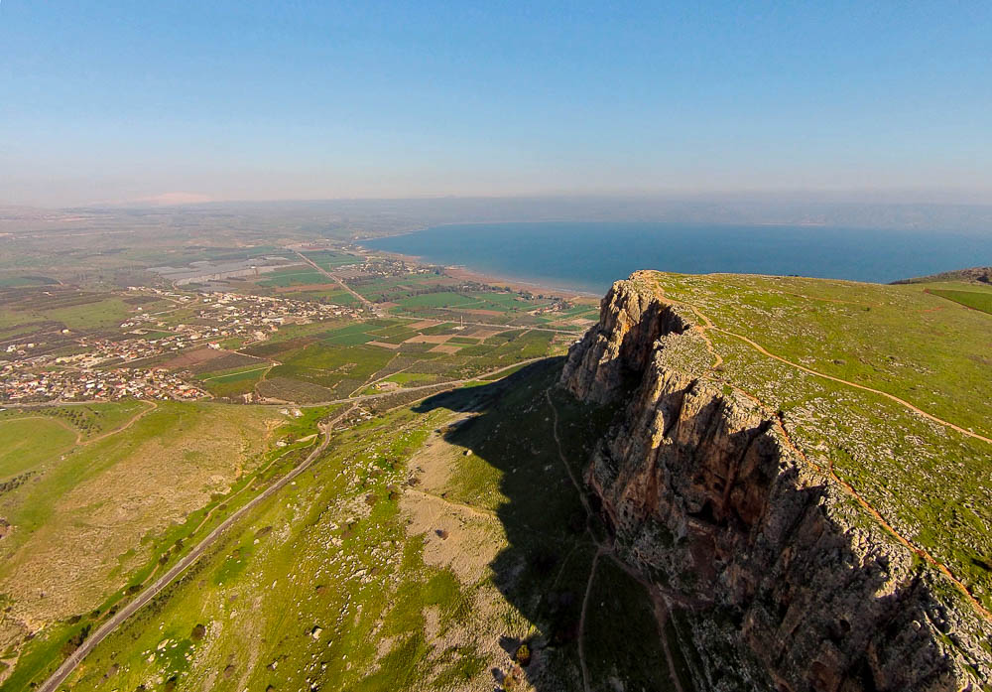
Now when He heard that John had been arrested, He withdrew into Galilee
Arbel cliffs and Sea of Galilee (aerial view from the southwest)
4:12
Notes:
ws011315157

Slide 11
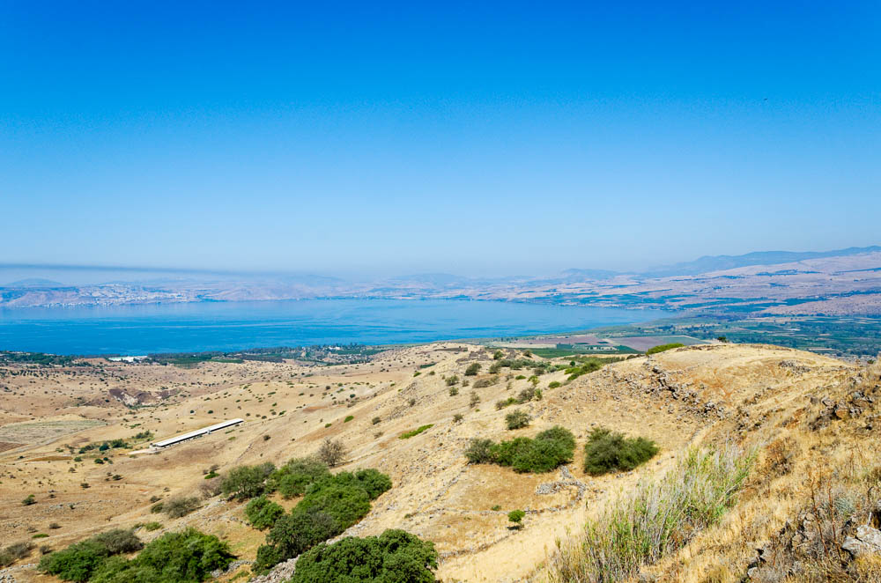
Now when He heard that John had been arrested, He withdrew into Galilee
Sea of Galilee view from Kanaf overview (from the east)
4:12
Notes:
tb053016692

Slide 12
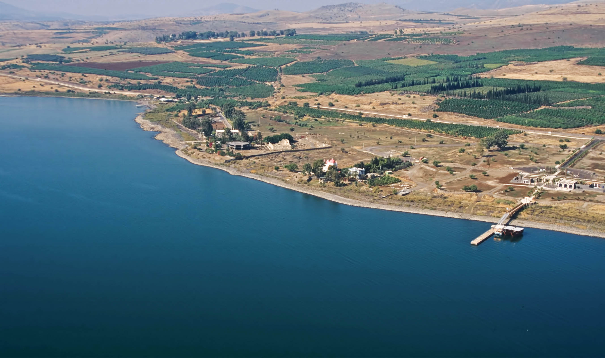
He came and settled in Capernaum, which is by the sea
Capernaum (aerial view from the southeast)
4:13
Notes:
Jesus may have chosen to live in Capernaum because it was close to routes with many travelers. Also, several of His disciples lived there.
tbs115200011

Slide 13
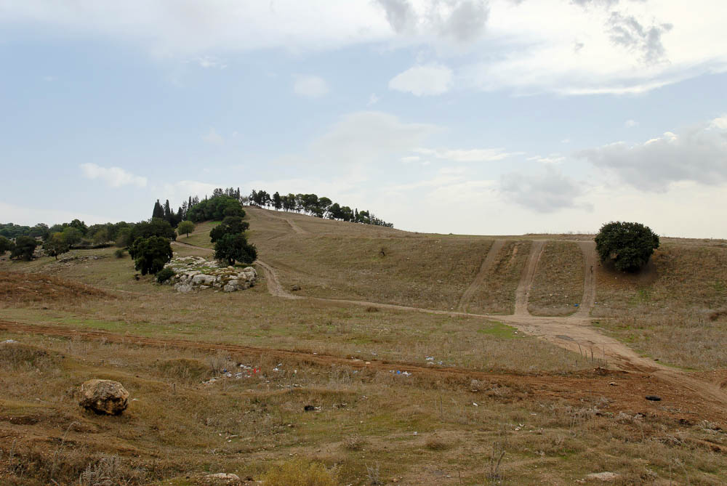
The land of Zebulun
Shimron (from the north)
4:15
Notes:
Shimron was one of the more important cities of Zebulun in the OT period. It is named in the city list for Zebulun in Joshua 19:15.
tb110106537

Slide 14
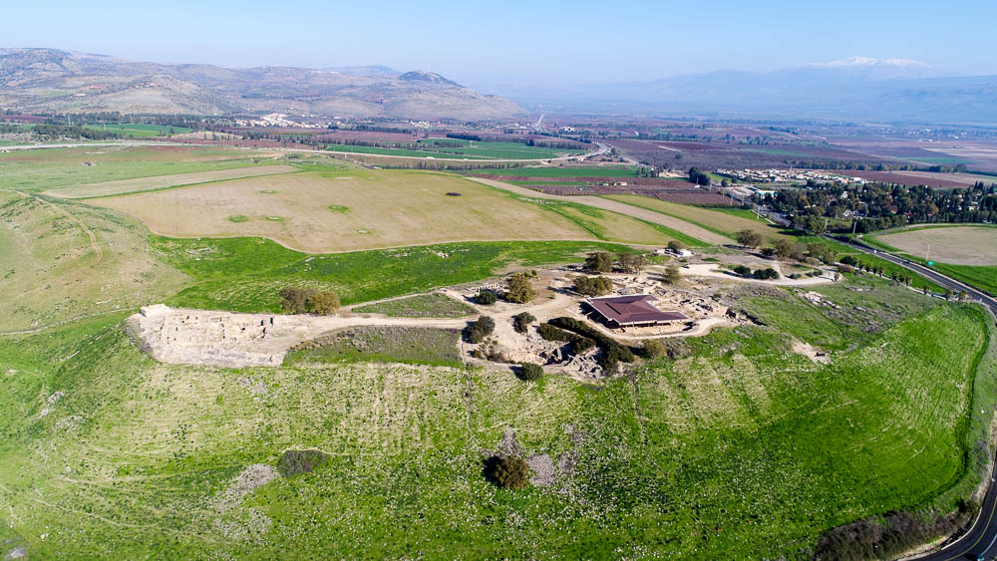
And the land of Naphtali
Hazor and the land of Naphtali (aerial view from the south)
4:15
Notes:
The large city of Hazor was allotted to the tribe of Naphtali. The mountains in the left distance were also part of Naphtali’s territory.
ws012317024

Slide 15
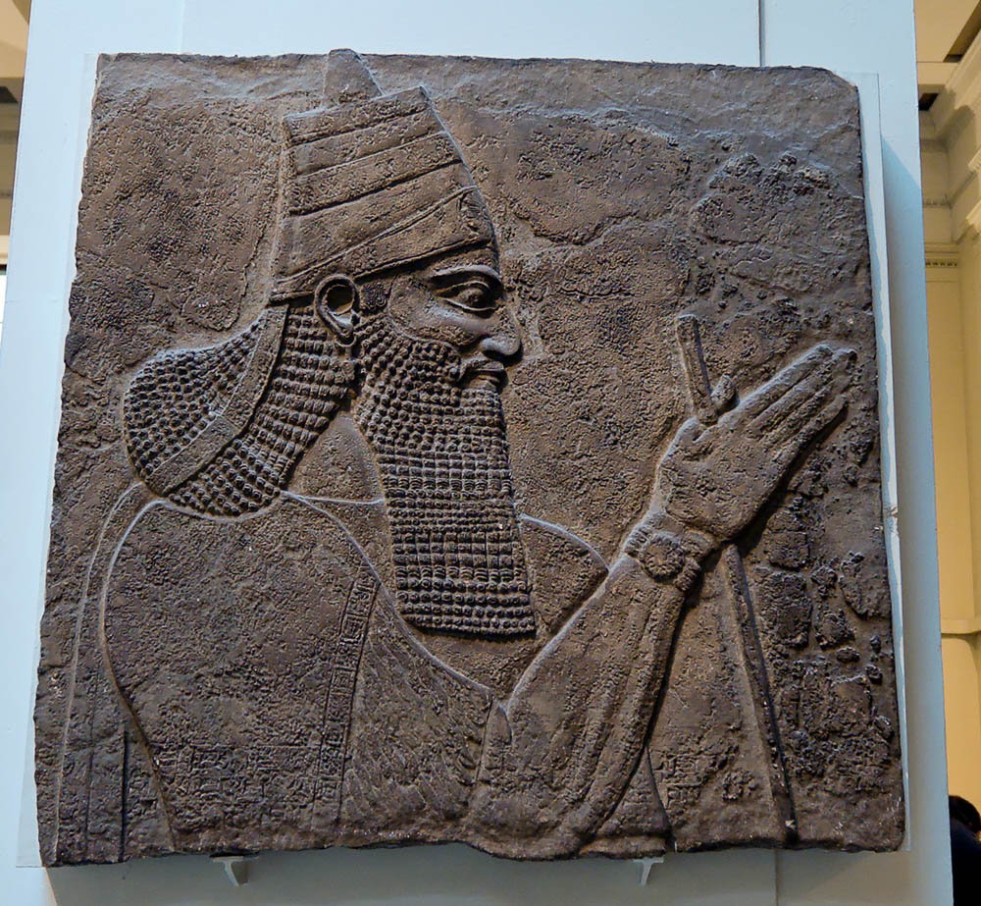
The people who sit in darkness have seen a great light
Relief of Tiglath-pileser III, conqueror of Galilee in the time of Isaiah
4:16
Notes:
Isaiah’s prophecy spoke of the hope that was to come to the land that had recently been destroyed in an invasion by Tiglath-pileser in 733 BC. This relief of the Assyrian king comes from the central palace of Nimrud and dates to 728 BC, a few years after Tiglath-pileser III laid waste to Galilee, as recorded in 2 Kings 15:29. This relief was photographed in the British Museum.
tb112004892

Slide 16
For Unto Us a Child Is Born. Isaiah 9
Isaiah’s prophecy spoke of the hope that was to come to the land that had recently been destroyed in an invasion by Tiglath-pileser in 733 BC.
This relief of the Assyrian king comes from the central palace of Nimrud and dates to 728 BC, a few years after Tiglath-pileser III laid waste to Galilee, as recorded in 2 Kings 15:29. This relief was photographed in the British Museum.

Slide 17
For Unto Us a Child Is Born. Isaiah 9
It was in those very places of Israel which had suffered the most that Christ first came forward to teach in a synagogue, and perform his first miracle in Cana of Galilee. “Thus the light began to shine in the land of Zebulun and Naphtali where the gloom had first settled centuries earlier.”
V6 “And his name shall be called Wonderful, Counselor, Mighty God, Everlasting Father, Prince of Peace …”
The world’s Deliverer is hailed as a child, a son, given by God Himself and destined to achieve eternal redemption for all of the sons of Adam willing to accept it upon the terms under which it became a gift to mankind.

Slide 18
For Unto Us a Child Is Born. Isaiah 9
Wonderful (creates wonder and amazement)
Christ is Wonderful in whatever dimension we view him.
He is wonderful in his pre-existence, in his Virgin birth, in his role in Creation and in the “upholding” of our universe.
He is wonderful in his miracles, his teaching, his sufferings, his prophecies, his death, burial, and resurrection.
He is wonderful in the Old Testament and his appearance as “The Angel of Jehovah!”

Slide 19
For Unto Us a Child Is Born. Isaiah 9
Wonderful
Christ is Wonderful in whatever dimension we view him.
He is wonderful in the establishment of his kingdom, the Church, and in his providential protection and blessing of his Holy Bride throughout history.
He is wonderful in what he will yet accomplish when he appears the Second Time, and shall judge the living and the dead, and assign to every man who ever lived his eternal destiny.

Slide 20
For Unto Us a Child Is Born. Isaiah 9
2. Counselor
Counselor—adviser, one with great wisdom
As the King in His kingdom, He will be a Counselor to all of His subjects.
When God said, “Let us make man in our own image,” the most logical view places Christ in the Godhead. What a Counselor! The Father in heaven would discuss with the Son the creation of mankind!
He is the only Counselor who ever had “the words of eternal life” (John 6:68); his counsel alone is truthfully described as “The Light of the World.” His counsel only will judge men at the last day (John 12:48).

Slide 21
For Unto Us a Child Is Born. Isaiah 9
2. Counselor
The counsel of the Son of God is eternal. “Heaven and earth shall pass away,” but Christ’s word abides forever. A single line of teaching from this Counselor is more valuable than libraries stacked full of the books of human wisdom. His counsel is the one and only to Christian religion. No other religious authority exists.
When at the Last Day all the nations of earth have been summoned to appear before the Lord, the word of this Counselor will be enforced as the final determination of the fate of every man ever born.

Slide 22
For Unto Us a Child Is Born. Isaiah 9
3. Mighty God
In the New Testament, the following texts refer to Jesus Christ Our Lord as “God.”
John 1:1: “In the beginning was the Word, and the Word was with God, and the Word was God.”
“Thomas (the apostle) answered and said unto him, My Lord and my God.” John 20:28

Slide 23
For Unto Us a Child Is Born. Isaiah 9
3. Mighty God
Mighty God—this identifies Him with the godhead and shows His omnipotence
Matt. 28:18 And Jesus came and spoke to them, saying, "All authority has been given to Me in heaven and on earth.
John 16:33 "These things I have spoken to you, that in Me you may have peace. In the world you will have tribulation; but be of good cheer, I have overcome the world."

Slide 24
For Unto Us a Child Is Born. Isaiah 9
3. Mighty God
Isaiah 7:14 Therefore the Lord himself shall give you a sign; Behold, a virgin shall conceive, and bear a son, and shall call his name Immanuel.
Isaiah 8:8 And he shall pass through Judah; he shall overflow and go over, he shall reach even to the neck; and the stretching out of his wings shall fill the breadth of thy land, O Immanuel.
IMMANUEL (עִמָּנוּאֵל, immanu'el; Ἐμμανουήλ, Emmanouēl). Means “God is with us.” Occurs primarily in Isa 7:14 (which is quoted in Matt 1:23).
Biblical Significance
In Isa 7:14, “Immanuel” is a symbolic name given to a child who was to be born in the reign of King Ahaz of Judah. Isaiah 8:8 repeats the name and Isa 8:10 echoes it. Matthew 1:23 claims that the baby Jesus fulfills Isa 7:14, especially with reference to His virgin birth.

Slide 25
For Unto Us a Child Is Born. Isaiah 9
3. Mighty God
Acts 20:28: “Take heed unto yourselves, and to all the flock, in which the Holy Spirit hath made you bishops to feed the church of God which he purchased with his own blood.”

Slide 26
For Unto Us a Child Is Born. Isaiah 9
3. Mighty God
1Timothy 3:16 And without controversy great is the mystery of godliness:
God was manifested in the flesh,
Justified in the Spirit,
Seen by angels,
Preached among the Gentiles,
Believed on in the world,
Received up in glory.

Slide 27
For Unto Us a Child Is Born. Isaiah 9
4. Everlasting Father
Everlasting Father—literally “the Father of eternity.” Two things are involved here:
1) Not a created being, but eternal (John 1:1 In the beginning was the Word, and the Word was with God, and the Word was God.
John 1:14 And the Word became flesh and dwelt among us, and we beheld His glory, the glory as of the only begotten of the Father, full of grace and truth.
2) Eternally watches over His people as does a father (John 10:11-15) (the Good Shepherd).

Slide 28
For Unto Us a Child Is Born. Isaiah 9
4. Everlasting Father
Everlasting Father-- He is "a child," yet the "everlasting Father" (John 10:30; 14:9). Earthly kings leave their people after a short reign; He will reign over and bless them for ever
John 10:30 "I and My Father are one."
John 14:9 Jesus said to him, "Have I been with you so long, and yet you have not known Me, Philip? He who has seen Me has seen the Father; so how can you say, 'Show us the Father'?

Slide 29
For Unto Us a Child Is Born. Isaiah 9
5. Prince of Peace
Jesus Christ is the only true Prince of Peace the world ever knew, and the only one that shall ever be.
When the angels announced his birth over the hills of Judaea, their first word was, “Glory to God in the highest. And on earth peace among men in whom he is well pleased (Luke 2:14).” Implicit in this verse, is the declaration that the promise of peace is not given to all men on earth, but only to those with whom God is pleased.
Only the obedient and faithful shall know the blessedness of that peace which only the Lord can give.
The rebellious majority of mankind shall continue to travel in the broad way that leads to destruction (Matt. 7:13).

Slide 30
For Unto Us a Child Is Born. Isaiah 9
5. Prince of Peace
Prince of Peace—He would be a ruler bringing a message of peace and His kingdom would be peaceable kingdom
Col. 1:20 and by Him to reconcile all things to Himself, by Him, whether things on earth or things in heaven, having made peace through the blood of His cross. (no longer enemies of God)

Slide 31
For Unto Us a Child Is Born. Isaiah 9

Slide 32
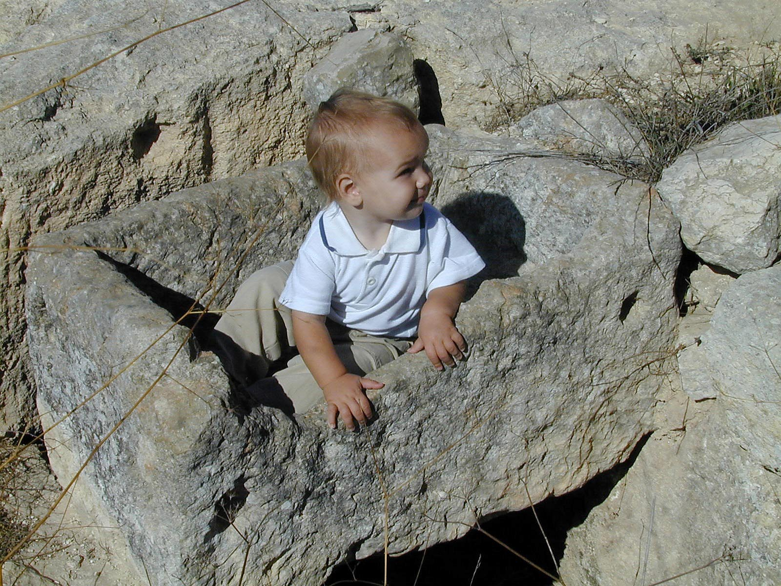
She gave birth to her firstborn son, and wrapped Him in cloths, and laid Him in a manger
Stone manger with child at Ramat Rahel
2:7
Notes:
The common building material in Israel is stone, and so it is not surprising that the mangers were made from stone. If wooden mangers existed in the 1st century, they have not been preserved. Ramat Rahel is located midway between Jerusalem and Bethlehem.
tb111100322

Slide 33
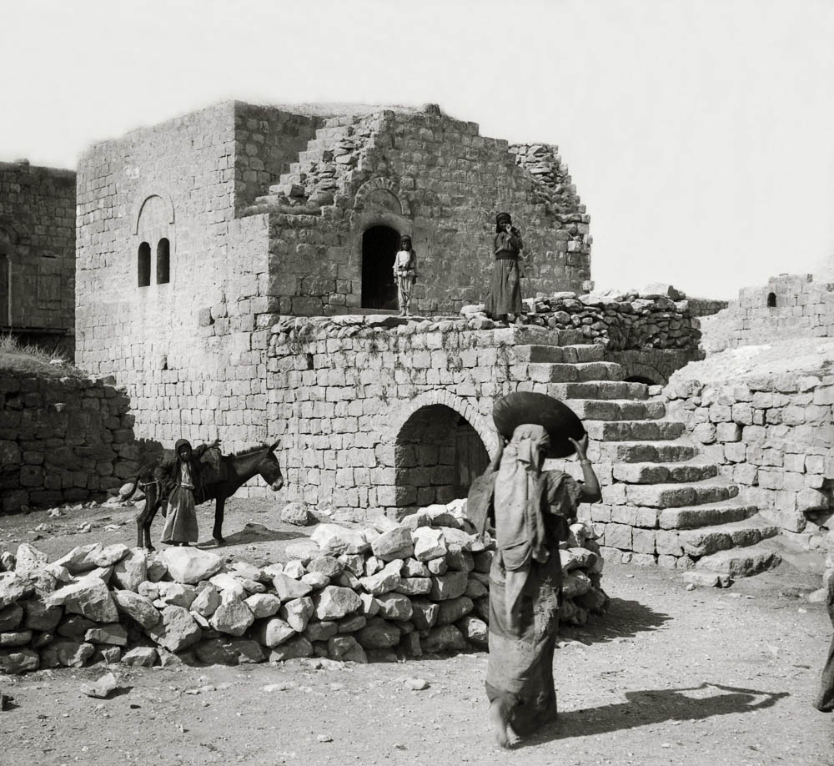
There was no room for them in the guest chamber
Luke 2:7
Luke22:11
"Then you shall say to the master of the house, 'The Teacher says to you, "Where is the guest room where I may eat the Passover with My disciples?"'
12 "Then he will show you a large, furnished upper room; there make ready."
Village guest chamber (upper story)
2:7
Notes:
The word translated as “inn” is the Greek word kataluma, used elsewhere by Luke and always translated as “guest chamber” or “upper room” (Luke 22:11; cf. Mark 14:14). When Luke wants to speak of a paid establishment (i.e., an inn), he uses a different Greek word, pandocheion, as in the story of the Good Samaritan (Luke 10:34). Dozens of English translations translate kataluma as “inn” in Luke 2:7 and not as “guest room,” but some translations use this including the NIV2011, CEB, and NJB. This American Colony photograph was taken between 1900 and 1920.
mat05610

Slide 34
For Unto Us a Child Is Born. Isaiah 9
The word translated as “inn” is the Greek word kataluma, used elsewhere by Luke and always translated as “guest chamber” or “upper room” (Luke 22:11; cf. Mark 14:14).
When Luke wants to speak of a paid establishment (i.e., an inn), he uses a different Greek word, pandocheion, as in the story of the Good Samaritan (Luke 10:34). Dozens of English translations translate kataluma as “inn” in Luke 2:7 and not as “guest room,” but some translations use this including the NIV2011, CEB, and NJB.
This American Colony photograph was taken between 1900 and 1920.

Slide 35
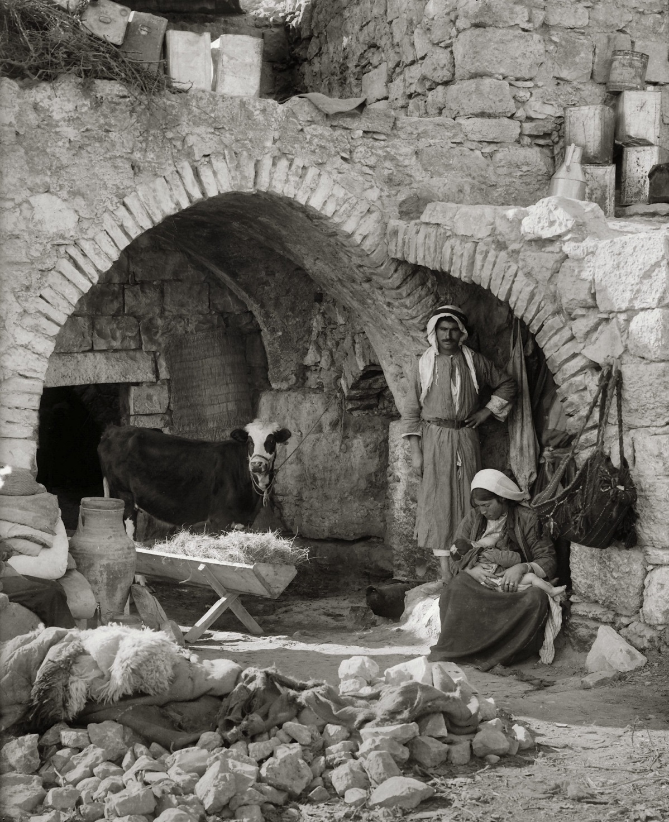
She gave birth to her firstborn son, and wrapped Him in cloths, and laid Him in a manger
Nativity scene recreated in native home near Bethlehem
2:7
Notes:
This is a reconstructed scene made by photographers from the American Colony between 1900 and 1920 to illustrate the nativity scene near Bethlehem. As shown on the previous slides, the manger was probably made of stone and not wood. For recreating scenes such as this one, wooden mangers are much easier to transport.
mat05495

Slide 36
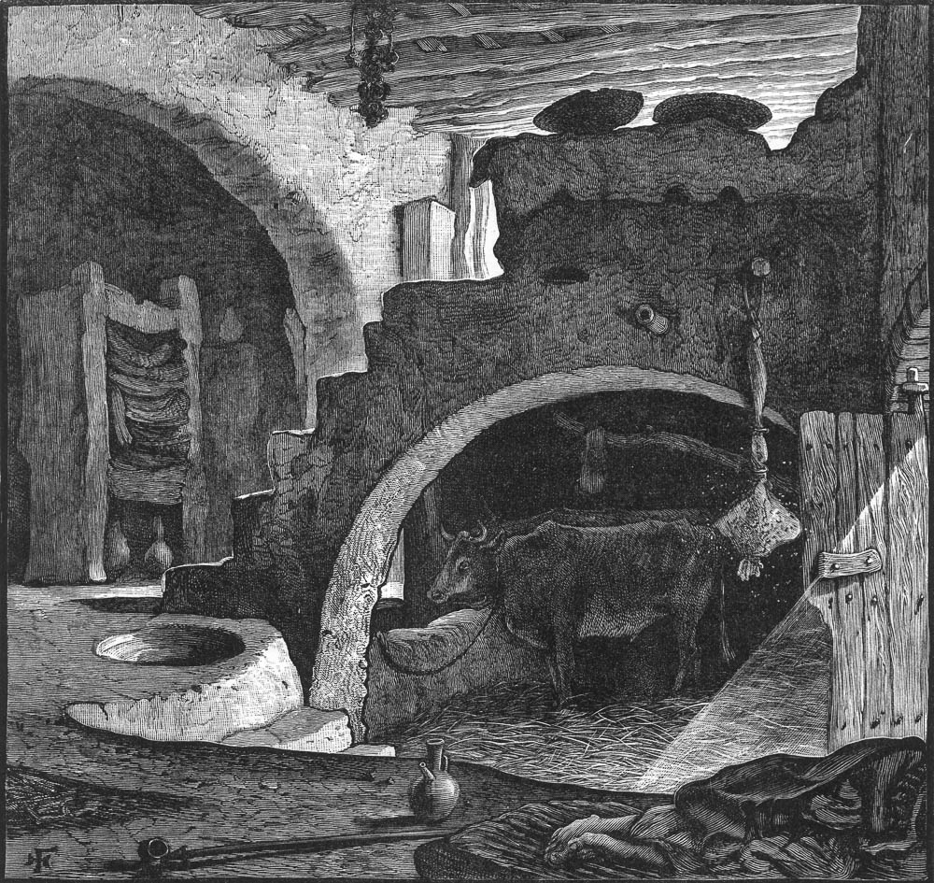
There was no room for them in the guest chamber
Peasant’s home with manger
2:7
Notes:
This illustration was drawn in the 1880s and provides another illustration for what the scene might have looked like if Mary gave birth to Jesus in a room in the house where animals were kept.
pp1129

Slide 37
For Unto Us a Child Is Born. Isaiah 9
Isaiah 9:6 For unto us a Child is born, Unto us a Son is given; And the government will be upon His shoulder. And His name will be called Wonderful, Counselor, Mighty God, Everlasting Father, Prince of Peace.

Slide 38
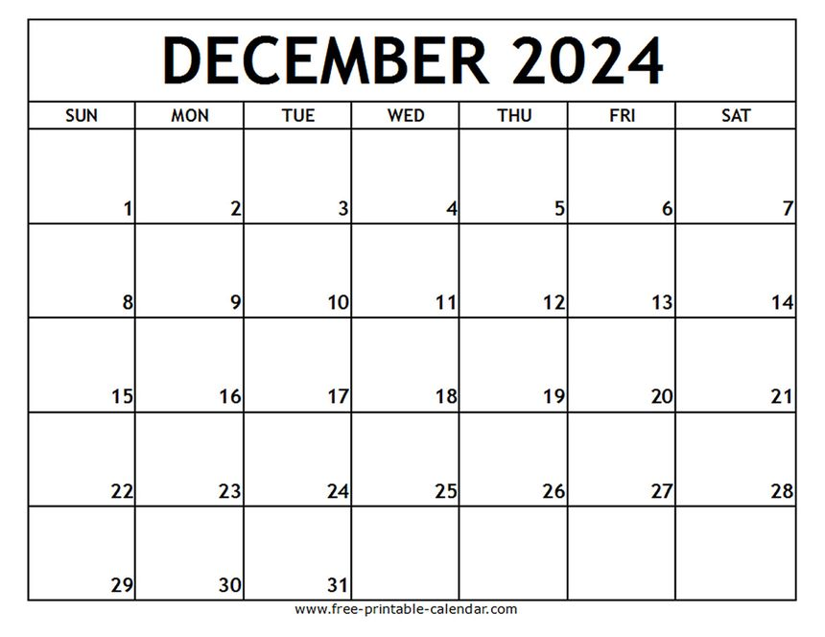
When do we celebrate the birth of Jesus?
X
We don’t. We celebrate His death.
Every first day of every week.

Slide 39
For Unto Us a Child Is Born. Isaiah 9
Many people want Jesus as their Savior but not their Lord.
He cannot be your Savior until you submit to Him as your Lord.

Slide 40
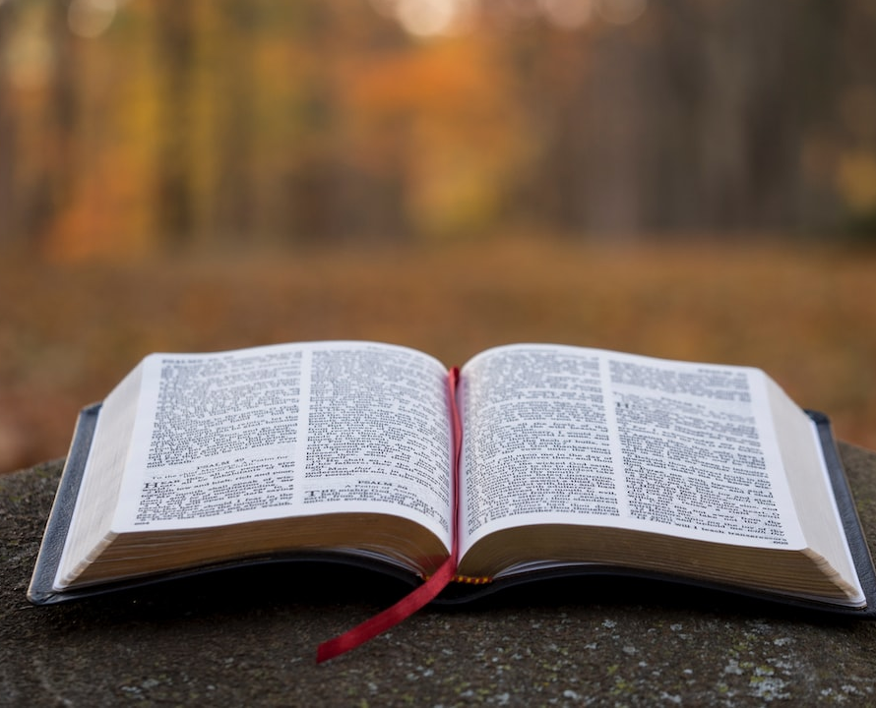
Isaiah 9:6 For unto us a Child is born, Unto us a Son is given; And the government will be upon His shoulder. And His name will be called Wonderful, Counselor, Mighty God, Everlasting Father, Prince of Peace.
The
New Lebanon
Church of Christ
1973 West Main St.
newlebanoncoc.com

