Slide 1
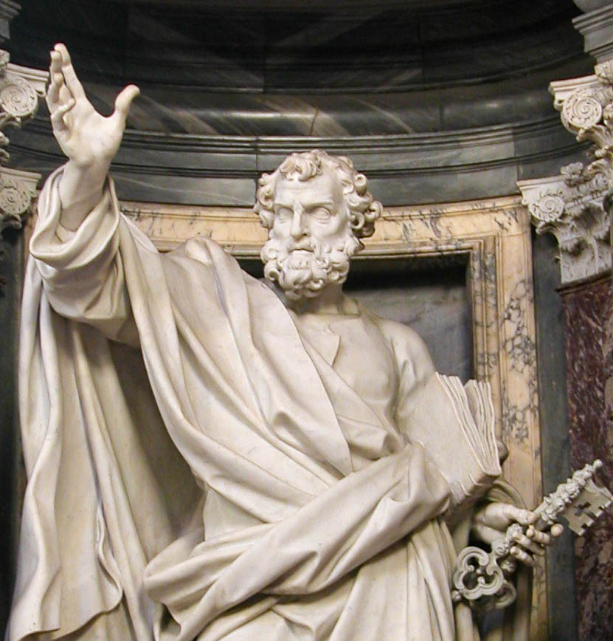
A Christian According To Peter.
Lesson Two:
God’s Obedient Children

Slide 2
A Christian According To Peter.
Lesson Two:
1Peter 1:13 Therefore gird up the loins of your mind, be sober, and rest your hope fully upon the grace that is to be brought to you at the revelation of Jesus Christ;
14 as obedient children, not conforming yourselves to the former lusts, as in your ignorance;
15 but as He who called you is holy, you also be holy in all your conduct,

Slide 3
A Christian According To Peter
Lesson 1. Acts 11:26, Acts 26:28, 1Peter 4:16, Isaiah 62:1-2.
1) A Christian is a taught disciple. 2) A Christian is one who is persuaded. 3) A Christian is one who is willing to suffer for doing right.

Slide 4
Christian – God’s Obedient Children
Holy scripture has a beautiful balance in God’s grace and man’s obedience with regard to salvation.
Peter defined “salvation” as: “Grace unto you.”
1Peter 1:10 Of this salvation the prophets have inquired and searched carefully, who prophesied of the grace that would come to you,
Eternal salvation will involve “grace brought to you.” 1 Peter 1:13 Therefore gird up the loins of your mind, be sober, and rest your hope fully upon the grace that is to be brought to you at the revelation of Jesus Christ;

Slide 5
Christian – God’s Obedient Children
Holy scripture has a beautiful balance in God’s grace and man’s obedience with regard to salvation.
James 2:17 Thus also faith by itself, if it does not have works, is dead.
18 But someone will say, "You have faith, and I have works." Show me your faith without your works, and I will show you my faith by my works.
19 You believe that there is one God. You do well. Even the demons believe--and tremble! 20 But do you want to know, O foolish man, that faith without works is dead?
21 Was not Abraham our father justified by works when he offered Isaac his son on the altar? 22 Do you see that faith was working together with his works, and by works faith was made perfect? 23 And the Scripture was fulfilled which says, "Abraham believed God, and it was accounted to him for righteousness." And he was called the friend of God. 24 You see then that a man is justified by works, and not by faith only.

Slide 6
Christian – God’s Obedient Children
Peter also emphasizes man’s responsibility to obey God. 1Peter 1:2,14,22
Christians are called “children of obedience.” 1Peter 1:14
A Christian has an obedient nature. A sinner, in contrast, is a “child of disobedience.”
1Peter 1:2 elect according to the foreknowledge of God the Father, in sanctification of the Spirit, for obedience and sprinkling of the blood of Jesus Christ: Grace to you and peace be multiplied.
V14 as obedient children, not conforming yourselves to the former lusts, as in your ignorance;
V22 Since you have purified your souls in obeying the truth through the Spirit in sincere love of the brethren, love one another fervently with a pure heart,

Slide 7
Grace with (loving) obedience

Slide 8
Christian – God’s Obedient Children
The Importance of Obedience -
The soul is purified when one obeys the truth.
1Peter 1:22 Since you have purified your souls in obeying the truth through the Spirit in sincere love of the brethren, love one another fervently with a pure heart,

Slide 9
Christian – God’s Obedient Children
Notice Peter’s use of “soul”
1Peter 1:9 receiving the end of your faith--the salvation of your souls.
1Peter 1:22 Since you have purified your souls in obeying the truth through the Spirit in sincere love of the brethren, love one another fervently with a pure heart,
1Peter 2:11 Beloved, I beg you as sojourners and pilgrims, abstain from fleshly lusts which war against the soul,
1Peter 2:25 For you were like sheep going astray, but have now returned to the Shepherd and Overseer of your souls.
1Peter 3:20 who formerly were disobedient, when once the Divine longsuffering waited in the days of Noah, while the ark was being prepared, in which a few, that is, eight souls, were saved through water.
1Peter 4:19 Therefore let those who suffer according to the will of God commit their souls to Him in doing good, as to a faithful Creator.

Slide 10
Christian – God’s Obedient Children
The Holy Spirit calls the soul the “hidden man of the heart”.
1Peter 3:4 rather let it be the hidden person of the heart, with the incorruptible beauty of a gentle and quiet spirit, which is very precious in the sight of God.
The “hidden man” or soul is not corruptible, it is incorruptible, therefore immortal.

Slide 11
Christian – God’s Obedient Children
The TRUTH reveals sin’s defilement of man’s soul.
1Peter 2:24 who Himself bore our sins in His own body on the tree, that we, having died to sins, might live for righteousness--by whose stripes you were healed. 25 For you were like sheep going astray, but have now returned to the Shepherd and Overseer of your souls.
1Peter 4:3 For we have spent enough of our past lifetime in doing the will of the Gentiles--when we walked in lewdness, lusts, drunkenness, revelries, drinking parties, and abominable idolatries.
4 In regard to these, they think it strange that you do not run with them in the same flood of dissipation, speaking evil of you.
5 They will give an account to Him who is ready to judge the living and the dead.
The TRUTH reveals God’s plan for saving man’s soul.

Slide 12
Christian – God’s Obedient Children
God’s grace offers salvation.
1Peter 1:8 whom having not seen you love. Though now you do not see Him, yet believing, you rejoice with joy inexpressible and full of glory, 9 receiving the end of your faith--the salvation of your souls.
10 Of this salvation the prophets have inquired and searched carefully, who prophesied of the grace that would come to you,
(Men must believe in Jesus as Savior.)
If men refuse to repent of sins, they will be lost.
2Peter 3:9 The Lord is not slack concerning His promise, as some count slackness, but is longsuffering toward us, not willing that any should perish but that all should come to repentance.

Slide 13
Christian – God’s Obedient Children
God’s grace offers salvation.
Men must be baptized for remission of sins and “answer of a good conscience.”
1Peter 3:20 who formerly were disobedient, when once the Divine longsuffering waited in the days of Noah, while the ark was being prepared, in which a few, that is, eight souls, were saved through water.
21 There is also an antitype which now saves us--baptism (not the removal of the filth of the flesh, but the answer of a good conscience toward God), through the resurrection of Jesus Christ,

Slide 14
Christian – God’s Obedient Children
When one obeys the truth:
His soul is purified from sin, the guilt and condemnation of sin. He is “born again,” he has a new life in Christ.
1Peter 1:22 Since you have purified your souls in obeying the truth through the Spirit in sincere love of the brethren, love one another fervently with a pure heart,

Slide 15
Christian – God’s Obedient Children
When one obeys the truth:
He has the joy of salvation
1Peter 1:8
He has a hope of heaven
1Peter 1:3, 13
He has an inheritance.
1Peter1:4

Slide 16
Christian – God’s Obedient Children
We Must OBEY the gospel - 1Peter 4:17
1Peter 4:17 For the time has come for judgment to begin at the house of God; and if it begins with us first, what will be the end of those who do not obey the gospel of God?

Slide 17
Christian – God’s Obedient Children
We must OBEY the gospel - 1Peter 4:17
If someone obeys something other than the gospel,
(the creeds and doctrines of man) they do not have any of the blessings, or promises, or protection that Peter mentions.

Slide 18
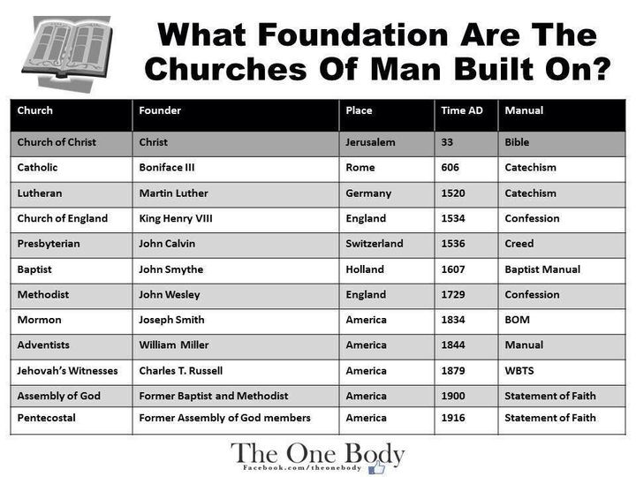
If someone obeys something other than the gospel,
(the creeds and doctrines of man) they do not have any of the blessings, or promises, or protection that Peter mentions.

Slide 19
Christian – God’s Obedient Children
We Must OBEY the gospel - 1Peter 4:17
1Peter 4:17 For the time has come for judgment to begin at the house of God; and if it begins with us first, what will be the end of those who do not obey the gospel of God?

Slide 20
Christian – God’s Obedient Children
We must OBEY the gospel - 1Peter 4:17
If someone obeys something other than the gospel,
(the creeds and doctrines of man) they do not have any of the blessings, or promises, or protection that Peter mentions.

Slide 21
Christian – God’s Obedient Children
God the Father
Baptized (born again) children
Loving obedience to the Father
Receive grace and blessings

Slide 22
Christian – God’s Obedient Children
The Christian lives a life of obedience.
1Peter 1:14
The Christian has the nature of obedience.
1Peter 1:14 as obedient children, not conforming yourselves to the former lusts, as in your ignorance;

Slide 24
Christian – God’s Obedient Children
As a sinner, we were in ignorance.
1Peter 1:14
2Peter 2:20
Our life was “fashioned according to lusts” or uncontrolled desire
1Peter 1:14, 4:3-5

Slide 25
Christian – God’s Obedient Children
As a Christian, we follow the way of truth. 2Peter2:3
Knowledge is connected with obedience. Rom.10:1-3
Rom. 10:1 Brethren, my heart's desire and prayer to God for Israel is that they may be saved.
2 For I bear them witness that they have a zeal for God, but not according to knowledge.
3 For they being ignorant of God's righteousness, and seeking to establish their own righteousness, have not submitted to the righteousness of God.

Slide 26
Christian – God’s Obedient Children
As a “child of obedience,” the Christian must:
1. Desire God’s word. 1Peter 2:2
2. Abstain from fleshly lusts. 1Peter 2:11
3. Be submissive to civil authority. 1Peter2:13-17
4. Let Christ be the pattern for life. 1Peter 2:21
5. Love one another. 1Peter 1:22, 3:8
6. Control the tongue. 1Peter 3:10

Slide 28
Christian – God’s Obedient Children
As a “child of obedience,” the Christian must:
7. Turn away from evil. 1Peter 3:11
8. Pray. 1Peter 3:12
9. Be ready to give a reason for possessed hope. 1Peter 3:15
10. Cast all care and anxiety on God. 1Peter 5:7
11. Resist the devil. 1Peter 5:8
12. In faith, supply the “Christian Graces.” 2Peter 1:5-11

Slide 29
Christian – God’s Obedient Children
Hope (1Peter1:3)
Joy (1Peter 1:8)
Inheritance (1Peter1:4)
cannot be realized apart from obedience.
Obedience does not negate grace
1Samuel 15:22 Then Samuel said: "Has the LORD as great delight in burnt offerings and sacrifices, As in obeying the voice of the LORD? Behold, to obey is better than sacrifice, And to heed than the fat of rams.
23 For rebellion is as the sin of witchcraft, And stubbornness is as iniquity and idolatry.

Slide 30
Christian – God’s Obedient Children
God’s grace offers salvation.
We must obey the gospel to be children of God.
We must be born again to be children of God.
The Christian lives a life of obedience to please the father and receive His grace.

Slide 31
A Christian According To Peter.
Lesson Two:
God’s Obedient Children

