Slide 1
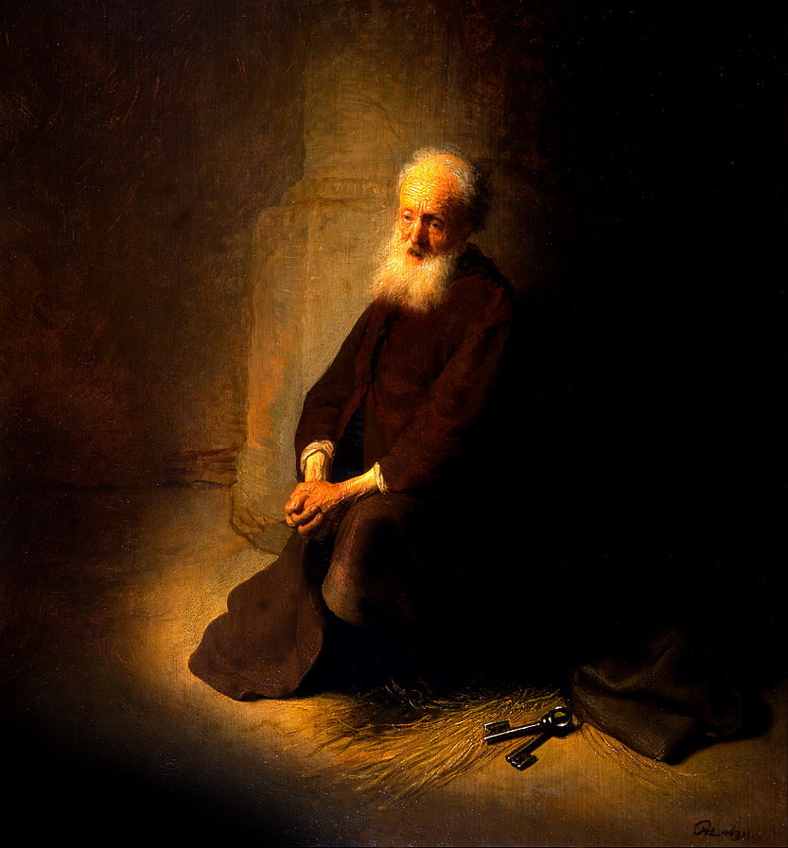
A Christian According To Peter.
Lesson Three:
1Peter 1:15 but as He who called you is holy, you also be holy in all your conduct,
16 because it is written, "Be holy, for I am holy."

Slide 2
A Christian According To Peter
Lesson 1. Acts 11:26, Acts 26:28, 1Peter 4:16, Isaiah 62:1-2.
1) A Christian is a taught disciple. 2) A Christian is one who is persuaded. 3) A Christian is one who is willing to suffer for doing right.
Lesson 2. Obedient Children - 1) God’s grace offers salvation. 2) We must obey the gospel to enjoy salvation and to be children of God. 3) We must be born again to be children of God. 4) The Christian lives a life of obedience to please the father and receive His grace.

Slide 3
Christian – Be Holy In All Your Conduct
Purpose statement- The Christian MUST live a life of separation from the world.
Holy:the root meaning of hagios (holy) is DIFFERENT.
The temple was holy because it was different from other buildings.
The Sabbath was holy because it was different from other days.
The Christian is holy because he is different from other men.

Slide 4
Christian – Be Holy In All Your Conduct
Christians are called to be a holy people.
Called by the gospel. 2Thess.2:13-14.
The design of the calling:
sanctification of the whole life to God.
God has always demanded holiness of His people. Lev.9:2 11:44-45 20:7, 26

Slide 5
Christian – Be Holy In All Your Conduct
Lev.10:2-3 Then Nadab and Abihu, the sons of Aaron, each took his censer and put fire in it, put incense on it, and offered profane fire before the LORD, which He had not commanded them. 2 So fire went out from the LORD and devoured them, and they died before the LORD. 3 And Moses said to Aaron, "This is what the LORD spoke, saying: 'By those who come near Me I must be regarded as holy; And before all the people I must be glorified.'" So Aaron held his peace. NKJV
KJV v3. This is it that the LORD spake, saying, I will be sanctified in them that come nigh me, and before all the people I will be glorified. And Aaron held his peace.

Slide 6
Christian – Be Holy In All Your Conduct
Holy – W.E Vine:
pure” and “devoted
devoted” or “dedicated” to a particular purpose:
Lev. 21:6 'They shall be holy to their God and not profane the name of their God, for they offer the offerings of the LORD made by fire, and the bread of their God; therefore they shall be holy.

Slide 7
Christian – Be Holy In All Your Conduct
Lev. 20:26 'And you shall be holy to Me, for I the LORD am holy, and have separated you from the peoples, that you should be Mine

Slide 8
Christian – Be Holy In All Your Conduct
The salvation of souls depends on living a holy life.
Eph.1:3 Blessed be the God and Father of our Lord Jesus Christ, who has blessed us with every spiritual blessing in the heavenly places in Christ, 4 just as He chose us in Him before the foundation of the world, that we should be holy and without blame before Him in love,
Eph.5:25 Husbands, love your wives, just as Christ also loved the church and gave Himself for her, 26 that He might sanctify and cleanse her with the washing of water by the word,
27 that He might present her to Himself a glorious church, not having spot or wrinkle or any such thing, but that she should be holy and without blemish.

Slide 9
Christian – Be Holy In All Your Conduct
God…is our standard of holiness…. because it is written, "Be holy, for I am holy."
1 Peter 1:15, 1Peter 3:15
Here God, as a perfect pattern of holiness, is set forth for us to follow.
(tape measure)
So how do we get started being holy? Peter tells us how.
Holiness begins in the mind,
1 Peter 1:13 Therefore gird up the loins of your mind, be sober, and rest your hope fully upon the grace that is to be brought to you at the revelation of Jesus Christ;
Must Gird Up the Loins of Your Mind, to be prepared, ready mind; unimpeded,
1 Pet.1:14. as obedient children, not conforming yourselves to the former lusts, as in your ignorance;

Slide 10
Christian – Be Holy In All Your Conduct
Peter gives another contrast :Mind of Christ is contrasted with mind of the world,
1 Pet 4:1-2. Therefore, since Christ suffered for us in the flesh, arm yourselves also with the same mind, for he who has suffered in the flesh has ceased from sin, 2 that he no longer should live the rest of his time in the flesh for the lusts of men, but for the will of God.
We Must be sober. (clarity of mind, able to discern, sound judgment.) Peter repeats this in thought in: 1Peter 5:8 Be sober, be vigilant; because your adversary the devil walks about like a roaring lion, seeking whom he may devour.
And if we don’t have our minds girded up. If we hesitate – satan will get us.
Friend,…………… Are you ready in your mind to be holy?

Slide 11
Christian – Be Holy In All Your Conduct
But it’s not good enough for holiness to just stay in our minds…
Holiness manifest itself in our action.
Our father is holy. We are his children – he expects us to be holy.
1. As children obey their parents, we obey our Father, who is holy.
2. In obedience… the mind is submissive to God…, resulting in holy conduct.
Submissiveness is a hard thing to learn.
Now consider this: Our holiness is affected – either strengthened or compromised – by what we join up with (have fellowship with). Do we associate with people or groups that might compromise our holiness?

Slide 12
Christian – Be Holy In All Your Conduct
Our thinking and our conduct is a serious matter. Satan wants us to think anything goes. You believe and do what you want to do and I will believe and do what I want to. ….That’s what Nadab and Abihu did and they were religious people.
Now look at 1 Pet.1:17. And if you call on the Father, who without partiality judges according to each one's work, conduct yourselves throughout the time of your stay here in fear;
So we notice in v 17 we will be judged by our holiness.
The word "if" is used as the introduction of a another thought that being accepted, establishes a definite duty…. conduct yourselves throughout the time of your stay here in fear;
So our heavenly Father is our judge;

Slide 13
Christian – Be Holy In All Your Conduct
Someone will say. Oh that’s great. God loves me. Well God is not going to judge us based on his love. He already demonstrated his love.
The judgment is to be "according to every man's work"; and
The judgment is to be conducted "without respect of persons," (with complete fairness and impartiality). Judgment is based on JUSTICE
The phrase, "without respect of persons," is the translation of one Greek word, aprosopoleptos, an adverb indicating complete impartiality, meaning literally, "who does not receive face." (See Thayer.)….(Lady Justice – blindfold and holding scale)
God does not judge individuals on the basis of education, wealth, cultural background or social position, but with reference to our work.

Slide 14
Christian – Be Holy In All Your Conduct
The Christian Has a Perfect Pattern Of Holiness.
1 Peter 1:16 because it is written, "Be holy, for I am holy."
Religion is in part imitation.
Heathenism creates “god” according to its own corrupt mind.

Slide 15
Christian – Be Holy In All Your Conduct
The Christian Has a Perfect Pattern Of Holiness.
The Christian is to imitate God.
Eph. 5:1Therefore be imitators of God as dear children.
When one follows Christ (1Pet. 2:21) he imitates.
For to this you were called, because Christ also suffered for us, leaving us an example, that you should follow His steps:

Slide 16
Christian – Be Holy In All Your Conduct
The Christian is to Be Holy In All Manner Of Living
1Pet.1:15
1Peter 1:15 but as He who called you is holy, you also be holy in all your conduct,
In dealing with the world, (that sphere of lust and disobedience controlled by Satan, Eph.2:1-3) the Christian is:
1.To be transformed, and not to conform. Rom. 12:1-2
2.To keep himself unspotted from the world. James 1:27
3.To refrain from making friends with the world James 4:4

Slide 17
Christian – Be Holy In All Your Conduct
The Christian is to Be Holy In All Manner Of Living
1Pet.1:15
In marriage, the Christian Is to be different.
Hold the marriage tie as sacred
Matt.19:1-9
Be faithful to the marriage contract
1Thess.4:3-6
1Thess. 4:3 For this is the will of God, your sanctification: that you should abstain from sexual immorality; 4 that each of you should know how to possess his own vessel in sanctification and honor, 5 not in passion of lust, like the Gentiles who do not know God; 6 that no one should take advantage of and defraud his brother in this matter, because the Lord is the avenger of all such, as we also forewarned you and testified

Slide 18
Christian – Be Holy In All Your Conduct
The Christian is to Be Holy In All Manner Of Living
1Pet.1:15
In business, the Christian is to be different.
He is to be honest.
Rom.12:17 Repay no one evil for evil. Have regard for good things in the sight of all men.
He is to be industrious
2Thess.3:10 For even when we were with you, we commanded you this: If anyone will not work, neither shall he eat.

Slide 19
Christian – Be Holy In All Your Conduct
The Christian is to Be Holy In All Manner Of Living
1Pet.1:15
In recreation, the Christian is to be different.
Puts the kingdom first in life.
Matt.6:33 "But seek first the kingdom of God and His righteousness, and all these things shall be added to you.
Seeks to let men see influence Jesus has had in his life.
Matt.5:14-16 "You are the light of the world. A city that is set on a hill cannot be hidden. 15 "Nor do they light a lamp and put it under a basket, but on a lampstand, and it gives light to all who are in the house. 16 "Let your light so shine before men, that they may see your good works and glorify your Father in heaven.

Slide 20
Christian – Be Holy In All Your Conduct
The Christian is Motivated To Be Holy
He lives in view of the Lord’s return.
1Peter 1:13 Therefore gird up the loins of your mind, be sober, and rest your hope fully upon the grace that is to be brought to you at the revelation of Jesus Christ;
The Christian interprets his thoughts and actions in light of the second coming.
2Peter 3:10-12
But the day of the Lord will come as a thief in the night, in which the heavens will pass away with a great noise, and the elements will melt with fervent heat; both the earth and the works that are in it will be burned up.
11 Therefore, since all these things will be dissolved, what manner of persons ought you to be in holy conduct and godliness,
12 looking for and hastening the coming of the day of God, because of which the heavens will be dissolved, being on fire, and the elements will melt with fervent heat?

Slide 21
Christian – Be Holy In All Your Conduct
The Christian is Motivated To Be Holy
The Christian knows that he must stand before God in judgment.
1Peter 1:17
1Peter 4:5
One must give account for deeds done in the body.
2Cor.5:11
God shall judge men in righteousness.
Acts 17:30-31

Slide 22
Christian – Be Holy In All Your Conduct
The Christian is Motivated To Be Holy
The Christian lives in gratitude for the death of Christ.
1Peter 1:18-19
The Lord died that men might be different.
Titus 2:11-14
We are reminded of Jesus’ death when we eat the Lord’s Supper
1Cor.11:23-26
knowing that you were not redeemed with corruptible things, like silver or gold, from your aimless conduct received by tradition from your fathers,
19 but with the precious blood of Christ, as of a lamb without blemish and without spot.

Slide 23
Christian – Be Holy In All Your Conduct
The Christian is not sanctified by a direct operation of the Holy Spirit.
The gospel call separates the Christian from the world.
1Peter 1:15 but as He who called you is holy, you also be holy in all your conduct,
2Thess. 3:13-14 But as for you, brethren, do not grow weary in doing good. 14 And if anyone does not obey our word in this epistle, note that person and do not keep company with him, that he may be ashamed.

Slide 24
Christian – Be Holy In All Your Conduct
The Christian must “come out- and be separate.”
2Cor.7:1 Therefore, having these promises, beloved, let us cleanse ourselves from all filthiness of the flesh and spirit, perfecting holiness in the fear of God.
Holiness is necessary if eternal life is realized
Heb.12:14 Pursue peace with all people, and holiness, without which no one will see the Lord:
People are being constantly pressured to conform, to follow the crowd; God’s people are different.
1John3:1 Behold what manner of love the Father has bestowed on us, that we should be called children of God! Therefore the world does not know us, because it did not know Him.

Slide 25
Christian – Be Holy In All Your Conduct
Do we understand how holy God cannot be approached by unholy man? Friend, do we understand how holy God views sin.
God being infinite in grace and mercy, cannot because of his justice, let sin go unpunished. Oh why would you and I want to commit sin when we know what awaits us if we do? And even more amazing, how can some who know this, consent to live in sin day after day.
Some people say that God demonstrated his justice in the OT and then demonstrated his love in the NT. I would not agree with that. God gave us very small glimpses of his justice in the OT. But he has not demonstrated it yet.

Slide 26
Christian – Be Holy In All Your Conduct
Consider in the NT. When the soldiers mocked Jesus,…. did we see his holy justice? No…..
When they spat on Jesus, did we see the holy justice of God? No…...
What about when they drove nails through the hand and feet of Christ?........No God withheld his holy justice.

Slide 27
Christian – Be Holy In All Your Conduct
But now look at 2Thess.1:6. since it is a righteous thing with God to repay with tribulation those who trouble you,7 and to give you who are troubled rest with us when the Lord Jesus is revealed from heaven with His mighty angels,
8 in flaming fire taking vengeance on those who do not know God, and on those who do not obey the gospel of our Lord Jesus Christ.
9 These shall be punished with everlasting destruction from the presence of the Lord and from the glory of His power,

Slide 28
Christian – Be Holy In All Your Conduct
Friend, has your sin separated you from holy God?
If you have never been baptized for the remission of your past sins – you need to do it.
But don’t do it because I say you need to do it. Don’t do it because your friends have been baptized. Don’t do it to please your family.
Friend, You need to be a Christian because you feel the pain that your sin has caused in the death of Christ. You need to be a Christian because you are cut to the heart. And then you need to start living a holy life.

