Slide 1
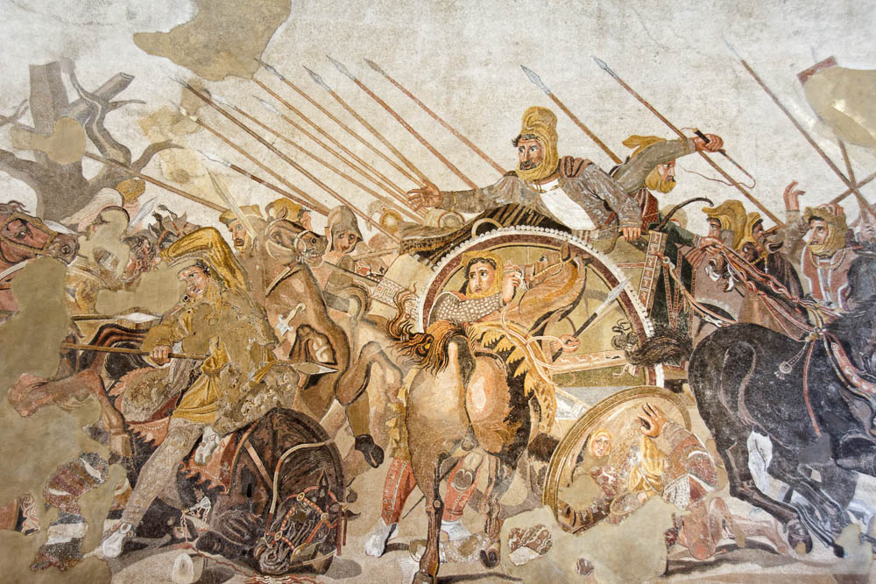
A Christian According To Peter.
Lesson four:
Abstaining and Attaining
1Peter 2:11 Beloved, I beg you as sojourners and pilgrims, abstain from fleshly lusts which war against the soul, 12 having your conduct honorable among the Gentiles, that when they speak against you as evildoers, they may, by your good works which they observe, glorify God in the day of visitation.

Slide 2
A Christian According To Peter
Lesson 1. Acts 11:26, Acts 26:28, 1Peter 4:16, Isaiah 62:1-2.
1) A Christian is a taught disciple. 2) A Christian is one who is persuaded. 3) A Christian is one who is willing to suffer for doing right.
Lesson 2. Obedient Children - 1) God’s grace offers salvation. 2) We must obey the gospel to enjoy salvation and to be children of God. 3) We must be born again to be children of God. 4) The Christian lives a life of obedience to please the father and receive His grace.
Lesson 3. Be holy for I am holy. The Christian MUST live a life of separation from the world. We are children of the Father. The Father has set a pattern for His children to follow. Holy God cannot be approached by unholy man. We must come out and be separate from the world.

Slide 3
Christian – Abstaining and Attaining
A Christian is one whose
life is a sermon.
1 Peter 2:11 1Peter 3:7

Slide 4
Christian – Abstaining and Attaining
Christianity is a very PRACTICAL religion.
Christianity is a DAILY religion.
Christianity is not a Sunday morning religion at 9 if you have nothing else going on then religion.

Slide 5
Christian – Abstaining and Attaining
1. The Christian abstains from fleshly lusts.
1Peter 2:11 Beloved, I beg you as sojourners and pilgrims, abstain from fleshly lusts which war against the soul,
12 having your conduct honorable among the Gentiles, that when they speak against you as evildoers, they may, by your good works which they observe, glorify God in the day of visitation.

Slide 6
To abstain from fleshly lusts, which war against the soul
Mosaic depicting the Persians fleeing from Alexander the Great, from Pompeii, 2nd century BC
2:11
Notes:
This mosaic shows the last king of Persia, Darius III, fleeing in his chariot from Alexander the Great. Although this mosaic dates to the late 2nd century BC (125–120 BC), it is thought to be a copy of an earlier, 4th century BC painting by Philoxenos. It comes from the exedra of the House of the Faun at Pompeii. It was photographed in the Naples Archaeological Museum.
tb0515170676

Slide 7
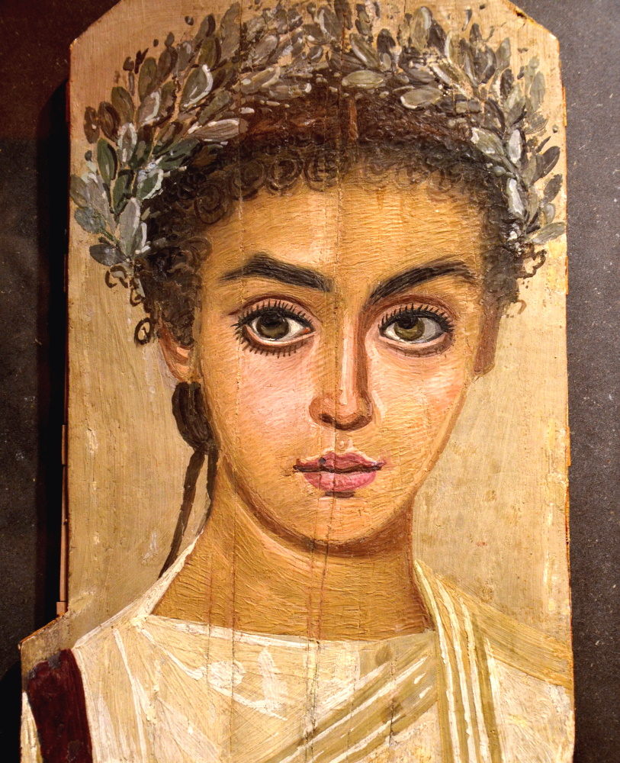
Keep your conduct excellent among the unbelievers
12 having your conduct honorable among the Gentiles, that when they speak against you as evildoers, they may, by your good works which they observe, glorify God in the day of visitation.
Mummy portrait of a girl, circa AD 120–150
2:12
Notes:
This encaustic painting on sycamore wood portrays a young woman who is beautiful without being ostentatious. Significantly, she is portrayed with a wreath of olive leaves, but otherwise has no jewelry. Many of the mummy portraits of this period included the depiction of expensive jewelry with gold, pearls, and precious stones. This portrait was photographed at the Liebieghaus sculpture collection, Frankfurt am Main. This image comes from Carole Raddato and is licensed under CC BY-SA 2.0, via Wikimedia Commons: https://commons.wikimedia.org/wiki/File:Mummy_portrait_of_a_girl,_AD_120-150,_Roman_Egypt,_wax_encaustic_painting_on_sycamore_wood,_Liebieghaus,_Frankfurt_am_Main_(14304151412).jpg.
wiki05252014121514304151412

Slide 8
Christian – Abstaining and Attaining
2. The Christian Preaches Good Citizenship. 1Peter 2:13-17
1Peter 2:13 Therefore submit yourselves to every ordinance of man for the Lord's sake, whether to the king as supreme, 14 or to governors, as to those who are sent by him for the punishment of evildoers and for the praise of those who do good.
15 For this is the will of God, that by doing good you may put to silence the ignorance of foolish men--
16 as free, yet not using liberty as a cloak for vice, but as bondservants of God. 17 Honor all people. Love the brotherhood. Fear God. Honor the king.

Slide 9
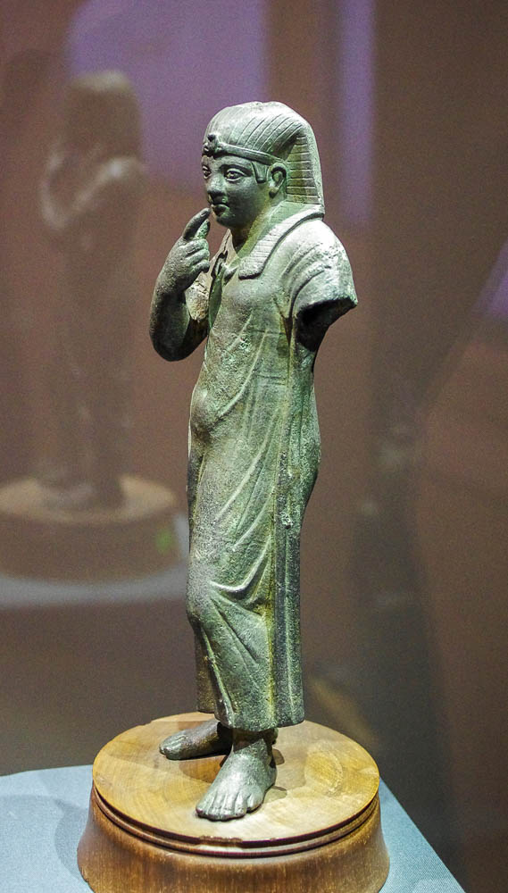
For such is the will of God, that by doing right you might silence the ignorance of foolish men
Harpocrates, the god of silence, from Alexandria, Ptolemaic period, circa 200 BC
2:15
Notes:
The verb “to silence” (Gk. phimoō, φιμόω) means to cease from speaking (cf. Mark 1:25). Harpocrates was the Greek god of silence, secrets, and confidentiality. His name is a Hellenized form of his Egyptian namesake, the Horus child Har-pa-khered. Figurines and statues of Harpocrates were quite common in the Roman world. Augustine of Hippo commented on their iconic gesture of holding a finger to the lips, “And since in practically all the temples where Serapis and Isis were worshiped there was also a figure that seemed to enjoin silence by a finger pressed against its lips, Varro thinks this had the same meaning, that no mention should be made of their having been human beings” (The City of God, XVIII). This bronze statue was photographed at the Alexandria National Museum.
adr1603268111

Slide 10
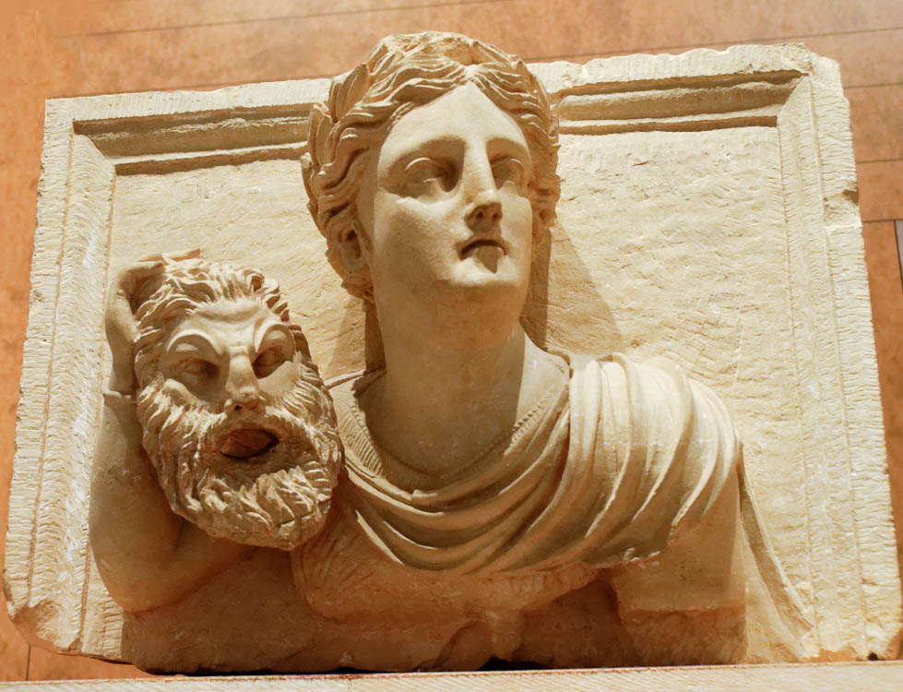
Do not use your freedom as a covering for wickedness
Melpomene, Greek muse, holding mask of Pan or Satyr, from Petra, 1st century AD
2:16
Notes:
The use of freedom as a potential “covering” for evil is illustrated here by a young woman with a grotesque theater mask of an older, bearded male. The mask would function as a covering for her face, allowing her to conceal her true identity in a theatrical setting. It is thought that the young woman represents Melpomene, the Greek muse of Tragedy. This sculpture comes from Petra and was photographed at the Jordan Museum in Amman.
tb031115484r

Slide 11
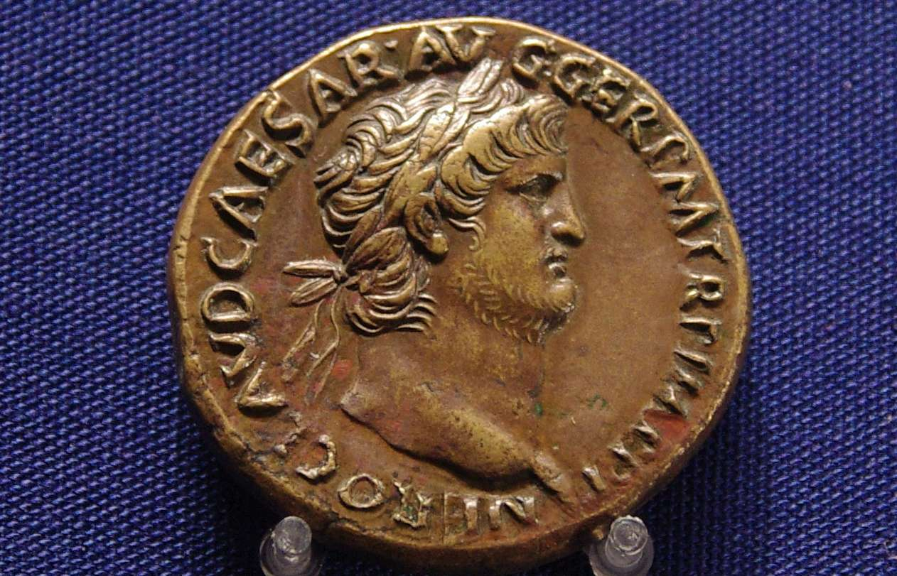
Honor the king
Bronze coin of Nero, giving his titles and likeness, AD 65
2:17
Notes:
The verb “honor” (Gk. timaō, τιμάω) means to show high regard or reverence for someone. In this case, Peter instructs his audience that they were to honor the “king” (Gk. basileus, βασιλεύς). As noted above (v. 13), the Romans avoided the use of the word “king” for their highest leader for historical reasons, preferring to use titles such as Caesar for their emperor/dictator. The title “Caesar” evolved from a surname of the Julian gens in Rome and became the basic designation for the Roman emperor (cf. Acts 25:11-12).
The coin shown here depicts a laureate bust of the Roman emperor Nero. It was issued right around the time of the writing of 1 Peter, and thus illustrates the “king” who ruled at that time. The inscription reads “Nero Claudius Caesar Augustus Germanicus Pontifex Maximus [high priest] Tribunicia Potestas [with tribune power] Imperator [emperor] Pater Patriae [father of the country]” (Lat. NERO CLAVD CAESAR AVG GER PM TR P IMP P P). This coin was photographed at the Ashmolean Museum at the University of Oxford.
adr1305249758

Slide 12
Christian – Abstaining and Attaining
3. The Christian’s Business Life Is A Sermon. 1Peter 2:18-24
1Peter 2:18 Servants, be submissive to your masters with all fear, not only to the good and gentle, but also to the harsh.
19 For this is commendable, if because of conscience toward God one endures grief, suffering wrongfully.
20 For what credit is it if, when you are beaten for your faults, you take it patiently? But when you do good and suffer, if you take it patiently, this is commendable before God. 21 For to this you were called, because Christ also suffered for us, leaving us an example, that you should follow His steps:

Slide 13
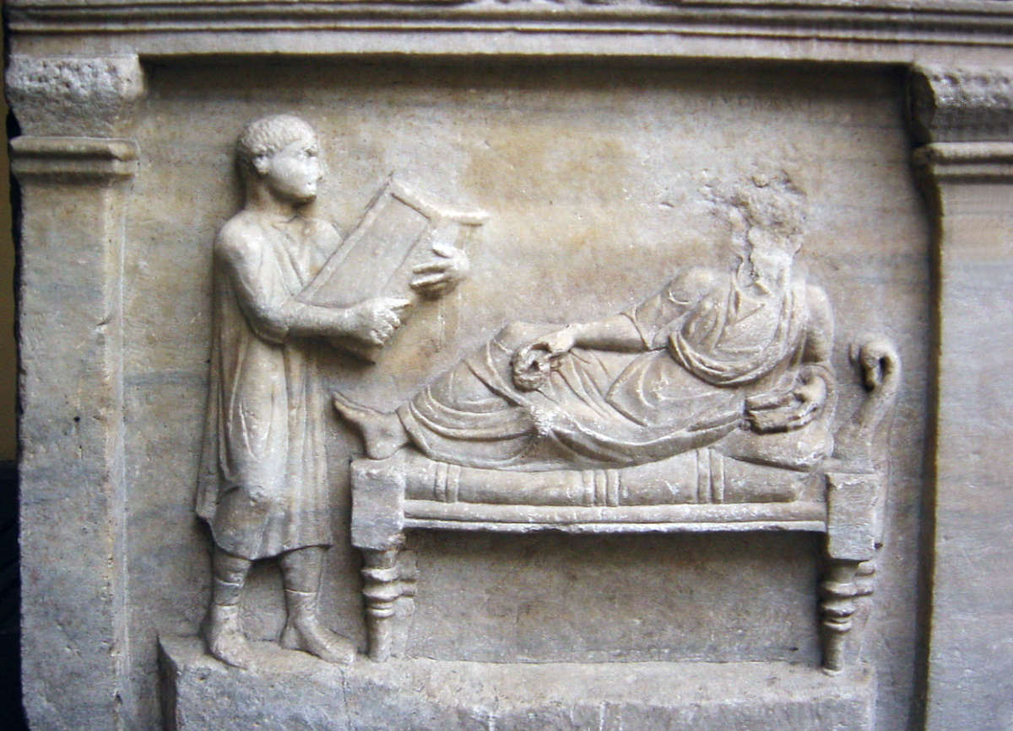
Household slaves, be subject to your masters with all respect
Relief of a household slave with writing tablets, circa AD 320
2:18
Notes:
Slaves were also employed in larger households as scribes and record keepers, sometimes entrusted to administer large amounts of money. This detail from a Roman sarcophagus depicts such a slave with a large set of writing tablets. An inscription on this sarcophagus identifies the reclining master as the lawyer Valerius Petronianus. This relief was photographed at the Archaeological Museum of Milan. This image comes from Giovanni Dall’Orto and is in the public domain, via Wikimedia Commons: https://commons.wikimedia.org/wiki/File:Sarcofago_avvocato_Valerius_Petrnianus-optimized.jpg.
wiki032120051141246954

Slide 14
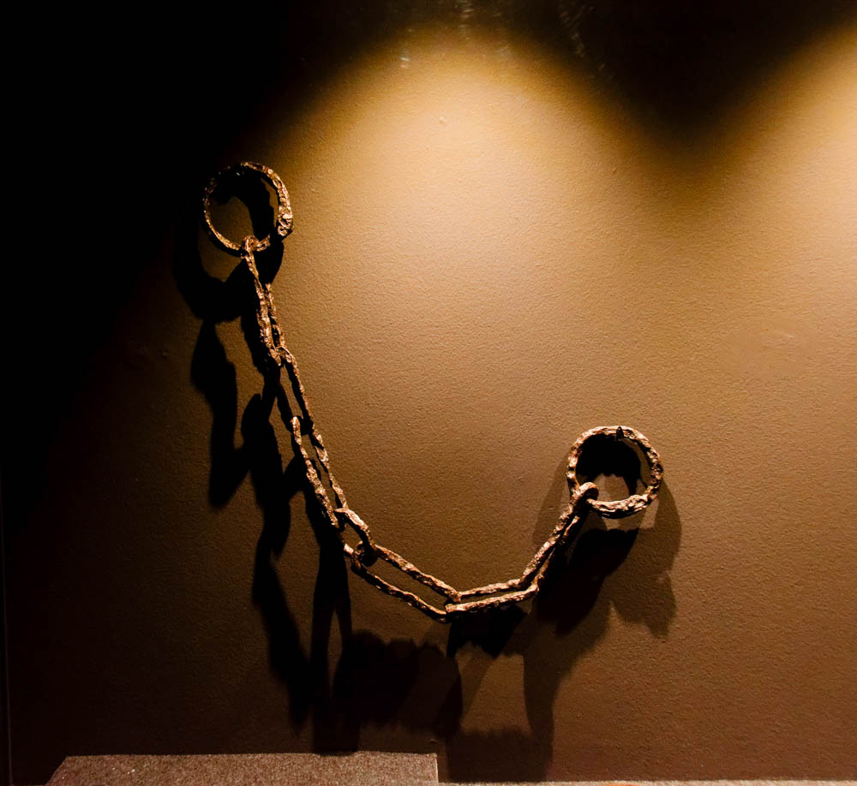
But also to harsh masters
Iron chains worn by slaves, 1st century AD
2:18
Notes:
Masters were given wide latitude to treat their slaves as they wished, even to the point of killing them. Although it was probably reserved for slaves who tended to be rebellious, disruptive, or to run away, slaves were sometimes forced to wear manacles or chains. This set of slave chains was photographed at the Spartacus Exhibit, a temporary exhibition at the Ara Pacis Museum in Rome.
tb0518174080

Slide 15
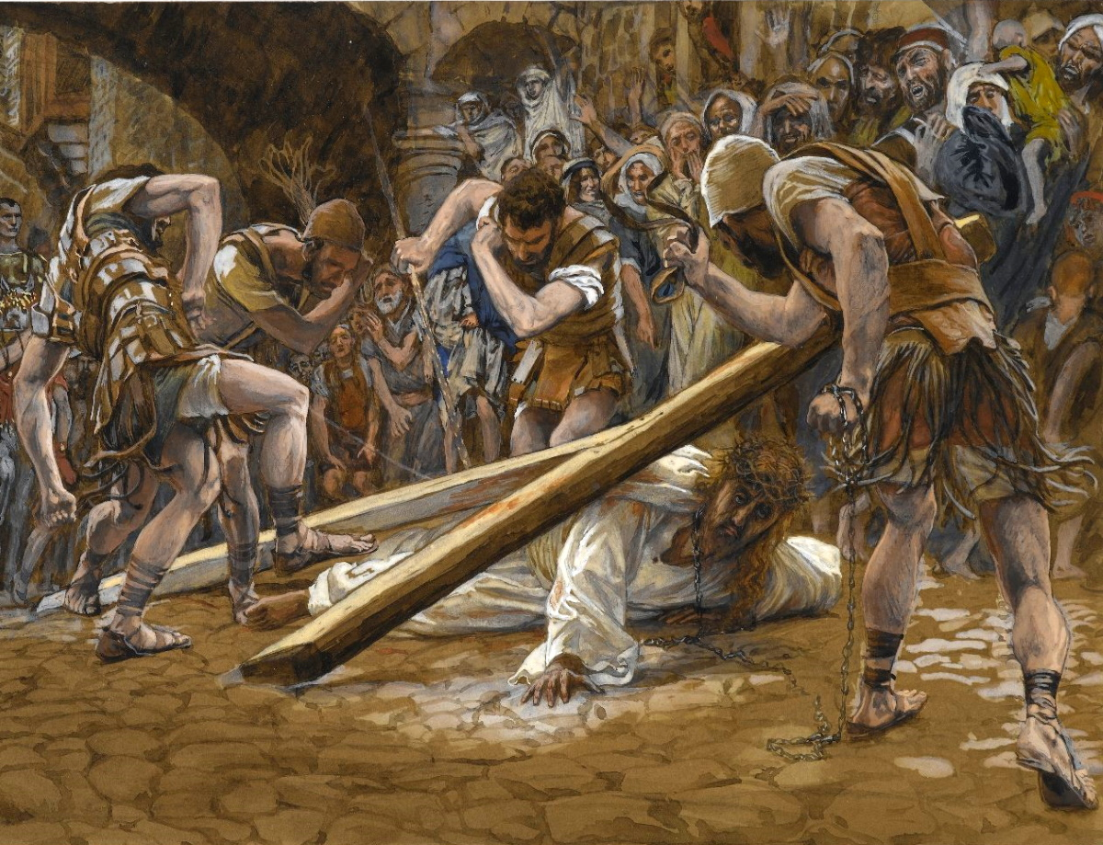
Christ also suffered for you, leaving an example for you to follow in His steps
Jesus Falls Beneath the Cross, by James Tissot, circa 1899
2:21
Notes:
This painting was photographed at the Brooklyn Museum in New York City. This image comes is in the public domain, via the Brooklyn Museum: https://www.brooklynmuseum.org/opencollection/objects/4578.
bmny4578

Slide 16
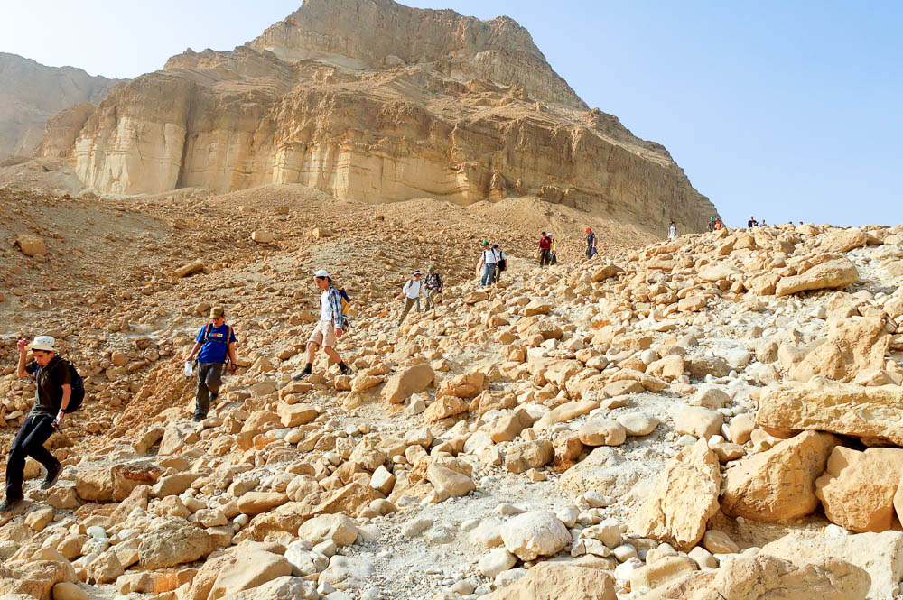
Christ also suffered for you, leaving an example for you to follow in His steps
Israeli kids hiking at Nahal Bokek in the Judean wilderness
2:21
Notes:
The idea of following in someone’s steps is illustrated here by a line of hikers following a leader.
tb030106472

Slide 17
Christian – Abstaining and Attaining
1Peter 2:22 "Who committed no sin, Nor was deceit found in His mouth";
23 who, when He was reviled, did not revile in return; when He suffered, He did not threaten, but committed Himself to Him who judges righteously;
24 who Himself bore our sins in His own body on the tree, that we, having died to sins, might live for righteousness--by whose stripes you were healed.
25 For you were like sheep going astray, but have now returned to the Shepherd and Overseer of your souls.

Slide 18
Christian – Abstaining and Attaining
4. The Power Of a Godly Life In The Home. 1Peter 3:1-7
1Peter 3:1 Wives, likewise, be submissive to your own husbands, that even if some do not obey the word, they, without a word, may be won by the conduct of their wives,
2 when they observe your chaste conduct accompanied by fear.
3 Do not let your adornment be merely outward--arranging the hair, wearing gold, or putting on fine apparel--

Slide 19
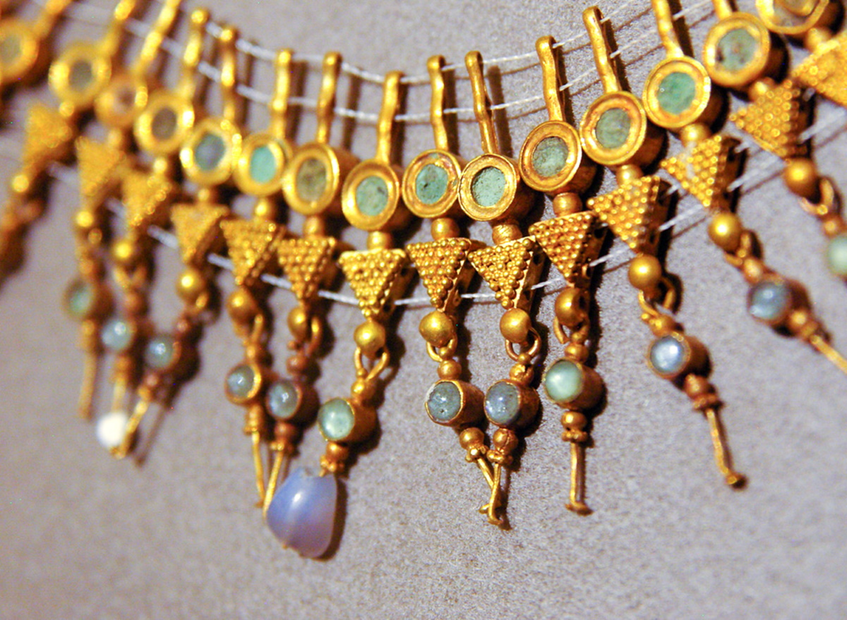
Do not let your adornment be external, like braided hair, gold jewelry, or fine clothing
Roman gold and semi-precious stones necklace, from Tyre, Roman period
3:3
Notes:
This example of jewelry from the Roman world was photographed at the Beirut National Museum.
adr090509451

Slide 20
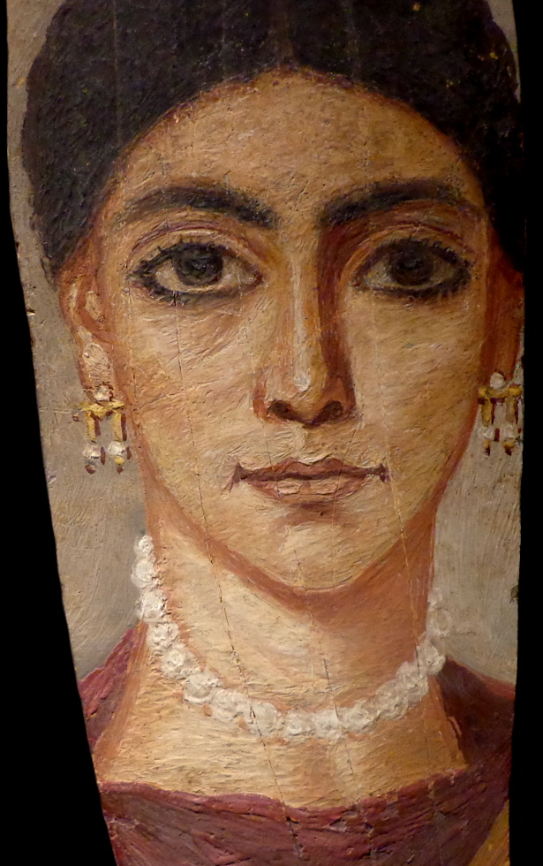
Do not let your adornment be external, like braided hair, gold jewelry, or fine clothing
Mummy painting of a woman with expensive jewelry, Roman period
3:3
Notes:
This encaustic mummy portrait depicts a woman with earrings of gold and pearl, and a pearl necklace. It was photographed at the Strasbourg Museum of Fine Arts. This image comes from Edelseider and is licensed under CC BY-SA 3.0, via Wikimedia Commons: https://commons.wikimedia.org/wiki/File:Fayum_StrasbourgMBA.JPG.
wiki06212013133927193492

Slide 21
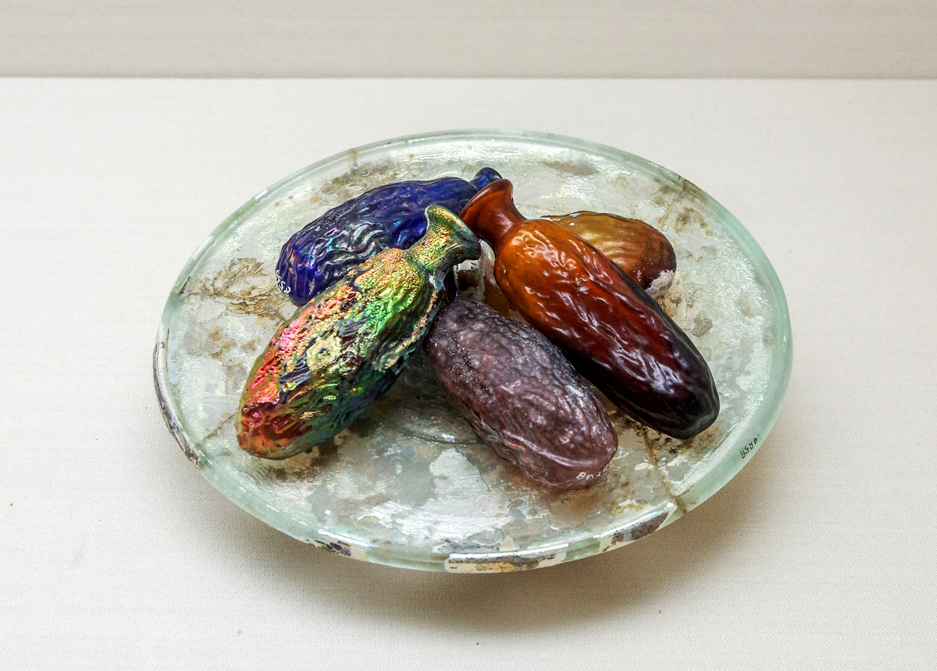
With the imperishable quality of a meek and quiet spirit, which is precious in the sight of God
Roman glass perfume bottles in the shape of dates, 1st–4th centuries AD
3:4
Notes:
Perfume was so precious in the Greco-Roman world that it was kept in small bottles that were often expensive in their own right. The small glass bottles shown in this display were used for perfume and are made of various colors of glass. This display was photographed at the Eretz Israel Museum in Tel Aviv.
adr1806295264

Slide 22
Christian – Abstaining and Attaining
5293. ὑποτάσσω hupotassō; from 5259 and 5021; to place or rank under, to subject, mid. to obey:—put in subjection
submit
conduct
chaste conduct
fear.
agoge (ἀγωγή, 72), from ago, “to lead,” properly denotes “a teaching”; then, figuratively, “a training, discipline,” and so, the life led, a way or course of life, conduct, V 2, p 120 2 Tim.3:10, RV, “conduct”; KJV, “manner of life.” See LIFE.¶
CHASTE
hagnos (ἁγνός, 53) signifies (a) “pure from every fault, immaculate,” 2 Cor. 7:11 (KJV, “clear”); Phil. 4:8; 1 Tim. 5:22; Jas. 3:17; 1 John 3:3 (in all which the RV rendering is “pure”), and 1 Pet. 3:2, “chaste”; (b) “pure from carnality, modest,” 2 Cor. 11:2, RV, “pure”; Titus 2:5, chaste. See CLEAR, HOLY, PURE.

Slide 23
Christian – Abstaining and Attaining
fear
phobos (φόβος, 5401) first had the meaning of “flight,” that which is caused by being V 2, p 230 scared; then, “that which may cause flight,” (a) “fear, dread, terror,” always with this significance in the four Gospels; also e.g., in Acts 2:43; 19:17; 1 Cor. 2:3; 1 Tim. 5:20 (lit., “may have fear”); Heb. 2:15; 1 John 4:18; Rev. 11:11; 18:10, 15; by metonymy, that which causes “fear,” Rom. 13:3; 1 Pet. 3:14, RV, “(their) fear,” KJV it seems best to understand it as that which is caused by the intimidation of adversaries;
(b) “reverential fear,” (1) of God, as a controlling motive of the life, in matters spiritual and moral, not a mere “fear” of His power and righteous retribution, but a wholesome dread of displeasing Him, a “fear” which banishes the terror that shrinks from His presence, Rom. 8:15, 1 Pet. 1:17 (a comprehensive phrase:
the reverential “fear” of God will inspire a constant carefulness in dealing with others in His “fear”); 3:2, 15; the association of “fear and trembling,” as, e.g., in Phil. 2:12, has in the Sept. a much sterner import, e.g., Gen. 9:2; Exod. 15:16; Deut. 2:25; 11:25; Ps. 55:5; Isa. 19:16; (2) of superiors, e.g., Rom. 13:7; 1 Pet. 2:18. See TERROR.

Slide 24
Christian – Abstaining and Attaining
1Peter 3:4 rather let it be the hidden person of the heart, with the incorruptible beauty of a gentle and quiet spirit, which is very precious in the sight of God.
5 For in this manner, in former times, the holy women who trusted in God also adorned themselves, being submissive to their own husbands,
6 as Sarah obeyed Abraham, calling him lord, whose daughters you are if you do good and are not afraid with any terror.

Slide 25
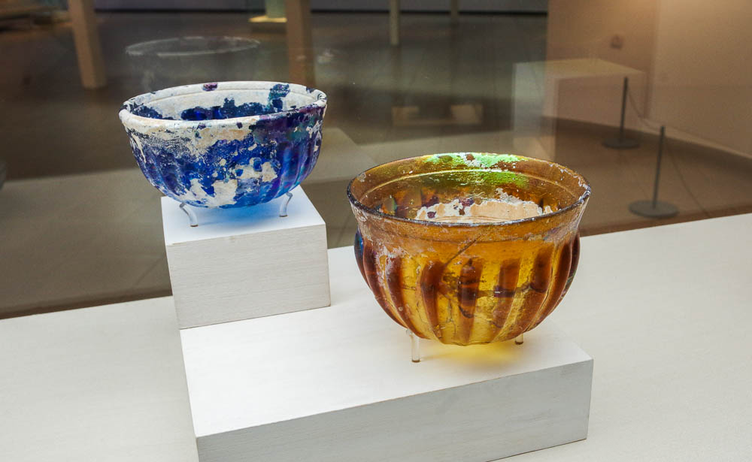
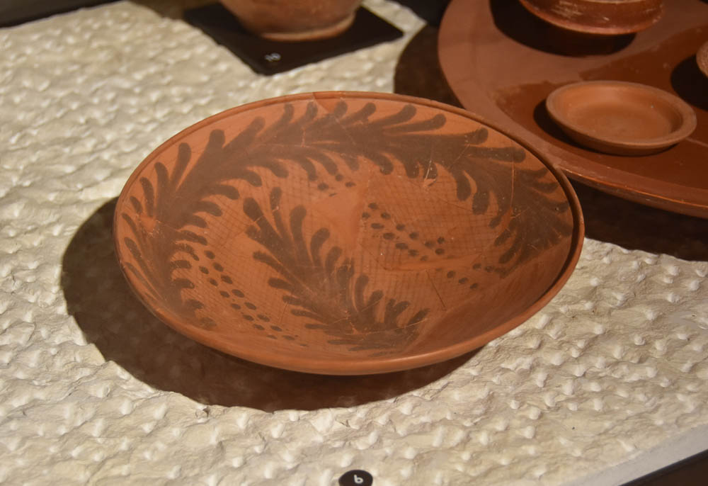
Christian – Abstaining and Attaining
1Peter 3:7 Husbands,
likewise, dwell with them with understanding, giving honor to the wife,
as to the weaker vessel,
and as being heirs together of the grace of life, that your prayers may not be hindered.

Slide 26
Christian – Abstaining and Attaining
1Peter 3:8 Finally, all of you be of one mind, having compassion for one another; love as brothers, be tenderhearted, be courteous;
9 not returning evil for evil or reviling for reviling, but on the contrary blessing, knowing that you were called to this, that you may inherit a blessing.

Slide 27
Christian – Abstaining and Attaining
1Peter 3:10 For "He who would love life And see good days, Let him refrain his tongue from evil, And his lips from speaking deceit.
11 Let him turn away from evil and do good; Let him seek peace and pursue it.
12 For the eyes of the LORD are on the righteous, And His ears are open to their prayers; But the face of the LORD is against those who do evil."

Slide 28
Christian – Abstaining and Attaining
A Christian is one whose
life is a sermon.
The Christian abstains from fleshly lusts. 1Peter 2:11
The Christian Preaches Good Citizenship. 1Peter 2:13-17
The Christian’s Business Life Is A Sermon. 1Peter 2:18-24
The Power Of a Godly Life In The Home. 1Peter 3:1-7

