Slide 1
Welcome to our services
New Lebanon Church of Christ
We are Simply Christians.
Our Emphasis is Spiritual, Not Material or Social.
We are striving to be The Same Church as Described in The New Testament.
Please Come Back Again

Slide 2
Are You Satisfied?
Isaiah 55:2 Why do you spend money for what is not bread, And your wages for what does not satisfy? Listen carefully to Me, and eat what is good, And let your soul delight itself in abundance.

Slide 3
Psalm 17:15. As for me, I will see Your face in righteousness; I shall be satisfied when I awake in Your likeness.

Slide 4
Are You Satisfied?
SATISFY
chortazo (χορτάζω, 5526), “to fill or satisfy with food,” is translated “satisfy” in Mark 8:4,
Mark 8:4 Then His disciples answered Him, "How can one satisfy these people with bread here in the wilderness?"
2. empiplemi or empletho (ἐμπίπλημι, 1705), “to fill up, fill full, satisfy” (en, “in,” pimplemi or pletho, “to fill”), is used metaphorically in Rom. 15:24, of taking one’s fill of the company of others, rv, “I shall have been satisfied” (kjv, “I be … filled”). See fill, No. 6.
For SATISFYING, Col. 2:23, kjv, see indulgence
W. E. Vine, Merrill F. Unger, and William White Jr., Vine’s Complete Expository Dictionary of Old and New Testament Words (Nashville, TN: T. Nelson, 1996), 547.

Slide 5
Are You Satisfied?
Satisfaction
noun
The fulfillment or gratification of a desire, need, or appetite.
Pleasure or contentment derived from such gratification. took satisfaction in being vindicated.
An instance of being satisfied or a source of gratification.
from The American Heritage® Dictionary of the English Language, 5th Edition.

Slide 8
Are You Satisfied?
1. The Nature Of “This World
It can give “pleasure” but not “satisfaction.”
It can give “entertainment,” but not “contentment.”
It can give “gold” but not “God.”

Slide 11
Are You Satisfied?
1. The Nature Of “This World
1John 2:17
And the world is passing away, and the lust of it;
but he who does the will of God abides forever.

Slide 12
Are You Satisfied?
1John 2:17
All of the vain things that charm, seduce and dominate the lives of people during their brief pilgrimage upon earth are actually endowed with no more permanence than a mirage.
Whatever glory or eminence may come to man is only for the fraction of a moment; he builds for himself a house, a palace or an empire; but the whirling suns brush him into the grave, and where is he? Whatever achievement, success or honor may place upon his head for an instant some distinction or accolade, tomorrow cannot remember it.
This tragic quality of all human glory is the reason why the apostles taught Christians to look to the unseen, the invisible realities of hope and faith in Christ for their true fulfillment.
James B. Coffman, , The James Burton Coffman Commentaries (A. C. U. Press, 1984).

Slide 13
“All of the vain things that so charm, seduce and dominate the lives of people during their brief pilgrimage upon earth are actually endowed with no more permanence than a mirage.”

Slide 14
Are You Satisfied?
Heb 11:25 choosing rather to suffer affliction with the people of God than to enjoy the passing pleasures of sin,

Slide 15
Are You Satisfied?
2. Why This World Cannot Satisfy The Soul.
Because the nature of the soul is “spiritual.” Not earthly.
Because man was made with a capacity for “deity.”

Slide 16
Why don’t you
?

Slide 17
Are You Satisfied?
Because the things you have are only temporary and passing away.
1John 2:17
And the world is passing away, and the lust of it;
but he who does the will of God abides forever.

Slide 18
Ecc. 3:11 He has made everything beautiful in its time. Also He has put eternity in their hearts, except that no one can find out the work that God does from beginning to end.

Slide 19
Are You Satisfied?
3. How Does God Offer Satisfaction?
God can satisfy the sinner in bondage with “deliverance.”
God can satisfy the soul in guilt with “pardon.”
God can satisfy the polluted conscience with “peace.”

Slide 20
Are You Satisfied?
4. David Realizes That Satisfaction Can Only Come From God’s Salvation.
Psalm 17:15 As for me, I will see Your face in righteousness; I shall be satisfied when I awake in Your likeness.
“I shall be satisfied when.” (Text)
When I awake from sin to salvation.
When I awake from death in heaven.
When we awake to be like him. (His image 1 Cor. 15:49)
The eye will be satisfied with seeing the King (Isaiah 33:17)
The ear with hearing (Rev. 5:11)

Slide 21
Are You Satisfied?
Psalm 17:1 <<A Prayer of David.>> Hear a just cause, O LORD, Attend to my cry; Give ear to my prayer which is not from deceitful lips.
2 Let my vindication come from Your presence; Let Your eyes look on the things that are upright.
3 You have tested my heart; You have visited me in the night; You have tried me and have found nothing; I have purposed that my mouth shall not transgress.
4 Concerning the works of men, By the word of Your lips, I have kept away from the paths of the destroyer.
5 Uphold my steps in Your paths, That my footsteps may not slip.

Slide 22
Are You Satisfied?
6 I have called upon You, for You will hear me, O God; Incline Your ear to me, and hear my speech.
7 Show Your marvelous lovingkindness by Your right hand, O You who save those who trust in You From those who rise up against them.
8 Keep me as the apple of Your eye; Hide me under the shadow of Your wings,
9 From the wicked who oppress me, From my deadly enemies who surround me.
10 They have closed up their fat hearts; With their mouths they speak proudly.

Slide 23
Are You Satisfied?
11 They have now surrounded us in our steps; They have set their eyes, crouching down to the earth,
12 As a lion is eager to tear his prey, And like a young lion lurking in secret places.
13 Arise, O LORD, Confront him, cast him down; Deliver my life from the wicked with Your sword,
14 With Your hand from men, O LORD, From men of the world who have their portion in this life, And whose belly You fill with Your hidden treasure. They are satisfied with children, And leave the rest of their possession for their babes.
15 As for me, I will see Your face in righteousness; I shall be satisfied when I awake in Your likeness.

Slide 24
Are You Satisfied?
Psalm 17:15 As for me, I will see Your face in righteousness; I shall be satisfied when I awake in Your likeness.
This is the cry of awakened souls. It is a spirit that has tasted earth’s treasures and found it wanting. Man was not made to be satisfied here.
David… Moses
How about YOU?

Slide 25
Are You Satisfied?
As Paul put it:
We look not at the things which are seen, but at the things which are not seen: for the things which are seen are temporal; but the things which are not seen are eternal (2 Cor. 4:18).
Are you satisfied?

Slide 26
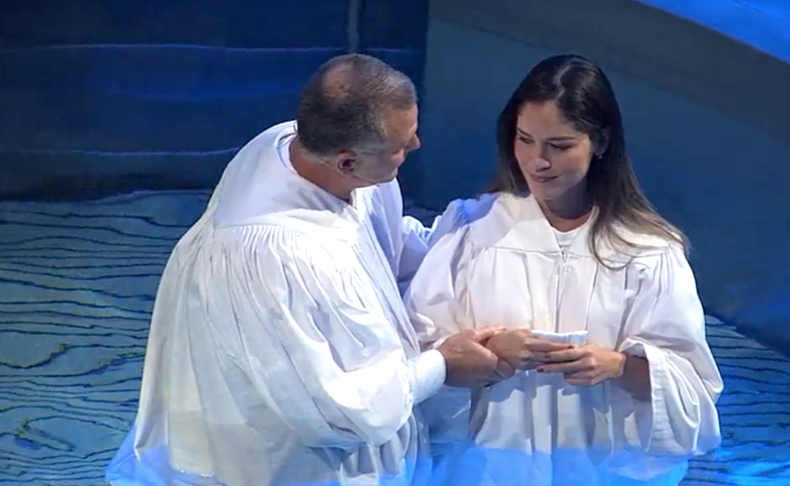
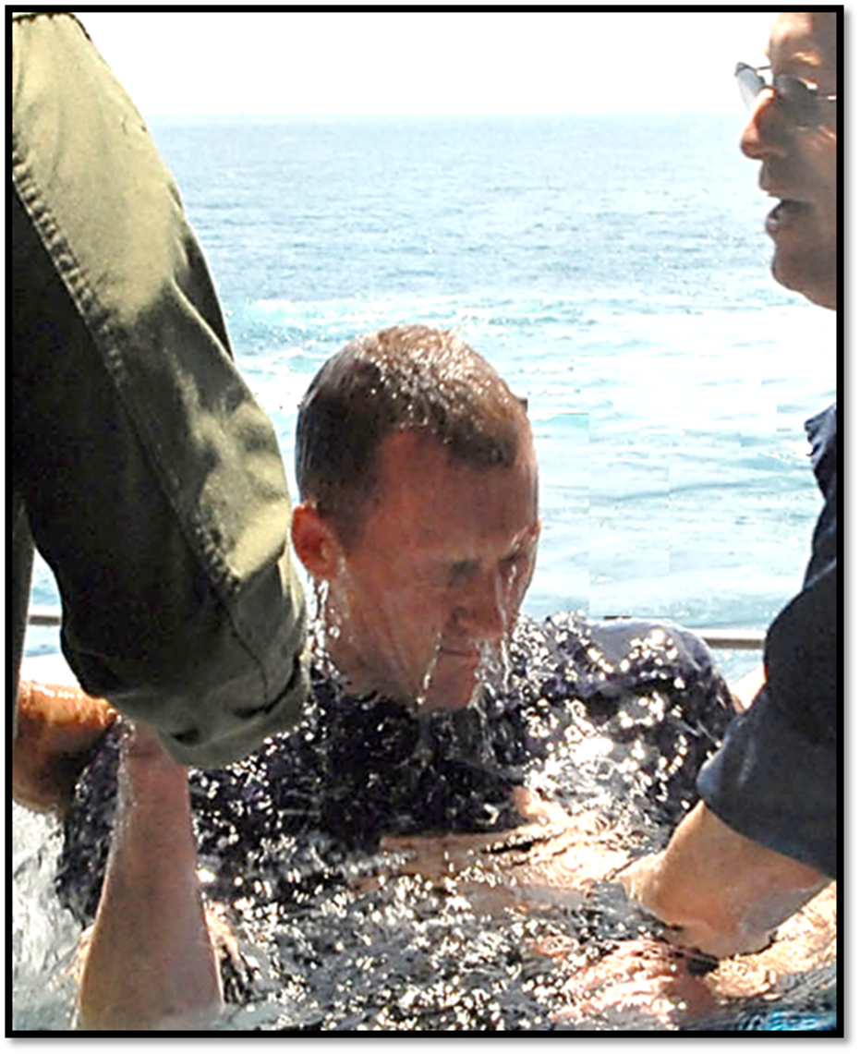
How do we get into the church? We are baptized into Christ and the Lord adds us to His church.
Acts 2:47 praising God and having favor with all the people. And the Lord added to the church daily those who were being saved.

