Slide 1
Welcome to our services
New Lebanon Church of Christ
We are Simply Christians.
Our Emphasis is Spiritual, Not Material or Social.
We are striving to be The Same Church as Described in The New Testament.
Please Come Back Again

Slide 2
Seven Lies Satan Wants You To Believe
John 8:44 "You are of your father the devil, and the desires of your father you want to do. He was a murderer from the beginning, and does not stand in the truth, because there is no truth in him.
When he speaks a lie, he speaks from his own resources, for he is a liar and the father of it.

Slide 3
Seven Lies Satan Wants You To Believe
Have you ever known someone who told lies?
Have you ever told a lie?
Has anyone ever told a lie on you? Ex.20:16 "You shall not bear false witness against your neighbor.
Have you ever believed a lie?
When we lie, we are claiming kinship with the devil.
John 8:44 for he is a liar and the father of it.
When one rejects the truth, all that is left are lies.
To believe a lie is to be deceived. The Bible says a lot about being deceived.

Slide 4
Seven Lies Satan Wants You To Believe
Purpose Statement.
Satan is the father of lies and the great deceiver. It is our responsibility that we do not allow him to deceive us. In this lesson, we want to consider some of the lies he tells us.

Slide 5
Seven Lies Satan Wants You To Believe
America is believing Many lies. America has:
Taught its people to ridicule God’s word and called it open-mindedness
Taught its people to worship other gods and called it multi-culturalism.
Taught its people to be lazy and called it welfare.
Taught its people to kill babies and called it a woman’s choice.
Taught its people to live in fornication (man with woman or man with man) and called it an alternate life style.

Slide 6
Seven Lies Satan Wants You To Believe
Taught its young people to use “protection” and called it sexual freedom.
Taught its people not to discipline its children and called it
the building of self-esteem.
Taught its people to throw God out of our schools and government and called it separation between church and state.
Taught its people to believe we evolved from an ape and we call it science.
Taught its people that there are no absolute truths and we call ourselves a learned generation.

Slide 7
Seven Lies Satan Wants You To Believe
America must get back in step with the word of God!
2 Thess. 2:8-12 And then the lawless one will be revealed, whom the Lord will consume with the breath of His mouth and destroy with the brightness of His coming. 9 The coming of the lawless one is according to the working of Satan, with all power, signs, and lying wonders,
10 and with all unrighteous deception among those who perish, because they did not receive the love of the truth, that they might be saved.
11 And for this reason God will send them strong delusion, that they should believe the lie,
12 that they all may be condemned who did not believe the truth but had pleasure in unrighteousness.

Slide 8
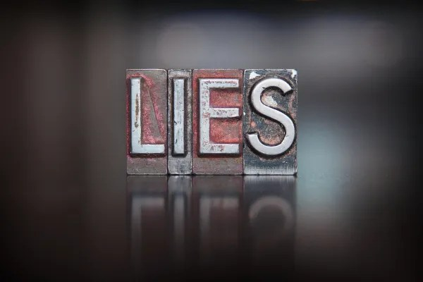
Seven Lies Satan Wants You To Believe
Billions of people are believing the devil’s lies.
Let’s look at 7

Slide 9
Seven Lies Satan Wants You To Believe
1. The word of God is not true.
Genesis 3:1-4 Now the serpent was more cunning than any beast of the field which the LORD God had made. And he said to the woman, "Has God indeed said, 'You shall not eat of every tree of the garden'?"
2 And the woman said to the serpent, "We may eat the fruit of the trees of the garden;
3 "but of the fruit of the tree which is in the midst of the garden, God has said, 'You shall not eat it, nor shall you touch it, lest you die.'"
4 Then the serpent said to the woman, "You will not surely die.”

Slide 10
Seven Lies Satan Wants You To Believe
2. God will make an exception in my case.
Joshua 7:12 "Therefore the children of Israel could not stand before their enemies, but turned their backs before their enemies, because they have become doomed to destruction. Neither will I be with you anymore, unless you destroy the accursed from among you.
13 "Get up, sanctify the people, and say, 'Sanctify yourselves for tomorrow, because thus says the LORD God of Israel: "There is an accursed thing in your midst, O Israel; you cannot stand before your enemies until you take away the accursed thing from among you."

Slide 11
Seven Lies Satan Wants You To Believe
2. God will make an exception in my case.
Joshua 7:21 "When I saw among the spoils a beautiful Babylonian garment, two hundred shekels of silver, and a wedge of gold weighing fifty shekels, I coveted them and took them. And there they are, hidden in the earth in the midst of my tent, with the silver under it.“
(Defeat at AI, and sin of Achan)

Slide 12
Seven Lies Satan Wants You To Believe
2. God will make an exception in my case.
Do not forget Sodom and Gomorrah.
Lot’s wife.
In the days of Noah, God judged those people because every imagination of their hearts were on evil continually.
Nadab and Abihu.

Slide 13
Seven Lies Satan Wants You To Believe
2. God will make an exception in my case.
Israel was carried into Babylonian captivity. The Northern Kingdom was carried into Assyrian captivity.
Judas Iscariot did not get by with his sin: John 17:12 While I was with them in the world, I kept them in Your name. Those whom You gave Me I have kept; and none of them is lost except the son of perdition, that the Scripture might be fulfilled.
You will not be, I will not be, the great exception.

Slide 14
Seven Lies Satan Wants You To Believe
3. I cannot be happy if I live a Christian life.
Some go out at night for happy hour. The only happy hour on the face of the earth is when one is right with his God:
John 10:10 "The thief does not come except to steal, and to kill, and to destroy. I have come that they may have life, and that they may have it more abundantly.

Slide 15
Seven Lies Satan Wants You To Believe
3. I cannot be happy if I live a Christian life.
Some believe that Christianity is for old people. Too old to have fun.
Some are so double-minded that they will never be happy: James 1:8 he is a double-minded man, unstable in all his ways.

Slide 16
Seven Lies Satan Wants You To Believe
3. I cannot be happy if I live a Christian life.
James 4:8 Draw near to God and He will draw near to you. Cleanse your hands, you sinners; and purify your hearts, you double-minded.
Some people have just enough religion to make them miserable. They want to know if they have to attend every service, do they have to read their Bible, do they have to pray, do they have to talk to others about their soul, etc.

Slide 17
Seven Lies Satan Wants You To Believe
4. That there are many ways to Heaven.
John 14:6 Jesus said to him, "I am the way, the truth, and the life. No one comes to the Father except through Me.
Matt.7:15 Beware of false prophets, who come to you in sheep's clothing, but inwardly they are ravenous wolves.

Slide 18
Seven Lies Satan Wants You To Believe
4. That there are many ways to Heaven.
2 Cor.11:13-15 For such are false apostles, deceitful workers, transforming themselves into apostles of Christ.
14 And no wonder! For Satan himself transforms himself into an angel of light.15 Therefore it is no great thing if his ministers also transform themselves into ministers of righteousness, whose end will be according to their works.

Slide 19
Seven Lies Satan Wants You To Believe
4. That there are many ways to Heaven.
Prov. 28:26 He who trusts in his own heart is a fool, But whoever walks wisely will be delivered.
Prov. 14:12 There is a way that seems right to a man, But its end is the way of death.
Matt. 7:21-23
You and I do not have a vote on how many ways there are to God.

Slide 20
Seven Lies Satan Wants You To Believe
5. My sin is my business and I am not hurting anyone but me.
My sin is my business and I am not hurting anyone but me.
A man gets involved in a sin and then does not want to talk about it. He thinks that it is none of the church’s business.
Mothers and fathers, where are we leading our children? (they will remember what they saw you do over what they were told)
David destroyed his family because of his adultery and murder.

Slide 21
Seven Lies Satan Wants You To Believe
5. My sin is my business and I am not hurting anyone but me.
2 Sam. 12:9-11 'Why have you despised the commandment of the LORD, to do evil in His sight? You have killed Uriah the Hittite with the sword; you have taken his wife to be your wife, and have killed him with the sword of the people of Ammon.
10 'Now therefore, the sword shall never depart from your house, because you have despised Me, and have taken the wife of Uriah the Hittite to be your wife.'
11 "Thus says the LORD: 'Behold, I will raise up adversity against you from your own house; and I will take your wives before your eyes and give them to your neighbor, and he shall lie with your wives in the sight of this sun.12 'For you did it secretly, but I will do this thing before all Israel, before the sun.’”….and the child shall die

Slide 22
Seven Lies Satan Wants You To Believe
5. My sin is my business and I am not hurting anyone but me.
Rom. 14:7 For none of us lives to himself, and no one dies to himself.
The only gospel that some people will read will be your life. What is the gospel according to your life?
How many mothers and fathers have taken their children to a devil’s hell?
How many husbands and wives have taken their mates to hell?

Slide 23
Seven Lies Satan Wants You To Believe
5. My sin is my business and I am not hurting anyone but me.
God expects you to maintain a great stewardship over your life. Do not tell me it is your life. The lives of others count too.
1 Cor. 4:2 Moreover it is required in stewards that one be found faithful.
I must control my vessel so as not to hurt others.

Slide 24
Seven Lies Satan Wants You To Believe
5. My sin is my business and I am not hurting anyone but me.
1 Thess. 4:3-6 For this is the will of God, your sanctification: that you should abstain from sexual immorality;4 that each of you should know how to possess his own vessel in sanctification and honor,
5 not in passion of lust, like the Gentiles who do not know God; 6 that no one should take advantage of and defraud his brother in this matter, because the Lord is the avenger of all such, as we also forewarned you and testified.

Slide 25
Seven Lies Satan Wants You To Believe
5. My sin is my business and I am not hurting anyone but me.
1 Cor. 15:33 Do not be deceived: "Evil company corrupts good habits."
1 Cor. 5:6 Your glorying is not good. Do you not know that a little leaven leavens the whole lump?

Slide 26
Seven Lies Satan Wants You To Believe
6. There is no judgment day.
Acts 17:30,31 Truly, these times of ignorance God overlooked, but now commands all men everywhere to repent, 31 "because He has appointed a day on which He will judge the world in righteousness by the Man whom He has ordained. He has given assurance of this to all by raising Him from the dead."

Slide 27
Seven Lies Satan Wants You To Believe
6. There is no judgment day.
Matt. 25:46 "And these will go away into everlasting punishment, but the righteous into eternal life.“
2 Thess. 1:7,8 and to give you who are troubled rest with us when the Lord Jesus is revealed from heaven with His mighty angels,
8 in flaming fire taking vengeance on those who do not know God, and on those who do not obey the gospel of our Lord Jesus Christ. 9 These shall be punished with everlasting destruction from the presence of the Lord and from the glory of His power,

Slide 28
Seven Lies Satan Wants You To Believe
6. There is no judgment day.
We will reap what we have sown: Gal. 6:7,8
What if today were your last day?

Slide 29
Seven Lies Satan Wants You To Believe
7. You have plenty of time to obey God.
The devil had a meeting in hell on how to deceive the people.
One demon said, Let us tell them the Bible is not true.
The devil replied, That will work but only up to a point.
A second demon said, Let us tell them that Jesus is not Lord.
The devil replied, That will work but only up to a point.
An older demon suggested, Let us say that the Bible is the word of God and that Jesus is Lord, but let us convince the people that they have all the time in the world to obey him.
The devil loved it!

Slide 30
Seven Lies Satan Wants You To Believe
7. You have plenty of time to obey God.
What if today were your last day on earth? Where would you be in eternity?
Acts 24:25 Now as he reasoned about righteousness, self-control, and the judgment to come, Felix was afraid and answered, "Go away for now; when I have a convenient time I will call for you."
If you wait for a convenient season to obey God, then I am afraid that it might not come. Now is the day of salvation.

Slide 31
Friend,
1. The word of God is true.
2. God will not make an exception in my case.
3. I can be happy if I live a Christian life.
4. There is only one way to Heaven.
5. My sin is your business and I affect and influence everyone I am around.
6. There is a judgment day.
7. You do not have plenty of time to obey God.

Slide 32
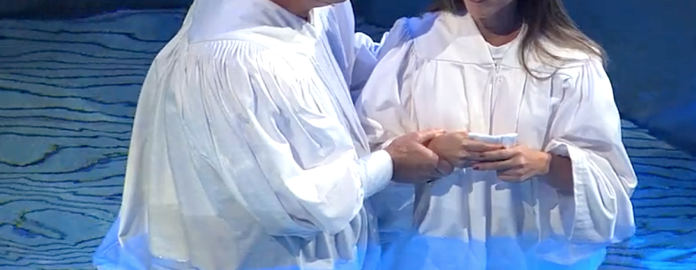
Are you a New Testament Christian?
Hear the Gospel (Rom.10:14)
Believe the Gospel (Heb. 11:6)
Repent of Sins (Acts 3:19)
Confess Christ (Rom.10:9)
Be Baptized Into Christ (1 Cor.12:13)
Serve our Lord the rest of our lives (Rev.2:10)
You Must Be Born Again. John 3:1-7

