Slide 1
Welcome to our services
New Lebanon Church of Christ
We are Simply Christians.
Our Emphasis is Spiritual, Not Material or Social.
We are striving to be The Same Church as Described in The New Testament.
Please Come Back Again

Slide 2
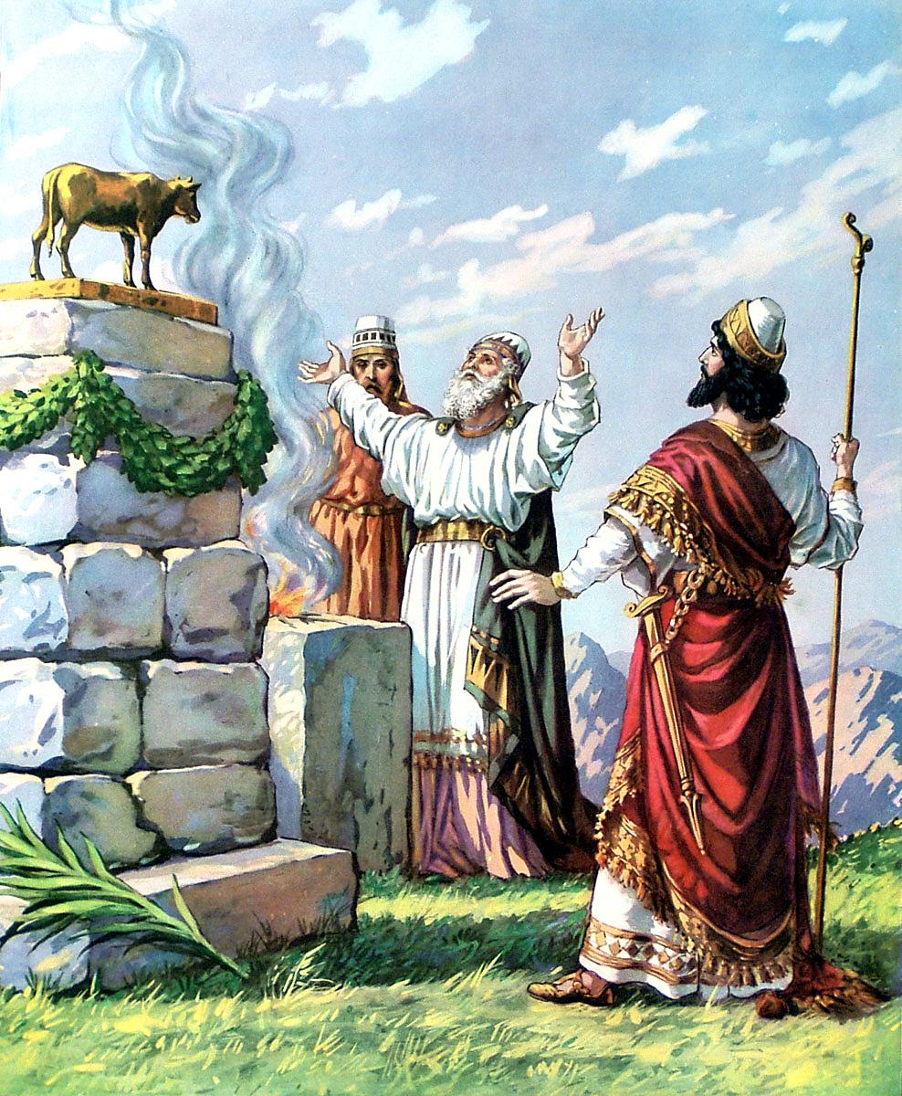
The Worship Service
Of Jeroboam.

Slide 3
The Worship Service Of Jeroboam
1Kings 12:25 Then Jeroboam built Shechem in the mountains of Ephraim, and dwelt there. Also he went out from there and built Penuel.
26 And Jeroboam said in his heart, "Now the kingdom may return to the house of David:
27 "If these people go up to offer sacrifices in the house of the LORD at Jerusalem, then the heart of this people will turn back to their lord, Rehoboam king of Judah, and they will kill me and go back to Rehoboam king of Judah."
28 Therefore the king asked advice, made two calves of gold, and said to the people, "It is too much for you to go up to Jerusalem. Here are your gods, O Israel, which brought you up from the land of Egypt!"
29 And he set up one in Bethel, and the other he put in Dan.

Slide 4
The Worship Service Of Jeroboam
30 Now this thing became a sin, for the people went to worship before the one as far as Dan.
31 He made shrines on the high places, and made priests from every class of people, who were not of the sons of Levi.
32 Jeroboam ordained a feast on the fifteenth day of the eighth month, like the feast that was in Judah, and offered sacrifices on the altar. So he did at Bethel, sacrificing to the calves that he had made. And at Bethel he installed the priests of the high places which he had made.
33 So he made offerings on the altar which he had made at Bethel on the fifteenth day of the eighth month, in the month which he had devised in his own heart. And he ordained a feast for the children of Israel, and offered sacrifices on the altar and burned incense.

Slide 5
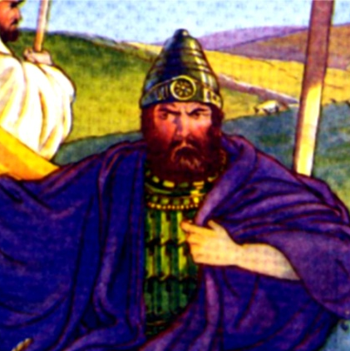
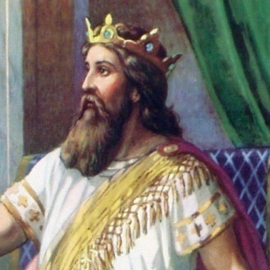
The End Of The United Kingdom
The kingdom lasted 120 years before dividing
Saul reigned 40 years (Acts 13:21)
David reigned 40 years (2 Sam. 5:4)
Solomon reigned 40 years (1 Kings 11:42)
10 Tribes formed the Northern Kingdom called Israel
The Southern Kingdom was the tribe of Judah
SAUL
DAVID
SOLOMON

Slide 6
The Worship Service Of Jeroboam
Jeroboam[1] (Jeroboam I)
(died 909 BC; reigned 930–909 BC)
Son of Nebat and Zeruah. Father of Nadab[2]. King of Israel. An Ephraimite from Zeredah. An official of Solomon, in charge of the labor force of the house of Joseph. Ahijah[3] told him that he would rule over the 10 tribes of Israel whereas only one tribe would be retained by Solomon and his descendants. When Solomon heard about this, he tried to kill Jeroboam, who fled to Egypt. He stayed there until Solomon died and was succeeded by his son Rehoboam. Rehoboam treated the Israelites harshly. Jeroboam settled in Shechem, in the hill country of Ephraim. He built up Peniel and set up golden calves in Bethel and Dan to deter the people from going to Jerusalem. Pagan worship developed among the Israelite tribes, leading to judgment from the Lord. Jeroboam did not heed the Lord’s warnings. His own son died because of his pagan tendencies and wicked activities. He reigned over the Israelite tribes for 22 years and was succeeded by his son Nadab. During his reign he warred against Judah, which was led by Rehoboam, Abijah[3] and Asa[1]. Jeroboam’s army was defeated by Abijah, and Jeroboam never really regained power before he died.
(11:26–40; 12:2–15, 25–33; 13:1–10, 33–34; 14:1–20; 15:1, 6–7, 9, 25–30; 2 Kings 3:3; 9:9; 13:2; 2 Chronicles 9:29; 10:2–16; 11:4, 14; 12:15; 13:1–20)
Martin H. Manser and Debra Reid, Who’s Who of the Bible: Everything You Need to Know about Everyone Named in the Bible (Oxford, England: Lion Books, 2013).

Slide 8
The Worship Service Of Jeroboam
Background of text:
Jeroboam had been promised rulership of 10 tribes while Solomon was still alive, and was promised he would prosper if faithful to God’s law 1 Kings 11:26-40.
Solomon died and Rehoboam reigned in his stead.
The people asked Rehoboam to lighten the yoke Solomon had placed upon them. Rehoboam refused, threatened to increase it instead.
Jeroboam was not content to trust God’s promise by keeping the law but chose instead to modify it to suit his own purposes.

Slide 9
The Worship Service Of Jeroboam
It’s source- human wisdom.
Jeroboam ordained a feast…in the month which he had devised of his own heart. v31-33
So it is with false religions now also.

Slide 10
The Worship Service Of Jeroboam
It’s source- human wisdom.
Paul tells us in Col.2:18-23 Let no one cheat you of your reward, taking delight in false humility and worship of angels, intruding into those things which he has not seen, vainly puffed up by his fleshly mind,
19 and not holding fast to the Head, from whom all the body, nourished and knit together by joints and ligaments, grows with the increase that is from God.
20 Therefore, if you died with Christ from the basic principles of the world, why, as though living in the world, do you subject yourselves to regulations-- 21 "Do not touch, do not taste, do not handle,"
22 which all concern things which perish with the using--according to the commandments and doctrines of men? 23 These things indeed have an appearance of wisdom in self-imposed religion, false humility, and neglect of the body, but are of no value against the indulgence of the flesh.

Slide 11
The Worship Service Of Jeroboam
It’s source- human wisdom.
Paul also tells us Acts 26:9 "Indeed, I myself thought I must do many things contrary to the name of Jesus of Nazareth.
Jesus tells us Matt.7:21-23 "Not everyone who says to Me, 'Lord, Lord,' shall enter the kingdom of heaven, but he who does the will of My Father in heaven.
22 "Many will say to Me in that day, 'Lord, Lord, have we not prophesied in Your name, cast out demons in Your name, and done many wonders in Your name?'
23 "And then I will declare to them, 'I never knew you; depart from Me, you who practice lawlessness!'

Slide 12
The Worship Service Of Jeroboam
Its motive – to make followers of the people.
Jeroboam was afraid to let the people go to Jerusalem to worship as God ordained for fear of losing their devotion to Rehoboam v26-27
The same motives underlies much of the false teaching done now
Paul warned the Ephesian elders in Acts 20:28-30 "Therefore take heed to yourselves and to all the flock, among which the Holy Spirit has made you overseers, to shepherd the church of God which He purchased with His own blood.
29 "For I know this, that after my departure savage wolves will come in among you, not sparing the flock.
30 "Also from among yourselves men will rise up, speaking perverse things, to draw away the disciples after themselves.

Slide 13
The Worship Service Of Jeroboam
Its motive – to make followers of the people.
Peter warns us in….2Peter 2:1-3
But there were also false prophets among the people, even as there will be false teachers among you, who will secretly bring in destructive heresies, even denying the Lord who bought them, and bring on themselves swift destruction.

Slide 14
The Worship Service Of Jeroboam
Its appeal – convenience, make worship easier for the people.
Jeroboam said Jerusalem was too far to go (God’s word to the contrary being ignored v.28).

Slide 16
The Worship Service Of Jeroboam
Its appeal – convenience, make worship easier for the people
False teaching uses the same appeal now
Paul exhorted Timothy in…2Tim 4:2-4 Preach the word! Be ready in season and out of season. Convince, rebuke, exhort, with all longsuffering and teaching.
3 For the time will come when they will not endure sound doctrine, but according to their own desires, because they have itching ears, they will heap up for themselves teachers; 4 and they will turn their ears away from the truth, and be turned aside to fables.

Slide 17
The Worship Service Of Jeroboam
Its appeal – convenience, make worship easier for the people
and Jude warns us in… Jude 4 For certain men have crept in unnoticed, who long ago were marked out for this condemnation, ungodly men, who turn the grace of our God into lewdness and deny the only Lord God and our Lord Jesus Christ.
Teachers and hearers need to consider Gal 1:10 For do I now persuade men, or God? Or do I seek to please men? For if I still pleased men, I would not be a bondservant of Christ.

Slide 18
The Worship Service Of Jeroboam
Its appearance – similar to the truth.
Jeroboam’s feast was like unto the feast that is in Judah (v32) False teachers contrive things in the same way now, make error palatable by giving it the appearance of truth
Warning of Paul in… (2Cor.11:12-15) But what I do, I will also continue to do, that I may cut off the opportunity from those who desire an opportunity to be regarded just as we are in the things of which they boast.
13 For such are false apostles, deceitful workers, transforming themselves into apostles of Christ.
14 And no wonder! For Satan himself transforms himself into an angel of light.
15 Therefore it is no great thing if his ministers also transform themselves into ministers of righteousness, whose end will be according to their works.

Slide 19
The Worship Service Of Jeroboam
Its effect – progressively downward
Jeroboam started with---
changing the place of worship,
2 calves of gold,
a different feast,
appointing unqualified priests,
Also the children of Israel secretly did against the LORD their God things that were not right, and they built for themselves high places in all their cities, from watchtower to fortified city.
Virtual services
Unqualified elders

Slide 20
The Worship Service Of Jeroboam
Its effect – progressively downward
10 They set up for themselves sacred pillars and wooden images on every high hill and under every green tree.
11 There they burned incense on all the high places, like the nations whom the LORD had carried away before them; and they did wicked things to provoke the LORD to anger,
12 for they served idols, of which the LORD had said to them, "You shall not do this thing."

Slide 21
The Worship Service Of Jeroboam
Its effect – progressively downward
(2Kings 17:16) So they left all the commandments of the LORD their God, made for themselves a molded image and two calves, made a wooden image and worshiped all the host of heaven, and served Baal.
17 And they caused their sons and daughters to pass through the fire, practiced witchcraft and soothsaying, and sold themselves to do evil in the sight of the LORD, to provoke Him to anger.
False religions do the same now, the path from God always leads downhill (2Tim.3:13) But evil men and impostors will grow worse and worse, deceiving and being deceived.

Slide 22
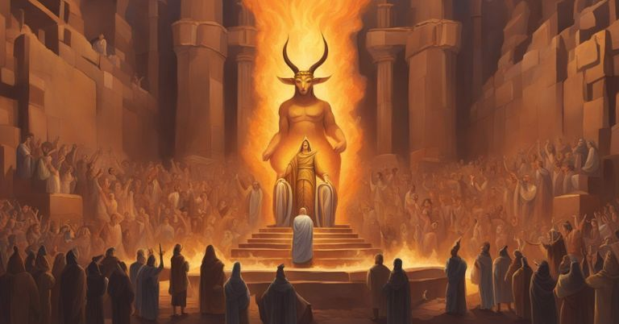
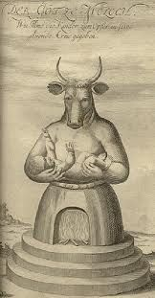
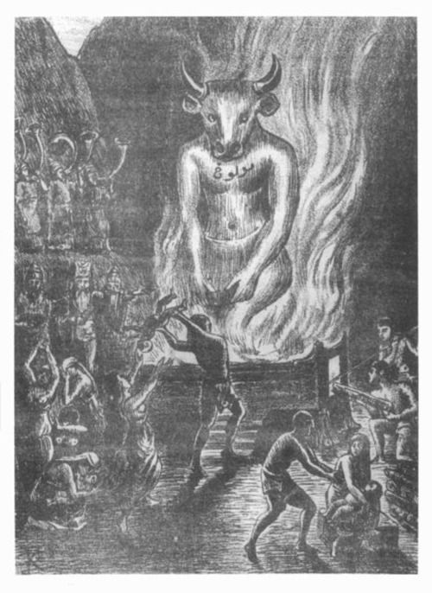
17 And they caused their sons and daughters to pass through the fire, practiced witchcraft and soothsaying, and sold themselves to do evil in the sight of the LORD, to provoke Him to anger.

Slide 23
The Worship Service Of Jeroboam
Its effect – progressively downward
Notice the antidote for this wickedness:
(2Tim 3:14-17) But you must continue in the things which you have learned and been assured of, knowing from whom you have learned them,
15 and that from childhood you have known the Holy Scriptures, which are able to make you wise for salvation through faith which is in Christ Jesus.
16 All Scripture is given by inspiration of God, and is profitable for doctrine, for reproof, for correction, for instruction in righteousness,
17 that the man of God may be complete, thoroughly equipped for every good work.

Slide 24
The Worship Service Of Jeroboam
Its result – perdition (destruction)
Natural perdition for Israel (2kings 17:18) Therefore the LORD was very angry with Israel, and removed them from His sight; there was none left but the tribe of Judah alone.
Eternal spiritual perdition eventually for all false worshippers
(Matt.7:21-23)

Slide 25
The Worship Service Of Jeroboam
Its result – perdition (destruction)
(Matt.13:42-43) "and will cast them into the furnace of fire. There will be wailing and gnashing of teeth. 43 "Then the righteous will shine forth as the sun in the kingdom of their Father. He who has ears to hear, let him hear!
Compare sacrificing children in fire with God casting disobedient souls into furnace of fire.

Slide 26
The Worship Service Of Jeroboam
The Sins Of Jeroboam 1 Kings 12:25-33 (2 Chron. 13:8-10) His attempt to secure his kingdom became his downfall (12:25-27) Calf worship in Bethel and Dan (12:28-33; cf. Hosea 8:4-7) 1. Changed the object of worship - 12:28 2. Changed the place of worship - 12:29, 31 3. Changed the priesthood - 12:31 (13:33) 4. Changed the feast days - 12:32 Devised in his own heart (12:33)
"More evil than all who were before you" (1 Kings 14:9) "The sins of Jeroboam" a marker of subsequent sins in Israel (1 Kings 14:16; 2 Kings 17:21-23)

Slide 27
Departing from the pattern is often based on emotion,
not scripture.

Slide 28
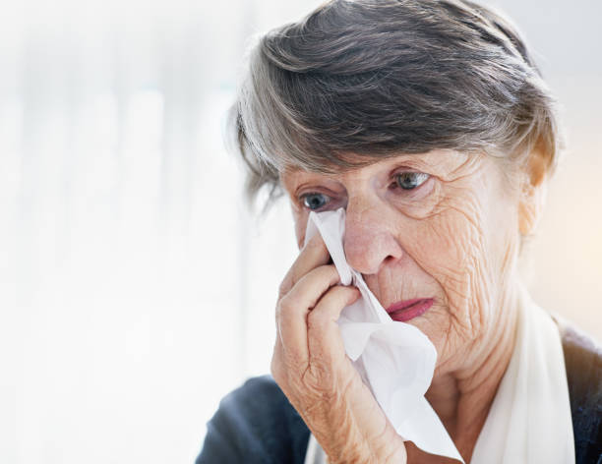
“You people from the church of Christ are too legalistic…
you just don’t care.”

Slide 30
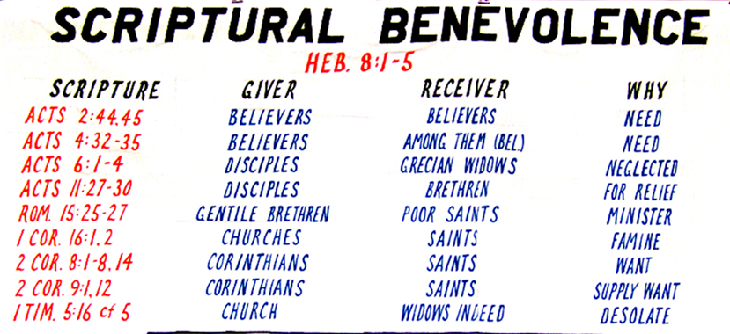
Acts 11:27-30 The Bible Pattern
And in these days prophets came from Jerusalem to Antioch. 28 Then one of them, named Agabus, stood up and showed by the Spirit that there was going to be a great famine throughout all the world, which also happened in the days of Claudius Caesar.
29 Then the disciples, each according to his ability, determined to send relief to the brethren dwelling in Judea. 30 This they also did, and sent it to the elders
by the hands of Barnabas and Saul.

Slide 31
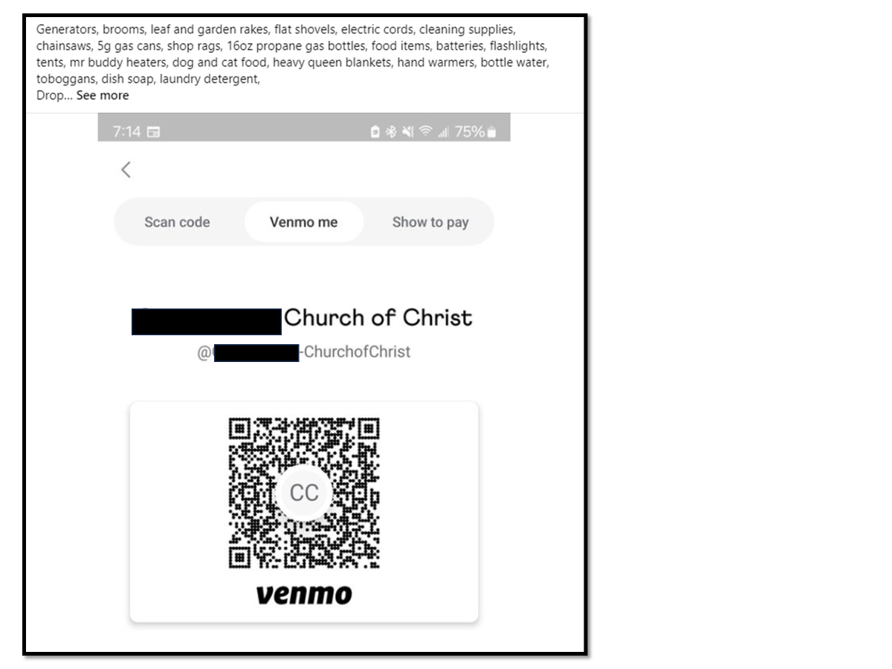
The Worship Service
Of Jeroboam.
…another “agency to do the Lord’s work – compare sending $ to elders of another congregation “earmarked” to support preacher.

Slide 32
The issue is not whether an individual or institution is worthy of receiving money.
The issue is - can we take
the $ from the Lord’s treasury?
The issue is - are we following
the Lord’s pattern?
Is it a responsibility
of the church or individual?

Slide 33
The Worship Service Of Jeroboam
Jeroboam is alive Today
Virtual vs assembly
Donate button vs 1 Cor16 now concerning the collection
Automatic withdrawal vs 1 Cor16 now concerning the collection
One assembly per week vs Acts 2:46 continuing daily
Lower qualifications for elders vs 1 Tim 3:1 an elder must be (modifies all qualifications)
Checklist worship vs Luke 17:10 unprofitable servants
Soft preaching vs reprove, rebuke, exhort 1Tim. 4:2

Slide 34
The Worship Service
Of Jeroboam.

