Slide 1
Welcome to our services
New Lebanon Church of Christ
We are Simply Christians.
Our Emphasis is Spiritual, Not Material or Social.
We are striving to be The Same Church as Described in The New Testament.
Please Come Back Again

Slide 2
How We Got The Bible
2Timothy 3:16 All Scripture is given by inspiration of God, and is profitable for doctrine, for reproof, for correction, for instruction in righteousness,
17 that the man of God may be complete, thoroughly equipped for every good work.
2Peter 1:20 knowing this first, that no prophecy of Scripture is of any private interpretation,
21 for prophecy never came by the will of man, but holy men of God spoke as they were moved by the Holy Spirit.

Slide 3
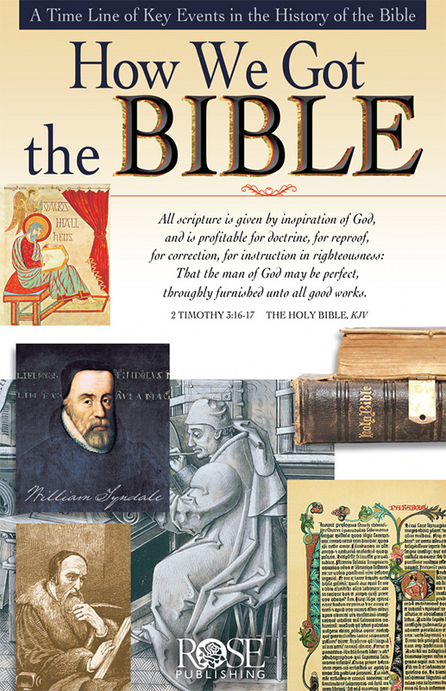

Slide 4
Ten Key Points
1 The Bible is inspired by God (2 Tim.3:16-17; 2 Peter 1:20-21).
2 The Bible is made up of 66 different books that were written over 1600 years (from approximately 1500 BC to AD 100) by more than 40 kings, prophets, leaders, and followers of Jesus. The Old Testament has 39 books (written approximately 1500-400 BC). The New Testament has 27 books (written approximately AD 45-100). The Hebrew Bible has the same text as the English Bible’s Old Testament, but divides and arranges it differently.
3 The Old Testament was written mainly in Hebrew, with some Aramaic. The New Testament was written in Greek.

Slide 5
4 The books of the Bible were collected and arranged and recognized as inspired sacred authority by councils of rabbis and councils of church leaders based on careful guidelines.
5 Before the printing press was invented, the Bible was copied by hand. The Bible was copied very accurately, in many cases by special scribes who developed intricate methods of counting words and letters to ensure that no errors had been made
6 The Bible was the first book ever printed on the printing press with moveable type (Gutenberg Press, 1455, Latin Bible).

Slide 6
7 There is much evidence that the Bible we have today is remarkably true to the original writings. Of the thousands of copies made by hand before 1500, nearly 5,900 Greek manuscripts from the New Testament alone still exist today. The text of the Bible is better preserved than the writings of Plato or Aristotle.
8 The discovery of the Dead Sea Scrolls confirmed the astonishing reliability of some of the copies of the Old Testament made over the years. Although some spelling variations exist, no variation affects basic Bible doctrines.

Slide 7
9 As the Bible was carried to other countries, it was translated into the common language of the people by scholars who wanted others to know God’s Word. Today there are still 2,000 groups with no Bible in their own language.
10 By AD 200, the Bible was translated into seven languages; by 500, 13 languages; by 900, 17 languages; by 1400, 28 languages; by 1800, 57 languages; by 1900, 537 languages; by 1980, 1,100 languages; by 2006, 2,426 languages have some portions of the Scripture.
(Source: The World Christian Encyclopedia; Wycliffe, International.)
Rose Publishing, How We Got the Bible (Torrance, CA: Rose Publishing, 2011).

Slide 8
Old Testament Written

Slide 9
New Testament Written

Slide 10
Bible Copied on Papyrus

Slide 11
Bible Copied on Fine Animal Skins

Slide 12
Bible Printed by Printing Press after 1455

Slide 13
The Bible, God’s Word to the World

Slide 14
2000 BC
Old Testament events are written down in Hebrew (portions in Aramaic) over centuries. In Exodus, the Lord tells Moses to write in a book. Other Old Testament writers, inspired by God, include leaders, kings and prophets. Together, these writings on leather scrolls and other materials are called the Hebrew Scriptures or Old Testament.
500 BC
Ezra, a priest and scribe, collects and arranges some of the books of the Hebrew Bible—the Old Testament—about 450 BC, according to Jewish tradition.
The Septuagint is the Greek translation of the Hebrew Bible (the Old Testament). It is translated in 250-100 BC by Jewish scholars in Alexandria, Egypt. (The word Septuagint means seventy, referring to the tradition that 70 or 72 men translated it. It is often abbreviated LXX, the Roman numeral for seventy.)

Slide 16
200 BC
The books are arranged by subject: historical, poetic, and prophetic. It includes the Apocrypha (meaning “hidden”), referring to seven books that were included in the Hebrew Bible until AD 90 when they were removed by Jewish elders.
Papyrus, a plant, is cut into strips and pressed into sheets of writing material and can be made into a scroll or a codex. The New Testament books were probably first written on papyrus scrolls. Later Christians begin to copy them on sheets of papyrus which are bound and placed between two pieces of wood for covers. This form of early book is known as a codex.

Slide 17
AD 1
Time of Jesus - 4 BC - AD 33?
Jesus quotes the Old Testament (Scriptures) often. He says that He did not come to destroy the Scriptures, but to fulfill them. He says to his disciples, “These are the words which I spoke unto you,... that all things must be fulfilled, which were written in the law of Moses, and in the prophets, and in the psalms, concerning me. Then opened he their understanding, that they might understand the scriptures.” Luke 24:44-45

Slide 18
AD 100
Followers of Jesus
Matthew, Mark, Luke, John, Paul, James, Peter, and Jude write the Gospels, history, letters to other Christians, and the Revelation between AD 45 and 100. The writers quote from all but eight of the Old Testament books. These writings in Greek are copied and circulated so that by about 150 there is wide enough use of them to speak of the “New Testament” (“New Covenant”). The new covenant God made with people was promised in Jer. 31:31-34 and referred to by Jesus (Lk. 22:20) and Paul (1 Cor. 11:25) and in the letter to the Hebrews.

Slide 19
AD 200
Old Testament Apocrypha
Evidence derived from first century AD writers Philo and Josephus indicates that the Hebrew canon did not include the Apocrypha.

Slide 22
AD 300
The New Testament books are collected and circulated throughout the Mediterranean about the time of Constantine, the Roman emperor who legalizes Christianity in 313. By 400 the standard of 27 New Testament books is accepted in the East and West as confirmed by Athanasius, Jerome, Augustine and three church councils.
The 27 books of the New Testament were formally confirmed as canonical by the Synod of Carthage in 397, thus recognizing three centuries of use by followers of Christ.

Slide 23
The Latin Vulgate

Slide 24
AD 500
Roman Empire declines. Germanic migrations (378-600) cause new languages to emerge.
The Masoretes are special Jewish scribes entrusted with the sacred task of making copies of the Hebrew Scriptures (Old Testament) approximately 500-900.
They develop a meticulous system of counting the number of words in each book of the Bible to make sure they have copied it accurately. Any scroll found to have an error is buried according to Jewish law.

Slide 25
AD 600
Christianity reaches Britain before 300, but Anglo-Saxon pagans drive Christian Britons into Wales (450-600). In 596, Augustine of Canterbury begins evangelization again.
Caedmon, an illiterate monk, retells portions of Scripture in Anglo-Saxon (Old English) poetry and song (676).
Aldhelm of Sherborne, 709, is said to have translated the Psalms.
Bede, a monk and scholar, makes an Old English (Anglo-Saxon) translation of portions of Scripture. On his deathbed in 735, he finishes translating the Book of John.
Alfred The Great, King of Wessex (871-901) translates portions of Exodus, Psalms, and Acts.
Aldred, Bishop of Durham, inserts a translation in the Northumbrian dialect between the lines of the Lindisfarne Gospels (950).
Aelfric (955-1020) translates portions of the Old Testament.

Slide 26
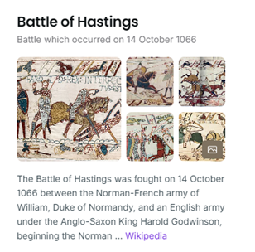
AD 1300
Normans conquer England (1066) and make French the official language. No English translation work produced until the 1300s.
Middle English emerges, popularized by works such as the Canterbury Tales and Richard Rolle’s Psalter (1340).

Slide 27
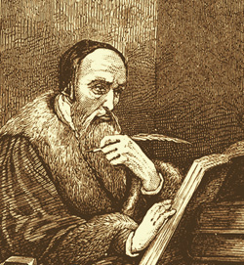
First English Bible is translated from Latin in 1382 and is called the Wycliffe Bible in honor of priest and Oxford scholar John Wycliffe. During his lifetime, Wycliffe had wanted common people to have the Bible. He also criticized a number of church practices and policies. His followers, derisively called Lollards (meaning “mumblers”), included his criticisms in the preface to the Wycliffe Bible. This Bible is banned and burned. Forty years after Wycliffe’s death, his bones are exhumed and burned for heresy.
In 1408, in England, it becomes illegal to translate or read the Bible in common English without permission of a bishop.

Slide 28
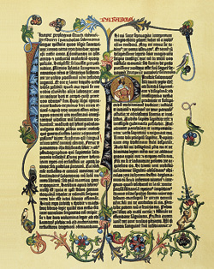
World’s first printing press with moveable metal type is invented in 1455 in Germany by Johann Gutenberg. This invention is perhaps the single most important event to influence the spread of the Bible.
The Gutenberg Bible is the first book ever printed. This Latin Vulgate version is often illuminated by artists who hand paint letters and ornaments on each page.

Slide 29
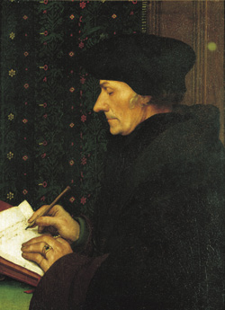
AD 1500
Erasmus, a priest and Greek scholar, publishes a new Greek edition and a more accurate Latin translation of the New Testament in 1516. His goal is that everyone be able to read the Bible, from the farmer in the field to the weaver at the loom. Erasmus’ Greek text forms the basis of the “textus receptus” and is used later by Martin Luther, William Tyndale, and the King James translators.

Slide 30
Martin Luther translates the New Testament into German in 1522.
William Tyndale, priest and Oxford scholar, translates the New Testament from Greek (1525), but cannot get approval to publish it in England.
*He moves to Germany and prints Bibles, smuggling them into England in sacks of corn and flour. In 1535 he publishes part of the Old Testament translated from Hebrew. In 1536, Tyndale is strangled and burned at the stake. His final words are “Lord, open the King of England’s eyes.”

Slide 31
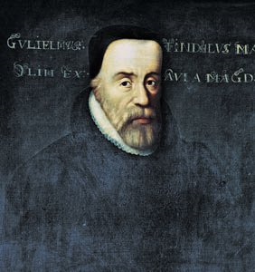
Tyndale is called the “Father of the English Bible” because his translation forms the basis of the King James Version. Much of the style and vocabulary we know as “biblical English” is traceable to his work.

Slide 32
AD 1500
The Coverdale Bible is translated by Miles Coverdale (1535) and dedicated to Anne Boleyn, one of King Henry VIII’s wives. This is the first complete Bible to be printed in English.
The Matthew’s Bible, translated by John Rogers under the pen name “Thomas Matthew,” is the first Bible published with the king’s permission (1537). Printed just one year after Tyndale’s death, its New Testament relies heavily on Tyndale’s version, and even has a tribute to him on the last page of the Old Testament. Tyndale’s initials are printed in 2½-inch block letters. Later Thomas Cromwell, advisor to King Henry VIII, entrusts Coverdale to revise Matthew’s Bible to make the Great Bible.

Slide 33
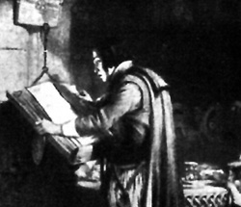
The Great Bible (1539) is placed in every church by order of Thomas Cranmer, archbishop under King Henry VIII. This Bible is chained to the church pillars to discourage theft.

Slide 34
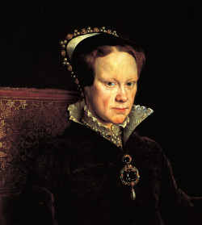
AD 1555
England’s Queen Mary bans Protestant translations of the English Bible. John Rogers and Thomas Cranmer are burned at the stake. Later some 300 men, women and children are also burned.

Slide 35
Bishops Bible
A new translation begins under Queen Elizabeth in 1568. It is translated by several bishops of the Church of England in answer to the Geneva Bible.
Rheims-Douai Bible was translated into English from the Latin Vulgate by Catholic scholar Gregory Martin, while in exile in France (New Testament in 1582/Old Testament in 1609). It becomes the standard translation for the Catholic church.

Slide 36
AD 1600
King James Version or Authorized Version
King James I of England commissions 54 scholars to undertake a new Bible translation. Over the next six years, six teams of scholars using the Bishops Bible and Tyndale’s Bible, as well as available Greek and Hebrew manuscripts, complete the new version in 1611. The King James Version (also called the “Authorized Version,” even though King James never gave the finished version his royal approval) is revised several times.
(The edition used today was revised in 1769.) It is the most popular Bible for more than 300 years.

Slide 37
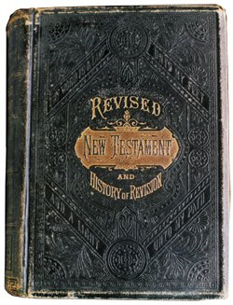
AD 1800
Older Manuscripts Discovered!
Between 1629 and 1947, several of the earliest known copies of the Bible are found.
The Revised Version (1885) In 1870, scholars in England decide to revise the King James Version to reflect the findings from the manuscripts discovered during the two previous centuries. Their goal is to use better Hebrew and Greek texts and to retranslate words based on new linguistic information about ancient Hebrew.

Slide 38
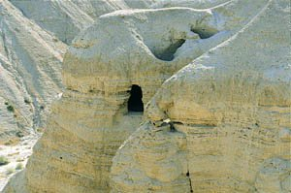
The Dead Sea Scrolls, found in a cave in 1947 by a shepherd, contain the oldest known copies of portions of the Old Testament. These copies were made between 100 BC and AD 100.

Slide 40
CASE STUDIES OF CONVERSION
Acts | Preaching | Believed | Repented | Confessed | Baptized | Saved
2:22-41 | Pentecost |  | vv. 37-38 |  | vv. 38-41 | Remission Of Sins
8:12 | Samaritans | v. 12 |  |  | v. 12 | Believed
8:13 | Simon | v. 13 |  |  | v. 13
8:35-39 | Eunuch | vv. 36-37 |  | v. 37 | v. 38 | Rejoiced
9:17-18 | Saul |  |  |  | v. 18 | Sins Washed Away
10:34-48 | Cornelius | v. 43 |  |  | v. 48 | Remission Of Sins
16:13 | Lydia | v. 14 |  |  | v. 15
16:31-34 | The Jailer | v. 31 |  |  | v. 33 | Rejoiced
18:8 | Corinthians | v. 8 |  |  | v. 8
19:5 | Ephesians |  |  |  | v. 5
Baptized

Slide 41
How We Got The Bible
The Bible is the infallible, inspired word of God.
We will be judged by this same word.
John 12:48 "He who rejects Me, and does not receive My words, has that which judges him--the word that I have spoken will judge him in the last day.

