Slide 1
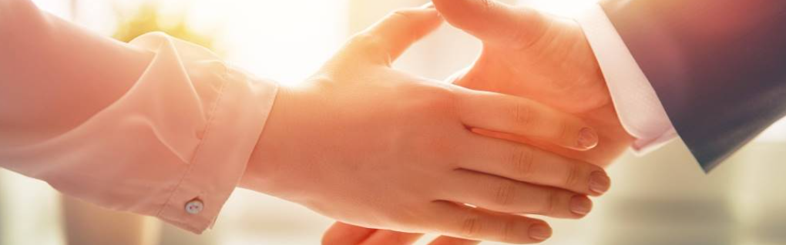
Welcome to our services
New Lebanon Church of Christ
We are Simply Christians.
Our Emphasis is Spiritual, Not Material or Social.
We are striving to be The Same Church as Described in The New Testament.
Please Come Back Again

Slide 2
How Beautiful Heaven Must Be
We read of a place that's called heaven, It's made for the pure and the free, These truths in God's word he has given,
How beautiful heaven must be.
Heaven is the most beautiful word In the English language or any language.

Slide 3
How Beautiful Heaven Must Be
The only way we can know about heaven is what God has revealed to us in His Holy Word.
Not from the books of men.
Not from Hollywood.
Not from dreams.

Slide 4
Title
Books of the New Testament
Gospels
Matthew
Mark
Luke
John
Paul’s Letters
Romans
1st Cor
2nd Cor
Gal.
Eph.
Phil.
Col
1Thess
2Thess
1Tim
2Tim
Titus
Phil.
General letters
Hebrews
James
1Peter
2Peter
1 John
2 John
3 John
Jude
The life of Christ
History
Acts
History of the church.
How to be a Christian
These letters tell us how to LIVE the Christian life.
Revelation –
Tells us how to DIE in Christ.
Be faithful unto death.
b hastings newlebanoncoc.com

Slide 5
How Beautiful Heaven Must Be
Many sermons preached on heaven. Many gravestones Have the inscription heaven on them. Many articles and books have been printed about heaven.
It should be on the lips of all God's people. And we sing these good songs about heaven and lift up our hearts and they bring joy to our soul .
There's something better brethren and friends than what this life has to offer.
There's eternal life where God is, and the son Jesus Christ who came to this earth to die for us.
Let’s talk about that wonderful place...

Slide 6
How Beautiful Heaven Must Be
Jesus in the 14 chapter of John Teaches that heaven is a real place.
It's as real as New Lebanon, Ohio.
The Bible talks about it as being up. Paul said he was called up to the third heaven. Somewhere beyond the farthest star. There is a beautiful place Called heaven.
In John 14 Jesus speaking to his disciples said “let not your heart be troubled. You believe in God believe also in Me. In my father's house are many mansions. If it were not so I would have told you. I go to prepare a place for you, and if I go to prepare a place for you I will come again. And receive you unto myself, that where I am, there you may be also.”

Slide 7
How Beautiful Heaven Must Be
In the Old Testament and the book of Psalms…..
Psalm 24:7
Lift up your heads, O you gates! And be lifted up, you everlasting doors! And the King of glory shall come in.

Slide 8
How Beautiful Heaven Must Be
In the Old Testament And the book of Psalms…..
Psalms chapter 24:7 speaking of the return of Jesus back to heaven after his resurrection,…
The words lift up your heads O you gates and Be lifted up. You everlasting doors, and the king of glory shall come in.
Who is this king of glory? the Lord strong and mighty. The Lord mighty in battle. Lift up your heads O you gates even lift him up you everlasting doors and the king of glory shall come in - and who is this king of glory, the Lord of host.

Slide 9
How Beautiful Heaven Must Be
…So the gates in heaven were opened wide for the return of Jesus.
So heaven is a place and it's a perfect place. What we build here has flaws in it.
We may think we've done a pretty good job but as time goes along we see some mistakes we made, and we wish we changed it here and there .
There are no imperfections In God's house.

Slide 10
How Beautiful Heaven Must Be
Another thing to notice -There is going to be real people there.
We see the throne scene In the Revelation letter.
(Rev 7:9) After these things I looked, and behold, a great multitude which no one could number, of all nations, tribes, peoples, and tongues, standing before the throne and before the Lamb, clothed with white robes, with palm branches in their hands, 10 and crying out with a loud voice, saying, "Salvation belongs to our God who sits on the throne, and to the Lamb!"

Slide 11
How Beautiful Heaven Must Be
The Apostle Paul said, “There is laid up for me a crown of righteousness Not only me but all those who love his appearing.”
People will be there. Those Old Testament characters, the New Testament apostles of Christ.
And we will be able to talk to God And the Lord Jesus Christ and the Holy Spirit all the angelic host.
Have you ever thought about what you will say to God or Jesus?
It’s a sobering thought.

Slide 12
How Beautiful Heaven Must Be
Heaven has real people and It's a place of happiness.
There is not going to be any gloominess. No one will get the blues. There's not going to be any hatred and jealousy or malice To fill our hearts. All monotony will be gone. And every hour will be filled with joy and happiness.
We are filled here with tears and heartaches and sorrows and affliction. But in heaven there's going to be one eternal day. Of rejoicing, of happiness.
Do you remember the happiest hour in your life? Multiply that many many times and you'll have a picture of heaven.

Slide 13
How Beautiful Heaven Must Be
In heaven, God's going to provide this fellowship and love. We will live In his sunshine of love. (There Is Sunshine In My Soul).
That's heaven. It's a place of Beauty and grandeur and glory. God shows us just a glimpse of His beauty here on this earth. The sunshine, the change of seasons. Soon flowers will be popping up out of the ground.
As we look into the sky, The azure blue. …And at night the stars as they twinkled and here's this moon as it reflects light….see the beauty of God.
God loves beauty. You imagine brethren what heaven has to be like in view of this universe, in which we live for just a short time. And then all this beauty here is going to be burned up.

Slide 14
How Beautiful Heaven Must Be
And we hear Peter saying in
1Peter 1:4 to an inheritance incorruptible and undefiled and that does not fade away, reserved in heaven for you,
Reserved in heaven for you….
Everything that we know, and everything that we touch dies, decays, fades with time, But not heaven.
And when we been there 10 trillion x 10 trillion years, It will be just as lovely and beautiful as the day when we began.

Slide 15
How Beautiful Heaven Must Be
Heaven is a place of reunion.
We're going to know one another in heaven. I don’t know how, or what we will look like because we will not have a fleshly body.
And one of these days, When time is no more when we leave this world, those who died in Jesus Christ, we're going to be able To be associated with throughout eternity.

Slide 16
How Beautiful Heaven Must Be
And there's our loved ones, our brothers and sisters. There's our father or mother there's our grandparents, there's our friends, our brethren in Christ, that we will dwell with forever and forever.
And what a grand reunion it'll be .
And one of these days we're going to be able to hold hands and never be divided by death. But will have life forever and forever.

Slide 17
How Beautiful Heaven Must Be
In Gen. 25:8 Then Abraham breathed his last and died in a good old age, an old man and full of years, and was gathered to his people.
And in
2Sam. 12:23 "But now he is dead; why should I fast? Can I bring him back again? I shall go to him, but he shall not return to me." he cannot be brought back to me, But I can go to him
And that's the hope of the child of God. And though our separation will be for a while and temporary one of these days, There will be a grand reunion.
We love to see those that we haven't seen for a while and we travel great distances. And we enjoy the social fellowship but what a great day this will be when all of God's children get home. (song)

Slide 18
How Beautiful Heaven Must Be
And friends, if our fleshly relatives do not make it to heaven, we are not going to sorrow or pain over them not making it – because there is no sorrow or pain in heaven.

Slide 19
How Beautiful Heaven Must Be
It's going to be a place of service
We are not just going to sit down and twiddle our thumbs throughout eternity But back in the Rev. letter again in chapter 7….
Rev. 7:15 "Therefore they are before the throne of God and serve Him day and night in His temple. And He who sits on the throne will dwell among them.
So there's activity. It never becomes boring. Always looking forward in anticipation an expectation in this place called heaven.

Slide 20
How Beautiful Heaven Must Be
And Paul says in
Philippians1:23 For I am hard pressed between the two, having a desire to depart and be with Christ, which is far better.
…I like this life, But Paul said that the one to come is far better than this. And this life in heaven is provided for by Jesus Christ. It's yours and it’s mine….

Slide 21
How Beautiful Heaven Must Be
Phil 3:20 For our citizenship is in heaven, from which we also eagerly wait for the Savior, the Lord Jesus Christ,
We are foreigners and strangers here we're just passing through.
1Peter 2:11 Beloved, I beg you as sojourners and pilgrims, abstain from fleshly lusts which war against the soul,
And here we are passing through this world and we see the proper perspective, that this world is not our home as we sing we're just passing through.

Slide 22
How Beautiful Heaven Must Be
We are foreigners to this land and that being the case, let’s not get tied down to this world. Friends somebody here today might not make it to heaven because they are tied down to this old world.
Abstain from fleshly lust. Don't become engrossed and engulfed with the cares of this life that we lose heaven. This world is not our home.
It's only temporary and it's transitory, and we're passing through, and one time through,…. we will never return again.

Slide 23
How Beautiful Heaven Must Be
So Peter says abstain from fleshly lust which war against the soul. And any worldly relationship that might detract or turn us away from that goal, I need to remove myself from it. We cannot be too cautious or too careful About our commitments and involvements in this world. Our citizenship is in heaven it is not here.
Another text
Matt. 6:19 "Do not lay up for yourselves treasures on earth, where moth and rust destroy and where thieves break in and steal;
20 "but lay up for yourselves treasures in heaven, where neither moth nor rust destroys and where thieves do not break in and steal. 21 "For where your treasure is, there your heart will be also.

Slide 24
How Beautiful Heaven Must Be
And what bearing does that have on my going to heaven? Well Jesus said Heaven is where our treasure is as a Christian …And if that's where our treasure is that's where our heart needs to be.!!!!!!!
And here is proper perspective brothers and sisters of this old materialistic life. And we can get so caught up in the things of this world and Paul said in-
Col.3 since we've been raised with Jesus Christ, set your affections not on the things of this world but in other words set your affections on things that are above.
We should not let these old worldly things of this life get in our way On our journey to heaven.

Slide 25
How Beautiful Heaven Must Be
We should not get so obsessed with things of this world that our minds are continuing on this life. Yes we have to spend time in dealing with the affairs of this world, but I want to tell you brethren the main thing that you need to focus on is where your TRUE treasure is. Heaven. And if we focus on heaven, then our hearts will be in the right place.
We need to watch what we get into. Is it going to interfere with my heavenly treasure? We need to watch what our entertainments are. We need to watch our social relationships. That it doesn't take our mind from that heavenly domain to this on this earth.

Slide 26
How Beautiful Heaven Must Be
Consider Joshua and Caleb –
They looked to the land of Canaan, not back to Egypt.
They persevered.
I'm talking about the effect that heaven has on us as the children of God
(2Cor. 4 v16 - 5:2)

Slide 27
How Beautiful Heaven Must Be
2Cor. 4:16 Therefore we do not lose heart. Even though our outward man is perishing, yet the inward man is being renewed day by day.
17 For our light affliction, which is but for a moment, is working for us a far more exceeding and eternal weight of glory,
18 while we do not look at the things which are seen, but at the things which are not seen. For the things which are seen are temporary, but the things which are not seen are eternal.
5:1 For we know that if our earthly house, this tent, is destroyed, we have a building from God, a house not made with hands, eternal in the heavens.
2 For in this we groan, earnestly desiring to be clothed with our habitation which is from heaven,

Slide 28
How Beautiful Heaven Must Be
Now how does HEAVEN affect our lives?
It gives us meaning and purpose and joy and carries us over the bumps in this life.
I don't care what the discouragement and heartaches may be and it gives us something to stand on and there's something to look forward to. And that's in the heart of God’s people. Life everlasting.
And if you are a faithful Christian, then you have that hope in your heart.

Slide 29
How Beautiful Heaven Must Be
Now how do I get there?
How do I get there? We have a roadmap. We get there thru the blood of Jesus Christ. No sin can enter there. It is a place of perfection.
Those who work the works of the flesh will not inherit the Kingdom of God Galatians 5 and first Corinthians 6.
So we have to be forgiven. And we're forgiven through the blood of Christ. And if we obey the gospel by faith and repentance and baptism, it brings us into the blood and then we are raised to walk in newness of life.

Slide 30
How Beautiful Heaven Must Be
The only way we can know about heaven is what God has revealed to us in His Holy Word.
The only way we can know who will go to heaven is by reading what God has left for us in His holy record.

Slide 31
Christ and the church He built.
Christ is coming back for His wife His church, the church of Christ, Eph.5:23-27, Matt.16:18, Rom. 16,16.
He will not be coming back for other men’s wives (denominations).
Are you ready for His return?

Slide 32
Christ and the church He built.
How do we get into the church?
“Jesus answered and said to him, "Most assuredly, I say to you, unless one is born again, he cannot see the kingdom of God. Nicodemus said to Him, How can a man be born when he is old? Can he enter a second time into his mother's womb and be born? Jesus answered, "Most assuredly, I say to you, unless one is born of water and the Spirit, he cannot enter the kingdom of God.” (John 3:3-5)
b hastings newlebanoncoc.com

Slide 33
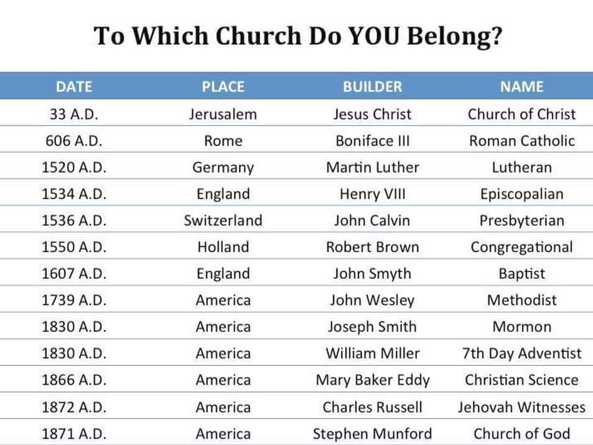
Christ and the church He built.
Acts 2:47 praising God and having favor with all the people. And the Lord added to the church daily those who were being saved.
These churches are too late to be the Lord’s church.
These churches are not the Bride of Christ (Eph.5) Christ has ONE Bride.
Which church were those in Acts 2:47 added to?

Slide 34
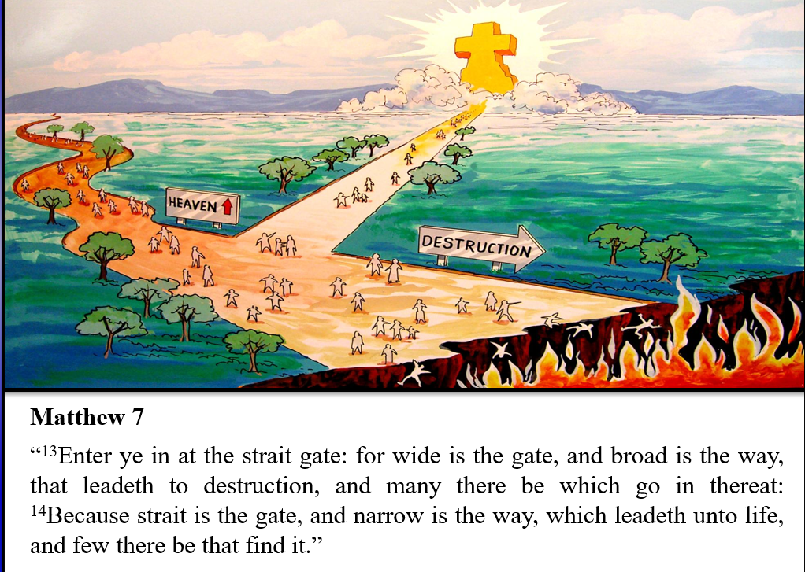

Slide 35
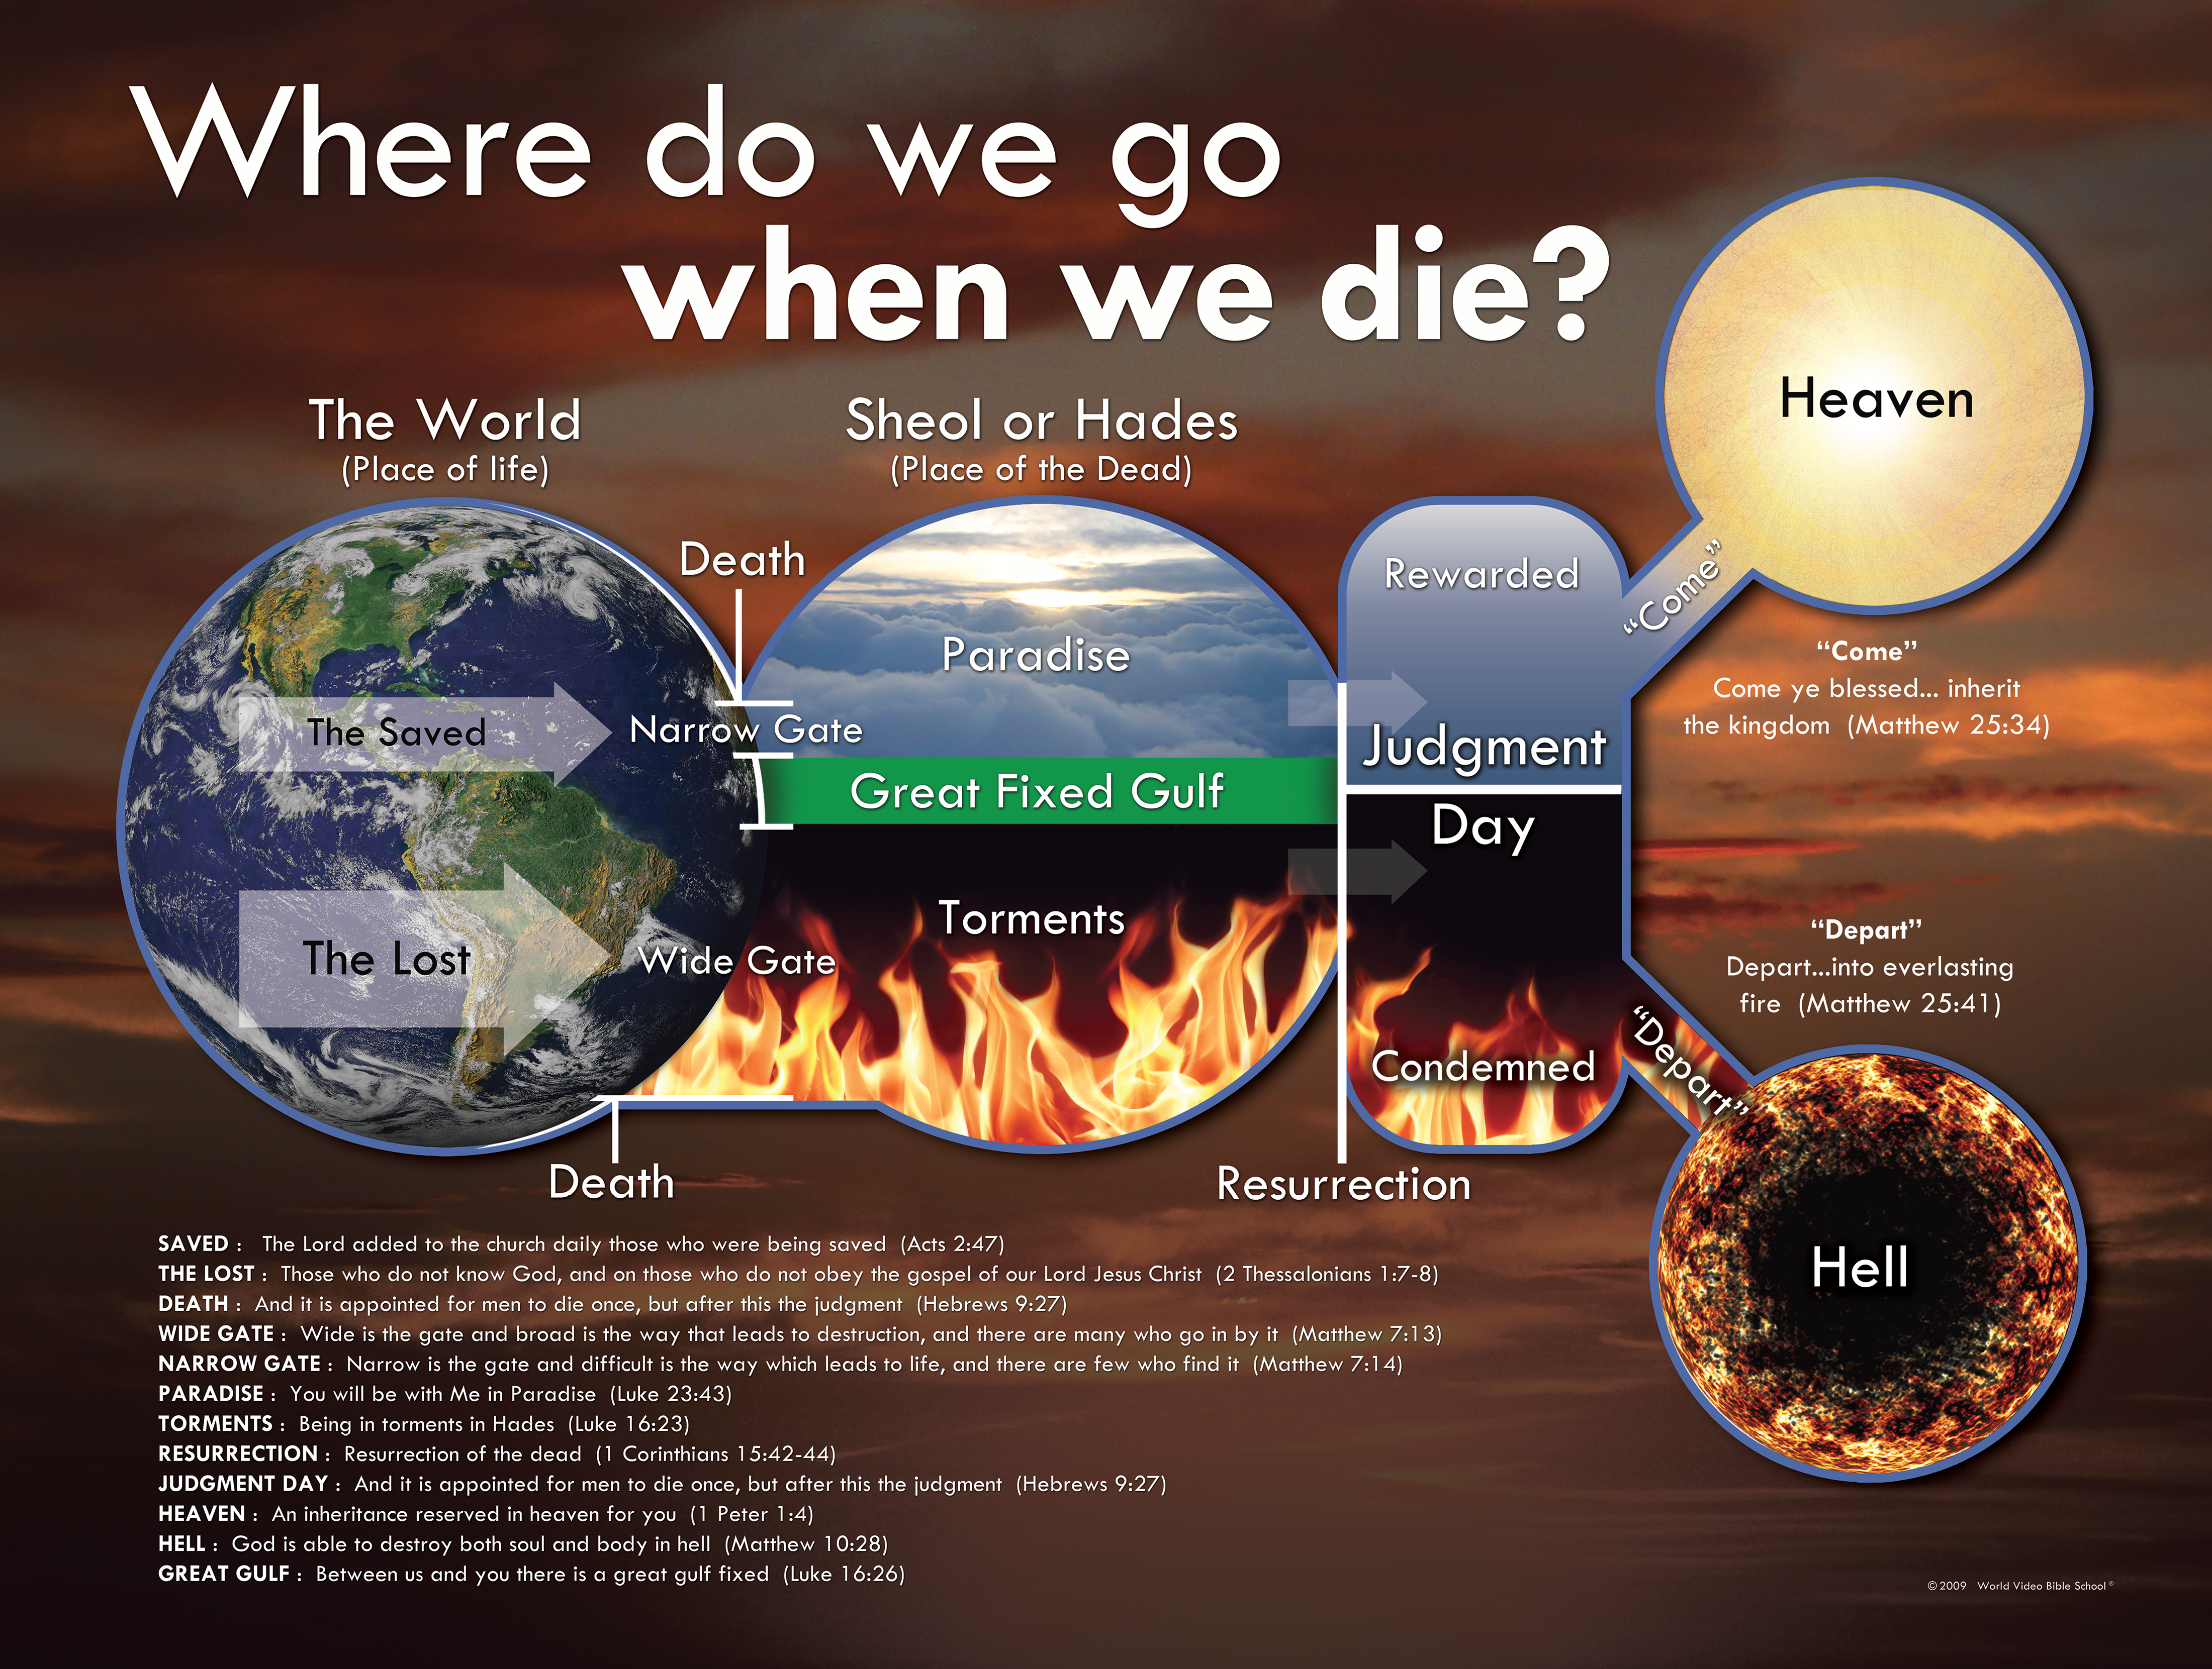

Slide 36
So you don’t want to go to His house on earth,
but you want to live in His mansion in heaven?
How do you think that is going to work???

Slide 37
How Beautiful Heaven Must Be
And as a Christian if we are faithful unto death Rev 2:10,
If we will persevere and continue,
If we will give diligence to make our calling and election sure (2Pet.1:10)
We shall never fall.
But there will be an abundant entrance into that eternal Kingdom.

Slide 38
How Beautiful Heaven Must Be
That's what God promises friend.
And Are you ready this morning to go?
Have you prepared to go?
Are you ready to give your life to Jesus Christ?
Friend we can’t afford to be lost.
Friend, the door is open, and Jesus is inviting you to come.
Come today.
Come to the blood of Christ.

