Slide 1
Welcome to our services
New Lebanon Church of Christ
We are Simply Christians.
Our Emphasis is Spiritual, Not Material or Social.
We are striving to be The Same Church as Described in The New Testament.
Please Come Back Again

Slide 2
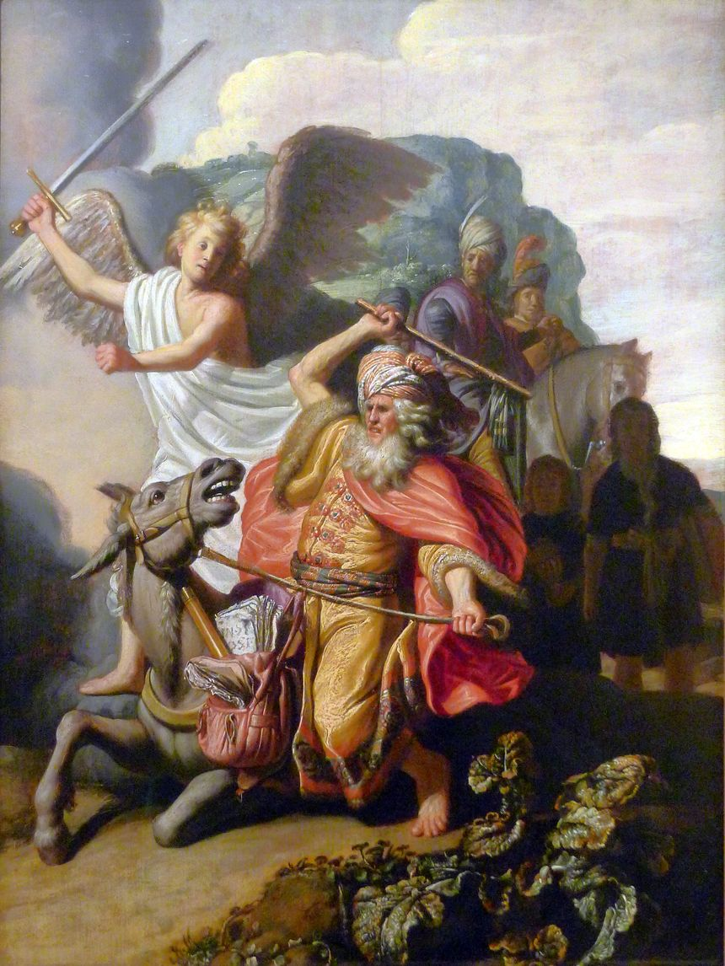
Coming To God With An Idol In Your Heart.
Numbers 22:12 And God said to Balaam, "You shall not go with them; you shall not curse the people, for they are blessed."
13 So Balaam rose in the morning and said to the princes of Balak, "Go back to your land, for the LORD has refused to give me permission to go with you.“… v22. 22 Then God's anger was aroused because he went, and the Angel of the LORD took His stand in the way as an adversary against him.

Slide 3
Coming To God With An Idol In Your Heart.
IDOL
terapim (תְּרָפִים, 8655), “idol; household idol; cultic mask; divine symbol.” This word is a loanword from Hittite-Hurrian (tarpish) which in West Semitic assumes the basic form tarpi. Its basic meaning is “spirit” or “demon.” Biblical Hebrew attests this word 15 times.
Terapim first appears in Gen. 31:19: “And Laban went to shear his sheep: and Rachel had stolen the [household gods] that were her father’s.” Hurrian law of this period recognized “household idols” as deeds to the family’s succession and goods. This makes these terapim (possibly a plural of majesty as is ˓elohim when used of false gods; cf. 1 Kings 11:5, 33) extremely important to Laban in every way.
Idol, an image worshiped by man; something man regards with more reverence than he does the word of God.— Webster.

Slide 4
Coming To God With An Idol In Your Heart.
Let’s consider an example
In Numbers 22–24, Balak, the king of Moab, hires the seer Balaam to curse the Israelites
Num. 22:10 So Balaam said to God, "Balak the son of Zippor, king of Moab, has sent to me, saying,
11 'Look, a people has come out of Egypt, and they cover the face of the earth. Come now, curse them for me; perhaps I shall be able to overpower them and drive them out.'"
12 And God said to Balaam, "You shall not go with them; you shall not curse the people, for they are blessed."
13 So Balaam rose in the morning and said to the princes of Balak, "Go back to your land, for the LORD has refused to give me permission to go with you."
14 And the princes of Moab rose and went to Balak, and said, "Balaam refuses to come with us."

Slide 5
Coming To God With An Idol In Your Heart.
This language was as plain as that part of the Bible which says-
"He that believeth and is baptized shall be saved" (Mark 16:16).

Slide 6
Coming To God With An Idol In Your Heart.
Num. 22:18 Then Balaam answered and said to the servants of Balak, "Though Balak were to give me his house full of silver and gold, I could not go beyond the word of the LORD my God, to do less or more.
19 "Now therefore, please, you also stay here tonight, that I may know what more the LORD will say to me.“
20 And God came to Balaam at night and said to him, "If the men come to call you, rise and go with them; but only the word which I speak to you-that you shall do.“ 21 So Balaam rose in the morning, saddled his donkey, and went with the princes of Moab.

Slide 7
Coming To God With An Idol In Your Heart.
Num. 22:22 Then God's anger was aroused because he went, and the Angel of the LORD took His stand in the way as an adversary against him. And he was riding on his donkey, and his two servants were with him.
23 Now the donkey saw the Angel of the LORD standing in the way with His drawn sword in His hand, and the donkey turned aside out of the way and went into the field. So Balaam struck the donkey to turn her back onto the road.

Slide 8
Coming To God With An Idol In Your Heart.
Num. 22:24 Then the Angel of the LORD stood in a narrow path between the vineyards, with a wall on this side and a wall on that side. 25 And when the donkey saw the Angel of the LORD, she pushed herself against the wall and crushed Balaam's foot against the wall; so he struck her again.
26 Then the Angel of the LORD went further, and stood in a narrow place where there was no way to turn either to the right hand or to the left. 27 And when the donkey saw the Angel of the LORD, she lay down under Balaam; so Balaam's anger was aroused, and he struck the donkey with his staff.
28 Then the LORD opened the mouth of the donkey, and she said to Balaam, "What have I done to you, that you have struck me these three times?"

Slide 9
Coming To God With An Idol In Your Heart.
Num. 22:32 And the Angel of the LORD said to him, "Why have you struck your donkey these three times? Behold, I have come out to stand against you, because your way is perverse before Me.
33 "The donkey saw Me and turned aside from Me these three times. If she had not turned aside from Me, surely I would also have killed you by now, and let her live."
34 And Balaam said to the Angel of the LORD, "I have sinned, for I did not know You stood in the way against me. Now therefore, if it displeases You, I will turn back."
35 Then the Angel of the LORD said to Balaam, "Go with the men, but only the word that I speak to you, that you shall speak." So Balaam went with the princes of Balak.

Slide 10
Coming To God With An Idol In Your Heart.
Balaam, like many preachers who have set up their idols in preference to the word of God,
did not like God's charge to him.

Slide 11
Coming To God With An Idol In Your Heart.
Ex. 20:1 And God spoke all these words, saying: 2 "I am the LORD your God, who brought you out of the land of Egypt, out of the house of bondage. 3 "You shall have no other gods before Me.
Ex. 34:14 '(for you shall worship no other god, for the LORD, whose name is Jealous, is a jealous God),
Col. 3:5 Therefore put to death your members which are on the earth: fornication, uncleanness, passion, evil desire, and covetousness, which is idolatry.

Slide 12
Coming To God With An Idol In Your Heart.
We read in the Old Testament that God through Samuel demanded Saul to go and destroy the Amalekites—men, women and children, as well as all the livestock.
Saul went forth to battle, destroyed all but the king himself, and the best of the stock to offer a great sacrifice to God. He set up his idol (what he wanted to do) and lost his throne; for God rejected him from being king over Israel.
Saul turned from God, and lost all, for following his idol instead of the word of God.

Slide 13
Coming To God With An Idol In Your Heart.
Jesus teaches that if we would be his disciples, we are not worthy of him unless we are willing to forsake father or mother, brother or sister for him.
We often find some who claim to believe the teaching of the Bible, yet their mother did not belong to the church of Christ, or their wife belongs to some human church, and they can not afford to turn from them, so they set up their idol,
and God says, "I'll answer them accordingly and let them believe a lie and be damned because they have no pleasure in the truth.

Slide 14
Coming To God With An Idol In Your Heart.
Others come like the rich young man, and are in love with riches, or set them up as an idol, and forsake the house of God to multiply riches, and declare they have no time to serve the Lord as it takes all their time to run their business.
This kind of a man has set up his riches as an idol in his heart and Jesus says it is easier for a camel to go through the eye of a needle than for him to go to heaven.

Slide 15
Coming To God With An Idol In Your Heart.
Then there is the whole system of protestant churches setting up their idol in their heart of justification by faith only. They will read, "He that believeth and is baptized shall be saved," and "Repent and be baptized for the remission of sins."
They read where Ananias told Paul to arise and be baptized and wash away his sins calling on the name of the Lord (Acts 22:16). Then they will hear James say, "Faith without works is dead, being alone" (James 2:17).
To all these Scriptures they will turn a deaf ear, and set up the idol of Martin Luther and John Wesley, "Wherefore we are justified by faith only is a wholesome doctrine and full of comfort."

Slide 16
Coming To God With An Idol In Your Heart.
Others will claim, "I do not know which church is right, therefore I'll set up my idol of goodness and morality." Notwithstanding the Bible says,
"Blessed are they that do his commandments that they may have right to the tree of life",
They will claim that they know as much about it as God does, and they know they will be saved on their goodness or works of righteousness which they have done, by which Paul plainly says we are not saved (Titus 3:5).

Slide 17
Coming To God With An Idol In Your Heart.
Others will set up their idol Of infant baptism, declaring their parents had them baptized when children, and to break off from their early training and obey the commandments of God would be a reflection on their dead parents, and they must honor and reverence the commands of man more than those of God.
Others will claim that immersion is baptism. They know that people went down into the water, that they were buried in baptism, they came up out of the water, they were born of water, yet they prefer sprinkling and pouring, as their kinfolks all had it that way. They are satisfied to fight it out along that line.

Slide 18
Coming To God With An Idol In Your Heart.
Some worship the idol of instrumental music.
Some worship the idol of the church kitchen.
Some worship the idol of the missionary society.
Some worship the idol of the human institutions – widow’s home, orphan’s home, any kind of home, etc.

Slide 19
Coming To God With An Idol In Your Heart.
In Eph. 4:1, we are taught to walk worthy of the vocation wherewith we have been called.
In 2 Cor. 5:7, we are told to walk by faith.
In Rom. 8:1-2, we are told there is no condemnation to those who are in Christ and who walk after the Spirit, and not after the flesh.
So we must conclude that all men are safe who will follow the spiritual law and walk to please God instead of to please man.

Slide 20
Coming To God With An Idol In Your Heart.
Jesus tells us to seek first the kingdom of God and his righteousness with the promise that all needed blessings will be added unto us.
In Rom. 12:1, we are commanded to offer our bodies a living sacrifice, which he claims as our reasonable service.

Slide 21
Coming To God With An Idol In Your Heart.
What do you regard with more reverence than the word of God?
What is your idol?
We can not go to heaven with an idol in our heart.

Slide 22
Are You A New Testament Christian?
Hear the Gospel (Rom.10:14).
Believe the Gospel (Heb. 11:6).
Repent of Sins (Acts 3:19).
Confess Christ (Rom.10:9).
Be Baptized Into Christ (1 Cor.12:13).
1 Timothy 4:16
“Take heed unto thyself, and unto the doctrine; continue in them: for in doing this thou shalt both save thyself, and them that hear thee.”

