Slide 1
A Christian According To Peter.
Lesson One:
Introduction and Peter’s Perspective

Slide 2
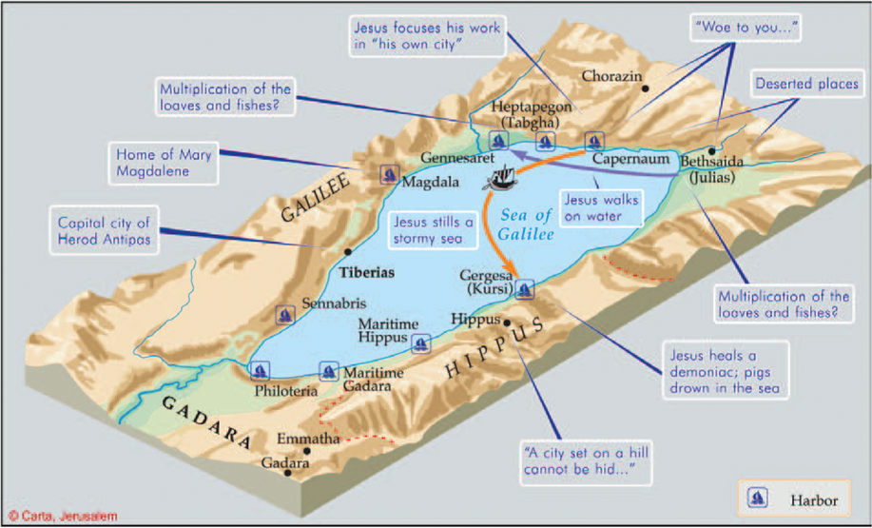
1. Sea of Chinnereth (Num 34:11; Josh 12:3; 13:27)
2. Sea of Gennesaret (Luke 5:1; Josephus, Antiquities 13)
3. Sea of Tiberias (John 6:1; 21:1)
4. Sea of Galilee (Matt 4:18)
6

Slide 3
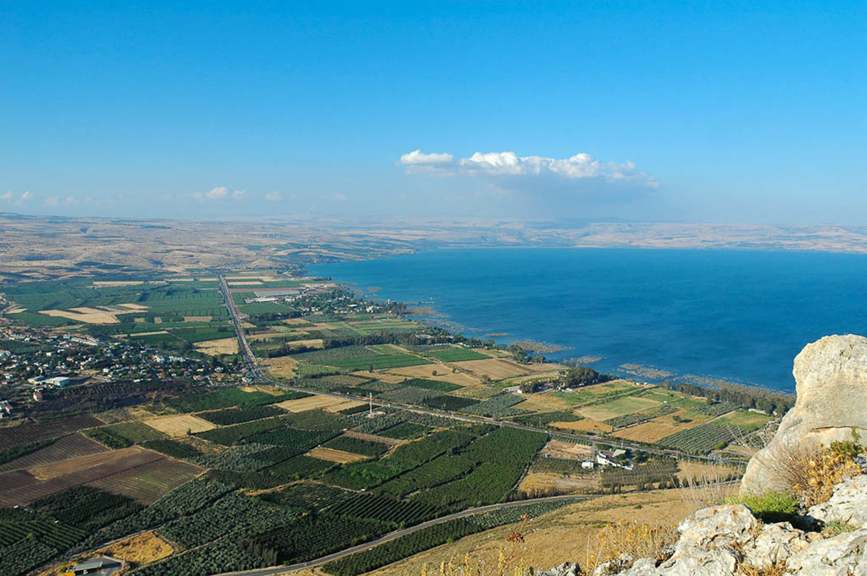
He was standing by the Lake of Gennesaret
Capernaum
Bethsaida
Golan Heights
Mt. of Beatitudes
Plain of Gennesaret
Magdala
5
Northern shoreline of the Sea of Galilee (from the southeast)
5:1
Notes:
The Lake of Gennesaret is an alternate name for the Sea of Galilee. Most of Jesus’s recorded ministry took place along the northern shore of the Sea of Galilee (shown here). This photo is looking northwest from the mountain of Arbel on the western side of the lake.
tb053005508

Slide 4
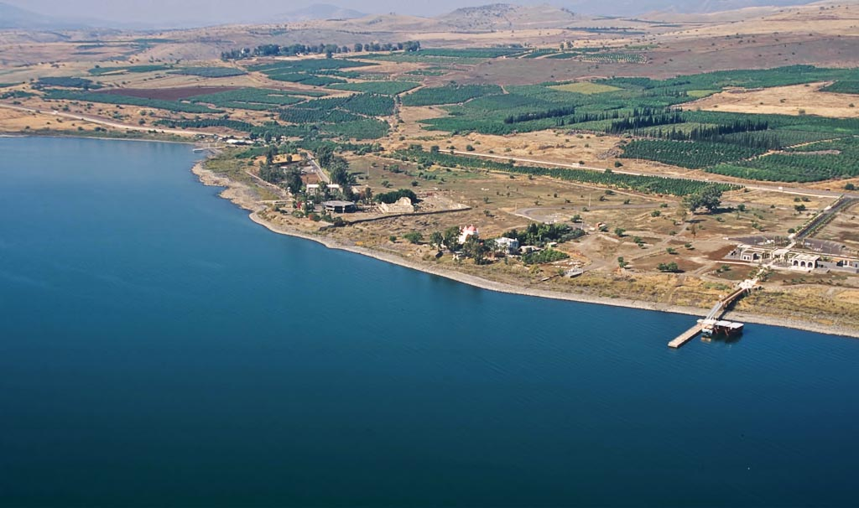
Church of the Beatitudes
Capernaum synagogue
Greek Orthodox church
Peter’s
house
modern pier
Capernaum area aerial from southeast
Notes:
tbs115200011

Slide 5
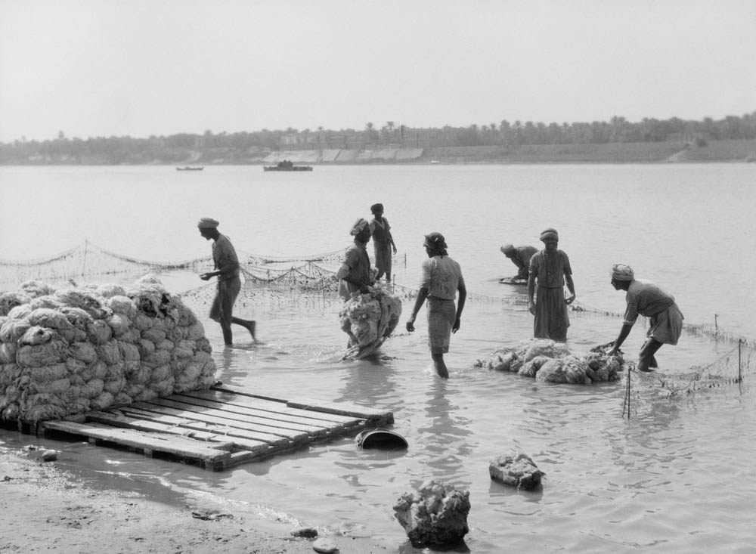
Therefore, gird up the loins of your mind for action
Wool washers on the Tigris River, 1932
1:13
Notes:
The man on the far right appears to have his garment tied up in the “girding of the loins” fashion. This American Colony photograph was taken in 1932.
mat16220

Slide 6
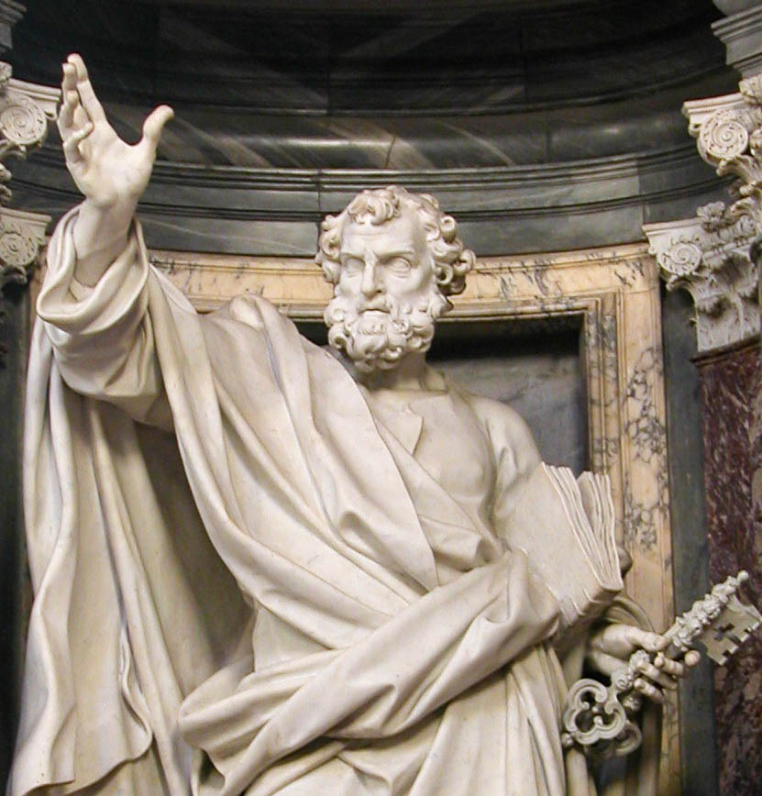
Simon Peter, a slave and apostle of Jesus Christ
Statue of the apostle Peter in Rome
1:1
Notes:
Peter is typically depicted with short, curly hair and a square beard. This statue was photographed at the Papal Archbasilica of St. John Lateran in Rome.
tb112102047

Slide 7
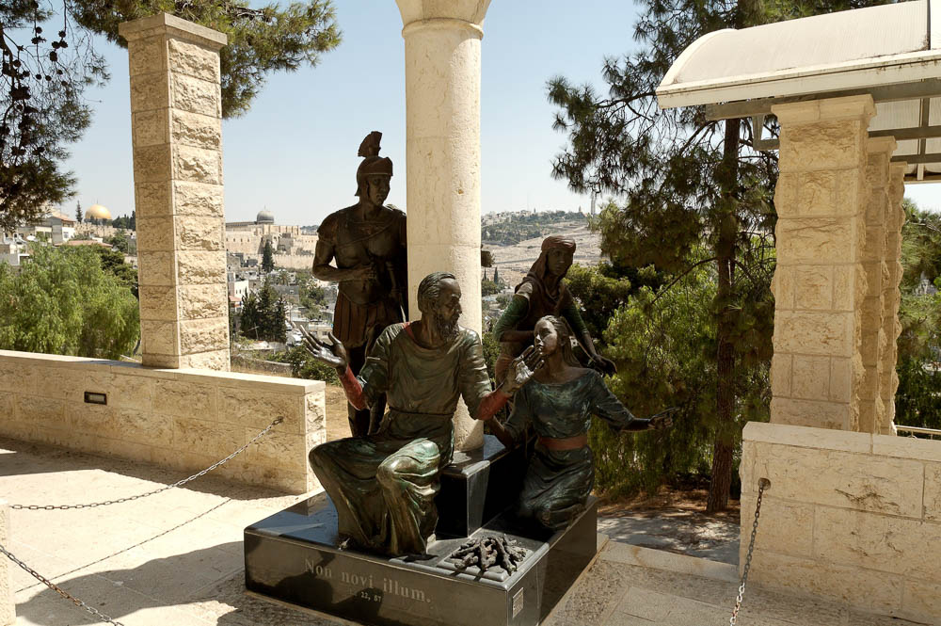

Slide 8
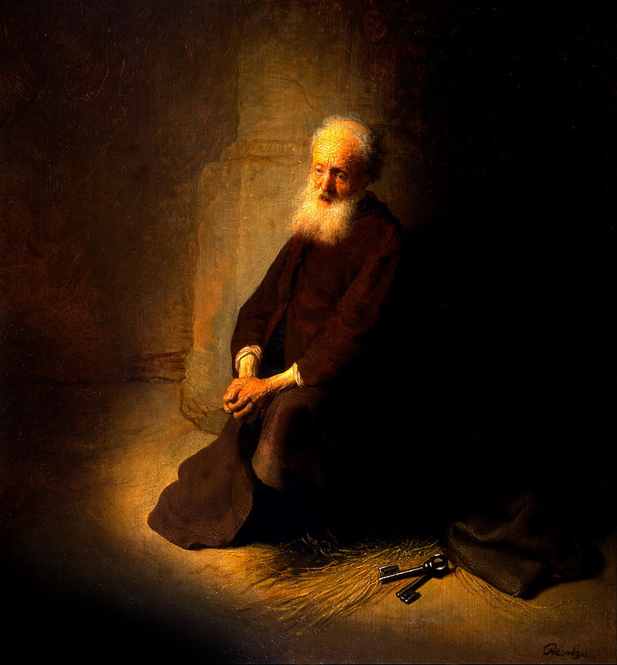
Simon Peter, a slave and apostle of Jesus Christ
Saint Peter in Prison, by Rembrandt, 1631
1:1
Notes:
Peter is nearly always depicted with a set of keys, associated with him because of the statement of Jesus, “I will give you the keys of the kingdom of heaven” (Matt 16:19). According to tradition, Peter was imprisoned and eventually executed in Rome. This oil on panel painting was photographed at the Israel Museum. This image comes from the Google Cultural Institute and is in the public domain, via Wikimedia Commons: https://commons.wikimedia.org/wiki/File:Rembrandt_van_Rijn_-_St._Peter_in_Prison_(The_Apostle_Peter_Kneeling)_-_Google_Art_Project.jpg.
wiki1914781222540607185552916

Slide 9
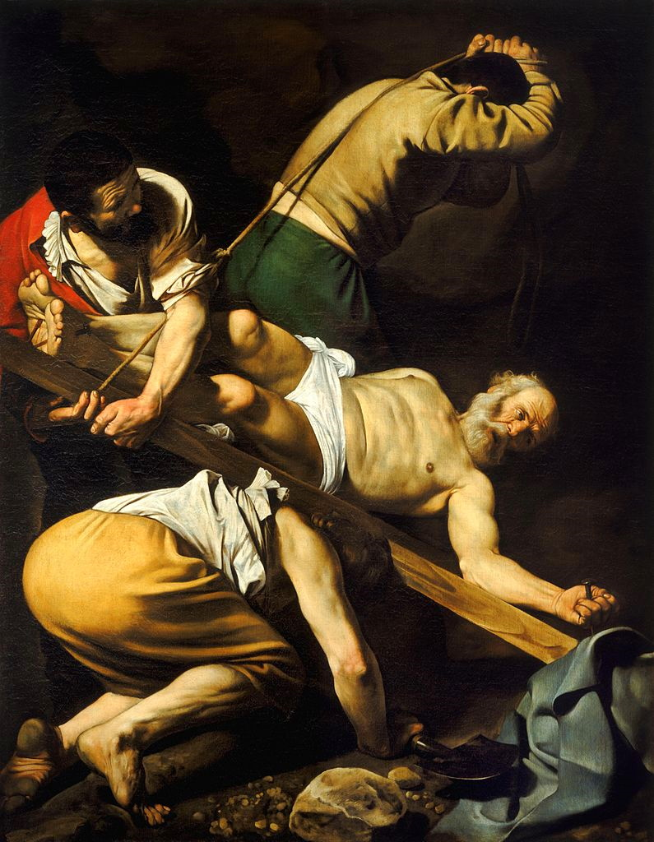
Peter, an apostle of Jesus Christ
Crucifixion of St. Peter, by Caravaggio, circa AD 1600
1:1
Notes:
This oil on canvas painting was photographed at the Parish Basilica of Santa Maria del Popolo. This image comes from Wikimedia Commons and is in the public domain. Source: https://commons.wikimedia.org/wiki/File:Crucifixion_of_Saint_Peter-Caravaggio_(c.1600).jpg
wiki05162011075510537

Slide 10
Christian – Introduction and Peter’s Perspective
Acts 11:26, And when he had found him, he brought him to Antioch. So it was that for a whole year they assembled with the church and taught a great many people. And the disciples were first called Christians in Antioch.
Acts 26:28, Then Agrippa said to Paul, "You almost persuade me to become a Christian."
1Peter 4:16 Yet if anyone suffers as a Christian, let him not be ashamed, but let him glorify God in this matter.

Slide 11
Christian – Introduction and Peter’s Perspective
Isaiah 62:1 For Zion's sake I will not hold My peace, And for Jerusalem's sake I will not rest, Until her righteousness goes forth as brightness, And her salvation as a lamp that burns.
2 The Gentiles shall see your righteousness, And all kings your glory. You shall be called by a new name, Which the mouth of the LORD will name.

Slide 12
Christian – Introduction and Peter’s Perspective
A Christian is a taught disciple of Christ

Slide 13
Christian – Introduction and Peter’s Perspective
A Christian is a taught disciple of Christ
John 6:44 "No one can come to Me unless the Father who sent Me draws him; and I will raise him up at the last day.
45 "It is written in the prophets, 'And they shall all be taught by God.' Therefore everyone who has heard and learned from the Father comes to Me.

Slide 14
Christian – Introduction and Peter’s Perspective
A Christian is a taught disciple of Christ
Matt. 28:18 And Jesus came and spoke to them, saying, "All authority has been given to Me in heaven and on earth.19 "Go therefore and make disciples of all the nations, baptizing them in the name of the Father and of the Son and of the Holy Spirit, 20 "teaching them to observe all things that I have commanded you; and lo, I am with you always, even to the end of the age." Amen.
One does not become a Christian through a direct working of the Holy Spirit independent of God’s word.

Slide 15
Christian – Introduction and Peter’s Perspective
A Christian is a taught disciple of Christ
The process of becoming a Christian is a learning process.
2Peter 3:18 but grow in the grace and knowledge of our Lord and Savior Jesus Christ. To Him be the glory both now and forever. Amen.

Slide 16
Christian – Introduction and Peter’s Perspective
A Christian is a taught disciple of Christ
Jesus left us an example to be followed.
1Peter 2:21 For to this you were called, because Christ also suffered for us, leaving us an example, that you should follow His steps:
The standard for Christian is not:
Worldly philosophy. Col.2:8
The Law of Moses. Col.2:14-16
Mysticism. Col.2:18
The crowd. Matt 7:13-14
Col 2:8 Beware lest anyone cheat you through philosophy and empty deceit, according to the tradition of men, according to the basic principles of the world, and not according to Christ.

Slide 17
Christian – Introduction and Peter’s Perspective
A Christian is a taught disciple of Christ
A Christian Is One Who Is Persuaded.

Slide 18
Christian – Introduction and Peter’s Perspective
A Christian Is One Who Is Persuaded.
The Christian is one who is convinced in his mind that Christianity is true.
Paul sought to persuade men at Ephesus.
Acts 19:8 And he went into the synagogue and spoke boldly for three months, reasoning and persuading concerning the things of the kingdom of God.

Slide 19
Christian – Introduction and Peter’s Perspective
A Christian Is One Who Is Persuaded.
Paul sought to persuade men at Corinth.
2Cor. 5:10 For we must all appear before the judgment seat of Christ, that each one may receive the things done in the body, according to what he has done, whether good or bad. 11 Knowing, therefore, the terror of the Lord, we persuade men; but we are well known to God, and I also trust are well known in your consciences.

Slide 20
Christian – Introduction and Peter’s Perspective
A Christian Is One Who Is Persuaded.
Phil. 4:13 I can do all things through Christ who strengthens me.
A Christian is persuaded that Christanity is worth the price that one must pay to become a Christian.
Denial of self Matt 16:24-26
Supreme love of the Lord. Luke 14:26-29
Sacrifice any and everything that stands between one and faithful service to Christ (Phil.2:7-8)

Slide 21
Christian – Introduction and Peter’s Perspective
A Christian is a taught disciple of Christ
A Christian Is One Who Is Persuaded.
A Christian is one who is willing to suffer for doing right.

Slide 22
Christian – Introduction and Peter’s Perspective
A Christian is one willing to suffer for doing right.
1Peter 4:15 But let none of you suffer as a murderer, a thief, an evildoer, or as a busybody in other people's matters. 16 Yet if anyone suffers as a Christian, let him not be ashamed, but let him glorify God in this matter.

Slide 23
Christian – Introduction and Peter’s Perspective
A Christian is one willing to suffer for doing right.
Some suffering is the result of living in a world of physical pain and death.
Some suffering is the result of foolish and sinful living and poor choices in life.
Some suffering is the result of doing God’s will.
1Peter 4:16 Yet if anyone suffers as a Christian, let him not be ashamed, but let him glorify God in this matter.
1Peter 3:14 But even if you should suffer for righteousness' sake, you are blessed. "And do not be afraid of their threats, nor be troubled."

Slide 24
Christian – Introduction and Peter’s Perspective
A Christian is one willing to suffer for doing right.
All who live godly lives will suffer.
2Tim. 3:12 Yes, and all who desire to live godly in Christ Jesus will suffer persecution.
Suffering may be in the form of unjust criticism and evil statements.
1Peter 4:4 In regard to these, they think it strange that you do not run with them in the same flood of dissipation, speaking evil of you.

Slide 25
Christian – Introduction and Peter’s Perspective
A Christian is one willing to suffer for doing right.
A Christian is willing to suffer for the Lord’s sake.
Early Christians were persecuted.
Acts 8:1 Now Saul was consenting to his death. At that time a great persecution arose against the church which was at Jerusalem; and they were all scattered throughout the regions of Judea and Samaria, except the apostles. 2 And devout men carried Stephen to his burial, and made great lamentation over him. 3 As for Saul, he made havoc of the church, entering every house, and dragging off men and women, committing them to prison. 4 Therefore those who were scattered went everywhere preaching the word.

Slide 26
Christian – Introduction and Peter’s Perspective
A Christian Is One Who Is Not Ashamed
1Peter 4:16 Yet if anyone suffers as a Christian, let him not be ashamed, but let him glorify God in this matter.
He is not ashamed of the Lord’s word.
Mark 8:38 "For whoever is ashamed of Me and My words in this adulterous and sinful generation, of him the Son of Man also will be ashamed when He comes in the glory of His Father with the holy angels."

Slide 27
Christian – Introduction and Peter’s Perspective
A Christian Is One Who Is Not Ashamed
He is not ashamed of the gospel of Christ.
Romans 1:16 For I am not ashamed of the gospel of Christ, for it is the power of God to salvation for everyone who believes, for the Jew first and also for the Greek.
He is not ashamed to be part of a religious minority.
Matt. 7:13 "Enter by the narrow gate; for wide is the gate and broad is the way that leads to destruction, and there are many who go in by it. 14 "Because narrow is the gate and difficult is the way which leads to life, and there are few who find it.

Slide 28
Christian – Introduction and Peter’s Perspective
A Christian Is One Who Is Not Ashamed
The Christian is one who glorifies God 1 Peter 4:16
He glorifies God by being a disciple of God’s son. Heb.1:1-2
Heb 1:1 God, who at various times and in various ways spoke in time past to the fathers by the prophets, 2 has in these last days spoken to us by His Son, whom He has appointed heir of all things, through whom also He made the worlds;
He glorifies God by living for God.
He is not ashamed for the world to know where he stands and what he stands for.

Slide 29
Christian – Introduction and Peter’s Perspective
Are You A Christian?
A Christian is a taught disciple of Christ
A Christian Is one who is persuaded.
A Christian is one who is willing to suffer for doing right.

