Slide 1

Love the Lord
With ALL Your Heart
Lesson 4. Heart of Flesh or Stone?
Ezekiel 36:26 "I will give you a new heart and put a new spirit within you; I will take the heart of stone out of your flesh and give you a heart of flesh.

Slide 2
With All Your Heart – Lesson 4. Heart of Flesh or Stone?
Review: Lesson 1
The most important thing in life is to love God with all our heart, soul, mind, and strength.
Our mind consists of our thoughts, feelings, motives, intentions.
What we put into our heart comes out in our life.
We must monitor our heart daily with our ‘Kardia-mobile”, the word of God.
We must have the proper diet and exercise for our
Physical heart and our Spiritual heart.

Slide 3
With All Your Heart – Lesson 3. Transformation & Renewal
Review: Lesson 2 God Gave Them Up.
God created man in His own image. When man gave in to temptation and sin, he allowed his heart to be changed. With his fall, man brought a curse into this world. Gen. 3:13-24
Sin produces its corruptive effects—always downward, always getting worse. Rom.1:18-32
The root of sin is pride and selfishness, which is the opposite of the heart of God. Col.3:1-5
Since the beginning of time, an invisible war has been taking place for possession of the hearts of all human beings Eph.6:12
The goal of the enemy is to take the human heart captive and to keep it captive. John 8:34

Slide 4
With All Your Heart – Lesson 3. Transformation & Renewal
Review: Lesson 3
  The heart is the gatekeeper of our lives.
  The heart enables intimate relationships.
  An open heart is necessary for any meaningful relationship, whether with God or man.
  God speaks to our heart.
  We worship God from our heart.
  The Heart Generates Both Belief and Trust in God (Prov.3:5).
  Trust Brings Perseverance
  “Being confident of this very thing, that He who has begun a good work in you will complete it until the day of Jesus Christ” (Phil. 1:6).
  If you do not submit, God will not commit.
  Speak from our heart, worship God from our heart.

Slide 5
With All Your Heart – Lesson 4. Heart of Flesh or Stone?
Luke 8:5 "A sower went out to sow his seed. And as he sowed, some fell by the wayside; and it was trampled down, and the birds of the air devoured it.
6 "Some fell on rock; and as soon as it sprang up, it withered away because it lacked moisture.
7 "And some fell among thorns, and the thorns sprang up with it and choked it.
8 "But others fell on good ground, sprang up, and yielded a crop a hundredfold." When He had said these things He cried, "He who has ears to hear, let him hear!"
Luke 8:13 "But the ones on the rock are those who, when they hear, receive the word with joy; and these have no root, who believe for a while and in time of temptation fall away.

Slide 6
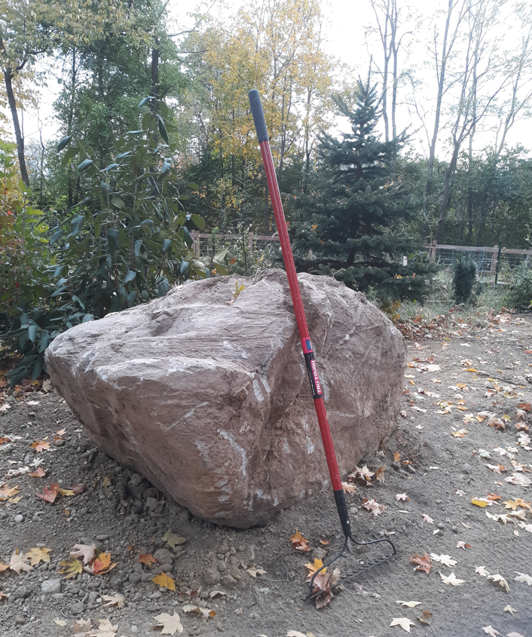
With All Your Heart – Lesson 4. Heart of Flesh or Stone?

Slide 7
With All Your Heart – Lesson 4. Heart of Flesh or Stone?
When someone is described as hardhearted, we usually imagine an individual who is cruel— who treats other people harshly. We don’t think of the word as applying to us. But we need to check our heart first.
All of us have a heart that is “hardened” in some areas and to certain degrees, and this heart condition hinders our life. We should be aware that any person’s heart has the potential to grow increasingly hard, so that it eventually affects his entire being. We are all susceptible to such a hardening process if we do not regularly monitor our heart.

Slide 8
With All Your Heart – Lesson 4. Heart of Flesh or Stone?
Consider the meaning of the Greek word translated “hardness of heart” in Mark 16:14, which reads, “Later Jesus appeared to the eleven as they sat at the table; and He rebuked their unbelief and hardness of heart, because they did not believe those who had seen Him after He had risen.”
This Greek word indicates “destitution of spiritual perception.” We would not think of Jesus’ disciples as having “hardness of heart,” except, maybe Judas. The other disciples made mistakes, lacked faith, and failed to understand Jesus’ teachings at times. But hardness of heart?

Slide 9
With All Your Heart – Lesson 4. Heart of Flesh or Stone?
Note again the implication of “hardheartedness”: “destitution of spiritual perception.” To be “destitute” is a serious condition. The word indicates a lack of spiritual discernment or sensitivity, a deficiency of understanding in relation to spiritual truth.
This deficiency blocks our knowledge of the true nature of God and Jesus, limits our intimacy with God, and causes us to neglect or disobey His commands.

Slide 10
With All Your Heart – Lesson 4. Heart of Flesh or Stone?
The fulfillment of the greatest commandment of all—to love God with our whole being, and to love other people as ourselves ( Mark 12:29–31)—is hindered by hardness of heart, because a lack of spiritual perception will distance our heart from God and other people.
Ask yourself: “Is my heart soft and yielded to God?” “Where might my spiritual perception be blocked due to a hardness of heart?”

Slide 11
With All Your Heart – Lesson 4. Heart of Flesh or Stone?
The concept of love “growing cold” refers to a hardened heart. When God created man, He gave man a heart after His own heart; but when man disobeyed God, their heart was corrupted, —including pride, immorality, a lust for power, etc.—the same sins we see reflected in our society today. they lack empathy for other people’s physical, emotional, or spiritual pain. They are not attuned to God, His Word, or His will.
They only care about themselves!

Slide 12
With All Your Heart – Lesson 4. Heart of Flesh or Stone?
Deut. 30:6 And the LORD thy God will circumcise thine heart, and the heart of thy seed, to love the LORD thy God with all thine heart, and with all thy soul, that thou mayest live.
Ezekiel 36:26 "I will give you a new heart and put a new spirit within you; I will take the heart of stone out of your flesh and give you a heart of flesh.

Slide 13
With All Your Heart – Lesson 4. Heart of Flesh or Stone?
God has always desired to write His commandments on the hearts of His people, because it is the only way they can truly love and obey Him. At the same time God was writing the Ten Commandments on the stone tablets with His own finger in the presence of Moses on Mount Sinai (Ex. 31:18), the people of Israel were rejecting God and worshipping a golden calf that they had asked Aaron to create. (Ex.32).
In essence, they were refusing what God Himself had written, for them.
Even today, many people reject the true Word of God for a religion of their own making.

Slide 14
With All Your Heart – Lesson 4. Heart of Flesh or Stone?
In the New Testament, when Stephen gave his speech to the Jewish leaders of the Sanhedrin, he said, “You stiffnecked and uncircumcised in heart and ears! You always resist the Holy Spirit; as your fathers did, so do you” (Acts 7:51). And God can say the same regarding many in the church today. They have hardened their heart toward Him, demonstrating an independent spirit, rebelliousness, and disobedience to His word. Consequently, they have “grieved” the Holy Spirit. (Eph.4:30.)

Slide 15
With All Your Heart – Lesson 4. Heart of Flesh or Stone?
What Causes the Heart to Harden?
1. Unbelief
“Beware, brethren, lest there be in any of you an evil heart of unbelief in departing from the living God” (Heb. 3:12).
“An evil heart of unbelief” is evidenced when a person decides, of his own free will, not to believe in God and therefore not to obey Him. This decision is an open act of rebellion and defiance.

Slide 16
With All Your Heart – Lesson 4. Heart of Flesh or Stone?
What Causes the Heart to Harden?
2. Repeatedly Committing Sin
The writer of Hebrews said, “But exhort one another daily, while it is called ‘Today,’ lest any of you be hardened through the deceitfulness of sin” (Heb.3:13).
Sin is “to miss the mark,” “to disobey God,” “to offend the Lord,” and “to violate God’s law.”
And when we commit a particular sin repeatedly, without repentance, we open the door of our heart to the enemy, allowing the devil to introduce some leaven of corruption, which causes our heart to become hardened.

Slide 17
With All Your Heart – Lesson 4. Heart of Flesh or Stone?
What Causes the Heart to Harden?
3. Holding On to an Offense
Offenses affect many people who have felt wronged by a spouse or child, a teacher or classmate, a boss or coworker, a preacher or fellow church member, etc. Taking offense at other people—as well as offending them—is rather unavoidable in life. Jesus said, “Woe to the world because of offenses! For offenses must come, but woe to that man by whom the offense comes!” (Matt.18:7).

Slide 18
With All Your Heart – Lesson 4. Heart of Flesh or Stone?
What Causes the Heart to Harden?
4. Harboring Emotional Wounds
(not forgiving others)
Our emotional wounds are usually inflicted by the people whom we love the most—often, those who are closest to us and to whom we have opened up our heart. Some young people are continually hurt or abused by a close relative—and many people are marked by such wounds for the rest of their life. Even when we are older, we may be wounded deeply by a parent, spouse, child, close friend, or authority figure we are close to.

Slide 19
With All Your Heart – Lesson 4. Heart of Flesh or Stone?
What Causes the Heart to Harden?
5. Disobeying the Word of God
God created man to be in relationship with Him. His plan was always to have clear and permanent communications with us. Even after the fall, God has continued to speak to humans through various means—sometimes directly, and at other times through His prophets, and His written Word. His ultimate expression of Himself is the person of Jesus Christ:
“The Word became flesh and dwelt among us, and we beheld His glory, the glory as of the only begotten of the Father, full of grace and truth” (John 1:14). “God, who at various times and in various ways spoke in time past to the fathers by the prophets, has in these last days spoken to us by His Son…” (Heb. 1:1–2).

Slide 20
With All Your Heart – Lesson 4. Heart of Flesh or Stone?
What Causes the Heart to Harden?
6. Lawlessness
Lawlessness means illegality and indicates violation of law, transgression of the law, wickedness, iniquity, or unrighteousness. It comes from another Greek word meaning without law.
Increasingly, generations demand to live without beneficial restrictions and laws. One result of this development is that those who are victims of other people’s lawlessness end up hardening their own hearts also.
Let’s look at some signs of a hard heart.

Slide 21
With All Your Heart – Lesson 4. Heart of Flesh or Stone?
Signs of a Hardened Heart
A Hardened Heart Moves from Commitment to “Wishful Thinking”
A person will abandon his commitments, disconnecting himself from service he had participated in with other believers. His mind is full of desires, but they lead nowhere because hardheartedness has immobilized his will and crippled his motivation. The person loses his passion and is left only wishing for the fulfillment of things that “would be good to do” but never become a reality. Many churches are filled with “wishful thinkers” whose hearts have become insensitive to faith and spiritual matters.

Slide 22
With All Your Heart – Lesson 4. Heart of Flesh or Stone?
Signs of a Hardened Heart
2. A Hardened Heart Rebels Against God
Rebellion against God is a clear sign of a hardened heart. However, it is possible for us to rebel against God without recognizing that we are doing so. Our mind provides us with excuses to justify our actions. A person may become indifferent and the person usually does not become involved in the church’s work. Sometimes, he simply doesn’t care! He may begin to criticize the church and its work. When a believer rebels against God’s authority, he is rebelling against God Himself.

Slide 23
With All Your Heart – Lesson 4. Heart of Flesh or Stone?
Signs of a Hardened Heart
3. A Hardened Heart Justifies Wrongdoing and blames others. -
Earlier, we discussed how the heart can grow cold after someone has been hurt or wronged, and that this coldheartedness can easily become hardheartedness. Many such people seem to have excuses for their wrong behavior.
Example:
• “I am not a good dad because I grew up without a dad myself, and no one taught me how to be a dad. You can’t expect me to do a better job as a dad.”

Slide 24
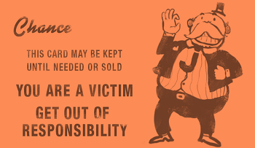
Don’t listen to the world when
The World Says “You are a Victim”
Victim playing
Victim playing is the fabrication or exaggeration of victimhood for a variety of reasons such as to justify abuse of others, to manipulate others, a coping strategy, attention seeking or diffusion of responsibility. A person who repeatedly does this is known as a "professional victim".

Slide 25
With All Your Heart – Lesson 4. Heart of Flesh or Stone?
Signs of a Hardened Heart
4. A Hardened Heart Resists Communication and Correction
Good communication is key every healthy relationship. A hardened heart has a strong resistance to communication. A person with a hardened heart will often ignore those who try to get him to recognize how his attitudes or actions are hurting others. He doesn’t want to hear it. He usually believes he is above the spiritual authority and accountability of congregation.

Slide 26
With All Your Heart – Lesson 4. Heart of Flesh or Stone?
Signs of a Hardened Heart
5. A Hardened Heart Is Emotionally Cold Toward Others
God gave us emotions to help us to connect with other people and to express ourselves. Our emotions also help us to recognize the pain and needs of other people and to empathize with them. Jesus was moved by people’s suffering and needs.
“When Jesus saw the multitudes, He was moved with compassion for them, because they were weary and scattered, like sheep having no shepherd” (Matt. 9:36). In another instance, “Jesus wept” (John 11:35) over the death of a friend. And, He was “sorrowful and deeply distressed” (Matt. 26:37)

Slide 27
With All Your Heart – Lesson 4. Heart of Flesh or Stone?
Signs of a Hardened Heart
6. A Hardened Heart Enjoys Sin
Giving free rein to the “lusts of the flesh” (2 Peter 2:18). This occurs when people’s sin becomes completely enthroned in their heart, so that it directs their life. Such people lack a proper fear of God, which would have restrained their corrupt behavior.
In contrast, when a person’s heart is aligned with God’s, he recognizes that sin is only a temporal pleasure that leads to destruction and eternal death, so that he doesn’t want anything to do with it! We need to follow the example of Moses:
By faith Moses, when he became of age, refused to be called the son of Pharaoh’s daughter, choosing rather to suffer affliction with the people of God than to enjoy the passing pleasures of sin, esteeming the reproach of Christ greater riches than the treasures in Egypt; for he looked to the reward. (Heb.11:24–26)

Slide 28
With All Your Heart – Lesson 4. Heart of Flesh or Stone?
Signs of a Hardened Heart
7. A Hardened Heart Does Not Worship God
When a person does not desire to worship God, it is a clear sign that some hardening of heart has taken place. When the person attends an assembly, he usually sees it as a formality that is far removed from true worship.
He often rejects the true worship because it convicts him of his need to repent of his sins and his lack of love and to experience the transformation of his heart.

Slide 29
With All Your Heart – Lesson 4. Heart of Flesh or Stone?
Review: Lesson 4. Heart of Flesh or Heart of Stone
Causes of a hard heart
Unbelief
Repeatedly Committing Sin
Holding On to an Offense
Harboring Emotional Wounds
Disobeying the Word of God
Lawlessness
Signs
1. A Hardened Heart Moves from Commitment to “Wishful Thinking”
2. A Hardened Heart Rebels Against God
3. A Hardened Heart Justifies Wrongdoing and blames others.
4. A Hardened Heart Resists Communication and Correction
5. A Hardened Heart Is Emotionally Cold Toward Others
6. A Hardened Heart Enjoys Sin
7. A Hardened Heart Does Not Worship God

