Slide 1
Love the Lord
With ALL Your Heart
Lesson 3. Transformation and Renewal
Romans 12:1 I beseech you therefore, brethren, by the mercies of God, that you present your bodies a living sacrifice, holy, acceptable to God, which is your reasonable service. 2 And do not be conformed to this world, but be transformed by the renewing of your mind, that you may prove what is that good and acceptable and perfect will of God.

Slide 2
With All Your Heart – Lesson 3. Transformation & Renewal
Review: Lesson 1
The most important thing in life is to love God with all our heart, soul, mind, and strength.
Our mind consists of our thoughts, feelings, motives, intentions.
What we put into our heart comes out in our life.
We must monitor our heart daily with our ‘Kardia-mobile”, the word of God.
We must have the proper diet and exercise for our
Physical heart and our Spiritual heart.

Slide 3
With All Your Heart – Lesson 3. Transformation & Renewal
Review: Lesson 2 God Gave Them Up.
God created man in His own image. When man gave in to temptation and sin, he allowed his heart to be changed. With his fall, man brought a curse into this world. Gen. 3:13-24
Sin produces its corruptive effects—always downward, always getting worse. Rom.1:18-32
The root of sin is pride and selfishness, which is the opposite of the heart of God. Col.3:1-5
Since the beginning of time, an invisible war has been taking place for possession of the hearts of all human beings Eph.6:12
The goal of the enemy is to take the human heart captive and to keep it captive. John 8:34

Slide 4
With All Your Heart – Lesson 3. Transformation & Renewal
The heart is the gatekeeper of our lives.
The heart also functions as a gate, or door, that we open or close to external influences, all of which have the potential to affect our motivations, decisions, and actions. The devil desires to block the flow of God’s life in us, redirecting us away from our Creator’s original design. His goal is to destroy us or, at least, to derail God’s purposes for us—whether those purposes are connected to our job, marriage, family life, financial prosperity, or any other aspect of our life.

Slide 6
With All Your Heart – Lesson 3. Transformation & Renewal
Consequently, Satan attempts to manipulate our heart by planting bad thoughts in our mind and enticing our sinful nature to rise up in the form of pride, lust, rebellion, and so forth. The
Bible uses other terms for the sinful nature, such as the “flesh” (see, for example, Rom. 7:5) or the “old man” (Eph. 4:22)—the “flesh” in this sense referring not to the physical body but to our sinful desires.
Whatever term we use for the sinful nature, the devil wants our heart to be contaminated by it.

Slide 7
With All Your Heart – Lesson 3. Transformation & Renewal
Satan often attacks in several areas of our life at the same time, because he wants to wear down our patience and take away our peace, making us vulnerable to sin—sin in our heart, and then sin in our actions.
So, he introduces spirits of fear, anxiety, worry, discouragement, depression, sickness, and so forth, as he seeks to corrupt our heart with doubt, unbelief, bitterness, resentment, hate, guilt, or an all-pervasive conviction of failure and hopelessness.

Slide 8
Transformation & Renewal

Slide 9
With All Your Heart – Lesson 3. Transformation & Renewal
This is why we must make a commitment to watch closely over our heart and to monitor its health.
Be careful about what, and who, you listen to. (Phil.4:8; Eph. 4:29.) Don’t accept words of doubt or fear; don’t receive—or join in with—other people’s murmuring and complaining.
As you guard the gate of your heart, grant entrance only to words that build and edify your faith, that bring you peace and joy, and that encourage truth, holiness, and a desire to seek God in a deeper way.
“Listen” closely to God’s Word as you read and study the Scriptures.

Slide 10
With All Your Heart – Lesson 3. Transformation & Renewal
The Heart Enables Intimate Relationships
Jesus cited the following as the greatest commandment God has given human beings: “You shall love the Lord your God with all your heart, with all your soul, and with all your mind” (Matt. 22:37).
The Lord never requires us to do anything that He hasn’t enabled us to do. He may already have given us the ability to do it in the inherent makeup with which we were born; or, He may give us the resources—or both.
So, when we are commanded to love God with all our heart, we can know that this is something He will help us to do. We were created for intimacy with God, and we can have a deep relationship with Him.

Slide 11
With All Your Heart – Lesson 3. Transformation & Renewal
Such a relationship with God arises from a love that is born in the heart and that surrenders completely to the Beloved.
A similar principle applies to our relationships with people. Every genuine relationship is born in the heart. Therefore, if a relationship that was established in love begins to die, it is because that relationship is no longer based in the heart; consequently, it grows cold and/or fades away.

Slide 12
With All Your Heart – Lesson 3. Transformation & Renewal
Any action we take for God—praying, serving others, proclaiming the gospel of Jesus Christ, giving, etc.—should flow from our love for Him. “Whatever you do, do it heartily, as to the Lord and not to men” (Col. 3:23).
This lifestyle of love was designed by the Creator. Again, if we discern a motivation in our heart other than love—for example, one that is merely expedient—it indicates that some area of our heart is controlled by Satan and needs to be transformed into the likeness of God’s own nature.

Slide 13
With All Your Heart – Lesson 3. Transformation & Renewal
An open heart is necessary for any meaningful relationship, whether with God or man.
Consider a working relationship with someone at your job. You never encounter any problems with this individual. He is a hard worker, cooperates with you, has a pleasant disposition. You enjoy working with him and you think you’d like to develop a friendship outside the workplace. However, you find that you cannot cross a certain point in your relationship with him. His heart is closed to anything beyond interaction at the job.
This shows that even when a person is intelligent and has an open mind toward others, he may still have a closed heart toward them. For many people, it can take a long time to feel comfortable enough with another person to open their heart to a deeper level of intimacy— whether in friendship, romantic love, or the spiritual relationship.

Slide 14
With All Your Heart – Lesson 3. Transformation & Renewal
We will not always experience a connection of the heart with the people we work with or the ones she share responsibility with.
And when a person’s heart is closed to us, our interactions with him can feel impersonal, sometimes even cold. While such an association may still allow us to function adequately in the workplace, it would be unhealthy if it occurred in a relationship with a member of our immediate family or a longtime friend.

Slide 15
With All Your Heart – Lesson 3. Transformation & Renewal
Closed heart is a closed gate.
In these cases, the party who has closed his heart has likely built up a defense mechanism in order to protect himself from someone or something that he fears or that has caused him to take offense—whether that “threat” is real or imagined.
There is no relationship without an open heart.

Slide 16
With All Your Heart – Lesson 3. Transformation & Renewal
Closed relationships sometimes occur within the church. Example, suppose a believer decides he will just attend church services but then go home as soon as the service ends. He does not want to develop spiritually meaningful relationships with the other members.
Such a believer may not recognize that Christians, being many, are one body in Christ, and individually members of one another” (Rom. 12:5). The effect of his decision to close himself off from other believers is similar to the business relationship described.
And, there are times when such closed behavior indicates that the individual simply wants to use other people in order to get something from them, rather than offering them the love of Christ.

Slide 17
With All Your Heart – Lesson 3. Transformation & Renewal
When a person has built emotional barriers that stifle the normal functions of his heart, leading to a closed heart, this means that others—whether they are members of his family, his church, or another group—will never truly know him or be able to develop a close relationship with him.
(SHAKERS)
Some church denominations teach (or imply) that to show emotion is an act of the “flesh”; others may not go that far, but they still do not encourage the members of their congregations to display their feelings openly. God gave us emotions and feelings to enable us to connect with other people and to express ourselves; therefore, they are both real and necessary.
We should not go to extremes, too much emotionalism or no emotionalism.
Both extremes are conditions of a heart that need to be molded, transformed, and renewed by God’s word.

Slide 18
With All Your Heart – Lesson 3. Transformation & Renewal
Is your own heart open or closed? Are you comfortable sharing your heart with your spouse, other family members, or friends?
Are you afraid to do so because you have been emotionally wounded by someone in the past?
Sometimes we create emotional wounds and sinful attitudes that prevent us from opening up our heart to God and others, and keep us from being healed, thus distorting our reflection of God’s heart.

Slide 19
With All Your Heart – Lesson 3. Transformation & Renewal
God Speaks to Our Heart
God has two “thrones”: one in heaven and the other on earth. His earthly throne is found in the heart of every believer. Recall that Jesus said, “If anyone loves Me, he will keep My word; and My Father will love him, and We will come to him and make Our home with him” (John 14:23).
In the Old Testament, the presence of God rested above the ark of the covenant, which was located in the Holy of Holies in the tabernacle or temple. Today, we are the temple of God as we carry His presence in our heart: “Do you not know that you are the temple of God and that the Spirit of God dwells in you?…For the temple of God is holy, which temple you are” (1 Cor.3:16–17).

Slide 20
With All Your Heart – Lesson 3. Transformation & Renewal
We Worship from the Heart
With our intimate relationship with God, our heart is also the source of our worship of Him. Worship that doesn’t come from our heart is tainted. For example, suppose you enter a time of worship but instead of focusing on God, you are absorbed by your own thoughts, desires, and needs.
Your heart is absent. Consequently, you do not give God the honor and devotion He deserves, you aren’t able to enter into His presence, and you don’t experience His blessings in your life.

Slide 21
With All Your Heart – Lesson 3. Transformation & Renewal
The Heart Generates Both Belief and Trust in God (Prov.3:5).
“Trust in the Lord with all your heart, and lean not on your own understanding” (Proverbs 3:5). Trust is another spiritual element that is born in the heart. We must realize that faith and trust are not the same. Trust represents our “walk” with God—the manner in which we love Him, obey Him, and live for Him. The presence of trust in our heart is an indicator that we have a true relationship with Him, that we really know Him and have come to totally depend on Him. When we trust God, we rest securely in His character, integrity, and faithfulness.
Any true relationship is based on trust. A relationship with God is established by trusting Him completely.

Slide 22
With All Your Heart – Lesson 3. Transformation & Renewal
Trust Brings Perseverance
Our trust in God not only establishes our relationship with Him but also maintains it over time. This is particularly true as we wait for the fulfillment of His promises. Consider the following questions: Is the foundation of your relationship with God one that will stay strong during the course of your life? Do you maintain your relationship with God on an everyday basis, whether you experience good times or bad times?
If you were to experience a distressing problem or enter into a difficult period that lasted a long time, would you continue to trust in Him, or would you turn to alternative sources for help? After all the ups and downs of life, will you be found still in relationship with God in the end?

Slide 23
The way you react
to troubles in your life is a testimony
of the depth of your faith.

Slide 24
With All Your Heart – Lesson 3. Transformation & Renewal
For God is not unjust to forget your work and labor of love which you have shown toward His name, in that you have ministered to the saints, and do minister. And we desire that each one of you show the same diligence to the full assurance of hope until the end, that you do not become sluggish, but imitate those who through faith and patience inherit the promises. (Heb.6:10–12)
We enter into greater dimensions of faith through trust.

Slide 25
With All Your Heart – Lesson 3. Transformation & Renewal
Abraham, who was a giant of faith, is a strong example of trust and its results. Abraham had to wait almost twenty-five years before God’s promise of a son manifested in the “now.” “And not being weak in faith, [Abraham] did not consider his own body, already dead (since he was about a hundred years old), and the deadness of Sarah’s womb” (Rom. 4:19).
We could call Abraham not only the “father of faith” (Rom. 4:11–12, 16) but also the “father of trust,” because he had to wait with patience and confidence, resting in the knowledge that God’s promise would manifest one day. Trust allowed him to wait without losing heart—even though he sometimes had questions. (Gen.15:1–6.) Trust enabled him to persevere and to believe in God and His word “against all hope” (Rom.4:18 ), regardless of his circumstances.

Slide 26
With All Your Heart – Lesson 3. Transformation & Renewal
Moreover, faith that is supported by trust cannot stay silent. It has to praise God and worship Him. Abraham “was strengthened in faith, giving glory to God” (Rom. 4:20).
In the midst of your circumstances, praise and worship God. Express your faith and trust as you submit to the faithful God who never changes.
Heb. 13:8. Jesus Christ the same yesterday, and to day, and for ever. - Your “now” is coming!
When trust is strong, faith comes into the “now.”

Slide 27
With All Your Heart – Lesson 3. Transformation & Renewal
Wait on the Lord.
If you do not submit, God will not commit.
Obedience comes first,
then blessings.

Slide 28
With All Your Heart – Lesson 3. Transformation & Renewal
Many people don’t take time to think about the state of their heart. We must ask ourselves—and answer honestly—each aspect of this question: “Is my heart in the right place in relation to:
God,
my family,
the church,
my occupation,
my entertainment and recreation, and my other activities and involvements?”
“Where your treasure is, there your heart will be also” (Matt. 6:21).

Slide 29
With All Your Heart – Lesson 3. Transformation & Renewal
What is your top priority in life?
Is it God and His kingdom? Or is it wealth? Success? Fame?
A good physical appearance? A desire for revenge?
Think about how you are spending the majority of your money and the largest portion of your time,
Again, you can easily look at your checkbook entries and credit card statements to determine how, and on what, you are spending your money.
You can also review your activities to assess your priorities in life and the nature of your involvements in light of the character of God and the purposes of His kingdom.

Slide 30
With All Your Heart – Lesson 3. Transformation & Renewal
Speak from Your Heart, worship from your heart
We must speak from our heart—not just from our head. To speak from our heart is to speak honestly, without guile or deception. We must not speak lies or flattery to other people in order to get something from them. Our words should have integrity; we should not speak something that our heart does not believe.
We have noted that “out of the abundance of the heart the mouth speaks” (Matt. 12:34). There is a connection between the heart and the mouth. Therefore, if what you are saying is not in accord with God’s Word—if you complain, gossip, curse, or speak something else that conflicts with His character— you know that there is a problem in your heart.

Slide 31
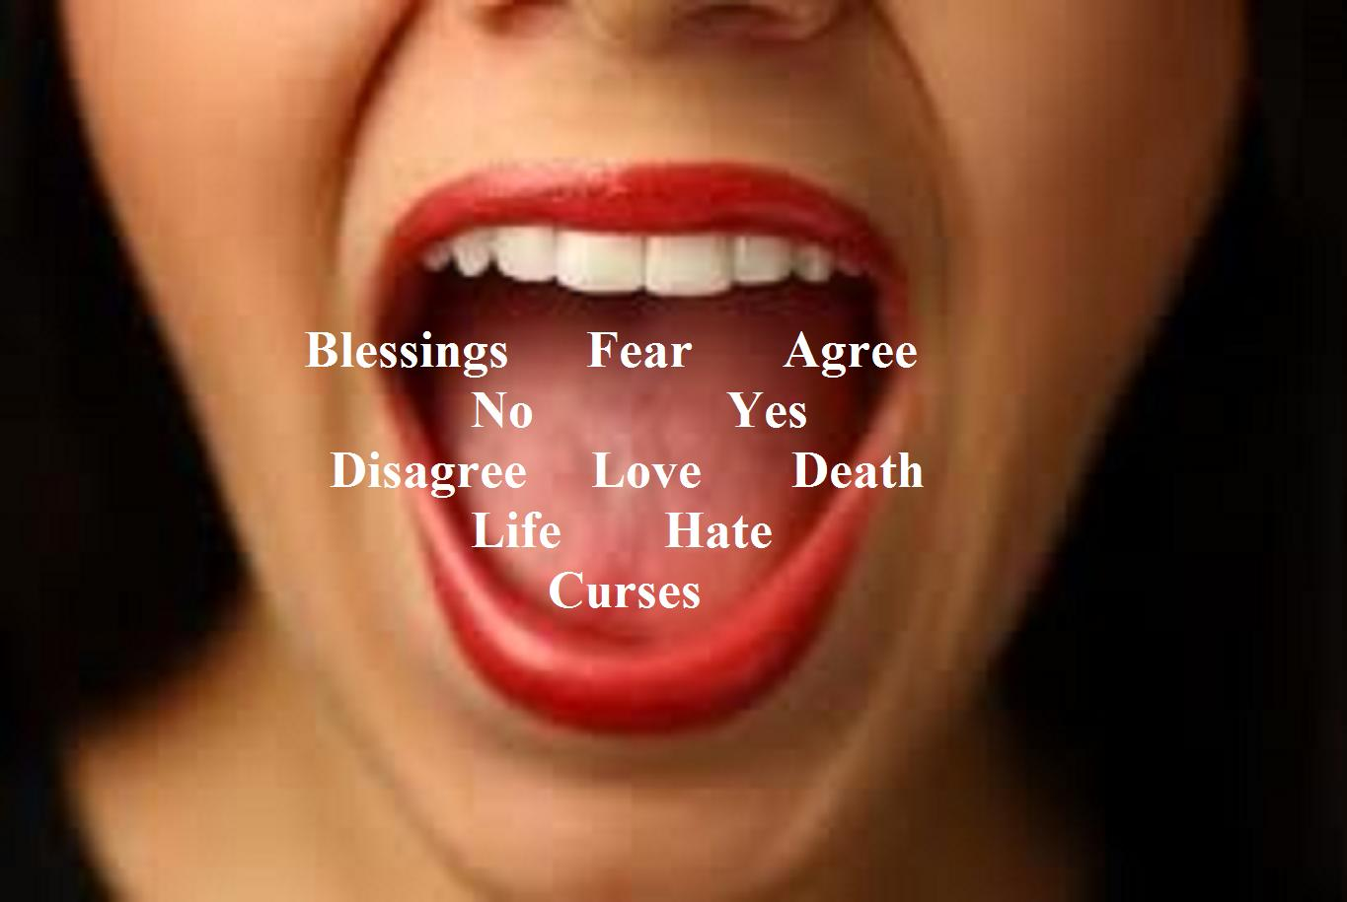
Mt 12:34 "Brood of vipers! How can you, being evil, speak good things? For out of the abundance of the heart the mouth speaks.

Slide 32
With All Your Heart – Lesson 3. Transformation & Renewal
Review: Lesson 3
The heart is the gatekeeper of our lives.
The heart enables intimate relationships.
An open heart is necessary for any meaningful relationship, whether with God or man.
God speaks to our heart.
We worship God from our heart.
The Heart Generates Both Belief and Trust in God (Prov.3:5).
Trust Brings Perseverance
“Being confident of this very thing, that He who has begun a good work in you will complete it until the day of Jesus Christ” (Phil. 1:6).
If you do not submit, God will not commit.
Speak from our heart, worship God from our heart.

Slide 33
With All Your Heart – Lesson 3. Transformation & Renewal
Transformation and renewal =
Belief + Trust + Perseverance + Obedience
Then comes the blessing

