Slide 1
Love the Lord
With ALL Your Heart
Lesson 2. God Gave Them Up
Romans 1:24 Therefore God also gave them up to uncleanness, in the lusts of their hearts, to dishonor their bodies among themselves,
25 who exchanged the truth of God for the lie, and worshiped and served the creature rather than the Creator, who is blessed forever. Amen.

Slide 3
With All Your Heart – Lesson 2 God Gave Them Up
Review: Lesson 1
The most important thing in life is to love God with all our heart, soul, mind, and strength.
Our mind consists of our thoughts, feelings, motives, intentions.
What we put into our heart comes out in our life.
We must monitor our heart daily with our ‘Kardia-mobile”, the word of God.
We must have the proper diet and exercise for our
Physical heart and our Spiritual heart.

Slide 5
With All Your Heart – Lesson 2 God Gave Them Up
(Gen. 1:26) And God said, Let us make man in our image, after our likeness: and let them have dominion over the fish of the sea, and over the fowl of the air, and over the cattle, and over all the earth, and over every creeping thing that creeps upon the earth.
27 So God created man in his own image, in the image of God created he him; male and female created he them.
From the beginning, it was God’s desire and purpose for man to have a heart like His.
God also breathed into man His own Spirit: “And the Lord God formed man of the dust of the ground, and breathed into his nostrils the breath of life; and man became a living being” (Gen. 2:7).

Slide 6
With All Your Heart – Lesson 2 God Gave Them Up
Man, therefore, was made with a heart, or spirit, fashioned after the Creator’s. This heart was pure and complete, filled with God’s nature and character.
But the first human beings, Adam and Eve, turned away from God’s heart and the nature in which they had been created.
Instead of cherishing God’s instructions and wisdom, they willfully disobeyed Him.

Slide 7
With All Your Heart – Lesson 2 God Gave Them Up
God had commanded them not to eat of the Tree of Knowledge of Good and Evil, warning them that if they did so, they would die.
Sadly, they listened to the voice of God’s enemy, Satan (the devil), who told them, “You will not surely die. For God knows that in the day you eat of it your eyes will be opened, and you will be like God, knowing good and evil” Gen. 3:4.

Slide 8
With All Your Heart – Lesson 2 God Gave Them Up
Tempted by a promise of “being like God”—although they had already been made in His image—the first man and woman went against their Creator.
Their disobedience, or sin, resulted in their fall and the loss of their innocence—it initiated the corruption of the human heart.

Slide 9
With All Your Heart – Lesson 2 God Gave Them Up
With their fall, they brought a difficult and cursed life on themselves. (Gen. 3:1–19.) And they did experience death, for “the wages of sin is death” (Rom. 6:23).
First, their hearts underwent spiritual death. And second, they eventually experienced physical death.
One of the worst results of the fall for humans was their removal from the immediate presence of God, no longer to enjoy direct fellowship with Him. Gen. 3:22–24.
Yet God never departed from His faithfulness to His beloved creation or His desire that they be restored to a close relationship with Him.

Slide 10
With All Your Heart – Lesson 2 God Gave Them Up
Gen. 3:22 Then the LORD God said, "Behold, the man has become like one of Us, to know good and evil. And now, lest he put out his hand and take also of the tree of life, and eat, and live forever" -
23 therefore the LORD God sent him out of the garden of Eden to till the ground from which he was taken.
24 So He drove out the man; and He placed cherubim at the east of the garden of Eden, and a flaming sword which turned every way, to guard the way to the tree of life.

Slide 11
With All Your Heart – Lesson 2 God Gave Them Up
From the point of Adam and Eve’s disobedience, humanity’s corruption continued in human history until it reached this peak: “Then the Lord saw that the wickedness of man was great in the earth, and that every intent of the thoughts of his heart was only evil continually” (Gen. 6:5).
This was the point when God destroyed the world through a flood—the only survivors being Noah, his wife, and his sons and their wives, whom God preserved. (Gen. 6.)

Slide 12
With All Your Heart – Lesson 2 God Gave Them Up
Noah was the most righteous man on the earth at the time of the flood, and that is why he and his family were spared. And, although the earth was repopulated by Noah’s family, corruption spread thru the world again, and people’s hearts turned away from God once more.
Ever since man’s first sin, we all have sinned, and we all continue to sin, in various ways.
As the apostle Paul wrote, “All have sinned and fall short of the glory of God.…Through one man sin entered the world, and death through sin, and thus death spread to all men, because all sinned” Rom. 3:23; 5:12.

Slide 13
With All Your Heart – Lesson 2 God Gave Them Up
Corruption may take a while to occur.

Slide 14
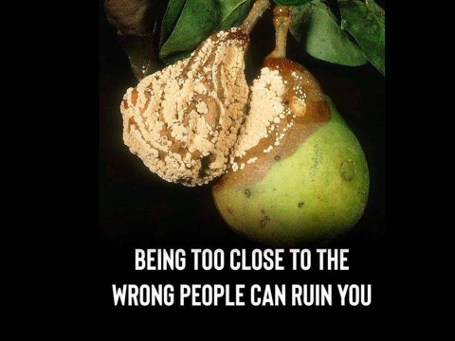

Slide 15
With All Your Heart – Lesson 2 God Gave Them Up
Corruption may take a while to occur…
Left to ourselves, we are corrupt, exhibiting various “treasures” of the evil heart , such as wicked thoughts, covetousness, deceit, pride, foolishness, selfishness, adultery, and murder.
Sin will produce its corruptive effects—always downward, always getting worse. The extreme cases of degradation we observe in our society did not take place suddenly or in one generation. Human morality has continually disintegrated until it has reached the evil condition we are witnessing today.

Slide 16
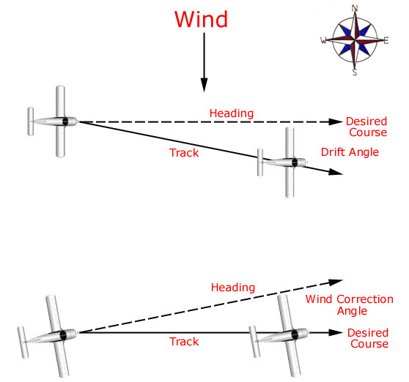
Don’t change your decision to reach your destination. Get back on course!!!
Always know your location – “Where am I, where am I headed?” dennis waitley

Slide 17
With All Your Heart – Lesson 2 God Gave Them Up
Rom. 1:18 For the wrath of God is revealed from heaven against all ungodliness and unrighteousness of men, who suppress the truth in unrighteousness,
19 because what may be known of God is manifest in them, for God has shown it to them.
20 For since the creation of the world His invisible attributes are clearly seen, being understood by the things that are made, even His eternal power and Godhead, so that they are without excuse,
21 because, although they knew God, they did not glorify Him as God, nor were thankful, but became futile in their thoughts, and
their foolish hearts were darkened.

Slide 18
With All Your Heart – Lesson 2 God Gave Them Up
Rom. 1:22 Professing to be wise, they became fools,
23 and changed the glory of the incorruptible God into an image made like corruptible man--and birds and four-footed animals and creeping things.
24 Therefore God also gave them up to uncleanness, in the lusts of their hearts, to dishonor their bodies among themselves,
25 who exchanged the truth of God for the lie, and worshiped and served the creature rather than the Creator, who is blessed forever. Amen.

Slide 19
With All Your Heart – Lesson 2 God Gave Them Up
Rom. 1:26 For this reason God gave them up to vile passions. For even their women exchanged the natural use for what is against nature.
27 Likewise also the men, leaving the natural use of the woman, burned in their lust for one another, men with men committing what is shameful, and receiving in themselves the penalty of their error which was due.
28 And even as they did not like to retain God in their knowledge, God gave them over to a debased mind, to do those things which are not fitting;
29 being filled with all unrighteousness, sexual immorality, wickedness, covetousness, maliciousness; full of envy, murder, strife, deceit, evil-mindedness;
they are whisperers,

Slide 20
With All Your Heart – Lesson 2 God Gave Them Up
Rom. 1:30 backbiters, haters of God, violent, proud, boasters, inventors of evil things, disobedient to parents,
31 undiscerning, untrustworthy, unloving, unforgiving, unmerciful;
32 who, knowing the righteous judgment of God, that those who practice such things are deserving of death, not only do the same but also approve of those who practice them.

Slide 21
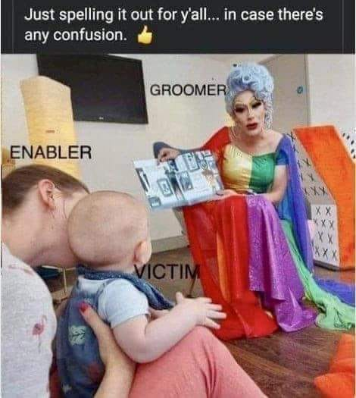

Slide 23
With All Your Heart – Lesson 2 God Gave Them Up
The root of sin is pride and selfishness - the opposite of the heart of God. It was pride and selfishness that caused man to want to be equal with God, so that they were deceived by the devil to the point of disobeying their Creator. Selfishness places ourselves first, above everyone else. The Scriptures say, “For men will be lovers of themselves,…having a form of godliness but denying its power. And from such people turn away!” 2 Tim. 3:2, 5.
Genuine godliness—not just a “form” of it—comes from changing our character, removing our selfishness and self-centeredness and replacing that with love, kindness, compassion, and self-sacrifice for the sake of others.

Slide 24
Our heart is the battleground for sin.
Win the battle!
Empty our heart
Fill our heart
Love
Deut.6:4-6
Kindness
compassion
Selfishness
Self-centeredness

Slide 25
With All Your Heart – Lesson 2 God Gave Them Up
Deut. 6:4 "Hear, O Israel: The LORD our God, the LORD is one!
5 "You shall love the LORD your God with all your heart, with all your soul, and with all your strength.
6 "And these words which I command you today shall be in your heart.

Slide 26
With All Your Heart – Lesson 2 God Gave Them Up
Ever since Satan tempted the first man and woman to reject God’s command, turning away from His nature, an invisible war has been taking place for possession of the hearts of all human beings. God’s kingdom of light and Satan’s kingdom of darkness are battling, even now for our heart.
Whoever holds the heart of someone also holds his potential and his resources—his entire person.
We must decide who we will surrender our heart to.

Slide 27
With All Your Heart – Lesson 2 God Gave Them Up
You may ask, “What if I decide not to give my heart to either kingdom? What if I just try to live on my own?” There is no “neutral zone” in this spiritual conflict.
When we choose to live on our own, apart from God, we effectively choose to side with God’s enemy, Satan.
The kingdom of darkness takes over any terrain—especially the human heart—it finds vulnerable or weak, using the most subtle weapons and tools imaginable. ( Matt. 12:43–45.)

Slide 28
With All Your Heart – Lesson 2 God Gave Them Up
“Be sober, be vigilant; because your adversary the devil walks about like a roaring lion, seeking whom he may devour. Resist him, steadfast in the faith” (1 Peter 5:8–9).
“For we do not wrestle against flesh and blood, but against principalities, against powers, against the rulers of the darkness of this age, against spiritual hosts of wickedness in the heavenly places” (Eph.6:12).

Slide 29
With All Your Heart – Lesson 2 God Gave Them Up
We must be aware of the fierce struggle for our heart taking place and make a decision to surrender our life to the Lord, who loves us and wants to give us His life. In contrast, the enemy hates us and seeks to destroy us.
“The thief [Satan] does not come except to steal, and to kill, and to destroy. I have come that they may have life, and that they may have it more abundantly” (John 10:10).
The goal of the enemy is to take the human heart captive and to keep it captive.
(sin captivates us, Satan captures us)

Slide 30
With All Your Heart – Lesson 2 God Gave Them Up
What does God see in your heart? He sees the motives, intentions, and intimate thoughts that come from it, whether good or evil.
What is your reason for getting out of bed every morning? What moves you? Is your primary incentive personal gain, or is it a desire to honor God?
Are you pursuing your own will or God’s will?
Do you speak and act in certain ways in order to be recognized by other people, or do you speak and act out of love and reverence for your heavenly Father?
Are your actions prompted by a generous heart or a selfish one?

Slide 31
With All Your Heart – Lesson 2 God Gave Them Up
What motivates you to take care of your family members—or to neglect them?
Do you spend your money on temporal things or on eternal purposes? Why do you pray, offer praises to God, or give offerings—or not do any of these things? Is your reason for serving God that you want to expand His kingdom and bless other people, or do you merely want to receive credit for being “godly”?
These are all questions of the heart, and each of us must address them. Again, “where your treasure is, there your heart will be also”
(Matt. 6:21).

Slide 32
With All Your Heart – Lesson 2 God Gave Them Up
How much of us does God have?
Perhaps, He has certain parts of our life—our stuff, our service, a little of our money.
Yet, until He has our entire heart, we will not fully love Him or be able to reflect His true nature.
The world, the devil, and the “lusts of the flesh” will continue to exert influence and power over us, pulling us in the direction of our false desires and weaknesses, and leading us into sin.

Slide 33
With All Your Heart – Lesson 2 God Gave Them Up
Sometimes, we give God only the things that don’t matter much to us or don’t interest us, or the areas that don’t cost us much to give up. But when God has our whole heart, He has both us and all of our resources.
It is then that He can trust us to be faithful stewards of His blessings, for achieving His purposes on earth and for blessing His people. Again, all of us have areas of our life that we need to surrender to God. Anytime we hold back something from Him, that is a part of our heart over which we haven’t allowed Him to be Lord.
Instead, we make ourselves the lord over that area. (Malachi)

Slide 34
With All Your Heart – Lesson 2 God Gave Them Up
If we have done something with the wrong motivation or attitude, our work will be burned by fire, as trash is burned.
When we do the right thing with the right motivation, we are guaranteed rewards on earth and in heaven. (1 Cor.3:11–15.)
When someone feels forced to do something, his heart is not in it.

Slide 35
With All Your Heart – Lesson 2 God Gave Them Up
Review: Lesson 2 God Gave Them Up.
God created man in His own image. When man gave in to temptation and sin, he allowed his heart to be changed. With his fall, man brought a curse into this world. Gen. 3:13-24
Sin produces its corruptive effects—always downward, always getting worse. Rom.1:18-32
The root of sin is pride and selfishness, which is the opposite of the heart of God. Col.3:1-5
Since the beginning of time, an invisible war has been taking place for possession of the hearts of all human beings Eph.6:12
The goal of the enemy is to take the human heart captive and to keep it captive. John 8:34

