Slide 1
Welcome to our services
New Lebanon Church of Christ
We are Simply Christians.
Our Emphasis is Spiritual, Not Material or Social.
We are striving to be The Same Church as Described in The New Testament.
Please Come Back Again

Slide 2
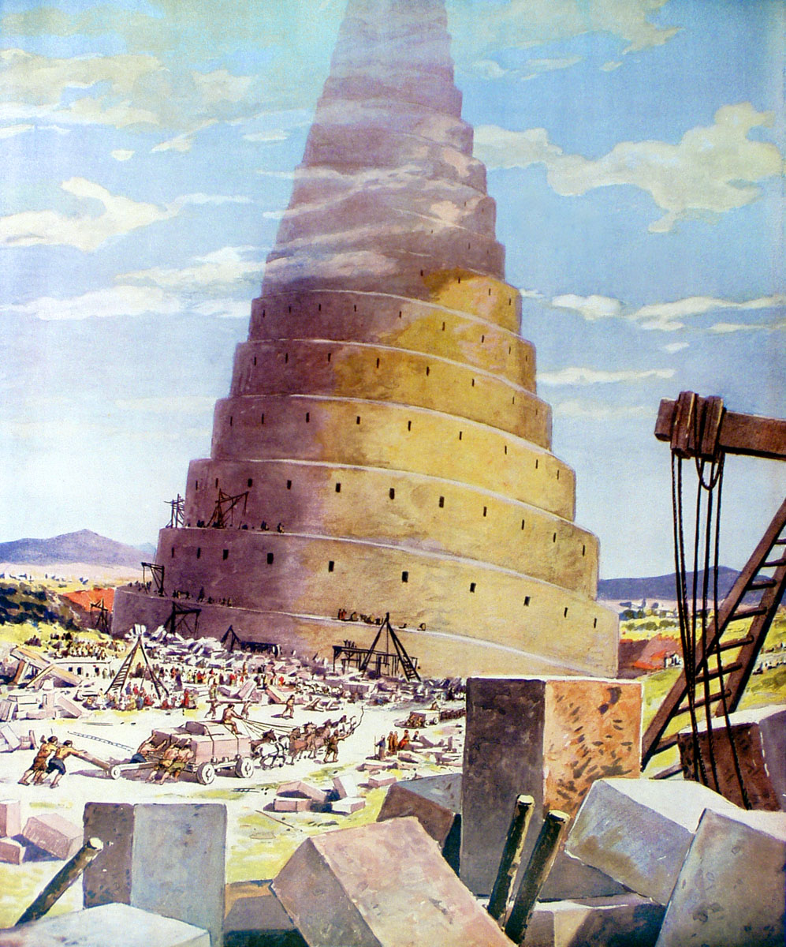
Some Impossible Things
Heb. 11:6
But without faith it is impossible to please Him, for he who comes to God must believe that He is, and that He is a rewarder of those who diligently seek Him.

Slide 3
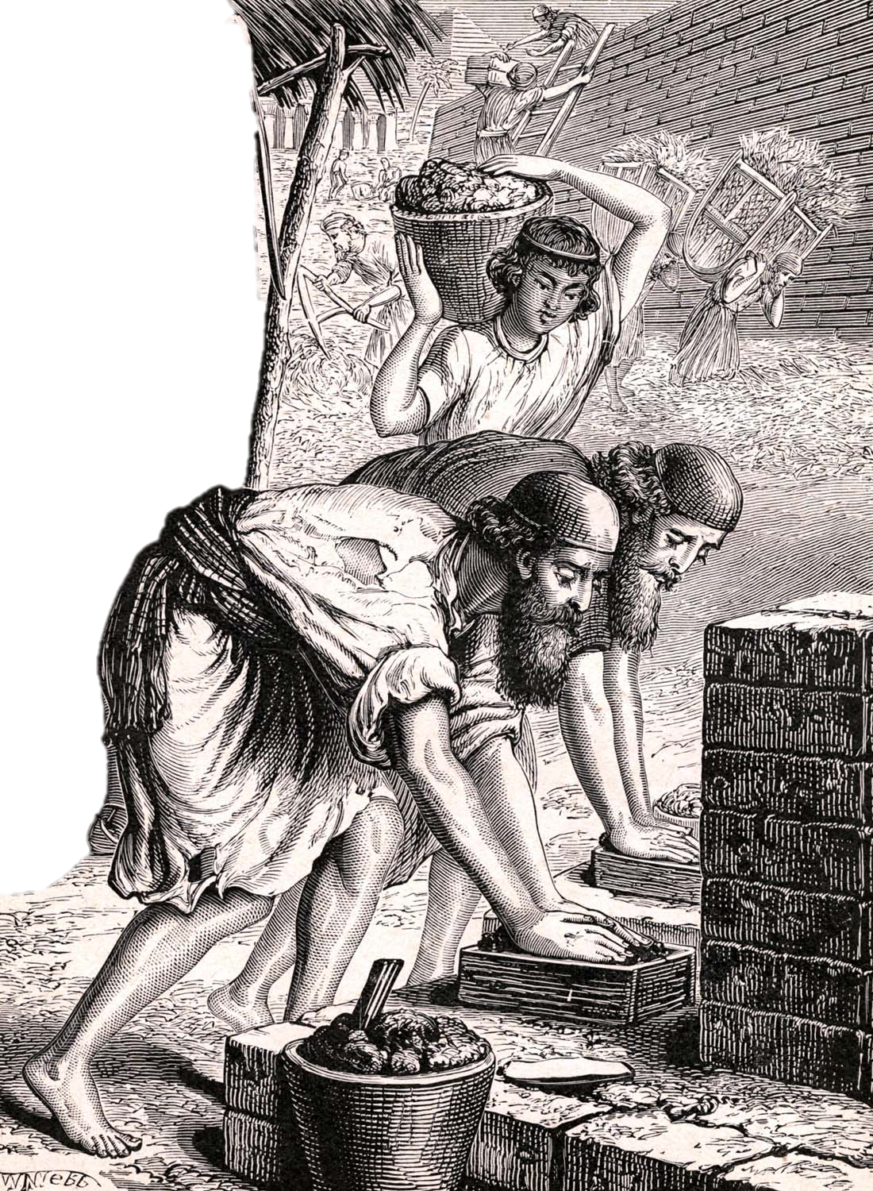
Genesis 11:3
“And they said one to another, Go to, let us make brick, and burn them thoroughly. And they had brick for stone, and slime had they for morter.”

Slide 4
Genesis 11:4
“And they said, Go to, let us build us a city and a tower, whose top may reach unto heaven; and let us make us a name, lest we be scattered abroad upon the face of the whole earth.”

Slide 5
Genesis 11:6
“And the LORD said, Behold, the people is one, and they have all one language; and this they begin to do: and now nothing will be restrained from them, which they have imagined to do.”
Genesis 11:7
“Go to, let us go down, and there confound their language, that they may not understand one another’s speech.”
Genesis 11:5
“And the LORD came down to see the city and the tower, which the children of men builded.”

Slide 6
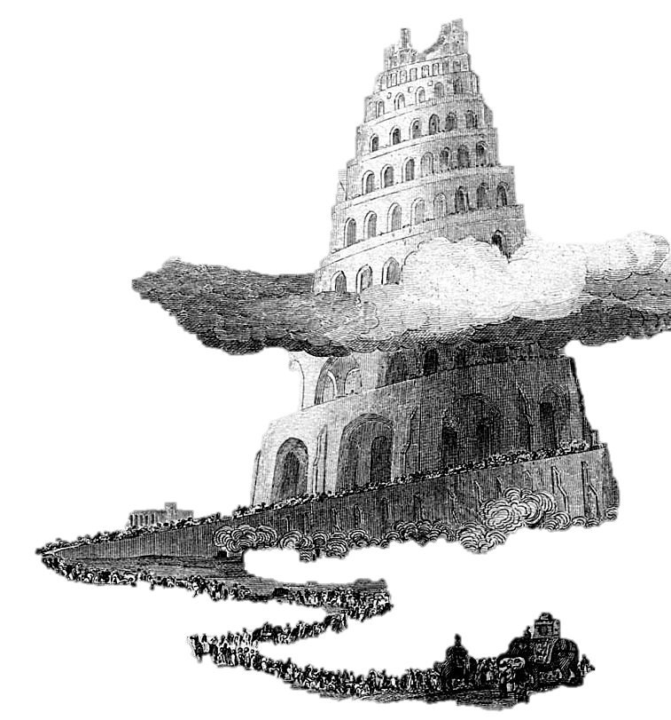
Genesis 11:8
“So the LORD scattered them abroad from thence upon the face of all the earth: and they left off to build the city.”

Slide 7
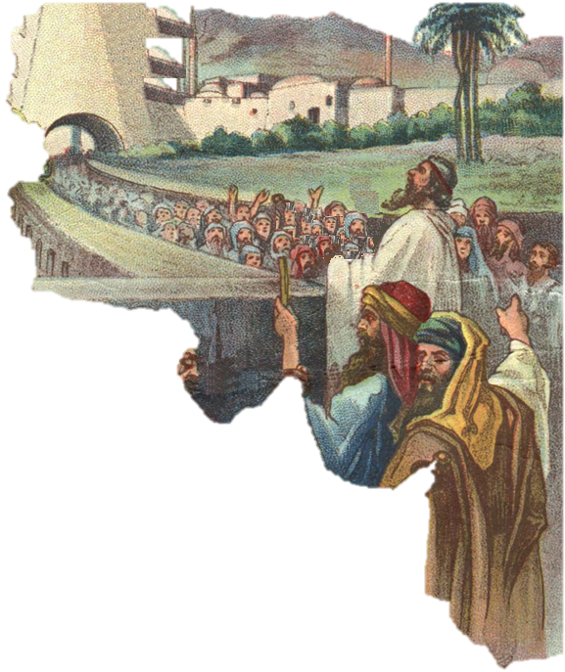
Genesis 11:9
“Therefore is the name of it called Babel; because the LORD did there confound the language of all the earth . . .”

Slide 8
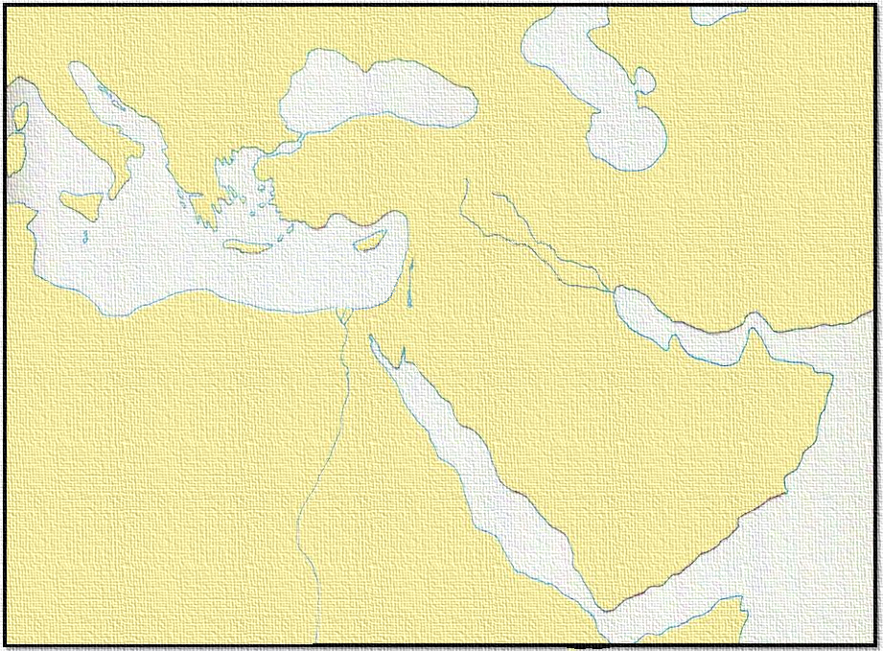
ITALY
ASIA
BABEL
CANAAN
EGYPT
ARABIA
Genesis 11:9
“ . . . and from thence did the LORD scatter them abroad upon the face of all the earth.”
AFRICA

Slide 9
Some Impossible Things
From the beginning of time, there has been a mindset that anything is possible.
That theory was proved false with the Tower of Babel.
God determines what is possible and what is impossible.
…let’s study a few things that are impossible according to the word of God.

Slide 10
Some Impossible Things
It is impossible to be in Christ
and not be in His church.
The church is the fullness of Christ.
Eph.1:22 – 23 And He put all things under His feet, and gave Him to be head over all things to the church, 23 which is His body, the fullness of Him who fills all in all.
The blood of Christ bought the church.
Acts 20:28; "Therefore take heed to yourselves and to all the flock, among which the Holy Spirit has made you overseers, to shepherd the church of God which He purchased with His own blood.
Eph.5:25 Husbands, love your wives, just as Christ also loved the church and gave Himself for her,

Slide 11
Some Impossible Things
1. It is impossible to be in Christ and not be in His church.
The act of baptism puts one in Christ
Gal. 3:27 For as many of you as were baptized into Christ have put on Christ.
The act of baptism puts one in the body of Christ, the church
1 Cor. 12:13 For by one Spirit we were all baptized into one body--whether Jews or Greeks, whether slaves or free--and have all been made to drink into one Spirit.

Slide 12
Some Impossible Things
1. It is impossible to be in Christ and not be in His church.
Christ saves ONLY the church.
Eph. 5:23 For the husband is head of the wife, as also Christ is head of the church; and He is the Savior of the body.
Christ is the HEAD of the church
Eph. 1: 22 -23 (already read) and the body submits to the head
Christ gave Himself for the church.
Eph. 5:25 And He put all things under His feet, and gave Him to be head over all things to the church, 23 which is His body, the fullness of Him who fills all in all.

Slide 13
Acts 2:47 praising God and having favor with all the people. And the Lord added to the church daily those who were being saved.
These churches are too late to be the Lord’s church.
These churches are not the Bride of Christ (Eph.5) Christ has ONE Bride.
Which church were those in Acts 2:47 added to?

Slide 14
Some Impossible Things
2. It is Impossible to love God but quit the church.
If we love God we will keep His commandments
1John 5:3 For this is the love of God, that we keep His commandments. And His commandments are not burdensome.
John 14:16 "And I will pray the Father, and He will give you another Helper, that He may abide with you forever--

Slide 15
Some Impossible Things
2. It is Impossible to love God but quit the church.
In keeping His commandments one is to join a local congregation -- Acts 9: 26 And when Saul had come to Jerusalem, he tried to join the disciples; but they were all afraid of him, and did not believe that he was a disciple. What do we do after we join?
One is to worship regularly with a local church.
Acts 20:7 Now on the first day of the week, when the disciples came together to break bread, Paul, ready to depart the next day, spoke to them and continued his message until midnight.

Slide 16
Some Impossible Things
2. It is Impossible to love God but quit the church.
Heb. 10:25-29 not forsaking the assembling of ourselves together, as is the manner of some, but exhorting one another, and so much the more as you see the Day approaching. 26 For if we sin willfully after we have received the knowledge of the truth, there no longer remains a sacrifice for sins,
27 but a certain fearful expectation of judgment, and fiery indignation which will devour the adversaries. 28 Anyone who has rejected Moses' law dies without mercy on the testimony of two or three witnesses.
29 Of how much worse punishment, do you suppose, will he be thought worthy who has trampled the Son of God underfoot, counted the blood of the covenant by which he was sanctified a common thing, and insulted the Spirit of grace?

Slide 17
Some Impossible Things
3. It is impossible to worship God, but forsake the assembly.
Heb. 10:25-29 not forsaking the assembling of ourselves together, as is the manner of some, but exhorting one another, and so much the more as you see the Day approaching. 26 For if we sin willfully after we have received the knowledge of the truth, there no longer remains a sacrifice for sins,
27 but a certain fearful expectation of judgment, and fiery indignation which will devour the adversaries. 28 Anyone who has rejected Moses' law dies without mercy on the testimony of two or three witnesses.
29 Of how much worse punishment, do you suppose, will he be thought worthy who has trampled the Son of God underfoot, counted the blood of the covenant by which he was sanctified a common thing, and insulted the Spirit of grace?

Slide 18
You Never Know
which church service
will profoundly
touch your life,
But it won’t be the one you missed.

Slide 19
Some Impossible Things
3. It is impossible to worship God, but forsake the assembly.
Private worship DOES NOT take the place of public worship.
Christians are not to forsake public worship
Heb. 10:25–31 (already read)
Acts 2:42 (already read)
Acts 20:7 (already read)

Slide 20
Some Impossible Things
3. It is impossible to worship God, but forsake the assembly.
1Cor. 16: 1 – 2 Now concerning the collection for the saints, as I have given orders to the churches of Galatia, so you must do also: On the first day of the week let each one of you lay something aside, storing up as he may prosper, that there be no collections when I come.

Slide 21
Some Impossible Things
It is impossible:
1. To be in Christ and not be in His church.
2. To love God but quit the church.
3. To worship God, but forsake the assembly.

Slide 22
Some Impossible Things
4. It is impossible to worship God, but have a heart of bitterness.
Jesus said we can't do it.
Matt.5:23–24 "Therefore if you bring your gift to the altar, and there remember that your brother has something against you, 24 "leave your gift there before the altar, and go your way. First be reconciled to your brother, and then come and offer your gift.

Slide 23
Some Impossible Things
4. It is impossible to worship God, but have a heart of bitterness.
Paul said, "Let all bitterness . . . be put away from you"
Eph. 4:31 Let all bitterness, wrath, anger, clamor, and evil speaking be put away from you, with all malice.
The Hebrew writer warned about a "root of bitterness"
Heb. 12:15 looking carefully lest anyone fall short of the grace of God; lest any root of bitterness springing up cause trouble, and by this many become defiled;

Slide 24
Some Impossible Things
4. It is impossible to worship God, but have a heart of bitterness.
1John 4: 20 – 21 If someone says, "I love God," and hates his brother, he is a liar; for he who does not love his brother whom he has seen, how can he love God whom he has not seen? 21 And this commandment we have from Him: that he who loves God must love his brother also.

Slide 25
Some Impossible Things
4. It is impossible to worship God, but have a heart of bitterness.
John 13: 34 - 35 "A new commandment I give to you, that you love one another; as I have loved you, that you also love one another.35 "By this all will know that you are My disciples, if you have love for one another.“ C E I

Slide 26
Some Impossible Things
5. It is impossible to love God, but not love the brethren.
Heb. 13: 1 Let brotherly love continue. 2 Do not forget to entertain strangers, for by so doing some have unwittingly entertained angels.
1 Pet. 1:22 Since you have purified your souls in obeying the truth through the Spirit in sincere love of the brethren, love one another fervently with a pure heart,

Slide 27
Some Impossible Things
5. It is impossible to love God, but not love the brethren.
Rom. 8: 5 - 6 For those who live according to the flesh set their minds on the things of the flesh, but those who live according to the Spirit, the things of the Spirit. 6 For to be carnally minded is death, but to be spiritually minded is life and peace. 7 Because the carnal mind is enmity against God; for it is not subject to the law of God, nor indeed can be.
Gal. 5: 16 I say then: Walk in the Spirit, and you shall not fulfill the lust of the flesh.

Slide 28
Some Impossible Things
6. It is impossible to prepare for heaven without being spiritual.
1 Cor. 3: 1 – 3 And I, brethren, could not speak to you as to spiritual people but as to carnal, as to babes in Christ. I fed you with milk and not with solid food; for until now you were not able to receive it, and even now you are still not able; for you are still carnal. For where there are envy, strife, and divisions among you, are you not carnal and behaving like mere men?

Slide 29
Some Impossible Things
6. It is impossible to prepare for heaven without being spiritual.
Col. 3: 1 – 2 If then you were raised with Christ, seek those things which are above, where Christ is, sitting at the right hand of God. 2 Set your mind on things above, not on things on the earth.

Slide 30
Some Impossible Things
It is impossible:
1. To be in Christ and not be in His church.
2. To love God but quit the church.
3. To worship God, but forsake the assembly.
4. To worship God, but have a heart of bitterness.
5. To love God, but not love the brethren.
6. To prepare for heaven without being spiritual.

