Slide 1
Welcome to our services
New Lebanon Church of Christ
We are Simply Christians.
Our Emphasis is Spiritual, Not Material or Social.
We are striving to be The Same Church as Described in The New Testament.
Please Come Back Again

Slide 2
Kingdom Citizens. Matt.5

Slide 3
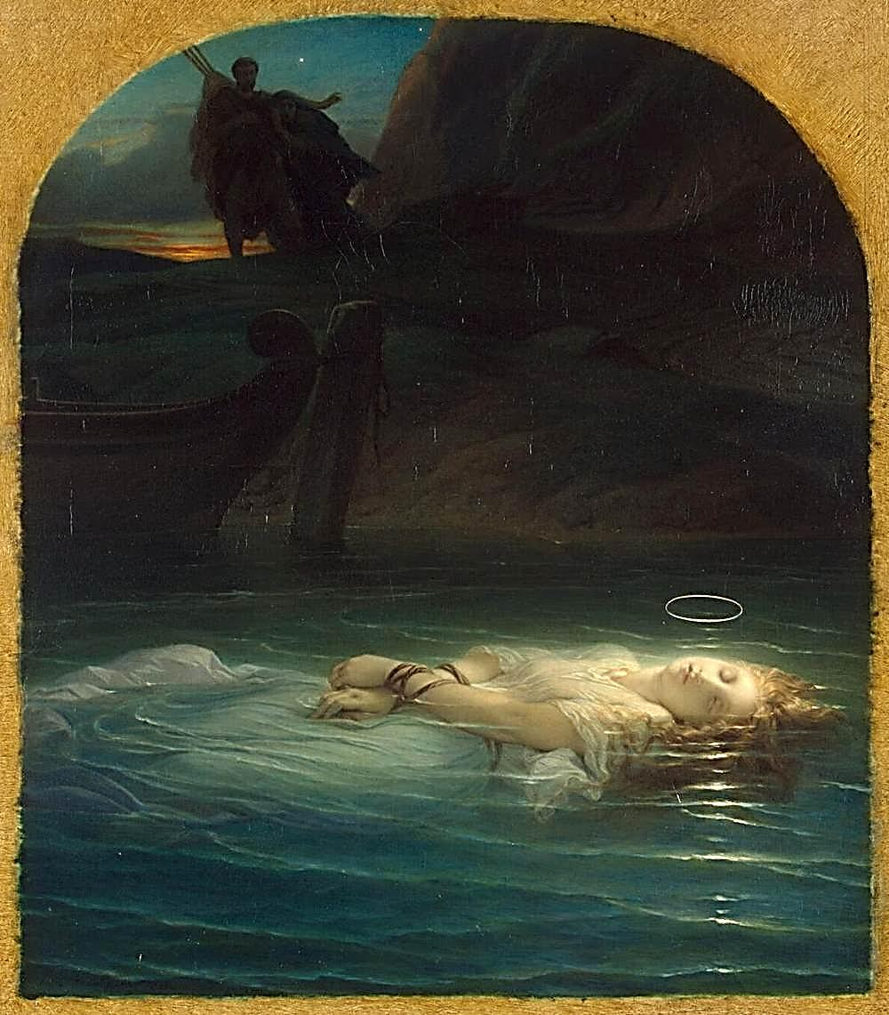
Matthew 5:10-12 “Blessed are they which are persecuted for righteousness’ sake: for theirs is the kingdom of heaven. Blessed are ye, when men shall revile you, and persecute you, and shall say all manner of evil against you falsely for my sake. Rejoice, and be exceeding glad: for great is your reward in heaven: for so persecuted they the prophets which were before you.”
Photo: Wikimedia – Public Domain in America, over 100 years old

Slide 4
Kingdom Citizens. Matt.5
The main theme of Matthew is The kingdom of God, The Kingdom of Heaven. Kingdom used 55 times in 28 chapters of Matthew.
So Jesus is defining in this sermon, the kingdom individual, who submits to the authority of Jesus as our king, and lets Jesus rule in his heart.
Jesus is our KING.
So to follow Jesus is to respect and develop the characteristics in this sermon. The manifestation of the kingdom on earth is seen in the individuals that make up the kingdom, the church.

Slide 5
Kingdom Citizens. Matt.5
The challenge of the sermon relates to our character. If Jesus rules your heart, then you are going to think and act differently than folks who do have not made Jesus king of their life. People that are not citizens of the kingdom submit and serve Satan.
And we are going to see in this sermon that God wants our sins to bother us. When we sin we have offended the one that gives us every good and perfect gift. God wants our sin to bother us to the point that we will repent of them and never do them anymore.
That is a different heart than one of the world that says I’m going to do what I’m going to do and I don’t care what you think about it (arrogance).
Compare- The man that would not even lift his eyes to heaven but said God be merciful to me a sinner.

Slide 6
Kingdom Citizens. Matt.5
Citizens of the Kingdom - 5:2-16.
1st. Beatitude - Blessed are the poor in spirit, for theirs is the kingdom of heaven - v.3.
Beatitude - Lat. beatitudo - perfect happiness.
What we have in the Beatitudes, is not a prescription for blessedness, but a prescription giving the conditions of blessedness, which are valued, not for the result which they produce, but for their own intrinsic worth.
Poor (in spirit) - there are two Greek words found in the NT which are translated poor.
One means to come or crouch. Used to describe Lazarus in Lk. 16:19-31.
poor in the sense of lacking this world’s goods - Deut.15:4,11.
poor who are downtrodden and oppressed.

Slide 7
Kingdom Citizens. Matt.5
- If a man is poor and downtrodden and oppressed, he has no influence on earth, no power, no prestige. He cannot look to men for help and when all the help and resources of earth are closed to him, he can only look to God.
The phrase (poor in spirit) deals with a poverty which is not a physical problem. You cannot pour anything into a full cup. Jesus tells us to become empty cups.
This poverty of spirit that leads us to Jesus Christ will also allow Him to be King and not self…. King of kings and Lord of lords.

Slide 8
Kingdom Citizens. Matt.5
2.nd Beatitude - Blessed are those who mourn, for they shall be comforted (v. 4).
Blessed / Happiness, as the world understands it, is conditioned by circumstances, but blessedness is God-conditioned.
Mourn (lit. Penthountes - the mourning ones - in Lk. 6:21 the word weep is used and defined as any loud expression of grief, especially in mourning for the dead. In John 11:35 the word for weep means to shed tears .
The word was Used by the ancients and still used today to express lamentation and extreme sorrow for the dead.
Used for Jacob’s mourning - Gen. 37:34 and David’s mourning - 2 Sam. 19:1.

Slide 9
Kingdom Citizens. Matt.5
No stronger word of mourning in the Greek language. Penthein describes the mourning which cannot be hidden.
The disciple of Christ’s who mourns for his sin -
The word penthein tells us that we have not even begun on the Christian way until we take sin with such seriousness that our sorrow is like the mourning of one who mourns for the dead. Christianity begins
with godly sorrow of the broken heart.
Mourning over sin - the helpless condition -
Comforted (parakaleo) (para-beside and kaleo - to call) lit. For these ones shall be comforted - Lk. 16:25;

Slide 10
Kingdom Citizens. Matt.5
What is important about mourning?
Why are there tears? They keep this world from becoming too attractive. Tears make heaven desirable. Our tears should be over the loss of souls.
TEARS make us feel our complete dependence on God. Only God (not self) can save a man.
They, on behalf of others, will enable us to remember the degradation from which we have been saved ourselves. The Christian cannot laugh at sin - Psa. 56:8; 126:5,6; Acts 20:19.
The Christian (disciple of Christ) does not go through life with a long face and a sour disposition (Prov. 17:22).
Only those who grieve for their sins, allowing their conscience to come to the surface will find God, and therefore comfort .

Slide 11
Kingdom Citizens. Matt.5
3^{rd.} Beatitude - Blessed are the gentle, for they shall inherit the earth (v. 5).
This Blessedness - Is not conditioned by circumstances from without. It is from God and is God-conditioned.
We must meet God’s conditions / requirements to be blessed by Him. The Beatitudes spell out those conditions. We usually think of life in terms of upward steps on the ladder of life. But in the spiritual realm, man must take three steps downward if he wants to be blessed; that is, to experience the presence of God within him.

Slide 12
Kingdom Citizens. Matt.5
These are the steps of humility, mourning, and meekness. The grace of God is poured out abundantly in this world, yet relatively few enjoy its benefits. Why is this? Because its life-giving waters are available only to those who will place themselves in a lowly position, as a cup is placed under a fountain.
In Christianity there is only one way up, and that is down.
Gentle - meek -
Praus was also used for the wild beast which has been tamed.

Slide 13
Kingdom Citizens. Matt.5
There is gentleness but behind the gentleness there is the strength of steel, for the man who is gentle is that man who is under perfect control. To such a character no man can attain by himself and his own efforts. In the context of Christ’s disciple, he is perfectly God-controlled, for only God can give him that perfect mastery. It should be our prayer that God will make us gentle, masters of ourselves; for only then can we be the servants of others
Meekness is not the passive acceptance of any or all forms of evil.

Slide 14
Kingdom Citizens. Matt.5
In this Beatitude, the Lord is not promising much or little, prosperity or poverty. He is promising the spiritual capacity to enjoy whatever He gives, much or little.
But this ability to enjoy our inheritance can be ours only if we have an attitude of complete resignation to God’s will for us on earth.
A meek person is one who is totally resigned to God’s will and allows no compromise with sin; he gets angry at it.

Slide 15
Kingdom Citizens. Matt.5
4.th Beatitude - Blessed are those who hunger and thirst for righteousness, for they shall be satisfied (v. 6).
The only person who does not get hungry or thirsty is the one who is sick or dead. Jn. 4:31-34.
So The Lord is telling us that he is blessed who is constantly evidencing hunger and thirst, not for just part of the righteousness of Christ, but for His whole righteousness.

Slide 16
Kingdom Citizens. Matt.5
Righteousness - The character or quality of being right or just; it was formerly spelled rightwiseness which clearly expresses the meaning (W.E. Vine, ). The Christian is blessed and can continue to be so even as he lives in a world of sin and unrighteousness.
His desire for the whole righteousness of Christ is a fervent desire for freedom from sin, in Christ and through Christ.
For they shall be satisfied - satisfied - Our Heavenly Father is constantly preparing food for us, and it is fresh each time we receive it. Each time we partake of it, we experience new enjoyment and we look forward to getting hungry again so that He can satisfy us again.
We are filled each time we hunger for righteousness and this is effective filling. We have no sense of dissatisfaction or emptiness, but at the end of the road we shall have complete satisfaction.

Slide 17
Kingdom Citizens. Matt.5
5th. Beatitude - Blessed are the merciful, for they shall receive mercy (v. 7)
Blessed - If you are blessed you will not be affected by circumstances but will make the circumstances of life serve God’s central purpose in your life.
Merciful -the outward manifestation of pity; it assumes need on the part of him who receives it, and resources adequate to meet the need on the part of him who shows it (W.E.).

Slide 18
Kingdom Citizens. Matt.5
6th. Beatitude - Blessed are the pure in heart, for they shall see God (v. 8).
Blessed - Pure - Heart
Heart - Kardia - Came to stand for man’s entire mental and moral activity, both the rational and the emotional elements. In other words, the heart is used figuratively for the hidden springs of the personal life ( W. E. Vine).
The heart deals with one’s being something - James. 3:11, 12; Mk. 7:7-23.
Pure in heart - Those whose motives are absolutely unmixed, whose minds are utterly sincere, who are completely and totally single-minded (Barclay).
They shall see God –

Slide 19
Kingdom Citizens. Matt.5
7th. Beatitude - Blessed are the peacemakers, for they shall be called sons of God (v. 9).
Blessed - makarios.
Peacemakers (eirenopois) - He is a peacemaker who brings another to Christ -2 Cor. 5:20,21.
The peace the child of God should seek is the one that has its roots in the meekness of the third beatitude.
Peace is not stagnation.
Peace in Greek thought is a joining.
Social peace.
The original peace of the garden - Gen. 1:27-31.
The peace of the garden restored - Isa. 57:21; Col. 1:19- 23; Rom.5:1.

Slide 20
Kingdom Citizens. Matt.5
Why are we called His sons and daughters?
Because we should be like God.
We do the work of God when we declare this good news.
Blessedness is the result of peace.

Slide 21
Kingdom Citizens. Matt.5
8th. Beatitude - Blessed are those who have been persecuted for the sake of righteousness, for theirs is the kingdom of heaven. Blessed are you when men cast insults at you, and persecute you, and say all kinds of evil against you falsely, on account of Me (vs. 10,11).
Persecution is not:
That which is brought upon oneself on purpose that one might be persecuted. You may be hated because you are a hateful person.
Being persecuted mainly for a cause - i.e., political cause, religious cause (such as a sect), philosophic cause - any not for righteousness sake.
Persecution for the sake of righteousness Mt. 5:10 –

Slide 22
Kingdom Citizens. Matt.5
But why?
Because we are light - Mt. 5:14-16.
Because we are salt - Mt. 5:13.
Because we are different than those of the world - Jn. 17:14-20; Jn. 15:20.
How does one face persecution?
Must not retaliate. Deny oneself
Must work to eliminate all feeling of resentment.
Must work to not be depressed by persecution - Rev. 2:10.
Learn to appreciate its value - Jas. 1:2.

Slide 23
Kingdom Citizens. Matt.5
How are the persecuted blessed?
Persecuted for righteousness sake, one is in good company - (God’s people throughout the ages - Mt. 5:12).
Trial will indicate the genuine character of one’s faith -
Christian character can be developed through suffering - 1 Pet. 4:14-16.
This is an opportunity to glorify God - Acts 5:41; Rom. 5:1-5.

Slide 24
Kingdom Citizens. Matt.5
Our example in Christ is one of suffering . 1 Pet. 2:21-24;
fellowship in suffering - Phil. 3:10; Heb. 5:8,9.
Suffering is nothing when compared to what God has in store for His suffering saints -
Rom. 8:18 For I reckon that the sufferings of this present time are not worthy to be compared with the glory which shall be revealed in us.
2Cor. 4:17 For our light affliction, which is but for a moment, worketh for us a far more exceeding and eternal weight of glory; 18 While we look not at the things which are seen, but at the things which are not seen: for the things which are seen are temporal; but the things which are not seen are eternal.

Slide 25
Kingdom Citizens. Matt.5
Rev. 14:13 And I heard a voice from heaven saying unto me, Write, Blessed are the dead which die in the Lord from henceforth: Yea, saith the Spirit, that they may rest from their labors; and their works do follow them.

Slide 26
Kingdom Citizens. Matt.5
The sermon on the mount shows us a series of contrast:
1. Total dependence vs total independence 5:3
2. Deep mourning vs carefree irresponsibility 5:4
3. Self discipline vs recklessness 5:5
4. Thirst for God vs No desire for God. 5:6

Slide 27
Kingdom Citizens. Matt.5
5. Mercy vs Selfishness. 5:7
6. Purity of heart vs lustful pursuits 5:8
7. Peaceful relationships vs disposable relationships
8. Willingness to suffer vs avoiding pain at all costs 5:10-12
If we hope to be a citizen of God’s kingdom, me must develop these characteristics.

Slide 28
Kingdom Citizens. Matt.5
So, the theme is The kingdom of God (the church). Jesus is defining in this sermon the kingdom citizen who submits to the authority of Jesus as their king, and let’s Jesus rule in their hearts. Jesus is KING
The Challenge of the sermon relates to our character. If Jesus rules your heart, then you are going to think and act differently than folks who have not made Jesus king of their life. People that are not citizens of the kingdom submit and serve Satan, and live in sin.
God wants our sins to bother us. When we sin we have offended the one that gives us every good and perfect gift. God wants our sin to bother us to the point that we will repent of them and never do them anymore. That is a different heart than one of the world that says I’m going to do what I’m going to do and I don’t care what you think about it.

Slide 29
Kingdom Citizens. Matt.5
We have not even begun as a kingdom citizen until we take sin with such seriousness,
that our sorrow is like the mourning of one who mourns for the dead.
Christianity begins with godly sorrow of the broken heart.

Slide 30
Kingdom Citizens. Matt.5
The sermon on the mount teaches We must meet God’s conditions and requirements to be blessed by Him.
The sermon spells out those conditions. We usually think of life in terms of upward steps on the ladder of success. But in the spiritual realm, man must take three steps downward if we want to be blessed.

Slide 31
Kingdom Citizens. Matt.5
The three steps are humility, mourning, and meekness.
Life-giving waters are available only to those who willing place themselves in a lowly position, as a cup is placed under a fountain. And before Christ can fill our cup, we must empty it of our self.
Humility, mourning, and meekness. To be a citizen of the kingdom, we must possess and demonstrate these characteristics.

Slide 32
Are You A New Testament Christian?
Hear the Gospel (Rom.10:14).
Believe the Gospel (Heb. 11:6).
Repent of Sins (Acts 3:19).
Confess Christ (Rom.10:9).
Be Baptized Into Christ (1 Cor.12:13).
1 Timothy 4:16
“Take heed unto thyself, and unto the doctrine; continue in them: for in doing this thou shalt both save thyself, and them that hear thee.”

