Slide 1

Welcome to our services
New Lebanon Church of Christ
We are Simply Christians.
Our Emphasis is Spiritual, Not Material or Social.
We are striving to be The Same Church as Described in The New Testament.
Please Come Back Again

Slide 2
Do Not Fear Them but rather Fear Him
Matthew 10:28
"And do not fear those who kill the body but cannot kill the soul.
But rather fear Him who is able to destroy both soul and body in hell.

Slide 3
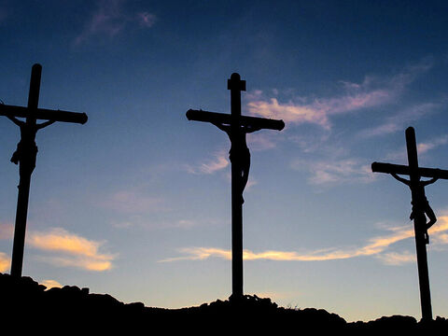
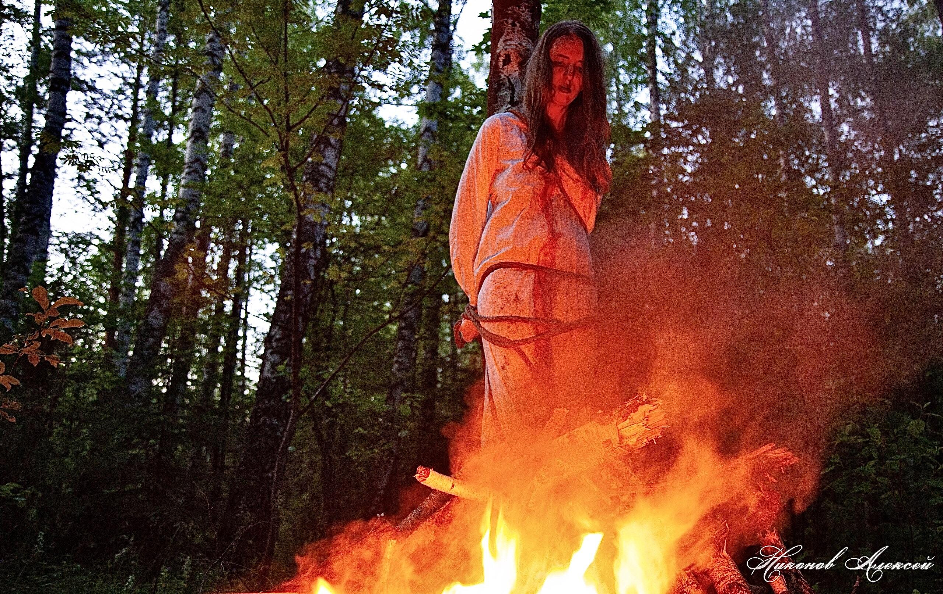
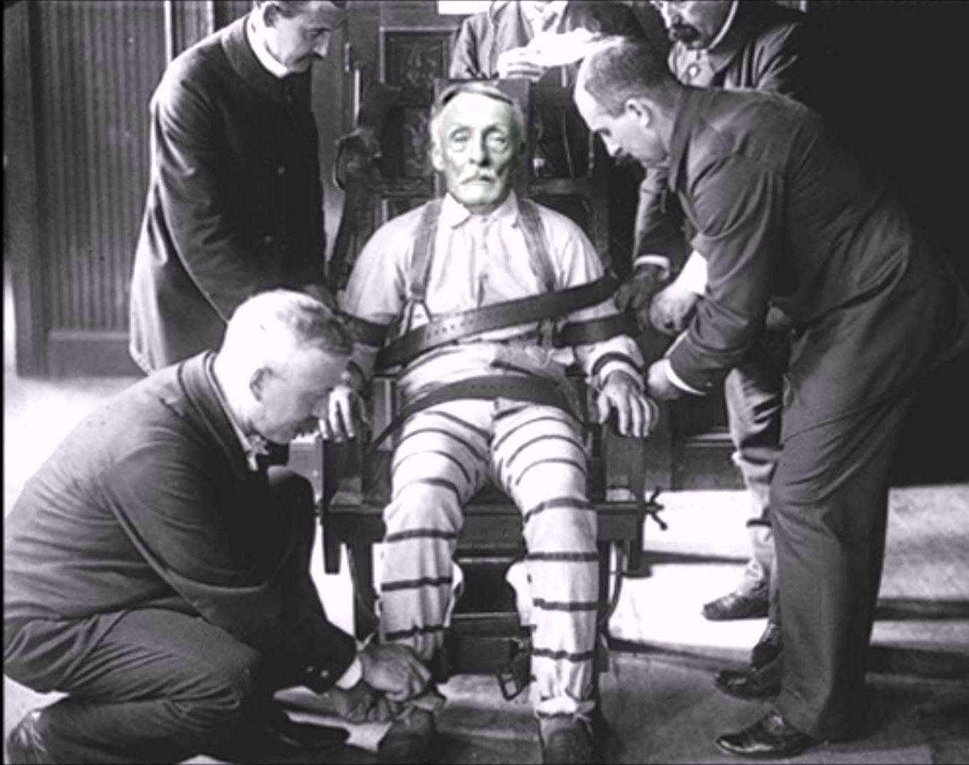
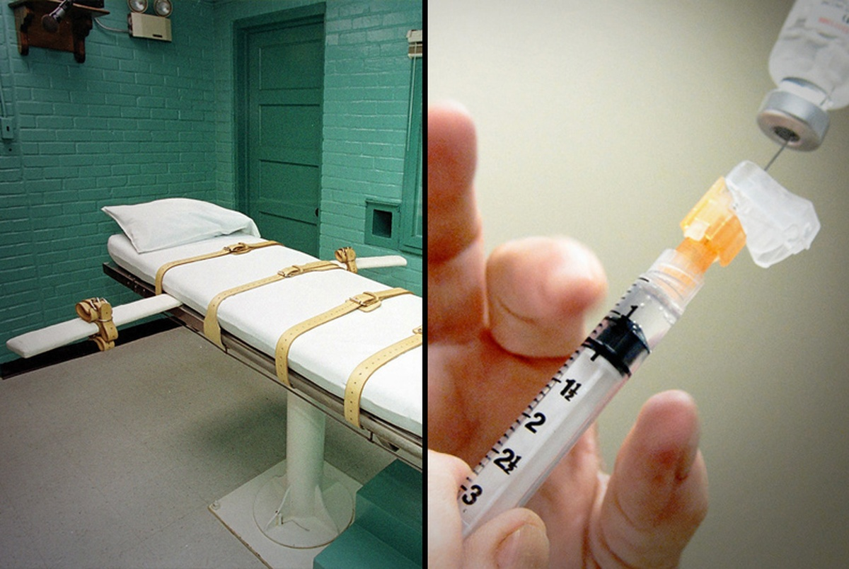

Slide 4
Do Not Fear Them but rather Fear Him
TO FEAR- definition
It may mean “fear” of men (Deut. 2:25), of things (Isa. 7:25), of situations (Jonah 1:10), and of God (Jonah 1:12);
it may also mean “reverence” of God.
Basically, this verb connotes the psychological reaction of “fear.” May indicate being afraid of something or someone.
Jacob prayed: “Deliver me, I pray thee, from the hand of my brother, from the hand of Esau: for I fear him, lest he will come and smite me, and the mother with the children” (Gen. 32:11).
To be afraid of
To be in awe and reverence

Slide 5
Do Not Fear Them but rather Fear Him
What are people afraid of?

Slide 6


Slide 7


Slide 8
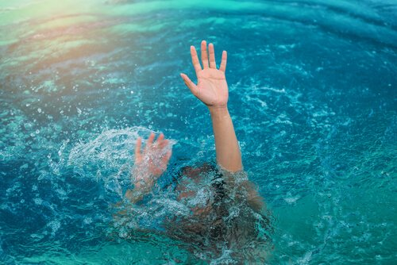
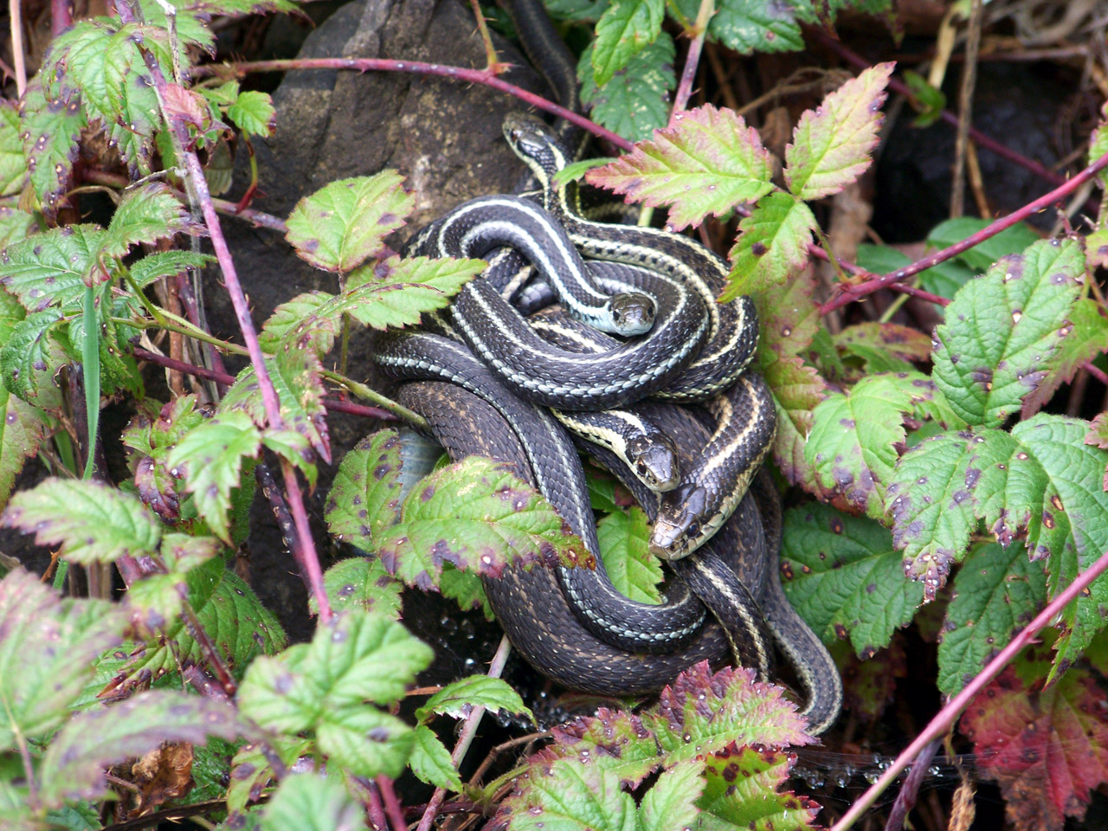
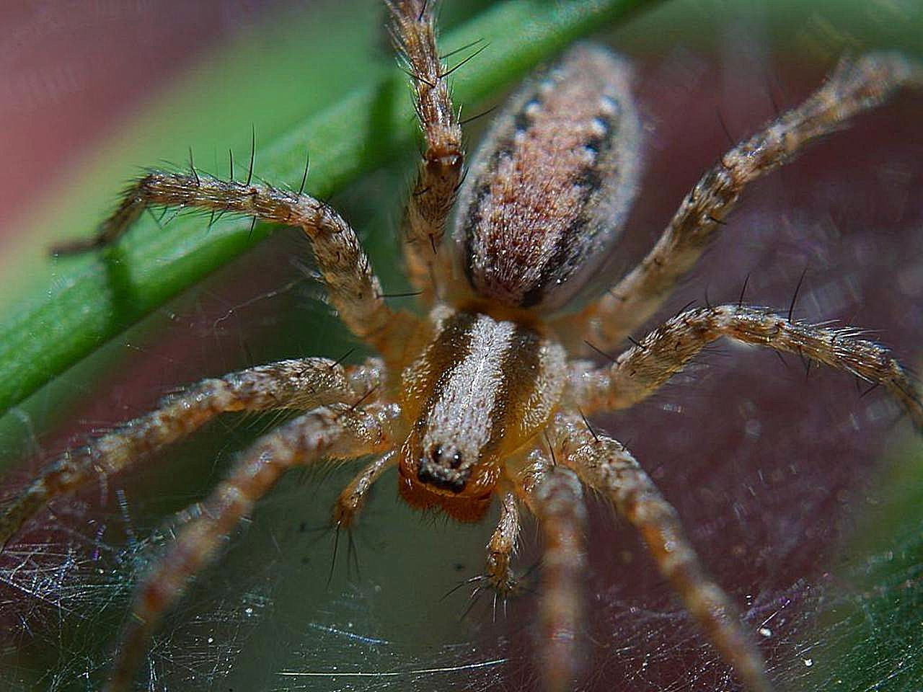

Slide 9
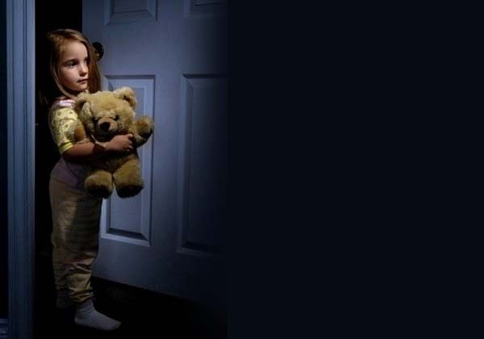

Slide 10


Slide 11
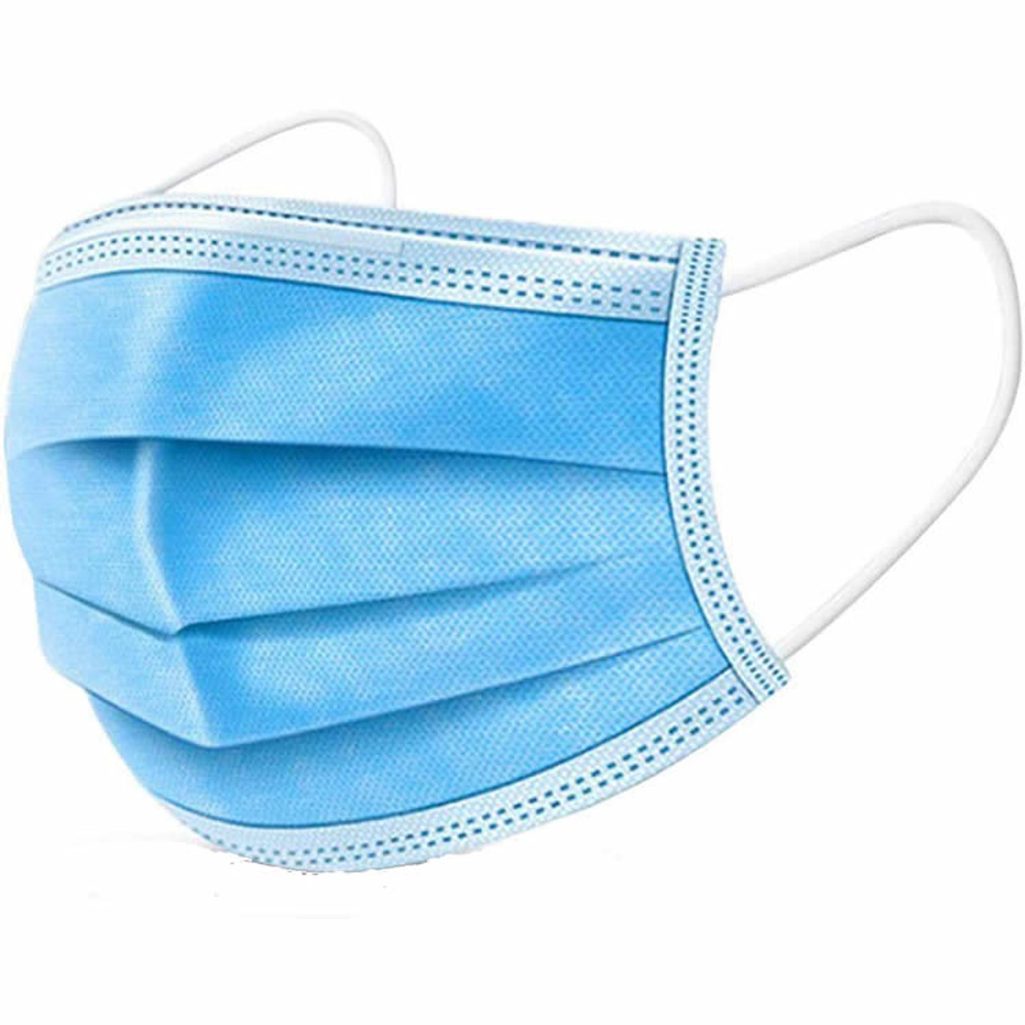
Do Not Fear Them but rather Fear Him
What are people afraid of?
Getting sick
Losing something – health, job, money, friends,
Fear the government, fear other governments, election…
Fear strangers
We spend money based on fear – $$$$$$$$$$$
Insurance – car, house, life, funeral, liability
Personal protection devices
Alarm systems, cameras, sirens…

Slide 12
Do we fear God more than all these other things?
Mt 10:28 "And do not fear those who kill the body but cannot kill the soul. But rather fear Him who is able to destroy both soul and body in hell.
Is our fear in the right place?

Slide 13
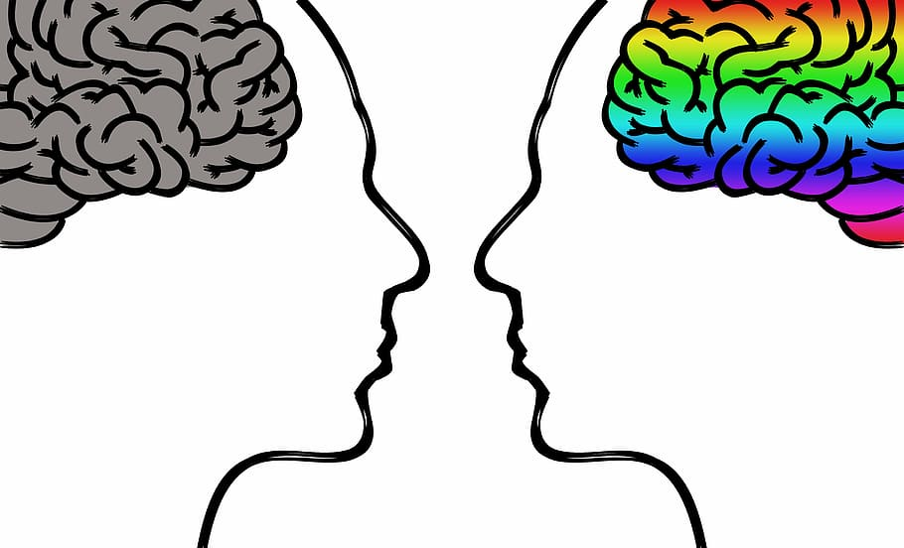
Do Not Fear Them but rather Fear Him

Slide 14
Do Not Fear Them but rather Fear Him
Matt. 10:16 "Behold, I send you out as sheep in the midst of wolves. Therefore be wise as serpents and harmless as doves. 17 "But beware of men, for they will deliver you up to councils and scourge you in their synagogues.
18 "You will be brought before governors and kings for My sake, as a testimony to them and to the Gentiles. 19 "But when they deliver you up, do not worry about how or what you should speak. For it will be given to you in that hour what you should speak;
20 "for it is not you who speak, but the Spirit of your Father who speaks in you. 21 "Now brother will deliver up brother to death, and a father his child; and children will rise up against parents and cause them to be put to death.

Slide 15
Do Not Fear Them but rather Fear Him
22 "And you will be hated by all for My name's sake. But he who endures to the end will be saved.23 "When they persecute you in this city, flee to another. For assuredly, I say to you, you will not have gone through the cities of Israel before the Son of Man comes.
24 "A disciple is not above his teacher, nor a servant above his master. 25 "It is enough for a disciple that he be like his teacher, and a servant like his master. If they have called the master of the house Beelzebub, how much more will they call those of his household!

Slide 16
Do Not Fear Them but rather Fear Him
Matt. 10:26 "Therefore do not fear them. For there is nothing covered that will not be revealed, and hidden that will not be known.
27 "Whatever I tell you in the dark, speak in the light; and what you hear in the ear, preach on the housetops.
28 "And do not fear those who kill the body but cannot kill the soul. But rather fear Him who is able to destroy both soul and body in hell.
29 "Are not two sparrows sold for a copper coin? And not one of them falls to the ground apart from your Father's will.
30 "But the very hairs of your head are all numbered.
31 "Do not fear therefore; you are of more value than many sparrows.

Slide 17
Do Not Fear Them but rather Fear Him
26 Therefore do not fear them, for there is nothing covered that will not be revealed, and hidden that will not be known.
Therefore = because of what transpires in the previous verse.
Do not fear them. This would be the tendency, but do not fear. The word “fear” is used four times in the next five verses.
Everything will come out and the truth must be made known. God sees all that happens and evil doers will be held accountable for all they do and say.
27 What I tell you in the darkness, speak in the light, and what you hear whispered in your ear, proclaim upon the housetops.
(Their private instructions were to be publicly proclaimed.)
28 And do not fear those who kill the body, but are unable to kill the soul; but rather fear Him who is able to destroy both soul and body in hell.

Slide 18
Do Not Fear Them but rather Fear Him
Jesus contrast between
the temporary and the eternal.
Do Not Fear Them but rather Fear Him
Do not worry, be afraid of, focus on the
Temporary, but have reverence and awe for the God of heaven and earth!
Do Not Have Misplaced Priorities.

Slide 19
Do Not Fear Them but rather Fear Him
Men have power, but it is limited. In our society the worst anybody can do is to kill us. Jesus says this is not the worst. He knows our bodies are nothing but temporary shells. Fear Him who...in hell.
This is “gehenna” - eternal punishment.
God has power, no man has - therefore, we need to fear God.
“The fear of the Lord is the beginning of knowledge;” Prov 1:7.

Slide 20
Do Not Fear Them but rather Fear Him
Some are confused about this instruction to fear God because of 1 John 4:18 - “There is no fear in love.”
Some believe we should not have any fear. But the Bible teaches us that fear is a part of growing to maturity. John is talking about that perfect love which casts out fear in the judgment.

Slide 21
Do Not Fear Them but rather Fear Him
God is One to be feared!
Heb.12:29 - “For our God is a consuming fire.”
Heb.10:31 - “It is a terrifying thing to fall into the hands of the living God.”
It was God who, on Mount Sinai, frightened the Israelites. Exodus 20:18-19. In verse 20 Moses says, “Do not be afraid; for God has come...that the fear of Him may remain with you, so that you may not sin.”

Slide 22
Do Not Fear Them but rather Fear Him
When someone fears the wrath of God it shapes their behavior. As parents we see this in our children. They obey because they fear the punishment if they do not. But when they are older they obey because of love and not fear. That is the way God deals with us.
We grow and mature to where we obey Him. Our relationship with God should be this way so that we can grow and mature to the level of love Christians need to have.
Husbands, do you want your wife to obey you because she loves you or because see fears you???

Slide 23
Do Not Fear Them but rather Fear Him
The word destroy here does not refer to total annihilation. There are too many passages which prove punishment lasts forever.
Matt. 3:12 talks about a fire that cannot be quenched. Jesus says the worm does not die (Mk. 9:44, Matt. 13:42).
Satan cannot destroy the soul; he does not have that power. God has that power!

Slide 24
Do Not Fear Them but rather Fear Him
29 Are not two sparrows sold for a cent? And yet not one of them will fall to the ground apart from your Father.
A sparrow is not really worth much, but God knows and loves them so much. If one falls to the ground, He is aware of it. Therefore, how much more is He aware of, and caring for, His children?

Slide 25
Do Not Fear Them but rather Fear Him
30 But the very hairs of your head are all numbered.
This is a beautiful illustration that God is aware of even the most minute part of our being. That is how much He knows us and loves us.
31 Therefore do not fear; you are of more value than many sparrows.
Do not fear. Do not fear men because of the tremendous love of the One who has such power.

Slide 26
Do Not Fear Them but rather Fear Him
Psalm 111:10 The fear of the LORD is the beginning of wisdom; A good understanding have all those who do His commandments. His praise endures forever.
Prov. 1:7 The fear of the LORD is the beginning of knowledge, But fools despise wisdom and instruction.
Prov. 8:13 The fear of the LORD is to hate evil; Pride and arrogance and the evil way And the perverse mouth I hate.
Prov. 9:10 "The fear of the LORD is the beginning of wisdom, And the knowledge of the Holy One is understanding.

Slide 27
Do Not Fear Them but rather Fear Him
Prov. 14:27 The fear of the LORD is a fountain of life, To turn one away from the snares of death.
Pro. 15:16 Better is a little with the fear of the LORD, Than great treasure with trouble.
Ecc. 12:13 Let us hear the conclusion of the whole matter: Fear God and keep His commandments, For this is man's all.
Isa 33:6 Wisdom and knowledge will be the stability of your times, And the strength of salvation; The fear of the LORD is His treasure.

Slide 28
Do Not Fear Them but rather Fear Him
Rev. 14:7 saying with a loud voice, "Fear God and give glory to Him,
for the hour of His judgment has come; and worship Him
who made heaven and earth,
the sea and springs of water."

Slide 29
Do Not Fear Them but rather Fear Him
Fears, phobias of some Christians today.
Bible reading
Prayer
Water (baptism)
Family (church family) phobia
Giving phobia
Teaching phobia
Soul winning phobia
Do we fear them… or Him

Slide 30
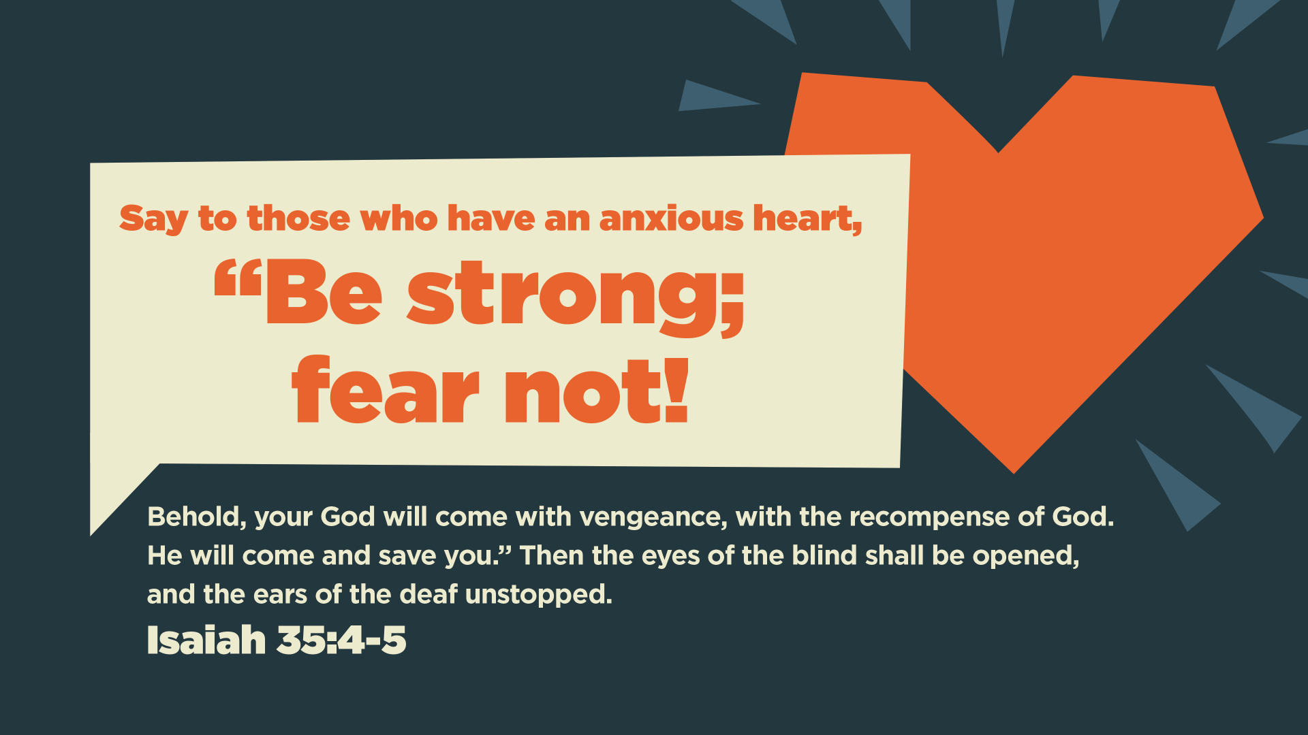

Slide 31
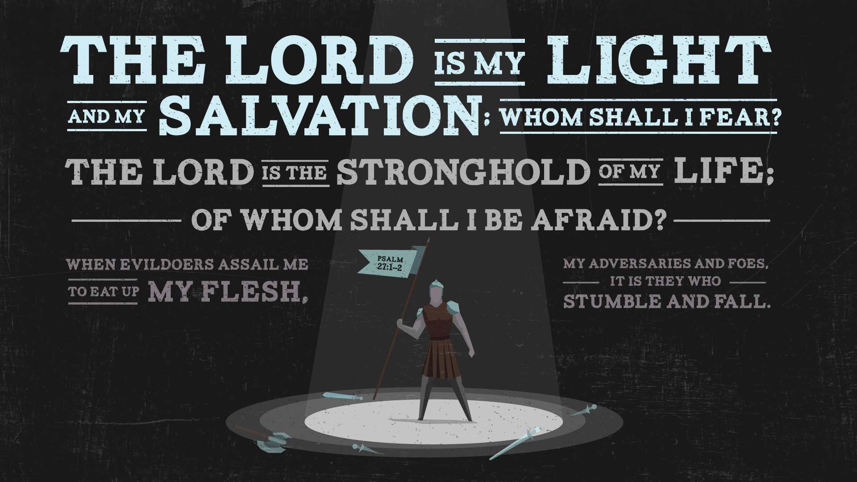

Slide 32


