Slide 1
Welcome to our services
New Lebanon Church of Christ
We are Simply Christians.
Our Emphasis is Spiritual, Not Material or Social.
We are striving to be The Same Church as Described in The New Testament.
Please Come Back Again

Slide 2
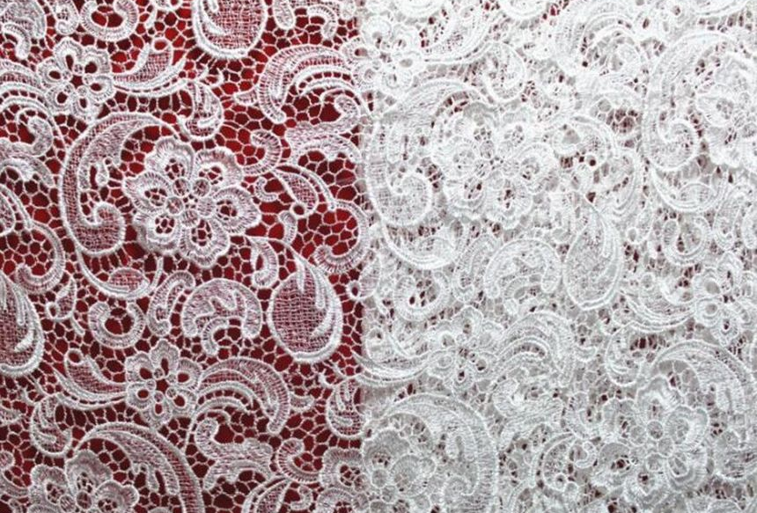
A Glorious Church Eph.5:27
Eph 5:25 Husbands, love your wives, just as Christ also loved the church and gave Himself for her,
26 that He might sanctify and cleanse her with the washing of water by the word,
27 that He might present her to Himself a glorious church, not having spot or wrinkle or any such thing, but that she should be holy and without blemish.

Slide 3
A Glorious Church Eph.5:27
In Eph. 5:27 we have the church spoken of as "a glorious church.“
This "glorious church" does not have "spot, or wrinkle, or any such thing."
In the New Testament the glory of the church is represented under various heads.
The glory has been represented by a bride. The inspired John saw the church: "And I John saw the holy city, new Jerusalem, coming down from God out of heaven, prepared as a bride adorned for her husband." (Rev. 21:2.)

Slide 4
A Glorious Church Eph.5:27
The life of the church is her head, who is Christ. The true fulfillment of the wife is in her husband. This is the Bible view of the family. The true fulfillment of the Christian is in Christ!
The current social unrest could indicate that this ideal will be overturned; but if it is ever replaced by another, women will not in any sense gain by the change.
Apart from the teachings of Christ and the apostles, the status of woman in society has tended to be lower and lower; and there can be no doubt that if woman should reject her place in the Bible home, the same forces which in the past destroyed and degraded her in practically every society on earth would do the same again.

Slide 5
A Glorious Church Eph.5:27
Eph. 5:25 Husbands, love your wives, even as Christ also loved the church, and gave himself up for it; that he might sanctify it, having cleansed it by the washing of the water with the word.
The measure of love that husbands are commanded to give their wives is that of Christ’s love of the church. A love that would die for the beloved! Any submission or subjection that a devoted wife might give to her husband would be more than rewarded and justified by such a love as that. “More excellent love than this is inconceivable.”

Slide 6
A Glorious Church Eph.5:27
Eph.5:27 That he might present the church to himself a glorious church, not having spot or wrinkle or any such thing; but that it should be holy and without blemish.
The absolute perfection of the church is stated here.
Eph.1:4 just as He chose us in Him before the foundation of the world, that we should be holy and without blame before Him in love,

Slide 7
A Glorious Church Eph.5:27
This is a beautiful picture. What is more beautiful than a bride adorned for her husband?
The church is the bride of Christ. Some day he is going to claim his bride.
We must be adorned for this. When we think of a bride, we do not think of spots, wrinkles, and such things; but we do think of purity, sweetness, and cleanliness.

Slide 8
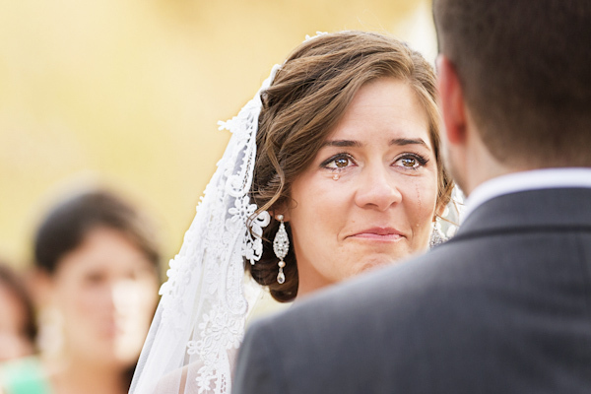

Slide 9
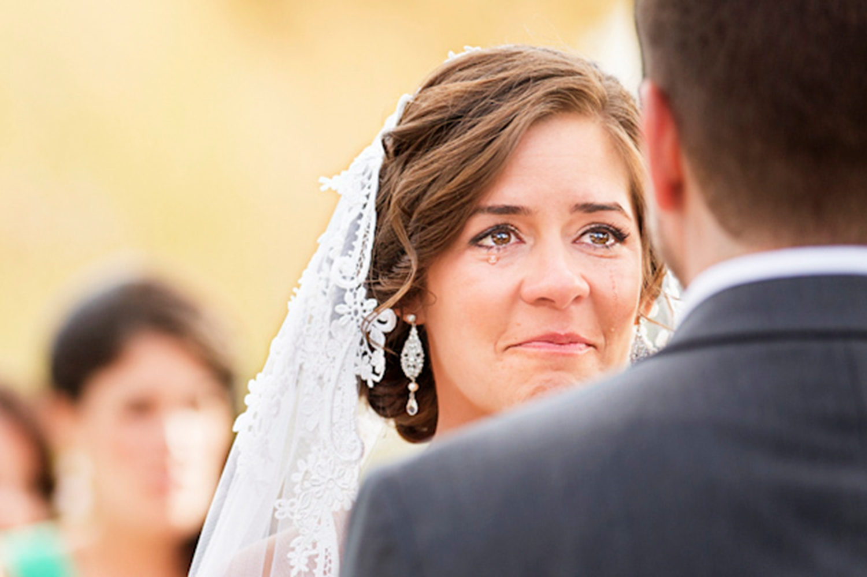
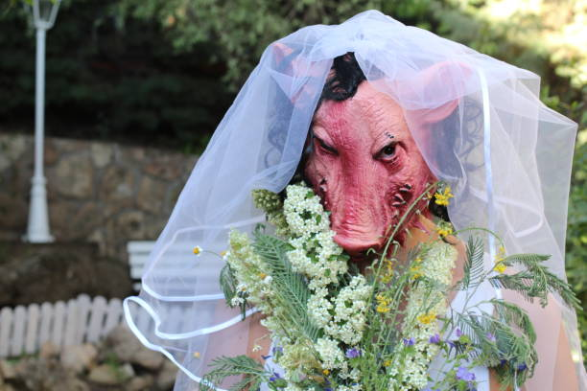
Spots, wrinkles, blemishes?
James 1:25 But he who looks into the perfect law of liberty and continues in it, and is not a forgetful hearer but a doer of the work, this one will be blessed in what he does

Slide 10
Spots, wrinkles, blemishes?
James 1:25 But he who looks into the perfect law of liberty and continues in it, and is not a forgetful hearer but a doer of the work, this one will be blessed in what he does
If we do not follow James 1:25, we will look hideous and repulsive before our beloved master.

Slide 11
A Glorious Church Eph.5:27
Consider -The head of an institution reflects glory on the institution itself.
The glory of the church is represented by the head - Christ: "And hath put all things under his feet, and gave him to be the head over all things to the church, which is his body, the fulness of him that filleth all in all." (Eph. 1:22, 23.)
The glory of an earthly kingdom is represented by the head.
Thus we have the glory of the church represented by its head.

Slide 12
A Glorious Church Eph.5:27
The glory of some things is represented by their cost.
The church is the most expensive thing on this earth. It cost God his Son, and it cost the Son his blood.
It is no wonder that Paul spoke thus to the elders of the Ephesian church: "Take heed therefore unto yourselves, and to all the flock, over the which the Holy Ghost hath made you overseers, to feed the church of God, which he hath purchased with his own blood." (Acts 20:28.)

Slide 13
A Glorious Church Eph.5:27
There are things that cause the glory of congregations to depart. Here’s just a few.
Lack of study
Hypocrisy
Cold formalism
Having a form of godliness
Lovers of pleasure
Lovers of self
Lovers of money
Lukewarmness
Love of pre-eminence

Slide 14
How many excuses were acceptable for not observing the Sabbath?

Slide 15
A Glorious Church Eph.5:27
1. A glorious church is a clean church. The members are clean.
John 15:2 "Every branch in Me that does not bear fruit He takes away; and every branch that bears fruit He prunes, that it may bear more fruit.
3 "You are already clean because of the word which I have spoken to you.
4 "Abide in Me, and I in you. As the branch cannot bear fruit of itself, unless it abides in the vine, neither can you, unless you abide in Me.
A glorious church does not have worldly members, money loving members, pleasure seeking members, adulterers, and adulteresses in a clean church.
A clean church does not have such spots and wrinkles.
A clean church keeps themselves unspotted from the world.

Slide 16
A Glorious Church Eph.5:27
The O.T. had laws concerning clean and unclean.
Lev. 11–15; Num. 19.
The chief design of these regulations seems to have been to establish a system of life which would distinguish the Jews from all other nations.
1Peter 2:9 But you are a chosen generation, a royal priesthood, a holy nation, His own special people, that you may proclaim the praises of Him who called you out of darkness into His marvelous light;
Leper shouting unclean

Slide 17
A Glorious Church Eph.5:27
2. A glorious church is a faithful church.
Faithful—as a designation of Christians, means full of faith, trustful, and not simply trustworthy (Acts 10:45; 16:1; 2 Cor. 6:15; Col. 1:2; 1 Tim. 4:3..)
It is used also of God’s word or covenant as true and to be trusted (Ps. 119:86, 138; Isa. 25:1; 1 Tim. 1:15; Rev. 21:5; 22:6, etc.).
M. G. Easton,
The members are always found at their post of duty.
They attend and participate in the services of the church.
They are faithful in discharging their Christian obligations.
They are faithful in their study of the Bible.
Compare faithful Christian with faithful spouse

Slide 18
A Glorious Church Eph.5:27
3. A glorious church is a working church.
Good works are an expression of gratitude in the believer’s heart (John 14:15, 23; Gal. 5:6).
They are the fruits of the Spirit (Titus 2:10–12), and thus they illustrate and strengthen in the heart.

Slide 19
A Glorious Church Eph.5:27
3. A glorious church is a working church.
Each member works. The work is not left to just a few members of the congregation.
There is no greater joy than working in the Master's vineyard. (your heart is where your treasure is)
And the work should be done in the Master's vineyard, and not in some other vineyard.
God is to be glorified in the church, not in something else.

Slide 20
A Glorious Church Eph.5:27
3. A glorious church is a working church.
Eph. 4:14 that we should no longer be children, tossed to and fro and carried about with every wind of doctrine, by the trickery of men, in the cunning craftiness of deceitful plotting,
15 but, speaking the truth in love, may grow up in all things into Him who is the head--Christ--
16 from whom the whole body, joined and knit together by what every joint supplies, according to the effective working by which every part does its share, causes growth of the body for the edifying of itself in love.

Slide 21
A Glorious Church Eph.5:27
3. A glorious church is a working church.
A glorious church is always abounding in the work of the Lord.
1 Cor. 15:58
They are busily engaged in working out their salvation with fear and trembling. (Phil. 2:12.)
They know that they must work while it is day, because the night is fast approaching. (John 9:4.)
1Cor 15:58 Therefore, my beloved brethren, be steadfast, immovable, always abounding in the work of the Lord, knowing that your labor is not in vain in the Lord.

Slide 22
A Glorious Church Eph.5:27
4. A glorious church is a loving church.
How they love the Lord, one another, and the souls of perishing men and women! The 3 great loves
They show their love by keeping the commands of the Lord.
They know that their Master said that if we love him we will keep his commandments.

Slide 23
A Glorious Church Eph.5:27
5. A glorious church is humble and unselfish.
Christ has set us an example of humility (Phil. 2:6–8). We should be led thereto by a remembrance of our sins (Lam. 3:39), and by the thought that it is the way to honor (Prov. 16:18), and that the greatest promises are made to the humble (Ps. 147:6; Isa. 57:15; 66:2; 1 Pet. 5:5). It is a “great paradox in Christianity that it makes humility the avenue to glory.”
The poor and humble feel perfectly at ease with such a church.
They are never seeking their own, but they are always seeking the good of others.
May the dear Lord help us to earnestly strive to make each congregation a glorious church, so that we may be part of that glorious church in the sweet afterwhile.

Slide 24
A Glorious Church Eph.5:27
5. A glorious church is humble and unselfish.
Phil. 2:6 who, being in the form of God, did not consider it robbery to be equal with God, 7 but made Himself of no reputation, taking the form of a bondservant, and coming in the likeness of men.
8 And being found in appearance as a man, He humbled Himself and became obedient to the point of death, even the death of the cross.
Lam. 3:39 Why should a living man complain, A man for the punishment of his sins? 40 Let us search out and examine our ways, And turn back to the LORD; 41 Let us lift our hearts and hands To God in heaven.
Prov. 16:18 Pride goes before destruction, And a haughty spirit before a fall.

Slide 25
A Glorious Church Eph.5:27
1. A glorious church is a clean church.
2. A glorious church is a faithful church.
3. A glorious church is a working church.
4. A glorious church is a loving church.
5. A glorious church is humble and unselfish.

Slide 26
A Glorious Church Eph.5:27
Eph. 5:27 that He might present her to Himself a glorious church, not having spot or wrinkle or any such thing, but that she should be holy and without blemish.

