Slide 1
Welcome to our services
New Lebanon Church of Christ
We are Simply Christians.
Our Emphasis is Spiritual, Not Material or Social.
We are striving to be The Same Church as Described in The New Testament.
Please Come Back Again

Slide 2
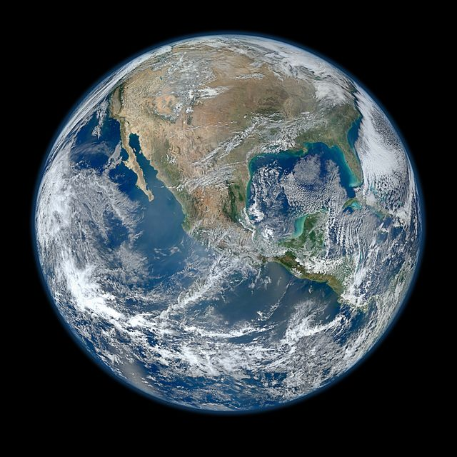
Psalm 42:10 As with a breaking of my bones, My enemies reproach me, While they say to me all day long, "Where is your God?"

Slide 3
Where Is Your God? Psalm 42
Psalm 42:10 As with a breaking of my bones, My enemies reproach me, While they say to me all day long, "Where is your God?"
This is the enemy mocking a follower of God
Many times the devil says to the believer, struggling with temptation, “Where is your God?”
Many times the world says it, and sorrow says it, and fear says it.
It is good to answer the question by the word of God.

Slide 4
Where Is Your God? Psalm 42
1. He Is Above Us.
Deut. 4:39 "Therefore know this day, and consider it in your heart, that the LORD Himself is God in heaven above and on the earth beneath; there is no other.

Slide 5
Where Is Your God? Psalm 42
1. He Is Above Us.
Joshua 2:11 "And as soon as we heard these things, our hearts melted; neither did there remain any more courage in anyone because of you, for the LORD your God, He is God in heaven above and on earth beneath.
(Rahab and spies – Exodus – Red Sea – Sihon and Og)

Slide 6
Where Is Your God? Psalm 42
1. He Is Above Us.
Eph. 1:19–21. and what is the exceeding greatness of His power toward us who believe, according to the working of His mighty power
20 which He worked in Christ when He raised Him from the dead and seated Him at His right hand in the heavenly places,
21 far above all principality and power and might and dominion, and every name that is named, not only in this age but also in that which is to come.

Slide 7
Where Is Your God? Psalm 42
2. He Is Around Us.
Psalm 34:7 The angel of the LORD encamps all around those who fear Him, And delivers them.
Psalm 125:2 As the mountains surround Jerusalem, So the LORD surrounds His people From this time forth and forever.

Slide 8
Where Is Your God? Psalm 42
2. He Is Around Us.
2 Kings 6:17 And Elisha prayed, and said, "LORD, I pray, open his eyes that he may see." Then the LORD opened the eyes of the young man, and he saw. And behold, the mountain was full of horses and chariots of fire all around Elisha

Slide 9
Where Is Your God? Psalm 42
3. He Is Before Us.
Exodus 13:21 And the LORD went before them by day in a pillar of cloud to lead the way, and by night in a pillar of fire to give them light, so as to go by day and night.
Psalm 68:7, 8. O God, when You went out before Your people, When You marched through the wilderness, Selah. 8 The earth shook; The heavens also dropped rain at the presence of God; Sinai itself was moved at the presence of God, the God of Israel. (Sinai and the crucifixion)

Slide 10
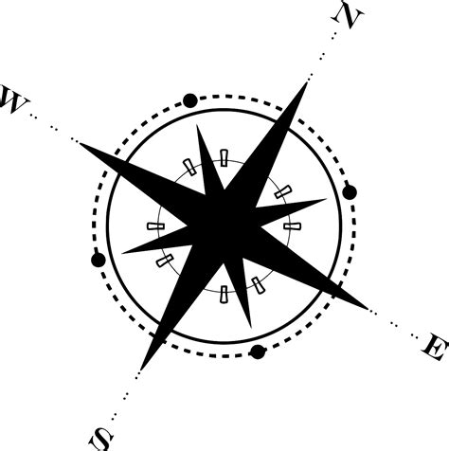
Where Is Your God? Psalm 42
3. He Is Before Us.
John 8:12 Then Jesus spoke to them again, saying, "I am the light of the world. He who follows Me shall not walk in darkness, but have the light of life."

Slide 11
Where Is Your God? Psalm 42
4. He Is Behind Us.
Exodus 14:19 And the Angel of God, who went before the camp of Israel, moved and went behind them; and the pillar of cloud went from before them and stood behind them.
Isaiah 30:21 Your ears shall hear a word behind you, saying, "This is the way, walk in it," Whenever you turn to the right hand Or whenever you turn to the left.

Slide 12
Where Is Your God? Psalm 42
4. He Is Behind Us.
Isaiah 58:8 Then your light shall break forth like the morning, Your healing shall spring forth speedily, And your righteousness shall go before you; The glory of the LORD shall be your rear guard.

Slide 13
Where Is Your God? Psalm 42
5. He Is Beneath Us.
Deut. 33:27 The eternal God is your refuge, And underneath are the everlasting arms; He will thrust out the enemy from before you, And will say, 'Destroy!'
2 Tim. 2:19 Nevertheless the solid foundation of God stands, having this seal: "The Lord knows those who are His," and, "Let everyone who names the name of Christ depart from iniquity."

Slide 14
Where Is Your God? Psalm 42
5. He Is Beneath Us.
Jude 24, 25 Now to Him who is able to keep you from stumbling, And to present you faultless Before the presence of His glory with exceeding joy,
25 To God our Savior, Who alone is wise, Be glory and majesty, Dominion and power, Both now and forever. Amen.

Slide 15
Where Is Your God? Psalm 42
6. He Is With Us.
Genesis 28:15 "Behold, I am with you and will keep you wherever you go, and will bring you back to this land; for I will not leave you until I have done what I have spoken to you."
Isaiah 43:2 When you pass through the waters, I will be with you; And through the rivers, they shall not overflow you. When you walk through the fire, you shall not be burned, Nor shall the flame scorch you. (Red Sea, Jordan River, furnace)

Slide 16
Where Is Your God? Psalm 42
6. He Is With Us.
Daniel 3:20 And he commanded certain mighty men of valor who were in his army to bind Shadrach, Meshach, and Abed-Nego, and cast them into the burning fiery furnace. 21 Then these men were bound in their coats, their trousers, their turbans, and their other garments, and were cast into the midst of the burning fiery furnace.
22 Therefore, because the king's command was urgent, and the furnace exceedingly hot, the flame of the fire killed those men who took up Shadrach, Meshach, and Abed-Nego.
23 And these three men, Shadrach, Meshach, and Abed-Nego, fell down bound into the midst of the burning fiery furnace.
24 Then King Nebuchadnezzar was astonished; and he rose in haste and spoke, saying to his counselors, "Did we not cast three men bound into the midst of the fire?" They answered and said to the king, "True, O king.“25 "Look!" he answered, "I see four men loose, walking in the midst of the fire; and they are not hurt, and the form of the fourth is like the Son of God."

Slide 17
Where Is Your God? Psalm 42
6. He Is With Us.
Mt 28:20 "teaching them to observe all things that I have commanded you; and lo, I am with you always, even to the end of the age." Amen.
Heb 13:5 Let your conduct be without covetousness; be content with such things as you have. For He Himself has said, "I will never leave you nor forsake you."
6 So we may boldly say: "The LORD is my helper; I will not fear. What can man do to me?"

Slide 18
Where Is Your God? Psalm 42
7. He Is Within Us.
John 14:26, 27, "But the Helper, the Holy Spirit, whom the Father will send in My name, He will teach you all things, and bring to your remembrance all things that I said to you.
27 "Peace I leave with you, My peace I give to you; not as the world gives do I give to you. Let not your heart be troubled, neither let it be afraid.;
1 Cor. 6:19; Or do you not know that your body is the temple of the Holy Spirit who is in you, whom you have from God, and you are not your own?
Col. 1:27; To them God willed to make known what are the riches of the glory of this mystery among the Gentiles: which is Christ in you, the hope of glory.

Slide 19
Where Is Your God? Psalm 42
7. He Is Within Us.
Eph 3:14 For this reason I bow my knees to the Father of our Lord Jesus Christ, 15 from whom the whole family in heaven and earth is named, 16 that He would grant you, according to the riches of His glory, to be strengthened with might through His Spirit in the inner man,17 that Christ may dwell in your hearts through faith; that you, being rooted and grounded in love,
18 may be able to comprehend with all the saints what is the width and length and depth and height—
19 to know the love of Christ which passes knowledge; that you may be filled with all the fullness of God. 20 Now to Him who is able to do exceedingly abundantly above all that we ask or think, according to the power that works in us,
21 to Him be glory in the church by Christ Jesus to all generations, forever and ever. Amen.

Slide 20
Where Is Your God? Psalm 42
He Is Above Us.
He Is Around Us.
He Is Before Us.
He Is Behind Us.
He Is Beneath Us.
He Is With Us.
He Is Within Us.

Slide 21
Where Is Your God? Psalm 42
Psalm 19:1 The heavens declare the glory of God; And the firmament shows His handiwork.
2 Day unto day utters speech, And night unto night reveals knowledge.
3 There is no speech nor language Where their voice is not heard.
4 Their line has gone out through all the earth, And their words to the end of the world. In them He has set a tabernacle for the sun,
5 Which is like a bridegroom coming out of his chamber, And rejoices like a strong man to run its race.
6 Its rising is from one end of heaven, And its circuit to the other end; And there is nothing hidden from its heat.

Slide 22
Where Is Your God? Psalm 42
application
Are you pushing God OUT of your life?

Slide 23
Where Is Your God? Psalm 42
application
Jesus knows that who or what we worship has the ultimate authority in our lives.
We give ourselves in worship to who or what we believe has power to meet our needs and then we arrange our lives to live by its rules and under its authority.
This is true whether we worship money, fame, our job, education, recreation, family… or God

Slide 24
Where Is Your God? Psalm 42
application
Sometimes God calms the wind and the waves other times he brings us through the storm.
Every once in awhile he calls us to get out of the boat and walk with him on the water.
At all times Jesus cares. He will always give us his best. The most important thing to remember when we are experiencing a storm is that Jesus is on our side and in our boat.
When we let anything other than Jesus take hold in our lives we become its slave. It binds us and steals our peace.
Are you at PEACE today?

Slide 25
Live To Please
application
God Not People.
One Day You Will
Stand Before Him
And They Will Not Be
There.
Exodus 20:3 "You shall have no other gods before Me.
Exodus 34:14 For thou shalt worship no other god: for the LORD, whose name is Jealous, is a jealous God:

Slide 26
Where Is Your God? Psalm 42
application
Are you pushing God OUT of your life?

Slide 27
Lukewarm
It’s time to pick your side NOW Jesus or the world?
Backsliders
It’s time to REPENT and come back home!
Unbelievers
It’s time to REPENT and surrender your lives to God
Believers
Stay encouraged, keep the Faith. Our Redemption draws near!

