Slide 1
Welcome to our services
New Lebanon Church of Christ
We are Simply Christians.
Our Emphasis is Spiritual, Not Material or Social.
We are striving to be The Same Church as Described in The New Testament.
Please Come Back Again

Slide 2
What Is The Word Of God?
Col 3:16 Let the word of Christ dwell in you richly in all wisdom, teaching and admonishing one another in psalms and hymns and spiritual songs, singing with grace in your hearts to the Lord.
17 And whatever you do in word or deed, do all in the name of the Lord Jesus, giving thanks to God the Father through Him.

Slide 3
What Is The Word Of God?
John 20:30 And truly Jesus did many other signs in the presence of His disciples, which are not written in this book;
31 but these are written that you may believe that Jesus is the Christ, the Son of God, and that believing you may have life in His name.

Slide 4
What Is The Word Of God?
It is the written word that reveals to us. There is not a man living today that knows anything about God’s will, except what he learned from the written word.
There is not a man living today that knows anything about heaven except what he learned from the written word.
We wouldn’t know that God created the heaven and the earth, and the earth was without form, and void, and the spirit of God moved upon the waters – we wouldn’t know any of this if it wasn’t written.

Slide 5
What Is The Word Of God?
And friends, we wouldn’t know that such a being ever made footprints upon the earth as Jesus Christ if it had not been written;
We wouldn’t have known that He died upon the cross of Calvary if it hadn’t been written,
and the most important thing is, we wouldn’t know that He was raised from the dead if the Bible hadn’t said so.
That same Bible tells us how to become God’s children.

Slide 6
What Is The Word Of God?
There is power in the written word.
And so important is it that God Gave us dozens of word pictures to help us understand what his word is.
So, ….. we’re going to spend just a few short minutes and look at 6 different word pictures to help us better understand the word of God.

Slide 7
What Is The Word Of God?
What is the word of God?........The word of God is a:
Lamp Psalm 119: 105
Psalm 119:105. Your word is a lamp to my feet And a light to my path.
Why is the word of God a lamp unto my feet?
It illuminates
It shows the way.
It shows where there are dangers

Slide 8
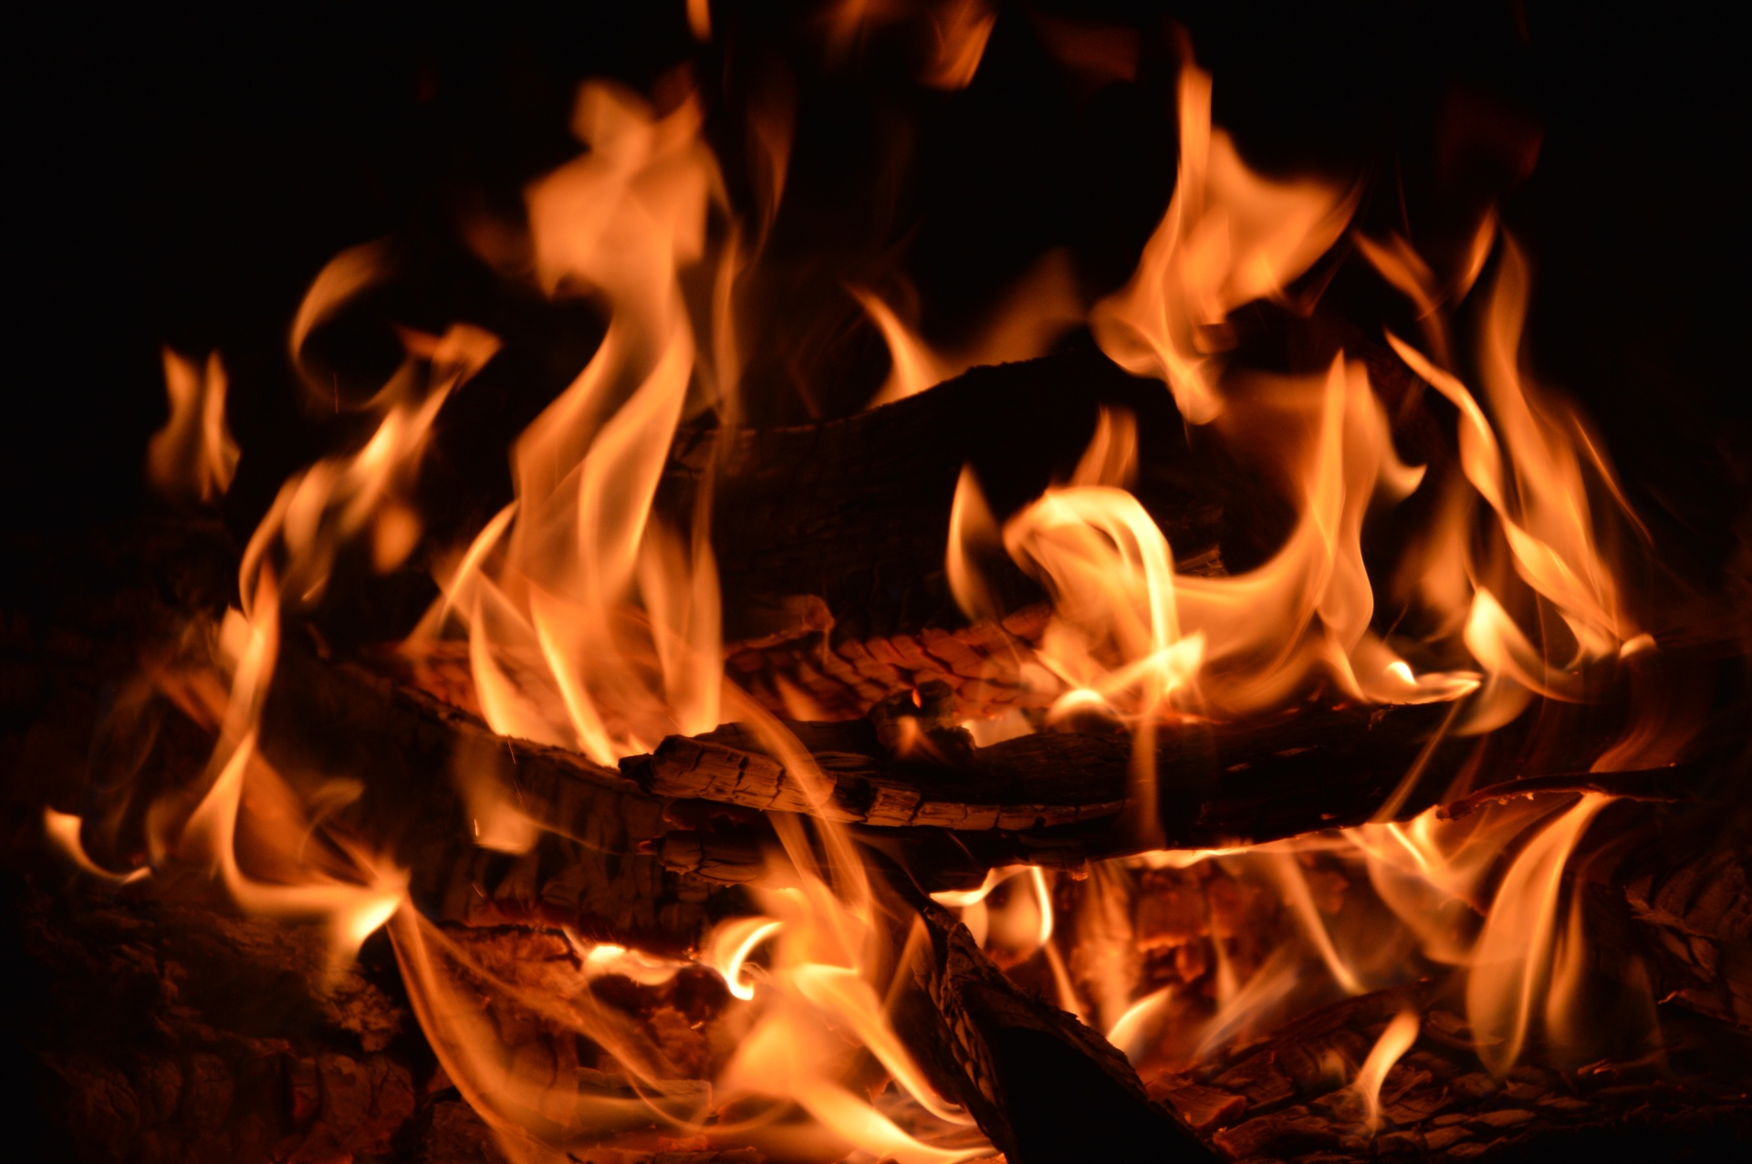
What Is The Word Of God?
What is the word of God?........The word of God is a:
Fire Jer. 23:29
Jer. 23:29 "Is not My word like a fire?" says the LORD,
Why is the word of God a fire?
It enlightens, warms, and penetrates and consumes every part it has access to. And when it is communicated to the true prophet – (and to us)..it is a fire shut up in our bones that he cannot contain and must release…

Slide 9
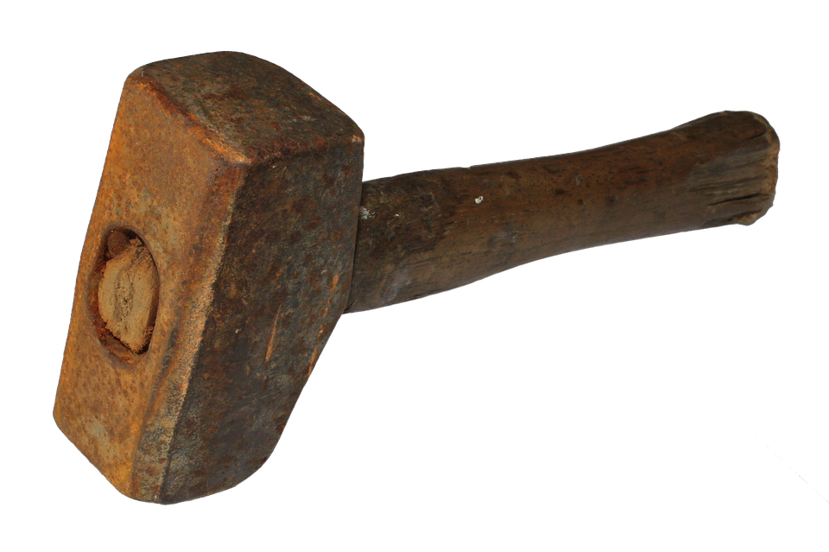
What Is The Word Of God?
What is the word of God?.........The word of God is a:
Hammer Jer. 23:29
Jer. 23:29 "Is not My word like a fire?" says the LORD, "And like a hammer that breaks the rock in pieces?
Why is the word of God a hammer?
The word of God strikes hard and sure, or at least it should.

Slide 10
What Is The Word Of God?
People are lost and are looking for the truth. If I stand up here and just tell stories and get you worked up emotionally so that you feel good when you leave – then I have failed.
If that is what I do then I have wasted my time, I have wasted your time, and I have shunned to declare the whole counsel of God. And I have given Satan the advantage in the battle of our souls.

Slide 11
What Is The Word Of God?
God’s word is a hammer. And when the word of God richly dwells within us – we become a hammer.
A hammer that strikes hard and sure.
And we ought to USE this hammer to teach and admonish in no uncertain terms, because the eternity of our souls is at stake.

Slide 12
What Is The Word Of God?
What is the word of God?........The word of God is a:
Mirror James 1:23-25
James 1:23 For if anyone is a hearer of the word and not a doer, he is like a man observing his natural face in a mirror; 24 for he observes himself, goes away, and immediately forgets what kind of man he was.
25 But he who looks into the perfect law of liberty and continues in it, and is not a forgetful hearer but a doer of the work, this one will be blessed in what he does.

Slide 13
What Is The Word Of God?
What is the word of God?........The word of God is a:
Mirror James 1:23-25
Why is the word of God a mirror?
• This is a very simple, but deep metaphor.
• When we hear the doctrine of God, we cannot help but discover our own character and short comings.
• And, when we STOP looking in the perfect law of liberty…we FORGET what manner of man he was.
• This is a G I A N T warning for us. We must continually, daily look into this mirror, God’s word.

Slide 14
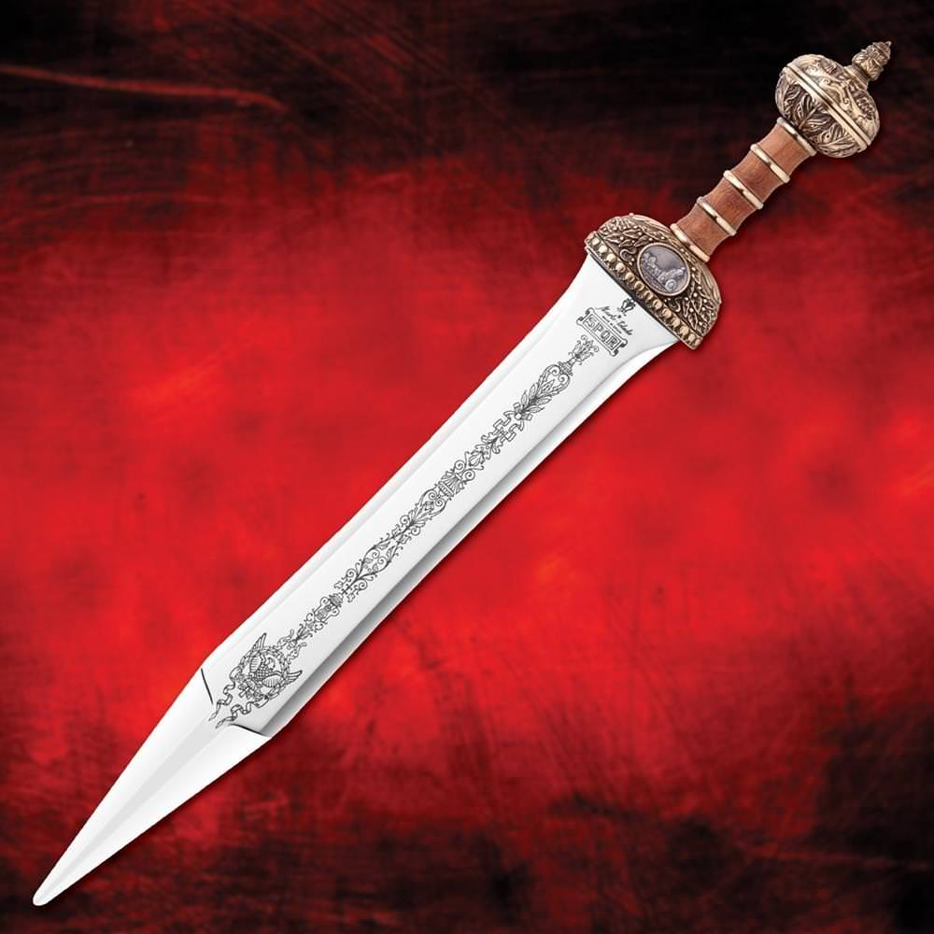
What Is The Word Of God?
What is the word of God?........The word of God is a:
Sword Heb. 4:12
Heb 4:12 For the word of God is living and powerful, and sharper than any two-edged sword, piercing even to the division of soul and spirit, and of joints and marrow, and is a discerner of the thoughts and intents of the heart.
13 And there is no creature hidden from His sight, but all things are naked and open to the eyes of Him to whom we must give account.

Slide 16
What Is The Word Of God?
A sword is……..Powerful….Sharp…..Piercing
It is a discerner not only of my THOUGHTS, but also of my INTENTIONS.
• God’s word is a sword. And when the word of God richly dwells within us, that sword will cut us to the heart.
• It will open us up and we will be laid bare.
• And we ought to USE this sword to teach and admonish in no uncertain terms, because the eternity of our souls is at stake.

Slide 17
What Is The Word Of God?
What is the word of God?........The word of God is a:
Diet 1 Pet 2: 1-3
1Peter 2:1 Therefore, laying aside all malice, all deceit, hypocrisy, envy, and all evil speaking,
2 as newborn babes, desire the pure milk of the word, that you may grow thereby,
3 if indeed you have tasted that the Lord is gracious.

Slide 18
What Is The Word Of God?
What is the word of God?........The word of God is a:
Diet 1 Pet 2: 1-3
Heb 5:12-14…. For though by this time you ought to be teachers, you need someone to teach you again the first principles of the oracles of God; and you have come to need milk and not solid food.

Slide 19
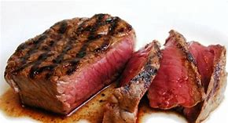
The Milk
and Meat
of the word

Slide 20
What Is The Word Of God?
1Peter 5:1-3 Shepherds that FEED the flock… The elders who are among you I exhort, I who am a fellow elder and a witness of the sufferings of Christ, and also a partaker of the glory that will be revealed:
2 Shepherd the flock of God which is among you, serving as overseers, not by compulsion but willingly, not for dishonest gain but eagerly;
3 nor as being lords over those entrusted to you, but being examples to the flock;

Slide 21
What Is The Word Of God?
God’s word is our spiritual FOOD, and just like with physical food,
• We must INGEST God’s word
• We must ingest it on a regular basis
• We must not only ingest or take it in, we must also DIGEST it.
We must continually take on more complex food, break it down,
• And make it strengthen and grow our body.

Slide 22
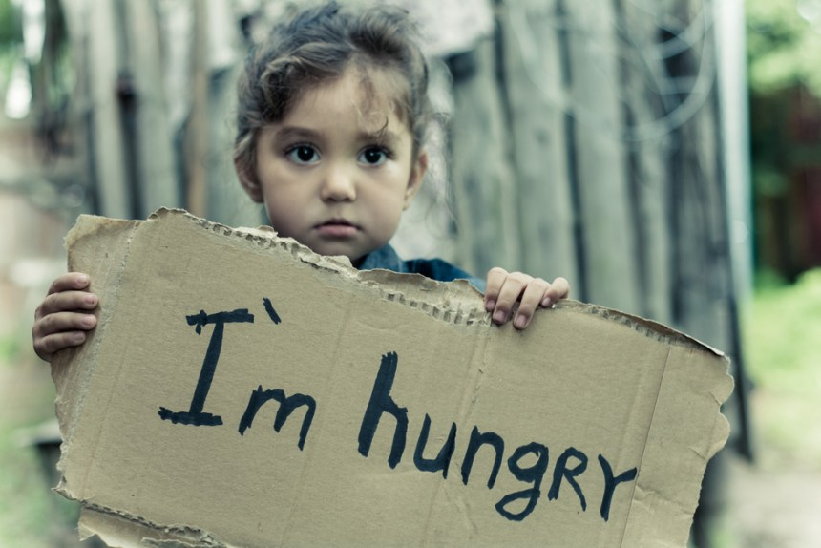
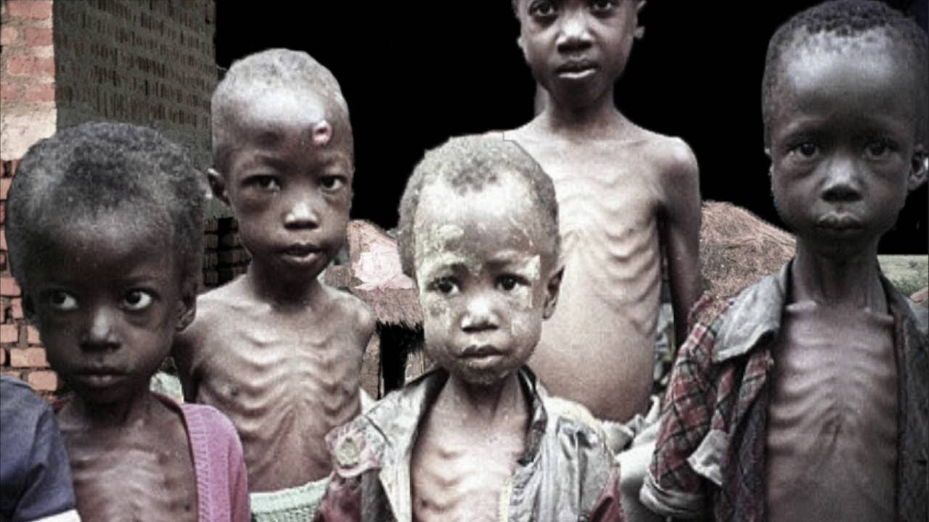
What Is The Word Of God?
If we don’t do this, we can not GROW.
If we don’t do this, we can not be healthy.
If we don’t eat a BALANCED diet, we are going to be lacking what we need and we will become sick.

Slide 23
What Is The Word Of God?

Slide 24
Are You A New Testament Christian?
Hear the Gospel (Rom.10:14).
Believe the Gospel (Heb. 11:6).
Repent of Sins (Acts 3:19).
Confess Christ (Rom.10:9).
Be Baptized Into Christ (1 Cor.12:13).
1 Timothy 4:16
“Take heed unto thyself, and unto the doctrine; continue in them: for in doing this thou shalt both save thyself, and them that hear thee.”

