Slide 1
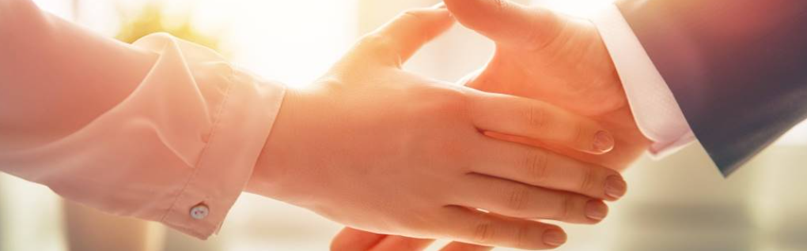
Welcome to our services
New Lebanon Church of Christ
We are Simply Christians.
Our Emphasis is Spiritual, Not Material or Social.
We are striving to be The Same Church as Described in The New Testament.
Please Come Back Again

Slide 2

2Cor. 5:17 Therefore, if anyone is in Christ, he is a new creation; old things have passed away; behold, all things have become new.

Slide 3
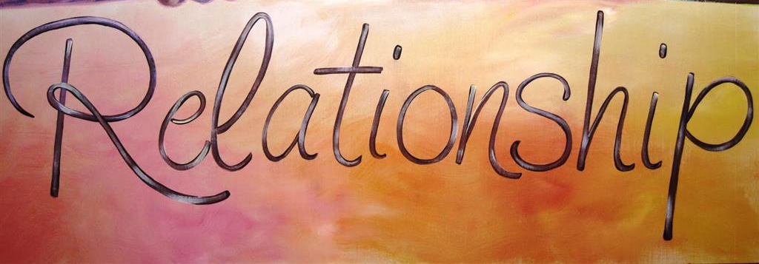
Our Relationship To Christ
relationship /rĭ-lā′shən-shĭp″/
noun
The condition or fact of being related; connection or association.
Connection by blood or marriage; kinship.
A particular type of connection existing between people related to or having dealings with each other.

Slide 4
When you truly
fall in love with
Jesus
you will fall
out of love
with the world.

Slide 5
Our Relationship To Christ
Crucified Relationship With Christ.
We glory in the cross.
We regard our lives hid with Christ in God.
We consider our earthly members put to death.

Slide 6
Our Relationship To Christ
Crucified Relationship With Christ.
Gal. 6:14. But God forbid that I should boast except in the cross of our Lord Jesus Christ, by whom the world has been crucified to me, and I to the world.
Col. 3:3. For you died, and your life is hidden with Christ in God.
Col. 3:5. Therefore put to death your members which are on the earth: fornication, uncleanness, passion, evil desire, and covetousness, which is idolatry.

Slide 7
Our Relationship To Christ
Consecrated Relationship To Christ.
We count all things loss for the excellency of the knowledge of Christ. Phil. 3:8
We purpose that Christ shall be magnified in our lives. Phil. 1:20
We live henceforth unto Him who died for us. 2 Cor. 5:15; Col. 3:17–23

Slide 8
Our Relationship To Christ
Consecrated Relationship To Christ.
Phil. 3:8 Yet indeed I also count all things loss for the excellence of the knowledge of Christ Jesus my Lord, for whom I have suffered the loss of all things, and count them as rubbish, that I may gain Christ
Phil. 1:20 according to my earnest expectation and hope that in nothing I shall be ashamed, but with all boldness, as always, so now also Christ will be magnified in my body, whether by life or by death.

Slide 9
Our Relationship To Christ
Consecrated Relationship To Christ.
Col 3:17 And whatever you do in word or deed, do all in the name of the Lord Jesus, giving thanks to God the Father through Him.
18 Wives, submit to your own husbands, as is fitting in the Lord.
19 Husbands, love your wives and do not be bitter toward them.
20 Children, obey your parents in all things, for this is well pleasing to the Lord.

Slide 10
Our Relationship To Christ
Walking Relationship With Christ.
We walk no longer in the vanity of our minds.
We walk in Him, established in the faith.
We walk constantly in the way pleasing to God.

Slide 11
Our Relationship To Christ
Walking Relationship With Christ.
Eph. 4:17 This I say, therefore, and testify in the Lord, that you should no longer walk as the rest of the Gentiles walk, in the futility of their mind,
Col. 1:10. that you may walk worthy of the Lord, fully pleasing Him, being fruitful in every good work and increasing in the knowledge of God; 11 strengthened with all might, according to His glorious power, for all patience and longsuffering with joy;
12 giving thanks to the Father who has qualified us to be partakers of the inheritance of the saints in the light.

Slide 12
Our Relationship To Christ
Walking Relationship With Christ.
Col 2:6 As you have therefore received Christ Jesus the Lord, so walk in Him,
7 rooted and built up in Him and established in the faith, as you have been taught, abounding in it with thanksgiving.

Slide 13
Our Relationship To Christ
Owned Relationship By Christ.
We bear the brand-marks of the Master.
We are always zealous of good works.
We rejoice in the friendship of Jesus.

Slide 14
Our Relationship To Christ
Owned Relationship By Christ.
We bear the brand-marks of the Master.
(Gal. 6:17) From now on let no one trouble me, for I bear in my body the marks of the Lord Jesus.
2Cor. 11:24 From the Jews five times I received forty stripes minus one.
25 Three times I was beaten with rods; once I was stoned; three times I was shipwrecked; a night and a day I have been in the deep;
26 in journeys often, in perils of waters, in perils of robbers, in perils of my own countrymen, in perils of the Gentiles, in perils in the city, in perils in the wilderness, in perils in the sea, in perils among false brethren;
27 in weariness and toil, in sleeplessness often, in hunger and thirst, in fastings often, in cold and nakedness--
28 besides the other things, what comes upon me daily: my deep concern for all the churches.

Slide 15

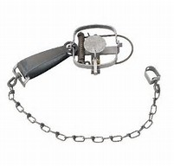
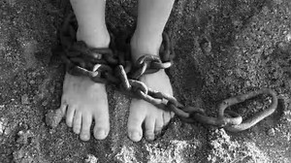
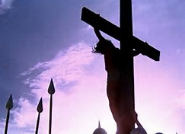
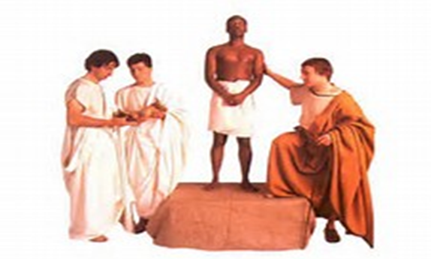
Sin Captivates
Satan Captures
Held in bondage. Servant of sin
Redemption
Christ redeems us. Buys us. Servant of Christ.
Christ paid ransom

Slide 16
Our Relationship To Christ
5. Serving Relationship With Christ.
We witness for our Lord. Acts 1:8 "But you shall receive power when the Holy Spirit has come upon you; and you shall be witnesses to Me in Jerusalem, and in all Judea and Samaria, and to the end of the earth."
We fish for men. Luke 5:10 and so also were James and John, the sons of Zebedee, who were partners with Simon. And Jesus said to Simon, "Do not be afraid. From now on you will catch men."
We serve in humility. 1 Cor. 1:27–29

Slide 17
Our Relationship To Christ
Serving Relationship With Christ.
We serve in humility. 1 Cor. 1:27–29
1Cor. 1:27 But God has chosen the foolish things of the world to put to shame the wise, and God has chosen the weak things of the world to put to shame the things which are mighty;
28 and the base things of the world and the things which are despised God has chosen, and the things which are not, to bring to nothing the things that are,
29 that no flesh should glory in His presence.

Slide 18
Our Relationship To Christ
5. Serving Relationship With Christ.
We witness for our Lord. Acts 1:8
We fish for men. Luke 5:10; Acts 18:6
We serve in humility. 1 Cor. 1:27–29

Slide 19
Our Relationship To Christ
Hopeful Relationship In Christ.
We love the appearing of Christ. 2 Tim. 4:8
We look for the crown of life. James 1:12; Rev. 2:10
We look for His appearing as a blessed hope. Titus 2:13

Slide 20
Our Relationship To Christ
Hopeful Relationship In Christ.
We love the appearing of Christ. 2 Tim. 4:8
Finally, there is laid up for me the crown of righteousness, which the Lord, the righteous Judge, will give to me on that Day, and not to me only but also to all who have loved His appearing.
We look for the crown of life. (James 1:12; Rev. 2:10). Blessed is the man who endures temptation; for when he has been approved, he will receive the crown of life which the Lord has promised to those who love Him.

Slide 21
Our Relationship To Christ
Hopeful Relationship In Christ.
We look for His appearing as a blessed hope. (Titus 2:13).
Titus 2:11 For the grace of God that brings salvation has appeared to all men, 12 teaching us that, denying ungodliness and worldly lusts, we should live soberly, righteously, and godly in the present age, 13 looking for the blessed hope and glorious appearing of our great God and Savior Jesus Christ,14 who gave Himself for us, that He might redeem us from every lawless deed and purify for Himself His own special people, zealous for good works.

Slide 22
Our Relationship To Christ
A Reward Relationship With Christ.
1Peter 1:1 Peter, an apostle of Jesus Christ, To the pilgrims of the Dispersion in Pontus, Galatia, Cappadocia, Asia, and Bithynia,
2 elect according to the foreknowledge of God the Father, in sanctification of the Spirit, for obedience and sprinkling of the blood of Jesus Christ: Grace to you and peace be multiplied.
3 Blessed be the God and Father of our Lord Jesus Christ, who according to His abundant mercy has begotten us again to a living hope through the resurrection of Jesus Christ from the dead,
4 to an inheritance incorruptible and undefiled and that does not fade away, reserved in heaven for you,
5 who are kept by the power of God through faith for salvation ready to be revealed in the last time.

Slide 23
I serve a God that
has a plan and a
purpose for my life.
I serve a God that
is greater than
my troubles.
I serve a God that
makes all things
possible.

Slide 24


Slide 25
Our Relationship To Christ
Crucified With Christ.
Consecrated To Christ.
Walking With Christ.
Owned By Christ.
Serving For Christ.
Hopeful In Christ.
A Reward With Christ.

Slide 26
Are You A New Testament Christian?
Hear the Gospel (Rom.10:14).
Believe the Gospel (Heb. 11:6).
Repent of Sins (Acts 3:19).
Confess Christ (Rom.10:9).
Be Baptized Into Christ (1 Cor.12:13).
1 Timothy 4:16
“Take heed unto thyself, and unto the doctrine; continue in them: for in doing this thou shalt both save thyself, and them that hear thee.”

