Slide 1
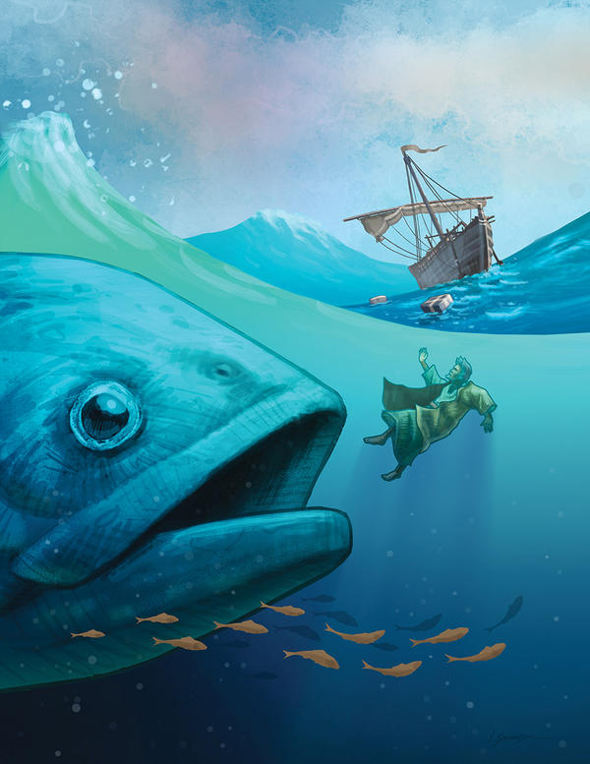
God Revealed In The Story Of Jonah
Jonah 1:3 But Jonah arose to flee to Tarshish from the presence of the LORD. He went down to Joppa, and found a ship going to Tarshish; so he paid the fare, and went down into it, to go with them to Tarshish from the presence of the LORD.
Have you ever felt anxious about having to confront someone with a truth that might cause conflict or hostility? Have you ever wanted to run from God?

Slide 2
Remember 4 Places, and 3 Times
Prophets before exile to get people to repent.
Prophets during the exile.
Prophets after the exile
2

Slide 3
Jonah
Nahum
Amos
Hosea
Isaiah
Jeremiah
Joel
Micah
Zephaniah
Habakkuk
Obadiah
Before exile
During exile
Ezekiel
Daniel
Haggai
Zechariah
Malachi
After exile

Slide 4
The Book Of Jonah
The story of Jonah is best known for the time the prophet spent inside a fish. However, the story and its message are more than a three-day fish story! Although the prophet usually has received the most attention, this is a story about a compassionate, merciful, and powerful God.
The book of Jonah is a window to meet a God that surprises, moves, challenges, and changes us in new and powerful ways.

Slide 5
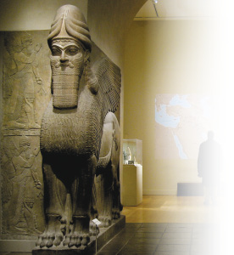
JONAH IN BIBLICAL HISTORY
We first meet Jonah in the book of Kings (2 Kings 14:25). There, Jonah prophesies during the reign of King Jeroboam II around the beginning of the 8th century (790–760 BC).
This period of history is significant in the life of ancient Israel and the kingdoms around it. The enemy empires of Egypt and Assyria were experiencing urgent internal crises that kept them near home, far away from the edges of their territory. With this temporary freedom, Israel experienced times of prosperity. The prophets Amos and Micah’s ministries occurred during these times.
During the reign of Jeroboam II, Jonah spoke a prophecy: King Jeroboam II would restore the boundaries of Israel (2 Kings 14:25). But in the book of Jonah, his task is quite different. This prophetic book is not promising new military victories.

Slide 6
The Story
1 God calls Jonah: Jonah Flees
God called the prophet Jonah from the northern kingdom of Israel to deliver a message to the city of Nineveh. “Go to the great city of Nineveh and preach against it…” (Jonah 1:2).
At first glance, it appears to be great news: God’s judgment is about to fall on the hated enemies. Surprisingly, however, the text informs us, “the prophet ran away from the LORD” (Jonah 1:3).
Why did he do that? It makes no sense. Yet, Jonah’s actions unleash a series of events that challenge us as believers.
Have you ever felt like “hiding” from God when he interrupts your life? Hiding from God doesn’t mean one flees to the end of the world. Sometimes getting lost in our busyness is enough to hide. Have you ever tried to hide or make excuses when you sense God might be trying to tell you something?

Slide 7
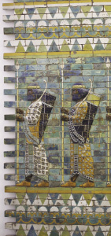
After a period of decline, the Assyrian king Ashurnasirpal II (reigned 883–859 BC) began to expand the kingdom. His famous palace reliefs depict his campaigns. His descriptions are gory and display great cruelty; he describes cutting off the hands, feet, noses, ears, and lips of his prisoners. One of his military strategies was to induce terror in his conquered territories and neighbors. This policy continued until the times of kings:
Tiglath-pileser III (reigned 747–727 BC),
Shalmaneser V (reigned 726–722 BC),
Sargon II (reigned 721–705 BC, and responsible for the destruction of Samaria), and
Sennacherib (reigned 704–681 BC, who conquered most of Judah but never the city of Jerusalem).
The Assyrians became known for their cruelty and ruthlessness as military conquerors. Israel, like all the small kingdoms of the area, held no love for the Assyrians.

Slide 8
Nowhere To Hide
Attempting to run away from God is a rather foolish thing to do. Yet, that is precisely what Jonah did. Jonah attempted to escape God by fleeing to “Tarshish”—as if saying that he went to the end of the world, since most scholars believe that Tarshish was at the end of the known world back in Jonah’s times.
Jonah boarded a ship on its way to deep sea. It was a cargo ship, on which the crew were non-Israelite merchants. On his way to Tarshish, however, God cast a storm that threatened to destroy the ship.
“Where can I go from your Spirit? Where can I go from your presence? ” Ps. 139:7

Slide 9
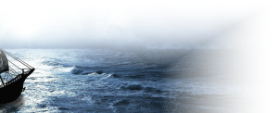
Nowhere To Hide
In their desperation, the sailors cast their cargo off the ship. Besides lightening the ship, it is also possible that the sailors were offering a sacrifice to the ancient god of the sea—in Hebrew, the word yam means “sea” and was also the ancient name of the god of the sea.
The word “cast” is important. The sailors “cast” their merchandise and “cast” Jonah off the ship.

Slide 10
In the meantime, Jonah went to the “belly” of the ship to sleep. It was as if Jonah was “dead” asleep, as if the “belly” of the ship were the grave itself. Jonah’s passiveness contrasts with the sailors’ frantic activity. As the sailors attempted to discover the cause of their trouble, they turned to Jonah.
As he informed them of his identity as a prophet, Jonah said “I am a Hebrew and I worship the LORD, the God of heaven, who made the sea and the dry land” (1:9). The common expression is “the God of heaven and earth,” which means the God of the whole creation. Yet, Jonah makes a point of introducing God as creator of the dry land and sea. Jonah means God is in control of all things, even the chaos of the sea!
Jonah knew these things about God, why would he try to flee at all?
One way we “flee” or “run away” from God is by pretending he’s not around to see what we do or don’t do.
Have you ever acted as if there were no God?

Slide 11
The sea continued to be rough and the threat of drowning remained. Jonah’s solution to the threat was to be cast over to the sea. Despite their best efforts, the sailors could not control the ship. They complied with Jonah’s request. They cast him to the sea, which became peaceful once again.
Their lives saved, the sailors feared the Lord, offered a sacrifice, and made vows. The Lord’s prophet should be the one fearing God, offering his obedience as sacrifice, and making vows by proclaiming God’s message. Yet, the sailors, who had asked for help from their gods, are the ones displaying behavior that should characterize God’s people.
The sailors display behavior that today we’d call “conversion.” God’s miracles, along with Jonah’s testimony, produced amazing results. God’s amazing mercy can soften and transform the hardest of hearts! (Ezek. 36:26).
Have you ever experienced God’s mercy in a way that melts your rebellion, soothes your pain, or sweetens your sadness?

Slide 12
2 God Provides a Fish for Jonah: Jonah Prays
God showed mercy to the sailors and he also showed mercy to Jonah: “the Lord provided a huge fish to swallow Jonah” and save him from drowning. Jonah spent three days and three nights in the belly of the fish!
There, Jonah prayed to God. In his prayer, Jonah testifies to God’s deliverance, remembers the trouble he’s in, and vows to worship God. Jonah’s prayer has interesting connections with the actions of the sailors in chapter one.

Slide 14
The book of Jonah is about a compassionate and merciful God. The experience of the sailors and Jonah show that God acts with compassion and grace to all people. Their experience shows that prayer and repentance move God to compassion.
To the sailors, Jonah confessed that the Lord is “the God of heaven, who made the sea and the dry land” (1:9). In his prayer, Jonah makes another powerful confession: “Salvation comes from the LORD” (2:9). Whether to pagan sailors or a rebellious prophet, God’s grace and compassion are available to all.
At the end of the chapter, just as God had prepared the fish, now he commands it to release Jonah.

Slide 15
3 God Sends Jonah to Nineveh: Jonah Preaches
God ordered Jonah to go to Nineveh. The instructions in chapter 3 are less specific than before:1:2)
“Go to the great city of Nineveh and proclaim to it the message )
This time, Jonah goes to Nineveh in obedience to God. The book turns its focus on the city. The text tells us that Nineveh was a “very large city.” The description, “it took three days to go through it” (3:3) seems to refer to the city’s size and importance. Jonah visits the city and preaches God’s announcement: “Forty more days and Nineveh will be overthrown” (3:4). Jonah’s message does not seem to leave any room for discussion. God will destroy Nineveh. It seems inevitable and decisive.

Slide 16
However, the next verse is surprising: “The Ninevites believed God” (3:5). It’s not clear whether Jonah was supposed to go around the whole city (the full three days), but the preaching of one day’s journey (3:4) was enough!
The Ninevites, including the king of Nineveh, believed God and repented. The extent of their repentance is shown by the extent of their fast: Even the animals of the city fasted and were covered with sackcloth. Jonah’s message didn’t seem to leave any room for repentance; it was a message of judgment.
Yet, the king showed an unexpected faith: “Who knows? God may yet relent and with compassion turn his fierce anger so that we will not perish” (3:9).

Slide 17
The Ninevites saw a resurrected man.
Matt.27:45-54
52-53
Do people see us as dead to the world and alive in Christ? – a resurrected person?
Acts 2:36-41, 3000 souls

Slide 18
But the book of Jonah is not, after all, about Nineveh’s repentance, as important as that event is. Rather, it is about Israel’s own lack of repentance.
Israel witnessed God’s miracles to the Patriarchs, in the Exodus, the conquest of the Promised Land, in David and Solomon’s kingdoms. Yet, Israel chose rebellion and unfaithfulness.

Slide 19
Jonah didn’t even have the chance to walk through the whole city before the city repented. Unintentionally, Jonah became the most effective preacher ever! What a wonderful testimony of God’s mercy reaching to the ends of the world.
The text informs us, “When God saw what they did and how they turned from their evil ways, he relented and did not bring on them the destruction he had threatened” (3:10).
This final act of repentance and compassion would have been a wonderful ending for the story. The Ninevites repented, and God’s glorious compassion shone through brighter than the sun. Nineveh’s repentance is not a complete surprise; it parallels that of the sailors.
What is surprising is that the book doesn’t end here!

Slide 20
4 God Talks with Jonah: Jonah’s Reactions
The book’s last chapter presents a series of conversations between God and the disgruntled prophet. At this point, we get an explanation for Jonah’s attempt to flee from God in chapter one: “I knew that you are a gracious and compassionate God, slow to anger and abounding in love, a God who relents from sending calamity” (4:2).
Think about that: Jonah fled because he knew God was compassionate! Shouldn’t a prophet of the Lord be happy and appreciate God’s grace and compassion?

Slide 21
There are at least two explanations for Jonah’s angry reaction:
1. Jonah refused to share God’s blessings with other people. Jonah’s limited vision desired to keep God and God’s blessings for Israel alone.
2. Jonah’s prophetic understanding allowed him to see that Nineveh would act as God’s instrument of judgment against Israel in the future.

Slide 22
Jonah’s Limited Vision
Jesus’ parable of the creditor and the two debtors in Luke 7:41–43 might help us understand the source of Jonah’s problem. In the parable, Jesus concludes that those who are forgiven much will have a correspondingly greater love.
Having witnessed God’s compassion, fulfilled promises, forgiveness, and love through their history, the Israelites’ gratitude and love for God and others should be evident. Yet, Jonah reacts with anger! How can we make sense of this reaction?

Slide 23
In his prayer to God, Jonah says, “I knew that you are a gracious and compassionate God, slow to anger and abounding in love, a God who relents from sending calamity” (4:2). Jonah is alluding to a wonderful text from
Exodus: “The LORD, the LORD, the compassionate and gracious God, slow to anger, abounding in love and faithfulness, maintaining love to thousands, and forgiving wickedness, rebellion and sin. Yet he does not leave the guilty unpunished; he punishes the children and their children for the sin of the parents to the third and fourth generation” (34:6–7).
This is a central confession in Israel. In his prayer, Jonah emphasizes God’s grace and forgiveness as the reason for not wanting to go to Nineveh.

Slide 24
Historical Background: God’s Dealings With Nineveh
In the book of Jonah, the acts of contrition that God saw in the people of Nineveh moved him to have compassion and to relent his judgment on the city. Although it’s very difficult to establish a date for the events in the book of Jonah, it is possible that they occurred early in the eighth century (700s BC). About a century later, sometime before 612 BC, the prophet Nahum spoke about the destruction of the powerful and proud city of Nineveh, which happened in 612 BC. Around the time of Jonah, God had already revealed to Isaiah that Assyria and its king would be punished for
“the willful pride of his heart and the haughty
look in his eyes” (Isa. 10:12).

Slide 25
God’s Compassion to All, Even Nineveh
God’s prophets understood the historical, social, and political climate of their times and how they connected with God’s plans. Jonah had correctly diagnosed the spiritual darkness in the city of Nineveh
He knew that its sin offended God. And Jonah knew that God’s holiness would move the Lord to act decisively to correct that darkness. Jonah understood God’s holiness and righteousness.

Slide 26
God’s intention to bless all the nations is first seen in his promise to bless Abraham: “…and all peoples on earth will be blessed through you” (Gen. 12:3).
Throughout the prophets, God reminded Israel that his blessing would extend to all the nations. Around the time of Jonah, God revealed to Isaiah that God would bless all the nations, even the hated enemies of Israel: Assyria and Egypt: “The LORD Almighty will bless them, saying, ‘Blessed be Egypt my people, Assyria my handiwork, and Israel my inheritance’” (Isa. 19:25).

Slide 27
Jonah also understood that God is merciful and compassionate—that’s why he alluded to Exodus. What he misunderstood or refused to accept was that God would extend such mercy and compassion to people other than Israel!
Jonah’s sadness about the fate of Nineveh is evident in his request to die: “take away my life, for it is better for me to die than to live” (4:3).
What could Jonah mean with this request? Let’s remember Jonah’s prayer in chapter 2. In his lament, Jonah affirms that being separated from God is the worst experience (“I have been banished from your sight”), yet his hope remained on God’s promise to be with his people (“yet I will look again toward your holy temple”). What changed so much to make Jonah wish to die? God’s relenting of his punishment against Nineveh? Jonah and the Israelites of his time were intelligent; they were perfectly able to understand God’s will. In fact, they had been told by God that Abraham’s descendants would be a source of blessing to other nations.

Slide 28
Perhaps this analogy will help us understand what happened. It was similar to a child who’s been told all of his life that he’s special and the most perfect being in the world, well deserving of all good things. This child will most likely become a spoiled child filled with disregard for others and expecting others to treat as special.
Israel expected God and other nations to treat them as special. They were special but not for who or what they were (Deut. 7:7) but because God loved them first (Deut. 7:8; 1 John 4:10).
Yet, we humans tend to be possessive; we pretend to own those who love us and we love. The Israelites pretended to possess and deserve God’s love. They claimed exclusivity over God’s attentions and regard. But God is clear that’s not the case:
“‘Are not you Israelites the same to me as the Cushites?’ declares the Lord. ‘Did I not bring Israel up from Egypt, the Philistines
from Caphtor and the Arameans from Kir?’” (Amos 9:7).

Slide 29
Jonah 4:11 "And should I not pity Nineveh, that great city, in which are more than one hundred and twenty thousand persons who cannot discern between their right hand and their left-and much livestock?"

Slide 30
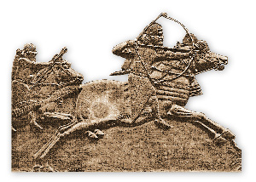
Future Role of Nineveh
Jonah understood history from God’s perspective. Jonah knew that all the things happening around him were God’s doing.
Perhaps Jonah knew more about Nineveh than what appears at first.
Around Jonah’s time, God had been sending prophets to Israel calling them to repentance and faithfulness. God was also beginning to reveal to his prophets that he would use the powerful Assyrian empire to punish Israel’s unfaithfulness
Isaiah 10:5 "Woe to Assyria, the rod of My anger And the staff in whose hand is My indignation.
6 I will send him against an ungodly nation, And against the people of My wrath I will give him charge, To seize the spoil, to take the prey, And to tread them down like the mire of the streets.

Slide 31
Jonah 3:4
And Jonah began to enter the city on the first day's walk.
Then he cried out and said,
"Yet forty days, and Nineveh shall be overthrown!"

