Slide 1

Welcome to our services
New Lebanon Church of Christ
We are Simply Christians.
Our Emphasis is Spiritual, Not Material or Social.
We are striving to be The Same Church as Described in The New Testament.
Please Come Back Again

Slide 2
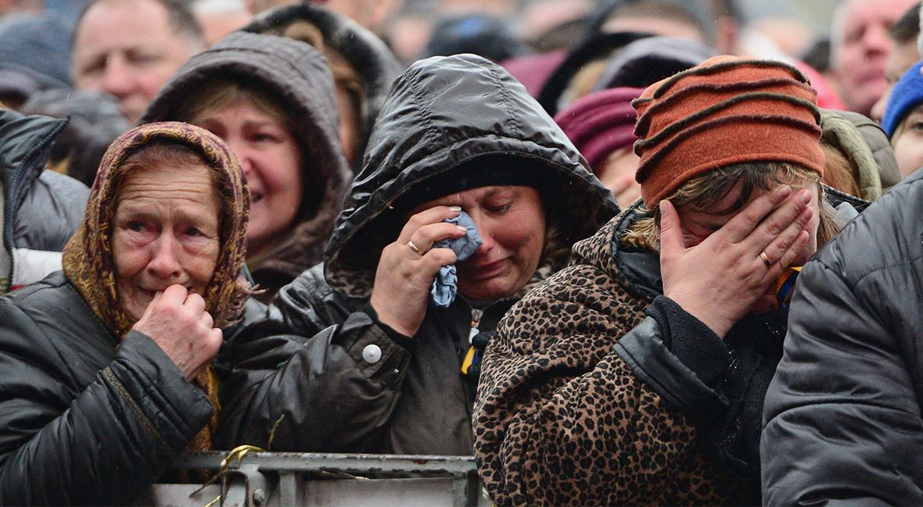
I Have Seen Your Tears
Isaiah 38:5 "Go and tell Hezekiah, 'Thus says the LORD, the God of David your father: "I have heard your prayer, I have seen your tears; surely I will add to your days fifteen years.

Slide 3
I Have Seen Your Tears

Slide 4
I Have Seen Your Tears
Jeremiah – The weeping prophet
Jeremiah 9:1 Oh, that my head were waters, And my eyes a fountain of tears, That I might weep day and night For the slain of the daughter of my people!
Jeremiah 9:18 Let them make haste And take up a wailing for us, That our eyes may run with tears, And our eyelids gush with water.
Jeremiah 31:16 Thus says the LORD: "Refrain your voice from weeping, And your eyes from tears; For your work shall be rewarded, says the LORD, And they shall come back from the land of the enemy.
17 There is hope in your future, says the LORD, That your children shall come back to their own border.

Slide 5
I Have Seen Your Tears
Jerusalem personified –
Lamentations 1:1 How lonely sits the city That was full of people! How like a widow is she, Who was great among the nations! The princess among the provinces Has become a slave!
2 She weeps bitterly in the night, Her tears are on her cheeks; Among all her lovers She has none to comfort her. All her friends have dealt treacherously with her; They have become her enemies.
3 Judah has gone into captivity, Under affliction and hard servitude; She dwells among the nations, She finds no rest; All her persecutors overtake her in dire straits.
4 The roads to Zion mourn Because no one comes to the set feasts. All her gates are desolate; Her priests sigh, Her virgins are afflicted, And she is in bitterness.
5 Her adversaries have become the master, Her enemies prosper; For the LORD has afflicted her Because of the multitude of her transgressions. Her children have gone into captivity before the enemy.

Slide 6
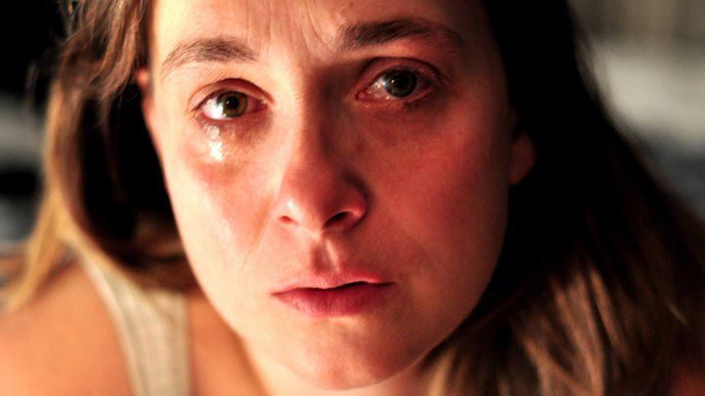

Slide 7
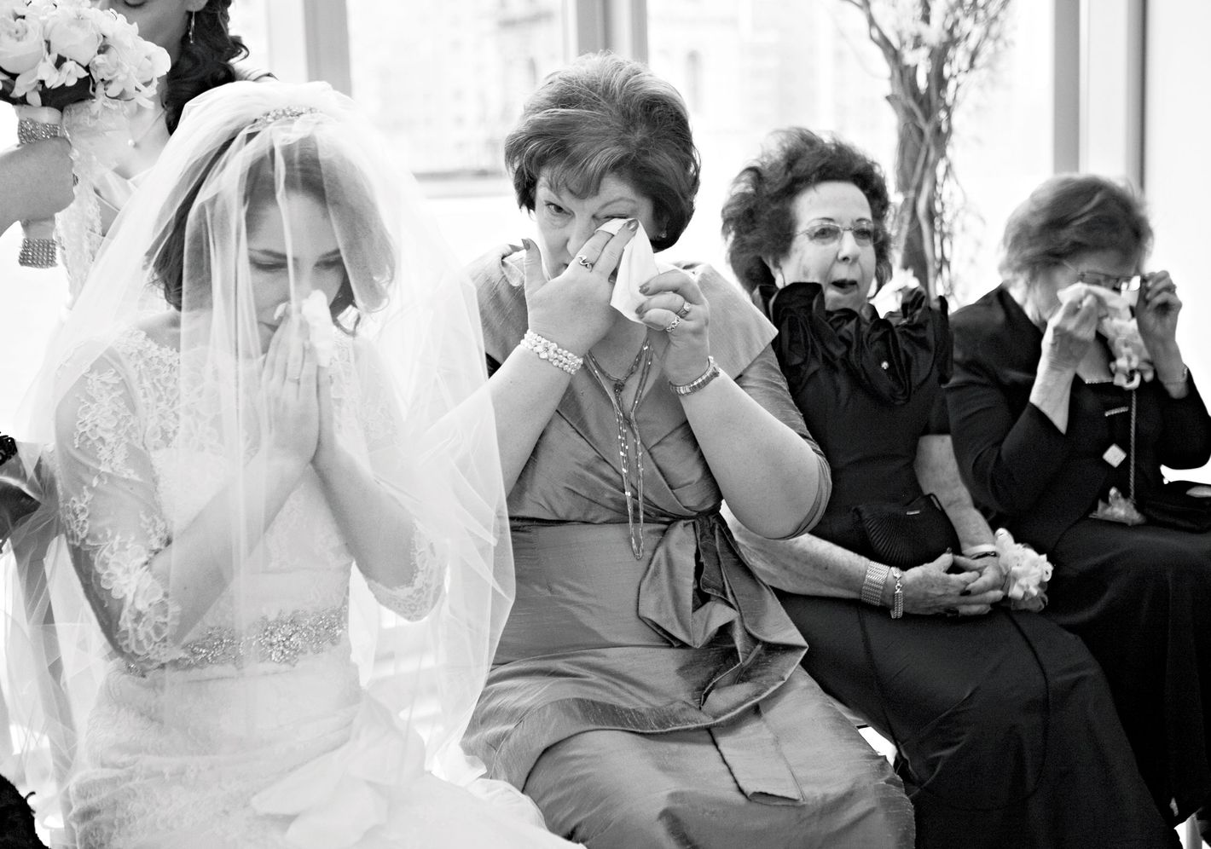

Slide 8


Slide 9
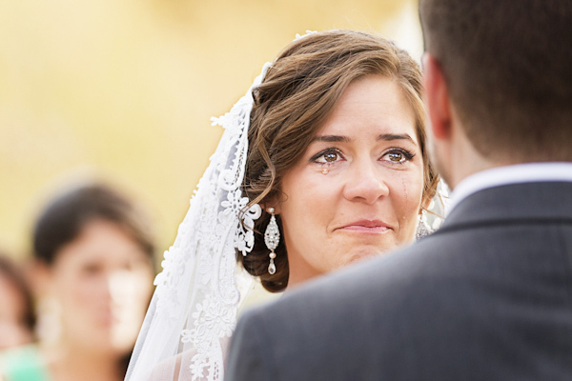

Slide 10
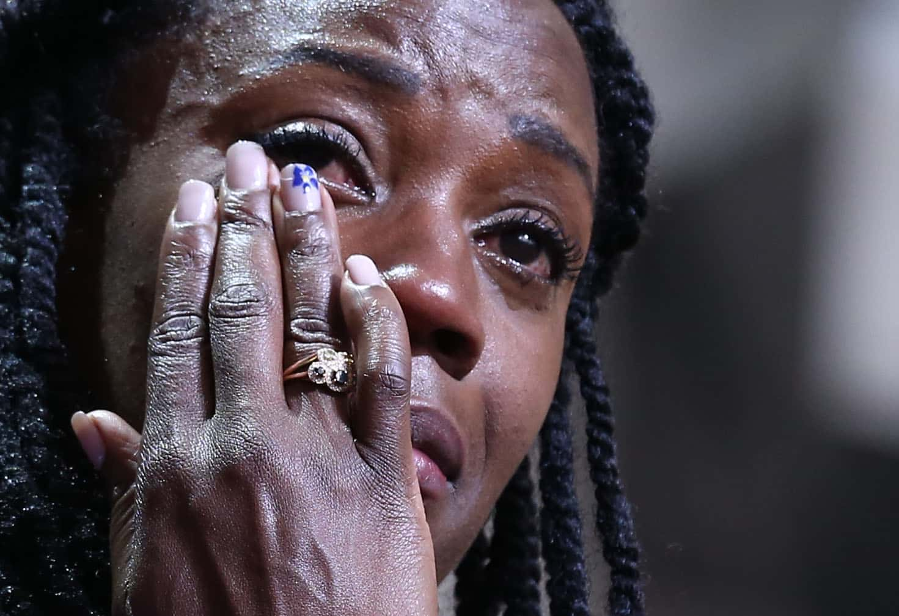

Slide 11
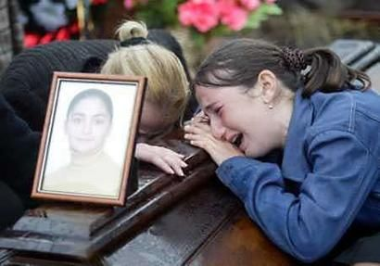

Slide 12


Slide 13
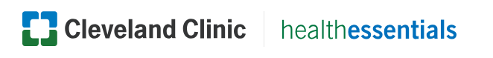
I Have Seen Your Tears
3. Psychic or emotional tears
These tears gush in response to strong emotions like sadness, grief, joy or rage. They have the same chemical makeup as basal tears, but contain more stress hormones and natural painkillers. Humans and animals have compounds in our body fluids that give off subtle messages to other members of the species. That’s why sometimes our tears can relay chemical messages (either intended or unintended) to someone close by. This can bring about empathy or compassion in other people, or signal them to stay away, for example.
According to the American Academy of
Ophthalmology emotional tears are triggered by empathy, compassionate and societal pain, physical pain, attachment-related pain, and sentimental or moral feelings. Some studies also suggest people are more likely to feel better after crying if they received social support while doing it.

Slide 14
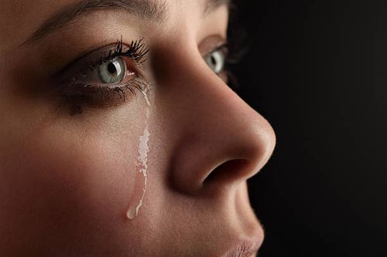
lonely
heartbroken
gloomy
disappointed
hopeless
grieved
unhappy
lost
troubled
resigned
miserable
worried
doubtful
nervous
anxious
terrified
panicked
horrified
desperate
confused
stressed

Slide 15
I Have Seen Your Tears
Romans 12:10 Be kindly affectionate to one another with brotherly love, in honor giving preference to one another;
11 not lagging in diligence, fervent in spirit, serving the Lord;
12 rejoicing in hope, patient in tribulation, continuing steadfastly in prayer;
13 distributing to the needs of the saints, given to hospitality.
14 Bless those who persecute you; bless and do not curse.
15 Rejoice with those who rejoice, and weep with those who weep.
16 Be of the same mind toward one another. Do not set your mind on high things, but associate with the humble. Do not be wise in your own opinion.

Slide 16
I Have Seen Your Tears
Tears move:
• The heart of God
• The heart of a sinner
• The heart in your own bosom
We have too much dry-eyed religion.
Notice some of the tears found in the Bible:

Slide 17
I Have Seen Your Tears
1. The Tears Of The Savior.
Jesus wept over Jerusalem—
Luke 19:41 Now as He drew near, He saw the city and wept over it, 42 saying, "If you had known, even you, especially in this your day, the things that make for your peace! But now they are hidden from your eyes.
43 "For days will come upon you when your enemies will build an embankment around you, surround you and close you in on every side, 44 "and level you, and your children within you, to the ground; and they will not leave in you one stone upon another, because you did not know the time of your visitation."
45 Then He went into the temple and began to drive out those who bought and sold in it, 46 saying to them, "It is written, 'My house is a house of prayer,' but you have made it a 'den of thieves.'"
47 And He was teaching daily in the temple. But the chief priests, the scribes, and the leaders of the people sought to destroy Him,
48 and were unable to do anything; for all the people were very attentive to hear Him.

Slide 18
I Have Seen Your Tears
1. The Tears Of The Savior.
Jesus wept at Lazarus’ grave—John 11:32 Then, when Mary came where Jesus was, and saw Him, she fell down at His feet, saying to Him, "Lord, if You had been here, my brother would not have died."
33 Therefore, when Jesus saw her weeping, and the Jews who came with her weeping, He groaned in the spirit and was troubled. 34 And He said, "Where have you laid him?" They said to Him, "Lord, come and see."
35 Jesus wept.
36 Then the Jews said, "See how He loved him!"

Slide 19
I Have Seen Your Tears
1. The Tears Of The Savior.
Jesus wept In the garden—
Heb 5:6 As He also says in another place: "You are a priest forever According to the order of Melchizedek";
7 who, in the days of His flesh, when He had offered up prayers and supplications, with vehement cries and tears to Him who was able to save Him from death, and was heard because of His godly fear,
8 though He was a Son, yet He learned obedience by the things which He suffered.

Slide 20
I Have Seen Your Tears
2. The Tears Of Joy.
Joseph wept over his brethren—
Genesis 45:8 "So now it was not you who sent me here, but God; and He has made me a father to Pharaoh, and lord of all his house, and a ruler throughout all the land of Egypt. 9 "Hurry and go up to my father, and say to him, 'Thus says your son Joseph: "God has made me lord of all Egypt; come down to me, do not tarry.
10 "You shall dwell in the land of Goshen, and you shall be near to me, you and your children, your children's children, your flocks and your herds, and all that you have. 11 "There I will provide for you, lest you and your household, and all that you have, come to poverty; for there are still five years of famine."'
12 "And behold, your eyes and the eyes of my brother Benjamin see that it is my mouth that speaks to you. 13 "So you shall tell my father of all my glory in Egypt, and of all that you have seen; and you shall hurry and bring my father down here."
14 Then he fell on his brother Benjamin's neck and wept, and Benjamin wept on his neck. 15 Moreover he kissed all his brothers and wept over them, and after that his brothers talked with him.

Slide 21
I Have Seen Your Tears
3. The Tears Of Gratitude.
A poor thankful woman wept upon Jesus’ feet—
Luke 7:36 Then one of the Pharisees asked Him to eat with him. And He went to the Pharisee's house, and sat down to eat.
37 And behold, a woman in the city who was a sinner, when she knew that Jesus sat at the table in the Pharisee's house, brought an alabaster flask of fragrant oil,
38 and stood at His feet behind Him weeping; and she began to wash His feet with her tears, and wiped them with the hair of her head; and she kissed His feet and anointed them with the fragrant oil.

Slide 22
I Have Seen Your Tears
4. The Tears Of Regret.
Heb 12:14 Pursue peace with all people, and holiness, without which no one will see the Lord:
15 looking carefully lest anyone fall short of the grace of God; lest any root of bitterness springing up cause trouble, and by this many become defiled;
16 lest there be any fornicator or profane person like Esau, who for one morsel of food sold his birthright.
17 For you know that afterward, when he wanted to inherit the blessing, he was rejected, for he found no place for repentance, though he sought it diligently with tears.

Slide 23
I Have Seen Your Tears
5. The Tears Of A Soul-Winner—Psalm 126:6
Psalm 126:5
Those who sow in tears Shall reap in joy.
6 He who continually goes forth weeping, Bearing seed for sowing, Shall doubtless come again with rejoicing, Bringing his sheaves with him.

Slide 24
I Have Seen Your Tears
6. The Tears Of A Back-Slider.
Psalm 137:1 By the rivers of Babylon, There we sat down, yea, we wept When we remembered Zion.
2 We hung our harps Upon the willows in the midst of it.
3 For there those who carried us away captive asked of us a song, And those who plundered us requested mirth, Saying, "Sing us one of the songs of Zion!"
4 How shall we sing the LORD'S song In a foreign land?

Slide 25
I Have Seen Your Tears
7. The Tears In Hell.
Luke 16:22 "So it was that the beggar died, and was carried by the angels to Abraham's bosom. The rich man also died and was buried.
23 "And being in torments in Hades, he lifted up his eyes and saw Abraham afar off, and Lazarus in his bosom.
24 "Then he cried and said, 'Father Abraham, have mercy on me, and send Lazarus that he may dip the tip of his finger in water and cool my tongue; for I am tormented in this flame.'

Slide 26
Acts 20:29 For I know this, that after my departing shall grievous wolves enter in among you, not sparing the flock.
30 Also of your own selves shall men arise, speaking perverse things, to draw away disciples after them.
31 Therefore watch, and remember, that by the space of three years I ceased not to warn every one night and day with tears.
2Cor. 2:4 For out of much affliction and anguish of heart I wrote unto you with many tears; not that ye should be grieved, but that ye might know the love which I have more abundantly unto you.
2Tim. 1:3 I thank God, whom I serve with a pure conscience, as my forefathers did, as without ceasing I remember you in my prayers night and day,
4 greatly desiring to see you, being mindful of your tears, that I may be filled with joy,

Slide 27
Rev. 7:17 "for the Lamb who is in the midst of the throne will shepherd them and lead them to living fountains of waters. And God will wipe away every tear from their eyes."
Rev. 21:4 "And God will wipe away every tear from their eyes; there shall be no more death, nor sorrow, nor crying. There shall be no more pain, for the former things have passed away."

Slide 28
1 No tears in heaven, no sorrows given,
All will be glory in that land;
There'll be no sadness, all will be gladness,
When we shall join that happy band.
Refrain:
No tears in heaven fair, no tears, no tears up there,
Sorrow and pain will have have flown;
No tear, in heaven fair, no tears, no tears up there,
No tears in heaven will be known.
2 Glory is waiting, waiting up yonder,
Where we shall spend an endless day;
There with our Savior, we'll be forever,
where no more sorrow can dismay. [Refrain]
3 Some morning yonder, we'll cease to ponder
O'er things this life has bro't to view;
All will be clearer, loved ones be dearer,
In heav'n where all will be made new. [Refrain]

Slide 29
God Has Seen Your Tears

