Slide 1
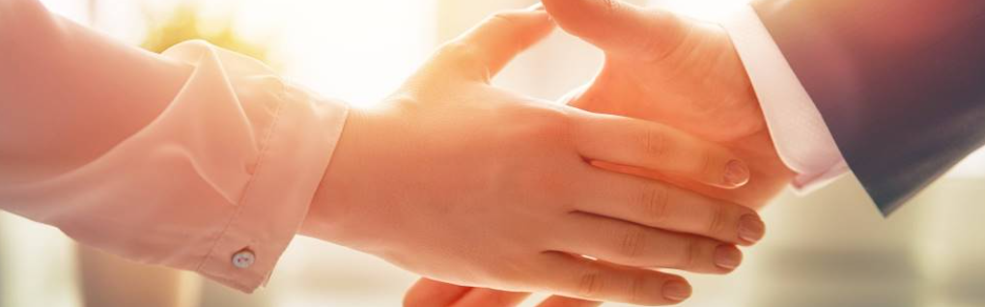
Welcome to our services
New Lebanon Church of Christ
We are Simply Christians.
Our Emphasis is Spiritual, Not Material or Social.
We are striving to be The Same Church as Described in The New Testament.
Please Come Back Again

Slide 2

Deut. 11:26 "Behold, I set before you today a blessing and a curse:
27 "the blessing, if you obey the commandments of the LORD your God which I command you today;
28 "and the curse, if you do not obey the commandments of the LORD your God, but turn aside from the way which I command you today, to go after other gods which you have not known.

Slide 3
Behold I Have Set Before You. Deut. 9-10-11
Moses shows the people of Israel of their utter unworthiness to receive from God those great favors that were now to be given to them. writing this, as it were, in capital letters at the head of their charter -
(Ezekiel 36:32 "Not for your sake do I do this," says the Lord GOD, "let it be known to you. Be ashamed and confounded for your own ways, O house of Israel!“)

Slide 4
Behold I Have Set Before You
Moses assures the Israelites of victory over their enemies,
Deut. 9:1 "Hear, O Israel: You are to cross over the Jordan today, and go in to dispossess nations greater and mightier than yourself, cities great and fortified up to heaven,
2 "a people great and tall, the descendants of the Anakim, whom you know, and of whom you heard it said, 'Who can stand before the descendants of Anak?'
3 "Therefore understand today that the LORD your God is He who goes over before you as a consuming fire. He will destroy them and bring them down before you; so you shall drive them out and destroy them quickly, as the LORD has said to you.

Slide 5
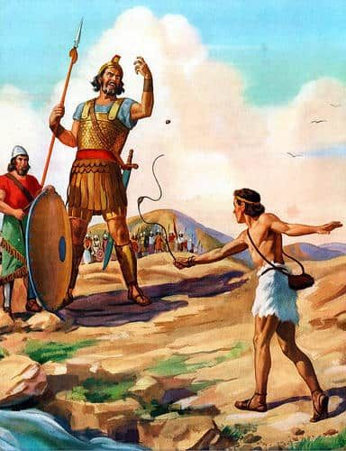
Behold I Have Set Before You
Moses represents to the people the strength of the enemies which they were now to encounter, Deut. 9:1. The nations they were to dispossess were mightier than themselves.
When they fight them, they will find their cities well fortified. If they fight them in the field, they would find the people great and tall, that no man could stand before.

Slide 6
Behold I Have Set Before You
Moses cautions them not to attribute their successes to their own merit, but to God's justice, which was against their enemies, and his faithfulness, which was toward their fathers, Deut. 9:4-6.
The Canaanites had become so wicked that God would no longer tolerate them.
When the Israelites become like the Canaanites – God will have them removed also.

Slide 7
Behold I Have Set Before You
Deut. 9:4 "Do not think in your heart, after the LORD your God has cast them out before you, saying, 'Because of my righteousness the LORD has brought me in to possess this land'; but it is because of the wickedness of these nations that the LORD is driving them out from before you.
5 "It is not because of your righteousness or the uprightness of your heart that you go in to possess their land, but because of the wickedness of these nations that the LORD your God drives them out from before you, and that He may fulfill the word which the LORD swore to your fathers, to Abraham, Isaac, and Jacob.
6 "Therefore understand that the LORD your God is not giving you this good land to possess because of your righteousness, for you are a stiff-necked people.

Slide 8
Behold I Have Set Before You
Moses explains to them the true reasons why God would take this good land out of the hands of the Canaanites, and give it to Israel,
God will be honored in the destruction of idolaters; they are justly looked upon as haters of him, and therefore he will visit their iniquity upon them. It is for the wickedness of these nations that God drives them out, Deut. 9:4-5. All those whom God rejects are rejected for their own wickedness.
None of those whom he accepts are accepted for their own righteousness.

Slide 9
Behold I Have Set Before You
The Canaanites –
“Their religion was polytheistic, with a strong emphasis on fertility rites. In the temples of the Canaanites, there were both male and female prostitutes (the qadesh and the qadeshah), and all sorts of sexual excesses were practiced. They thought these rites caused crops and herds to prosper. Asherah was the goddess consort of Baal, and she was the inspiration of every form of passion, whether in war or in love

Slide 10
Behold I Have Set Before You
Deut. 13:6 "If your brother, the son of your mother, your son or your daughter, the wife of your bosom, or your friend who is as your own soul, secretly entices you, saying, 'Let us go and serve other gods,' which you have not known, neither you nor your fathers,
7 "of the gods of the people which are all around you, near to you or far off from you, from one end of the earth to the other end of the earth,
8 "you shall not consent to him or listen to him, nor shall your eye pity him, nor shall you spare him or conceal him;
9 "but you shall surely kill him; your hand shall be first against him to put him to death, and afterward the hand of all the people.
10 "And you shall stone him with stones until he dies, because he sought to entice you away from the LORD your God, who brought you out of the land of Egypt, from the house of bondage.

Slide 11
Behold I Have Set Before You
To make it evident that they had no reason to boast of their own righteousness, he mentions their faults, shows Israel their transgressions, and their sins. In general, they had been all along a provoking people, Deut. 9:7-24. In particular,
1. The golden calf, Deut. 9:8-21.
2. He mentions other instances of their rebellion, Deut. 9:22-23. And,
3. Returns, at Deut. 9:25, to speak of the intercession he had made for them at Horeb, to prevent their being ruined for the golden calf.

Slide 12
Behold I Have Set Before You
Moses having, in the previous chapter, reminded them of their own sin, as a reason why they should not depend upon their own righteousness,
in this chapter he sets before them God's great mercy to them,
notwithstanding their provocations, as a reason why they should be more obedient for the future.

Slide 13
Behold I Have Set Before You
Deut. 10:12 "And now, Israel, what does the LORD your God require of you, but to fear the LORD your God, to walk in all His ways and to love Him, to serve the LORD your God with all your heart and with all your soul,
13 "and to keep the commandments of the LORD and His statutes which I command you today for your good?
14 "Indeed heaven and the highest heavens belong to the LORD your God, also the earth with all that is in it.
15 "The LORD delighted only in your fathers, to love them; and He chose their descendants after them, you above all peoples, as it is this day.
16 "Therefore circumcise the foreskin of your heart, and be stiff-necked no longer. >>>

Slide 14
Behold I Have Set Before You
Deut. 10:17 "For the LORD your God is God of gods and Lord of lords, the great God, mighty and awesome, who shows no partiality nor takes a bribe.
This verse is worth comparing with the N.T. texts which extol the Father of Lights, the Father of Mercies, the Everlasting Father, etc. as Blessed and Only Potentate, King of Kings, Lord of Lords, who Only Hath Immortality, and Lord of Lords and King of Kings (1 Tim. 6:15; Rev. 17:14; 19:16).
The characteristics added here, namely, that “He regards not persons, nor takes reward,” are merely another way of saying that “God is no respecter of persons,” and that no one can bribe God!

Slide 15
Behold I Have Set Before You
10:12 - what does the LORD your God require of you?
Micah 6:8 is an echo of this passage, indicating that Deuteronomy is far older than the minor prophets (848–844 B.C.), and at the time of their writing, already well known throughout Israel.
A lesson for today in this passage is that, “If God expected the kind of ultimate and total devotion enjoined here from those who had received physical deliverance only at God’s hands, what level of devotion should we return who have known and received the blessings of Christ’s atoning death, the promise of eternal life, etc.?

Slide 16
Behold I Have Set Before You
Moses argues the obligations they have to fear,
and love,
and serve God,
which he presses upon them with many motives,
Deut. 10:12-22.

Slide 17
Behold I Have Set Before You
There were four things by which God showed himself God to Israel
1. He gave them his law, gave it to them in writing, as a standing pledge of his favor.
2. He led them forward towards Canaan, though they in their hearts turned back towards Egypt, Deut. 10:6-7. He brought them to a land of rivers of waters, out of a dry and barren wilderness.

Slide 18
Behold I Have Set Before You
God appointed a standing ministry among them, to deal for them in holy things.
At that time when Moses went up a second time to the mount, or soon after, he had orders to separate the tribe of Levi to God, and to his immediate service, they having distinguished themselves by their zeal against the worshippers of the golden calf, Deut. 10:8-9.
The Kohathites carried the ark; they and the other Levites stood before the Lord, to minister to him in all the offices of the tabernacle; and the priests, who were of that tribe, were to bless the people.

Slide 19
Behold I Have Set Before You
God accepted Moses as an advocate or intercessor for them, and therefore made him their prince and leader (Deut. 10:10-11):
Deut. 10:10 "As at the first time, I stayed in the mountain forty days and forty nights; the LORD also heard me at that time, and the LORD chose not to destroy you.
11 "Then the LORD said to me, 'Arise, begin your journey before the people, that they may go in and possess the land which I swore to their fathers to give them.'

Slide 20
Behold I Have Set Before You
Deut. 11:1 "Therefore you shall love the LORD your God, and keep His charge, His statutes, His judgments, and His commandments always.
Deut. 11:2 "Know today that I do not speak with your children, who have not known and who have not seen the chastening of the LORD your God, His greatness and His mighty hand and His outstretched arm-
3 "His signs and His acts which He did in the midst of Egypt, to Pharaoh king of Egypt, and to all his land;
4 "what He did to the army of Egypt, to their horses and their chariots: how He made the waters of the Red Sea overflow them as they pursued you, and how the LORD has destroyed them to this day;
5 "what He did for you in the wilderness until you came to this place;
6 "and what He did to Dathan and Abiram the sons of Eliab, the son of Reuben: how the earth opened its mouth and swallowed them up, their households, their tents, and all the substance that was in their possession, in the midst of all Israel-
7 "but your eyes have seen every great act of the LORD which He did.

Slide 21
Behold I Have Set Before You
Moses sets before them, for the future, life and death, the blessing and the curse, according as they did, or did not, keep God's commandments, that they should certainly prosper if they were obedient, should be blessed with plenty of all good things (Deut. 11:8-15)
Deut. 11:8 "Therefore you shall keep every commandment which I command you today, that you may be strong, and go in and possess the land which you cross over to possess,
9 "and that you may prolong your days in the land which the LORD swore to give your fathers, to them and their descendants, 'a land flowing with milk and honey.'
10 "For the land which you go to possess is not like the land of Egypt from which you have come, where you sowed your seed and watered it by foot, as a vegetable garden; >>>

Slide 22
Behold I Have Set Before You
11 "but the land which you cross over to possess is a land of hills and valleys, which drinks water from the rain of heaven,
12 "a land for which the LORD your God cares; the eyes of the LORD your God are always on it, from the beginning of the year to the very end of the year.
13 'And it shall be that if you earnestly obey My commandments which I command you today, to love the LORD your God and serve Him with all your heart and with all your soul,
14 'then I will give you the rain for your land in its season, the early rain and the latter rain, that you may gather in your grain, your new wine, and your oil.
15 'And I will send grass in your fields for your livestock, that you may eat and be filled.'

Slide 23
Behold I Have Set Before You
He directs them what means to use that they might keep in mind the law of God, Deut. 11:18-21. And,
Deut. 11:18 "Therefore you shall lay up these words of mine in your heart and in your soul, and bind them as a sign on your hand, and they shall be as frontlets between your eyes.
19 "You shall teach them to your children, speaking of them when you sit in your house, when you walk by the way, when you lie down, and when you rise up.
20 "And you shall write them on the doorposts of your house and on your gates,
21 "that your days and the days of your children may be multiplied in the land of which the LORD swore to your fathers to give them, like the days of the heavens above the earth.

Slide 24
Behold I Have Set Before You
Concludes with solemnly charging them to choose which they would have, the blessing or the curse, Deut. 11:26-32.
Deut. 11:26 "Behold, I set before you today a blessing and a curse:
27 "the blessing, if you obey the commandments of the LORD your God which I command you today;
28 "and the curse, if you do not obey the commandments of the LORD your God, but turn aside from the way which I command you today, to go after other gods which you have not known.
29 "Now it shall be, when the LORD your God has brought you into the land which you go to possess, that you shall put the blessing on Mount Gerizim and the curse on Mount Ebal.
30 "Are they not on the other side of the Jordan, toward the setting sun, in the land of the Canaanites who dwell in the plain opposite Gilgal, beside the terebinth trees of Moreh?
31 "For you will cross over the Jordan and go in to possess the land which the LORD your God is giving you, and you will possess it and dwell in it.
32 "And you shall be careful to observe all the statutes and judgments which I set before you today.

Slide 25
Behold I Have Set Before You
Why can’t we learn this lesson that Israel stubbornly refused to learn, that faithful service of God will enable us to do things that appear totally impossible,
accomplish things that try even the imagination, conquer the unconquerable,
and to overcome difficulties that seem to be insurmountable?…

