Slide 1
Welcome to our services
New Lebanon Church of Christ
We are Simply Christians.
Our Emphasis is Spiritual, Not Material or Social.
We are striving to be The Same Church as Described in The New Testament.
Please Come Back Again

Slide 2
When I’ve Gone The Last Mile Of The Way
1 If I walk in the pathway of duty,
If I work till the close of the day,
I shall see the great King in His beauty
When I've gone the last mile of the way.
When I've gone the last mile of the way,
I will rest at the close of the day,
And I know there are joys that await me
When I've gone the last mile of the way.
2 If for Christ I proclaim the glad story,
If I seek for His sheep gone astray,
I am sure He will show me His glory
When I've gone the last mile of the way.

Slide 3
When I’ve Gone The Last Mile Of The Way
3 Here the dearest of ties we must sever,
Tears of sorrow are seen ev'ry day,
But no sickness, no sighing forever
When I've gone the last mile of the way.
4 And if here I have earnestly striven,
And have tried all His will to obey,
'Twill enhance all the rapture of heaven
When I've gone the last mile of the way.
When I've gone the last mile of the way,
I will rest at the close of the day,
And I know there are joys that await me
When I've gone the last mile of the way.

Slide 4
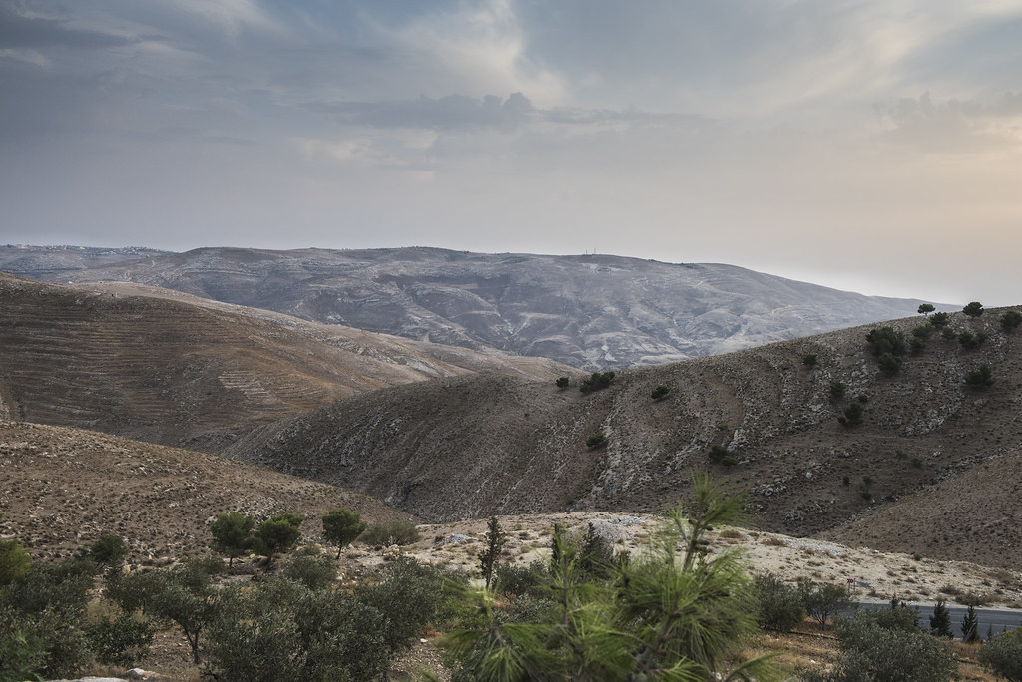
When I’ve Gone The Last Mile Of The Way
Deuteronomy 34

Slide 5
When I’ve Gone The Last Mile Of The Way
Moses was 120 years old when he died. His life was divided in 3 forty year spans.
First forty years spent in a palace (had all Devil had to offer).
Second forty years spent on backside of desert. (out of circulation).
Third forty years spent in the wilderness (learning to look up).

Slide 6
When I’ve Gone The Last Mile Of The Way
When Moses stood on the top of Pisgah it was not as “a trembling candidate for God’s compassion,” but as a servant who had found great favor with Him, as one whose work was finished before his strength and vigor were exhausted.
Like the law which he represented, he was set aside before his natural force was abated. There are some things about this unique departure of Moses that suggest characteristics which belong to the death of every saint. It was—

Slide 7
When I’ve Gone The Last Mile Of The Way
1. Revelation v. 1–3
Deut. 34:1 Then Moses went up from the plains of Moab to Mount Nebo, to the top of Pisgah, which is across from Jericho. And the LORD showed him all the land of Gilead as far as Dan,
2 all Naphtali and the land of Ephraim and Manasseh, all the land of Judah as far as the Western Sea,
3 the South, and the plain of the Valley of Jericho, the city of palm trees, as far as Zoar.

Slide 8
When I’ve Gone The Last Mile Of The Way
Going Up. - “And Moses went up to the top of Pisgah” (v. 1). Going up to die. What a thought! Mounting up in spirit to the gate of Heaven that we might depart and be with Christ. “Like Enoch, he was not, for God took him.” In dying the body departs to the earth, but the spirit, up to God, who made it and saved it. Those who live on the hill top of communion with the Father have not far to go when the home-call comes.
Lonely.- Moses was alone with God on the mount (v. 6). With regard to the friendships of earth, every man is alone when he meets God. - But the dying servant of God does not feel any loss at the absence of friends by his side. He was so filled with the glory of His presence that he forget the things which are behind. Alone, but without any feeling of loneliness. At home with God.

Slide 9
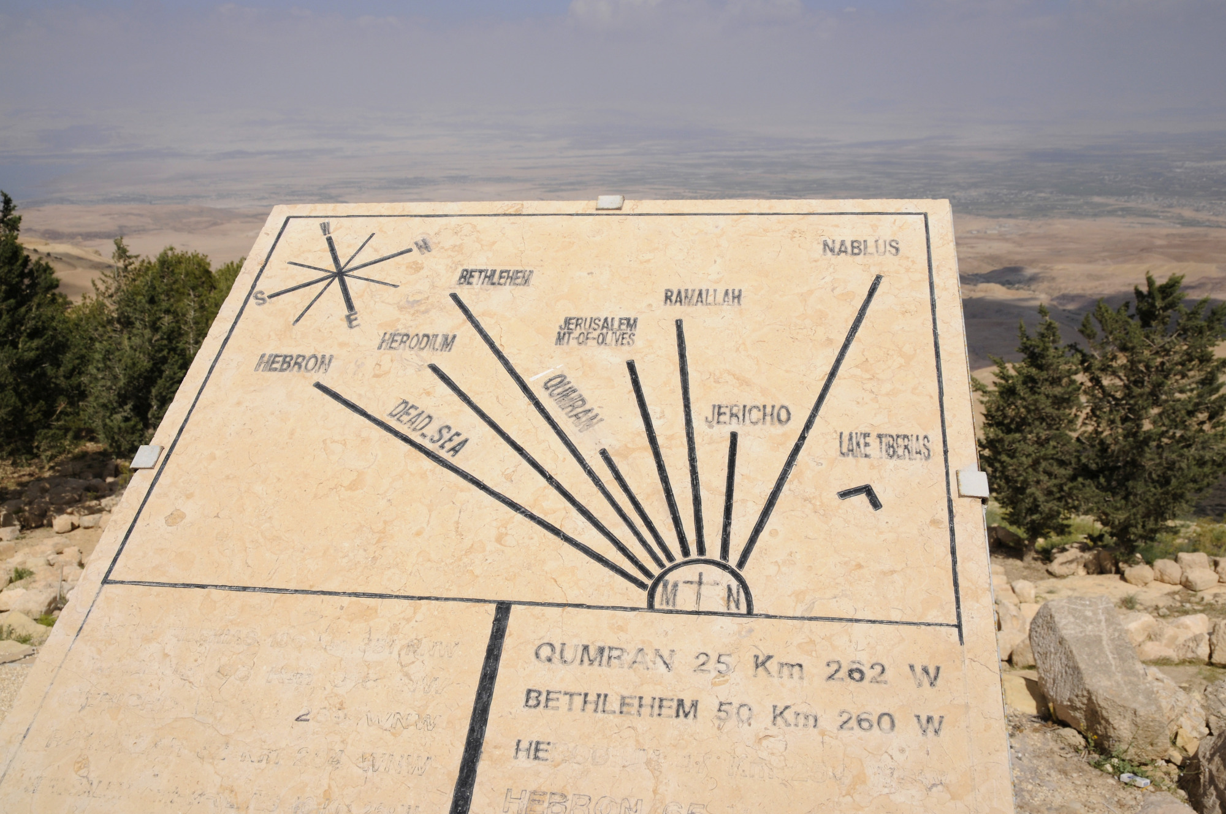
When I’ve Gone The Last Mile Of The Way
Full of a Satisfying Vision. - “The Lord showed him all the land” (v. 1). This vision of the land of promise had been before him for many years, but now the Lord caused him to see it (v. 4).

Slide 10
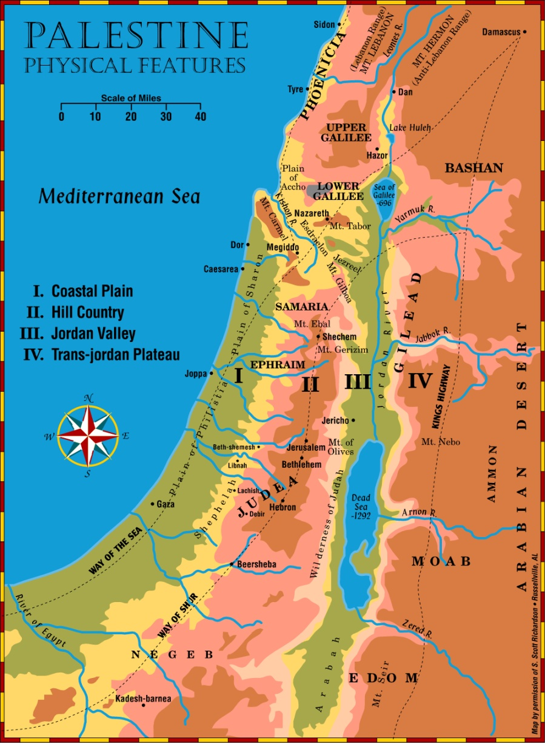
When I’ve Gone The Last Mile Of The Way
Deut. 34:1 Then Moses went up from the plains of Moab to Mount Nebo, (to the top of Pisgah), which is across from Jericho.
And the LORD showed him all the land of Gilead as far as Dan,
2 all Naphtali and the land of Ephraim and Manasseh, all the land of Judah as far as the Western Sea,
3 the South, and the plain of the Valley of Jericho, the city of palm trees, as far as Zoar.

Slide 11
When I’ve Gone The Last Mile Of The Way
1. Revelation v. 1–3
He saw preview of the promised land (went up to meet death unafraid).
Other dying saints have also had the curtain pulled back, veil of eternity (Steven and Paul).
Moses saw:
A land of rest after wandering 40 years.
A land of plenty flowing with milk and honey.
A land of victory.

Slide 12
When I’ve Gone The Last Mile Of The Way
2. Regret v. 4
Deut. 34:4 Then the LORD said to him, "This is the land of which I swore to give Abraham, Isaac, and Jacob, saying, 'I will give it to your descendants.' I have caused you to see it with your eyes, but you shall not cross over there."

Slide 13
When I’ve Gone The Last Mile Of The Way
2. Regrets v. 4
The Lord said, “But thou shalt not go over.”
He missed the only thing he had looked forward to.
His regrets:
Killing the Egyptian.
Marrying the Ethiopian.
Smiting the rock.
Four saddest words. “It might have been.”

Slide 14
When I’ve Gone The Last Mile Of The Way
3. Reckoning Hand Of God v. 5–7
Deut. 34:5 So Moses the servant of the LORD died there in the land of Moab, according to the word of the LORD.
6 And He buried him in a valley in the land of Moab, opposite Beth Peor; but no one knows his grave to this day.
7 Moses was one hundred and twenty years old when he died. His eyes were not dim nor his natural vigor diminished.

Slide 15
When I’ve Gone The Last Mile Of The Way
4. Remorse v. 8
Deut. 34:8 And the children of Israel wept for Moses in the plains of Moab thirty days. So the days of weeping and mourning for Moses ended.

Slide 16
When I’ve Gone The Last Mile Of The Way
4. Remorse v. 8
Israel wept 30 days. While he lived they murmured against him.
Their conscience hurt.

Slide 17
When I’ve Gone The Last Mile Of The Way
4. Remorse v. 8
Ex. 15:24 And the people murmured against Moses, saying, What shall we drink?
Ex. 16:2 And the whole congregation of the children of Israel murmured against Moses and Aaron in the wilderness:
Ex. 17:3 And the people thirsted there for water; and the people murmured against Moses, and said, Wherefore is this that thou hast brought us up out of Egypt, to kill us and our children and our cattle with thirst?
Num. 14:2 And all the children of Israel murmured against Moses and against Aaron: and the whole congregation said unto them, Would God that we had died in the land of Egypt! or would God we had died in this wilderness!
Num. 16:41 But on the morrow all the congregation of the children of Israel murmured against Moses and against Aaron, saying, Ye have killed the people of the LORD.

Slide 18
When I’ve Gone The Last Mile Of The Way
5. Replacement v. 9
Deut. 34:9 Now Joshua the son of Nun was full of the spirit of wisdom, for Moses had laid his hands on him; so the children of Israel heeded him, and did as the LORD had commanded Moses.

Slide 19
When I’ve Gone The Last Mile Of The Way
5. Replacement v. 9
Moses had laid his hand on Joshua, the son of Nun.
No man is irreplaceable. God always raises up a man.

Slide 20
When I’ve Gone The Last Mile Of The Way
6. Remembrance v. 10–12
Deut. 34:10 But since then there has not arisen in Israel a prophet like Moses, whom the LORD knew face to face,
11 in all the signs and wonders which the LORD sent him to do in the land of Egypt, before Pharaoh, before all his servants, and in all his land,
12 and by all that mighty power and all the great terror which Moses performed in the sight of all Israel.

Slide 21
When I’ve Gone The Last Mile Of The Way
6. Remembrance v. 10–12
“Remembered the terror of the Lord” (at the hand of Moses) God showed terror at the hand of Moses crossing the Red Sea.
(Pharaoh who go and show thy face no more.) “And there was not a prophet like Moses in the land of Israel.”

Slide 22
When I’ve Gone The Last Mile Of The Way
6. Remembrance v. 10–12
What will be said about you when You die?
How will you be remembered?

Slide 23
When I’ve Gone The Last Mile Of The Way
6. Remembrance v. 10–12
“In the acceptance of Joshua, the people needed to understand that Joshua was not Moses’ equal. God spoke to Moses face to face, but Joshua needed to find the divine will through priestly mediation.”
Later on when Joshua neglected to consult through proper channels the will of God, in the case of the Gibeonites, a very costly error resulted.

Slide 24
When I’ve Gone The Last Mile Of The Way
6. Remembrance v. 10–12
“A prophet … like unto Moses …” There was never but One, in all human history who was indeed a prophet like unto Moses in several ways-
(1) in the mighty signs and wonders;
(2) in his being the mediator of a Covenant;
(3) who knew directly from God what was indeed the divine will; and
(4) who actually led the people out of bondage.

Slide 25
When I’ve Gone The Last Mile Of The Way
6. Remembrance v. 10–12
“There is but One who is worthy of greater honor than Moses, namely, the Apostle and High Priest of our profession, who is placed as a Son over all the House of God, in which Moses was found a faithful servant (See Heb. 3:2–6, and Num. 12:7). He is Jesus Christ, the founder and mediator of the new and everlasting Covenant.
.

Slide 26
When I’ve Gone The Last Mile Of The Way
6. Remembrance v. 10–12
Heb 3:2 who was faithful to Him who appointed Him, as Moses also was faithful in all His house. 3 For this One has been counted worthy of more glory than Moses, inasmuch as He who built the house has more honor than the house.4 For every house is built by someone, but He who built all things is God.
5 And Moses indeed was faithful in all His house as a servant, for a testimony of those things which would be spoken afterward,6 but Christ as a Son over His own house, whose house we are if we hold fast the confidence and the rejoicing of the hope firm to the end.
Num. 12:7 Not so with My servant Moses; He is faithful in all My house.

Slide 27
Are You A New Testament Christian?
Hear the Gospel (Rom.10:14).
Believe the Gospel (Heb. 11:6).
Repent of Sins (Acts 3:19).
Confess Christ (Rom.10:9).
Be Baptized Into Christ (1 Cor.12:13).
1 Timothy 4:16
“Take heed unto thyself, and unto the doctrine; continue in them: for in doing this thou shalt both save thyself, and them that hear thee.”

