Slide 1
Welcome to our services
New Lebanon Church of Christ
We are Simply Christians.
Our Emphasis is Spiritual, Not Material or Social.
We are striving to be The Same Church as Described in The New Testament.
Please Come Back Again

Slide 2
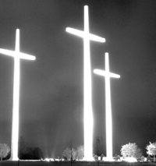
Three Wooden Crosses
This Photo by Unknown Author is licensed under CC BY-SA-NC

Slide 3
Three Wooden Crosses - Song
Song by Randy Travis
Song is about a story of four individuals that are in a wreck with only one survivor—a prostitute
The preacher in the song happens to be the son of the survivor in the car crash

Slide 4
The Ninevites – Jonah’s Time
Jonah 1:1-3
Jonah 3:1-10
This Photo by Unknown Author is licensed under CC BY-SA-NC

Slide 5
Rahab
Joshua 2:1-7
Matthew 1:5
Hebrews 11:30-31

Slide 6
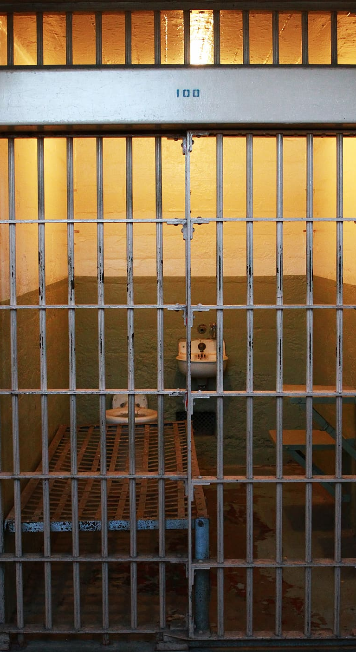
The Philippian Jailer
Acts 16:16-24
Acts 16:25-34

Slide 7
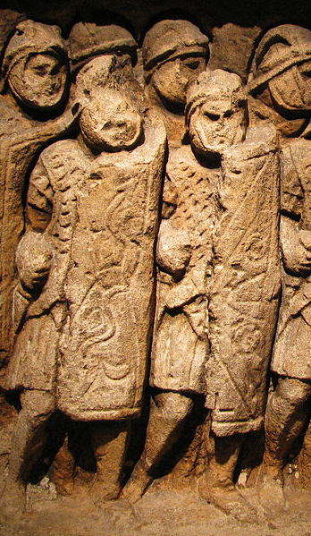
Paul
Acts 8:1-3
Acts 9:1-7, 17-19
Acts 9:26
This Photo by Unknown Author is licensed under CC BY-SA

