Slide 1
Welcome to our services
New Lebanon Church of Christ
We are Simply Christians.
Our Emphasis is Spiritual, Not Material or Social.
We are striving to be The Same Church as Described in The New Testament.
Please Come Back Again

Slide 2
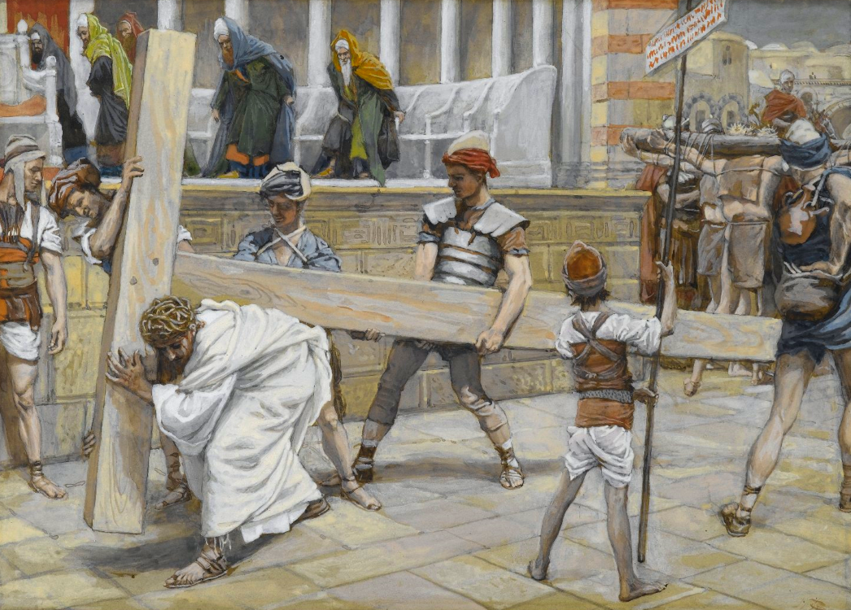
The Old Rugged Cross
1Cor. 1:18 For the message of the cross is foolishness to those who are perishing, but to us who are being saved it is the power of God.
Gal. 6:14 But God forbid that I should boast except in the cross of our Lord Jesus Christ,
Phil. 3:18 For many walk, of whom I have told you often, and now tell you even weeping, that they are the enemies of the cross of Christ:

Slide 3
They took Jesus, therefore, and He went out, bearing the cross for Himself John 19:17
The Old Rugged Cross. John 19
Jesus Bearing the Cross, by James Tissot, circa 1890
Notes:
This image is in the public domain, via the Brooklyn Museum: https://www.brooklynmuseum.org/opencollection/objects/4577.
bm4577

Slide 4
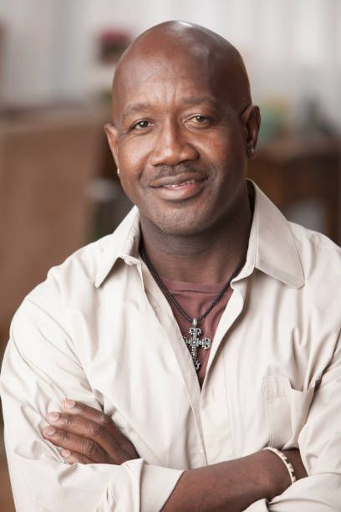
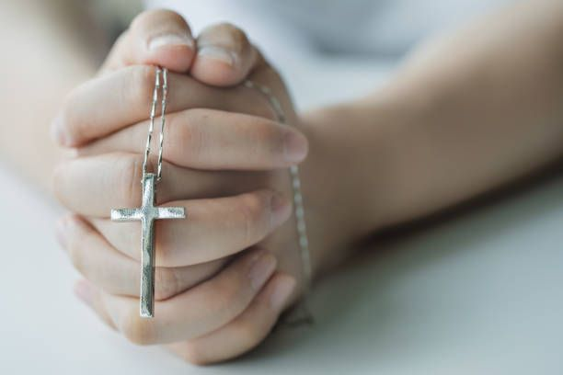

Slide 5
The Old Rugged Cross. John 19
John 19:17 And He, bearing His cross, went out to a place called the Place of a Skull, which is called in Hebrew, Golgotha,
18 where they crucified Him, and two others with Him, one on either side, and Jesus in the center.
19 Now Pilate wrote a title and put it on the cross. And the writing was: JESUS OF NAZARETH, THE KING OF THE JEWS.
20 Then many of the Jews read this title, for the place where Jesus was crucified was near the city; and it was written in Hebrew, Greek, and Latin.
21 Therefore the chief priests of the Jews said to Pilate, "Do not write, 'The King of the Jews,' but, 'He said, "I am the King of the Jews."'"

Slide 6
The Old Rugged Cross. John 19
The roads to the city were filled with thousands traveling to the Holy City for Passover; and it must have been a matter of widespread interest when the entire city was filled with conversation about the “King of the Jews” being crucified just outside the city.
22 Pilate answered, "What I have written, I have written."
Intended by Pilate as a joke and as a final slap in the face of the priests, the inscription was nevertheless the truth of God!

Slide 7
The Old Rugged Cross. John 19
23 Then the soldiers, when they had crucified Jesus, took His garments and made four parts, to each soldier a part, and also the tunic. Now the tunic was without seam, woven from the top in one piece.
24 They said therefore among themselves, "Let us not tear it, but cast lots for it, whose it shall be," that the Scripture might be fulfilled which says: "They divided My garments among them, And for My clothing they cast lots." Therefore the soldiers did these things.
(They did not wait for Jesus to die but went about, dividing up his clothes as if he were already dead.)

Slide 8
The Old Rugged Cross. John 19
25 Now there stood by the cross of Jesus His mother, and His mother's sister, Mary the wife of Clopas, and Mary Magdalene.
26 When Jesus therefore saw His mother, and the disciple whom He loved standing by, He said to His mother, "Woman, behold your son!“
27 Then He said to the disciple, "Behold your mother!" And from that hour that disciple took her to his own home.

Slide 9
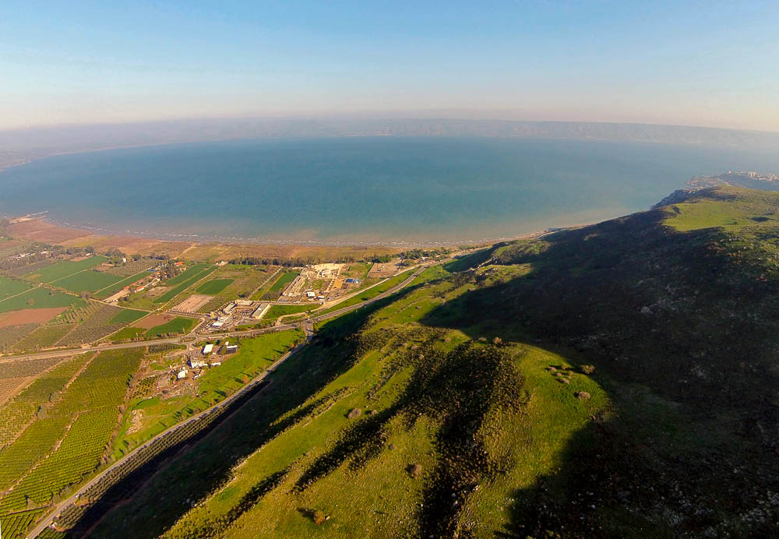
Standing by the cross of Jesus were . . . Mary the wife of Clopas, and Mary Magdalene
Magdala (aerial view from the west)
19:25
Notes:
A “Magdalene” is someone from Magdala. The town of Magdala, on the northwest shore of the Sea of Galilee, is visible in this photo.
ws011315176

Slide 10
The Old Rugged Cross. John 19
28 After this, Jesus, knowing that all things were now accomplished, that the Scripture might be fulfilled, said, "I thirst!"
29 Now a vessel full of sour wine was sitting there; and they filled a sponge with sour wine, put it on hyssop, and put it to His mouth.
30 So when Jesus had received the sour wine, He said, "It is finished!" And bowing His head, He gave up His spirit.

Slide 11
The Old Rugged Cross. John 19
31 Therefore, because it was the Preparation Day, that the bodies should not remain on the cross on the Sabbath (for that Sabbath was a high day), the Jews asked Pilate that their legs might be broken, and that they might be taken away.
32 Then the soldiers came and broke the legs of the first and of the other who was crucified with Him.
33 But when they came to Jesus and saw that He was already dead, they did not break His legs.
34 But one of the soldiers pierced His side with a spear, and immediately blood and water came out.
35 And he who has seen has testified, and his testimony is true; and he knows that he is telling the truth, so that you may believe.

Slide 12
The Old Rugged Cross. John 19
Christ was the great antitype of the paschal lamb, fulfilling the type in every conceivable manner. He died at the very moment the lambs were being slain for the Passover; and no bone of him was broken, despite the governor’s specific orders, which were disobeyed. His innocence, submissiveness, and vicarious suffering also fulfilled the type.
John 19:32 The soldiers therefore came, and broke the legs of the first, and of the other that was crucified with him: but when they came to Jesus, and saw that he was dead already, they broke not his legs: howbeit one of the soldiers with a spear pierced his side, and straightway there came out blood and water.

Slide 13
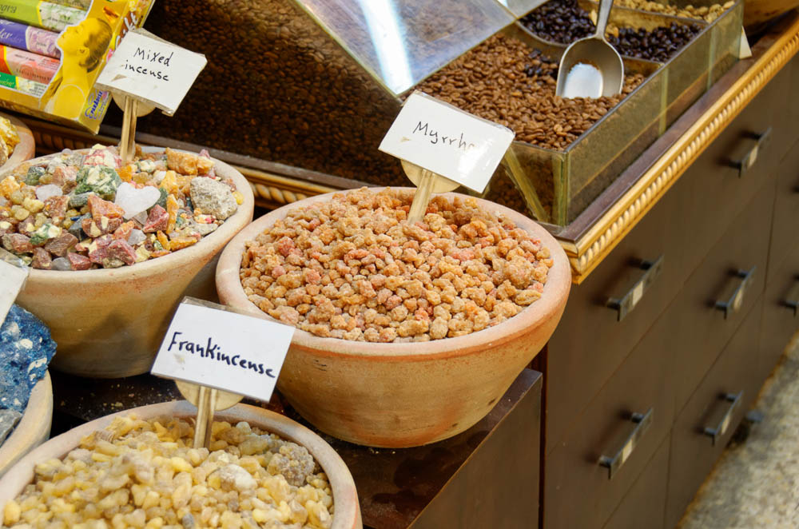
The Old Rugged Cross. John 19
36 These things were done that the Scripture should be fulfilled, "Not one of His bones shall be broken."
37 And again another Scripture says, "They shall look on Him whom they pierced."
38 After this, Joseph of Arimathea, being a disciple of Jesus, but secretly, for fear of the Jews, asked Pilate that he might take away the body of Jesus; and Pilate gave him permission. So he came and took the body of Jesus.

Slide 14
The Old Rugged Cross. John 19
39 And Nicodemus, who at first came to Jesus by night, also came, bringing a mixture of myrrh and aloes, about a hundred pounds.
40 Then they took the body of Jesus, and bound it in strips of linen with the spices, as the custom of the Jews is to bury.
41 Now in the place where He was crucified there was a garden, and in the garden a new tomb in which no one had yet been laid.
42 So there they laid Jesus, because of the Jews' Preparation Day, for the tomb was nearby.
Observe the record of all four Gospels: Joseph took the body, and wrapped it in a clean linen cloth (Matt. 27:59). Joseph bought a linen cloth, and taking him down, wound him in the linen cloth (Mark 15:46). Joseph took the body down and wrapped it in a linen cloth (Luke 23:53). Joseph and Nicodemus took the body of Jesus and bound it in linen cloths with the spices (John 19:40).

Slide 15
The Old Rugged Cross. John 19
All four Gospels specifically mention Golgotha. Matt. 27:33, Mark 15:22, Luke 23:33, and John 19:17 tell of Jesus being led away to “The Place of the Skull” or “The Skull” after Pilate handed Him over to be crucified.
Heb.13:12–13 supports the Gospel implications that Golgotha was outside the city during Jesus’ time.
John also indicates that there was a garden at the site of Golgotha, and Jesus was buried within a new tomb in this garden.
Beyond these short passages, there is no other biblical evidence pointing to Golgotha’s location. It has been a point of debate for many centuries.
“The site may have been called Golgotha because it was a common place of execution. If so, people may have used the title of Golgotha or “Skull” symbolically to represent death, or because actual skulls were present. Alternatively, it may have been named for its shape.

Slide 16
The Old Rugged Cross. John 19
It should be stated, contrary to popular hymns, that the Gospels never state that Jesus was crucified on a hill. The reason why the location was called “The Place of the Skull” is not known.
(…on a hill, far away)

Slide 17
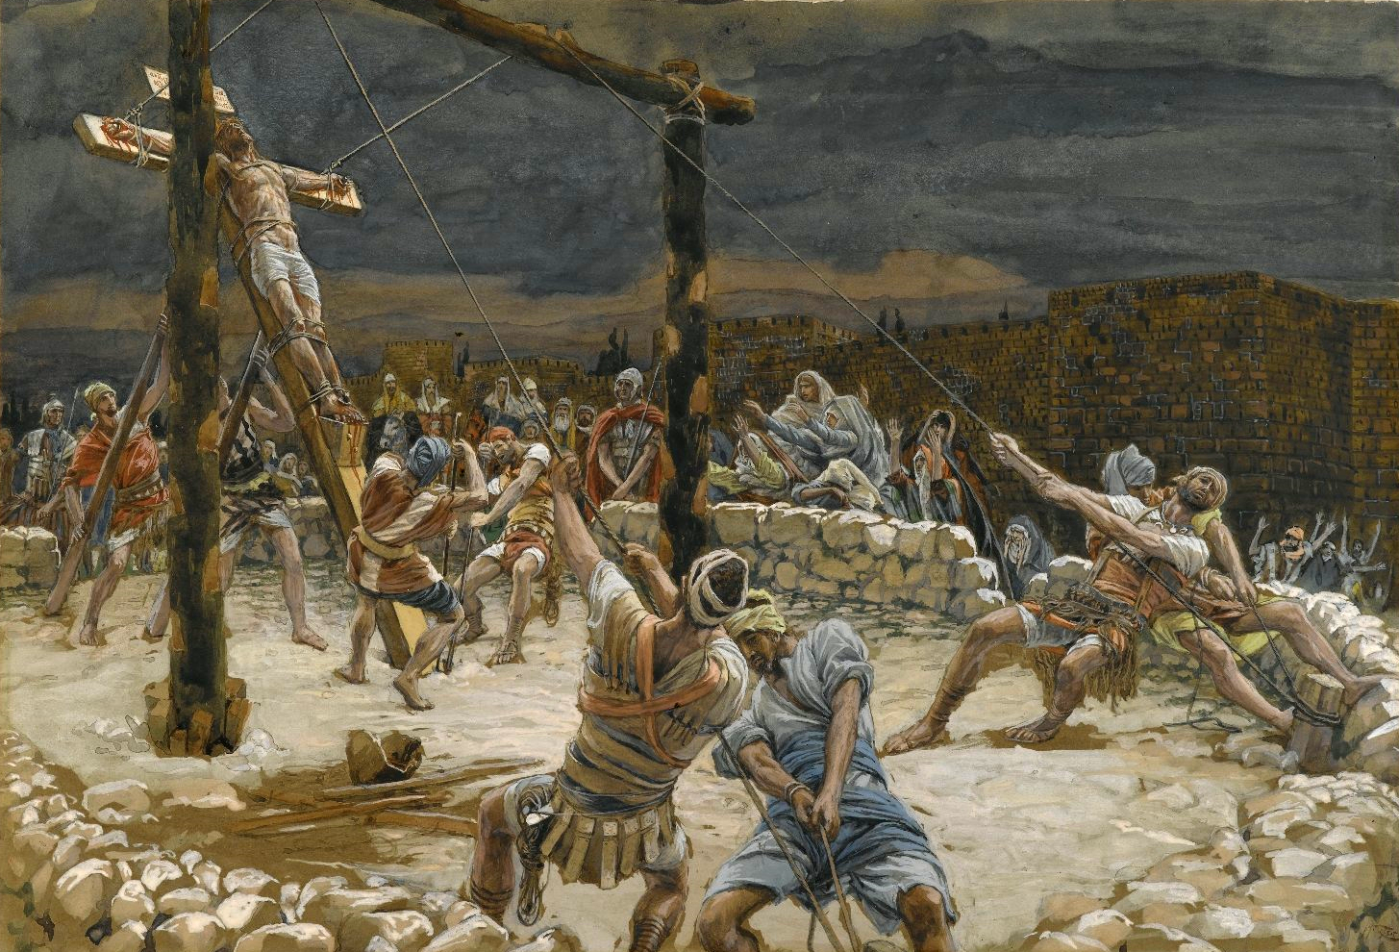
Where they crucified Him, and with Him two others
The Raising of the Cross, by James Tissot, circa 1890
19:18
Notes:
This painting by James Tissot was executed using opaque watercolor over graphite on gray wove paper. This image is in the public domain, via the Brooklyn Museum: https://www.brooklynmuseum.org/opencollection/objects/4587.
bmny001592944587

Slide 18
The Old Rugged Cross. John 19
1. Bearing The Cross (v. 17–18)
Jesus was compelled to carry the cross as was customary for a criminal. Simon the Cyrenian is reported in the Gospels as a conscript who was made to share the cross with Jesus.

Slide 19
The Old Rugged Cross. John 19
2. On The Cross (v. 19–22)
The title was required by Roman law so that all might read the charge of the crime. What he wrote, Pilate did not erase. His witness stands. How solemn that all we write abides in its finality. Thus the Lord was “lifted up” (John 12:32) and began to draw men without distinction. He reigns from the tree.

Slide 20
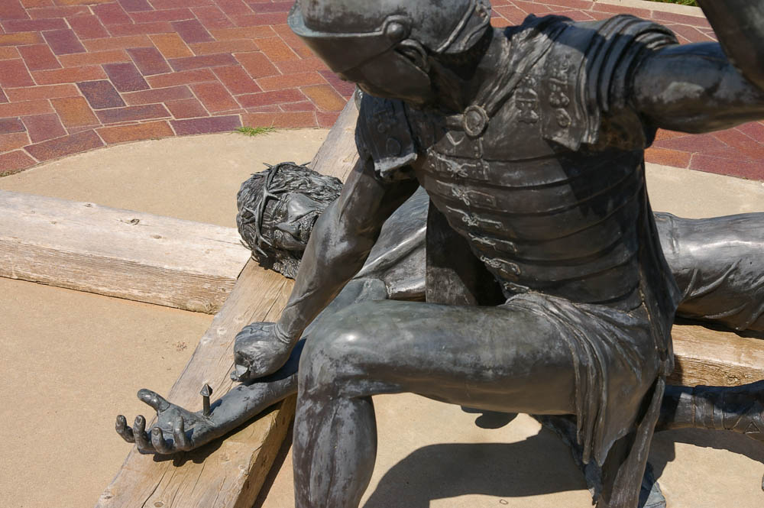
Then the soldiers, when they had crucified Jesus . . .
Sculpture of Jesus being nailed to the cross
19:23
Notes:
This sculpture is part of the display at the Cross of Our Lord Jesus Christ in Groom, Texas.
adr1006307704

Slide 21
The Old Rugged Cross. John 19
3. Beneath The Cross (John 19 v. 23–24)
The soldiers took Jesus’ clothes, they tossed the dice for greed of gain when the Son of God laid down His life.
Song – Beneath The Cross Of Jesus

Slide 22
The Old Rugged Cross. John 19
4. By The Cross (John 19 v. 25–27)
In contrast to wicked men, the loved ones of Jesus expressed their devotion by standing by. Their faith and love stand out in contrast to others who have followed afar off.
What an embarrassing situation! Crucifixion was naked and shameful. There were four women present.

Slide 23
The Old Rugged Cross. John 19
5. Above The Cross (v. 28–30).
Another cry from Jesus indicates that the end is drawing near. The sorrows of the Crucified will soon be ended in His victory and triumph.
He cries out in triumph.

Slide 24
The Old Rugged Cross. John 19
6. Down From The Cross (v. 31–42)
The body of Jesus is taken down and given a burial. Those who attended the spectacle made choice of the Crucified in their acceptance or rejection of Him. Sinful men rejected, while men of faith accepted.
Actions speak louder than words. Joseph and Nicodemus with the women and a few disciples are given honor because of their devotion.

Slide 25
The Old Rugged Cross. John 19
7. Beyond The Cross (chaps. 20–21)
After He had won His victory, now He is the Christ beyond the cross. We see not a dead Christ on a cross, but we worship a living Lord.
When I Survey The Wondrous Cross

Slide 27
Are You A New Testament Christian?
Hear the Gospel (Rom.10:14).
Believe the Gospel (Heb. 11:6).
Repent of Sins (Acts 3:19).
Confess Christ (Rom.10:9).
Be Baptized Into Christ (1 Cor.12:13).
1 Timothy 4:16
“Take heed unto thyself, and unto the doctrine; continue in them: for in doing this thou shalt both save thyself, and them that hear thee.”

