Slide 1
Welcome to our services
New Lebanon Church of Christ
We are Simply Christians.
Our Emphasis is Spiritual, Not Material or Social.
We are striving to be The Same Church as Described in The New Testament.
Please Come Back Again

Slide 2
The Man Who Got In Trouble By Staying Home
There may be times when one should be at home, but when the time comes to go out for the Lord, to stay at home will always bring sorrow and punishment.

Slide 3
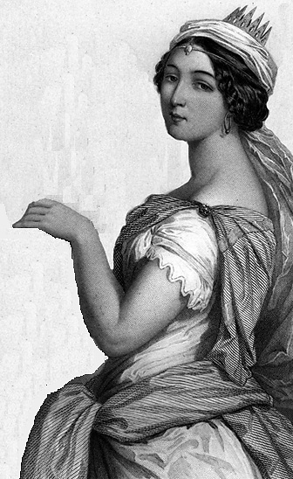
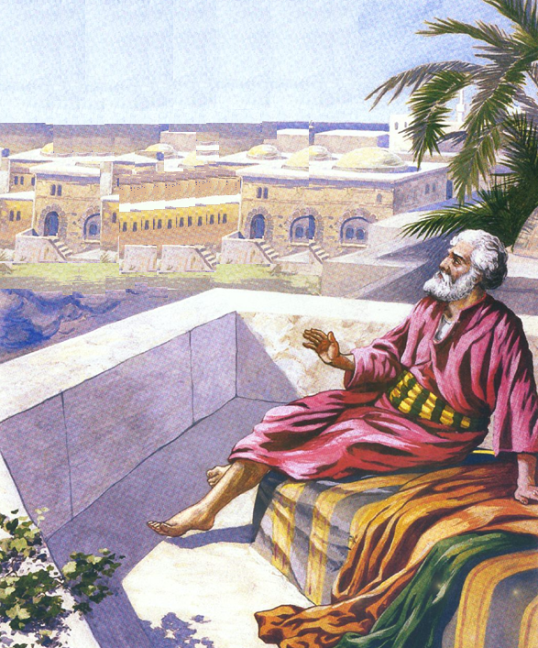
2 Samuel 11
“¹And it came to pass, after the year was expired, at the time when kings go forth to battle, that David sent Joab, and his servants with him, and all Israel; and they destroyed the children of Ammon, and besieged Rabbah. But David tarried still at Jerusalem.
²And it came to pass in an eveningtide, that David arose from off his bed, and walked upon the roof of the king’s house: and from the roof he saw a woman washing herself; and the woman was very beautiful to look upon.”
Roof tops were used like
an extra room of the house, for a garden or as a porch.

Slide 4
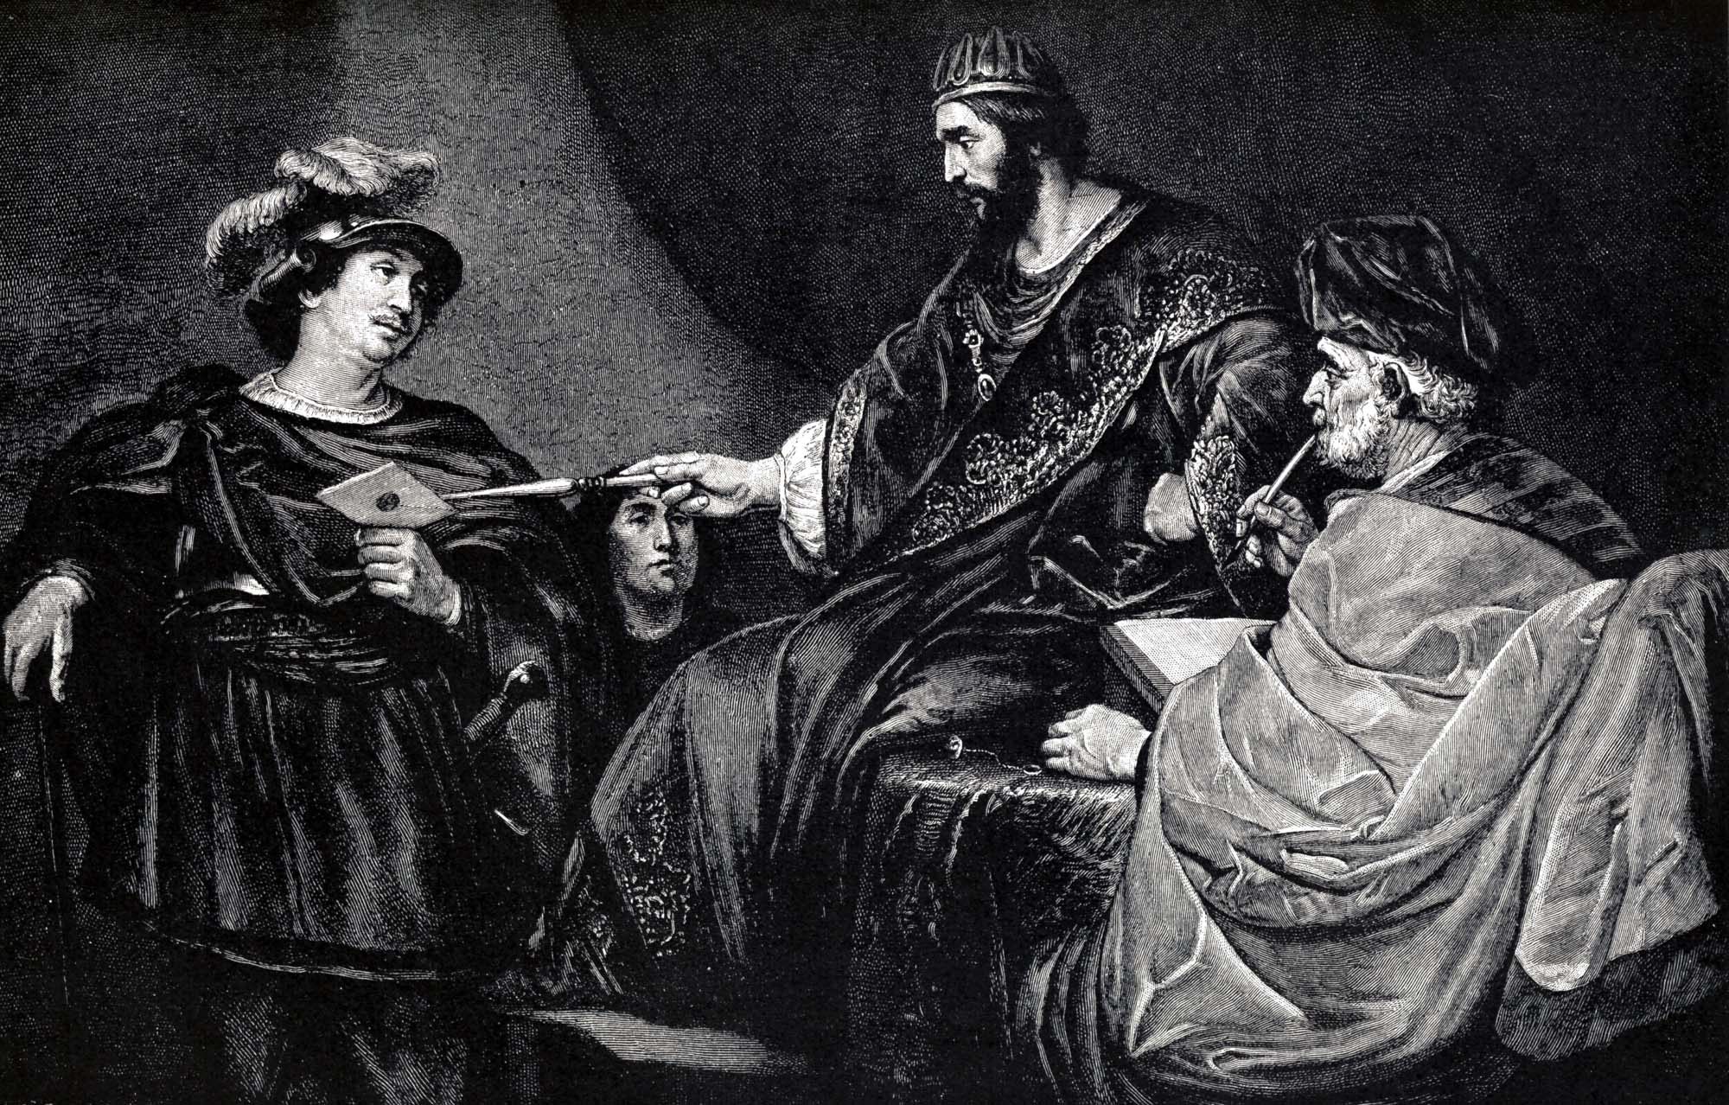
2 Samuel 11
“³And David sent and enquired after the woman. And one said, Is not this Bathsheba, the daughter of Eliam, the wife of Uriah the Hittite?”

Slide 5
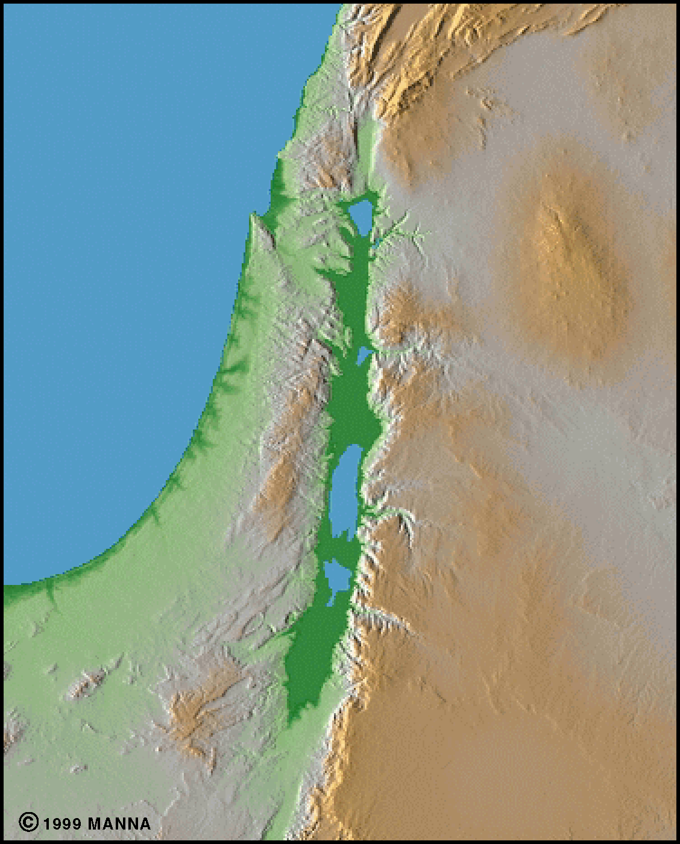
Name the Canaanite tribes who lived in the land of Canaan (Deuteronomy 7:1)
Hittites, Girgashites, Amorites, Canaanites, Perizzites, Hivites, Jebusites
Hittites
Hivites
Girgashites
Perizzites
Amorites
Canaanites
Jebusites

Slide 6
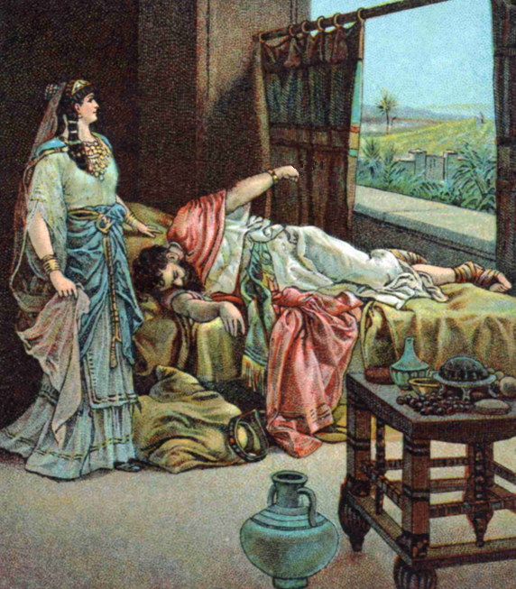
2 Samuel 11
“⁴And David sent messengers, and took her; and she came in unto him, and he lay with her; for she was purified from her uncleanness: and she returned unto her house.”

Slide 8
“And he lay with her” (2 Sam. 11:4). “The man who had previously shown himself so noble, here stoops to rob one of his own officers of his honor.
Here David set the stage for the brutal, savage rape of his daughter Tamar, by one of David’s sons. Here was the cause of Absalom’s murder of Amnon. Absalom’s conceited rebellion was another consequence of this lustful violation of Bathsheba’s honor by David. (2 Samuel 13)
God revealed to David that because of this terrible sin, “The sword shall never depart from thy house.” “From that day, David’s house was the scene of horrible crimes, feuds, scandals, miseries of every kind; and the long interval after his repentance, reaching from the birth of Solomon until David’s death, is passed over by the Scriptures in silence. No act of the penitent king after he was restored to his throne (after Absalom’s rebellion) was deemed worthy by the sacred historian of any mention whatever.”
Commentary on Second Samuel, The James Burton Coffman Commentaries (A. C. U. Press, 1992), 2 Sa 11:2.

Slide 9
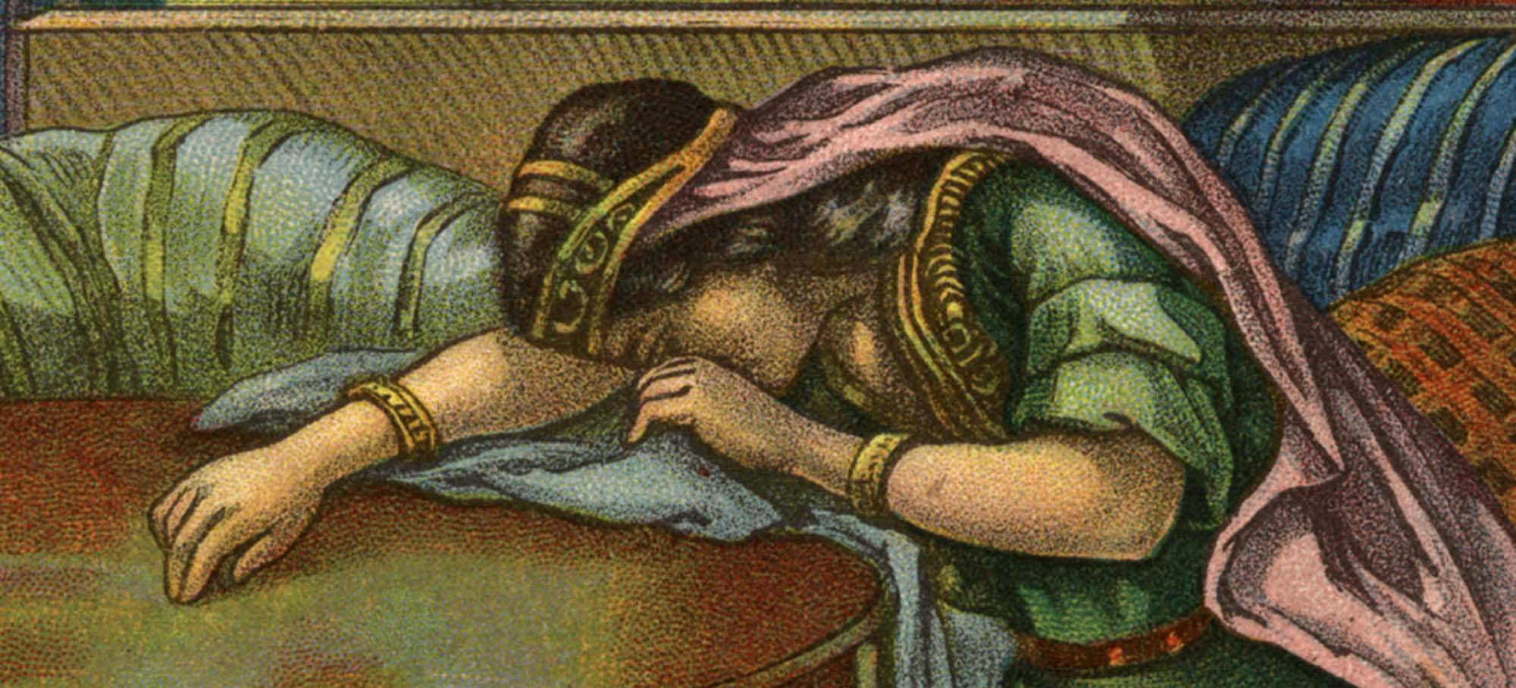
Bathsheba must have been horrified when she realized she was having David’s child. According to the law her husband could have her stoned to death. She sought David’s protection.
2 Samuel 11
“⁵And the woman conceived, and sent and told David, and said, I am with child.”

Slide 10
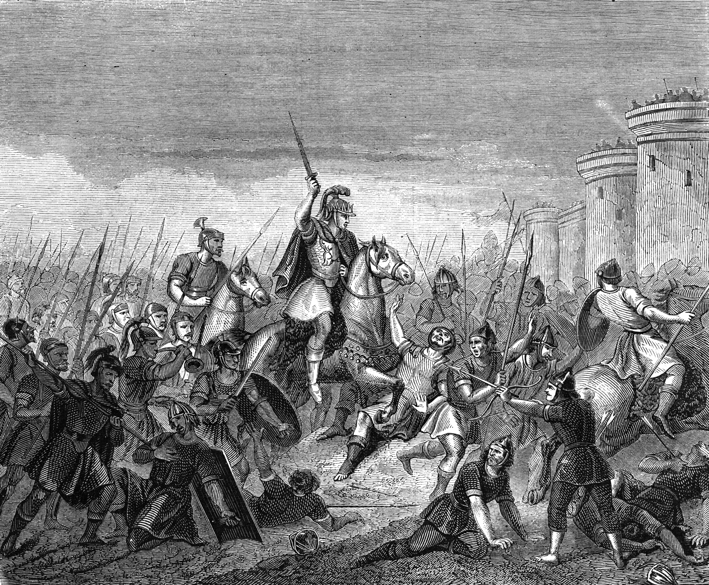
Joab, the captain of David’s army, was leading the battle in which Bathsheba’s husband, Uriah, fought. They were laying siege against the Ammonite city Rabbah when Joab received a message from David requesting him to send Uriah to David.

Slide 11
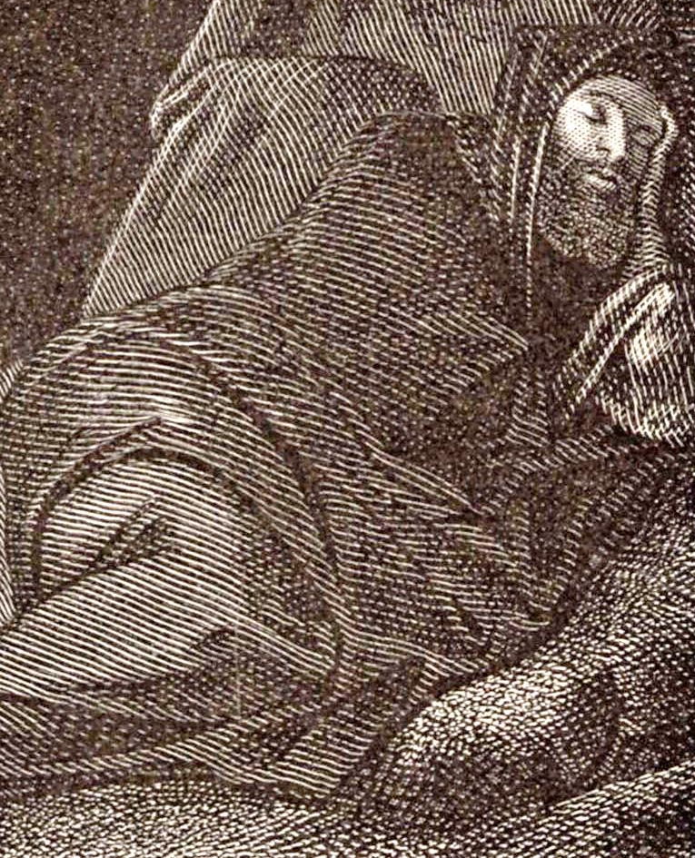
David wanted Uriah to sleep at home with his wife to deceive him into thinking Bathsheba’s child was Uriah’s.
Uriah went home as King David had ordered him, but he slept at the door and did not go in to his wife because of his loyalty to his fellow soldiers who were sleeping in the fields.

Slide 12
David was determined to hide his sin. He got Uriah drunk hoping he would go in to his wife, but Uriah did not go to his house.

Slide 13
David carried his sin further . . . he had Uriah deliver a note to Joab, and little did Uriah know that the note held his demise.
Set ye Uriah in the forefront of the hottest battle, and retire ye from him, that he may be smitten and die.
--King David

Slide 14
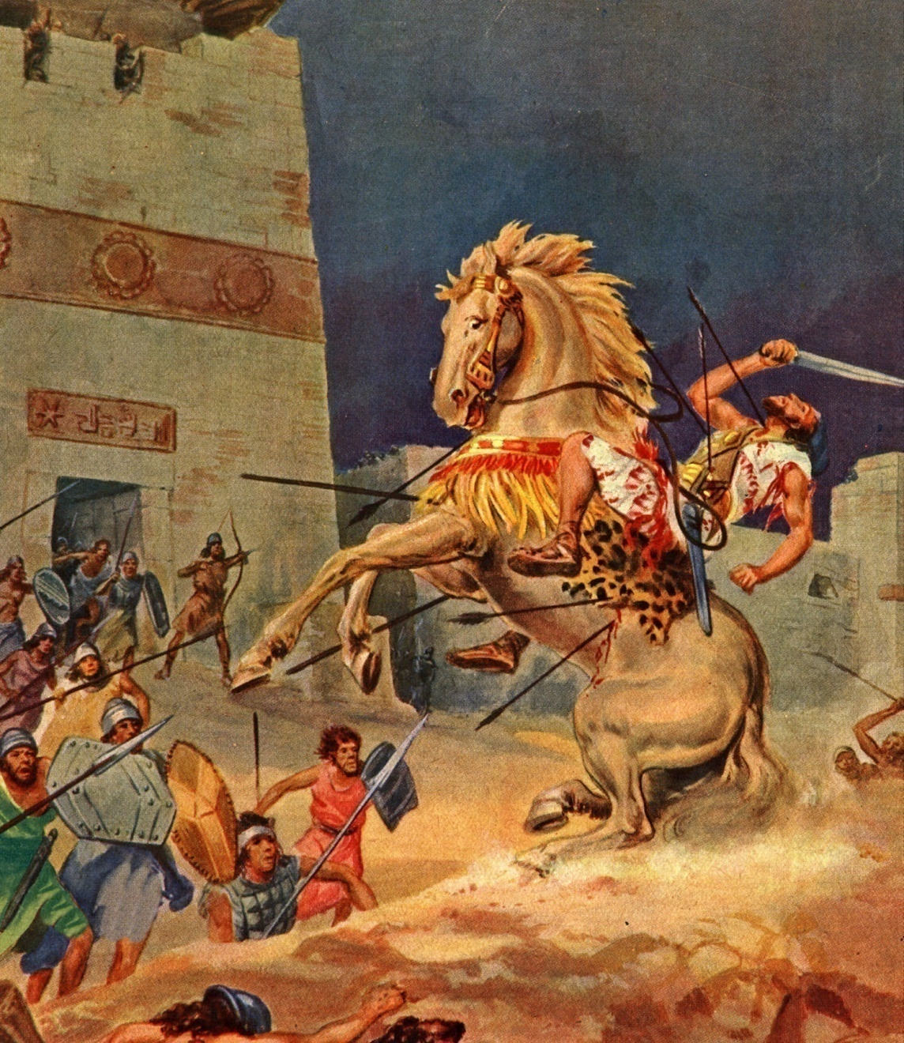
2 Samuel 11
“¹⁶And it came to pass, when Joab observed the city, that he assigned Uriah unto a place where he knew that valiant men were.”
2 Samuel 11
“¹⁷And the men of the city went out, and fought with Joab: and there fell some of the people of the servants of David; and Uriah the Hittite died also.”

Slide 15
The Man Who Got In Trouble By Staying Home
1. Notice The Beginning Of David’s Sin.
He put on others what he should have done himself—
2 Samuel 11:1 It happened in the spring of the year, at the time when kings go out to battle, that David sent Joab and his servants with him, and all Israel; and they destroyed the people of Ammon and besieged Rabbah. But David remained at Jerusalem.

Slide 16
The Man Who Got In Trouble By Staying Home
1. Notice The Beginning Of David’s Sin.
He became more interested in his personal pleasure than he did the condition of his people—2 Sam. 11:2.
2 Samuel 11:2 Then it happened one evening that David arose from his bed and walked on the roof of the king's house. And from the roof he saw a woman bathing, and the woman was very beautiful to behold.

Slide 17
The Man Who Got In Trouble By Staying Home
1. Notice The Beginning Of David’s Sin.
Notice, when a person gets interested in their personal pleasure, the devil will always furnish them a beautiful temptation.

Slide 18
The Man Who Got In Trouble By Staying Home
1. Notice The Beginning Of David’s Sin.
He entertained a temptation, when he should have shunned it—2 Sam. 11:3.
2 Samuel 11:3. So David sent and inquired about the woman. And someone said, "Is this not Bathsheba, the daughter of Eliam, the wife of Uriah the Hittite?"

Slide 19
The Man Who Got In Trouble By Staying Home
2. Notice David’s Attitude Toward His Sin.
He manifested a hypocritical friendship in an effort to cover his sin—2 Sam. 11:6–8.
2 Samuel 11:6–8. Then David sent to Joab, saying, "Send me Uriah the Hittite." And Joab sent Uriah to David.
7 When Uriah had come to him, David asked how Joab was doing, and how the people were doing, and how the war prospered.
8 And David said to Uriah, "Go down to your house and wash your feet." So Uriah departed from the king's house, and a gift of food from the king followed him.

Slide 20
The Man Who Got In Trouble By Staying Home
2. Notice David’s Attitude Toward His Sin.
He turned to sinful disobedience in an effort to cover his sin—2 Sam. 11:13.
2 Samuel 11:13 Now when David called him, he ate and drank before him; and he made him drunk. And at evening he went out to lie on his bed with the servants of his lord, but he did not go down to his house.

Slide 21
The Man Who Got In Trouble By Staying Home
2. Notice David’s Attitude Toward His Sin.
He fell on the plan of shedding innocent blood in an effort to cover his sin—2 Sam. 11:14–15.
2 Samuel 11:14–15 In the morning it happened that David wrote a letter to Joab and sent it by the hand of Uriah.
15 And he wrote in the letter, saying, "Set Uriah in the forefront of the hottest battle, and retreat from him, that he may be struck down and die."

Slide 22
The Man Who Got In Trouble By Staying Home
3. Notice God’s Action Concerning David’s Sin.
2Samuel 12:1 Then the LORD sent Nathan to David. And he came to him, and said to him: "There were two men in one city, one rich and the other poor.
2 "The rich man had exceedingly many flocks and herds.
3 "But the poor man had nothing, except one little ewe lamb which he had bought and nourished; and it grew up together with him and with his children. It ate of his own food and drank from his own cup and lay in his bosom; and it was like a daughter to him.
4 "And a traveler came to the rich man, who refused to take from his own flock and from his own herd to prepare one for the wayfaring man who had come to him; but he took the poor man's lamb and prepared it for the man who had come to him."
5 So David's anger was greatly aroused against the man, and he said to Nathan, "As the LORD lives, the man who has done this shall surely die!
6 "And he shall restore fourfold for the lamb, because he did this thing and because he had no pity."
7 Then Nathan said to David, "You are the man! Thus says the LORD God of Israel: 'I anointed you king over Israel, and I delivered you from the hand of Saul.

Slide 23
Borderland Christians. Numbers 32
“Be sure your sin will find you out …” The meaning here is not, “Be sure your sins will be found out, or discovered,”
but that your sin will get to you and punish you. “Note also that the sin warned against here is primarily a sin of omission.”
“The implication here is that their sin would eventually bring its own punishment along with it.”

Slide 24
The Man Who Got In Trouble By Staying Home
3. Notice God’s Action Concerning David’s Sin.
God reminded him of his love, by pointing out the blessings he had already received— 2 Sam. 12:8.
2 Samuel 12:8. 'I gave you your master's house and your master's wives into your keeping, and gave you the house of Israel and Judah. And if that had been too little, I also would have given you much more!

Slide 25
The Man Who Got In Trouble By Staying Home
3. Notice God’s Action Concerning David’s Sin.
God pronounced the penalty for his sin— 2 Sam. 12:10.
2 Samuel 12:10 'Now therefore, the sword shall never depart from your house, because you have despised Me, and have taken the wife of Uriah the Hittite to be your wife.'

Slide 26
The Man Who Got In Trouble By Staying Home
4. Notice The Price David Had To Pay Because Of His Sin.
He had to look on the suffering of another, knowing it was because of his sin— 2 Sam. 12:14–15.
2 Sam. 12:14 "However, because by this deed you have given great occasion to the enemies of the LORD to blaspheme, the child also who is born to you shall surely die."
15 Then Nathan departed to his house. And the LORD struck the child that Uriah's wife bore to David, and it became ill.

Slide 27
The Man Who Got In Trouble By Staying Home
4. Notice The Price David Had To Pay Because Of His Sin.
He spent sleepless hours and anguish of soul, because of his sin—2 Sam. 12:16–17.
2 Samuel 12:16–17 David therefore pleaded with God for the child, and David fasted and went in and lay all night on the ground.
17 So the elders of his house arose and went to him, to raise him up from the ground. But he would not, nor did he eat food with them..

Slide 28
The Man Who Got In Trouble By Staying Home
4. Notice The Price David Had To Pay Because Of His Sin.
He saw death come into his home, because of his sin—2 Sam. 12:18.
2 Samuel. 12:18. Then on the seventh day it came to pass that the child died. And the servants of David were afraid to tell him that the child was dead. For they said, "Indeed, while the child was alive, we spoke to him, and he would not heed our voice. How can we tell him that the child is dead? He may do some harm!"

Slide 29
The Man Who Got In Trouble By Staying Home
What a terrible picture and all because of one little word, SIN.
Don’t make the same mistake David made, shedding innocent blood to cover your sin. BUT RATHER BE WILLING TO ACCEPT THE BLOOD THAT HAS ALREADY BEEN SHED FOR YOUR SINS.

Slide 30
Are You A New Testament Christian?
Hear the Gospel (Rom.10:14).
Believe the Gospel (Heb. 11:6).
Repent of Sins (Acts 3:19).
Confess Christ (Rom.10:9).
Be Baptized Into Christ (1 Cor.12:13).
1 Timothy 4:16
“Take heed unto thyself, and unto the doctrine; continue in them: for in doing this thou shalt both save thyself, and them that hear thee.”

