Slide 1
Welcome to our services
New Lebanon Church of Christ
We are Simply Christians.
Our Emphasis is Spiritual, Not Material or Social.
We are striving to be The Same Church as Described in The New Testament.
Please Come Back Again

Slide 2
The Kind of a Wife That Christ Wants His Wife to Be
Rev. 19:6 And I heard, as it were, the voice of a great multitude, as the sound of many waters and as the sound of mighty thunderings, saying, "Alleluia! For the Lord God Omnipotent reigns!
7 "Let us be glad and rejoice and give Him glory, for the marriage of the Lamb has come, and His wife has made herself ready."
8 And to her it was granted to be arrayed in fine linen, clean and bright, for the fine linen is the righteous acts of the saints.

Slide 3
The Kind of a Wife That Christ Wants His Wife to Be
Revelation 19:6-8

Slide 4
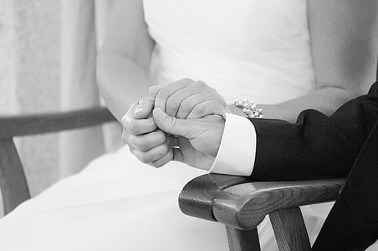
The Kind of a Wife That Christ Wants His Wife to Be
Marriage is a covenant relationship.
legal relationship
rights, duties, blessings
obligations
love and affection

Slide 5
The Kind of a Wife That Christ Wants His Wife to Be
1. Christ Wants His Wife To “Love” Him.
John 21:15 So when they had eaten breakfast, Jesus said to Simon Peter, "Simon, son of Jonah, do you love Me more than these?" He said to Him, "Yes, Lord; You know that I love You." He said to him, "Feed My lambs."
16 He said to him again a second time, "Simon, son of Jonah, do you love Me?" He said to Him, "Yes, Lord; You know that I love You." He said to him, "Tend My sheep."
17 He said to him the third time, "Simon, son of Jonah, do you love Me?" Peter was grieved because He said to him the third time, "Do you love Me?" And he said to Him, "Lord, You know all things; You know that I love You." Jesus said to him, "Feed My sheep.

Slide 6
The Kind of a Wife That Christ Wants His Wife to Be
1. Christ Wants His Wife To “Love” Him.
Eph 5:22 Wives, submit to your own husbands, as to the Lord.
23 For the husband is head of the wife, as also Christ is head of the church; and He is the Savior of the body. 24 Therefore, just as the church is subject to Christ, so let the wives be to their own husbands in everything. 25 Husbands, love your wives, just as Christ also loved the church and gave Himself for her,

Slide 7
The Kind of a Wife That Christ Wants His Wife to Be
1. Christ Wants His Wife To “Love” Him.
Deut. 6:4 "Hear, O Israel: The LORD our God, the LORD is one!
5 "You shall love the LORD your God with all your heart, with all your soul, and with all your strength.
6 "And these words which I command you today shall be in your heart.
7 "You shall teach them diligently to your children, and shall talk of them when you sit in your house, when you walk by the way, when you lie down, and when you rise up.

Slide 8
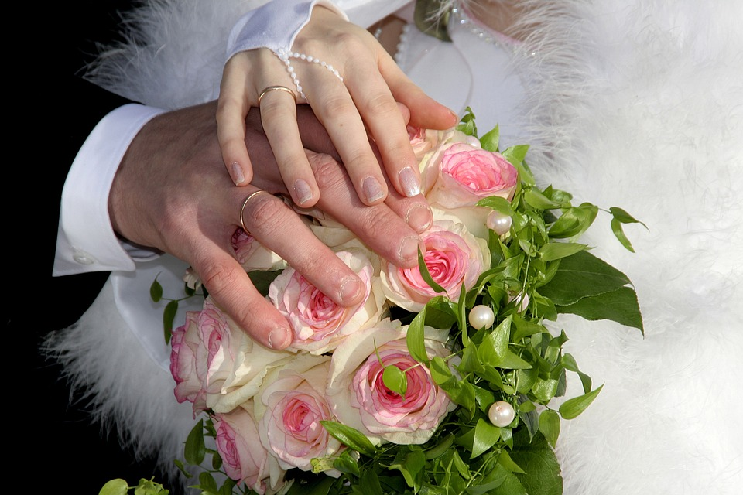
The Kind of a Wife That Christ Wants His Wife to Be
2. Christ Wants His Wife To Be “Attractive.”
Not necessarily physically attractive, that is for the world, and not for Christ.
Christ wants his wife to have an attractive personality.
Friendly—kind—humble—compassionate—gentle—lovable.

Slide 9
The Kind of a Wife That Christ Wants His Wife to Be
2. Christ Wants His Wife To Be “Attractive.”
Gal. 5:22 But the fruit of the Spirit is love, joy, peace, longsuffering, kindness, goodness, faithfulness, 23 gentleness, self-control. Against such there is no law.
24 And those who are Christ's have crucified the flesh with its passions and desires. 25 If we live in the Spirit, let us also walk in the Spirit.
26 Let us not become conceited, provoking one another, envying one another.

Slide 10
The Kind of a Wife That Christ Wants His Wife to Be
3. Christ Wants His Wife To Be Loyal To Him.
Christ does not want a wife that just wants him when emergencies arise.
Unfaithful Christians break the heart of Jesus. “Thou shalt have not other gods before Me.” (No other lovers, love me with all your heart).

Slide 11
The Kind of a Wife That Christ Wants His Wife to Be
3. Christ Wants His Wife To Be Loyal To Him.
Hosea 3:1 Then the LORD said to me, "Go again, love a woman who is loved by a lover and is committing adultery, just like the love of the LORD for the children of Israel, who look to other gods and love the raisin cakes of the pagans."
Hosea 13:4 "Yet I am the LORD your God Ever since the land of Egypt, And you shall know no God but Me; For there is no Savior besides Me.

Slide 12
The Kind of a Wife That Christ Wants His Wife to Be
4. Christ Wants His Wife To Help Him In His Business.
A good wife will be interested in her husband’s business and work.
Man has never had a partner and a helper like a good wife.
God made Eve for a wife and helpmate for Adam.
Some men have wives that hurt their business.
Genesis 2:18 And the LORD God said, It is not good that the man should be alone; I will make him an help meet for him (suitable for him).

Slide 13
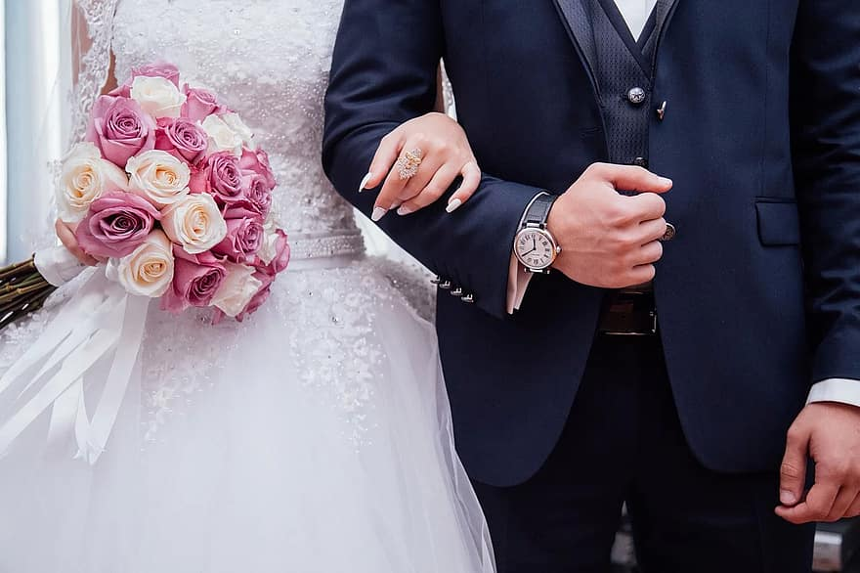
The Kind of a Wife That Christ Wants His Wife to Be
5. Christ Wants His Wife To Be “Like Him.”
Like Him In Love.
John 13:34 "A new commandment I give to you, that you love one another; as I have loved you, that you also love one another.
35 "By this all will know that you are My disciples, if you have love for one another."

Slide 14
The Kind of a Wife That Christ Wants His Wife to Be
5. Christ Wants His Wife To Be “Like Him.”
Like Him In Forgiveness.
Matt. 6:14 "For if you forgive men their trespasses, your heavenly Father will also forgive you.
15 "But if you do not forgive men their trespasses, neither will your Father forgive your trespasses.

Slide 15
The Kind of a Wife That Christ Wants His Wife to Be
5. Christ Wants His Wife To Be “Like Him.”
Be Like Him In Mercy.
Luke 6:36 "Therefore
be merciful,
just as your Father
also is merciful.

Slide 16
The Kind of a Wife That Christ Wants His Wife to Be
5. Christ Wants His Wife To Be “Like Him.”
Christ Wants His Wife To Like The Things That He Likes.
It is a sad sight to see a husband involved in good things...involved in eternal things, and his wife has no interest in it.

Slide 17
The Kind of a Wife That Christ Wants His Wife to Be
5. Christ Wants His Wife To Be “Like Him.”
Jesus likes to “go to Church.”
Luke 4:16 So He came to Nazareth, where He had been brought up. And as His custom was, He went into the synagogue on the Sabbath day, and stood up to read.

Slide 18
The Kind of a Wife That Christ Wants His Wife to Be
You are the bride of Christ.
You are the wife of Christ.

Slide 19
The Kind of a Wife That Christ Wants His Wife to Be
Christ Wants YOU To “Love” Him.
Christ Wants YOU To Be “Attractive.”
Christ Wants YOU To Be Loyal To Him.
Christ Wants YOU To Help Him In His Business.
Christ Wants YOU To Be “Like Him.”

Slide 20
Are You A New Testament Christian?
Hear the Gospel (Rom.10:14).
Believe the Gospel (Heb. 11:6).
Repent of Sins (Acts 3:19).
Confess Christ (Rom.10:9).
Be Baptized Into Christ (1 Cor.12:13).
1 Timothy 4:16
“Take heed unto thyself, and unto the doctrine; continue in them: for in doing this thou shalt both save thyself, and them that hear thee.”

Slide 21
Have You Made Yourself Ready For The Groom?
Rev. 19:7
Let us be glad and rejoice and give Him glory, for the marriage of the Lamb has come, and His wife has made herself ready.

