Slide 1
Welcome to our services
New Lebanon Church of Christ
We are Simply Christians.
Our Emphasis is Spiritual, Not Material or Social.
We are striving to be The Same Church as Described in The New Testament.
Please Come Back Again

Slide 2
Some Strange Things Sent By The Lord
Ruth 1:20–21
Ruth 1:20 But she said to them, "Do not call me Naomi; call me Mara, for the Almighty has dealt very bitterly with me.
21 "I went out full, and the LORD has brought me home again empty. Why do you call me Naomi, since the LORD has testified against me, and the Almighty has afflicted me?"

Slide 3
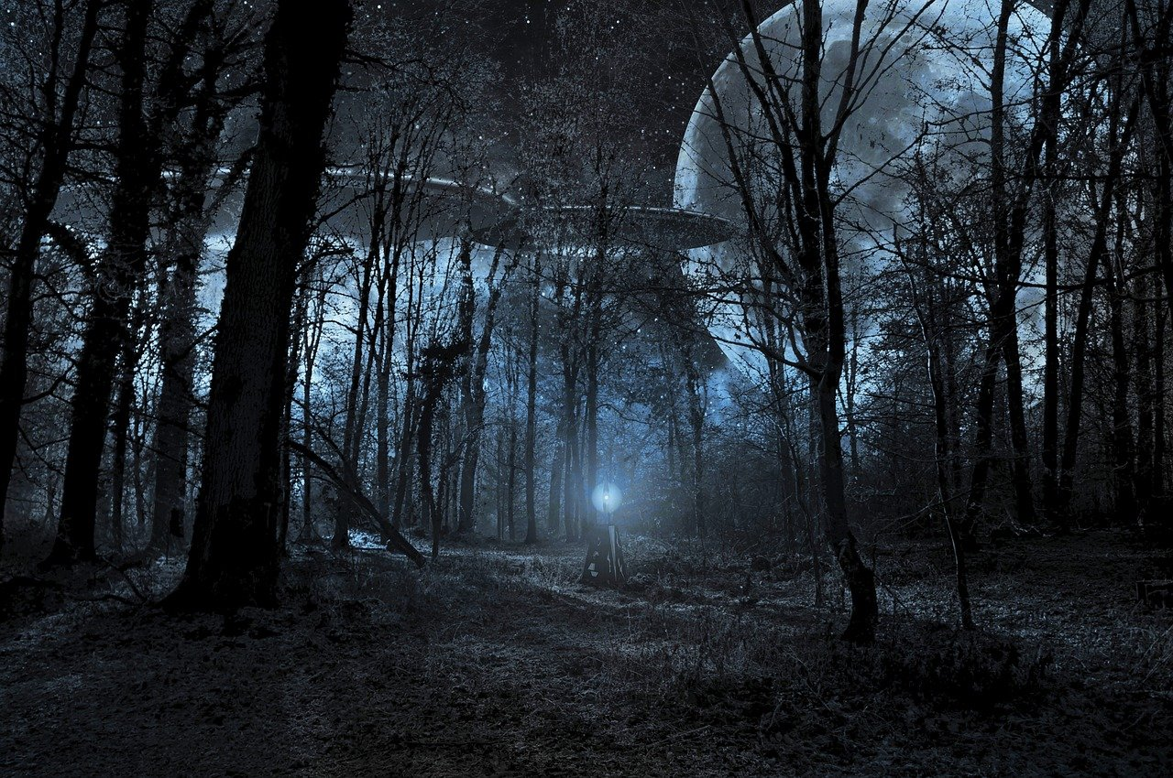
Some Strange Things Sent By The Lord

Slide 4
Some Strange Things Sent By The Lord
Ruth 1:20–21
“Call me not Naomi, call me Mara” (Ruth 1:20). Naomi (sweet) and Mara (bitter) were contrasting names that illustrated the disastrous changes that had come in the life of Naomi. Significantly, the bitter waters of Mara, encountered by Israel during the wilderness wanderings, were again brought into memory by the use of this name (Exo. 15:22ff).
Naomi’s thoughts of what she believed that God had done unto her were by no means correct, but she knew of none other upon whom she could fasten the responsibility, and she had not learned the great lesson that Christ brought to mankind at a later time, namely, that the saints of God frequently SUFFER, sustained by the marvelous promise, that, “If we suffer with him, we shall also reign with him.”
James B. Coffman and Thelma B. Coffman, Judges and Ruth, The James Burton Coffman Commentaries (A. C. U. Press, 1992), Ru 1:20.

Slide 5
Some Strange Things Sent By The Lord
Ruth 1:20–21
Psalm 100:4 Enter into His gates with thanksgiving, And into His courts with praise. Be thankful to Him, and bless His name.
We should always give thanks to God for all things (Psalm 100:4) yet many things come into our lives that we don’t like but God allows them to come upon us for our good and His glory.

Slide 6
Some Strange Things Sent By The Lord
1. God Sends Afflictions
Psalm 66:10-12
Psalm 66:10 For You, O God, have tested us; You have refined us as silver is refined.
11 You brought us into the net; You laid affliction on our backs.
12 You have caused men to ride over our heads; We went through fire and through water; But You brought us out to rich fulfillment.

Slide 7
Some Strange Things Sent By The Lord
1. God Sends Afflictions
Job 16:11-20
Job 16:11 God has delivered me to the ungodly, And turned me over to the hands of the wicked.
12 I was at ease, but He has shattered me; He also has taken me by my neck, and shaken me to pieces; He has set me up for His target,
13 His archers surround me. He pierces my heart and does not pity; He pours out my gall on the ground.
14 He breaks me with wound upon wound; He runs at me like a warrior.
15 "I have sewn sackcloth over my skin, And laid my head in the dust.
16 My face is flushed from weeping, And on my eyelids is the shadow of death;
17 Although no violence is in my hands, And my prayer is pure.
18 "O earth, do not cover my blood, And let my cry have no resting place!
19 Surely even now my witness is in heaven, And my evidence is on high.
20 My friends scorn me; My eyes pour out tears to God.

Slide 8
Some Strange Things Sent By The Lord
2. God Sends Grief
Lamentations. 3:32
Lam. 3:32 Though He causes grief, Yet He will show compassion According to the multitude of His mercies.

Slide 9
Some Strange Things Sent By The Lord
3. God Sends Wounds
Job 5:17-24
Job 5:17 "Behold, happy is the man whom God corrects; Therefore do not despise the chastening of the Almighty.
18 For He bruises, but He binds up; He wounds, but His hands make whole.
19 He shall deliver you in six troubles, Yes, in seven no evil shall touch you.
20 In famine He shall redeem you from death, And in war from the power of the sword.
21 You shall be hidden from the scourge of the tongue, And you shall not be afraid of destruction when it comes.
22 You shall laugh at destruction and famine, And you shall not be afraid of the beasts of the earth.
23 For you shall have a covenant with the stones of the field, And the beasts of the field shall be at peace with you.
24 You shall know that your tent is in peace; You shall visit your dwelling and find nothing amiss

Slide 10
Some Strange Things Sent By The Lord
3. God Sends Wounds
Job 5:17-24
Job 5:17 "Behold, happy is the man whom God corrects; Therefore do not despise the chastening of the Almighty.
Happy /blessed
Not because of circumstances
But happy because God looks on us with favor
Because we have repented of our sins and turned to God our creator.

Slide 11
Some Strange Things Sent By The Lord
4. God Sends Leanness
Isaiah 10:16
Isaiah 10:16 Therefore the Lord, the Lord of hosts, Will send leanness among his fat ones; And under his glory He will kindle a burning Like the burning of a fire.

Slide 12
Some Strange Things Sent By The Lord
4. God Sends Leanness
Psalm 106:10-15
Psalm 106:10 He saved them from the hand of him who hated them, And redeemed them from the hand of the enemy. 11 The waters covered their enemies; There was not one of them left.
12 Then they believed His words; They sang His praise.
13 They soon forgot His works; They did not wait for His counsel, 14 But lusted exceedingly in the wilderness, And tested God in the desert.
15 And He gave them their request, But sent leanness into their soul.

Slide 13
Some Strange Things Sent By The Lord
4. God Sends Leanness
Job 16:4-8
Job 16:4 I also could speak as you do, If your soul were in my soul's place. I could heap up words against you, And shake my head at you; 5 But I would strengthen you with my mouth, And the comfort of my lips would relieve your grief.
6 "Though I speak, my grief is not relieved; And if I remain silent, how am I eased? 7 But now He has worn me out; You have made desolate all my company.
8 You have shriveled me up, And it is a witness against me; My leanness rises up against me And bears witness to my face.

Slide 14
Some Strange Things Sent By The Lord
5. God Sends Tears
Psalm 80:4–5
Psalm 80:4 O LORD God of hosts, How long will You be angry Against the prayer of Your people?
5 You have fed them with the bread of tears, And given them tears to drink in great measure.

Slide 15
Some Strange Things Sent By The Lord
5. God Sends Tears
Psalm 80:4–5
The Tears Of Regret.
Esau found no place for repentance—Heb.12:17. Though he sought it carefully with tears. (sold birthright, could not get it back)
The Tears Of A Back-slider.
Psalms 137:1–2 There we sat and wept by rivers of Babylon when we remembered Zion.
The Tears In Hell.
The rich man lifted his eyes in Hell and cried, “Father Abraham, have mercy on me… for I am tormented in this flame.”— Luke 16:24

Slide 16
Some Strange Things Sent By The Lord
5. God Sends Tears
Psalm 80:4–5
bread of tears-- an Eastern figure for affliction.
Tears move: The heart of God. The heart of a sinner. They should move your heart also. We have too much dry-eyed religion.
Jesus wept over Jerusalem—Luke 19:41. At Lazarus’ grave—John 11:35 In the garden—Heb.5:7. Over Jerusalem—Luke 19:41
Joseph wept over his brethren—Gen. 45:15
He kissed and wept upon each of his brethren.
A poor thankful woman wept upon Jesus’ feet—Luke 7:38
She began to wash His feet with her tears.

Slide 17
Some Strange Things Sent By The Lord
6. God Sends Trouble
Psalm 71:20
Psalm 71:20 You, who have shown me great and severe troubles, Shall revive me again, And bring me up again from the depths of the earth.

Slide 18
Some Strange Things Sent By The Lord
7. God Sends Death
1 Samuel 2:6
1Sam. 2:6 "The LORD kills and makes alive; He brings down to the grave and brings up.
Deut.32:39 'Now see that I, even I, am He, And there is no God besides Me; I kill and I make alive; I wound and I heal; Nor is there any who can deliver from My hand.

Slide 19
Some Strange Things Sent By The Lord
Job 5:17-27
Job 5:17 "Behold, happy is the man whom God corrects; Therefore do not despise the chastening of the Almighty.
18 For He bruises, but He binds up; He wounds, but His hands make whole.
19 He shall deliver you in six troubles, Yes, in seven no evil shall touch you.
20 In famine He shall redeem you from death, And in war from the power of the sword.
21 You shall be hidden from the scourge of the tongue, And you shall not be afraid of destruction when it comes. > > >

Slide 20
Some Strange Things Sent By The Lord
Job 5:17-27
22 You shall laugh at destruction and famine, And you shall not be afraid of the beasts of the earth.
23 For you shall have a covenant with the stones of the field, And the beasts of the field shall be at peace with you. 24 You shall know that your tent is in peace; You shall visit your dwelling and find nothing amiss.
25 You shall also know that your descendants shall be many, And your offspring like the grass of the earth.
26 You shall come to the grave at a full age, As a sheaf of grain ripens in its season. 27 Behold, this we have searched out; It is true. Hear it, and know for yourself."
(NKJV)

Slide 21
Some Strange Things Sent By The Lord
1. God Sends Afflictions Job 16:11-20
2. God Sends Grief Lam. 3:32
3. God Sends Wounds Job 5:17-24
4. God Sends Leanness Isaiah 10:16
5. God Sends Tears Psalm 80:4–5
6. God Sends Trouble Psalm 71:20
7. God Sends Death 1 Samuel 2:6

Slide 22
Are You A New Testament Christian?
Hear the Gospel (Rom.10:14).
Believe the Gospel (Heb. 11:6).
Repent of Sins (Acts 3:19).
Confess Christ (Rom.10:9).
Be Baptized Into Christ (1 Cor.12:13).
1 Timothy 4:16
“Take heed unto thyself, and unto the doctrine; continue in them: for in doing this thou shalt both save thyself, and them that hear thee.”

