Slide 1
Welcome to our services
New Lebanon Church of Christ
We are Simply Christians.
Our Emphasis is Spiritual, Not Material or Social.
We are striving to be The Same Church as Described in The New Testament.
Please Come Back Again

Slide 2
The Casual Christian At The Strait Gate
Luke 13:23 Then one said to Him, "Lord, are there few who are saved?" And He said to them,
24 "Strive to enter through the narrow gate, for many, I say to you, will seek to enter and will not be able.
25 "When once the Master of the house has risen up and shut the door, and you begin to stand outside and knock at the door, saying, 'Lord, Lord, open for us,' and He will answer and say to you, 'I do not know you, where you are from,'

Slide 3
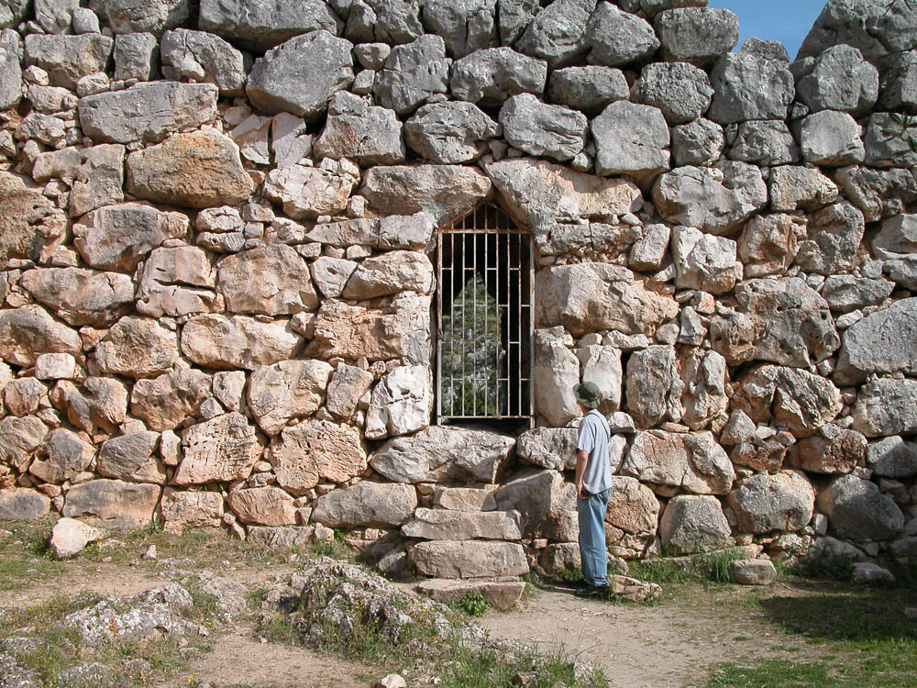
The Casual Christian At The Strait Gate

Slide 4
The Casual Christian At The Strait Gate
Strait gate / door
NARROW
A. Adjective.
stenos (στενός, 4728), from a root sten-, seen in stenazo, “to groan,” stenagmos, “groaning” (Eng., “stenography,” lit., “narrow writing”), is used figuratively in Matt. 7:13, 14, of the gate which provides the entrance to eternal life, “narrow” because it runs counter to natural inclinations, and “the way” is similarly characterized; so in Luke 13:24 (where the more intensive word agonizomai, “strive,” is used); rv, “narrow” (kjv, “strait”) in each place. Cf. stenochoreo, “to be straitened,” and stenochoria, “narrowness, anguish, distress.
W. E. Vine, Merrill F. Unger, and William White Jr., Vine’s Complete Expository Dictionary of Old and New Testament Words (Nashville, TN: T. Nelson, 1996), 426.

Slide 5
The Casual Christian At The Strait Gate
Luke 13:24 "Strive to enter through the narrow gate, for many, I say to you, will seek to enter and will not be able.

Slide 6
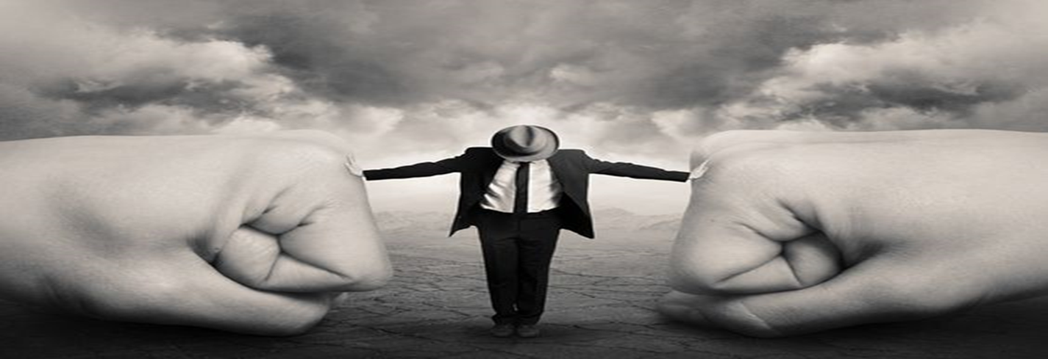
Joshua 1:7 "Only be strong and very courageous, that you may observe to do according to all the law which Moses My servant commanded you; do not turn from it to the right hand or to the left, that you may prosper wherever you go. (NKJV)

Slide 7
The Casual Christian At The Strait Gate
v.24 "Strive to enter through the narrow gate, for many, I say to you, will seek to enter and will not be able.
This is a door / gate which everybody should desire to enter through.
We should desire it because:
It is the gate of man’s spiritual home,
It is the gate of the city of refuge (Heb. 6:18).
It is the gate of eternal life.
It is the gate of escape from the fate of the wicked.

Slide 8
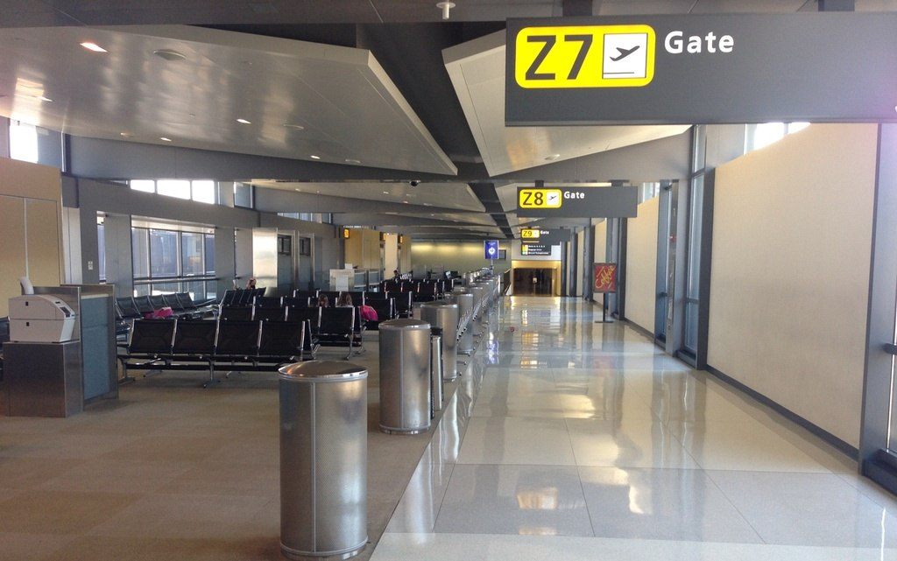

Slide 9
The Casual Christian At The Strait Gate
We should strive to enter -
Because it is the gate of man’s spiritual home,
Our citizenship is there (Phil. 3:20).
Phil. 3:20 For our citizenship is in heaven, from which we also eagerly wait for the Savior, the Lord Jesus Christ,
21 who will transform our lowly body that it may be conformed to His glorious body, according to the working by which He is able even to subdue all things to Himself.
4:1 Therefore, my beloved and longed-for brethren, my joy and crown, so stand fast in the Lord, beloved.
Heb 11:13 These all died in faith, not having received the promises, but having seen them afar off, and were persuaded of them, and embraced them, and confessed that they were strangers and pilgrims on the earth.
1Peter 2:11 Dearly beloved, I beseech you as strangers and pilgrims, abstain from fleshly lusts, which war against the soul;

Slide 10
The Casual Christian At The Strait Gate
We should strive to enter -
Because it is the gate of man’s spiritual home,
Our treasure is there (Matt. 6:20).
Matt. 6:19 "Do not lay up for yourselves treasures on earth, where moth and rust destroy and where thieves break in and steal;
20 "but lay up for yourselves treasures in heaven, where neither moth nor rust destroys and where thieves do not break in and steal.
21 "For where your treasure is, there your heart will be also.

Slide 11
The Casual Christian At The Strait Gate
We should strive to enter -
Because it is the gate of man’s spiritual home,
The hope of every man is there (Heb 6:19).
Heb. 6:17 Thus God, determining to show more abundantly to the heirs of promise the immutability of His counsel, confirmed it by an oath, 18 that by two immutable things, in which it is impossible for God to lie, we might have strong consolation, who have fled for refuge to lay hold of the hope set before us.
19 This hope we have as an anchor of the soul, both sure and steadfast, and which enters the Presence behind the veil, 20 where the forerunner has entered for us, even Jesus, having become High Priest forever according to the order of Melchizedek.

Slide 12
The Casual Christian At The Strait Gate
We should strive to enter -
Because it is the gate of man’s spiritual home,
Our Lord is there (John 14:1–3).
John 14:1 "Let not your heart be troubled; you believe in God, believe also in Me.
2 "In My Father's house are many mansions; if it were not so, I would have told you. I go to prepare a place for you.
3 "And if I go and prepare a place for you, I will come again and receive you to Myself; that where I am, there you may be also.
4 "And where I go you know, and the way you know."

Slide 13
The Casual Christian At The Strait Gate
We should strive to enter -
Because it is the gate of man’s spiritual home,
Our names are written there (Luke 10:20).
Luke 10:18 And He said to them, "I saw Satan fall like lightning from heaven. 19 "Behold, I give you the authority to trample on serpents and scorpions, and over all the power of the enemy, and nothing shall by any means hurt you. 20 "Nevertheless do not rejoice in this, that the spirits are subject to you, but rather rejoice because your names are written in heaven.“
21 In that hour Jesus rejoiced in the Spirit and said, "I thank You, Father, Lord of heaven and earth, that You have hidden these things from the wise and prudent and revealed them to babes. Even so, Father, for so it seemed good in Your sight.

Slide 14
The Casual Christian At The Strait Gate
We should strive to enter -
Because it is the gate of the city of refuge (Heb. 6:18).
Heb 6:18 that by two immutable things, in which it is impossible for God to lie, we might have strong consolation, who have fled for refuge to lay hold of the hope set before us

Slide 15
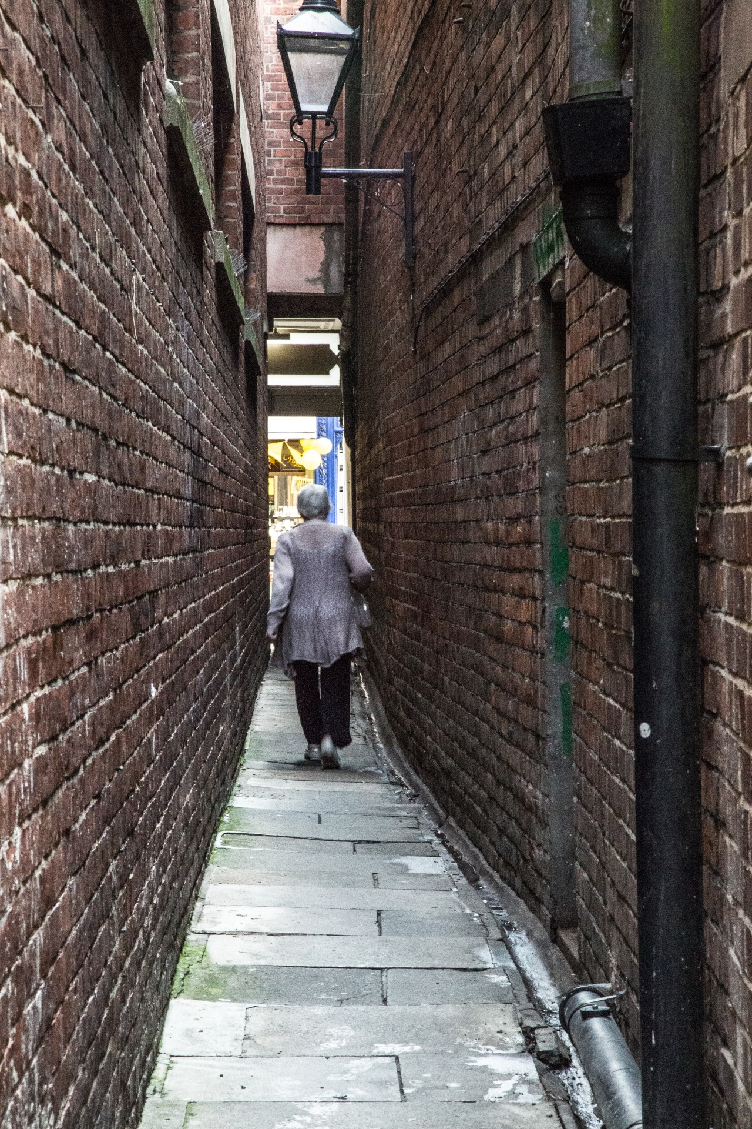
The Casual Christian At The Strait Gate
We should strive to enter -
Because it is the gate of eternal life.

Slide 16
The Casual Christian At The Strait Gate
We should strive to enter -
Because it is the gate of escape from the fate of the wicked.

Slide 17
The Casual Christian At The Strait Gate
How is it that some will seek to enter and not be able?
Some may not enter because of the pride of life.
1Peter 5:5 Likewise you younger people, submit yourselves to your elders. Yes, all of you be submissive to one another, and be clothed with humility, for "God resists the proud, But gives grace to the humble."
6 Therefore humble yourselves under the mighty hand of God, that He may exalt you in due time,

Slide 18
The Casual Christian At The Strait Gate
How is it that some will seek to enter and not be able?
Procrastination will prevent some from entering.
2Cor. 6:2 For He says: "In an acceptable time I have heard you, And in the day of salvation I have helped you." Behold, now is the accepted time; behold, now is the day of salvation.

Slide 19
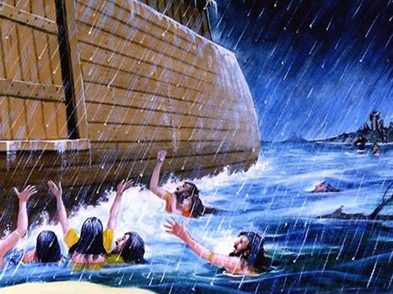
The Casual Christian At The Strait Gate
How is it that some will seek to enter and not be able?
Some wait until the “door is shut.”
Psalm 32:6 For this cause everyone who is godly shall pray to You In a time when You may be found; Surely in a flood of great waters They shall not come near him.

Slide 20
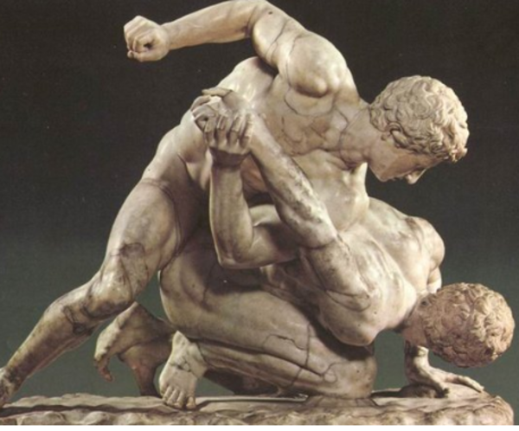
The Casual Christian At The Strait Gate
How is it that some will seek to enter and not be able?
The casual seeker cannot enter. The word “strive” in the text means “agonize.”

Slide 21
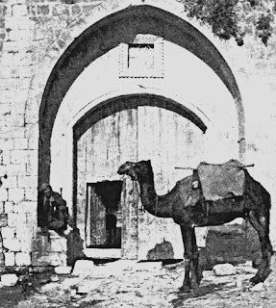
The Casual Christian At The Strait Gate
How is it that some will seek to enter and not be able?
Some carry contraband. Many things must be abandoned by all who would enter this door.

Slide 22
The Casual Christian At The Strait Gate
How is it that some will seek to enter and not be able?
And hath shut to the door … These words have the effect of placing the scene Jesus spoke of here at the final judgment. Only then, may it be said that the door is shut.
“Jesus does not say that many strive in vain to enter, but that there will be many who seek in vain to enter, after the time of salvation is past.”
“Jesus does not say nor mean that many will seek to enter in at the strait gate and not be able;—but that they will seek to enter heaven without going through the strait gate.”

Slide 23
The Casual Christian At The Strait Gate
The east and the west, and north and south …The universality of the kingdom of God is seen in these words.
Luke 11:29 And while the crowds were thickly gathered together, He began to say, "This is an evil generation. It seeks a sign, and no sign will be given to it except the sign of Jonah the prophet.
30 "For as Jonah became a sign to the Ninevites, so also the Son of Man will be to this generation. 31 "The queen of the South will rise up in the judgment with the men of this generation and condemn them, for she came from the ends of the earth to hear the wisdom of Solomon; and indeed a greater than Solomon is here.
32 "The men of Nineveh will rise up in the judgment with this generation and condemn it, for they repented at the preaching of Jonah; and indeed a greater than Jonah is here.

Slide 24
The Casual Christian At The Strait Gate
Abraham … Isaac … and all the prophets …
Here is a statement by the Christ that these ancient worthies are to be considered among those eternally saved;
and, in view of the sins of which these, and other Old Testament worthies, were guilty, there must be found a ground of encouragement for disciples of all ages.
Not sinlessness, but acknowledgment of their need of forgiveness followed by the proper repentance.

Slide 25
The Casual Christian At The Strait Gate
Sit down with Abraham … etc. “This graphically portrays the messianic banquet, a symbol of the joys of the age in which the Messiah shall rule”; but the passage goes beyond that to include the eternal joys of the redeemed in heaven.

Slide 26
The Casual Christian At The Strait Gate
And you yourselves thrust out … Many of the fleshly seed of Abraham, through their rejection of Christ, shall fail to attain unto the promise of Abraham.
Last who shall be first … and first who shall be last … These words mean that the final judgment will bring many surprises, a fact Jesus often stressed.
Must follow steps of Jesus on the narrow path.

Slide 27
Are You A New Testament Christian?
Hear the Gospel (Rom.10:14).
Believe the Gospel (Heb. 11:6).
Repent of Sins (Acts 3:19).
Confess Christ (Rom.10:9).
Be Baptized Into Christ (1 Cor.12:13).
1 Timothy 4:16
“Take heed unto thyself, and unto the doctrine; continue in them: for in doing this thou shalt both save thyself, and them that hear thee.”

Slide 28
HELL
Is Not Full
of people that
God rejected.
HELL Is Full Of People
That rejected GOD!
John 14:6
newlebanoncoc.com

