Slide 1
Welcome to our services
New Lebanon Church of Christ
We are Simply Christians.
Our Emphasis is Spiritual, Not Material or Social.
We are striving to be The Same Church as Described in The New Testament.
Please Come Back Again

Slide 2
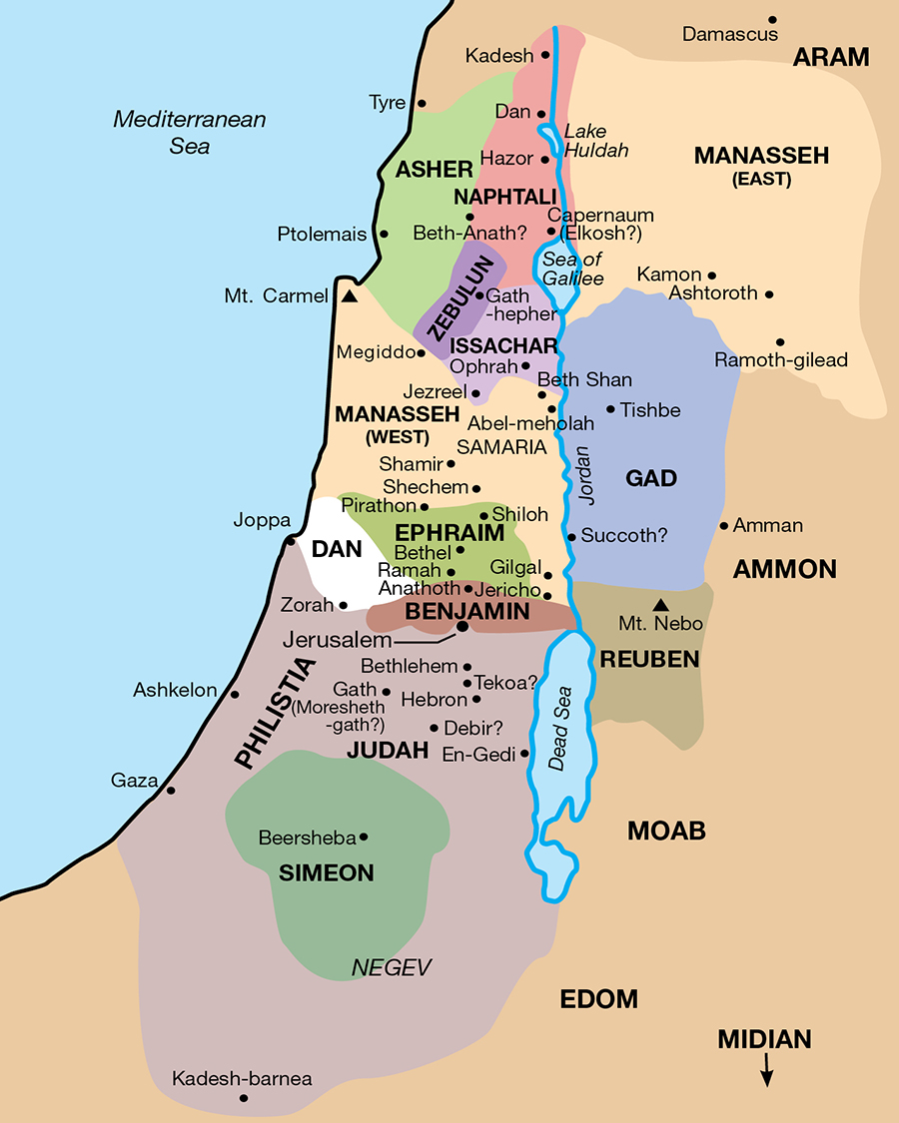
Borderland Christians. Numbers 32
Numbers 32:22 “…and the land is subdued before the LORD, then afterward you may return and be blameless before the LORD and before Israel; and this land shall be your possession before the LORD.
23 "But if you do not do so, then take note, you have sinned against the LORD; and be sure your sin will find you out.

Slide 3
Borderland Christians. Numbers 32
Numbers 32:1 Now the children of Reuben and the children of Gad had a very great multitude of livestock; and when they saw the land of Jazer and the land of Gilead, that indeed the region was a place for livestock,
2 the children of Gad and the children of Reuben came and spoke to Moses, to Eleazar the priest, and to the leaders of the congregation, saying,
3 "Ataroth, Dibon, Jazer, Nimrah, Heshbon, Elealeh, Shebam, Nebo, and Beon,
4 "the country which the LORD defeated before the congregation of Israel, is a land for livestock, and your servants have livestock."

Slide 4
Borderland Christians. Numbers 32
Numbers 32:5 Therefore they said, "If we have found favor in your sight, let this land be given to your servants as a possession. Do not take us over the Jordan."
6 And Moses said to the children of Gad and to the children of Reuben: "Shall your brethren go to war while you sit here?
7 "Now why will you discourage the heart of the children of Israel from going over into the land which the LORD has given them?
8 "Thus your fathers did when I sent them away from Kadesh Barnea to see the land.

Slide 5
Borderland Christians. Numbers 32
Numbers 32:9 "For when they went up to the Valley of Eshcol and saw the land, they discouraged the heart of the children of Israel, so that they did not go into the land which the LORD had given them.
10 "So the LORD'S anger was aroused on that day, and He swore an oath, saying,
11 'Surely none of the men who came up from Egypt, from twenty years old and above, shall see the land of which I swore to Abraham, Isaac, and Jacob, because they have not wholly followed Me,
12 'except Caleb the son of Jephunneh, the Kenizzite, and Joshua the son of Nun, for they have wholly followed the LORD.'

Slide 6
Borderland Christians. Numbers 32
Numbers 32:13 "So the LORD'S anger was aroused against Israel, and He made them wander in the wilderness forty years, until all the generation that had done evil in the sight of the LORD was gone.
14 "And look! You have risen in your father's place, a brood of sinful men, to increase still more the fierce anger of the LORD against Israel.
15 "For if you turn away from following Him, He will once again leave them in the wilderness, and you will destroy all these people."

Slide 7
Borderland Christians. Numbers 32
Numbers 32:16 Then they came near to him and said: "We will build sheepfolds here for our livestock, and cities for our little ones,
17 "but we ourselves will be armed, ready to go before the children of Israel until we have brought them to their place; and our little ones will dwell in the fortified cities because of the inhabitants of the land.
18 "We will not return to our homes until every one of the children of Israel has received his inheritance.

Slide 8
Borderland Christians. Numbers 32
Numbers 32:19 "For we will not inherit with them on the other side of the Jordan and beyond, because our inheritance has fallen to us on this eastern side of the Jordan.“
20 Then Moses said to them: "If you do this thing, if you arm yourselves before the LORD for the war,
21 "and all your armed men cross over the Jordan before the LORD until He has driven out His enemies from before Him,

Slide 9
Borderland Christians. Numbers 32
Numbers 32:22 "and the land is subdued before the LORD, then afterward you may return and be blameless before the LORD and before Israel; and this land shall be your possession before the LORD.
23 "But if you do not do so, then take note, you have sinned against the LORD; and be sure your sin will find you out.

Slide 10
Borderland Christians. Numbers 32
Here are reported the events that led to the settlement of the tribes of Reuben, Gad, and half the tribe of Manasseh on the east side of the Jordan.
Was this a sinful request on the part of these tribes? In the light of Moses’ severe rebuke in the next verses, the conclusion is that their request represented a fundamental departure by those tribes away from the true will of God.
The same in all generations where men look on present advantages and temporary benefits and choose instead of following God’s will, choose to walk in their own ways.

Slide 11
Borderland Christians. Numbers 32
Moses’ anger and frustration were justified. He listened to the promises of these rebels and permitted them to do as they wished, but there can hardly be any doubt that Moses’ first and immediate response to this was correct.
This response, was a rehearsal of events following Kadesh-Barnea and the sending out of the spies which resulted as follows:
it discouraged Israel;
Jehovah’s anger was kindled against Israel;
God forbade any of that generation except Caleb and Joshua to enter Canaan; and
the Lord punished the whole nation by forty years of wandering in the wilderness.

Slide 12
Borderland Christians. Numbers 32
Now, forty years later, once more standing on the verge of entering Canaan, here the sons of those original sinners once more appear with a plan of their own. They would NOT enter Canaan at all, but settle EAST of Jordan! What a fine place to pasture sheep!
Moses’ rebuke did not stop the tribes pleading. They at once continued the request, making promises about how they would, after all, enter Canaan with their armed troops, and after the land was conquered, they would, of course, return EAST of Jordan, leaving more room for the rest of Israel WEST of the Jordan! It was the kind of request that would probably have been supported by the vast majority of the whole nation.

Slide 13
Borderland Christians. Numbers 32
“We will not inherit with them on the other side of Jordan …” Here is the departure from God’s will, based upon the same grounds that always underlies disobedience, “We will not!”
The promises were good, no doubt made in good faith, and with the approving support of the whole nation; so Moses yielded. After all, it was the end of the line for him, and Israel would face the responsibilities of the future WITHOUT Moses.
So he granted their request but included a final warning of what would be involved if they failed to keep their promises.
DID THEY KEEP THESE PROMISES?
No! They did not. The women and children left behind under this arrangement could by no means have manned and defended the fortified towns and villages where they lived.

Slide 14
Borderland Christians. Numbers 32
“Many of the men of war from these tribes were, of course, left behind. The total roster of the men of war for Reuben, Gad and half of the tribe of Manasseh was 110,580, according to the census in Numbers 26,
But how many actually aided in the conquest?
From Joshua 4:13, we learn that of those two and one half tribes, only 40,000 armed men passed over Jordan, meaning that 70,580 armed men remained at home for the defense of the women and children.”

Slide 15
Borderland Christians. Numbers 32
The key to the success of God’s plan of moving Israel into Canaan was the driving out of all the original inhabitants. Only this could have saved the Israelites from their intermarriage with the native pagan peoples and the ultimate acceptance of their gods.
Without these two and a half tribes Israel was not large enough to require the removal of all the pagan peoples, which was left undone.
Also, these reluctant tribes were not strong enough, unaided, to drive out the pagan populations they dispossessed, with the result that all Israel was ultimately corrupted by the events recorded here. “The subsequent history of the trans-Jordan tribes is a sad commentary upon the real foolishness of their choice.”

Slide 16
Borderland Christians. Numbers 32
Numbers 32:22 “…and the land is subdued before the LORD, then afterward you may return and be blameless before the LORD and before Israel; and this land shall be your possession before the LORD.
23 "But if you do not do so, then take note, you have sinned against the LORD; and be sure your sin will find you out.

Slide 17
Borderland Christians. Numbers 32
“These two tribes (Reuben and Gad) were the very first to go into captivity because they transgressed against the God of their fathers and went a-whoring after strange gods.”
Thus, as Matthew Henry put it: “There was much amiss in the principle upon which they acted: they consulted their own private convenience more than the public good. To the present time, many seek their own things more than the things of Christ, and being led by worldly interests and advantages, pull up short of the heavenly Canaan.”

Slide 18
Borderland Christians. Numbers 32
“Be sure your sin will find you out …” The meaning here is not, “Be sure your sins will be found out, or discovered,”
but that your sin will get to you and punish you. “Note also that the sin warned against here is primarily a sin of omission.”
“The implication here is that their sin would eventually bring its own punishment along with it.”

Slide 19
Borderland Christians. Numbers 32
Consider
The People:
They were a “called out” people.
They were a “chosen people” of the Lord.
They were a “redeemed people.”
Miraculously delivered!
They were a “God led” people. Tenderly, carefully led.

Slide 20
Borderland Christians. Numbers 32
The Place:
On the Borderland of Canaan!
Their enemy, Pharaoh was behind.
Their greatest testing, was before.
Their “redemption” crisis was behind.

Slide 21
Borderland Christians. Numbers 32
The Plan:
They planned to give up their “ideal” (Canaan). Have you?
They planned for material gain (Cattle Num 32:1) ahead of the will of God!

Slide 22
Borderland Christians. Numbers 32
The Plan:
They planned to put their judgment on what was best for them and their children ahead of that “goodly country” God had called them to. In short, their judgment against God’s promise.
They wanted a “possession,” rather than a “profession.” (v. 5)

Slide 23
Borderland Christians. Numbers 32
The Plague of sin:
Their actions grieved their preacher, Moses. (v. 6)
Their actions displeased God. God does not compromise! (v. 10)
Their actions “discouraged” their brethren. (v. 7)
Their actions proved they were their father’s sons (v. 14)

Slide 24
Borderland Christians. Numbers 32
Their Plight:
They stopped short of “victory.” Lost sight of their “ideal.”

Slide 25
Borderland Christians. Numbers 32
Their Plight:
They cut themselves off from full fellowship with their brethren!

Slide 26
Borderland Christians. Numbers 32
Their Plight:
They cut themselves off from the “services of God.”

Slide 27
Borderland Christians. Numbers 32
Their Plight:
They separated themselves from God’s anointed leader.

Slide 28
Borderland Christians. Numbers 32
They stopped short of “victory.
Lost sight of their “ideal.”
They cut themselves off from full fellowship with their brethren!
They cut themselves off from the “services of God.”
They separated themselves from God’s anointed leader.

Slide 29
Are You A New Testament Christian?
Hear the Gospel (Rom.10:14).
Believe the Gospel (Heb. 11:6).
Repent of Sins (Acts 3:19).
Confess Christ (Rom.10:9).
Be Baptized Into Christ (1 Cor.12:13).
1 Timothy 4:16
“Take heed unto thyself, and unto the doctrine; continue in them: for in doing this thou shalt both save thyself, and them that hear thee.”

